Slide 1
EBSD Electron Backscattered Diffraction, Crystallography in the SEM: Detector Requirements
Mark Stewart
Materials Characterisation
Workshop on low gain fast silicon detectors for EM and synchrotron applications Nov 25th
Workshop on low gain fast silicon detectors for EM and synchrotron applications
Welcome to the National Physical Laboratory

Slide 2
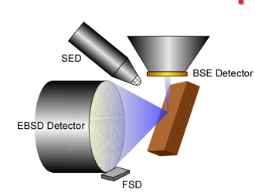
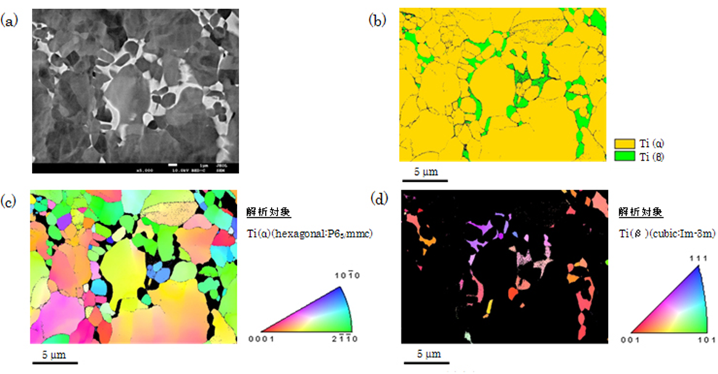
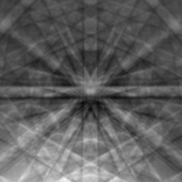
EBSD (Electron Backscattered Diffraction)
Crystallography in the SEM
Relatively simple sample prep cf TEM
High tilt angle 70
Typical max 30kV
Phosphor detector + low light CCD or CMOS camera.
Phosphor size ~ 30mm sample to phosphor distance similar
Structure mapping
Texture/Grain Size
Strain & dislocations

Slide 3
Practical EBSD: Electron Dose
Beam current ~ 10nA
For 3000fps (0.3ms) ~2 10⁷e
Backscattered coefficients ~0.1-0.7
Solid angle ~ 100e per pixel in 0.3ms
(55micron pixel)
Probably only 5% is diffracted signal.
High dose = 10nA beam current
~ 60 electrons in 1nS

Slide 4
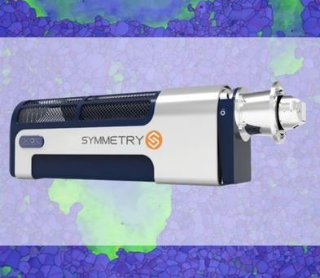
State of the Art in EBSD: Speed + Resolution
C-Nano
Resolution | Speed
1244 x 1024 | > 80 pps
312 x 256 | 400 pps
Symmetry
Increased speed achieved through binning.
Resolution | Speed
1244 x 1024 | > 240 pps
622 x 512 | > 800 pps
156 x 128 | > 3000 pps

Slide 5
State of the Art in EBSD: Sensitivity
Fibre optic collection system
Order of magnitude greater sensitivity
Standard Lens based system
Lens only collects a small amount of the light
“Note that increasing the electron gain further (as may be possible by using simple direct electron detection, for example) offers no significant benefit.”

Slide 6
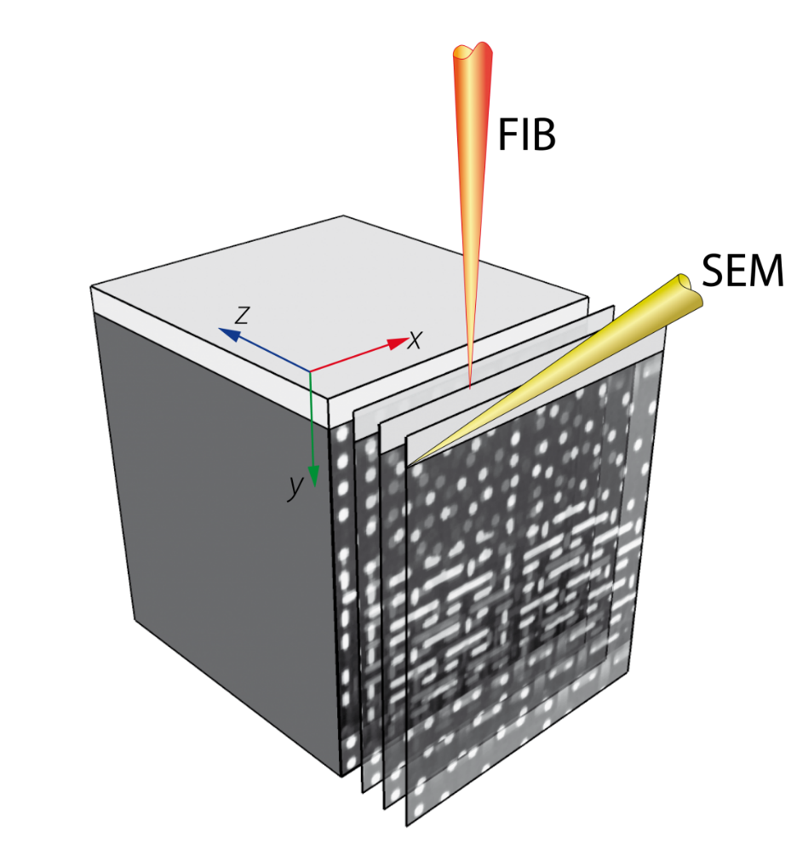
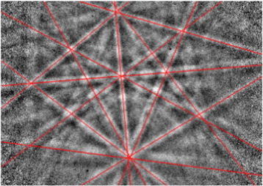
EBSD: Why is speed important?
Typical digital SEM images are at least 1k
~ capture times of 10-200 seconds will give excellent images
For EBSD longer dwell times mean tens of minutes to hours are more typical
Typically EBSD images are processed on the fly and not stored
  Data storage difficulties + processing time
  Don’t want to come back after an hour and find its been wasted
3D characterisation with FIB – Typically would do ~100 slices = 100 times longer
  Typical 3D FIB run is overnight, if not a weekend and more
Increased resolution only becoming important now as better models available
Until now mainly used lines to index patterns
Not used detailed dynamic information

Slide 7
What can Direct Detection give/promise us?
Ease of install
Energy Filtering
Calibration?
Improved low energy (kV) performance?
Better sensitivity no phosphor?
Prospect of higher speed?
Variable Gain?

Slide 8
Ease of Install: 3D FIB
Rotation
Tilt
SEM chamber cramped
~5mm WD for FIB
EBSD camera positions limited

Slide 9
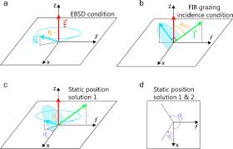
Ease of Install: 3D FIB static setup
A cone where surface is 70 to e-beam
Angle which FIB grazing incidence
2 possible planes for 3D EBSD
2 positions in the SEM chamber for camera

Slide 10
Energy Filtering & low kv performance
Improved performance from energy filtering

Slide 11
Calibration?
Calibration using electrons
b) Calibration using X-rays
Good agreement – yet find still get viable EBSD patterns when threshold set way above the incident beam energy

Slide 12
Direct Detection: Higher Speed?
Timepix USB 2 Advacam
Resolution | Speed
256 x 256 | >850 pps
High Speed CMOS camera
Practical pps ~50
Power 2.3W
Vacuum compatible
Resolution | Speed
1244 x 1024 | > 240 pps
622 x 512 | > 800 pps
156 x 128 | > 3000 pps
Timepix 3 USB 3 Advacam
Resolution | Speed
256 x 256 | 40M hits/s
Frame readout time 33ms?
Power 7.5W
Not Vacuum compatible

Slide 13
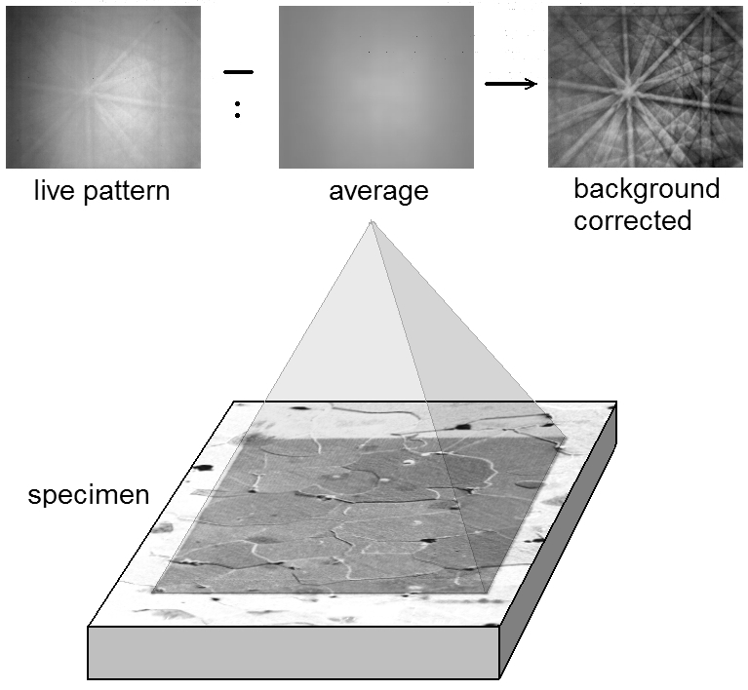
Direct Detection: Variable Gain?
Large Dynamic range needed on image
Can variable gain pixels improve this?

Slide 14
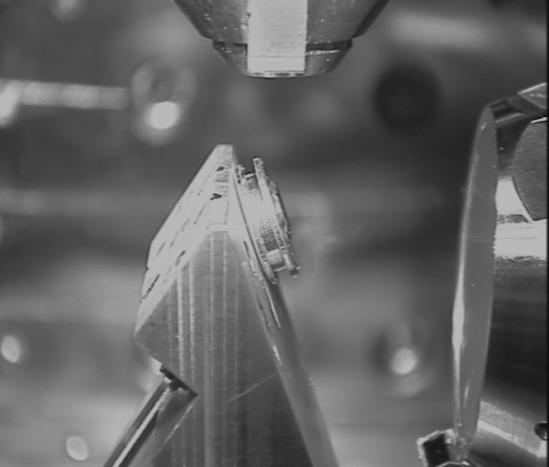
Direct detector issues: Proximity
Shadowing
Bias required for detection bad for imaging
Mechanical Damage
Medipix chip
(14mm square)
Pole piece
Sample
13mm diameter
30mm
EBSD Camera

Slide 15
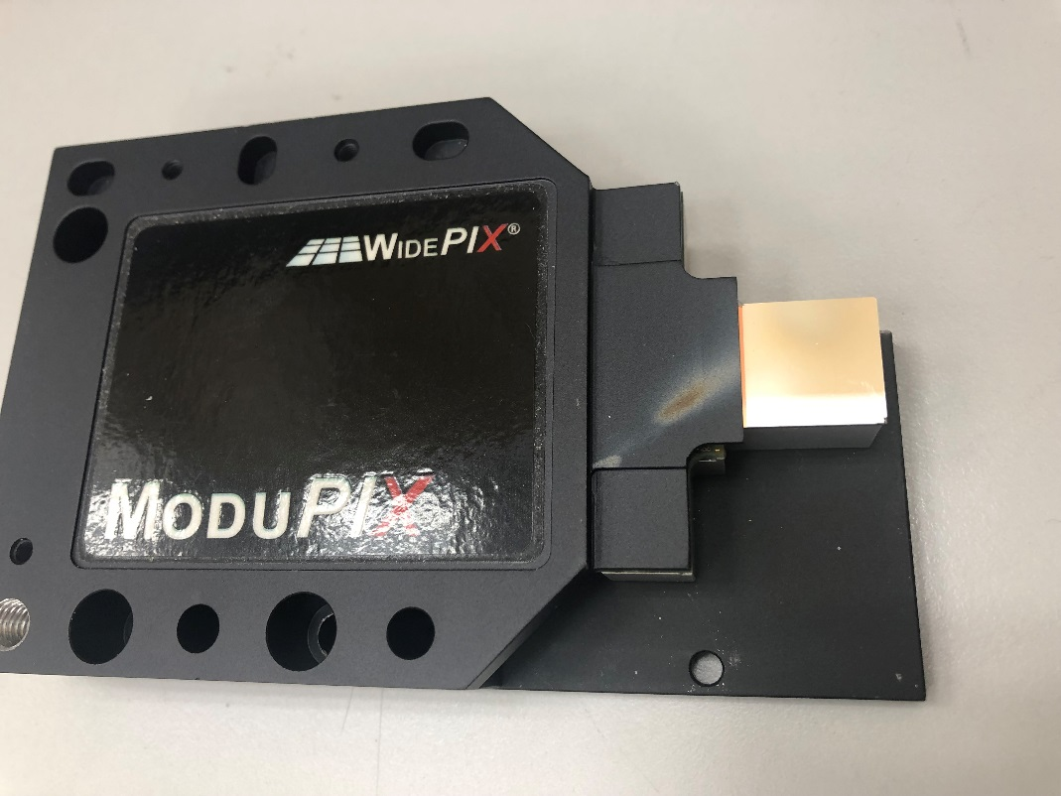
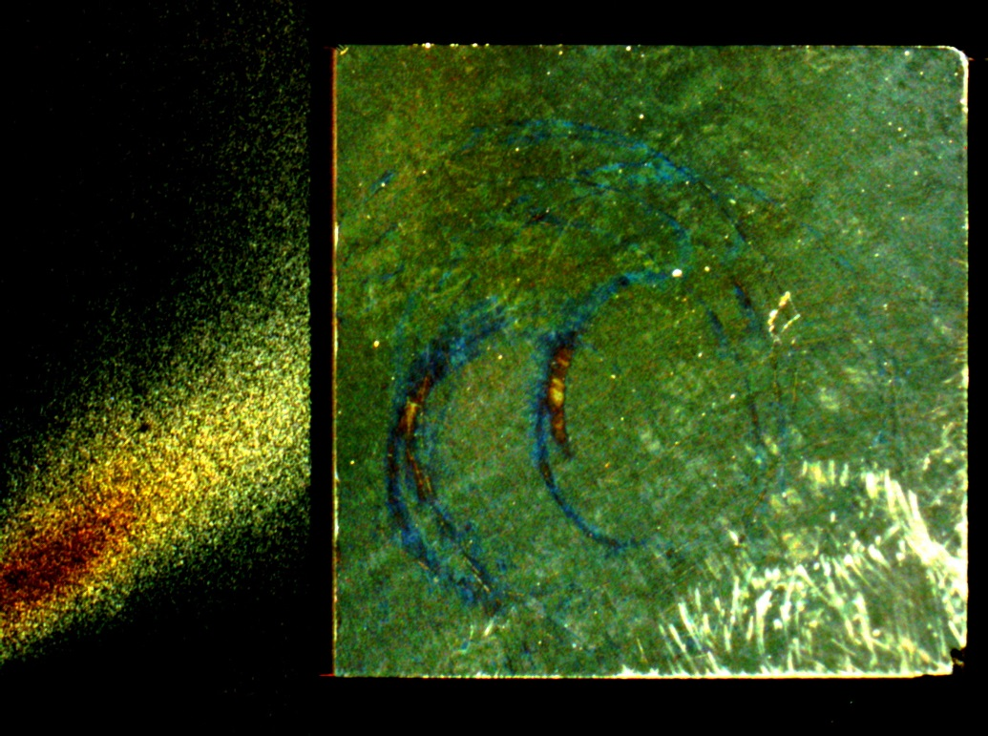
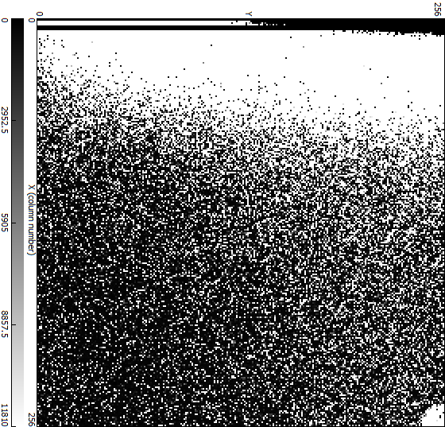
Direct detector issues: Damage
Physical damage and issue because of proximity to sample and pole piece
Worse than for conventional camera because of size
Direct Detector needs to be closer for same solid angle
In FIB ion beam damage is also an issue
Both problems minimised by a shutter.

Slide 16
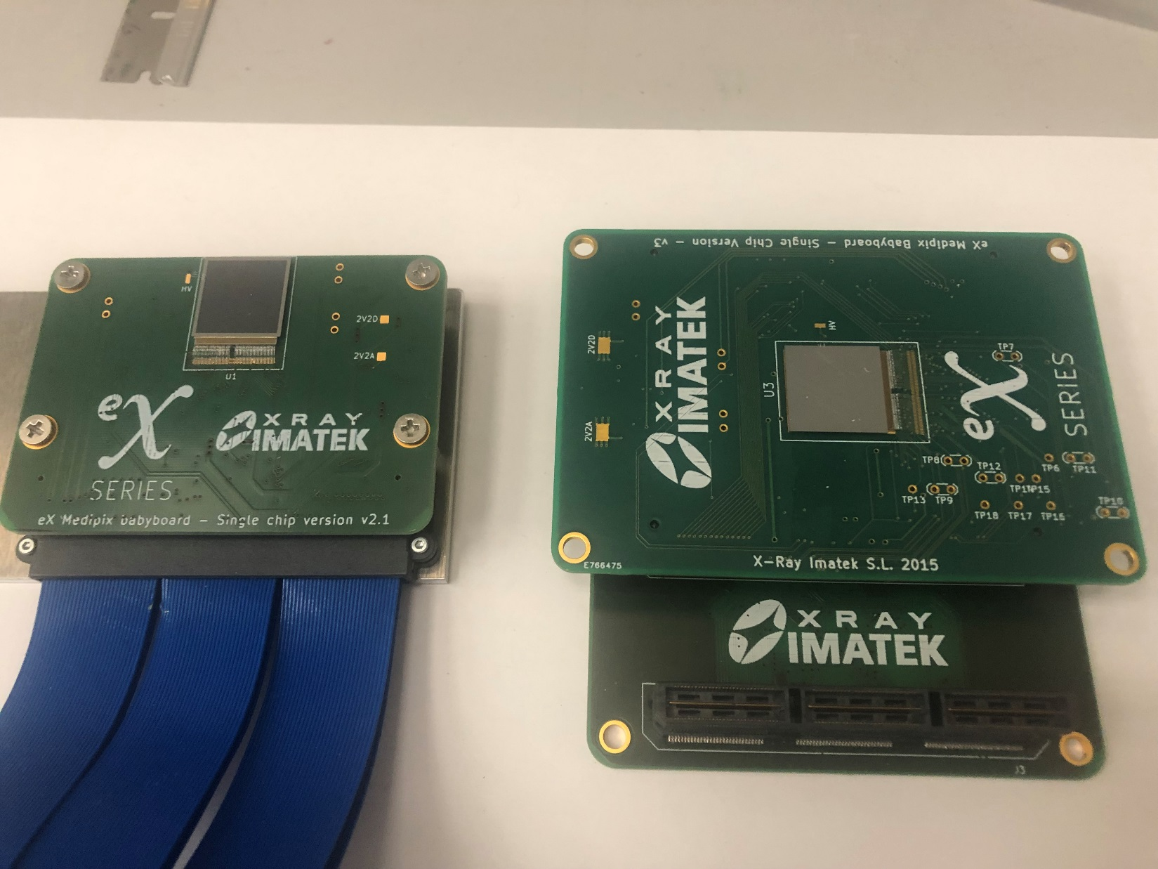
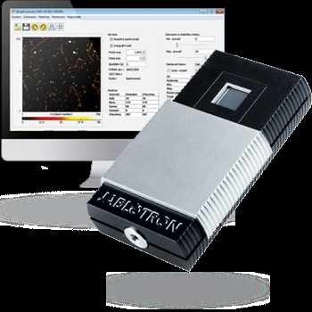
Direct detector issues: Vacuum compatibility
Feedthroughs
Overheating
Not designed as Vacuum compatible
Only lasts 15 minutes before overheating
Difficult finding feedthrough for > 180 lines
Also long lead lengths unreliable

Slide 17
Direct detector issues: Thermal issues
Sample stage drift from heating
Power consumption of Modupix ~2.3W
Passive cooling

Slide 18

Direct detector issues: Geometry
Detector needs to go close and under the pole piece
✓
✗
✓

Slide 19
Wishlist
Small form factor
Calibration
Higher Speed - Binning
Energy filtering
Higher pixel count
Variable gain
Don’t need ps or even ns response time?
SEM only 30kV electron beam
Low heat output

Slide 20

Thank you for listening
The National Physical Laboratory is operated by NPL Management Ltd, a wholly-owned company of the Department for Business, Energy and Industrial Strategy (BEIS).

