Slide 1

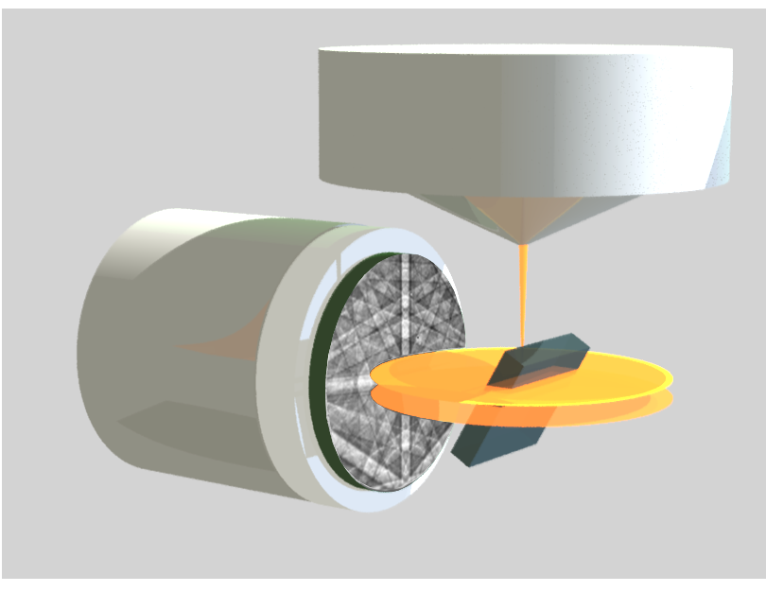
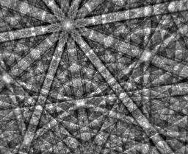
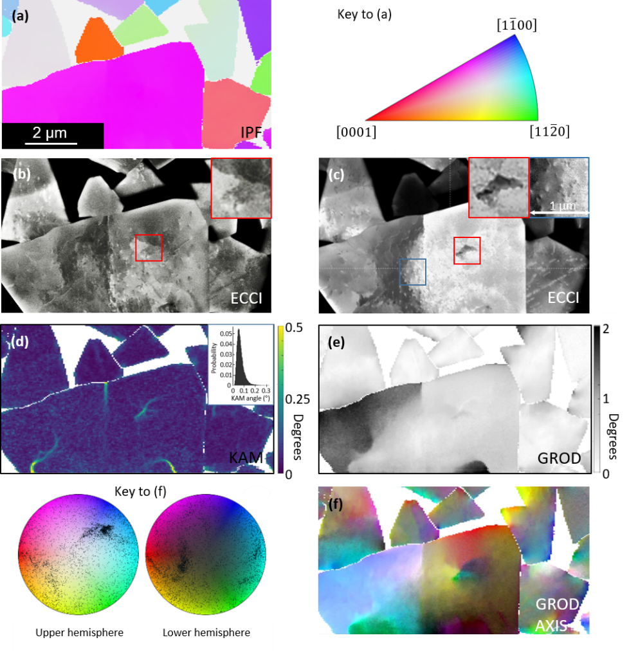
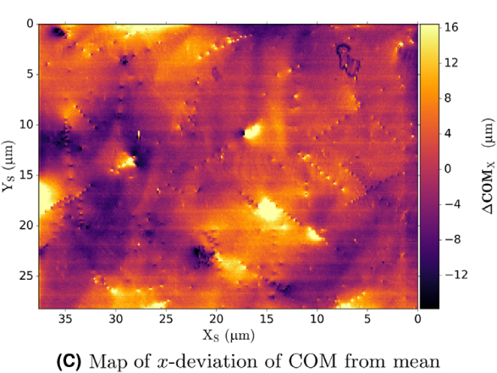
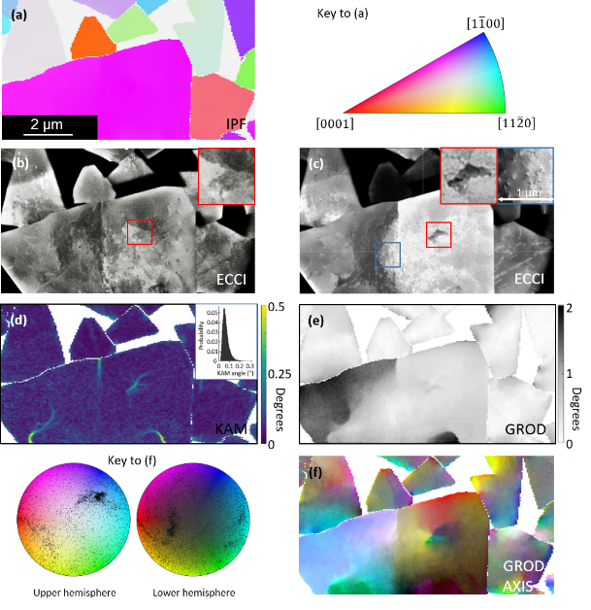
Electron microscopy applications – materials science
Investigation of the structure of crystalline materials in the scanning electron microscope using electron backscatter diffraction (EBSD)
Carol Trager-Cowan^{1*}, S. Vespucci¹, G. Naresh-Kumar¹,
D. Maneuski², V. O’Shea², B. M. Jablon¹, A. Vilalta-Clemente³,
A. J. Wilkinson³, K. Mingard⁴ and A. Winkelmann^{1,4}
¹Department of Physics, SUPA, University of Strathclyde, Glasgow, UK
²School of Physics and Astronomy, SUPA, University of Glasgow, Glasgow, G12 8QQ, UK
³Department of Materials, University of Oxford, Oxford, UK
⁴National Physics Laboratory, Teddington, TW11 0LW, UK
⁵Academic Centre for Materials and Nanotechnology,
AGH University of Science and Technology, Krakow, Poland
EBSP
CCD camera +
lenses
Electron beam
Diffraction cones
Specimen
Phosphor screen
*E-mail: c.trager-cowan@strath.ac.uk

Slide 2
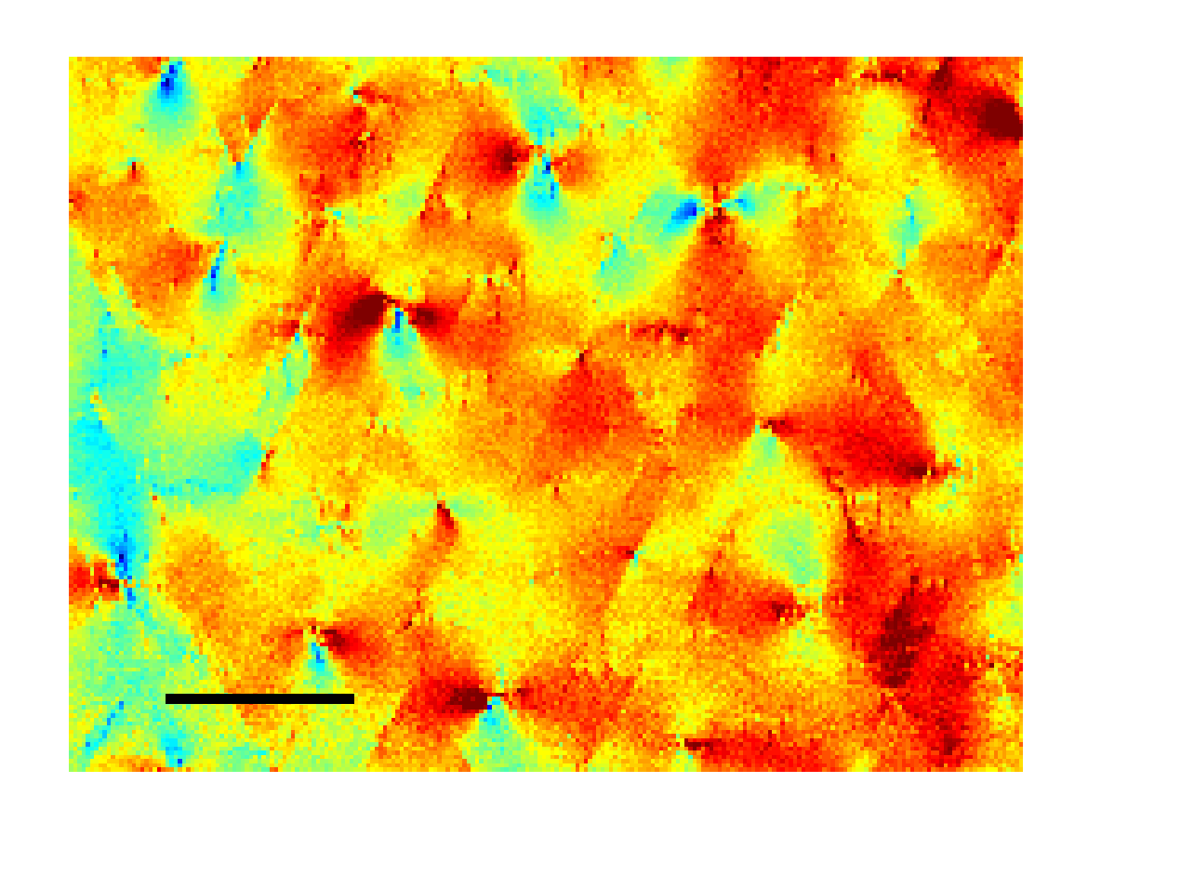
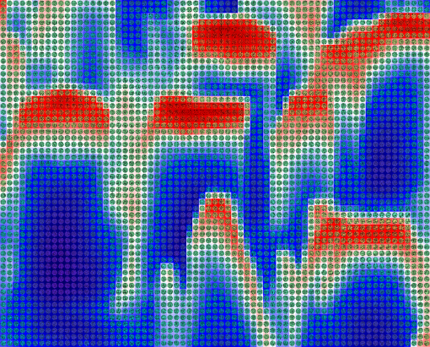
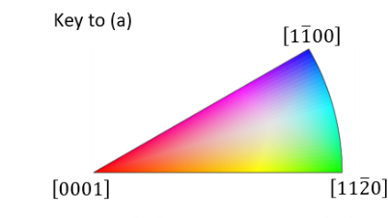
Talk Outline
2 µm
10 µm
Description of imaging modes in the scanning electron microscope (SEM), particularly those exploiting diffraction and thus capable of imaging defects and strain in crystalline materials, in particular:
Electron backscatter diffraction (EBSD)
Some applications of EBSD
Limitation of conventional EBSD systems
Advantages of direct electron detection
(using hybrid pixel detectors)
Some new applications made possible with direct electron detection

Slide 3
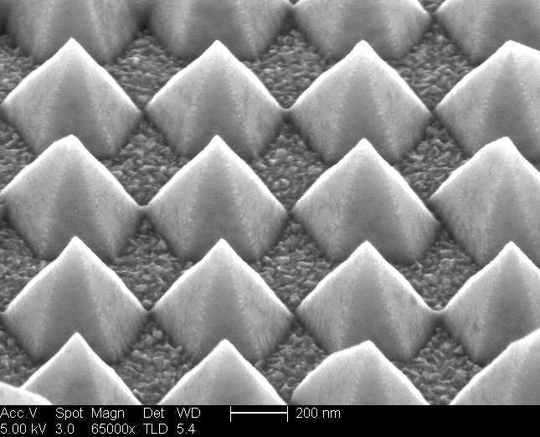
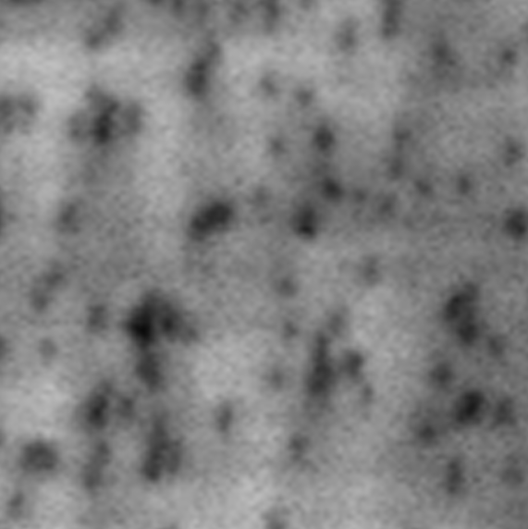
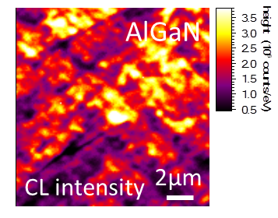
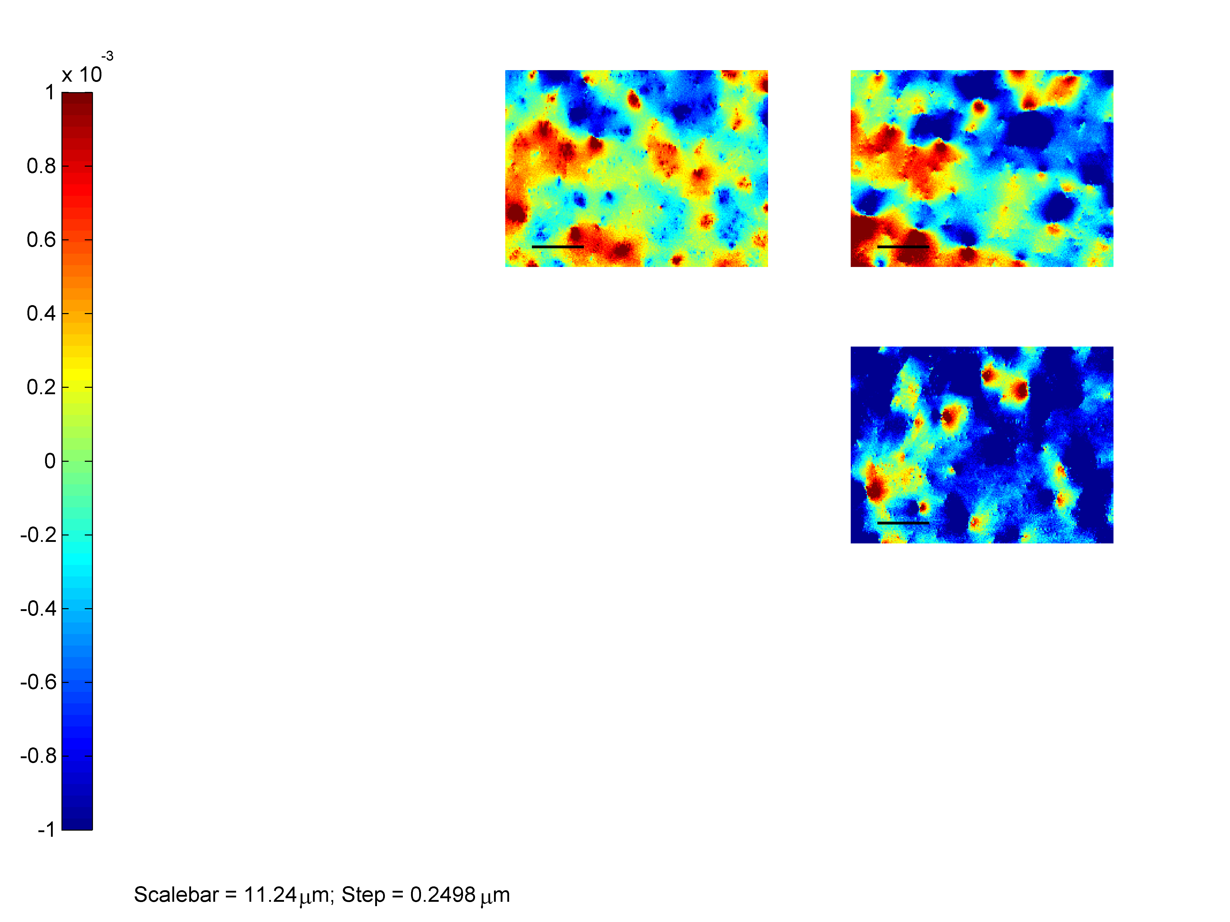

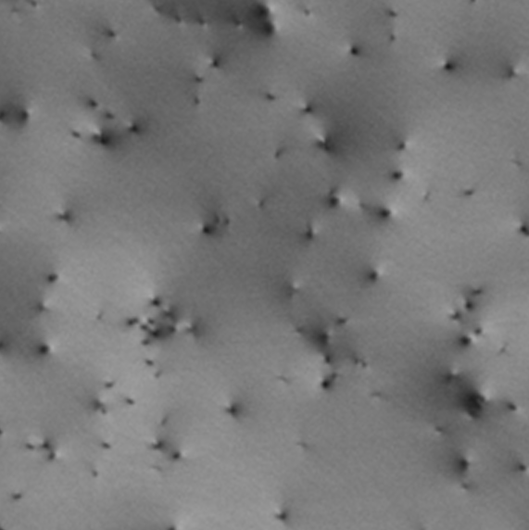
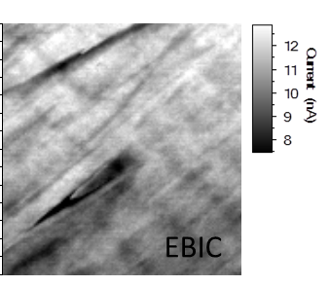
Imaging Modes in the Scanning Electron Microscope (SEM)
Electron beam
select energy between 0.2 to 30 keV
Secondary electrons
- surface imaging, topography
Backscattered electrons
- atomic contrast, topography,
- Structure or defect imaging if electrons are diffracted
X-rays
- composition
GaN
200 nm
Cathodoluminescence
CL
1 µm
Forescattered electrons
- atomic contrast, topography,
- Structure or defect imaging if electrons are diffracted
A
GaN
1
0
-1
GaN
Electron beam induced current
× 10⁻³ rads
11 µm
EBSD
twist
1 µm
ECCI

Slide 4
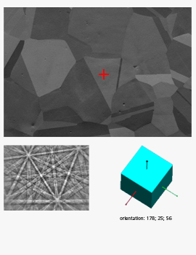
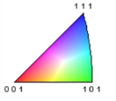
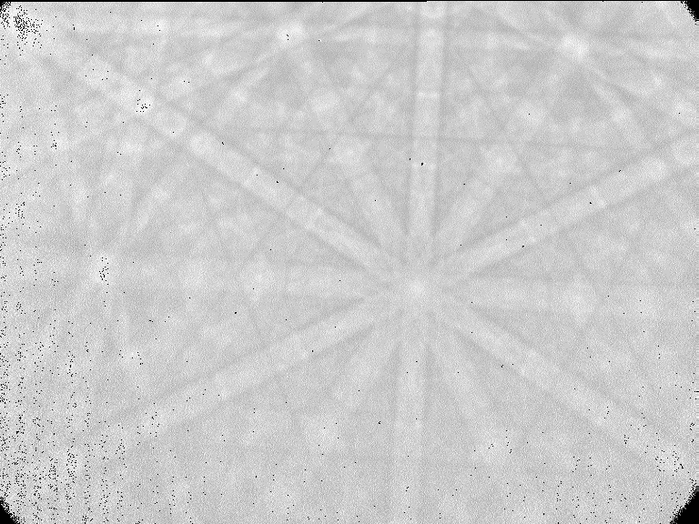
What is Electron Backscatter Diffraction (EBSD)?
EBSD provides
information on:
Crystal structure
Crystal orientation
Misorientation
Grain size
Grain boundaries
Strain
Defects
[2-1-13]
[10-12]
Electron beam
[0001]
Diffraction
cones
GaN thin film
Specimen
EBSP
CCD camera + lenses
Phosphor screen
Note the phosphor screen is of order
40 mm × 30 mm in size where the number of pixels can range from 640 x 480 to
1280 x 960 to even 2k × 2k.
So an effective pixel size ranges from
60 µm × 60 µm down to
20 µm × 20 µm.
Orientation map of a nickel sample courtesy of Ken Mingard, NPL
From: http://www.ebsd.com/index.php/component/content/article/83-ebsd-for-beginners/125-introduction

Slide 5
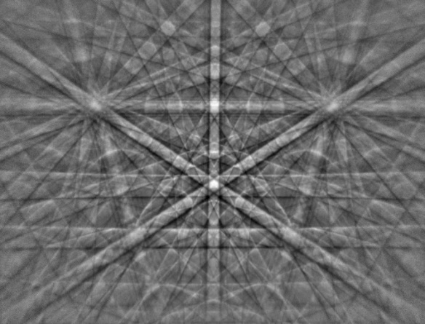
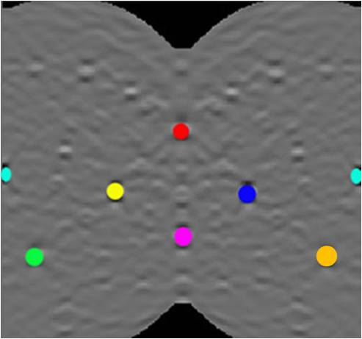
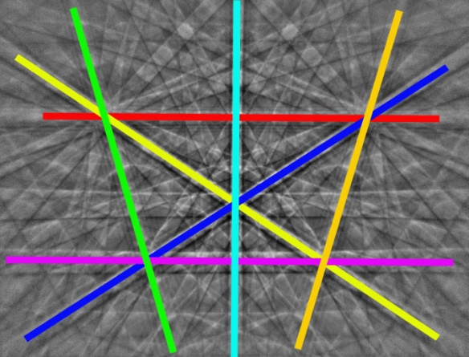
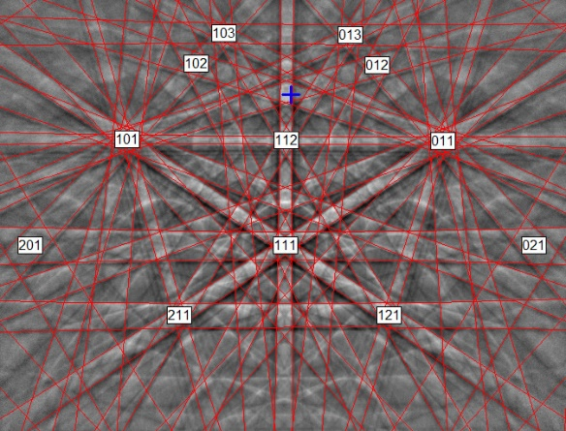
Measuring tilt, rotation & strain with EBSD
Rotating (or twisting a crystal rotates its EBSD pattern. This illustration shows a rotation around the
[113] direction (in silicon).
A distortion of a crystal will produce a distortion of the EBSD pattern.
EBSD patterns acquired from a mesh of points on a sample can thus be used to produce maps of strain in that sample.
Tilting a crystal shifts its EBSD pattern. This illustration shows a tilt of ≈ 10º.
[001]
[113]
[112]
Hough transform
EBSP from Si
From: http://www.ebsd.com/ebsd-explained/basics-of-automated-indexing

Slide 6
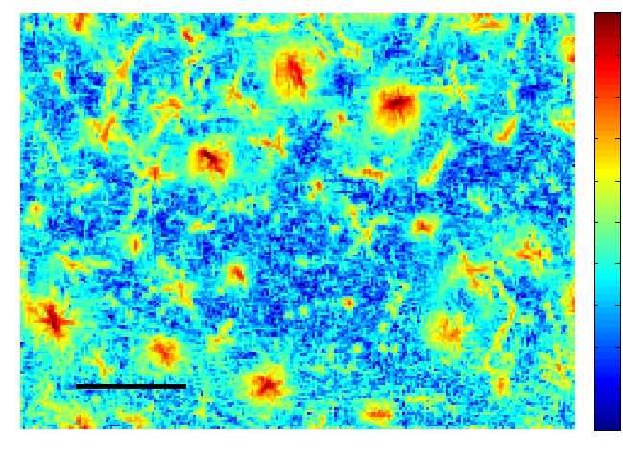

Measuring tilt, rotation & strain with EBSD with better sensitivity
Angus Wilkinson and Arantxa Vilalta-Clemente, Department of Materials, University of Oxford
Rotating (or twisting a crystal rotates its EBSD pattern. This illustration shows a rotation around the
[113] direction (in silicon).
A distortion of a crystal will produce a distortion of the EBSD pattern.
EBSD patterns acquired from a mesh of points on a sample can thus be used to produce maps of strain in that sample.
Strain changes of order
2 × 10⁻⁴ have been resolved with cross-correlation techniques.
Tilting a crystal shifts its EBSD pattern. This illustration shows a tilt of ≈ 10º.
[001]
[113]
[112]
Rotations of 0.01°
are measurable.
with cross-correlation techniques.
1
0
-1
From measurement of tilt, twist and strain, geometrically necessary dislocations
(GNDs) can be derived.
High
× 10⁻³ rads
11 µm
Measuring twist and GNDs in a GaN thin film
11 µm
twist
Low

Slide 7

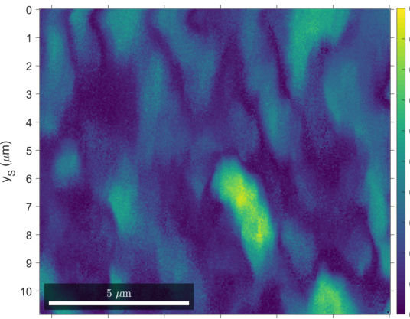
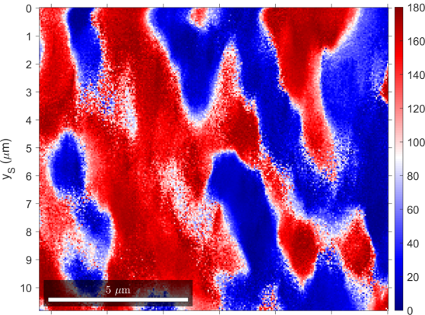
Measuring orientation with EBSD with better sensitivity
by pattern matching to dynamical simulations
– Aimo Winkelmann
Rotating (or twisting a crystal rotates its EBSD pattern. This illustration shows a rotation around the
[113] direction (in silicon).
A distortion of a crystal will produce a distortion of the EBSD pattern.
EBSD patterns acquired from a mesh of points on a sample can thus be used to produce maps of strain in that sample.
Tilting a crystal shifts its EBSD pattern. This illustration shows a tilt of ≈ 10º.
[001]
[113]
[112]
0.5°
degrees
Map derived from
EBSD data from
c-plane AlN:
Grain reference orientation deviation (GROD)
Red and blue depict opposite
in-plane rotations
5 µm
5 µm
0

Slide 8
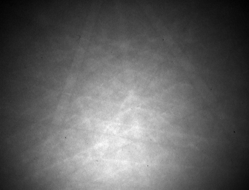
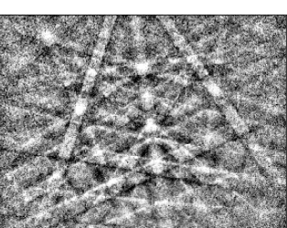

Extracting more information from EBSD patterns
Revealing defects with EBSD
Raw EBSD pattern
Underlying angular intensity distribution of BSE electrons
Flatfielded EBSD pattern

Slide 9
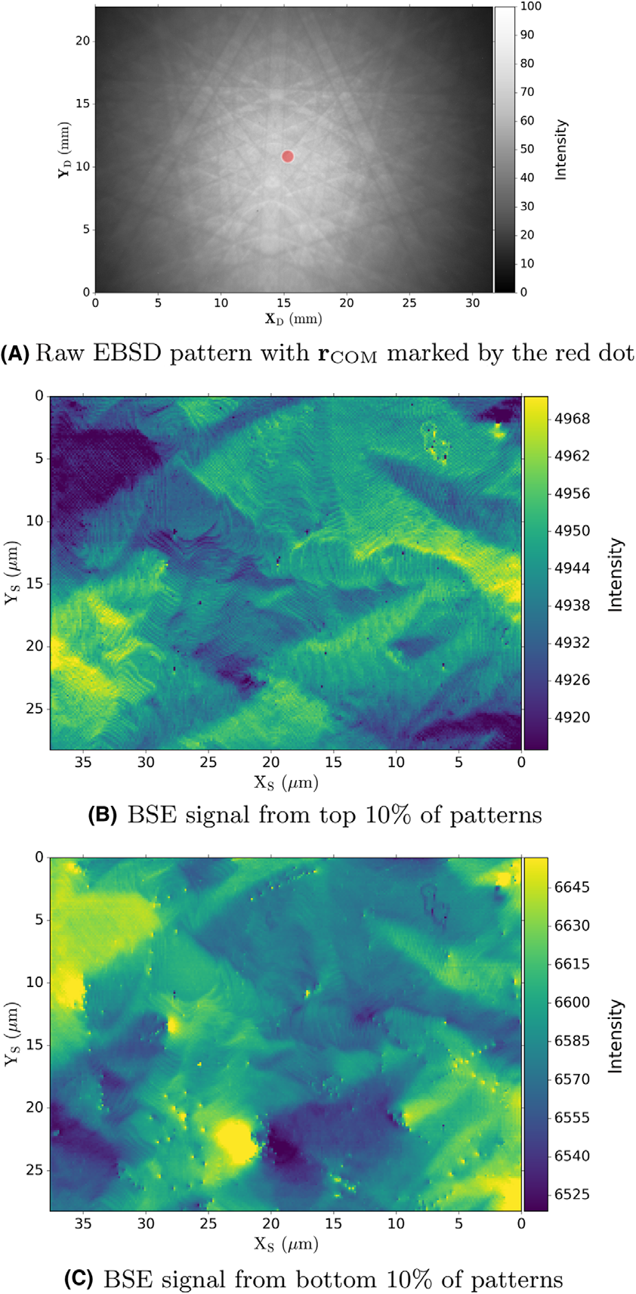

“virtual diode”
EBSD SCREEN
BSE signal from top 10% of EBSD patterns
In this case topographic contrast dominates (GaN thin film)
EBSD SCREEN
“virtual diode”
A. Winkelmann al,
J. Microsc. 267, 330 (2017)
BSE signal from bottom 10% of EBSD patterns
In this case diffraction contrast dominates

Slide 10
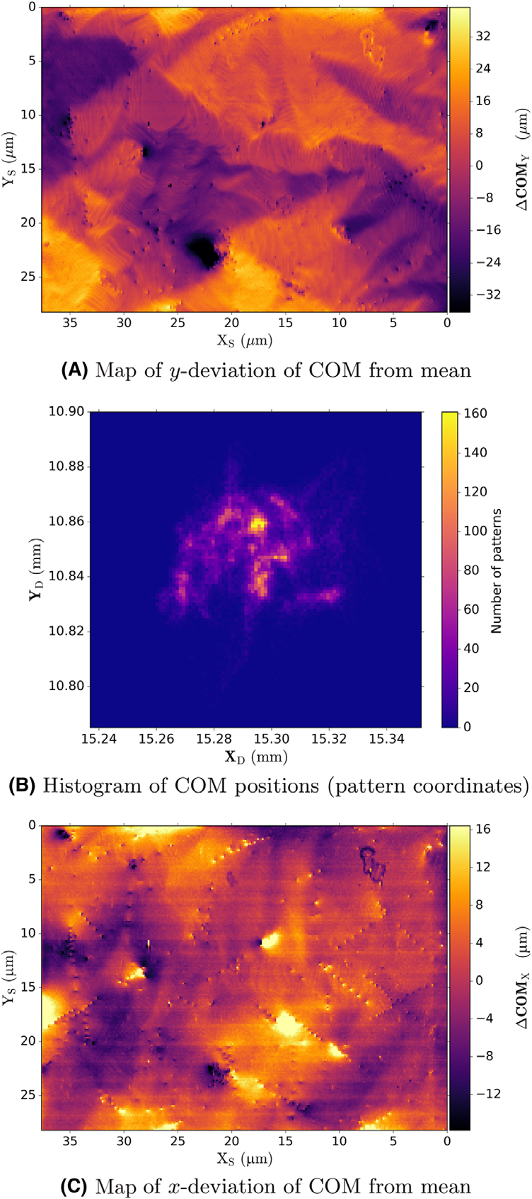
Virtual diode
Virtual diode
BSE signal from top 10% of EBSD patterns
In this case topographic contrast dominates
BSE signal from bottom 10% of EBSD patterns
In this case diffraction contrast dominates
COM Y
COM X
Map of y-deviation of the centre of mass of intensity of each EBSD pattern (COM) from mean
Map of x-deviation of the centre of mass of intensity of each EBSD pattern (COM) from mean

Slide 11
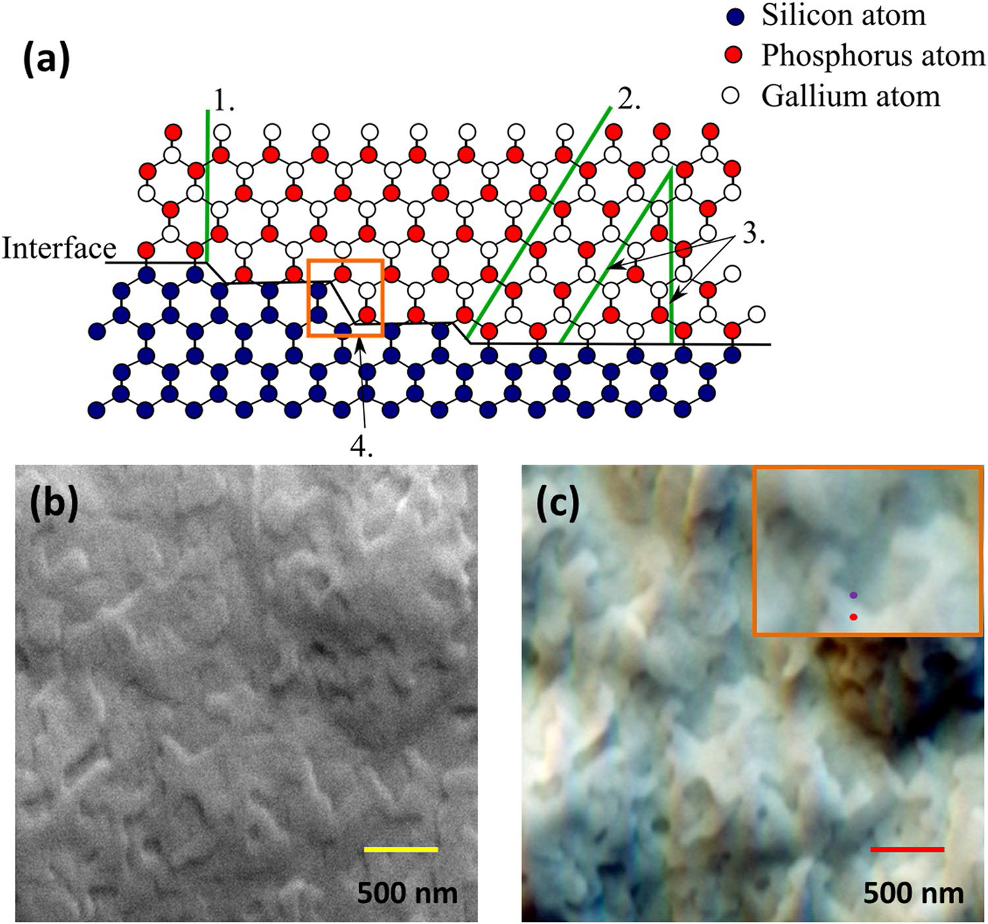

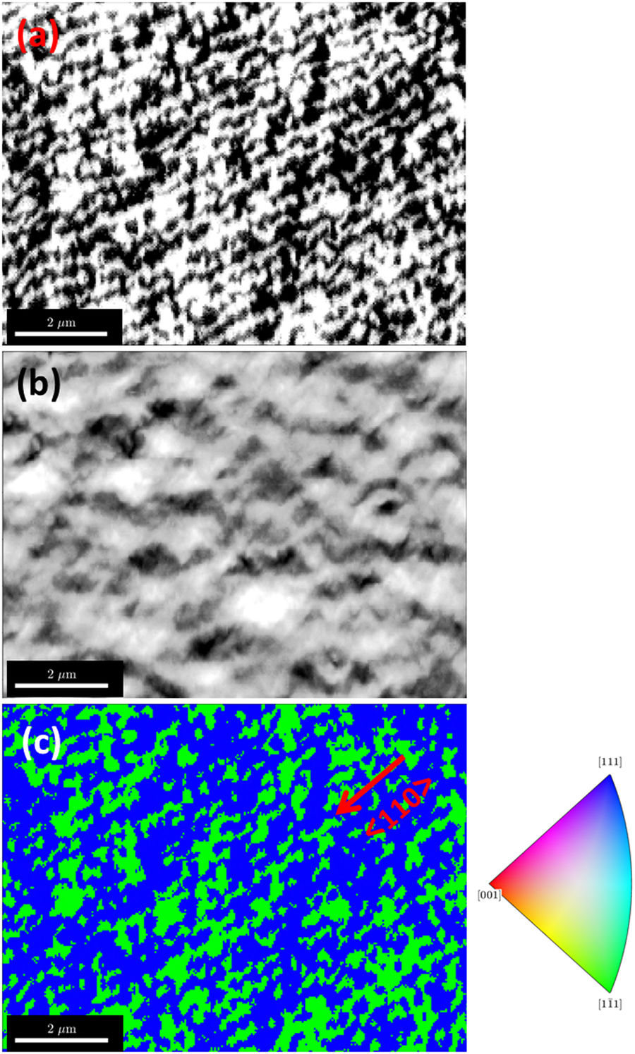

Revealing defects with EBSD – antiphase domains (APBs) in GaP
Antiphase domains in GaP. G. Naresh-Kumar, A. Vilalta-Clemente, H. Jussila, A. Winkelmann, G. Nolze, S. Vespucci, S. Nagarajan, A. J. Wilkinson & C. Trager-Cowan, Sci. Rep. 7, 10916 (2017)
1. APBs parallel to (110)
2. APBs along the {111}Si
3. annihilation of APBs along
(111) and (110) and
4. annihilation of APBs due to diatomic steps.
4.
[111]
2 µm
[1-11]
EBSD inverse pole figure (IPF) map revealing the APDs produced from cross-correlation with dynamical simulations
K. Momma and F. Izumi, "VESTA 3 for three-dimensional visualization of crystal, volumetric and morphology data," J. Appl. Crystallogr., 44, 1272-1276 (2011) & https://github.com/cryos/avogadro/blob/master/crystals/phosphides/GaP.cif

Slide 12
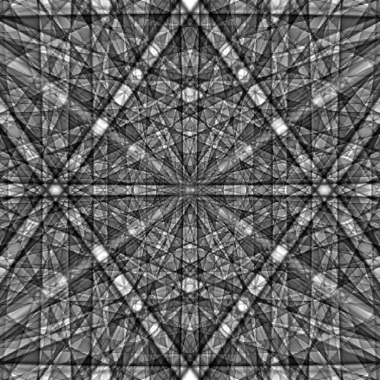
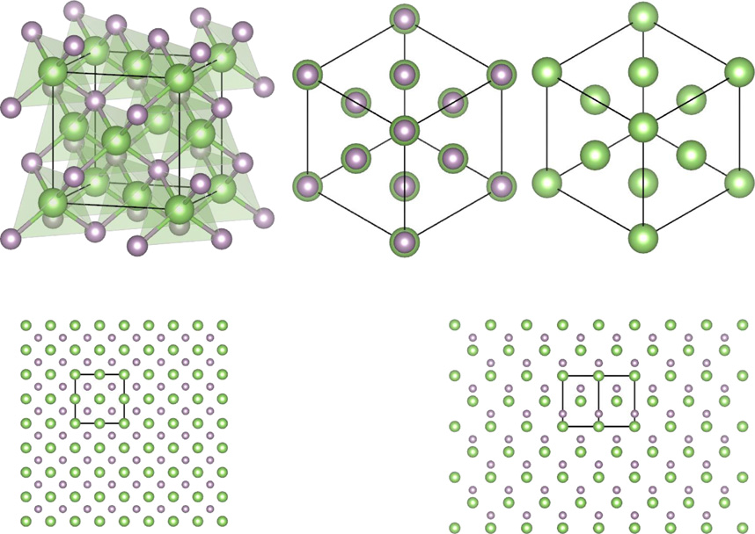
APBs in GaP – revealed through non-centrosymmetry
(1-11)
(111)
Dynamical simulation of EBSD pattern from GaP (15 keV)

Slide 13
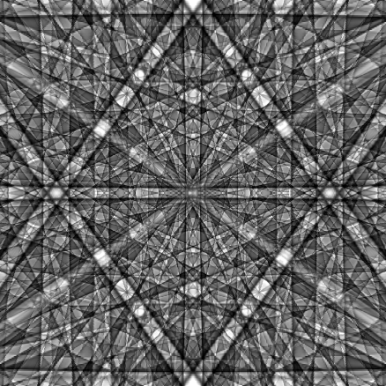
APBs in GaP – revealed through non-centrosymmetry
(1-11)
(111)
Dynamical simulation of EBSD pattern from GaP (15 keV)

Slide 14
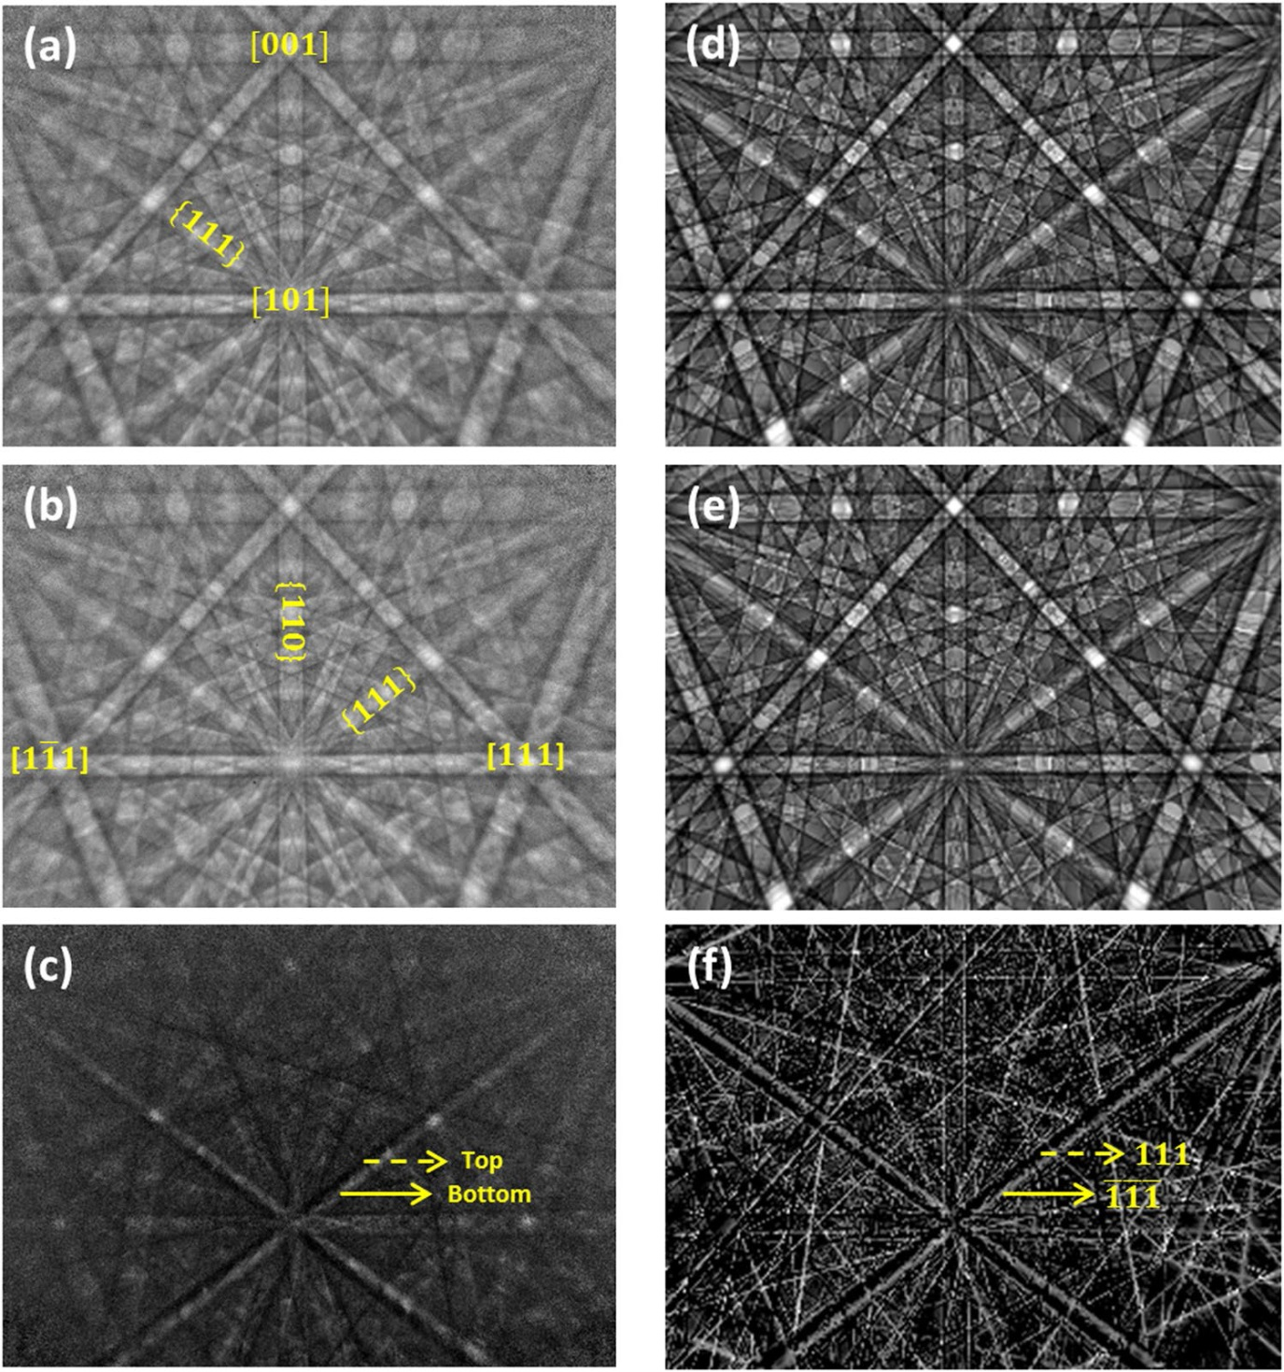
APBs in GaP – revealed through non-centrosymmetry
Experiment
Theory
(f)
Difference between experimental patterns
Difference between theoretical patterns
(111)
(1-11)

Slide 15
Revealing defects with EBSD – antiphase domains (APBs) in GaP
Antiphase domains in GaP. G. Naresh-Kumar, A. Vilalta-Clemente, H. Jussila, A. Winkelmann, G. Nolze, S. Vespucci, S. Nagarajan, A. J. Wilkinson & C. Trager-Cowan, Sci. Rep. 7, 10916 (2017)
(111)
(1-11)
Region of interest asymmetry imaging from the {111} bands
produced from background corrected EBSD patterns.
[111]
2 µm
[1-11]
EBSD inverse pole figure (IPF) map revealing the APDs produced from cross-correlation with dynamical simulations

Slide 16
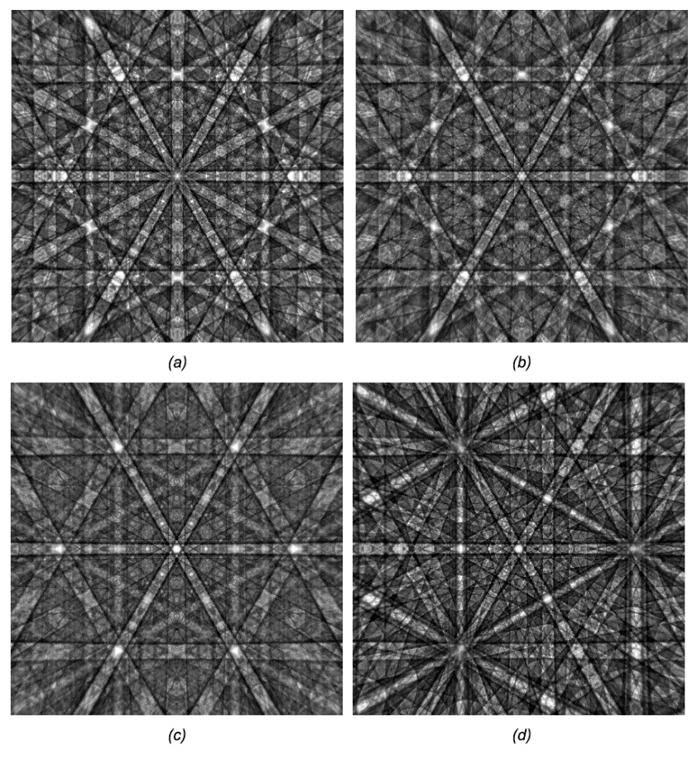
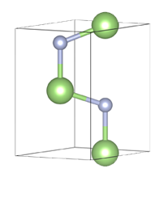

To summarise what we can measure:
Crystal structure
Crystal orientation
Misorientation
Grain size
Grain boundaries
Strain
Structural defects,
in particular
extended defects
– dislocations
– stacking faults
EBSP Wurtzite GaN EBSP Zincblende GaN
ECCI
CL
1 µm
1 µm
In particular if EBSD is used with electron channeling contrast imaging (ECCI)
The influence of the structural properties on the light emission properties of materials can be determined if EBSD and ECCI are used together with cathodoluminescence (CL)

Slide 17
Limitations of conventional EBSD systems
Inefficient conversion of electrons to light, and light back to electrons
Intrinsic light scattering and optical interference within the phosphor
→ intrinsic loss of spatial resolution
Intrinsic noise of the CCD camera
→ reduced signal to noise ratio
Distortion of the pattern due to the optics
Inability to select electrons having a specific energy range
Electron gun
Electron beam
Diffraction
cones
Specimen
CCD camera + lenses
Phosphor screen

Slide 18
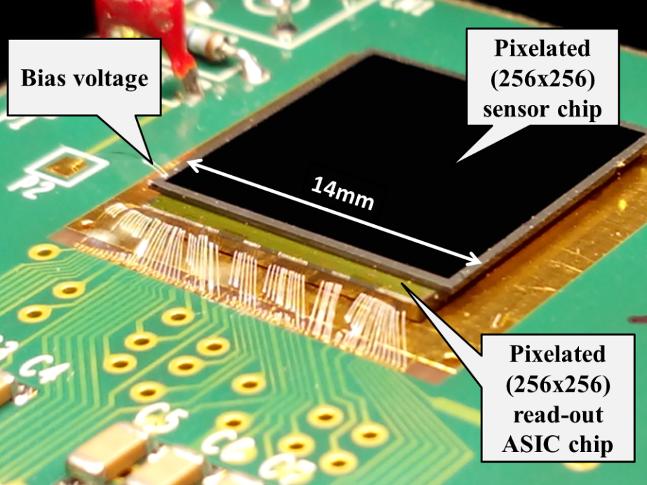
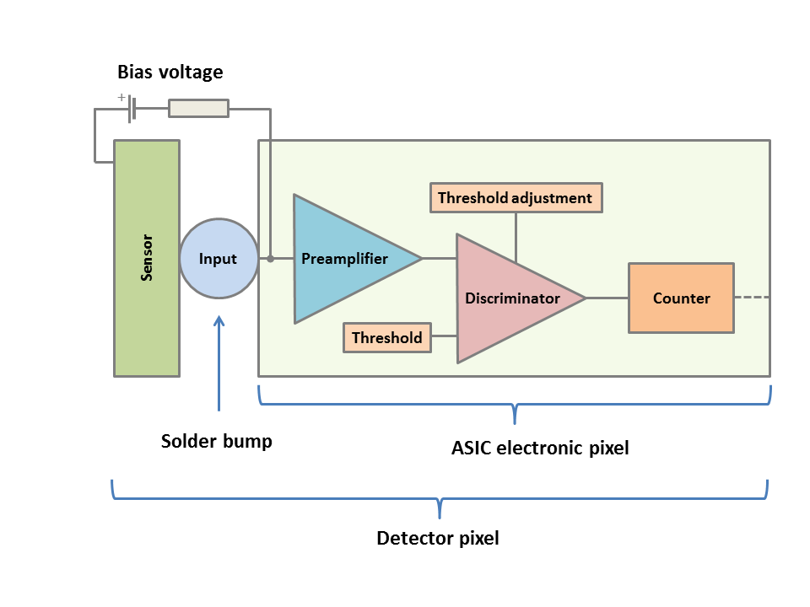
Advantages of direct electron detection, with hybrid pixel detectors, for EBSD pattern acquisition
Sensor separated from the electronics:
→ Radiation hardness
Direct electron imaging:
→ Can use lower electron beam currents
and voltages – lower dose, exciting for characterisation of materials which
damage under electron beam irradiation
– Improvement in lateral and depth resolution
→ no need for distorting optics
Energy discrimination:
→ Work in noise-free conditions
→ Energy filtered EBSD pattern
– Improved contrast and sharpness of
electron backscatter patterns (EBSPs)
– Increase in detail in EBSPs
– Improvement in lateral and depth resolution
Compact size
Timepix detector

Slide 19
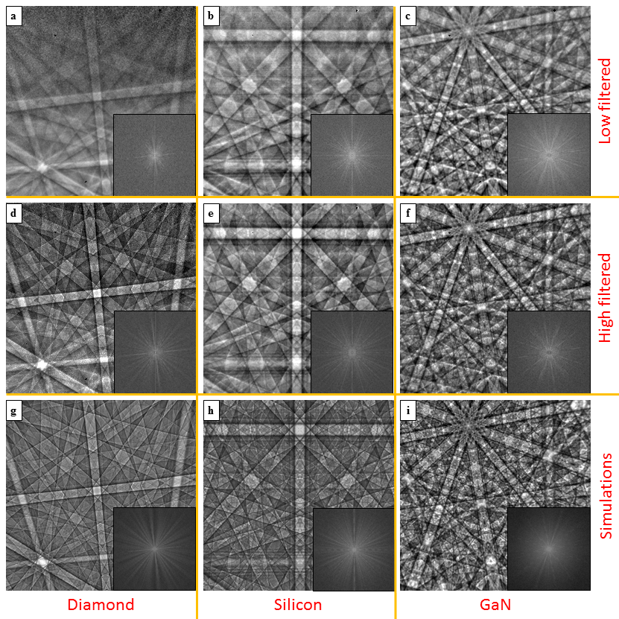



Energy filtering direct electron detectors and dynamical simulations for EBSD
Experimental and simulated EBSPs from diamond (a),(d) (g), Si (b), (e), (h) & GaN (c), (f), (i) for an incident beam energy of 20 keV, and a probe current of
≈ 10 nA
(a), (b) and (c) were acquired with a high pass energy filter of 4.6 keV
(d), (e) and (f) were acquired with a high pass energy filter of 19.4 keV
(g), (h) and (i) are simulations
The insets are 2D fast Fourier transforms of each image.
Aunt Daisy Scientific
Digital direct electron imaging of energy filtered electron backscatter diffraction patterns, S. Vespucci et al, Phys. Rev. B. 92 205301 (2015)

Slide 20
Example application – EBSD of Halide Perovskites
Morphology and local crystal orientation measurements of CH₃NH₃PbI₃ thin films. (A) SEM image of CH₃NH₃PbI₃ thin film tilted at 45° with representative sharp Kikuchi diffraction lines of a measurement point inside a grain (circled) collected in EBSD geometry at 6 kV, 10 kV and 20 kV accelerating voltage. (B) SEM image and (C) Inverse Pole Figure (IPF) map generated from EBSD of a representative CH₃NH₃PbI₃ film with IPF color key. The 001(in bold) in the IPF color key indicates that the IPF map plotted is along the sample z-direction. (D) Depiction of changes in local crystal orientation along the black arrow in (B) and (C) as viewed normal to the sample. EBSD conditions - 100 pA at 6 kV accelerating voltage with a pixel integration time of 100 ms.
From: Jariwala S, Sun H, Adhyaksa GW, Lof A, Garnett EC, Ginger DS. Imaging Grain Structure in Halide Perovskites: Local Crystal Misorientation Influences Non-Radiative Recombination. arXiv preprint arXiv:1903.11033. 2019 Mar 26.

Slide 21
Commercial applications
Webinar broadcast on 21/09/2016
The EDAX ClarityTM detector is based on 2 × 2 Timepix chips
(QUAD)

Slide 22
Slide from “Direct Electron Detection with Clarity™ - Viewing EBSD Patterns in a New Light” presentation

Slide 23
Patent

Slide 24
From: Vespucci S, Naresh-Kumar G, Trager-Cowan C, Mingard KP, Maneuski D, O'Shea V, Winkelmann A. “Diffractive triangulation of radiative point sources.” Applied Physics Letters. 2017 Mar 20;110(12):124103.

Slide 25
(a)
(b)
(c)
(d)
FIG. 4. Backscattered electron diffraction measurement at 25 keV obtained from a film of 10 nm HfO₂ on Si (001) using a Timepix detector. (a) Measurement containing simultaneously a detector diffraction pattern (DDP, dark bands) together with a backscatter Kikuchi pattern (BKP, light bands) of the silicon sample. (b) Negative of the left pattern (d) Best-fit simulation of the pattern structure corresponding to the DDP. This gives the projection point (xP, yP, and zP). (c) Best-fit simulation of the BKP corresponding to the sample orientation of (φ₁ = 179.95; Φ = 19.93; φ₂ = 215.59), assuming the projection center determined via (d).

Slide 26
Requirements for next generation
direct electron detectors for EBSD
Existing chips already offer the benefits of operating at lower current and voltages, can we do better?
Can energy filtering be improved – towards spectroscopy?
Can we go to a 40 mm × 40 mm device with 2k × 2k pixels (20 µm × 20 µm pixel size)?
Can we acquire images faster? Existing EBSD systems can go up to 4500 patterns per second.

