Slide 1
Low Gain Avalanche Photodiode Detectors at Diamond Light Source
Nicola Tartoni
LGAD workshop at Diamond

Slide 2
Potentially two major uses of LGADs
Detection of tender energy X-ray photons
Detection of X-ray photons in time resolved experiments

Slide 3
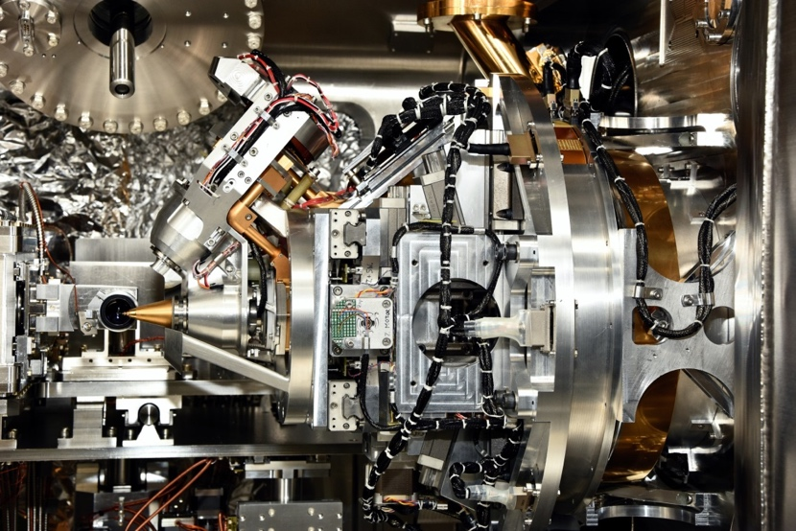
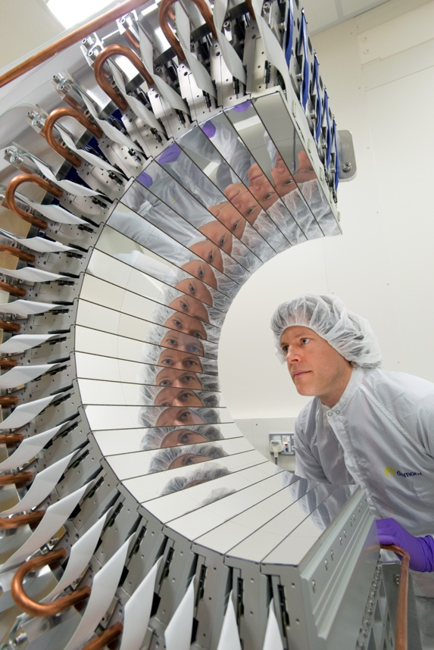
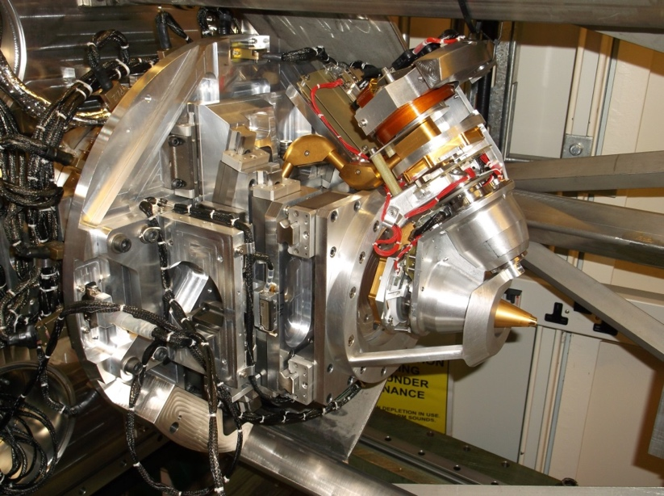
I23 – Long-wavelength macromolecular crystallography
First in-vacuum MX beamline
Access to wavelengths far beyond any other MX beamline (λ < 5.9 Å, E > 2.1 keV)
Largest area detector for MX
At the forefront of synchrotron technology
Many aspects pioneered at I23
  In-vacuum Pilatus for low energies
  Sample cooling in vacuum
  Cryogenic sample transfer
  Collision prevention system

Slide 4
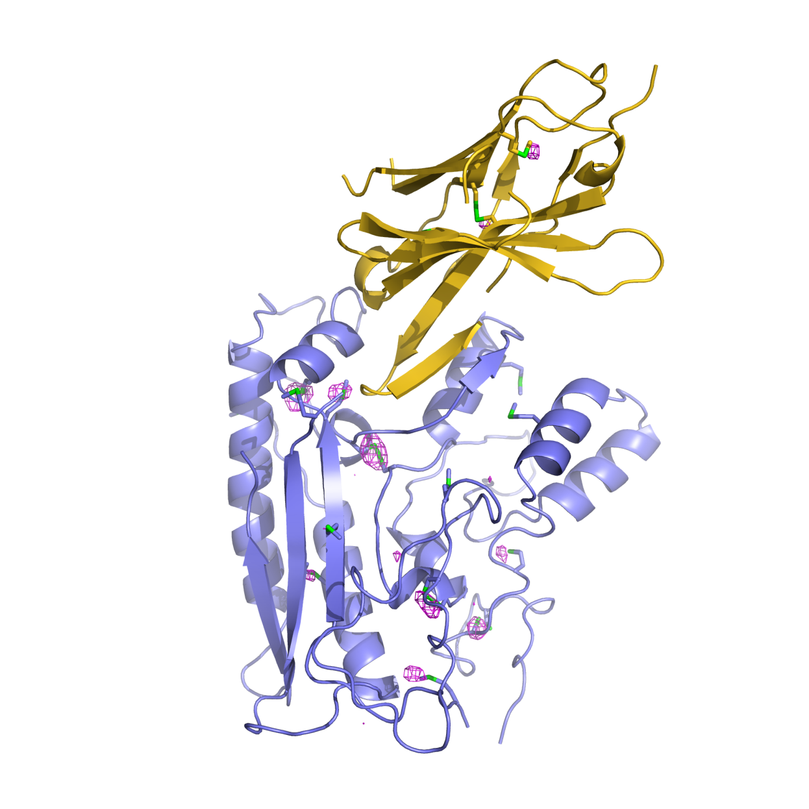
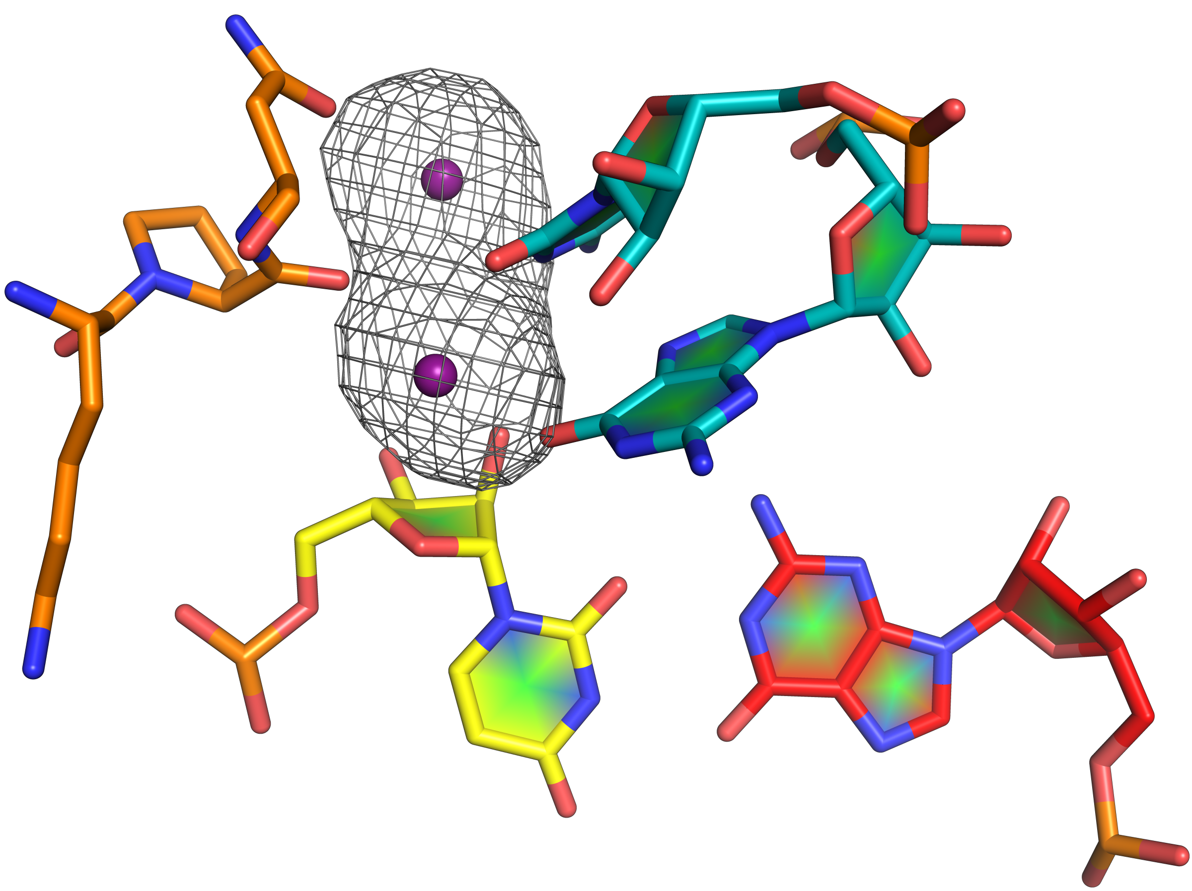
I23 – New opportunities for structural biology
P
S
Unique scientific opportunities exploiting anomalous diffraction from lighter atoms.
I23 provides access to absorption edges of elements of biological importance such as Ca, K, Cl, S and P
Cl
K
Ca
Phasing
Ion identification
Ion occupancies
Langan et al. Nat. Commun. (2018) 9:4540.
.
Rudolph et al. Nat. Chem. Biol. 15 (2019) 975.
.
Rozov et al. Nat. Commun. (2019) 10:2519.
.

Slide 5
Other use cases of tender X-ray photons
Medipix3 photon counting detector for I20 spectrometer (wish to go down to 2 keV)
Medipix3 photon counting detector for I16 polarimeter (down to 2.5 keV)

Slide 6
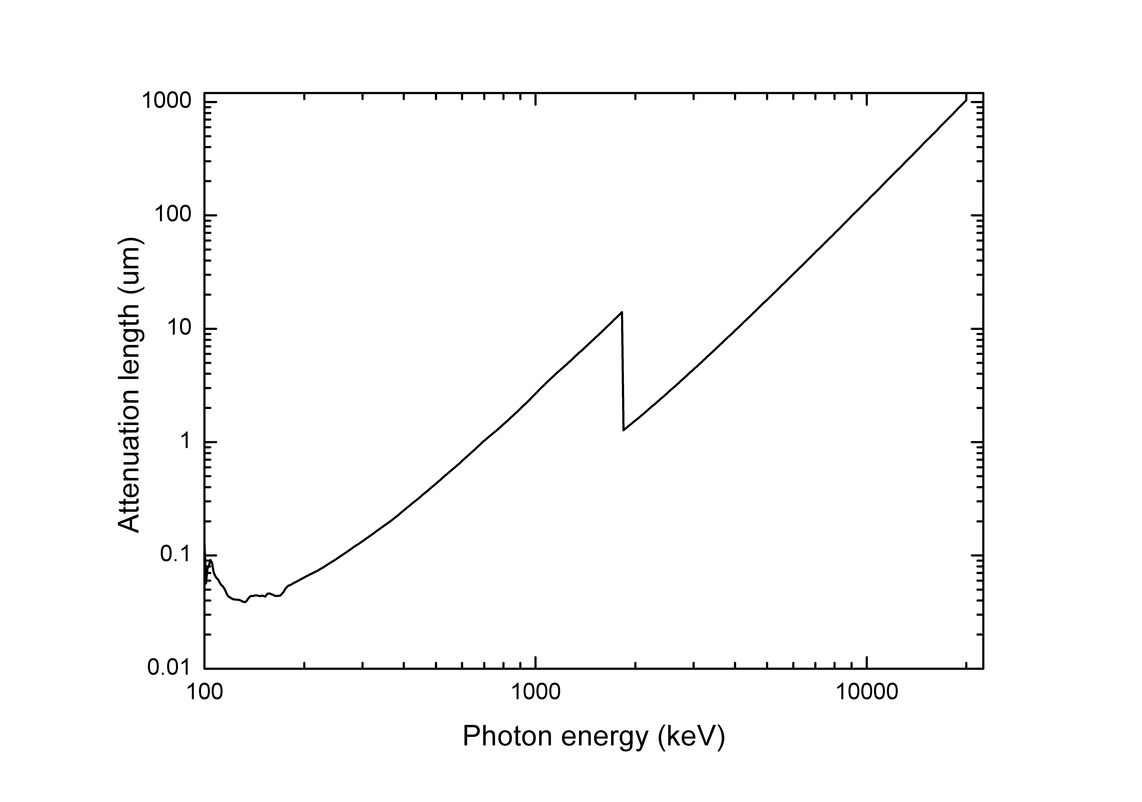
Photons attenuation length in Si

Slide 7
Some naive ideas…
p
n
Charge collection
n++
n++
n++
n++
n++
Charge multiplication
p
Entrance window

Slide 8
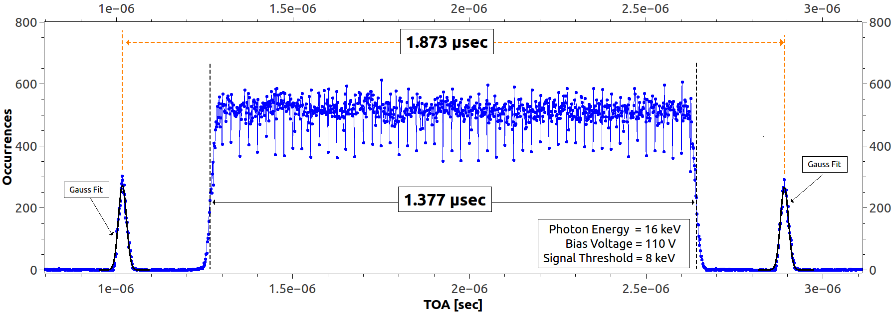
Timepix3 for Time Resolved Experiments

Slide 9
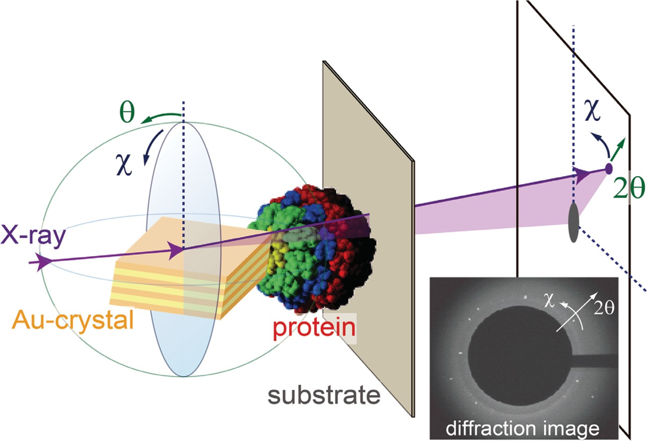
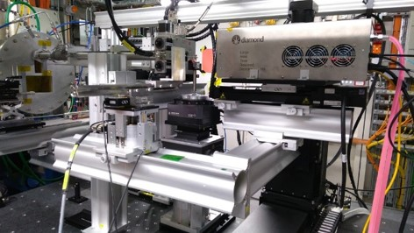
DXT- Diffracted X-ray Tracking
User experiment performed in B16 @ DLS – previously performed only at SPring-8 on a dedicated beamline
Detector positioned with sensitive area just outside the direct beam
One-shot dynamic experiment
White beam
Many thanks to Prof Yuji Sasaki (University of Tokyo) and Dr Hiroshi Sekiguchi (SPring-8)

Slide 10
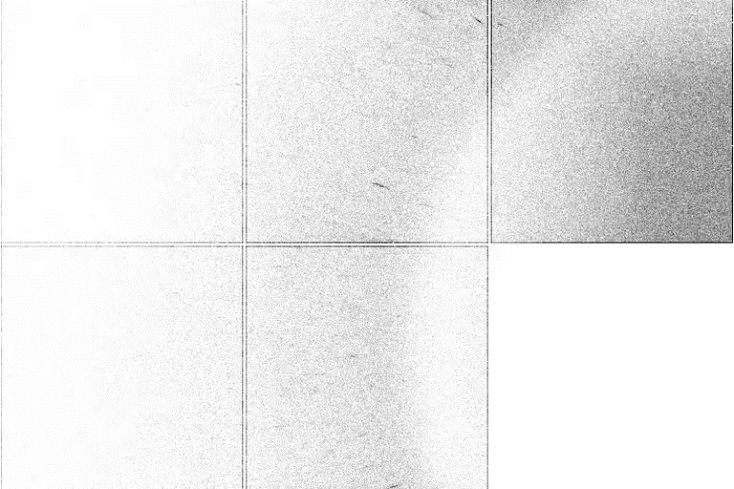

DXT- Diffracted X-ray Tracking
Most of time spent to limit the background
Part of the detector sensitive area shielded
Several protein sample tested
Continuous exposures with different duration (between 1 and 10 seconds)
RESULT:
3 s exposure
Frame duration is not fixed: possibility to change frame duration using event timing without need to perform another exposure
MASKED
ASIC
FOR BACKGROUND
SUPPRESSION
60 frames of 50 ms
1200 frames of 2.5 ms

Slide 11
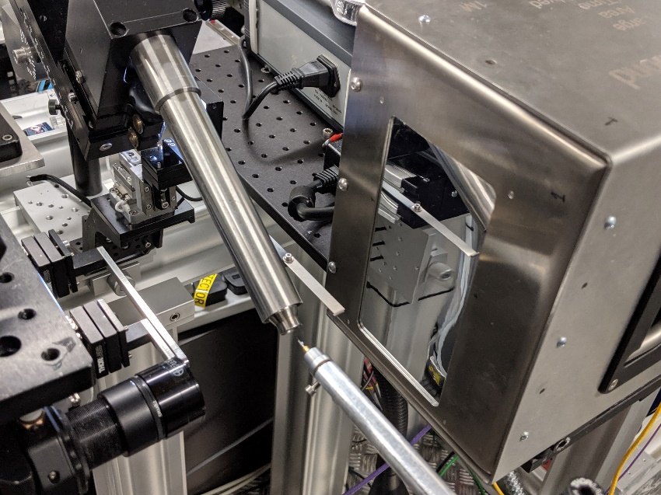
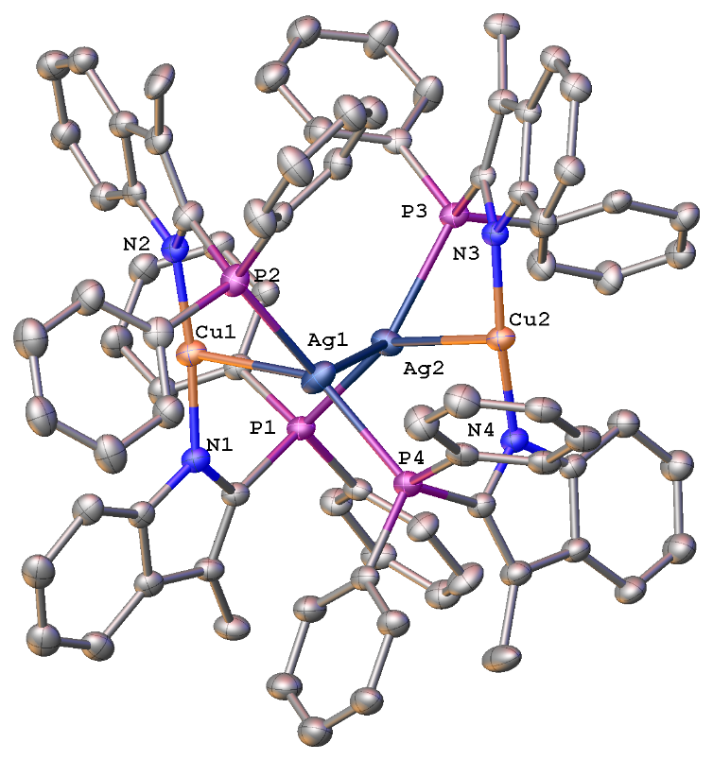
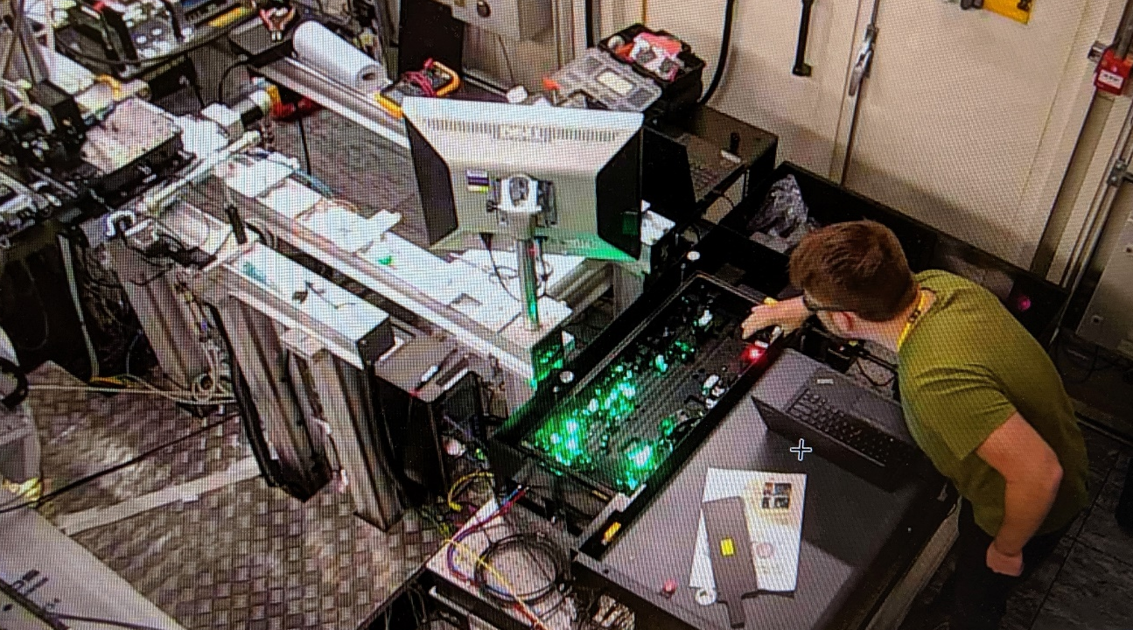
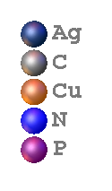
Time-Resolved Crystallography
User experiment performed in I19 @ DLS
Detector positioned with sensitive area in direct beam path using beamstop
Pump-and-probe experiment using pulsed laser (femtosecond)
Monochromatic beam
Sample: AgCu Complex
Many thanks to Dr Mark Warren and all I19’s team

Slide 12
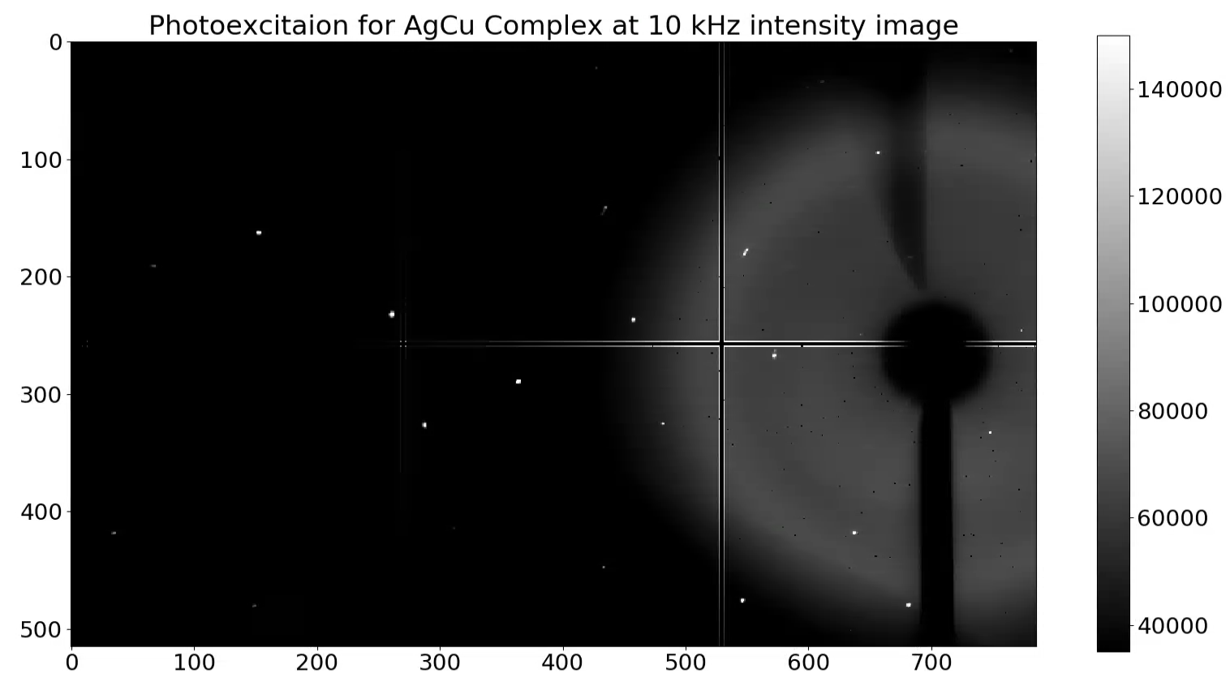
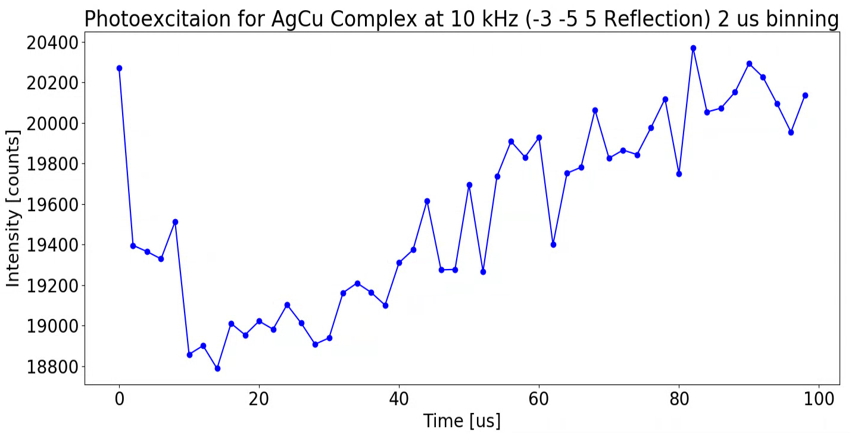
Time-Resolved Crystallography
1000 s continuous exposure with laser pump at 10 kHz: continuous probe, periodic pump
Pump signal (trigger) timestamped by detector on same time base of events to realign data in processing
Data driven readout → no downtime!
ADVANTAGES:
µs regime easily accessible
Data collection is 50x faster than the current imaging detector
Samples are less exposed hence less subjected to radiation damage

Slide 13
Timepix3 Main Characteristics
Pixel arrangement | 256 x 256
Pixel size | 55 x 55 µm²
Chip active area | 1.98 cm²
Total chip area | 2.29 cm²
Dead time per pixel | 475 ns
Measurable time interval | 409.6 µs
Timing resolution | 1.56 ns
Minimum detectable charge | 500 e-
Readout Type | Frame Based Zero Suppressed Data Driven Zero Suppressed

Slide 14
Signal latency depends on interaction depth
p
n
n++
n++
n++
n++
n++
Electron saturation velocity in Si:
~ 10^7 cm/s
Latency spread in 500 um thick sensor:
At least 5 ns
p

Slide 15
A long way but… let’s start!
Thank you!

