Slide 1

Compton Imaging
Dan Judson
judson@liverpool.ac.uk
University of Manchester
22/11/19

Slide 2

Outline
Compton camera principles
Detector configurations
What makes a good Compton camera?
  Detector materials
  Energy resolution
  Position-of-interaction resolution
  Doppler broadening
Reconstruction techniques
Compton images
Example Compton cameras

Slide 3

  Compton camera - Principles
Compton scattering formula relates scattering angle to deposited energies
Need (at least) one scattering interaction and one absorption
As we cannot track the scattered electron, scattering is only constrained in θ and not 𝜀
Create cone of possible source locations projected along axis

Slide 4
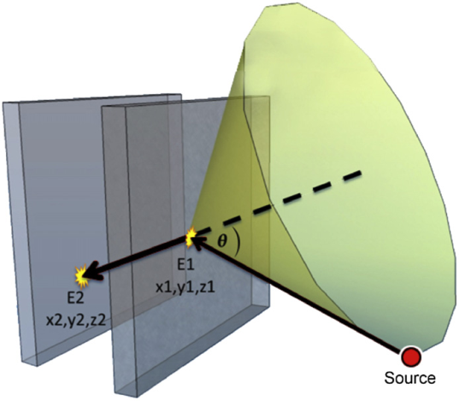
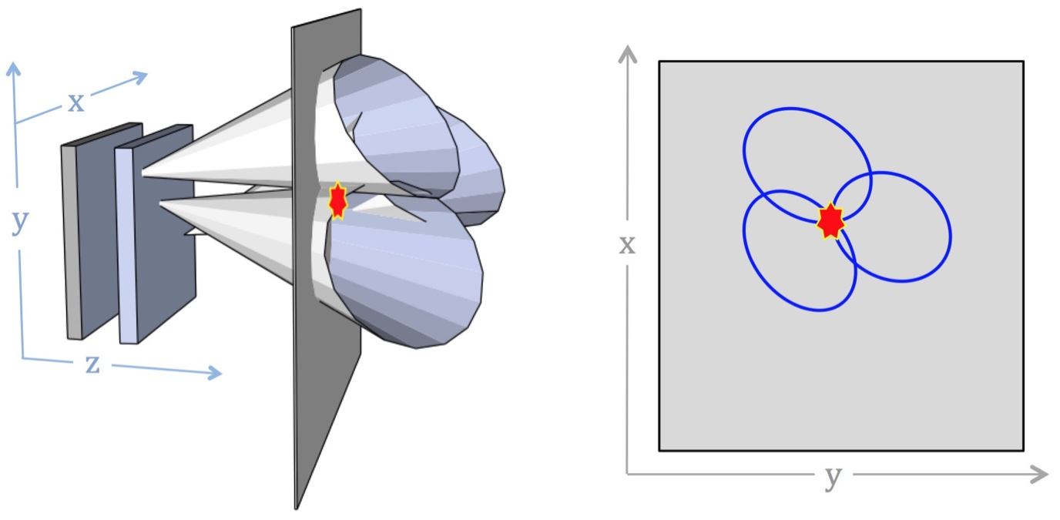
  Compton camera - Principles
Need to know exact positions of interactions and energy deposited at each point + timing of each
Create cone of possible source locations – axis projected along vector between interactions
Overlap of many cones gives source location - in 3D

Slide 5
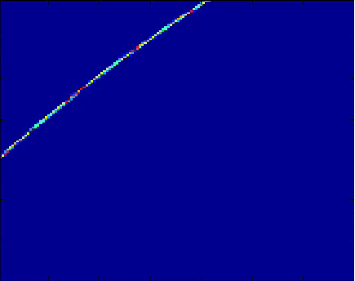
  Compton camera - Principles
Need to know exact positions of interactions and energy deposited at each point + timing of each
Create cone of possible source locations – axis projected along vector between interactions
Overlap of many cones gives source location - in 3D

Slide 6
  Compton camera - Principles
FWHM = 20.74 mm
Slice taken in x and/or y axis through point of maximum overlap
Image resolution is calculated as the FWHM of the peak from a point source

Slide 7
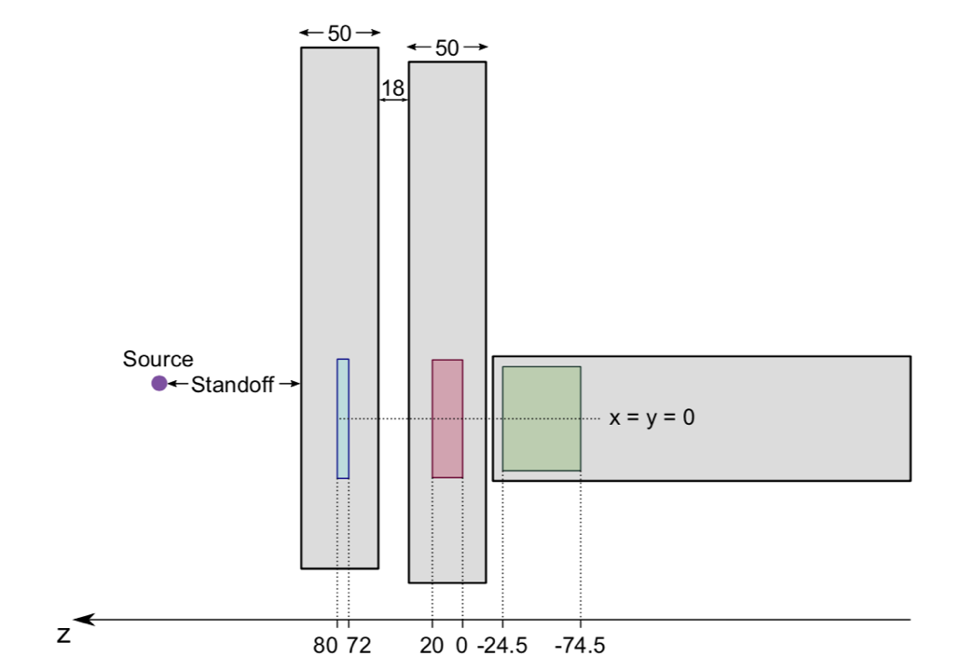
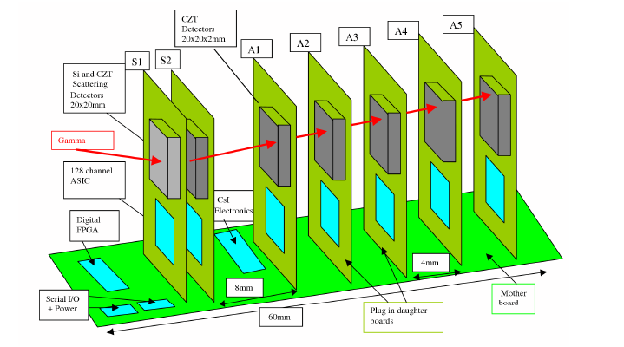
Detector configurations

Slide 8
What makes a good Compton camera?
Sensitivity of a Compton camera is a factor of:
  Detector materials: Compton scattering cross-section in front detector and Photoelectric absorption cross-section in back detector
  Detector thicknesses
  Configuration geometry
  Low energy noise thresholds
Image resolution of a Compton camera is a factor of :
  Energy resolution
  Detector position resolution
  Doppler broadening

Slide 9
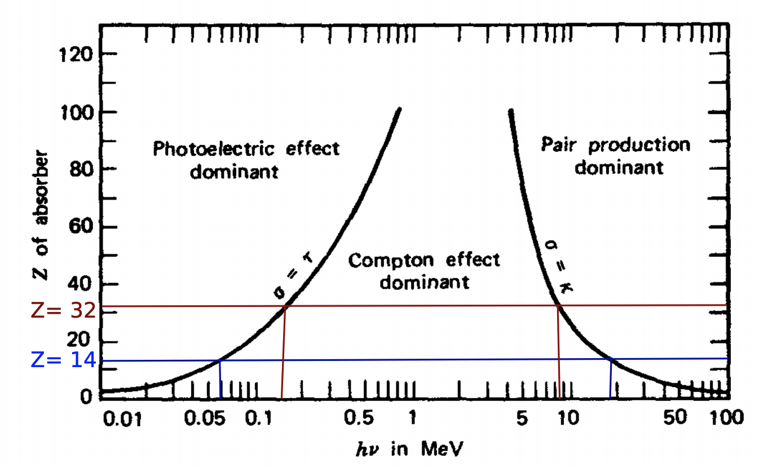
Compton Imaging - Materials
Scattering cross sections depends on gamma energy and Z of material
Lower Z => higher cross section for scattering
Higher Z => better stopping power

Slide 10
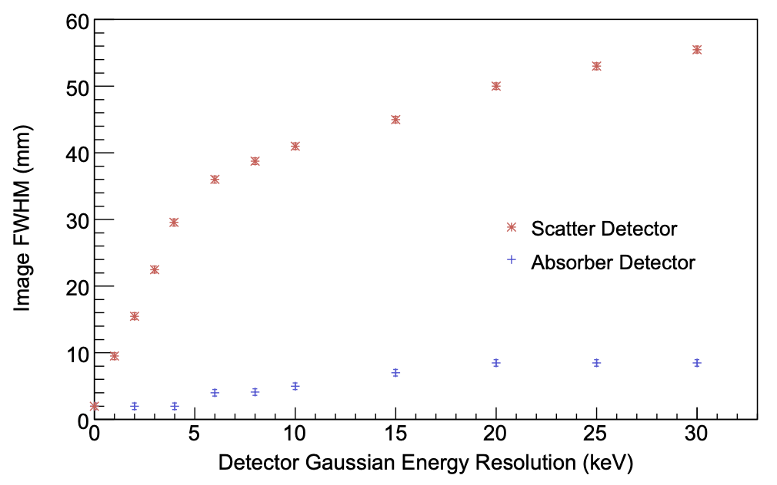
Performance factors – Energy resolution
Energy resolution of scattering detector is more important than that of absorber

Slide 11
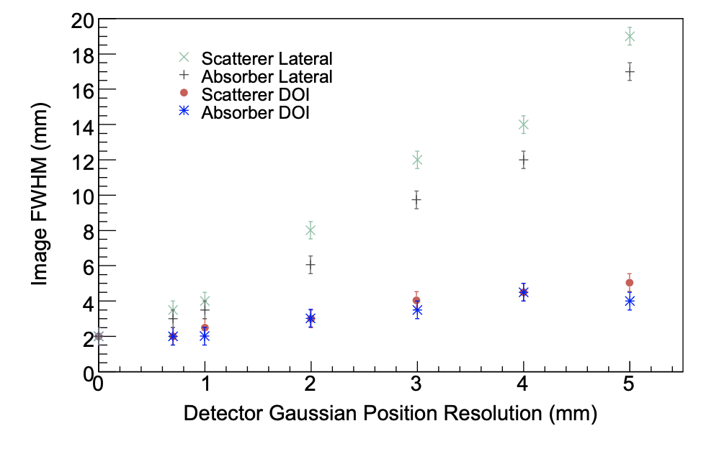
Performance factors – Position resolution
Position resolution can be improved by
  Increased detector granularity / segmentation
    + Better rate capabilities, - more electronic complexity
  Pulse shape analysis techniques
    + Less electronics channels, - more computationally intensive

Slide 12
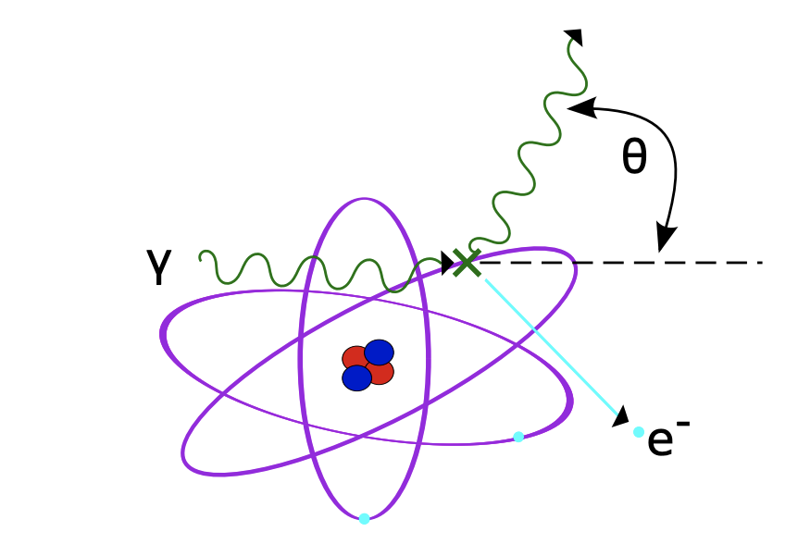
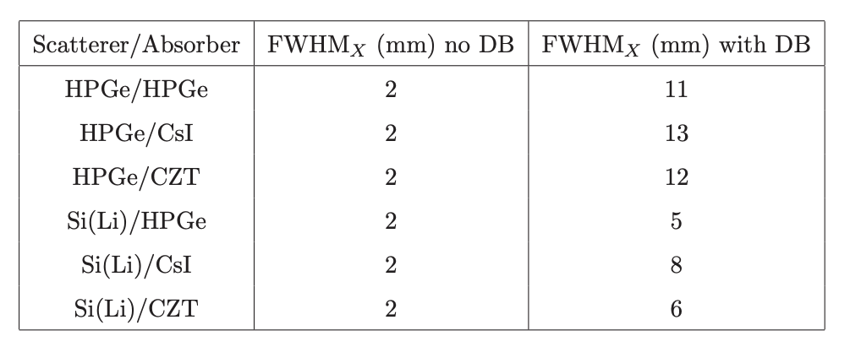
Performance factors - Doppler broadening
Compton scattering formula assumes electron is free and at rest
In reality e⁻ is in motion and bound to scattering material
Introduces additional uncertainty in angle 𝜃 - Doppler broadening
Scales with Z of scattering material

Slide 13
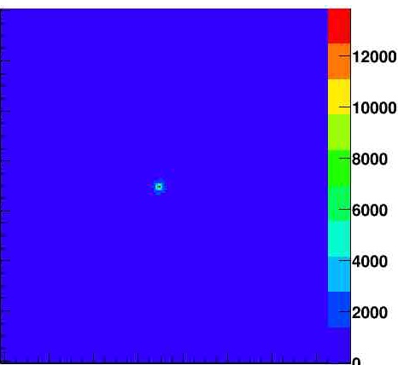
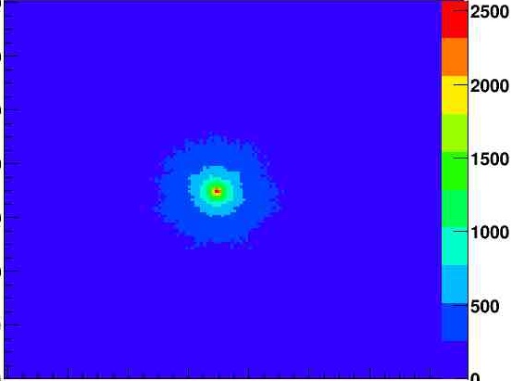
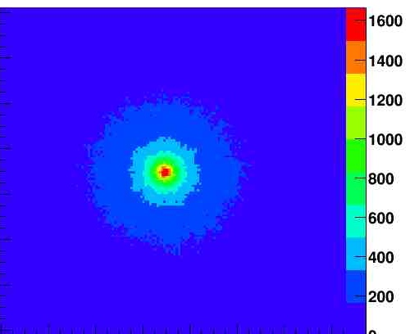
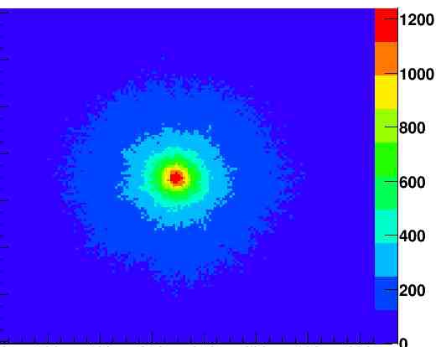
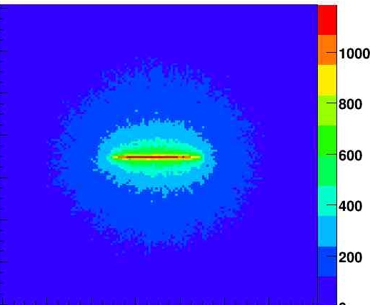
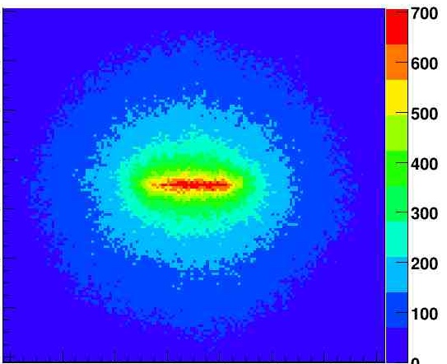
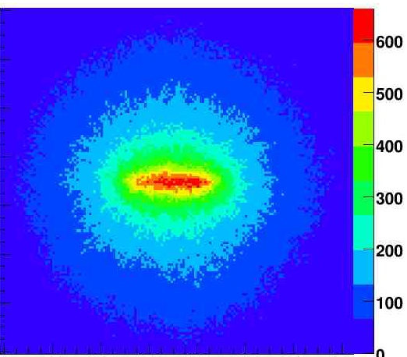
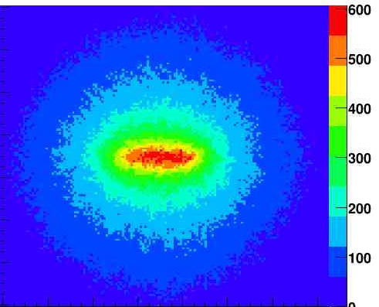
Performance factors – Detector effects
“Perfect” +Doppler Broadened +Pos Res 1mm +Energy Res 2keV
2 mm
6 mm
10 mm
15 mm
Y: 6 mm
Y: 17 mm
Y: 21 mm
Y: 22 mm
Simple Back Projection reconstruction

Slide 14
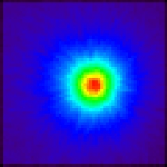
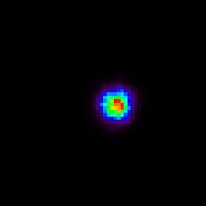
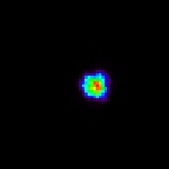
  Reconstruction techniques
Simple Back Projection algorithms – fast (real time) but ‘noisy’
Iterative (OSEM/MLEM/stochastic etc.) imaging – better resolution but computationally more intensive (not real time) + loss of quantitative information
  Backprojection
  MLEM – 10 iterations
  SOE – 1000 iterations
  7°
  13.4 mm
  3°
  5.8 mm
  3°
  5.8 mm

Slide 15
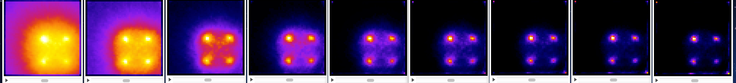
Image quality
4 point sources (0,0)(0,15)(15,0)(15,15), Z = 125mm
OSEM reconstruction
0 2 4 6 8 10 12 14 16
Simple back projection images can be improved with post processing filters

Slide 16
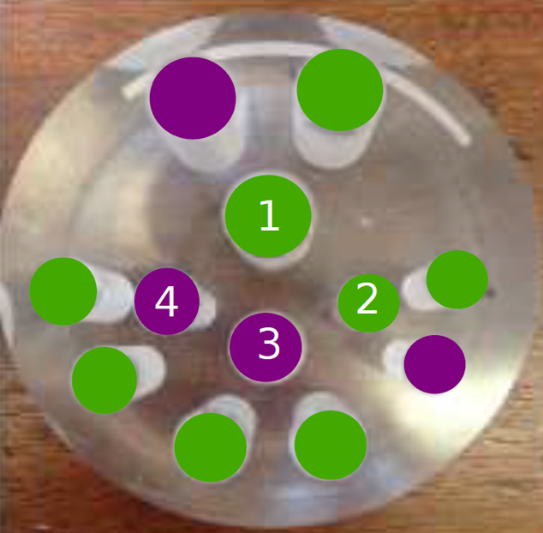
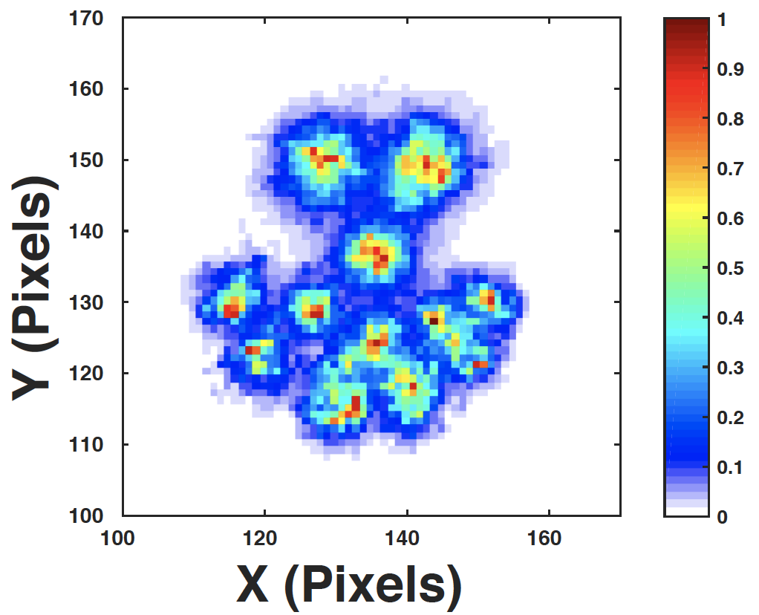
Image quality
Compton camera using Si(Li) scatterer + HPGe absorber
^{99m}Tc (green) and ¹²³I (purple) vials: 10, 11, 12.4 and 16.4mm
MLEM Iterative Reconstruction algorithm

Slide 17

Image quality
3D reconstruction (OSEM)
Gamma-ray source located in (x,y,z)

Slide 18
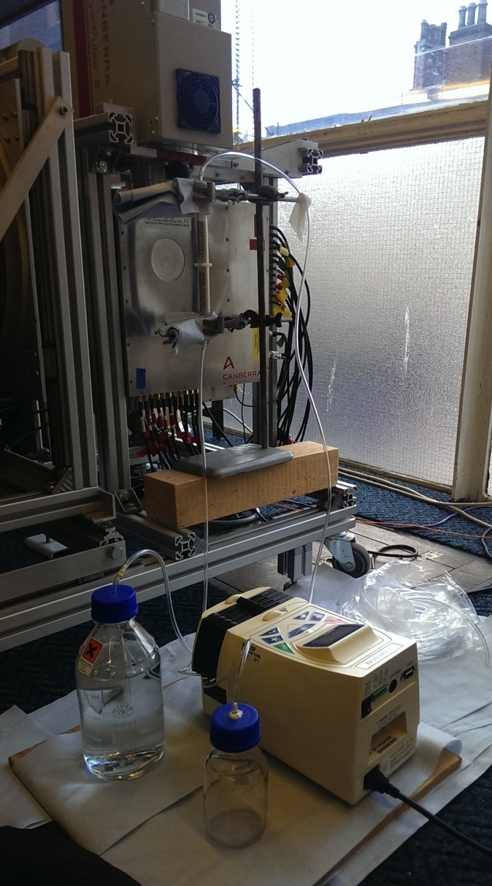
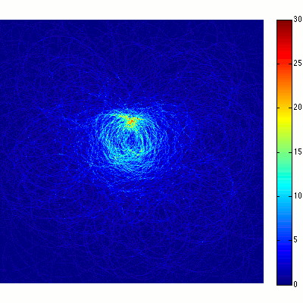
Image quality
Tracking moving source over time
Liquid ¹³⁷Cs diffusing through sand column

Slide 19
Potential difficulties
Multiple interactions within a detector
  Need to be able to accurately determine order of interactions to be able to correctly reconstruct Compton kinematics
Very high count rates + high background
  Need to be able to accurately identify true coincidences and maintain good energy resolution (avoid coincidence summing/pile up…)
High gamma-ray energies
  Need to know total initial energy of gamma ray. Fully absorbing several MeV gamma ray requires large/multiple detectors
Low energy noise performance

Slide 20
Compton cameras at Liverpool
GRI+ is a mobile Compton camera consisting of three electronically cooled semiconductor detectors
Si(Li) DSSD planar detector
Ge DSSD planar detector
Coaxial HPGe detector

Slide 21
Compton cameras at Liverpool
Si(Li) planar detector:
13 AC and 13 DC strips
5.5 mm strip pitch
8 mm thick – 71.5 mm diameter

Slide 22
Compton cameras at Liverpool
Ge planar detector:
12 AC and 12 DC strips
5 mm strip pitch
60 x 60 x 20 mm³

Slide 23
Compton cameras at Liverpool
HPGe coaxial detector:
Model GC4018
Relative efficiency > 40 %
50 mm thick, 66.5 mm diameter

Slide 24
Compton cameras at Liverpool
HPGe scattering + absorbing detectors
60 x 60 x 5 mm Scattering detector
60 x 60 x 20 mm Absorbing detector
12 + 12 Orthogonal strips on each detector face giving 144 voxels

Slide 25
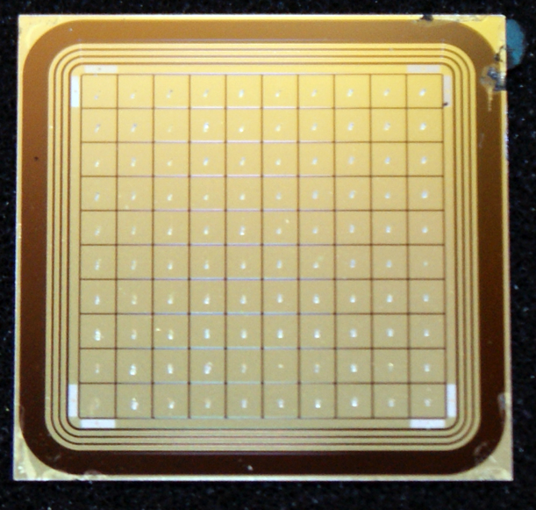
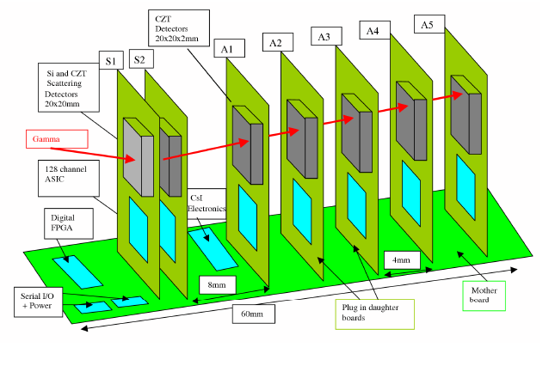
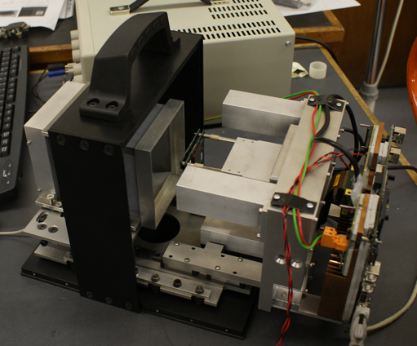
Compton cameras at Liverpool
CZT or Si scattering + stack of CZT absorbing detectors
10x10 pixels, 2 mm², 2 mm or 5 mm thick
ASIC readout
Portable

Slide 26
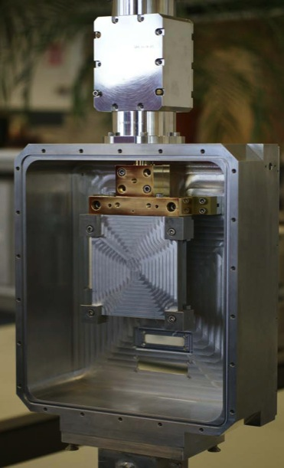
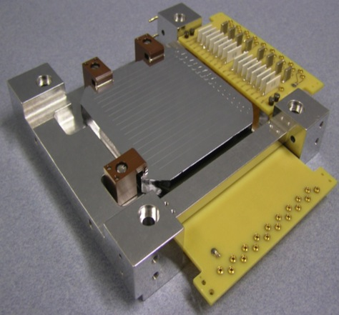
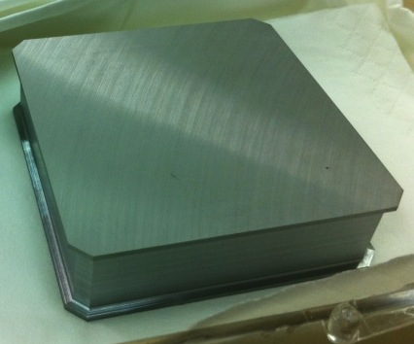
Compton cameras at Liverpool
Si scattering + HPGe absorbing detectors in single custom cryostat
Si(Li) 60 x 60 x 9 mm, 16 + 16 strips each 4 mm wide
HPGe 60 x 60 x 20, 12 + 12 strips each 5 mm wide
Prototype system for use with medical
radionuclides

Slide 27
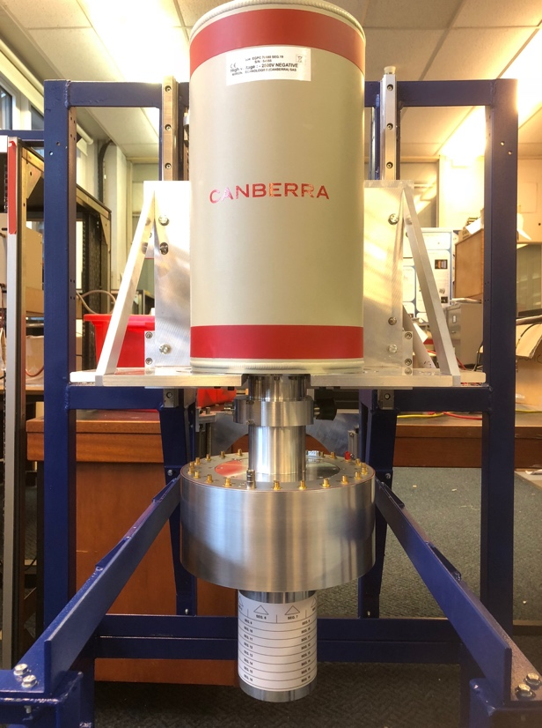
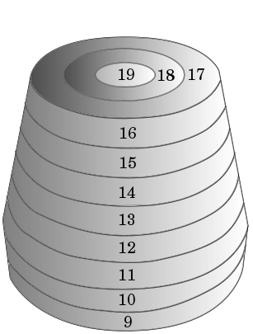
Compton cameras at Liverpool
Single crystal HPGe
Segmented germanium detectors
Around 90 mm length, 70 mm diameter
20-40 segments each several cm³
Pulse Shape Analysis + gamma tracking

Slide 28
Acknowledgements
Boston. A, Boston. H, Harkness-Brennan. L, Creswell. J, Nolan. P, Caffrey. A, Rintoul. E, Alshamiri. H, Kantalan. S, Platt. J, Dormand. D, Patel. A, Woodroof. T, Unsworth. C, Holliway. F

Slide 29
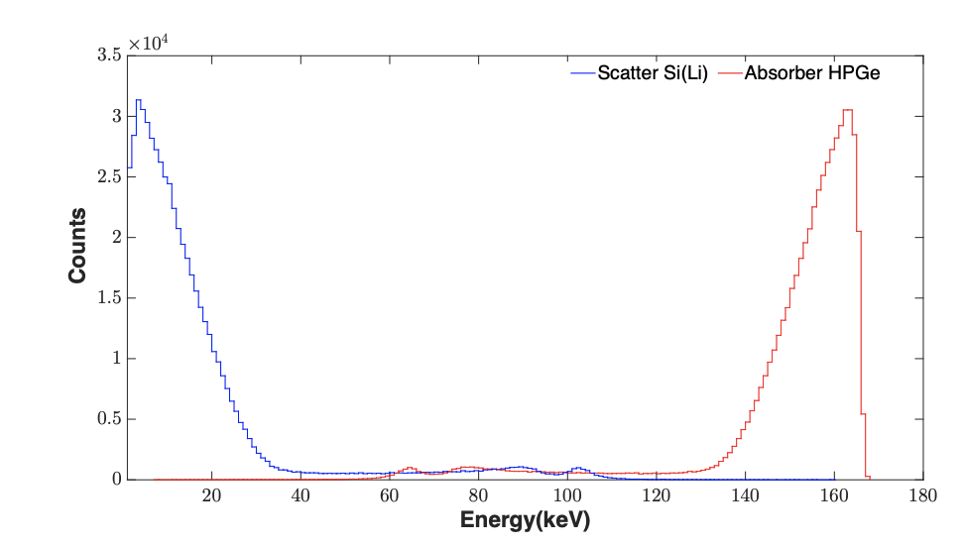
Compton Imaging – Noise threshold
Typical energies deposited in the scattering interaction are low
High energy gammas are highly forward focused when scattered
Need low threshold, low noise electronics

