Slide 1
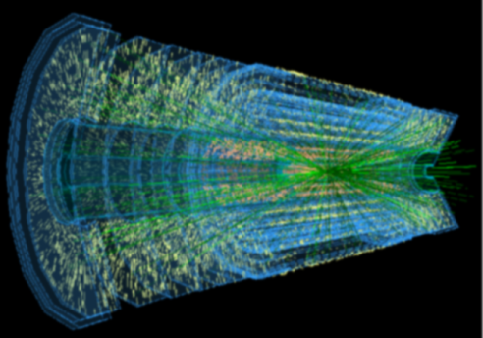
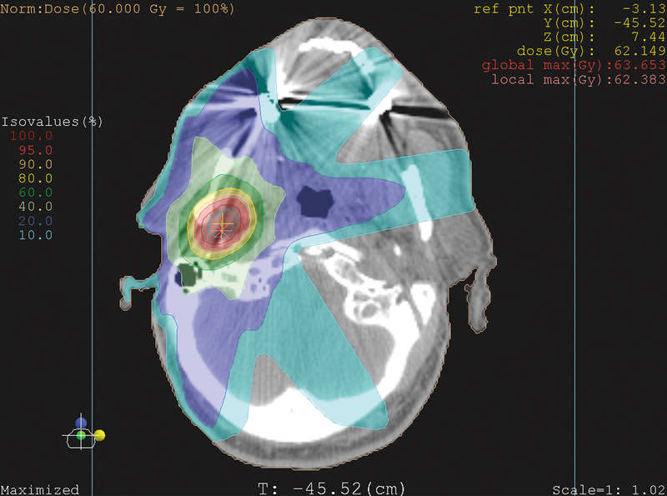
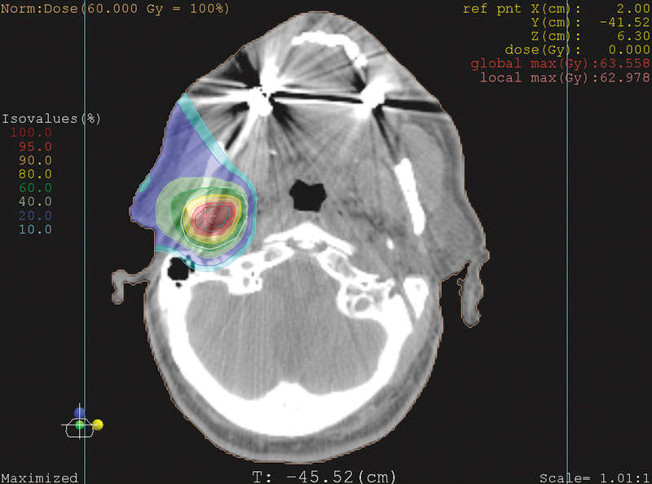
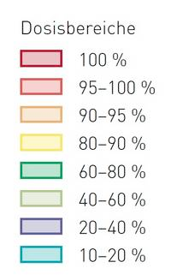
Proton Computed Tomography with Particle Physics Tracking Detectors
Phil Allport
Fast timing silicon pixel detectors for new applications: proton therapy
22/11/19
University of Manchester
Development of Silicon Detector Arrays in Particle Physics
  Strip Detectors
  Hybrid Pixel Detectors
  Charge Transfer Detectors
  Monolithic Active Pixel Sensors
  Silicon Fast Timing Detectors
Applications in Hadron Radiotherapy
  Dosimetry
  Motivation for Proton CT
  PRaVDA Results
  Selected International Activities
Conclusions
Dose range
X-ray radiotherapy
Proton radiotherapy

Slide 2
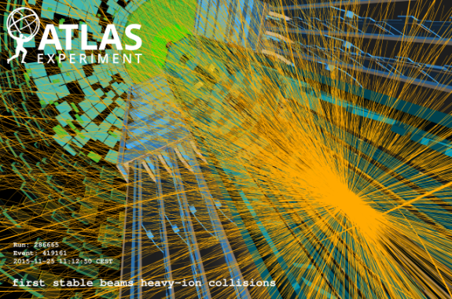
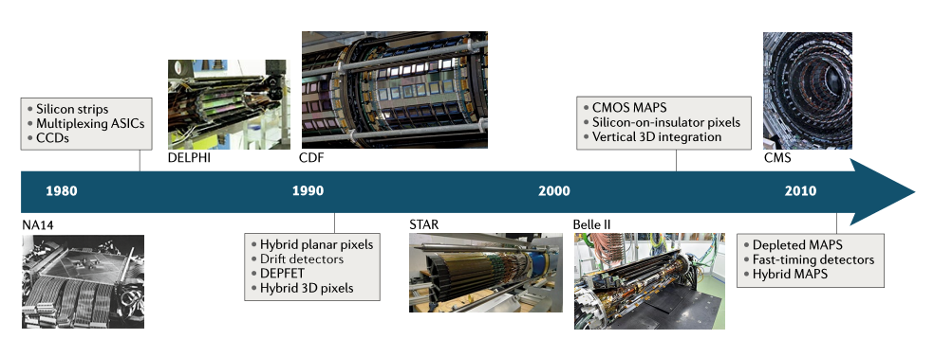
Silicon Sensor Technology Developments .
For charged particle tracking in particle physics, a large number of different solid-state detector technologies have been developed over the last four decades.
Applications of silicon strip and pixel-based particle tracking detectors - Nature Reviews Physics - https://doi.org/10.1038/s42254-019-0081-z - Allport2019ER
Key requirements have included efficiency (signal/noise), resolution (electrode size and pitch), speed/rate (microelectronics), large area (wafer size, yield and cost), low multiple scattering (minimal total material including cooling and services) and radiation hardness.
Gaseous and scintillating fibre technology also widely used but not discussed here due to rate and radiation hardness limitations.

Slide 3
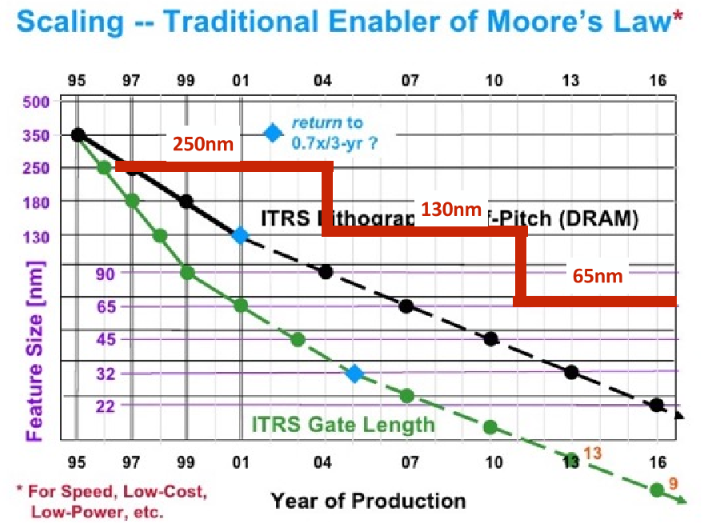
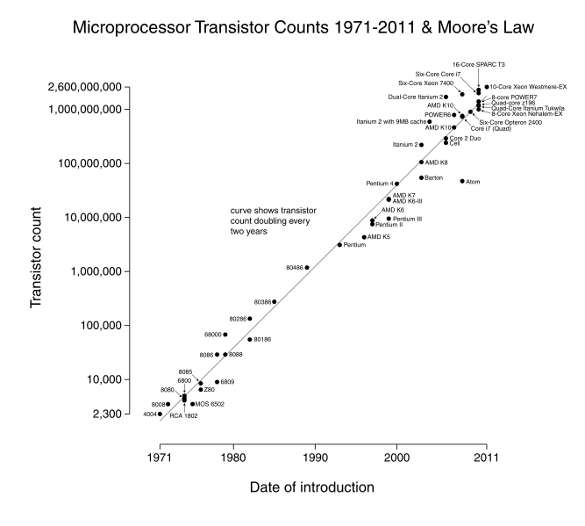
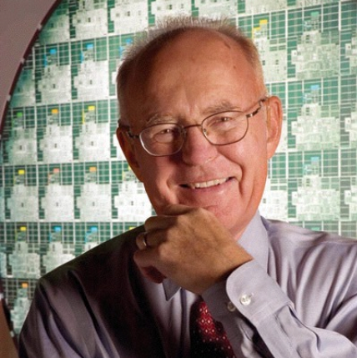
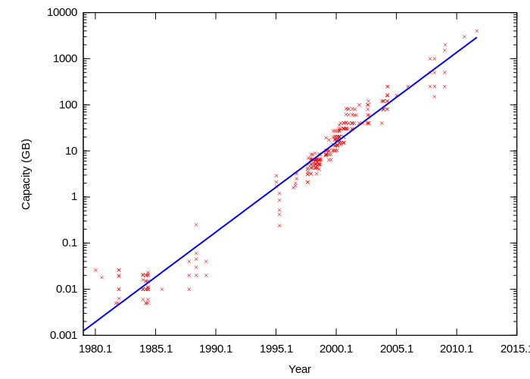
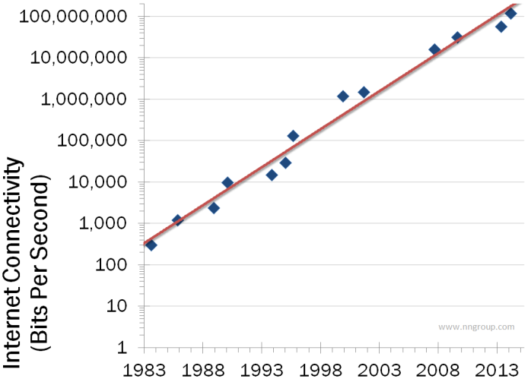
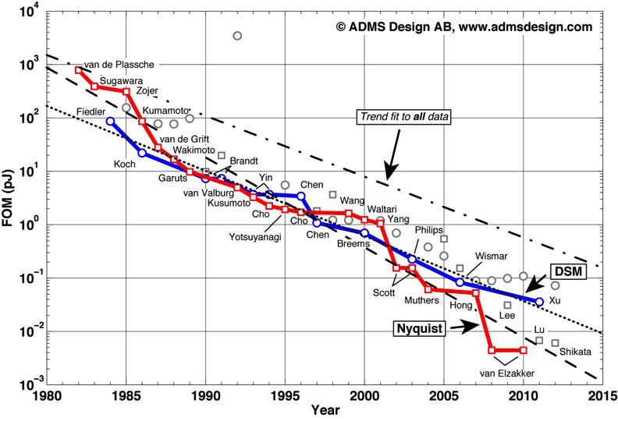
Commercial Microelectronics Evolution
Transistors/mm²
ADC pJ/conversion
Data Storage
Bandwidth
All these figures showed doubling times of < 2 years up to now. Some scalings stopping, but other improvements conceivable. Can still hope for major detector improvements and enhanced data aquisiiton plus computing capabilities. However, storage and CPU costs may not scale as fast as might be desired for future projects.

Slide 4
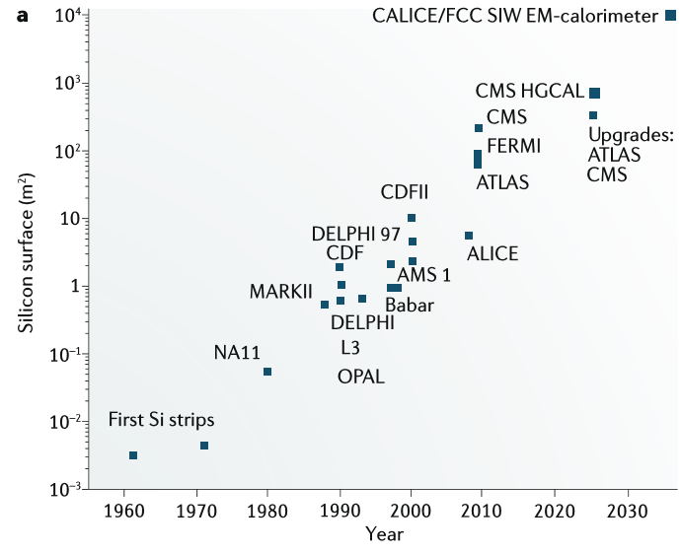
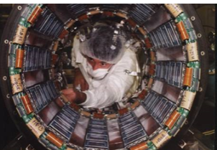
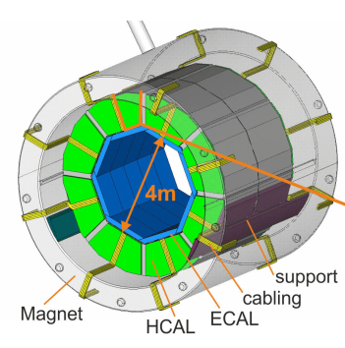
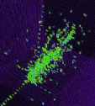
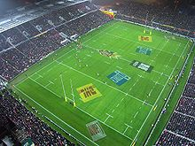
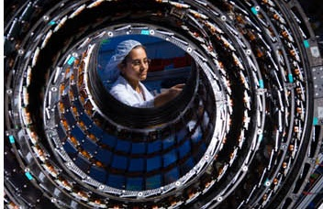
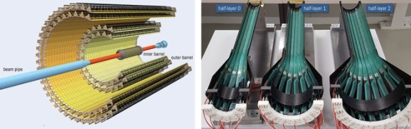
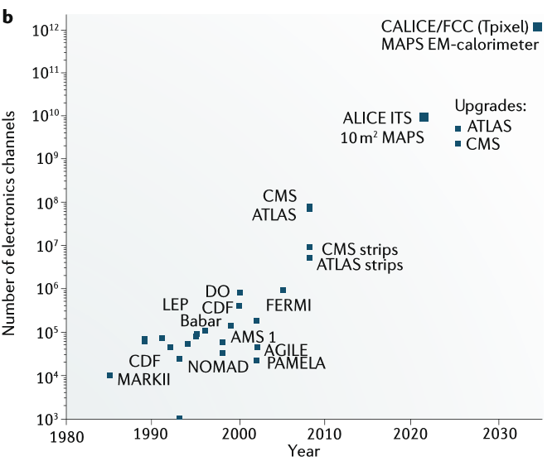
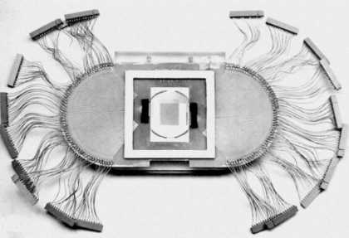
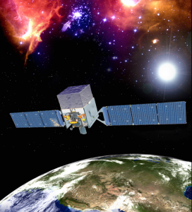
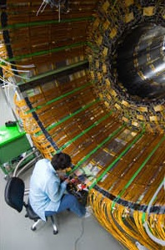
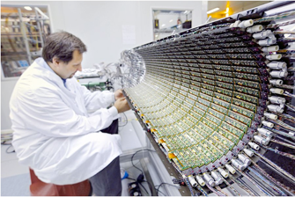
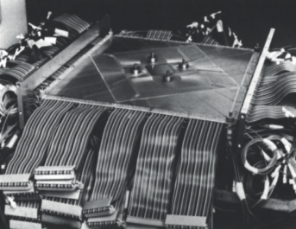
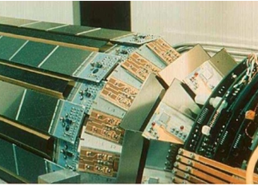
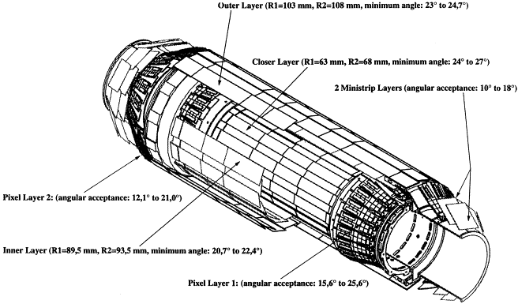
Historical Development of Silicon Sensor Arrays .
10⁴m² = 1 hectare

Slide 5
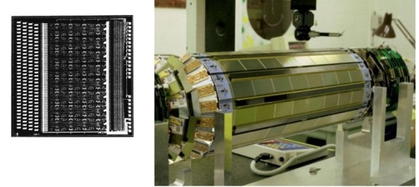
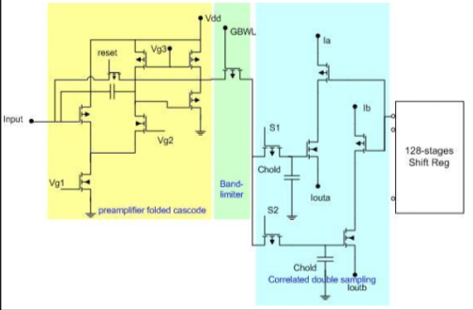
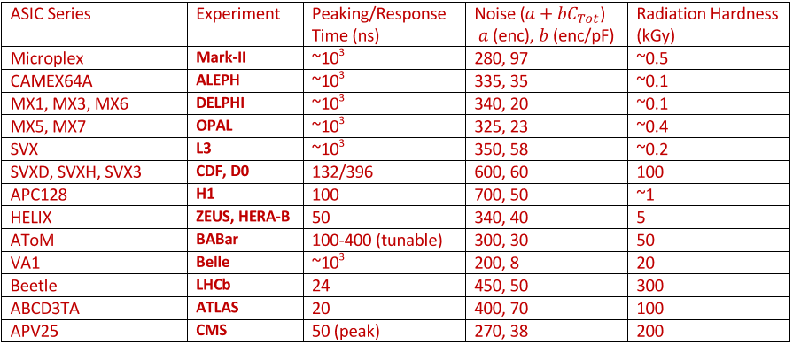
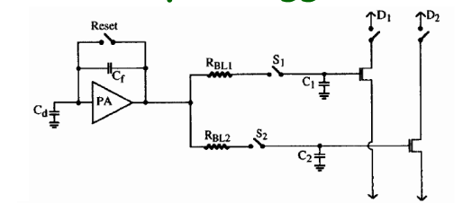
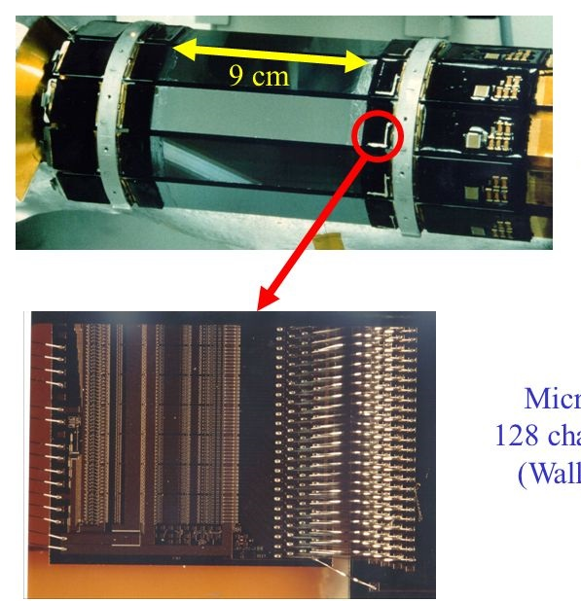
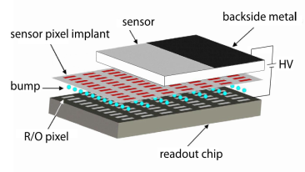
Historical Development of Silicon Sensor Arrays .
Application Specific Integrated Circuit
(ASIC) development has been essential
10
DELPHI (LEP) MX6 (CMOS)
Monolithic Pixel Detectors
Strip Readout ASICs
Hybrid Pixel
Detectors
MARK II (SLAC)
128 Channel
Microplex
Chip (NMOS)
High Density Wire-bonds

Slide 6

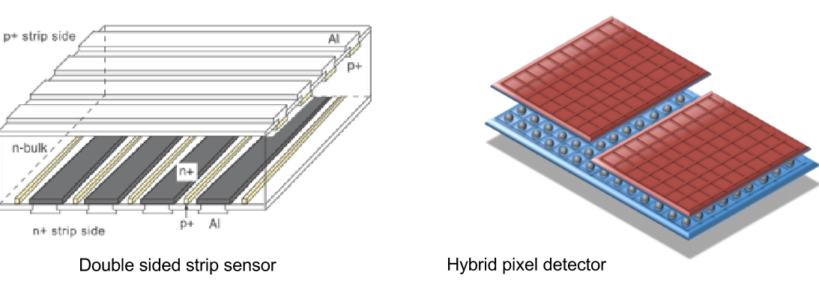
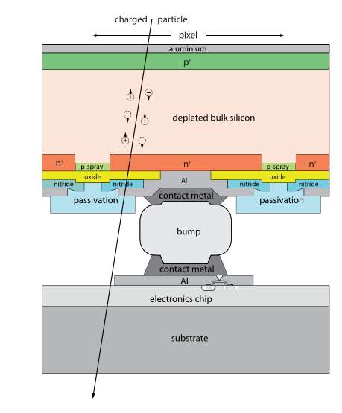
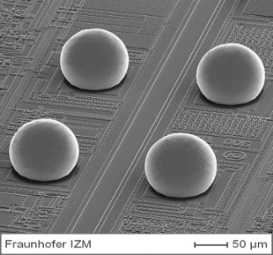
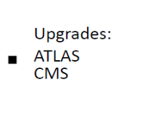
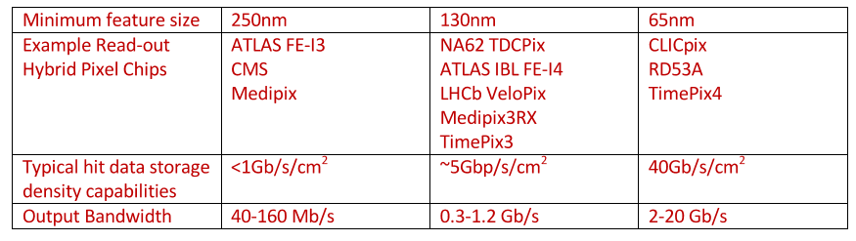
Historical Development of Silicon Sensor Arrays .
The highest channel count arrays are based on pixelated detectors.
For hybrid pixel sensors connection to the electronics requires flip-chip technologies.
10
Two orthogonal projections
True space-points
Required in high track density environments to avoid ambiguities
Hybrid Pixel
Detectors
Hybrid Pixel Readout ASICs

Slide 7
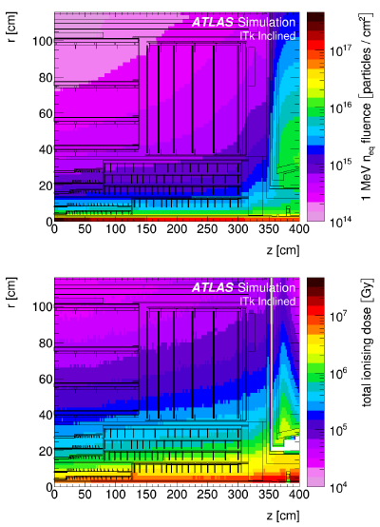
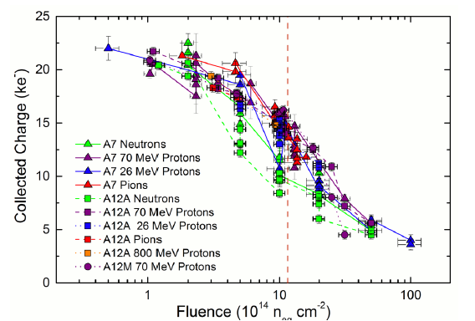


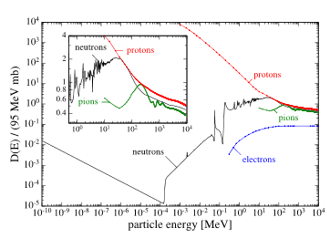
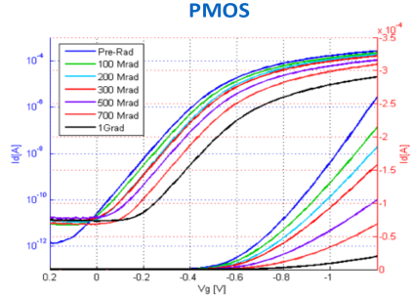
Radiation Effects: Sensors and Electronics
Hybrid silicon detectors (pixels/strips) signal output drops with irradiation to very high doses
RD50
ATLAS
CMS
LHCb
Bulk damage (measured in units of 1MeV equivalent neutrons/cm² (assuming scaling with non-ionising energy loss) drives the deterioration of sensors.
For microelectronics worry about total ionising dose.
(65nm CMOS - RD53) can start to see significant deterioration above 500Mrad (5MGy) ◊Many different effects◊
1.2×10¹⁵n_{eq}/cm²
Example of radiation expected at High Luminosity
LHC (HL-LHC)
n⁺ strips
in p⁻ bulk
Strips
1.9×10¹⁶n_{eq}/cm²
Pixels
For Pixels: also need rad-hard data links
with up to ~40 hits/cm² each 25ns
5×10⁵Gy
Fluence (10¹⁴n_{eq}/cm²)
1.3×10⁷Gy
niel
Federico Faccio: PMOS turn-on V_{g} https://indico.cern.ch/event/468486/

Slide 8
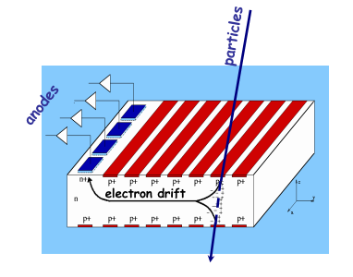
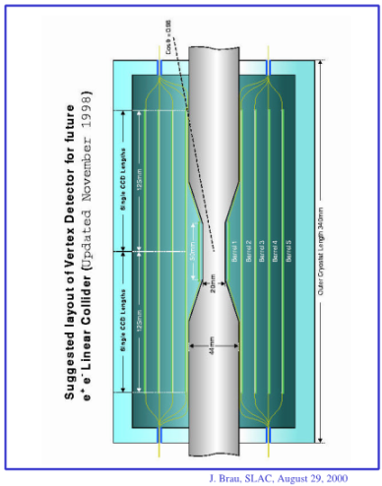
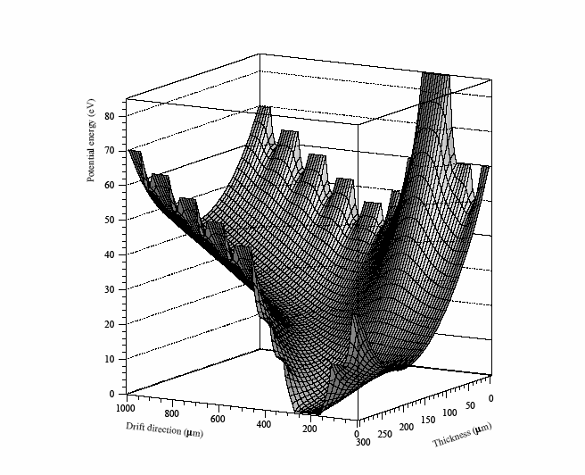
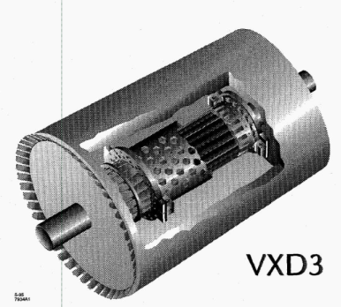
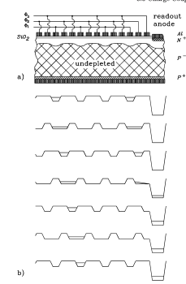
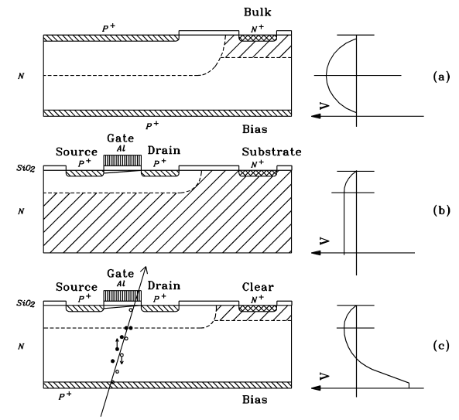
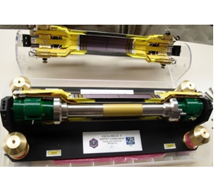
CCD, Drift and DEPFET
A number of technologies have been adopted and could be suitable for future facilities where the charge is moved through the silicon by clocking potentials (CCD), lateral field (Drift) or stored in the silicon beneath a transistor allowing non-destructive read-out (DEPFET)
CCD
Drift
DEPFET
SLD Vertex
Arrival time gives lateral drift distance
Charge stored beneath gate can be read out as giving increased I_{d} for given V_{g}
BELLE II Vertex Detector at SuperKEKB

Slide 9
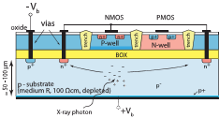


Monolithic: SoI and 3D Integration
Monolithic pixel sensors combine the functionality of the microelectronics with the sensor substrate as part of a single silicon object.
CCDs and DEPFETs already incorporate active circuit elements in the sensors which are therefore no longer simple passive devices.
However, these devices are potentially slow and prone to radiation damage.
Silicon on Insulator technology allows integration of full read-out circuitry above a buried oxide over the sensing substrate.
  Wafer bonding, through silicon via (TSV) and back-thinning technologies allow circuits to be stacked in 3D.
Could imagine detector concept with stacked opto-electronics digital electronics, analogue electronics and sensor substrate

Slide 10






MAPS: HV/HR-CMOS Detectors
Commercial CMOS Image Sensors offer possible dramatic decrease in costs (Monolithic Active Pixel Sensors)
MAPS can deliver very low power consumption at low R/O speeds, possibly <100mW/cm² i.e. simple water cooling
  Ultra low material budget (cf ALICE ITS upgrade: <0.5% for inner layers, <1% for outer layers)
  But these devices limited in speed and radiation hardness
  Current and near future MAPS for heavy ion experiments
    integration time up to 4μs (noise, electron diffusion)
    radiation resistance up to few 10¹³ n_{eq}cm⁻²
Major developments in HV/HR-CMOS → deep depletion region with charge collection by drift not diffusion → huge improvements in collection speed and radiation hardness
Can usually either have small collecting node (and therefore faster and low noise) but shallow charge collection or deplete from the deep n-well with larger signal produced in up to 100μm of silicon but higher capacitance (= noise+slower)
Modified process with junction in substrate
If DMAPS could approach hybrid pixel radiation hardness they should offer much less material and cost

Slide 11










Ultra Fast Timing Detectors
RD50, ATLAS, CMS: Low Gain Avalanche Detectors (LGAD) (Radiation issues still under study for HL-LHC applications)
Bump-bonded hybrid 6.4m² of 1.3mm×1.3mm
pads proposed in ATLAS
2/3 layers of LGAD sensors
Corner of 15×15 array
11

Slide 12









    Hadron Radiotherapy
www.pravda.uk.com
Proton and Ion therapy
Proton vs photon
Medulloblastoma
Paediatric CNS Tumour
Tumour
https://www.ptcog.ch/index.php/
Lists 94 hadron radiotherapy facilities “in operation”, 45 “in construction” and 21 “in planning stage”

Slide 13


    Hadron Radiotherapy
www.pravda.uk.com
Impact of under/over estimating stopping power
Tumour
Proton Computed Tomography (pCT) hoped to be the solution
https://www.ptcog.ch/index.php/
Lists 94 facilities internationally “in operation”, 45 “in construction” and 21 “in planning stage”

Slide 14








Proton Radiotherapy Verification and Dosimetry Applications
www.pravda.uk.com
https://physicsworld.com/a/proton-imaging-comes-to-the-christie/
Need to know momentum vector and entry point of each proton going into the patient and also momentum vector and exit point coming out.
Need tracks plus incoming and outgoing energies
Uses HL-LHC strip tracking detectors
Except at the highest energies multiple scattering dominates, so thin is better than fine pitch
14

Slide 15










Computed Tomography
Most common imaging modality for treatment planning is Computed Tomography (CT)
Measure the linear attenuation of x-rays (μ) along a path through patient (line integral) to form a radiograph
Rotate the source and detectors around the patient and take another radiograph from different angles
Use a reconstruction algorithm to combine all of the line integrals as a function of position in the patient
Information in CT image stored as the Houndsfield unit which is the linear attenuation relative to water and air
$HU=1000×\frac{μ −μ_{W}}{μ_{W}−μ_{A}}$
Currently x-ray CT is performed, which is then converted into stopping powers
Lung = -850 to -910
Bone = 700 to 3000
Water = 0
Uncertainties in RSP Estimation (1σ)
“The values recommended in this study based on typical treatment sites and a small group of patients roughly agree with the commonly referenced value (3.5%) used for margin design.”
M Yang et al PMB. 57
4095–4115 (2012)
Main range uncertainty caused by imaging the patient with x-rays, but treating with protons

Slide 16





Proton Computed Tomography
www.pravda.uk.com
x-u-v: A disadvantage of other systems with crossed strips is that they cannot cope with two or more protons per frame without ambiguities.
The usual way round this with strips is to have a third layer
Depending on strip pitch, still problems above several hits / frame
Then need truly pixelated sensor, but needs to be fast
(3N Channels)
(N² Channels)

Slide 17
Proton Computed Tomography
www.pravda.uk.com
Proton energy after passing through the patient found from the distance penetrated in the range telescope
Need to know momentum vector and entry point of each proton going into the patient and also momentum vector and exit point coming out.
Need tracks plus incoming and outgoing energies
https://gow.epsrc.ukri.org/NGBOViewGrant.aspx?GrantRef=EP/R023220/1

Slide 18



Proton Computed Tomography
www.pravda.uk.com
21 silicon planes interspersed with absorber to measure proton stopping distance
In final realisation, range telescope and tracker used common (n-in-p) strip technology
4 sets of 3 silicon strip planes reading out at the duty cycle of the cyclotron

Slide 19

Proton Radiotherapy Verification and Dosimetry Applications
www.pravda.uk.com
Installed at iThemba for first tests May 2016 (125 MeV degraded beam).
Compensator in place.
180 rotations at 1º steps.
Over 1M protons / rotation.
Second run November 2016.

Slide 20




Proton Radiotherapy Verification and Dosimetry Applications
www.pravda.uk.com
Installed at iThemba for first tests May 2016 (125 MeV degraded beam).
Compensator in place.
180 rotations at 1º steps.
Over 1M protons / rotation.
Second run November 2016.
280 M proton histories recorded.
Proton scattering power CT

Slide 21


Proton Radiotherapy Verification and Dosimetry Applications
www.pravda.uk.com
Installed at iThemba for first tests May 2016 (125 MeV degraded beam).
Compensator in place.
180 rotations at 1º steps.
Over 1M protons / rotation.
Second run November 2016.
280 M proton histories recorded.
Reconstructed using novel Back-Projection-Filtering algorithm specifically developed for proton CT.
Raw data rate ~ 360 Gbit/s

Slide 22


Proton Radiotherapy Verification and Dosimetry Applications
www.pravda.uk.com
Installed at iThemba for first tests May 2016 (125 MeV degraded beam).
Compensator in place.
180 rotations at 1º steps.
Over 1M protons / rotation.
Second run November 2016.
280 M proton histories recorded.
Reconstructed using novel Back-Projection-Filtering algorithm specifically developed for proton CT.
Stopping power for all inserts (except lung) agree within 1.6% of expected values.
Stopping Power
High contrast inserts (LN10, Air, SB5)
Low contrast inserts (AP7, WT1, RB2)

Slide 23







Proton Radiotherapy Verification and Dosimetry Applications
www.pravda.uk.com
Installed at iThemba for first tests May 2016 (125 MeV degraded beam).
Compensator in place.
180 rotations at 1º steps.
Over 1M protons / rotation.
Second run November 2016.
280 M proton histories recorded.
Reconstructed using novel Back-Projection-Filtering algorithm specifically developed for proton CT.
Stopping power for all inserts (except lung) agree within 1.6% of expected values.
Still need optimal way to combine scattering and stopping power.
Lamb chop chosen as first test of proton CT on real tissue due to regions of bone, soft tissue and fat
Same parameters as for imaging phantom, but with 2º rotation steps
Proton CT
Cone beam CT

Slide 24



The pCT Collaboration
R. P. Johnson, Tia Plautz, Hartmut F.-W. Sadrozinski, A. Zatserklyaniy: SCIPP, U.C. Santa Cruz, Santa Cruz, CA , USA
V. Bashkirov, V. Giacometti, F. Hurley, P. Piersimoni, R. Schulte: Division of Radiation Research, Loma Linda University, CA, USA
P. Karbasi, K. Schubert, B.Schultze: Baylor University, Waco, TX, USA
Loma Linde with SCIPP (UCSC) see for example Robert P Johnson et al 2017 “Review of medical radiography and tomography with proton beams” https://doi.org/10.1088/1361-6633/aa8b1d
1 million individual protons reconstructed per second
Rotation Stage
5-Stage Energy Detector
Trackers
H.F.-W. Sadrozinski, et al, Development of a Head Scanner for Proton CT, Nucl. Instr. Meth. A 699 (2013) 205.
protons
Four 9cm*9cm silicon strip sensors with thin-edge technology in x-y configuration

Slide 25


The pCT Collaboration
Proton
X-ray
Three cardinal planes of 3D RSP images obtained with Phase II scans of the anthropomorphic head phantom.
3D rendering of the pCT-reconstructed RSP map of a pediatric anthropomorphic head phantom
The relative stopping power
(RSP) of the variety of materials in the phantom is accurately measured

Slide 26




Some Other Silicon Based Trackers
  Another group using similar sensors to the pCT Collaboration is based at Niigata University
  A very promising approach being followed by Padua with CERN is the use of MAPS technologies for the tracking but with intelligent on-chip data sparsification to deliver faster, low power readout
  However, the approach does not yet address the radiation tolerance challenges. Although these are being addressed for particle physics applications, these are yet to be demonstrated in a wafer-scale sensor, which is ideally what is needed for pCT.
Item | Specifications
Outer dimensions | 89.5×89.5 mm²
Active area | 87.6×87.6 mm²
Substrate thickness | 410±10μm
Strip pitch | 228μm
Readout pitch | 456μm
Number of strips | 384
Full depletion voltage | <120 V

Slide 27









CMOS Imaging Sensors and BGO
  MAPS (Mimosa) are also being looked at by groups in the Netherlands and Norway
  There are a number of other initiatives using different tracking/calorimeter technologies, scintillating fibres, multi-wire proportional chambers, … all of which have potential advantages and disadvantages when compared with silicon detectors
  Also Micro-Pattern Gas Detectors (CERN, Vienna, ...)
Sodai Tanaka et al 2018 Phys. Med. Biol. in press https://doi.org/10.1088/1361-6560/aaa515
•••• CCD Camera
Chicken leg

Slide 28


Scintillating Fibre Tracking
Fermilab, Delhi and Northern Illinois system uses scintillating fibre tracker
Area 20x24 cm² (4 planes upstream) and 24x30 cm² (4 planes downstream) with 15 cm separation between planes.
96 plastic scintillating tiles with dimensions of 27cm width, 36 cm height, and 3.2mm thickness were used in the range stack.
At the proton beam at the Central DuPage Hospital in Warrenville, IL
FERMILAB-TM-2617-AD-CD-E

Slide 29

Limitation in Adaption for Clinical Use
The main issue for many systems is the size of the system and the problem with coping with multiple protons per cyclotron/synchrotron spill both in the tracker and in the calorimeter or range telescope
Spot scanning makes the issue with ambiguities more difficult. Also hard to get very low currents in clinical setting. → Are there proton time differences within each spill?
Example calculation: $n$×10pA would imply $n$×6.25×10⁹ protons per second.
cf pCT 10⁶ protons reconstructed per second
If 72* MHz rep rate, then $n$×0.87 protons per spill. Spot size ~cm² anticipated to be continuously scanned across the field of view with $⪅$180 different projections needed.
Depending on volume to be imaged, could need 10⁹-10¹⁰ protons, so 10⁷-10⁸ per angle.
Might need ~10³ spot locations so ~(10⁴-10⁵) proton spills per location ie on average ≳ $\frac{10}{n}$µs per 1cm² location ≳ $\frac{10}{n}$ms per angle
Another thought for fast timing is energy measurement where 10ps could give 1MeV energy resolution with 1m ToF up to ~200MeV
*Varian ProBeam®
https://www.varian.com/oncology/solutions/proton-therapy

Slide 30





Radiotherapy Detector Systems
Collaboration of Birmingham, Queen Elizabeth Hospital, STFC TD, VivaMOS Ltd and NPL towards developing bulk-damage radiation-hard sensors to enhance the UK primary standard for absorbed dose for proton radiotherapy by incorporating real-time spot profile measuring apparatus with NPL calorimetry.
Currently using strips (from PRaVDA) in 3 projections and CMOS pixels
LASSENA is radiation-hard against ionising dose but not protons. Need to take advantage of latest HL-LHC CMOS MAPS developments to have truly 2D imaging capability.
Reconstruction of a 1.5 x 1.5 cm² square 6 MV beam, centred at (0.5 cm, 0.5 cm).
NPL Calorimeter at Clatterbridge

Slide 31




Radiotherapy Detector Systems
FLASH (2-40 Gy in few 100ms) and Micro-beam (sub mm segmentation) currently very exciting as both show much better sparing of healthy tissue for a given dose although mechanisms still not fully understood.
STFC TD, NPL, VivaMOS Ltd and Birmingham demonstration of imaging of micro-beam slit system at clinical X-Ray source with large area CMOS sensor (225 kV, 1.65 Gy/min, Helmhotz Research Centre in Munich).
Resolution at least as good as film (in fact better contrast) and gives real time image.
Also:
STFC Global Challenge Network+ in Advanced Radiotherapy*: many projects, including work combining UCL Calorimetry with PRaVDA tracker, DMAPS with Bonn, developments towards proton Micro-beam studies and several dedicated studies using Birmingham MC40 cyclotron.
ENLIGHT: The European Network for Light ion Hadron Therapy
*led by Karen Kirkby

Slide 32
Conclusions
  Many individual ingredients for “4D” detectors now exist in particle physics (high sensor segmentation, sensors with intrinsic fast response, 40MHz data rates, 50µm×50µm pixel electronics, radiation hardness, …. ) which could give interesting devices for different aspects of hadron radiotherapy applications
  Many groups internationally looking at proton CT (only some discussed here) but a spot scanning clinical system will probably give a time structure leading to multiple nearby protons per frame (with frame rates in the many tens of MHz) that need resolving
  A critical requirement is to both use protons efficiently to minimise dose during imaging while taking the image in a time consistent with a sensible patient treatment plan and gantry/spot scanning hardware capabilities
  OPTIma, in the UK, is building on PRaVDA successes to address many of these requirements but is likely for the tracking aspects to use the mature silicon strip technology to meet the very high data rates, area cost and radiation requirements
  A key observation is that multiple scattering dominates so, for the tracker, material must be minimal so monolithic thin devices would be idea if able to cope with the frame rate
  Pitches can be large (or pixels can be ganged together) to reduce channel count
  Ambiguities for nearby protons might be resolvable with timing information (tbc)
  Time of flight with 10ps resolution could give useful energy resolution capability

