Slide 1


Slide 2

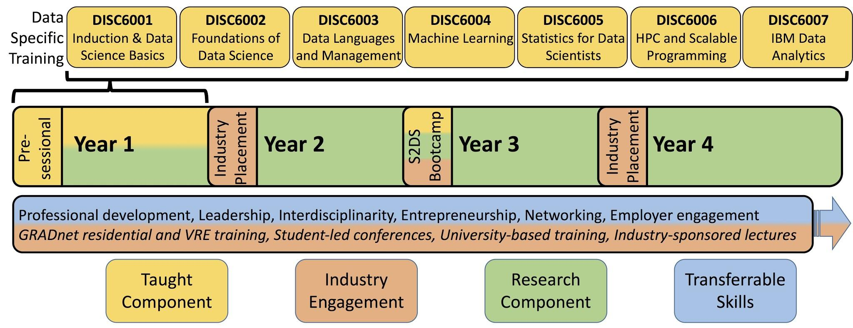
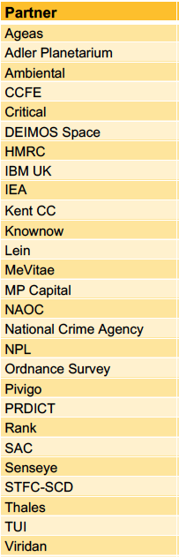

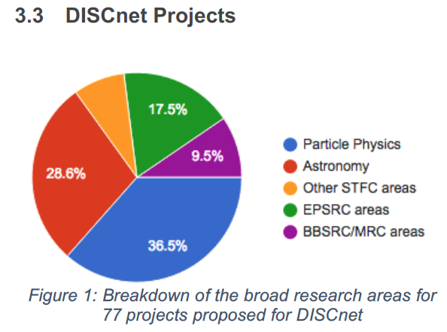
DISCnet: Data Intensive Science Centre in SEPnet
STFC Data Intensive Science Centre call October 2016
Sussex, Soton, QMUL, OU, Portsmouth, building on GRADnet
9% of all STFC activity in UK
Leveraging 44 PhD years of STFC → 228 PhD years Training
Data intensive training e.g. from IBM-UK
132 months of commercial placements in 27 companies
5-week commercial transfer with
Not just STFC. Sussex DISCUS interdisciplinary e.g. linking to GCRF
Director Prof. Seb Oliver, University of Sussex (Also STFC ETCC Chair)
Ranked 2nd in STFC competition
DISCnet pilot being developed 56 PhD students and postdocs registered interest

Slide 3
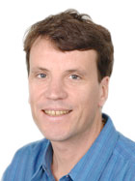
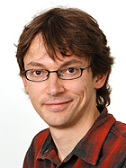
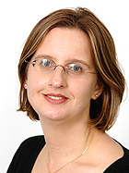
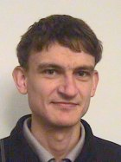
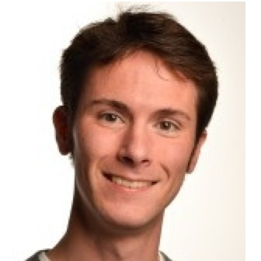
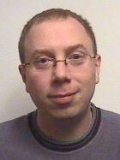
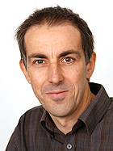
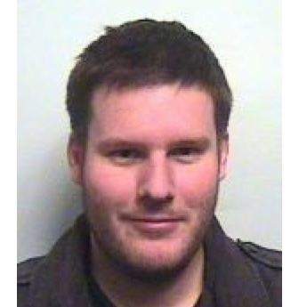
Faculty members
Chris Byrnes
Ilian Iliev
Antony Lewis
Jon Loveday
Seb Oliver
Kathy Romer
Stephen Wilkins
Mark Sargent
David Seery
Robert Smith
Peter Thomas

Slide 4
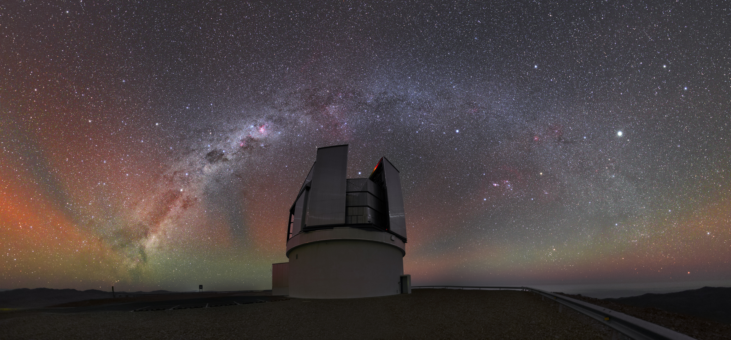
4MOST
Sussex is a member of the 4-metre Multi-Object Spectroscopic Telescope (4MOST)
The premier spectroscopic facility in the southern hemisphere
Most new PhD students will be involved in 4MOST survey planning
Ideally positioned for postdoc positions when 4MOST starts in 2021

Slide 5

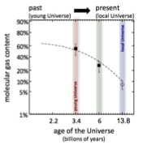

Gas and star formation in galaxies through cosmic time
(supervisor: Mark Sargent)
Gradual gas consump- tion in spiral galaxies?
Central question: How did it come to this…?
Rapid/efficient gas consumption in merger-induced starbursts?
Stripping of gas reservoirs in dense environments, e.g. in galaxy groups?
Removal of gas by feedback, e.g. from AGN or star-formation?
JCMT
IRAM/NOEMA
IRAM/30m
JVLA
GMRT
ALMA

Slide 6
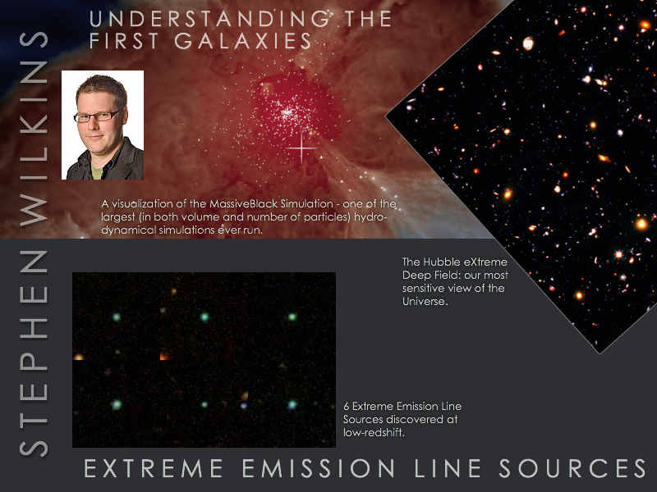

Slide 7
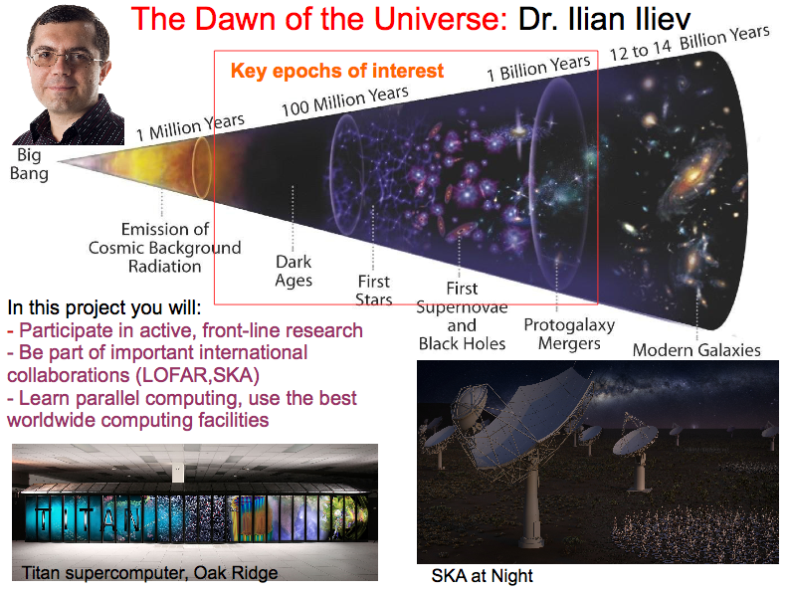

Slide 8
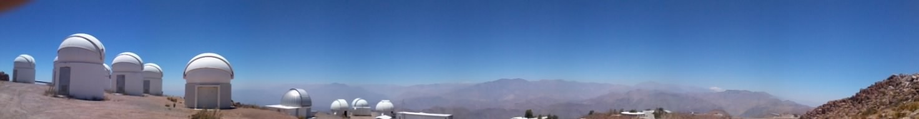
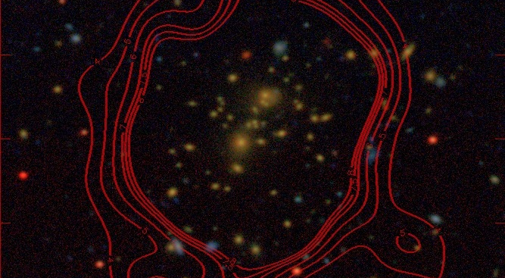
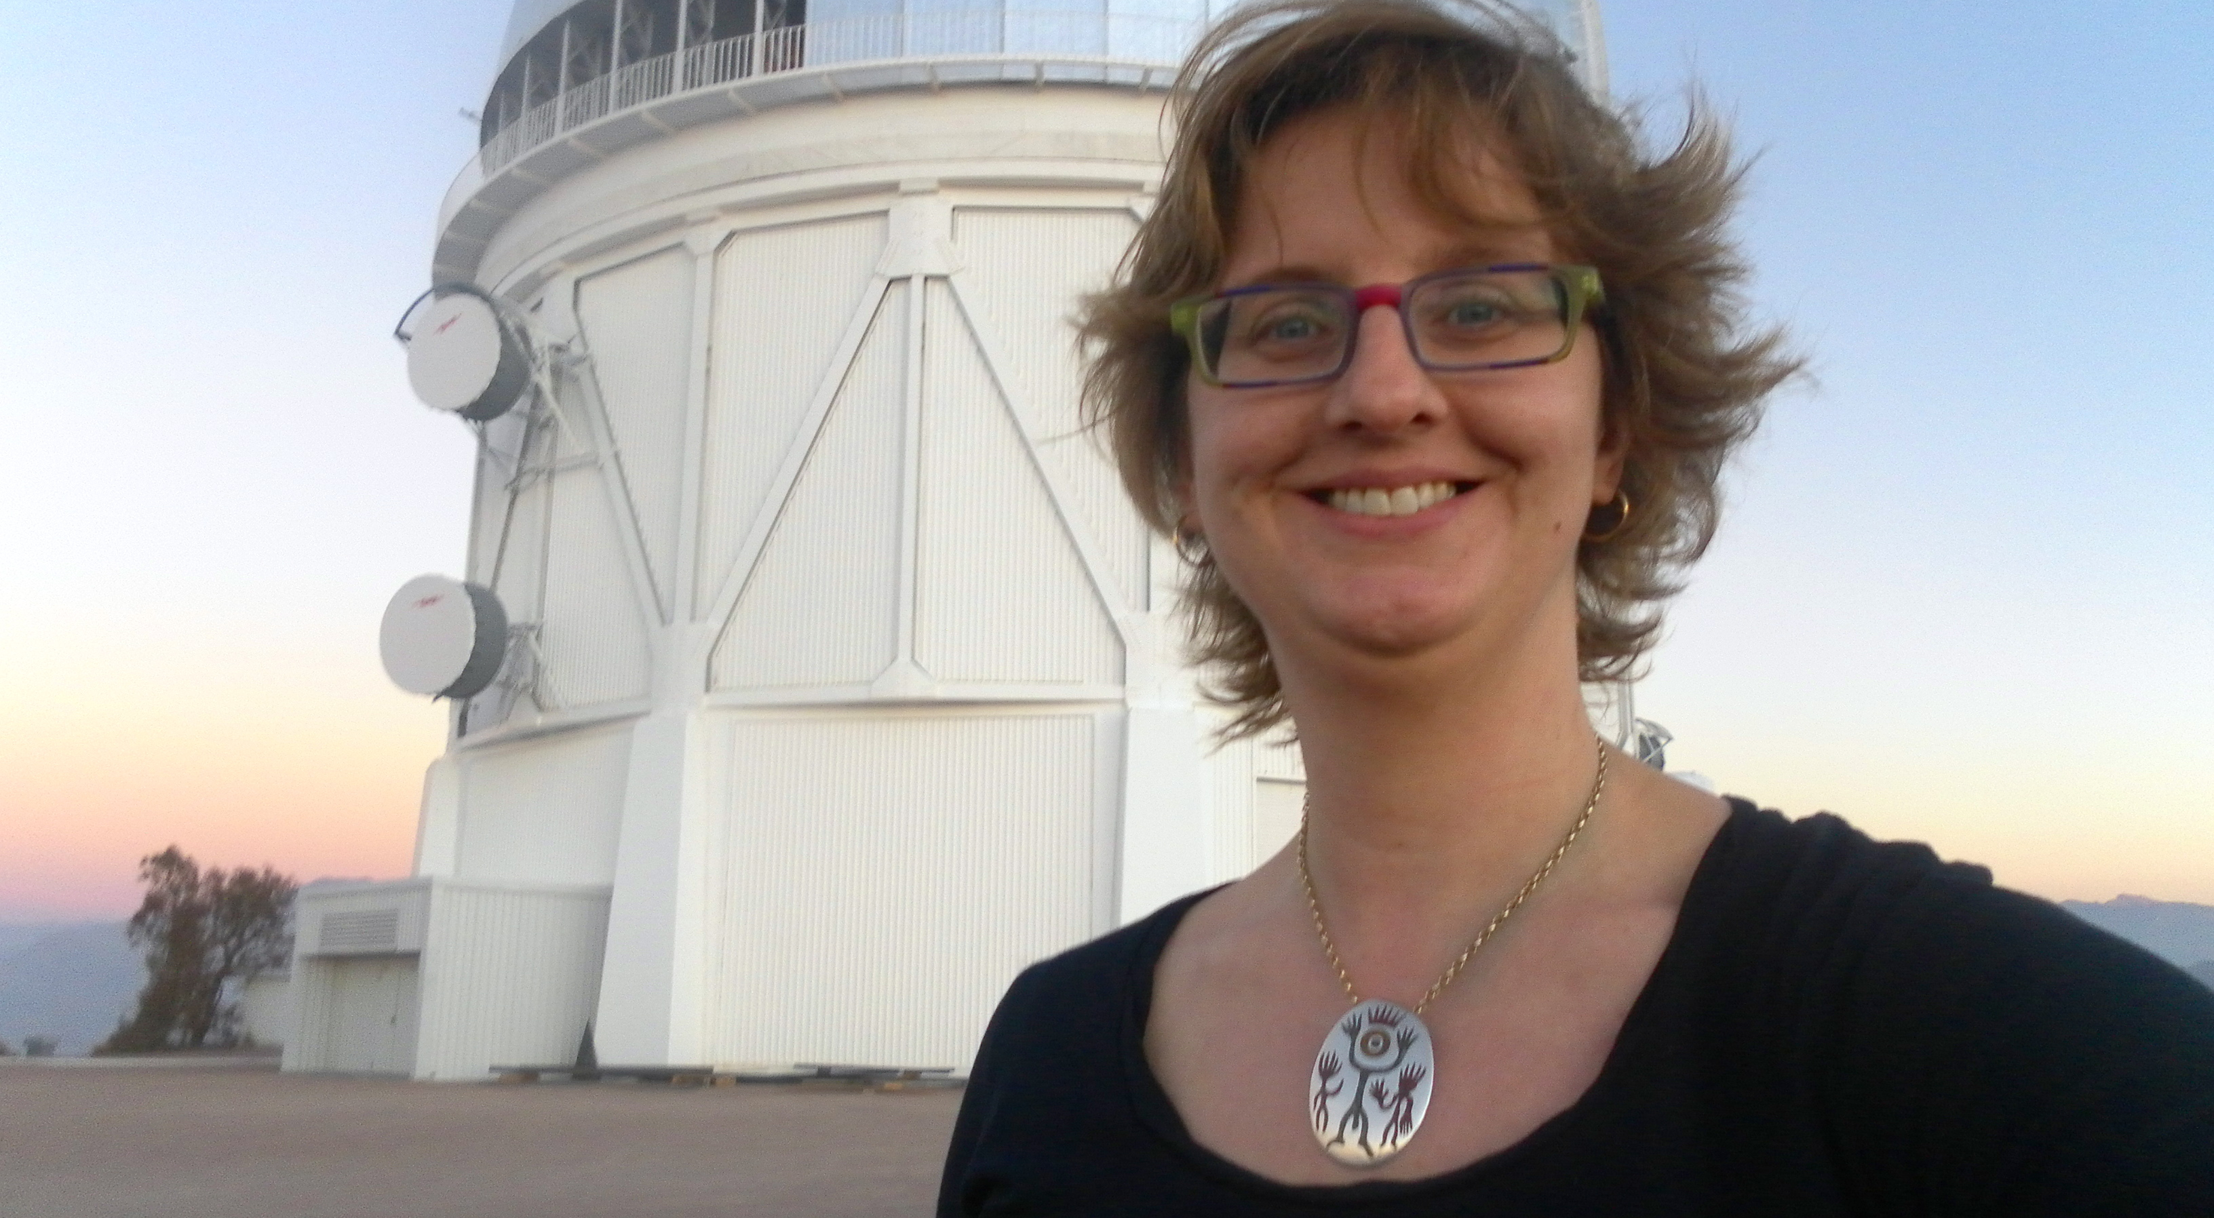
Kathy Romer: Cosmology using observations of clusters of galaxies
(Dark Energy Survey)
DES is the leading Dark Energy experiment in world
5000 square degrees of deep imaging (optical and near IR)
Season 2 (of 5) has just finished, so it is a great time for students to get involved
Kathy is the only DES member at Sussex
You will be working with X-ray and optical observations of clusters
You will attend collaboration meetings in USA, Europe and South America (and you will be able to go observing to Chile)
DES NEEDS YOU!

Slide 9
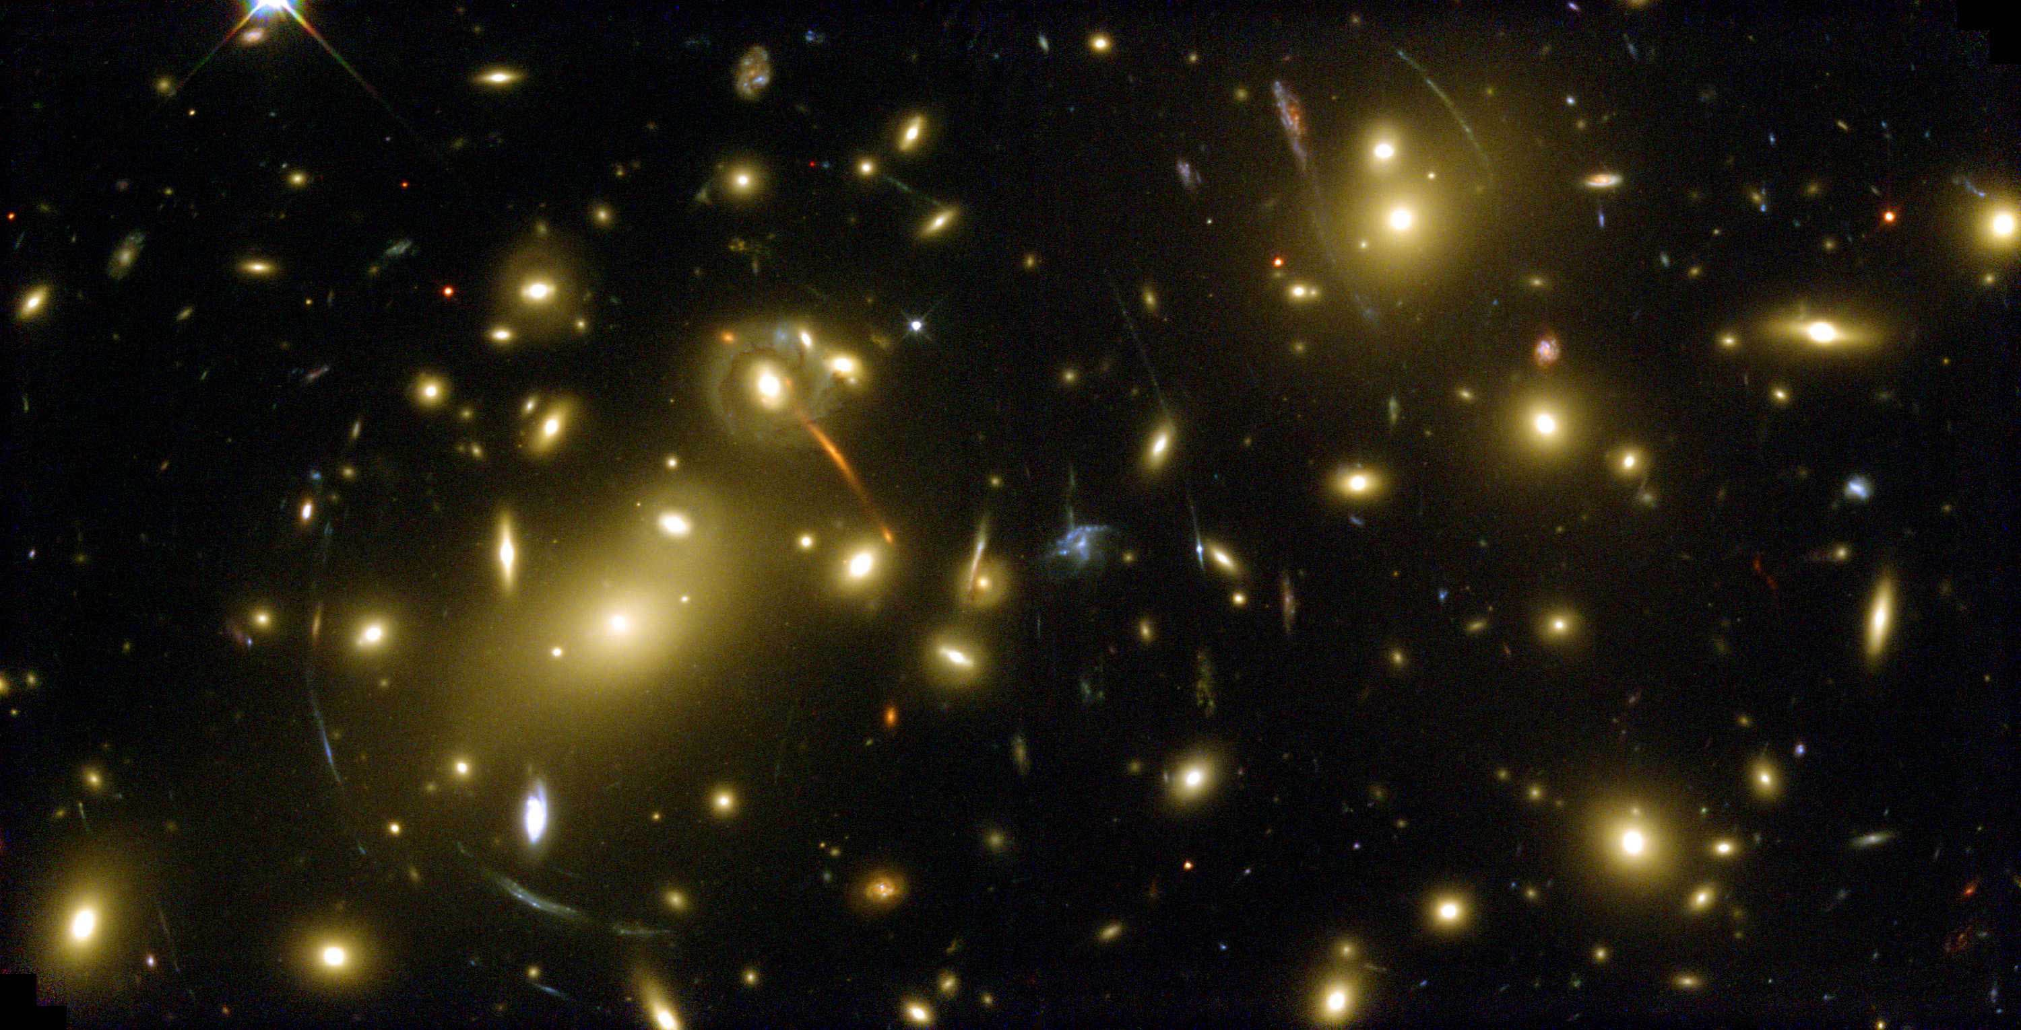
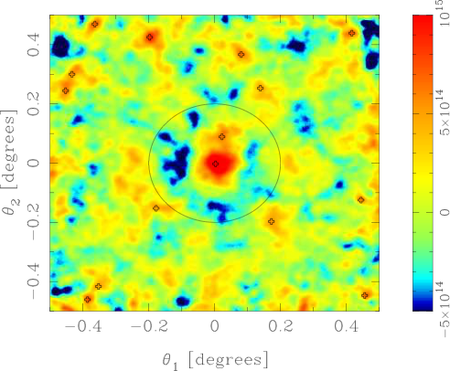
Combining cosmic shear and large-scale structure data to constrain the acceleration of the Universe. Supervisor: Dr Robert E. Smith
We will explore how the combination of weak lensing
aperture mass statistics and redshift space distortions
can help shed light on this great mystery.
Is Dark Energy quantum vacuum,
scalar field or a modification to
General Relativity?
Aperture mass map showing the presence
of a cluster in the mock CFHTLens data
Project will involve analytic calculations,
numerical simulations and data analysis.

Slide 10
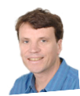
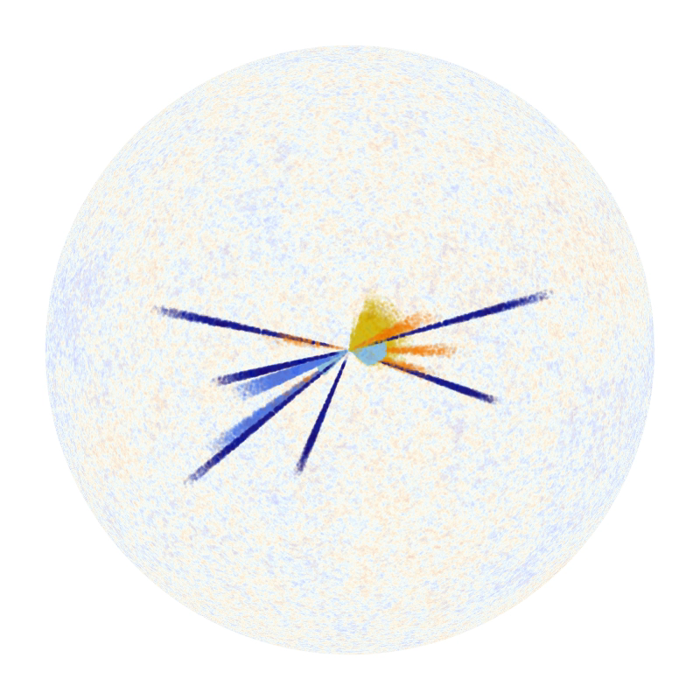
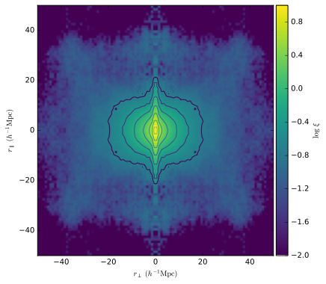

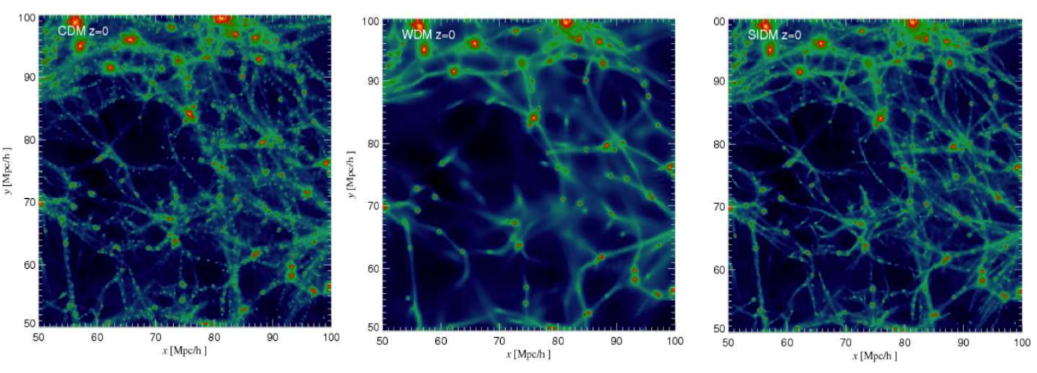
Observational constraints on modified gravity
and dark matter - Jon Loveday
Utilise existing GAMA data to measure galaxy pairwise velocity dispersion and infall into galaxy groups
Sensitive test of modified gravity and dark matter
Optimise future surveys with 4MOST

Slide 11
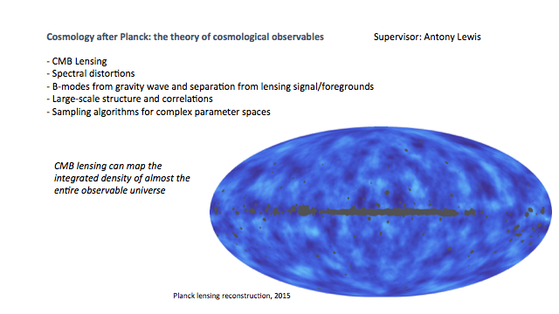

Slide 12
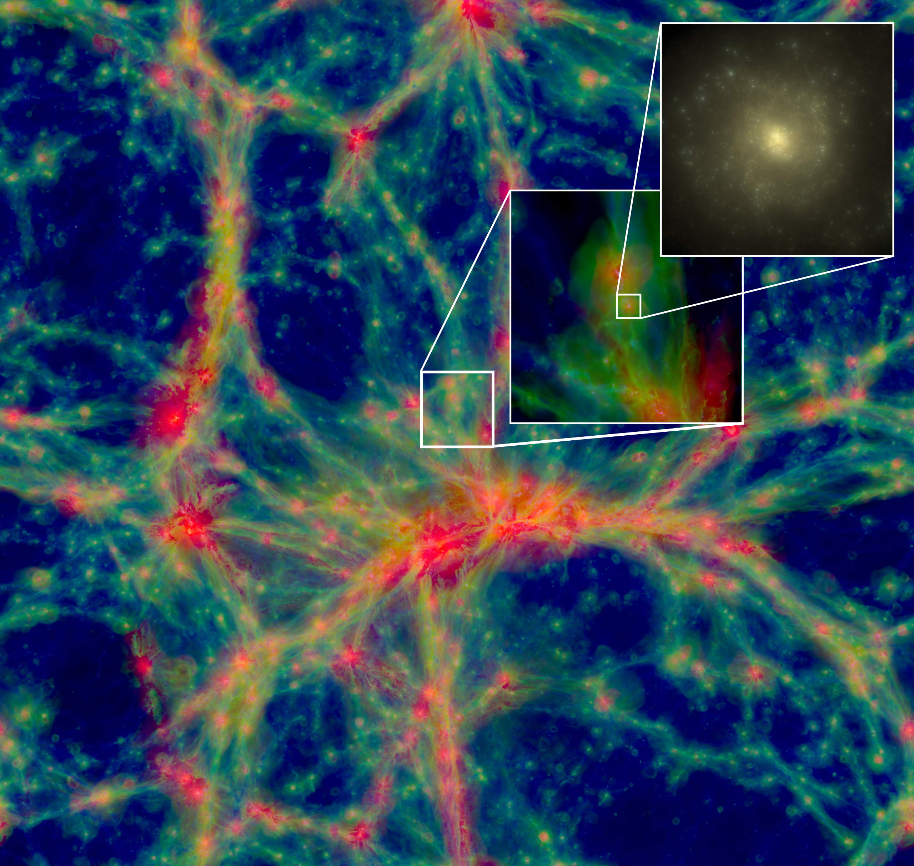
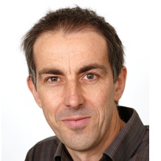
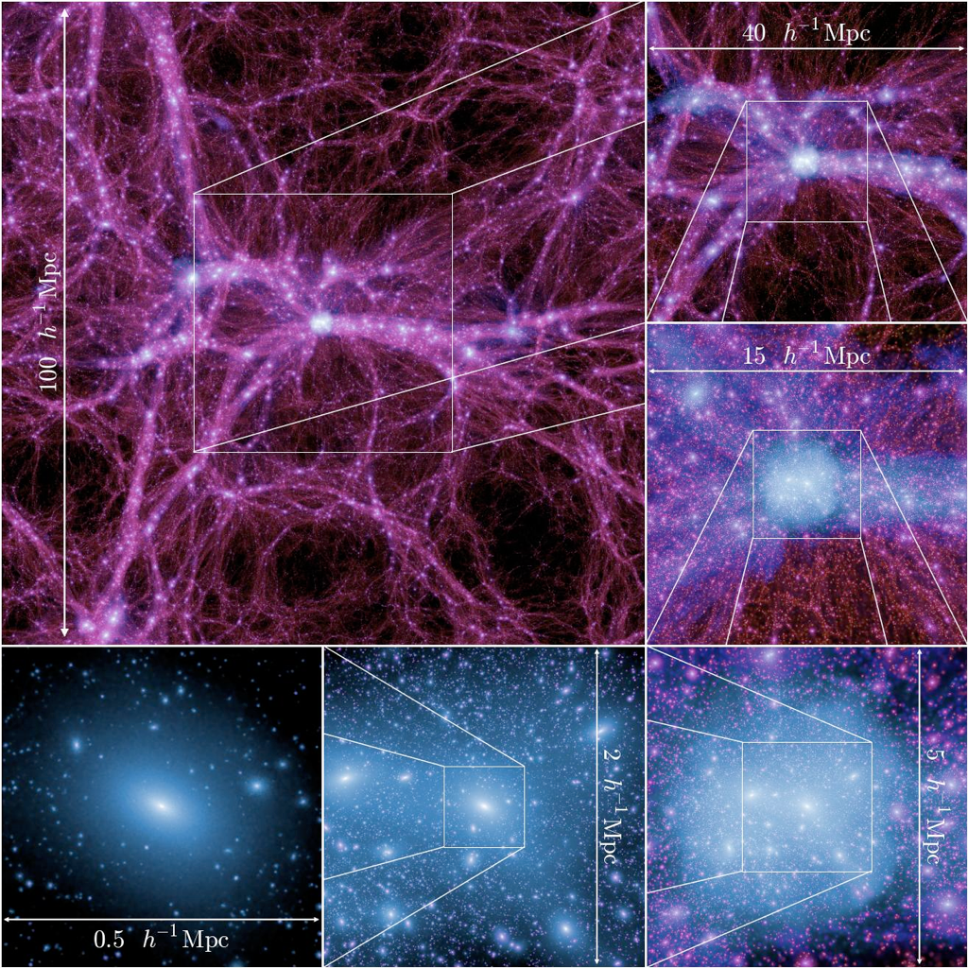
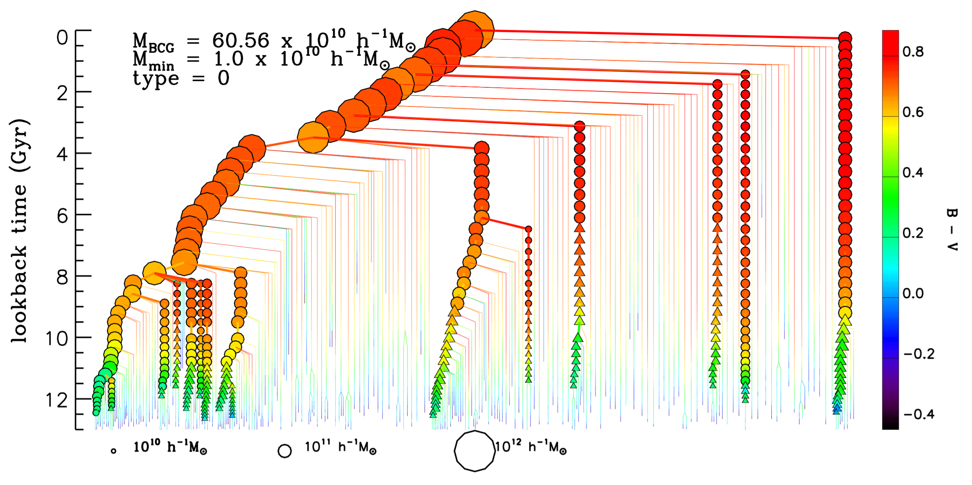
Making galaxies:
semi-analytics
simulation
Notes:
New features: Resolved galaxies, Dust/complete SEDs
Preparation for JWST (high-z), 4-MOST/WAVES (low mass)
Also EAGLE simulations

Slide 13
Astronomy key skills
Used to handling very big data sets
Cradle to grave
Raw data processing
Image analysis
Object detection
Object classification
Machine learning for classification and regression
Application of statistics to research problems
Bayesian methodologies for
  model parameter estimation
  Hierarchical probabilistic modelling
  Model selection
Numerical simulation on massive scales
In general highly numerate and computationally skilled with access to a vast “toolkit” of methods and experienced in applying these methods to real research problems

Slide 14
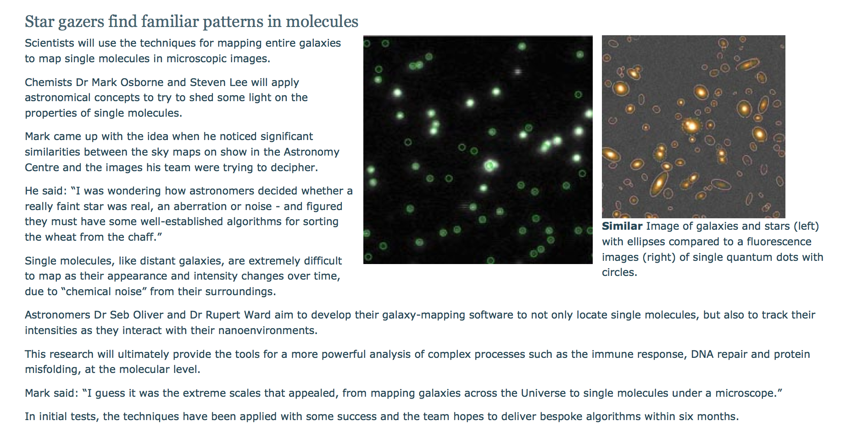
Quantum Dots
“Bayesian Methods of Astronomical Source Extraction”
Savage & Oliver 2007ApJ...661.1339S

Slide 15
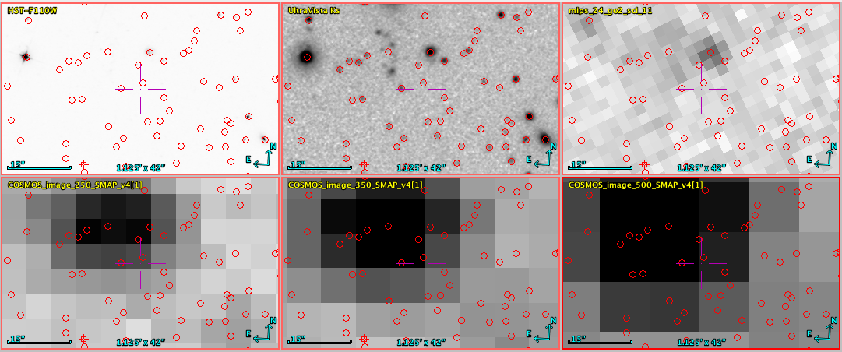
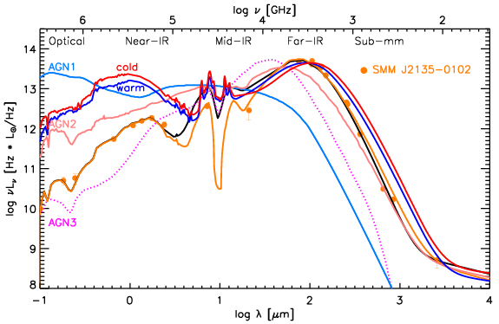
Cross identification in Extragalactic Astronomy:
Notes:
15’’ = 1/120th of Diameter of full moon..

Slide 16
Astronomy – ECFSPR
The analogy
Galaxies
Wavelength
Redshift
Position
Intensity
Patient
Time
Age
e.g. Gender, Genotype, Age
e.g. BMI

Slide 17
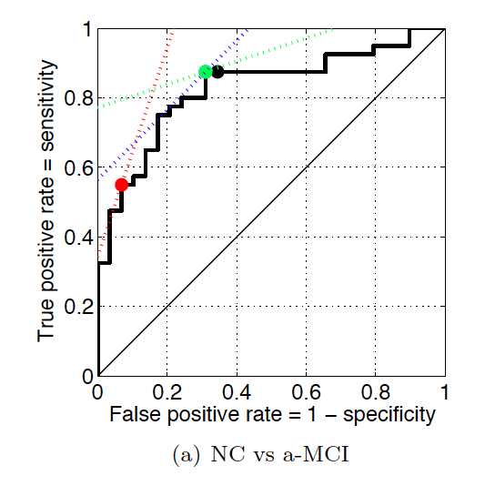
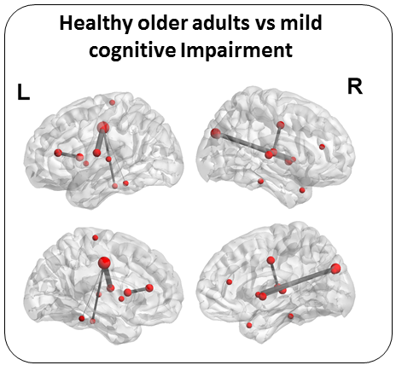


Gaussian process classification of Alzheimer's disease and mild cognitive impairment from resting state fMRI
Challis E, Hurley P,
Serra L, Bozzali M,
Oliver S, Cercignani M
Neuroimaging, 2014
Tunable, e.g.
Sensitivity = 88%
Specificity = 69%
Sensitivity = 55%
Specificity = 93%
Global Challenge Concepts fund
Notes:
Most significant features is the Rolandic Oper L $ Cingulum Mid L
The AUC for this
model and dataset is 0: 82. For a symmetric miss-classication cost function the optimal classication
threshold is at = 0: 52, at this setting the classier has classication performance AC = 80%,
SS = 88% and SC = 69% (blue dot). For a stronger sensitivity score we can set the threshold to
= 0: 52 and achieve accuracies: AC = 80%, SS = 88% and SC = 69% (green dot). For a stronger
specicity score we can set the threshold to = 0: 91 and achieve accuracies: AC = 71%, SS = 55%
and SC = 93% (red dot). Using a threshold of = 0: 5 we obtain the results presented in Table 2
(black dot).

Slide 18
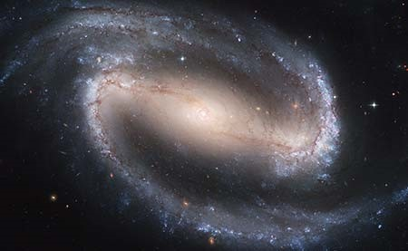





Finding Early Indicators of Dementia Using Astronomical Techniques
Medical researchers and astrophysicists have been awarded £94,000 by the Wellcome Trust to improve the early diagnosis of dementia.
Astrophysicists will swap galaxies for general practice and analyse 96,000 anonymous GP records and identify common, early indicators of dementia.
Only 50-60% of patients with dementia currently receive a diagnosis, and the UK government has prioritised increasing diagnosis rates.
Timely diagnosis allows patients to maximise their quality of life, benefit from treatments and plan for the future
Researchers will create probabilistic models to predict each patient’s risk of having dementia from their GP records
Novel analysis techniques will accounting for errors in diagnosis to better understand the correlations between underlying conditions.

