Slide 1
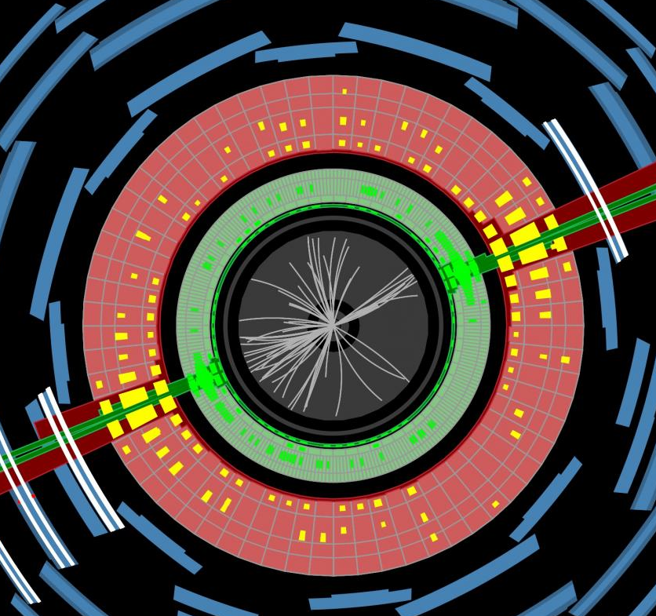

IoP Halfday, Sussex
14/6/2022
Jon Butterworth, UCL Physics & Astronomy
Overview, and Contur

Slide 2
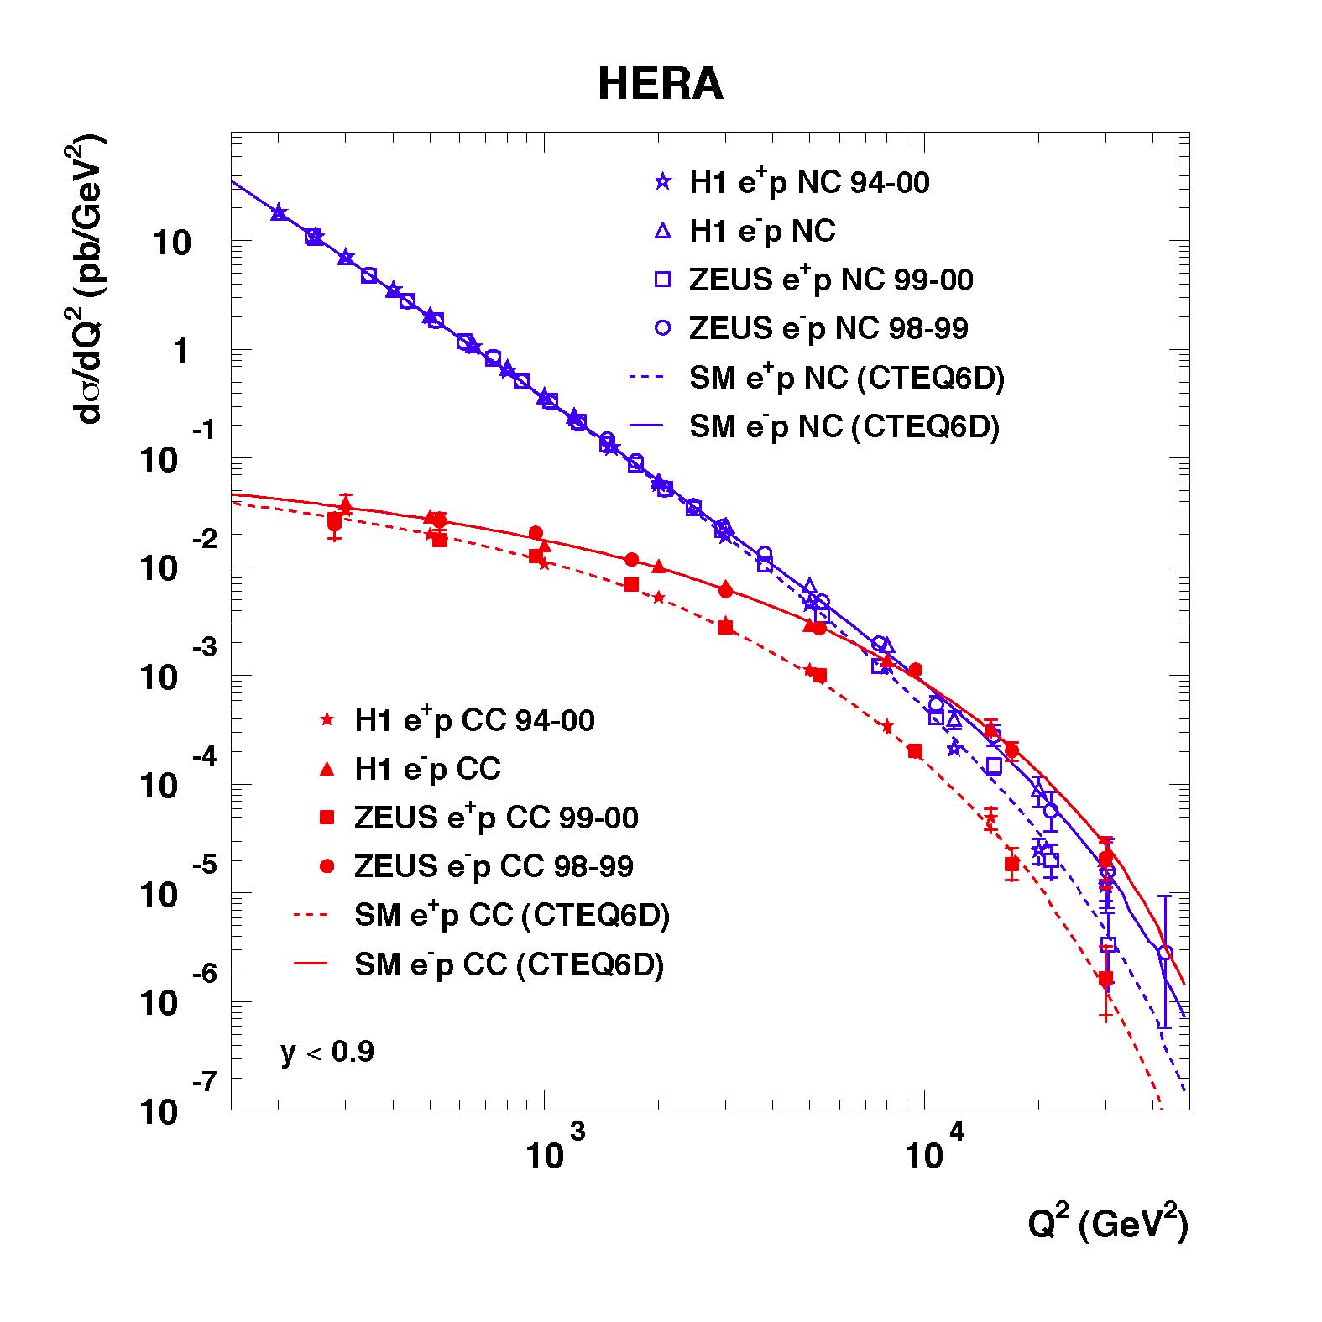
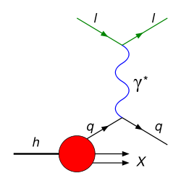

Slide 3
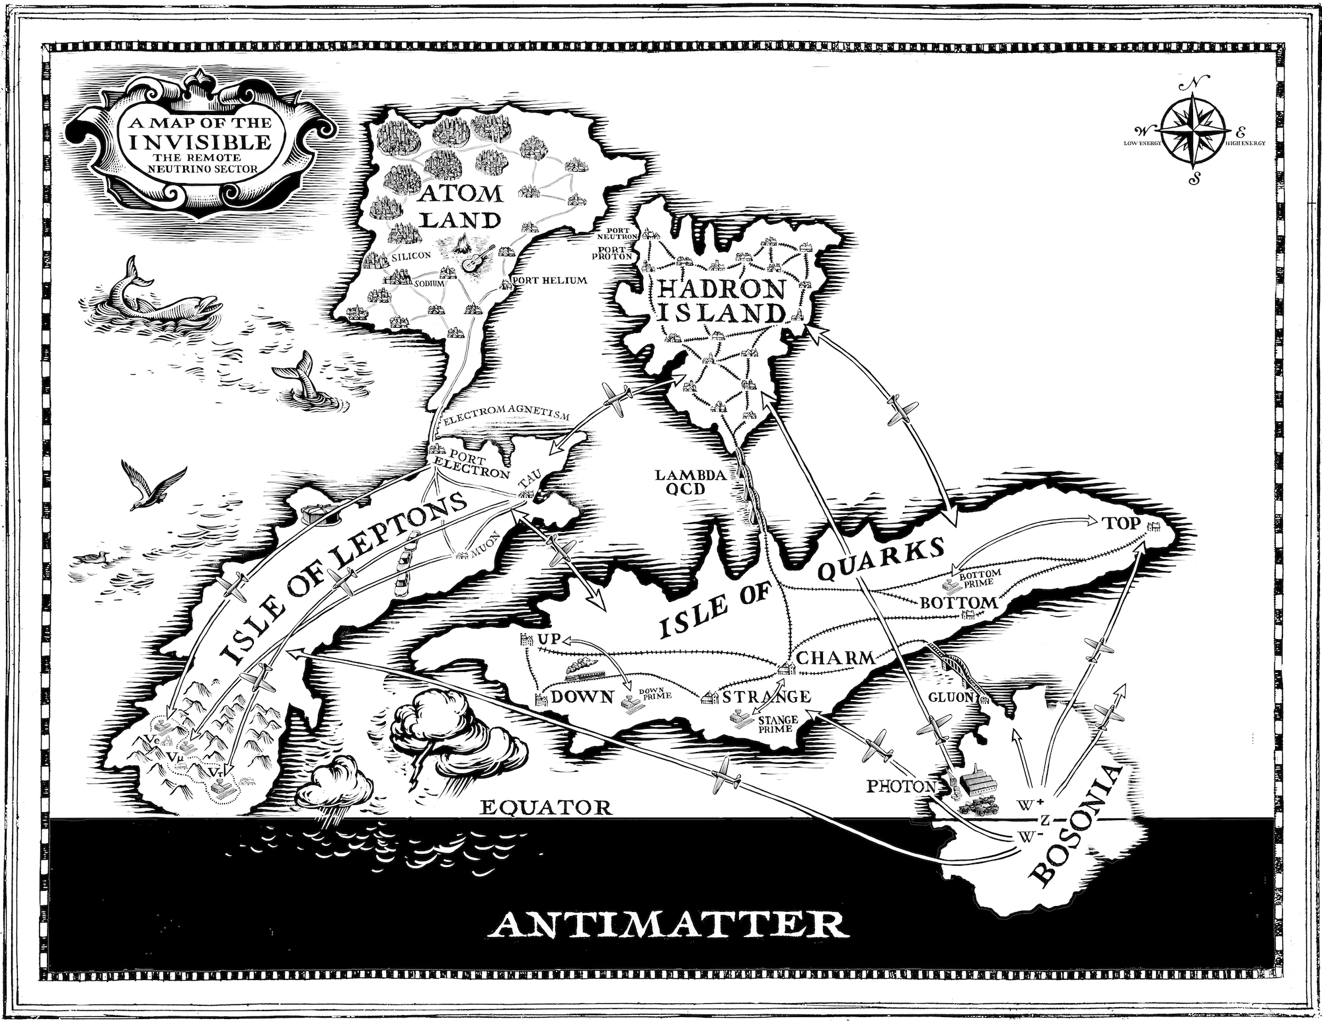
Before the LHC

Slide 4
Now

Slide 5
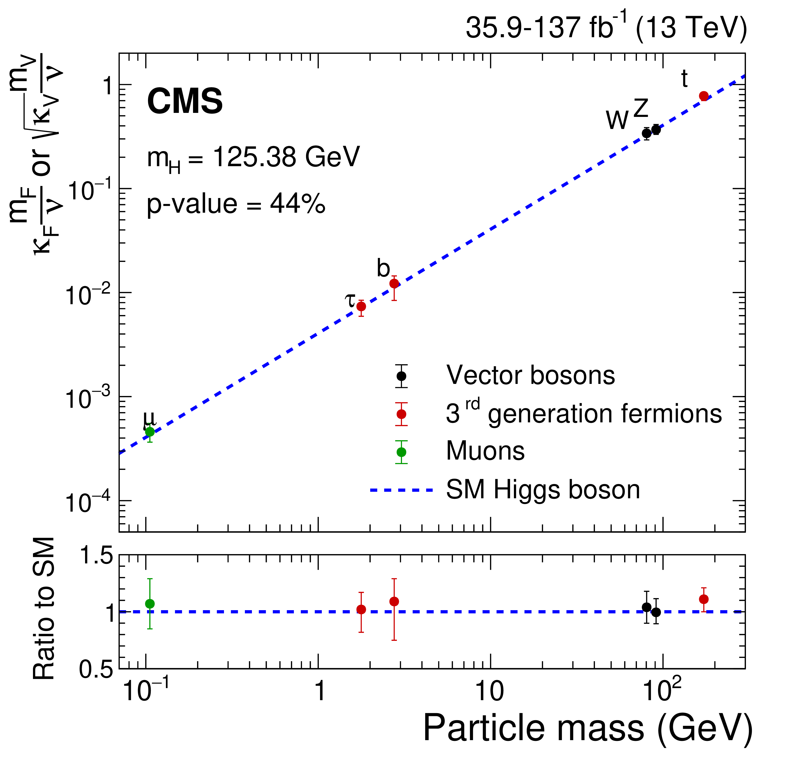
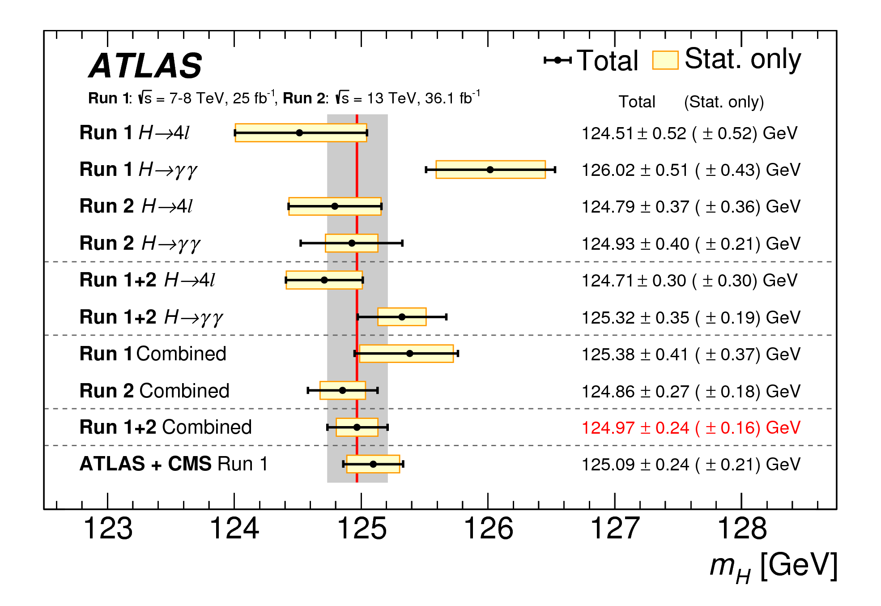
Now

Slide 6
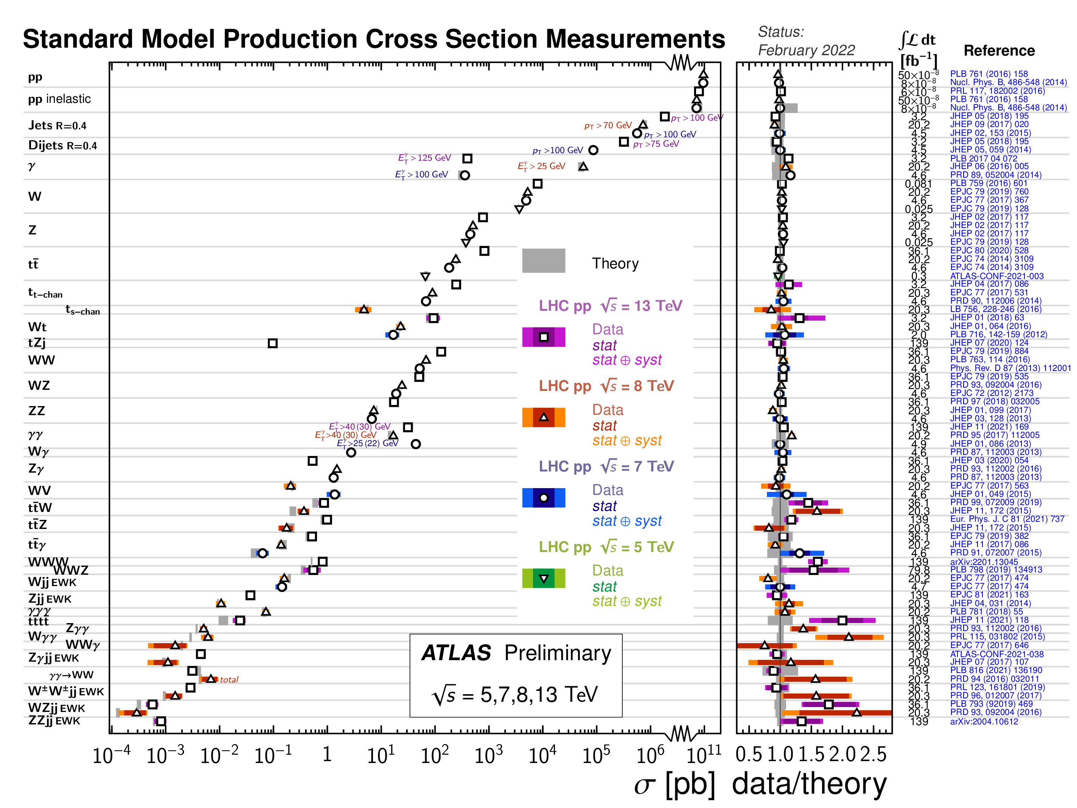

Slide 7
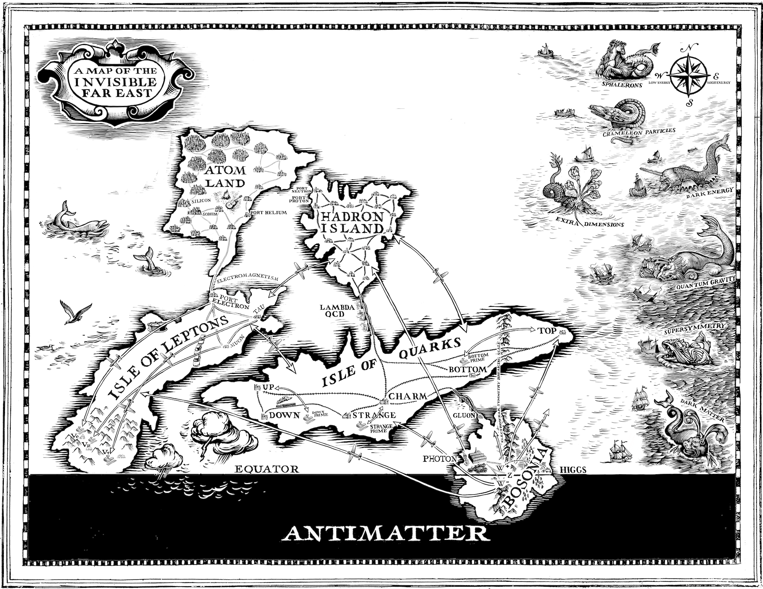
Off the map…?

Slide 8
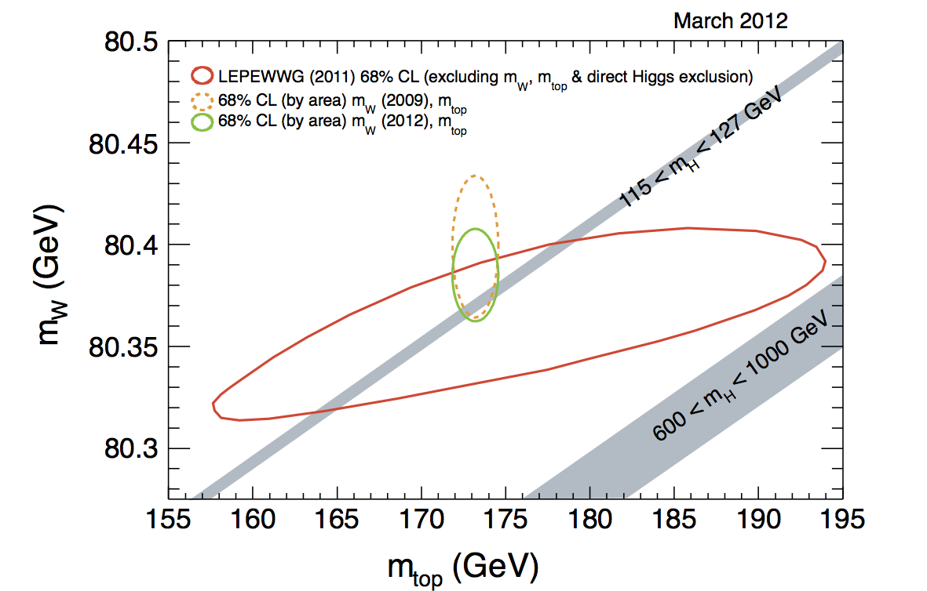
Before the LHC

Slide 9
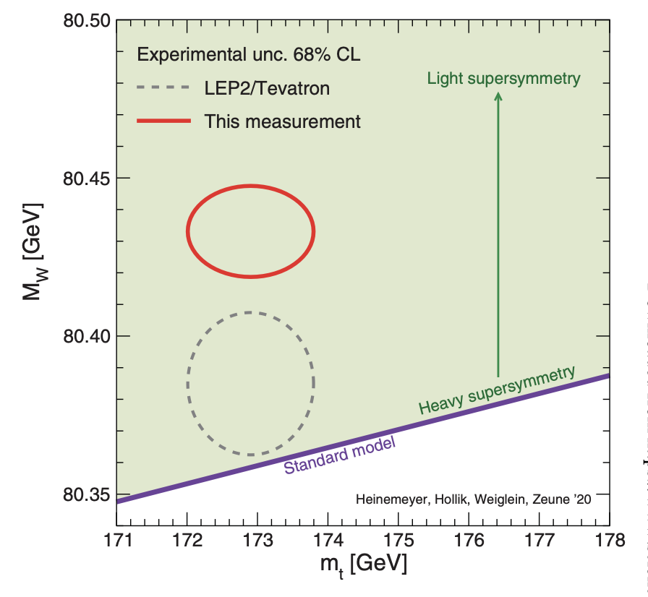
Update from CDF
Last month
CDF https://inspirehep.net/literature/2064224

Slide 11
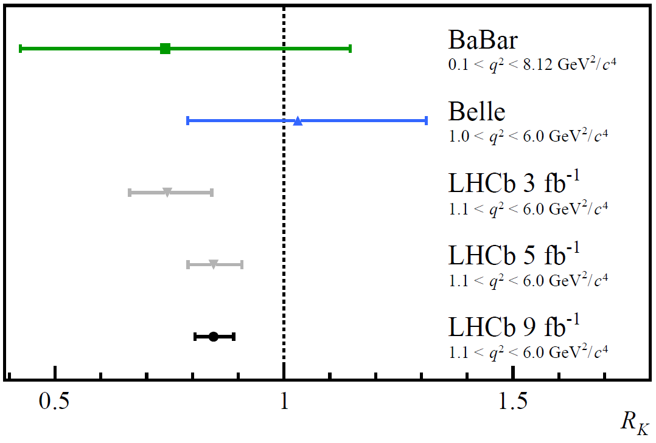
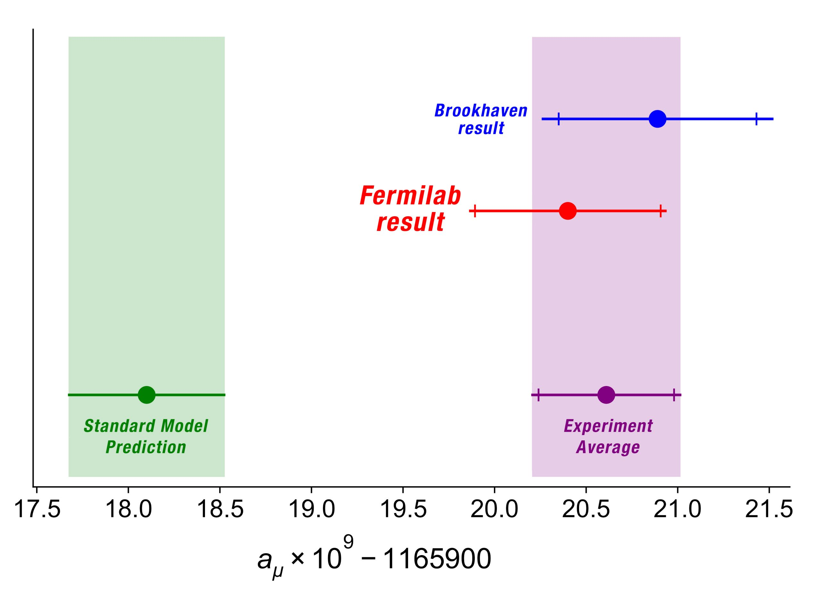
It’s not just M_{W}
LHCb, arXiv:2103.11769
g-2 arXiv:2104.03281

Slide 13
Measurements at the Energy Frontier
High Luminosity
Run 3, HL-LHC

Slide 14
Particle Level Measurements
If you
  Have already calibrated the detector/reconstruction
  Define the final state carefully
  Use this to define a fiducial phase space
  Use a simulated prior that describes all relevant distributions
… then “unfolding” is not a big final step
Several standard techniques and implementations available

Slide 15
Simulation and Experiment
Particle Four-Vectors
MC Event Generator
Digitized Readout
Detector & Trigger Simulation
Data for Analysis
Event Reconstruction

Slide 16
Simulation and Experiment
Particles
Collider!
Digitized Readout
Detector & Trigger
Data for Analysis
Event Reconstruction

Slide 17
Simulation and Experiment
Particle Four-Vectors
MC Event Generator
Digitized Readout
Detector & Trigger Simulation
Data for Analysis
Event Reconstruction
Unfolding & Data Correction: Test and evaluate

Slide 18
Simulation and Experiment
Particles
Collider!
Digitized Readout
Detector & Trigger
Data for Analysis
Event Reconstruction
Unfolding & Data Correction: Make the measurement!

Slide 19
Where to compare nature to our ideas?
Raw detector readout
Each specific theory must follow all implications through to final state particles and full detector simulation, including specific run conditions and time-dependent calibrations.
Zero model dependence.

Slide 20
Where to compare nature to our ideas?
Reconstructed objects
Raw detector readout
Theory must follow all implications through to final state and at least some parameterised approximation of detector resolution and efficiency.
Calibrations applied which may have some dependence on models, but minimal and dependence can be controlled.

Slide 21
Where to compare nature to our ideas?
Reconstructed objects
Fiducial final state particles
Raw detector readout
Need to predict the exclusive final state.
In addition to calibrations, need unfolding for resolution and efficiency, though uncertainties can generally be controlled.

Slide 22
Where to compare nature to our ideas?
Reconstructed objects
Fiducial final state particles
Raw detector readout
Process/ Intermediates
In addition to previous, need theory extrapolations into unobserved regions, theory background subtractions, and corrections for soft/long distance physics.
Can integrate over inclusive phase spaces and ignore soft/long distance physics.

Slide 23
Where to compare nature to our ideas?
Reconstructed objects
Fiducial final state particles
EFT Parameters
Raw detector readout
Process/Intermediates
In addition to previous, interpret in a particular (simplified?) model.
Need to think about running from high energies, but not much else…

Slide 24
Where to compare nature to our ideas?
UV Para- meters
Reconstructed objects
Final state particles
EFT Parameters
Raw detector readout
Process/Intermediates
In addition to all previous, interpret in a particular UV complete model.
Have a good idea, then play golf.

Slide 25
Where to compare nature to our ideas?
UV Para- meters
Reconstructed objects
Fiducial final state particles
EFT Parameters
Raw detector readout
Intermediates

Slide 26
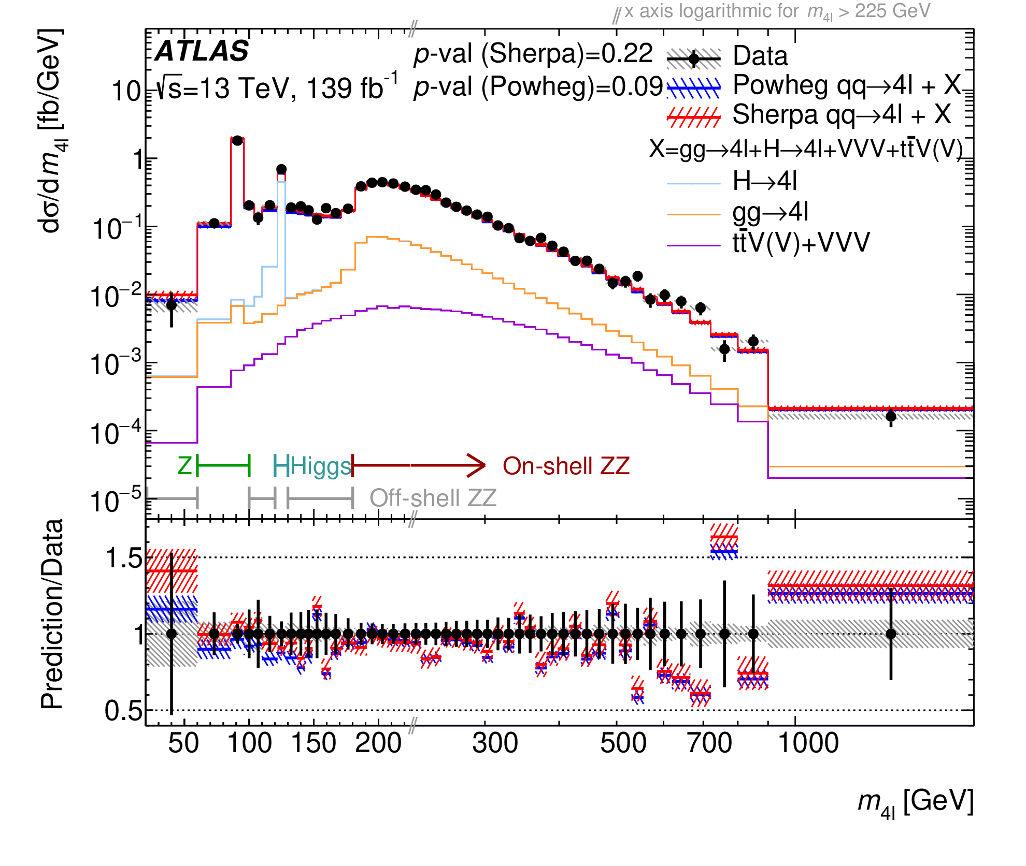
arXiv:2103.01918

Slide 27
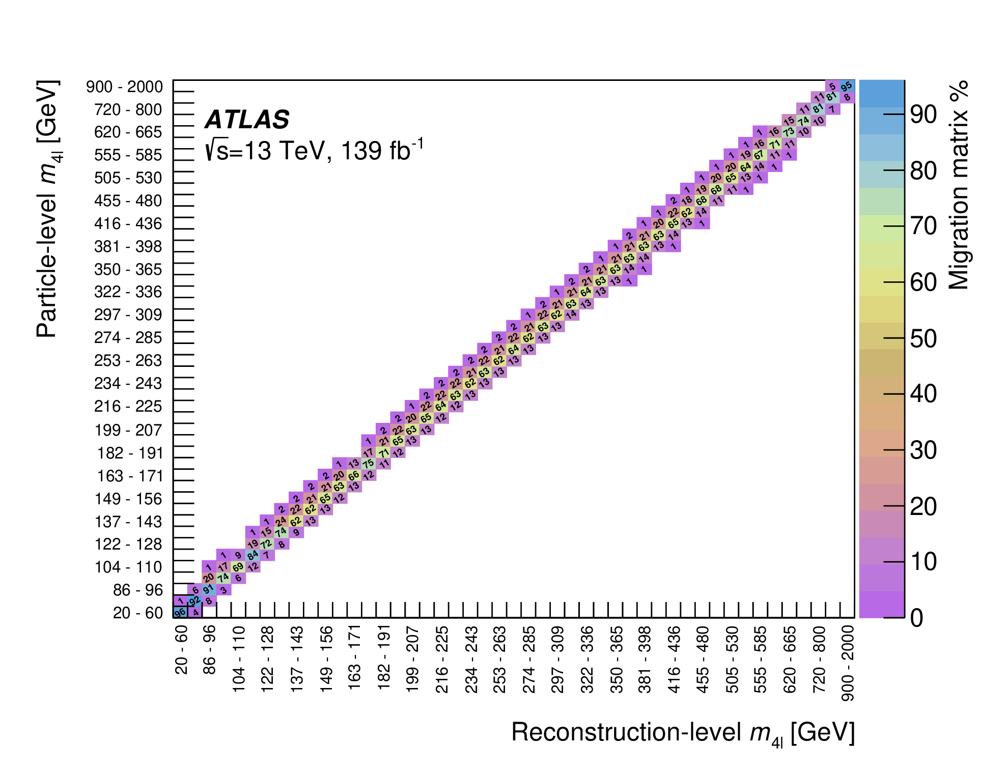
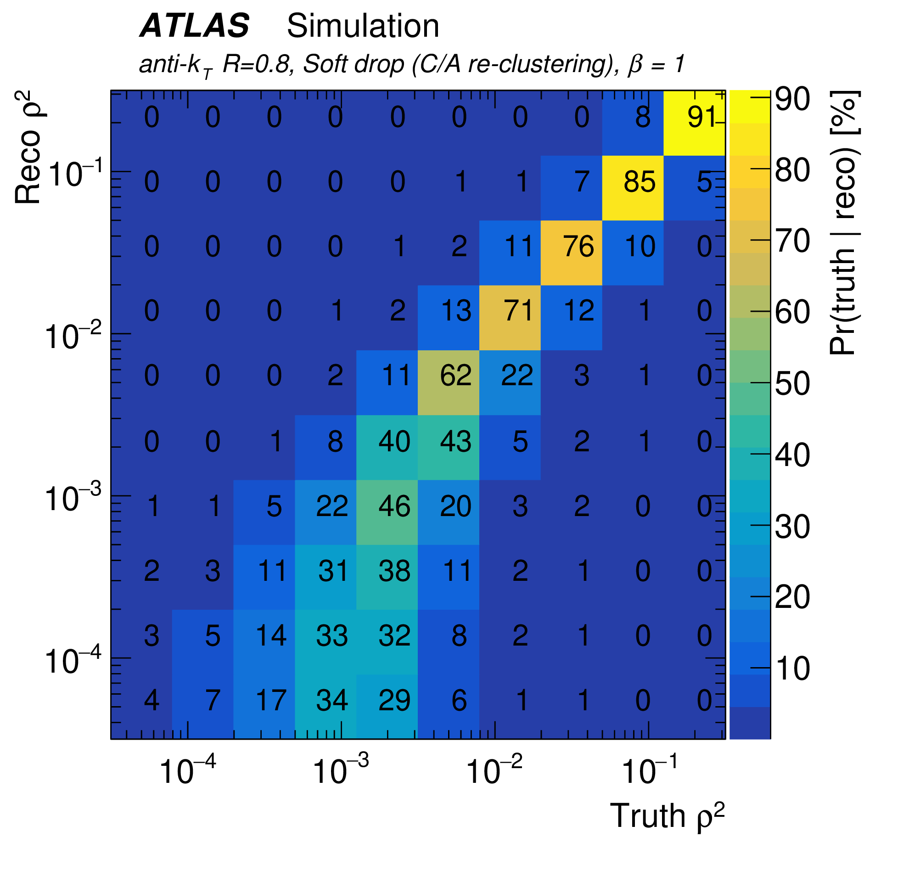
Unfolding Matrices
(Examples)
arXiv:1711.08341
arXiv:2103.01918

Slide 28
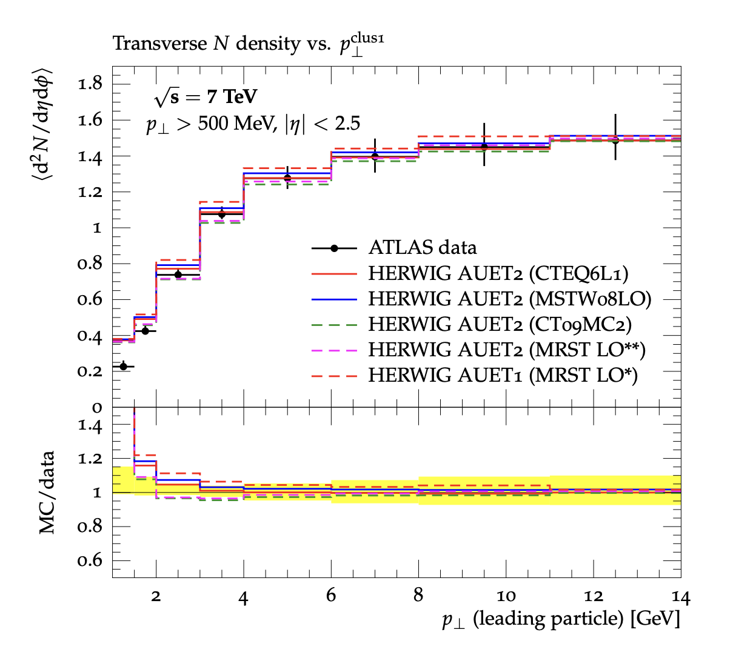
Introducing Rivet
“Robust Independent Validation of Experiment and Theory” arXiv:1003.0694, arXiv:1912.05451
Direct legacy from HERA (1990s, HZTOOL)
Developed by MCnet for tuning and validation of new MC event generators
  e.g. What does the underlying event look like in 7 TeV pp collisions?
Vast library of measurements of final state particles produced in collisions, and variables derived from them
Buckley et al, Bierlich et al: Talk from Chris Gütschow next
From ATL-PHYS-PUB-2011-008

Slide 29
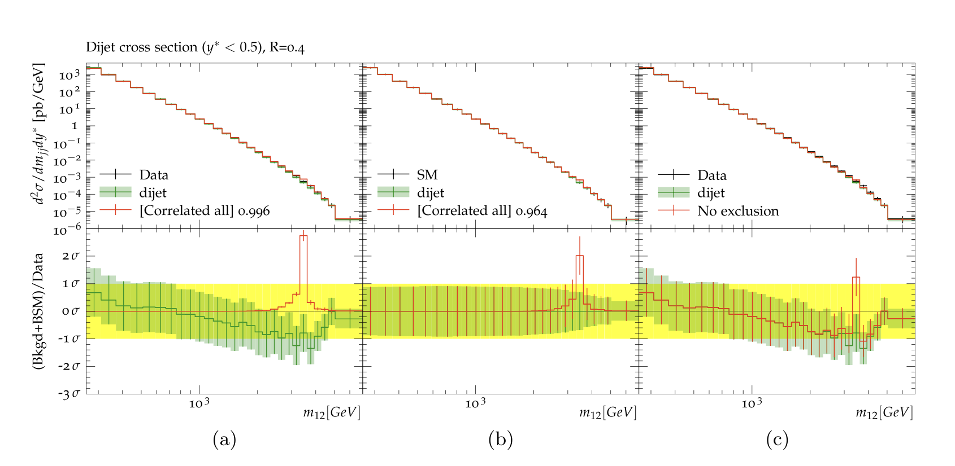
Introducing Contur
“Constraints On New Theories Using Rivet” arXiv:1605.05296, arXiv:2102.04377
Extend the power of Rivet beyond the Standard Model
Signal-injection of final-state particles from Beyond-the-SM physics events on to the measured cross sections in Rivet
From Altakach, JMB, Ježo, Klasen, Schienbein arXiv:2111.15406
Increasingly precise measurements and calculations together extend the reach
JMB, Grellscheid, Krämer, Sarrazin, Yallup; Buckley et al

Slide 30
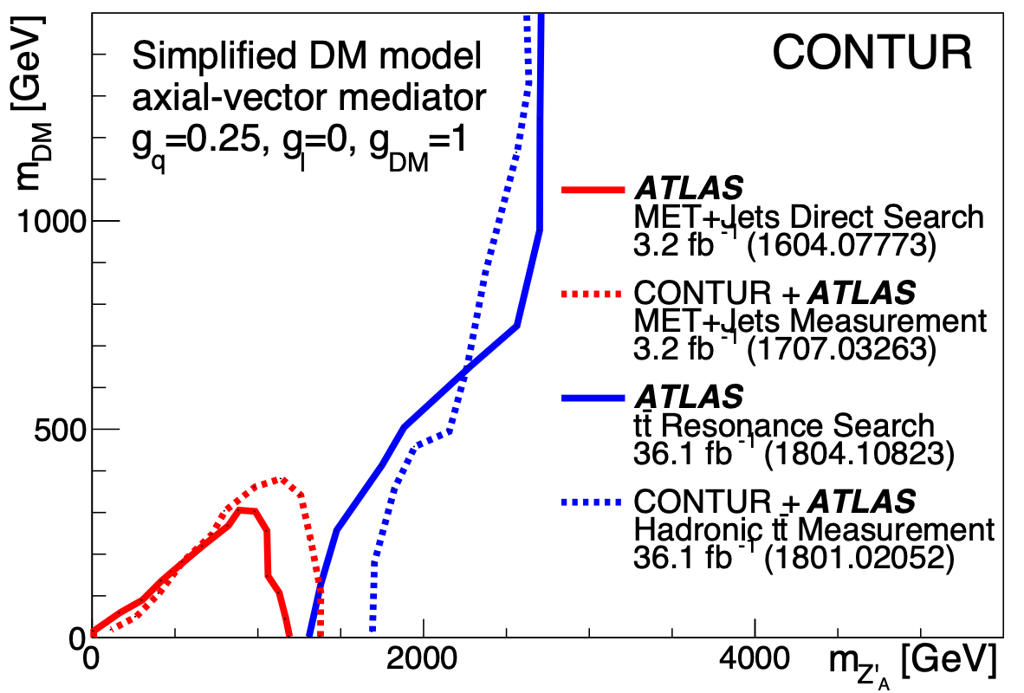
Unleashing the power of high luminosity LHC data
(example case studies)
Z’ models motivated by Lepton Flavour Violation anomalies
Composite Dark Matter
Vector-like Quarks
Louie Corpe

Slide 31
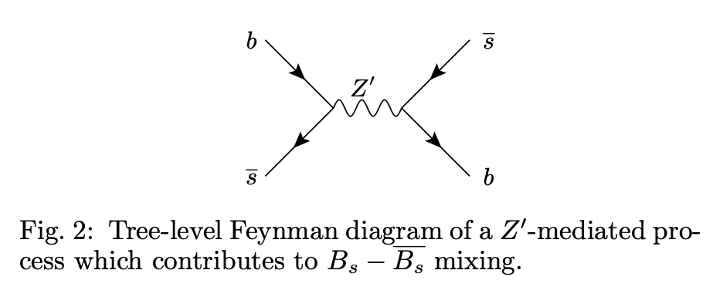
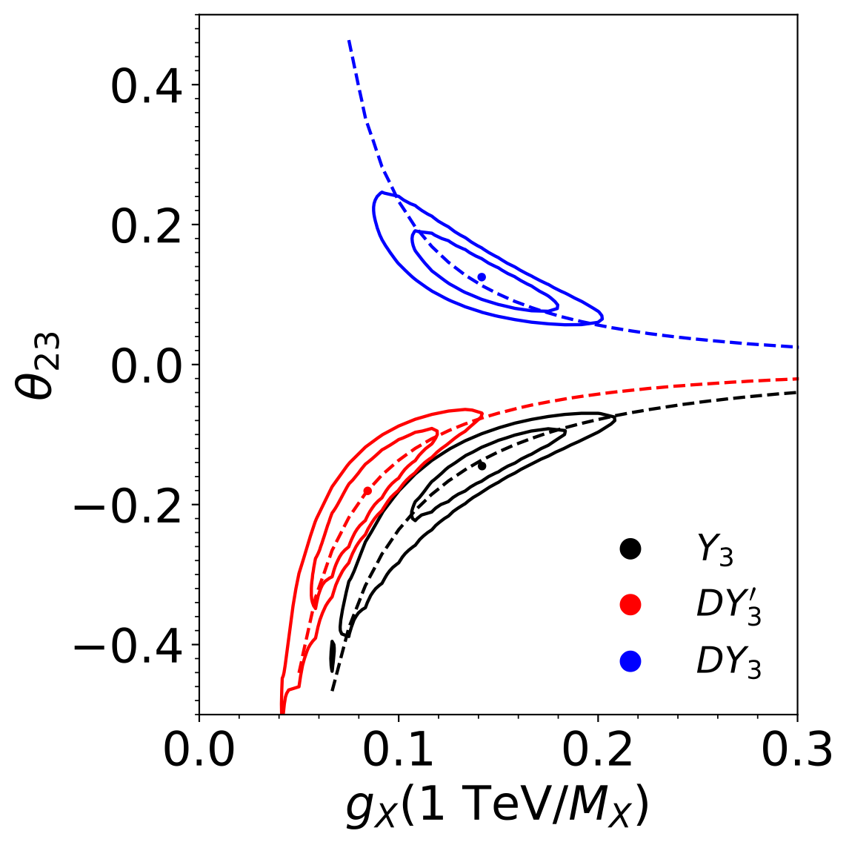
Z’ models motivated by Lepton Flavour Violation anomalies
Muon deficit in R_{K*} may be explained by introducing a new gauge boson (Z’) with non-trivial flavour coupling structure
Fit to LHCb data gives favoured parameter values away from SM
Take these parameter points and see whether other measurements still allow them
Allanach, JMB, Corbett . arXiv:2110.13518

Slide 32
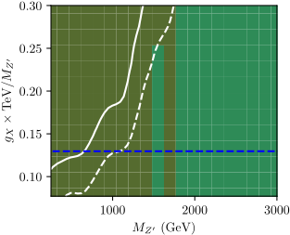
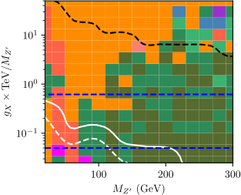
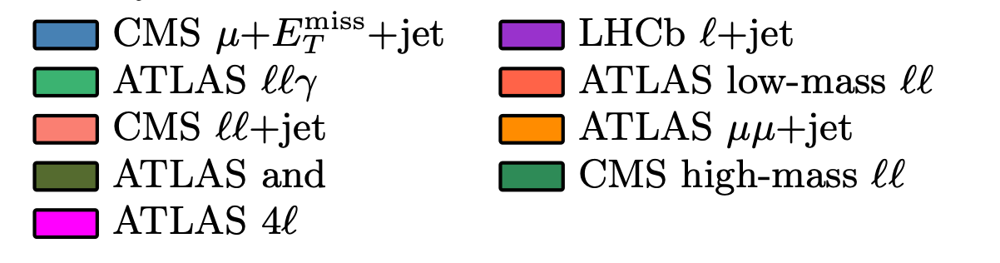
Main signature is dimuons.
In the high Z’ mass regions, what sensitivity there is comes from the ATLAS dimuon search. For Third Family Hypercharge Models models that’s all there is.
In the B₃-L₂ model, the “window” at low mass largely is closed by low mass Drell Yan and Z →leptons measurements
Deformed 3rd Family Hypercharge Model (DY3’).
Favoured region is below blue line. Above white line, 95% exclusion.
B₃-L₂ Model.
Favoured region is between blue lines. Above black line, Z’ width >30% of mass. Below white line, 95% exclusion.
Allanach, JMB, Corbett . arXiv:2110.13518

Slide 33
Composite Dark Matter Models
What if Dark Matter is a composite particle arising from e.g. an SU(4) symmetry which confines at some scale Λ_{dark}?
Lead to bound states ”dark” mesons and baryons.
  Kribs et al. arXiv:1809.10183
Dark fermions transform under electroweak part of the Standard Model: communication with SM
There are no direct searches for this model by ATLAS or CMS:
instead to constrain this model using the bank of existing LHC measurements using Contur
Dynamics of the theory depend a lot on 𝜂=𝑚(𝜋_{𝐷})/𝑚(𝜌_{𝐷})
JMB, Corpe, Kong, Kulkarni, Thomas. arXiv:2105.08494

Slide 34
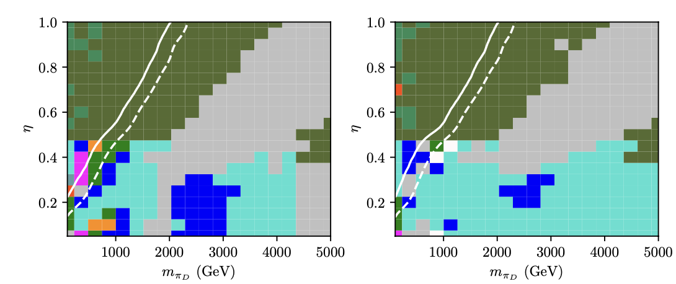
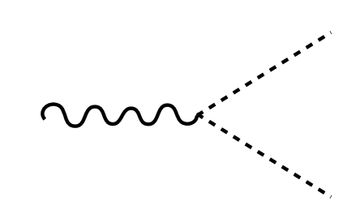
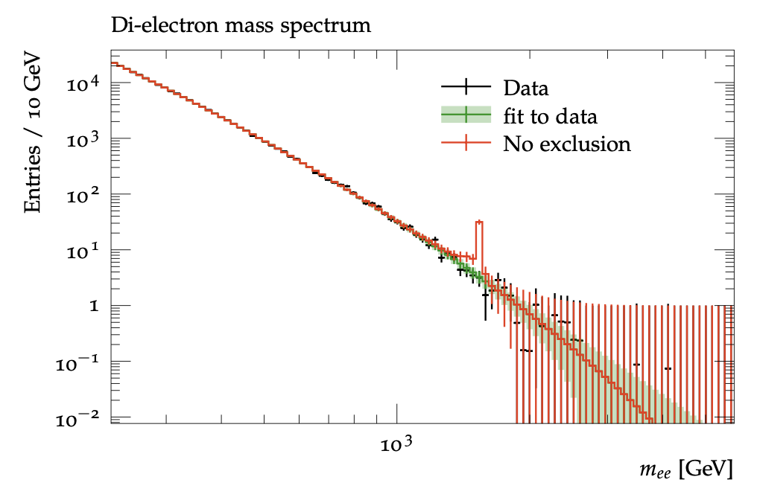
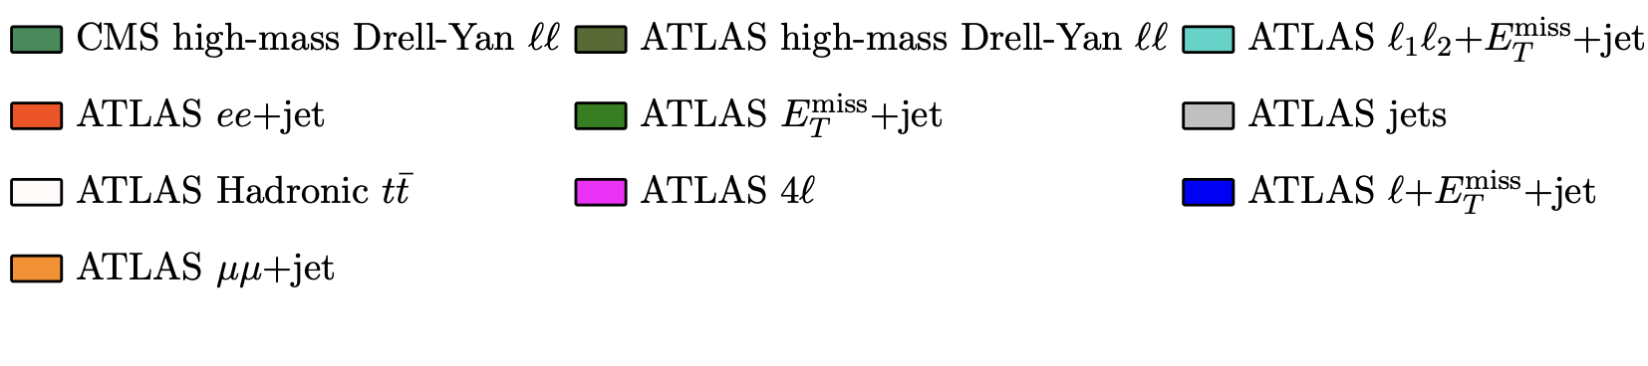





Composite Dark Matter Models
Left-handed model
ρ⁰D, ρ⁺D, ρ⁻D
Right-handed model
ρ⁰D only
$$p$$
$$l^{±}$$
$$ρ_{D}^{0},ρ_{D}^{±}$$
$$p$$
$$l^{±}$$
JMB, Corpe, Kong, Kulkarni, Thomas. arXiv:2105.08494

Slide 35
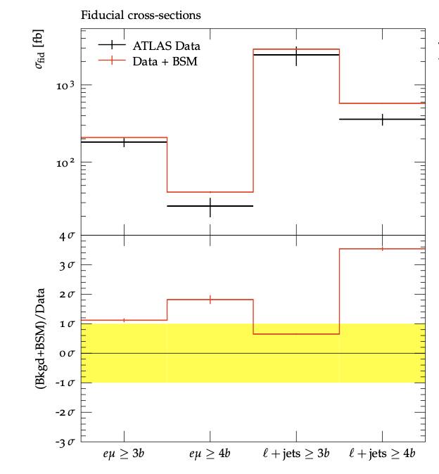
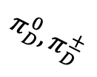
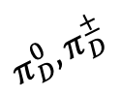



Composite Dark Matter Models
Left-handed model
ρ⁰D, ρ⁺D, ρ⁻D
Right-handed model
ρ⁰D only
$$p$$
$$π_{D}^{0},π_{D}^{±}$$
$$ρ_{D}^{0},ρ_{D}^{±}$$
$$π_{D}^{0},π_{D}^{±}$$
$$p$$
JMB, Corpe, Kong, Kulkarni, Thomas. arXiv:2105.08494

Slide 36
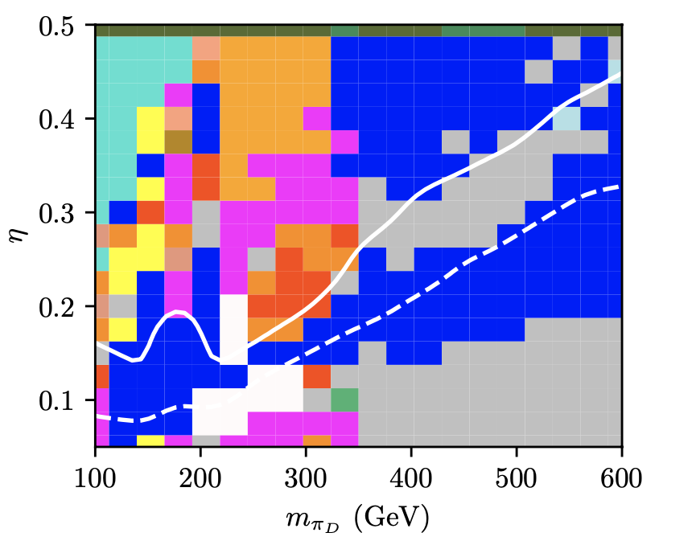
Composite Dark Matter Models
Large areas excluded:
  When pion mass is close to Higgs mass, H→gg analysis contributes
  Boosted hadron ”top” measurements contribute when pion mass ~200 GeV: Pions decay to tb and are boost from heavy r.
  Other sensitivity from Z-pole dileptons, and lepton+missing energy (Z, top, W production in decay chains)
Left-handed model
ρ⁰D, ρ⁺D, ρ⁻D
JMB, Corpe, Kong, Kulkarni, Thomas. arXiv:2105.08494

Slide 37
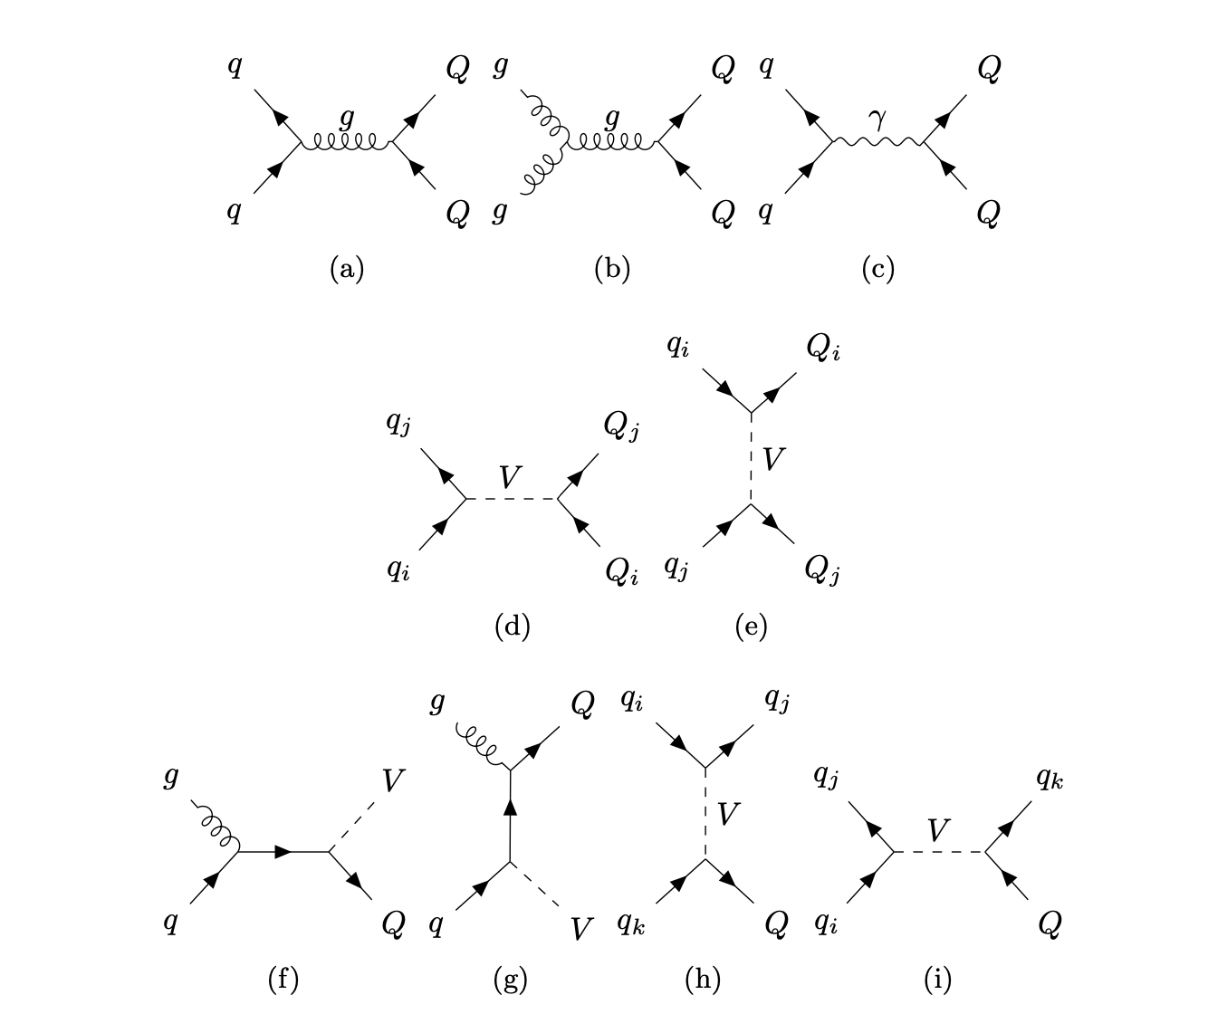
Vector-like Quarks
Very common extension to SM, general model by Buchkremer et al (arXiv:1305.4172). Introduces up to four quark partners, B, T, X, Y.
  Usual strong couplings to SM
  Evade bounds from Higgs because they are vectors
  B, T interact with with W, Z, H with modfied weak couplings
  X, Y interact with W (only) similarly
Three sets of parameters (in additon to masses)
  𝜅: absolute coupling of VLQs to SM quarks
  𝜁i: relative coupling of VLQs to i^{th} generation
  𝜉v: relative coupling of B,T to V in {W, H, Z}
Buckley, JMB, Corpe, Huang, Sun arXiv:2006.07172

Slide 38
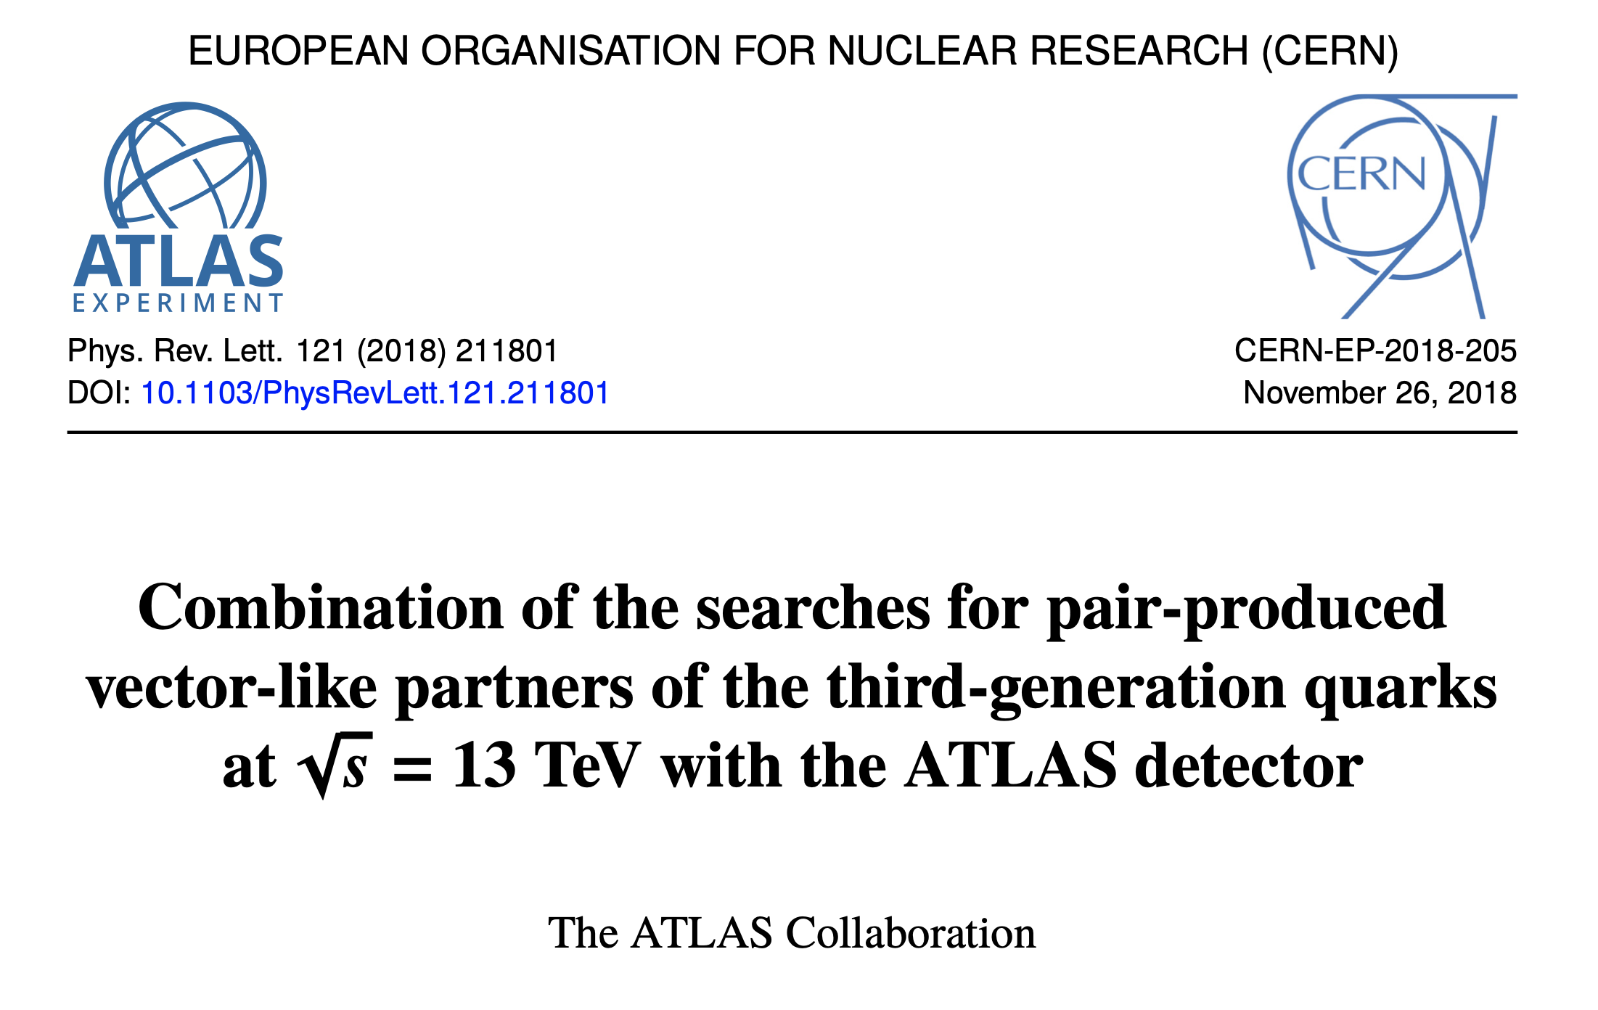
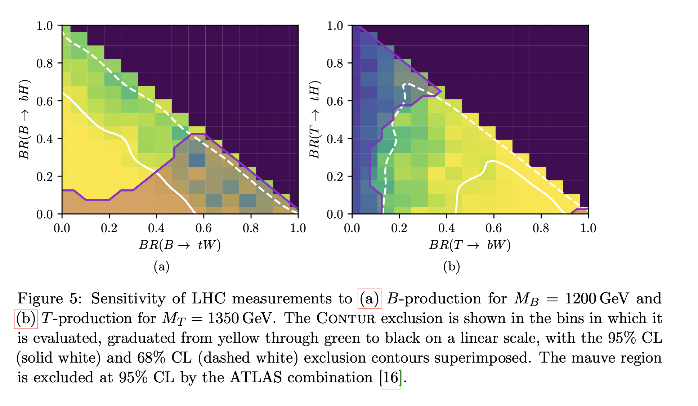
Vector-like Quarks
Compare to (quite limited) direct searches: ATLAS limits from arXiv:1808.02343
Assumes 3rd generation coupling only, and X, Y are decoupled.
Only include pair production
Buckley, JMB, Corpe, Huang, Sun arXiv:2006.07172

Slide 39
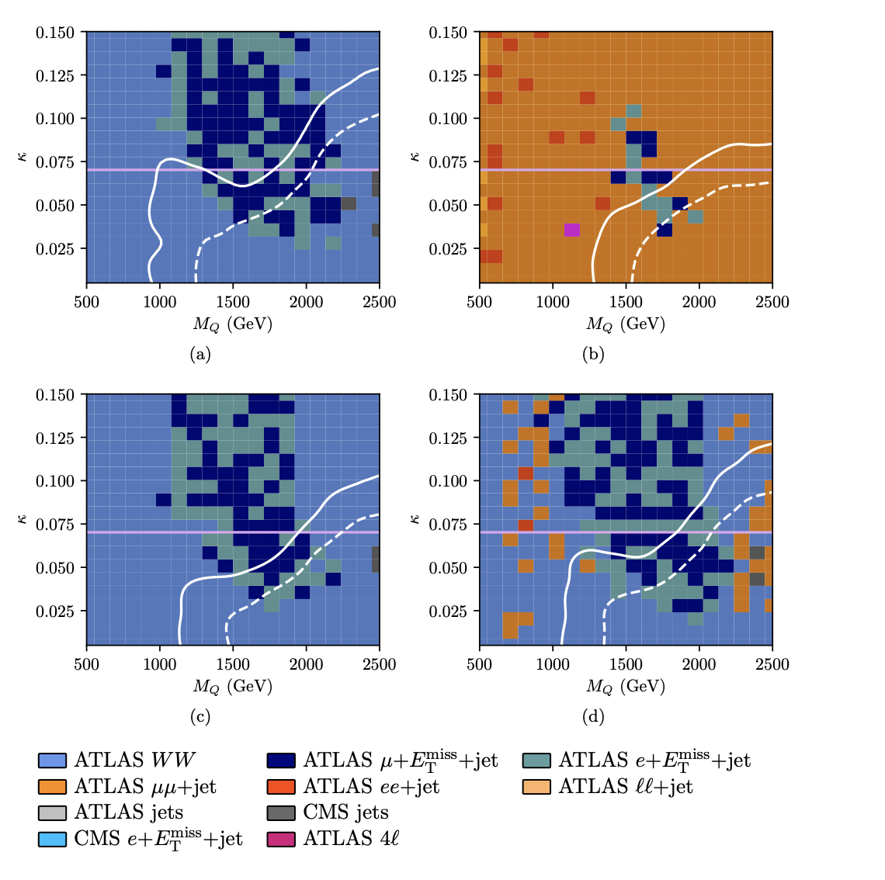
Vector-like Quarks
Coupling to 1st generation.
Region above line excluded by non-collider constraints
No LHC search analyses exist
Measurements exclude most of the plane.
Single VLQ production very important at highest masses
Buckley, JMB, Corpe, Huang, Sun arXiv:2006.07172

Slide 40
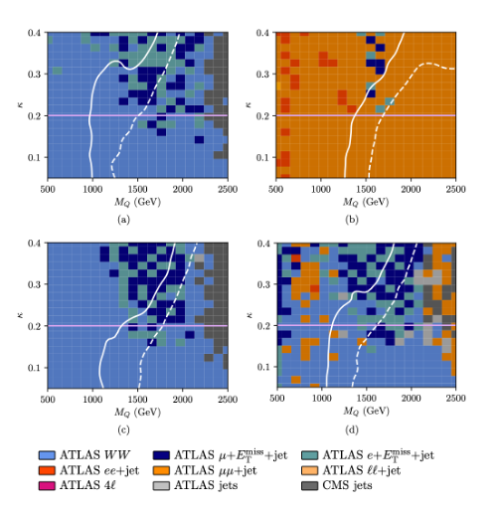
Vector-like Quarks
Coupling to 2nd generation.
Region above line excluded by non-collider constraints
No LHC search analyses exist
Measurements exclude significant part of the plane.
Single VLQ production again very important at highest masses
Buckley, JMB, Corpe, Huang, Sun arXiv:2006.07172

Slide 41
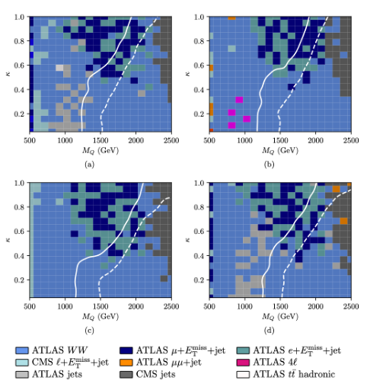
Vector-like Quarks
Coupling to 3rd generation.
No exclusion from non-collider, but there are several LHC searches
Measurements also exclude significant part of the plane.
Single VLQ production still significant at highest masses
Buckley, JMB, Corpe, Huang, Sun arXiv:2006.07172

Slide 42
Vector-like Quarks
Addendum: During journal review for this paper, it was pointed put that we’d missed some of the most compelling scenarios, and should instead consider:
  B, T singlets
  BT, XT, TY doublets
  BYX, BTY triplets
… for each generational coupling scenario and for four different decay branching benchmarks to W, Z, H.
i.e. 7 x 3 x 4 two dimensional parameter scans
Hmm. A challenge for Contur?
Buckley, JMB, Corpe, Huang, Sun arXiv:2006.07172

Slide 43


Vector-like Quarks

Slide 44
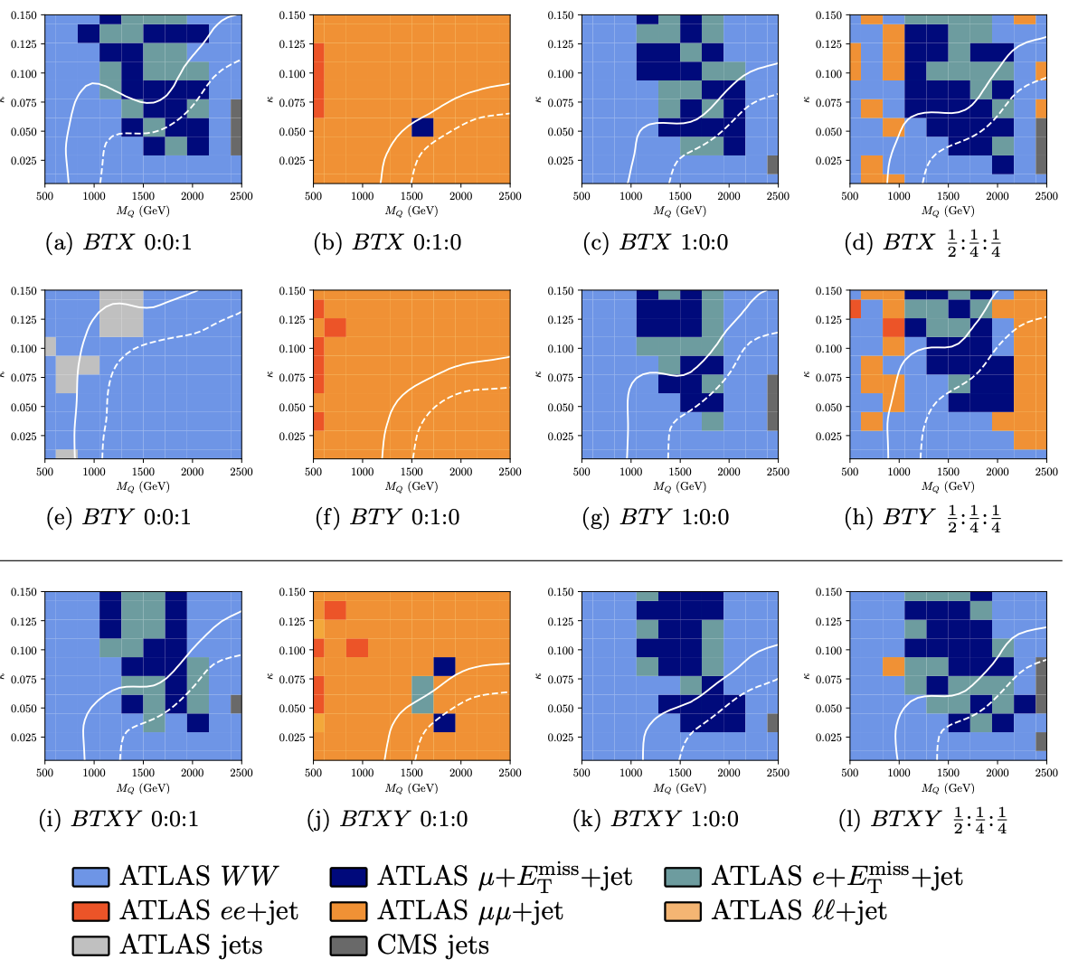
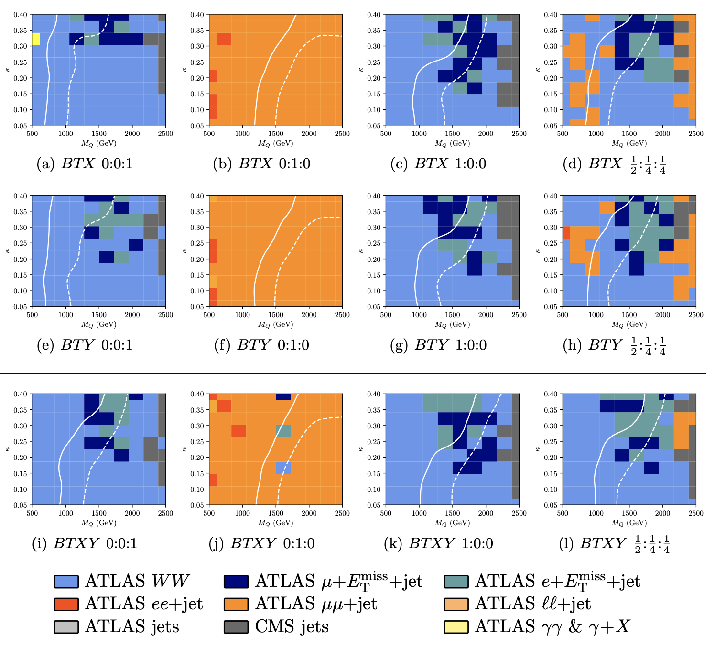
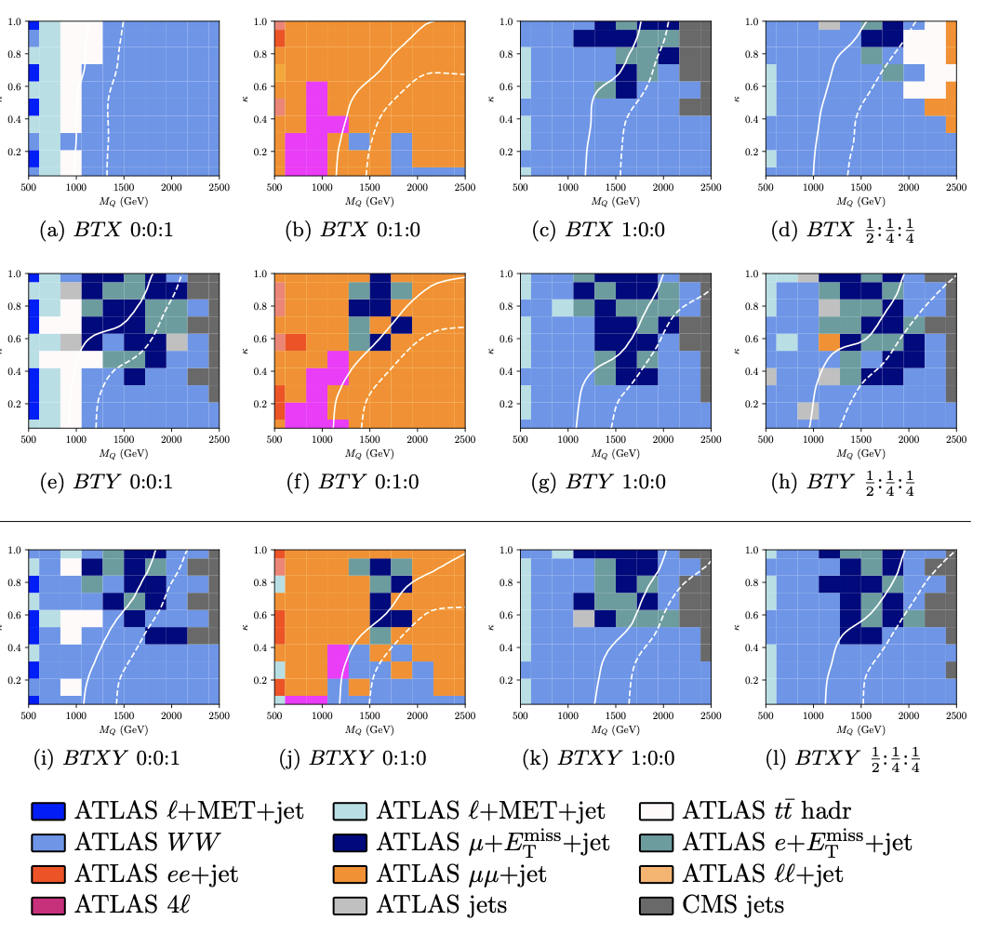
Vector-like Quarks
1st Generation 2nd Generation 3rd Generation
Buckley, JMB, Corpe, Huang, Sun arXiv:2006.07172

Slide 45
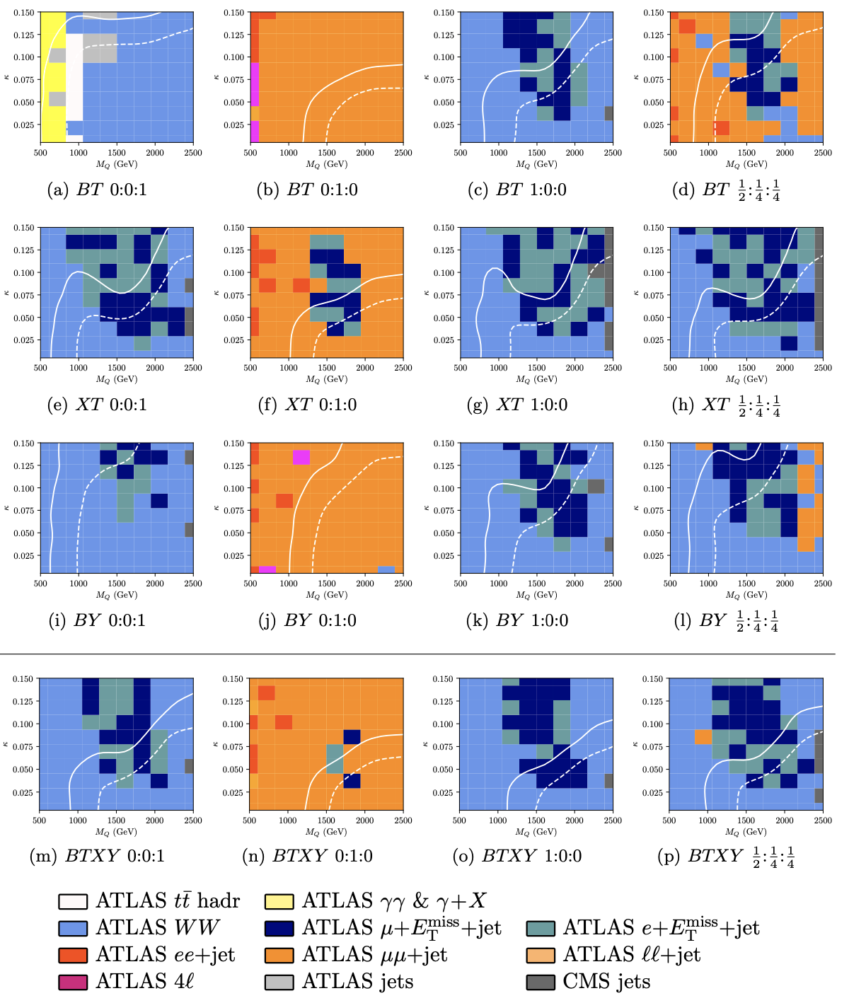
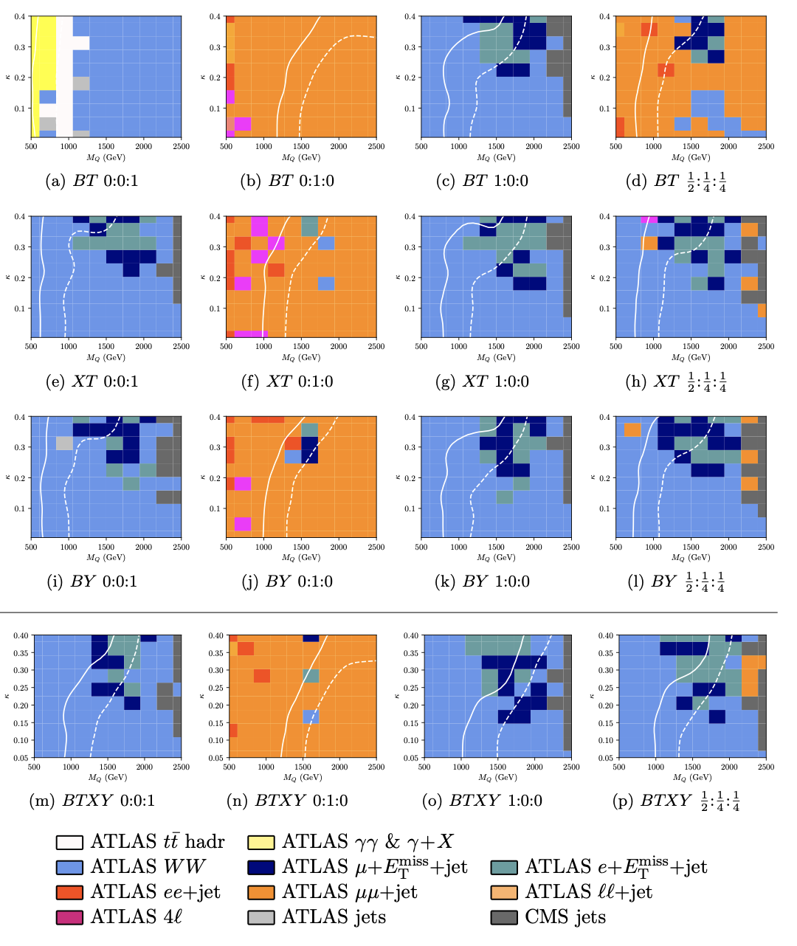
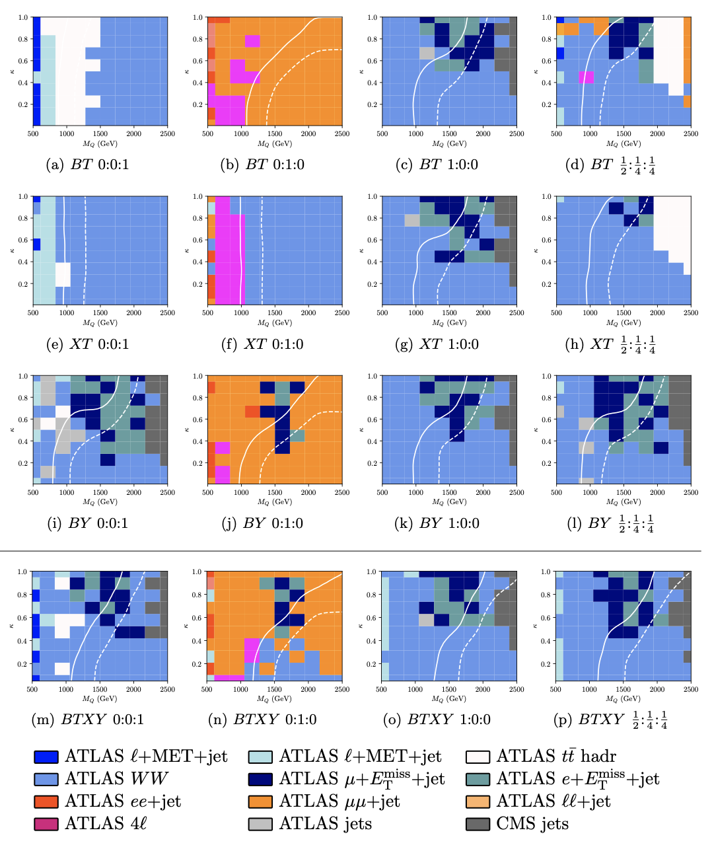
Vector-like Quarks
1st Generation 2nd Generation 3rd Generation
Buckley, JMB, Corpe, Huang, Sun arXiv:2006.07172

Slide 46
Vector-like Quarks
1st Generation 2nd Generation 3rd Generation
Buckley, JMB, Corpe, Huang, Sun arXiv:2006.07172

Slide 47
So where are we now?
No agreed “fave” extensions to the Standard Model
Change of approach required
  This is about exploration of new physics territory
  No guarantee that Dark Matter, Supersymmetry, or indeed anything else beyond the Standard Model will be within reach
Not enough to say “we looked for everything we could think of”
  Quantify whether or not the Standard Model continues to apply, well beyond the region in which it was developed, and to extreme precision
  Need precise, theory-independent measurements, and comparable calculations in Standard Model & beyond.
Into the future (new models, more precise calculations) this requires particle-level measurements
Notes:
This list came out of what I am doing personally on the LHC, but actually applies across the board.

Slide 48

Maps by Chris Wormell

