Slide 1

Supporting particle physics research in schools

Slide 2
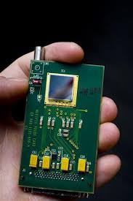
Medipix chip

Slide 3
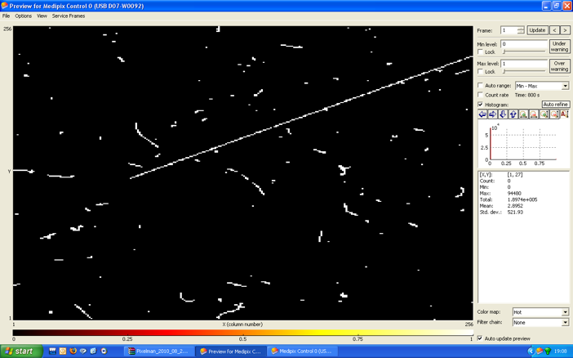

Slide 4

Participating
Schools

Slide 5
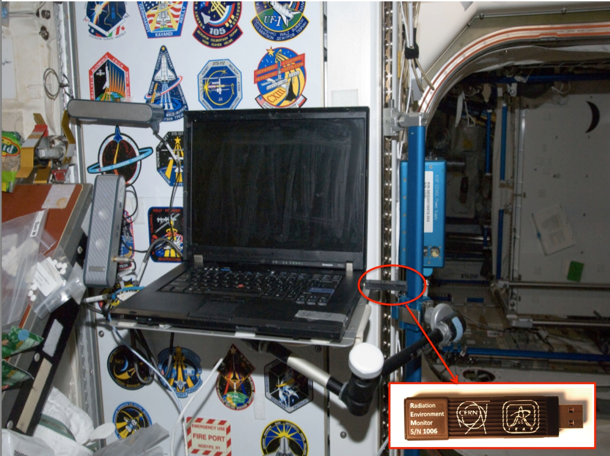

Slide 6
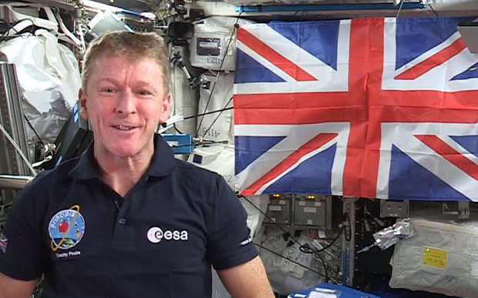

Slide 7

TimPix
We are linking with British ESA Astronaut Tim
Peake’s mission on the International Space Station.
We are monitoring radiation the
astronauts encounter whilst orbiting the Earth using
NASA data.

Slide 8
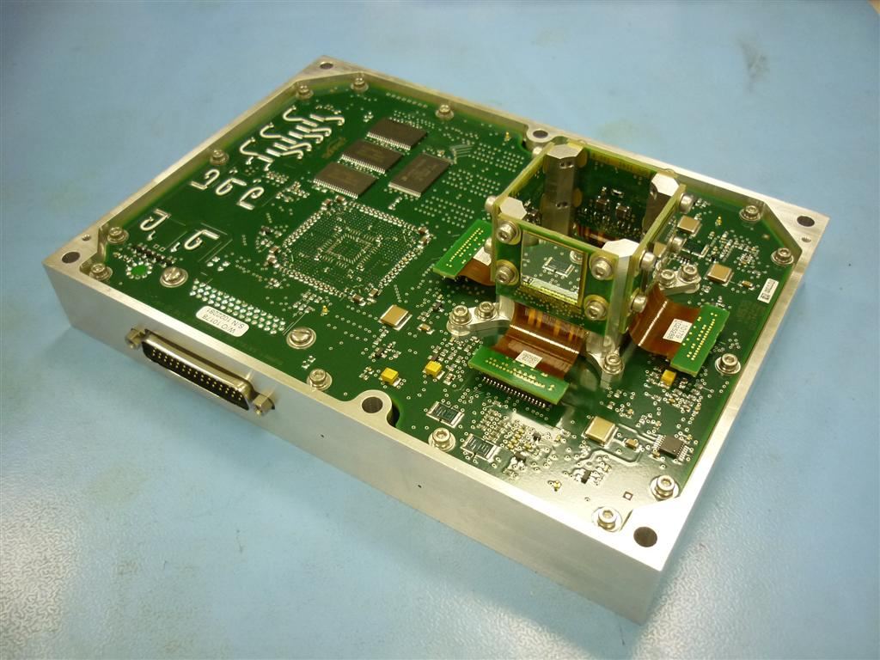
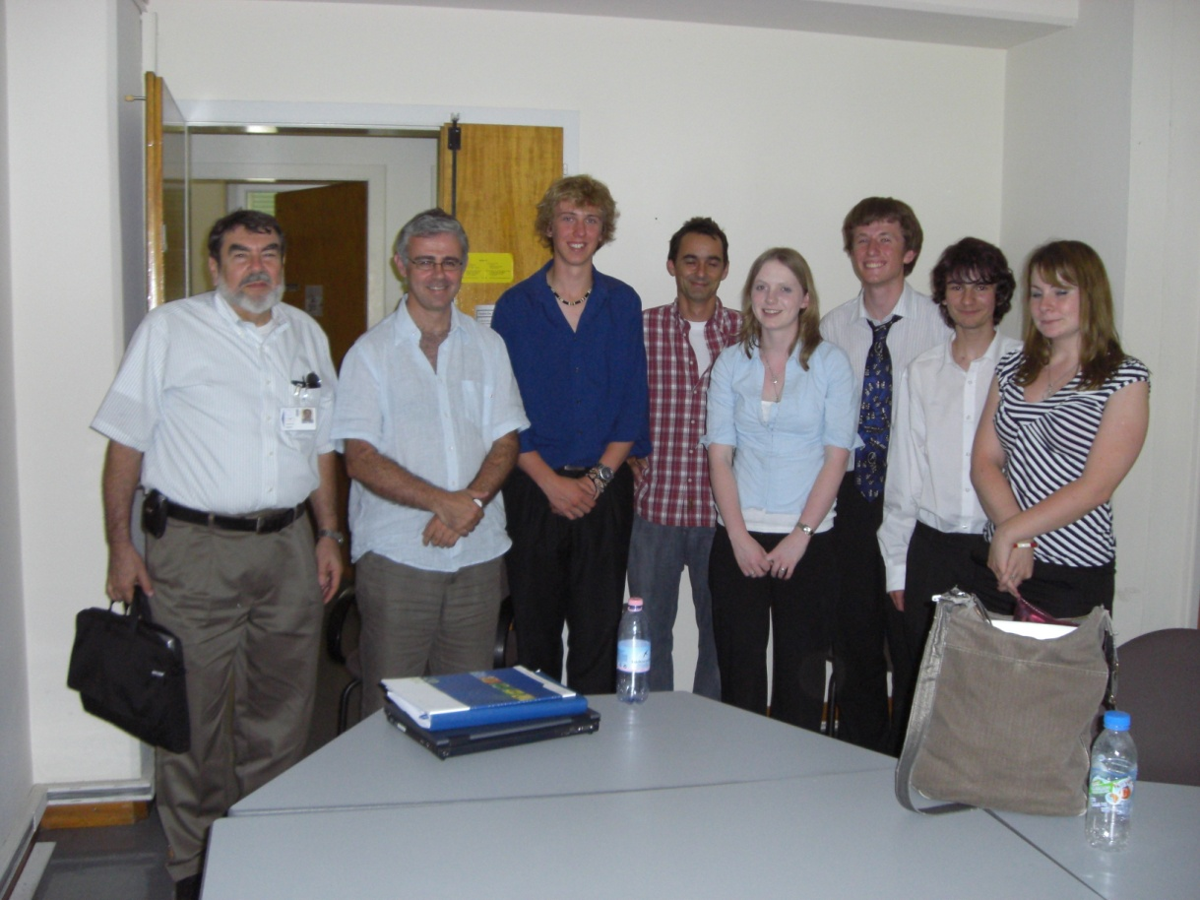
The
Langton Ultimate Cosmic ray Intensity Detector

Slide 9
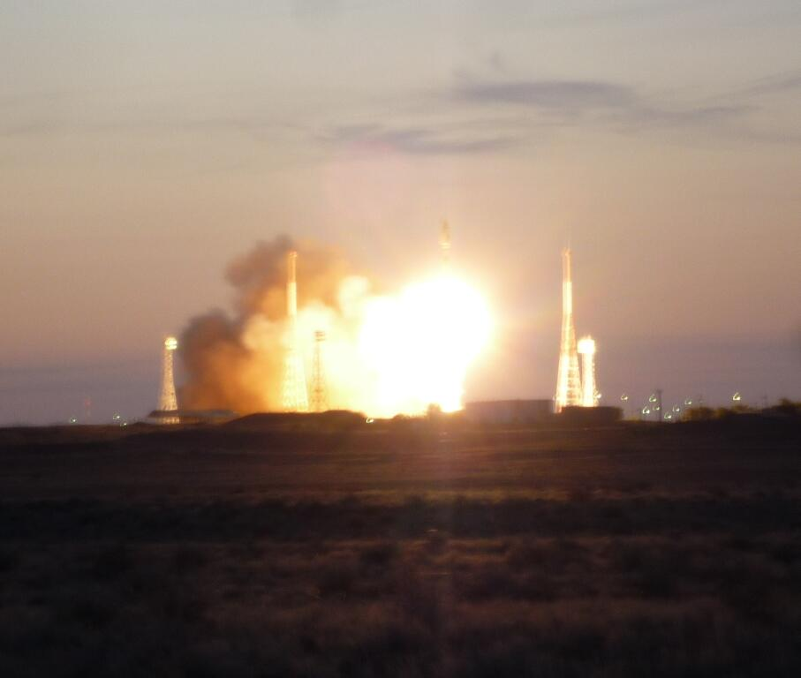
LUCID was
launched on
TechDemoSat-1 from Baikonur
on a Soyuz 2
rocket on 8th
July 2014

Slide 10
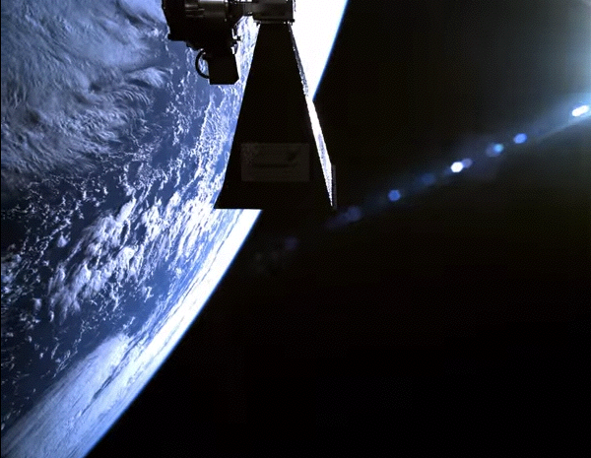
TDS-1 selfie!

Slide 11
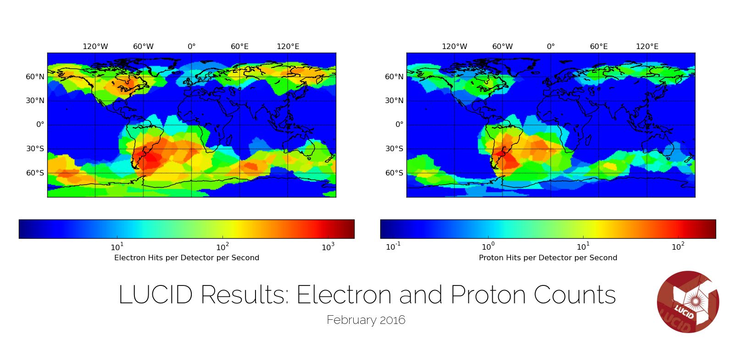

Slide 12

Making Light of the Dark
Investigating the effects of dark matter on cosmological anisotropy
Notes:
Introducing ourselves and title

Slide 13
Aims of IRIS
Nurture the potential and ability of young people to contribute to the scientific community
Increase uptake of post 16 maths, science and technology courses
Increase applications for STEM subjects at university, especially with girls
Enhance teachers’ expertise and job satisfaction and so retain teachers and recruit more to the profession
Engage Universities and Industry in sustained interaction with schools
Develop soft skills of communication, creativity, critical thinking, collaboration

Slide 14
Thank you
beckyparker@researchinschools.org
www.researchinschools.org
@ProfBeckyParker
@ResearchInSch

