Slide 1
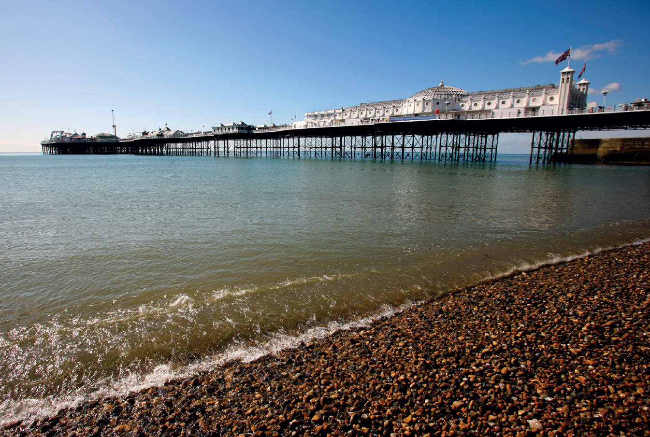








Welcome

Slide 2
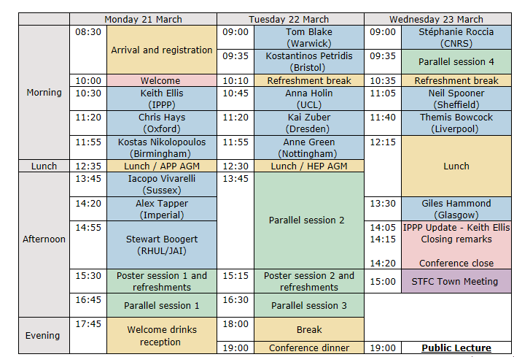
Programme overview

Slide 3
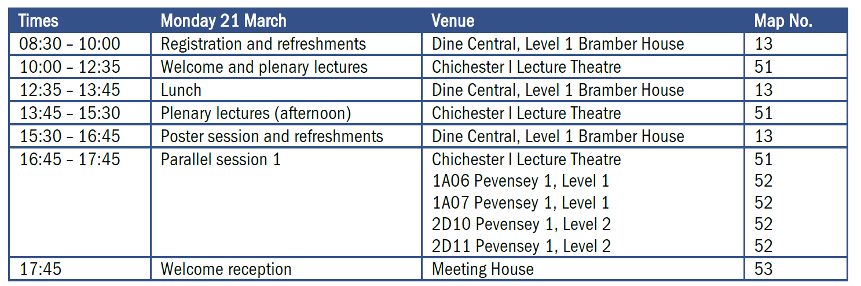
Monday programme

Slide 4
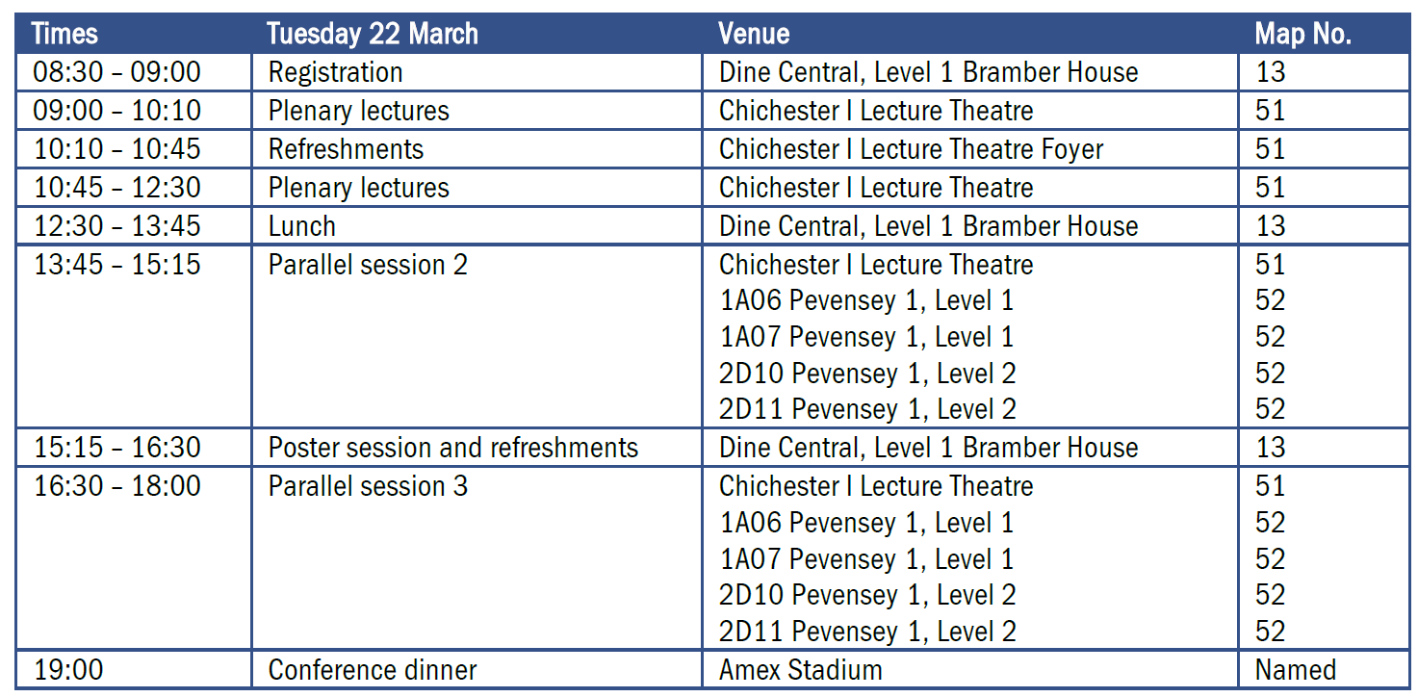
Tuesday programme

Slide 5
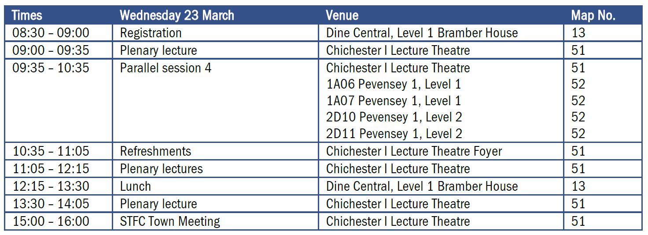
Wednesday programme

Slide 6
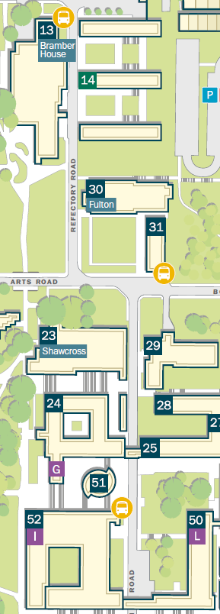
Dine Central
(Bramber House)
Lunch, coffee, poster sessions, sponsors
Photo exhibition by Kate Shaw (ICTP):
Women in Physics in the Palestinian Territories

Slide 7
Parallel sessions
(Pevensey I)

Slide 8
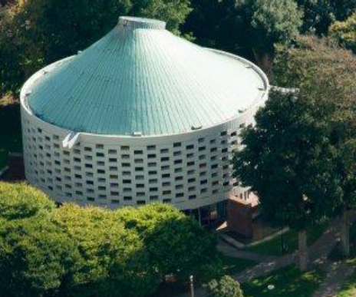
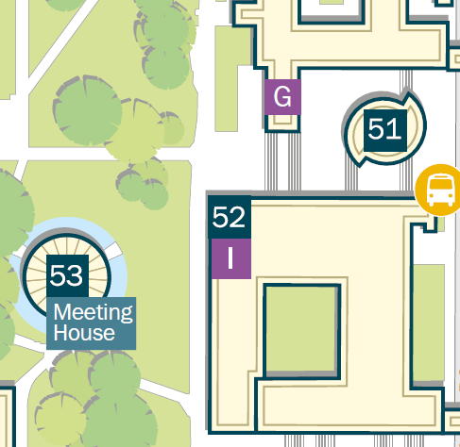
Reception
Meeting House

Slide 9
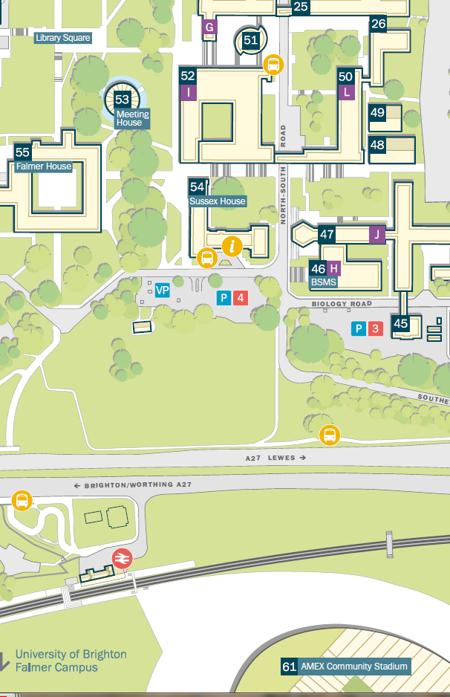
Conference Dinner
7PM

