Slide 1
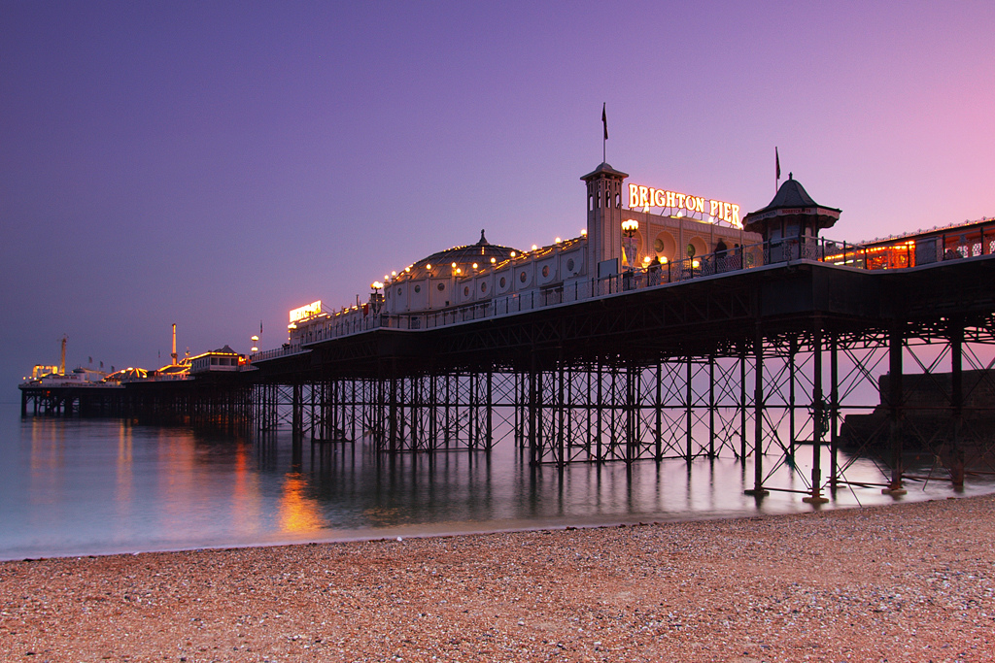
Quark and Lepton Flavour -probing the PeV scale
IOP Sussex 2016

Slide 2
Purpose
(New) Physics up to PeV Scale
(Quarks – well covered)
Leptons
Charged Leptons
EDMs
Give a taste of the physics that can be done

Slide 3

Landscape
Physics
We have discovered the 125 GeV Higgs
We know neutrinos oscillate
Seen gravitational waves
Haven’t yet seen any sign of SUSY
CP in quark sector not enough for matter and antimatter asymmetry
No understanding of neutrino mass
Tantalizing hints of NP at HE, energy frontier and at lower energies
  2TeV, 750 GeV, g-2,…

Slide 4
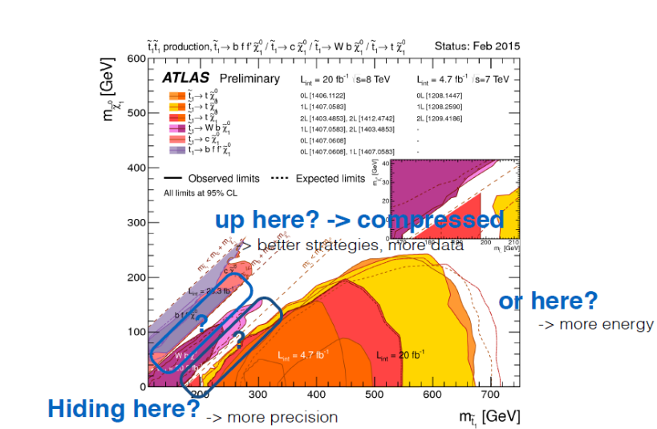
Caveat: Scales
Physics
Not all “new” experiments tell the same story
  Explanations for g-2 probe ~1 TeV models
    Useful for SUSY
  cLFV/EDMS probe up PEV > scales
    Keep probing for SUSY at higher energies
    (Split) SUSY PeV Scale 1308.3653
  Non zero θ_{QCD} can hide NP
    (no energy scale dim 4 operator)
Weiler, EPS 2015

Slide 5
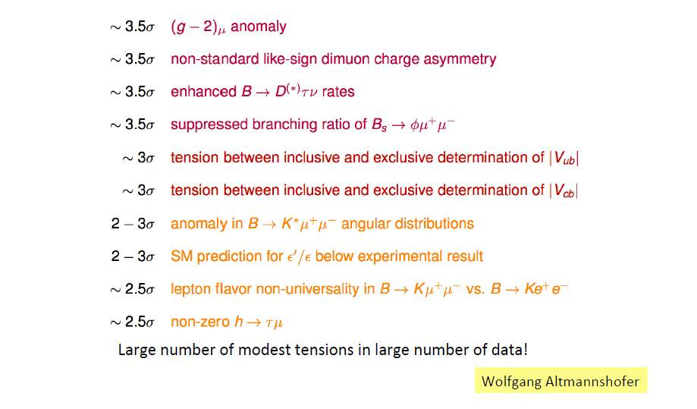
Anomalies
Physics
Silvestrini: QCD?
1512.07157

Slide 6
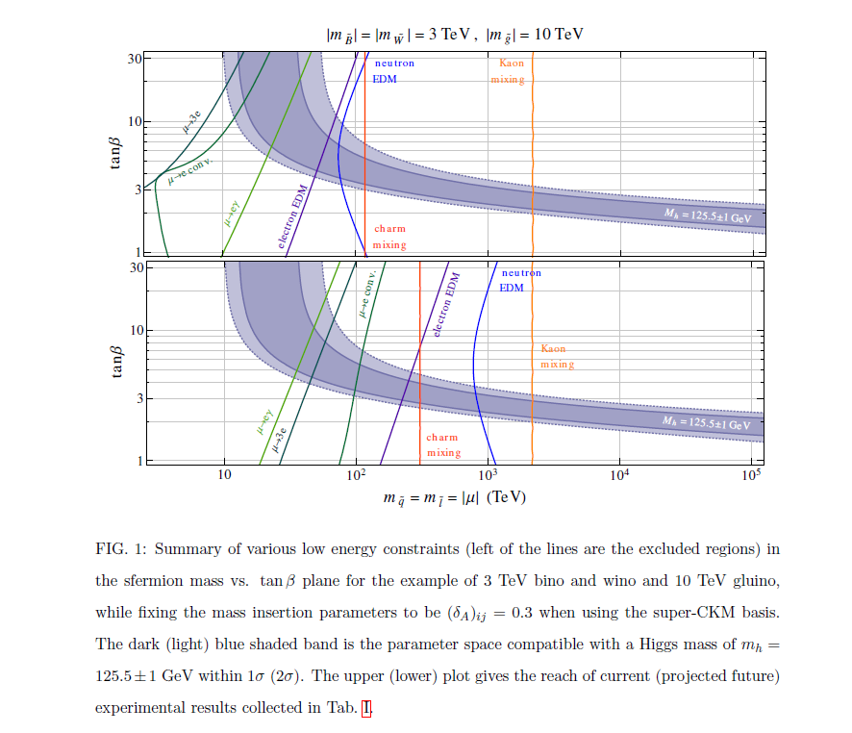
SUSY to PeV
Physics
Altmannshofer et. al.
1308.3653

Slide 7
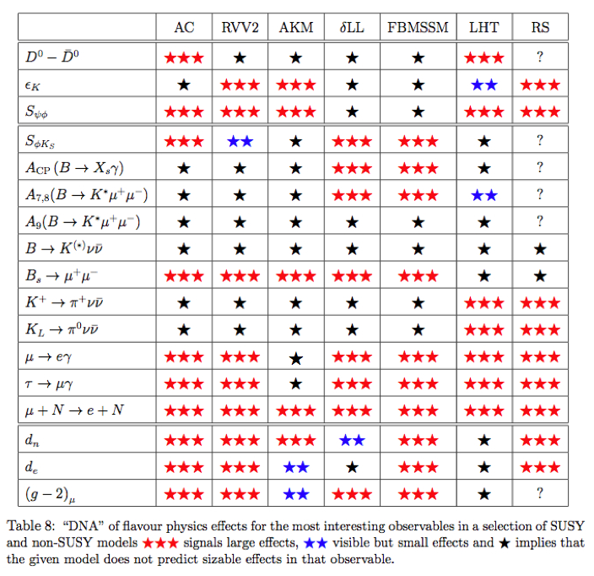
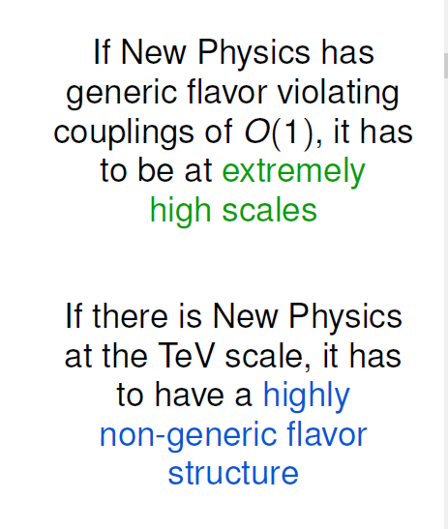
Probes for NP
RH Currents
AC = Agashe , Carone hep-ph/0304229 (Abelian)
RVV2 = Calibbi et al. 0907.4069 (non-Abelian)
AKM = Antusch et al. 0708.128 (flavour symmetry)
δLL = (CKM LH currents)
FBMSSM = (flavour blind MSSM)
LHT = (Little Higgs with T parity)
RS = (Randall-Sundrum)
= Discovery Sensitivity
arXiv:0909.1333[hep-ph]
W. Altmannshofer, A.J.Buras, S.Gori, P.Paradisi, D.M.Straub

Slide 8
Probes for NP
Physics
LNV
Neutrinos
Quarks
LFV
Rare
Charged
Leptons
Mixing
LUV
EDM
Universality

Slide 9
very Selected topics
Quarks

Slide 10
Overview
Mixing
Quarks: b,c,s
Rare
Mixing
Rare decays
  Kπνν, Bμμ, …
R_{K}
Theory precision high
LUV

Slide 11
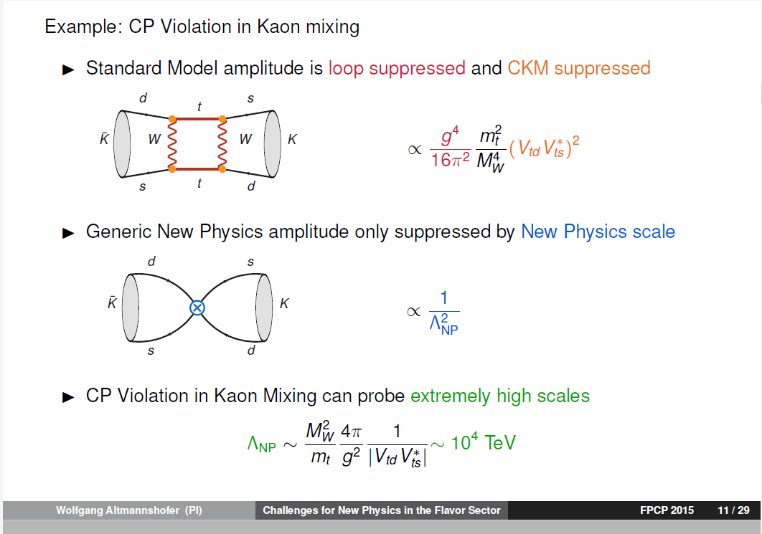
Mixing
Mixing
Quarks: strange

Slide 12
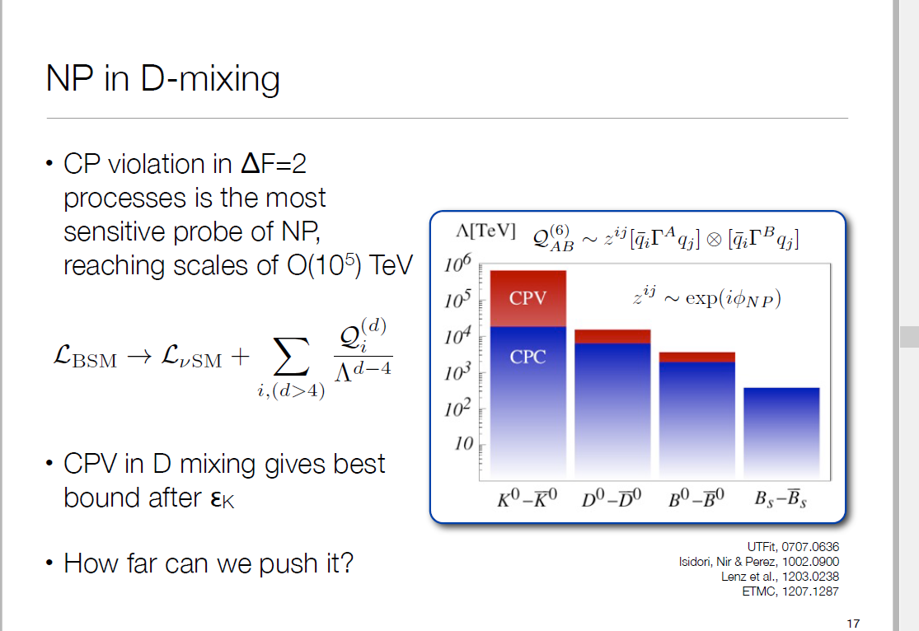
Mixing
Mixing
Quarks: charm+

Slide 13
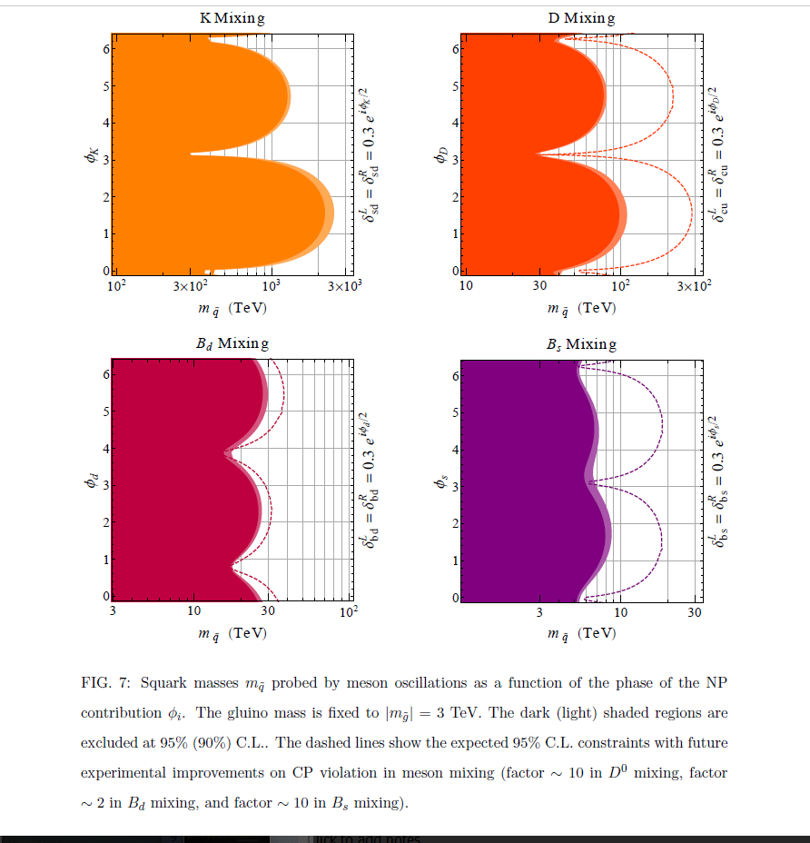
Mixing
Quarks: charm+
Squark Masses
Altmannshofer et. al.
1308.3653

Slide 14
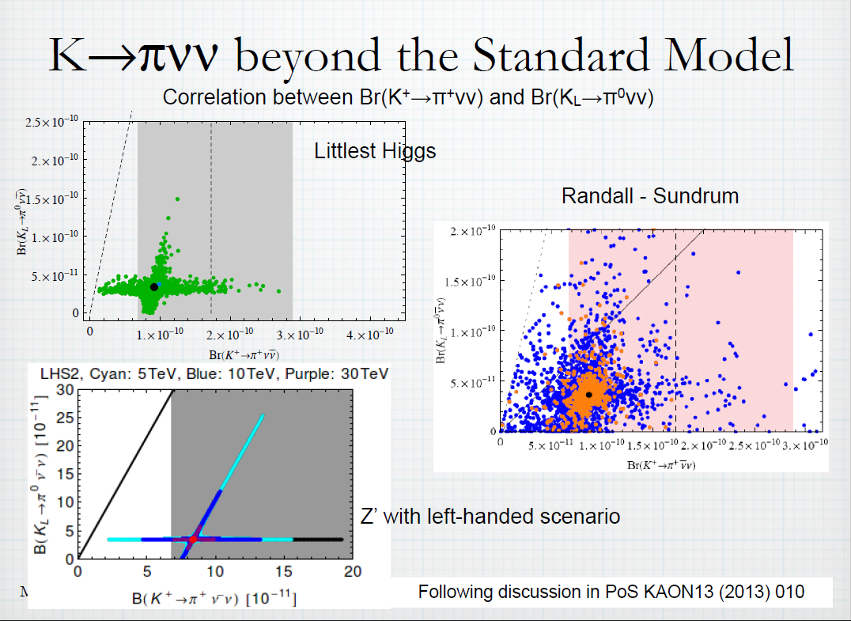
NP (rare decays)
Rare
Quarks: strange

Slide 15
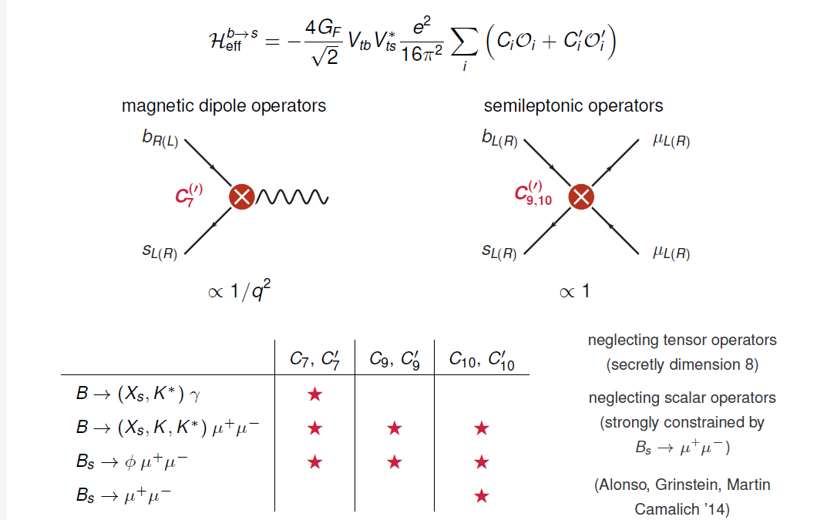
b → s
FCNC
Quarks: beauty

Slide 16
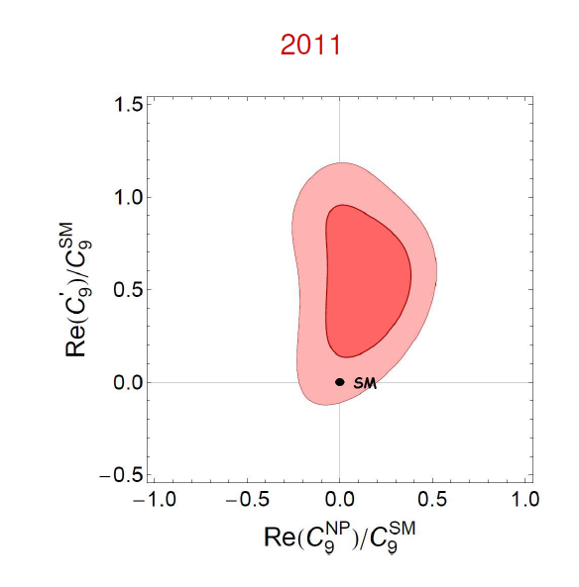
Quarks: beauty

Slide 17
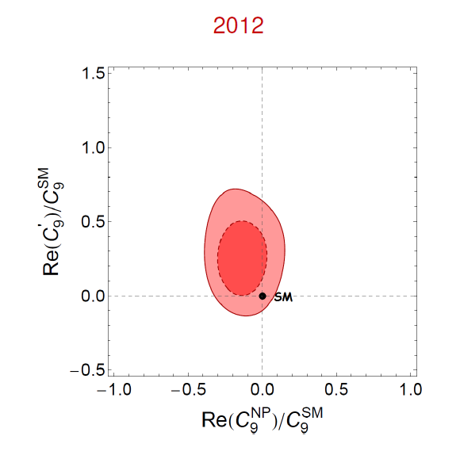
Quarks: beauty

Slide 18
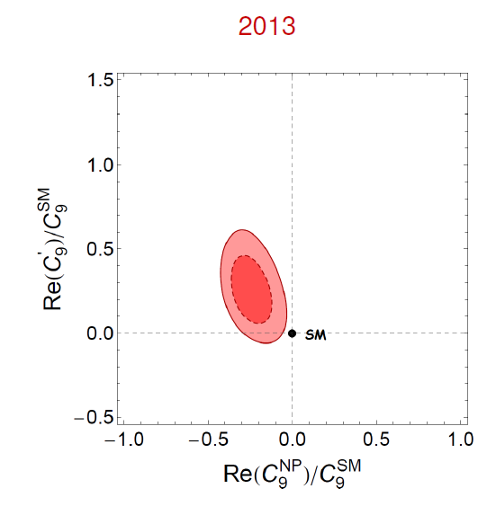
Quarks: beauty

Slide 19
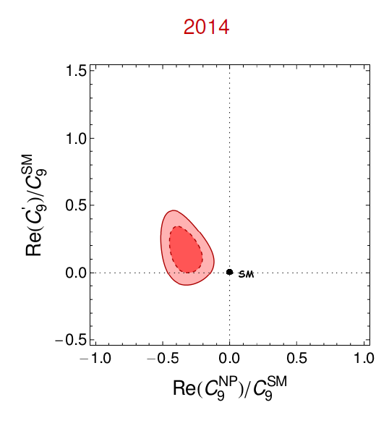
Quarks: beauty

Slide 20
Quarks: beauty

Slide 21
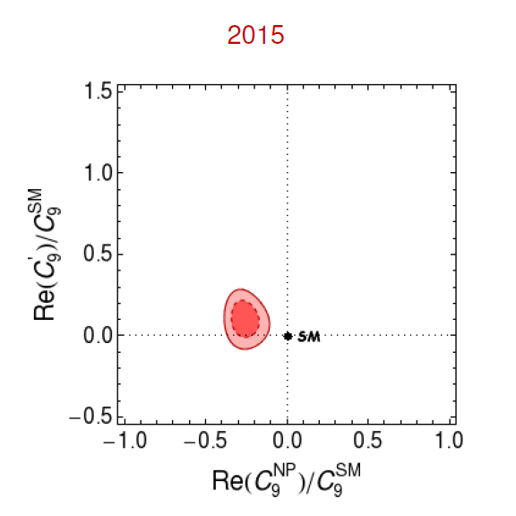
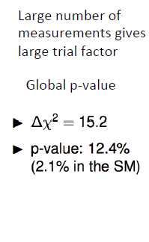
Quarks: beauty
Many experimental improvements: Theoretical uncertainties?

Slide 22
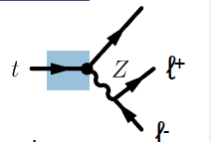
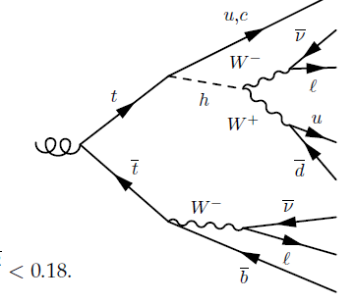
FCNC
Quarks: top
FNCN top decays arxiv:1312.419
tqZ
Multileptons (CMS) PAS TOP-13-017
Top quark flavour violation can be tensioned against measurements from B&K physics and EDMs
Cirigliano / top quark arxiv.org/pdf/1603.03049.pdf

Slide 23
Selected topics another way to reach a PeV
Leptons

Slide 24
LFV
Leptons
Many tests at different facilities
Process | Current Limit | Next Generation exp
τ −−> μη | BR < 6.5 E-8
τ −−> μγ | BR < 6.8 E-8 | 10⁻⁹ - 10⁻¹⁰ (Belle II)
τ −−> μμμ | BR < 3.2 E-8
τ −−> eee | BR < 3.6 E-8
K_{L} --> eμ | BR < 4.7 E-12
K⁺ --> π⁺e⁻μ⁺ | BR < 1.3 E-11 | NA62
B⁰ --> eμ | BR < 7.8 E-8
B⁺ --> K⁺eμ | BR < 9.1 E-8
μ⁺ −−> e⁺γ | BR < 5.7 E-13 | 10⁻¹⁴ (MEG)
μ⁺ −−> e⁺e⁺e⁻ | BR < 1.0 E-12 | 10⁻¹⁶ (PSI)
μN --> eN | R_{μe} < 7.0 E-13 | 10⁻¹⁷ (Mu2e, COMET)
Belle II, LHCb
The most sensitive CLFV probes use muons
Notes:
We are not alone in pursuing discovery science via charged lepton flavor violation… Why? Well, we know quarks mix, we know neutrinos mix, so – to me (and many others) – it would be surprising if charged leptons didn’t mix. It’s a question then of “at what level” do they mix. These are FCNC, you have to work hard to suppress them. It turns out that in most BSM models CLFV effects are present at rates that some next generation experiments will be sensitive to. And in that regard the muon experiments really shine - MEG and muon-to-electron conversion in particular. MEG is searching for a muon decaying to e/gamma, released a new result last year, and is in the middle of an upgrade to improve another order of magnitude in the next few years. Muon conversion is being pursued by Mu2e here at Fermilab and a very similar experiment called COMET at JPARC in Japan.

Slide 25
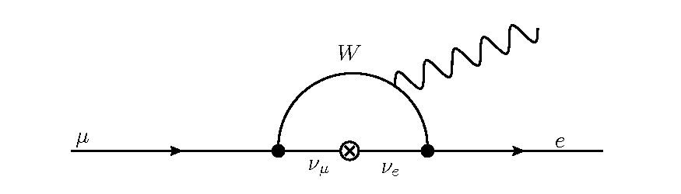
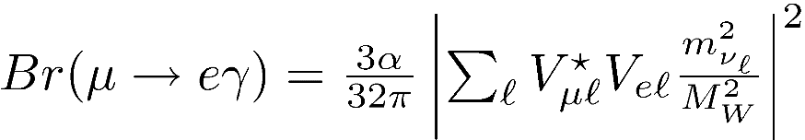

Neutrino Oscillations and CLFV
LFV
Leptons
Neutrinos oscillate, so lepton flavor is not conserved.
Charged leptons must mix through neutrino loops.
  But the mixing is so small, it’s effectively forbidden.
No Standard Model pollution! Observation is unambiguous evidence for new physics.
25

Slide 26

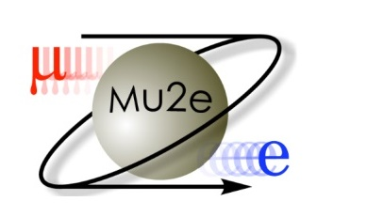



mostly MUONS AND edmS g-2 COMET MEG mu2e mu3e srEDMs
Experiments

Slide 27

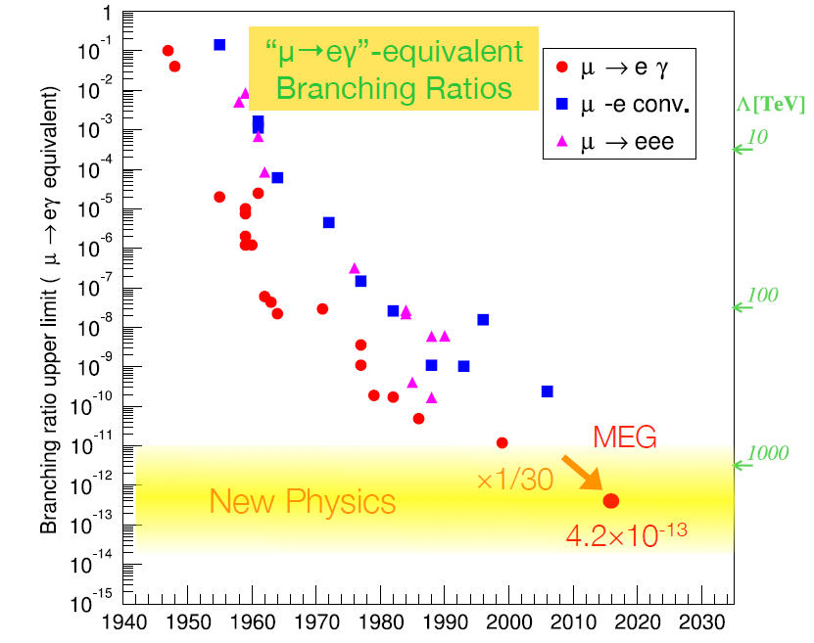
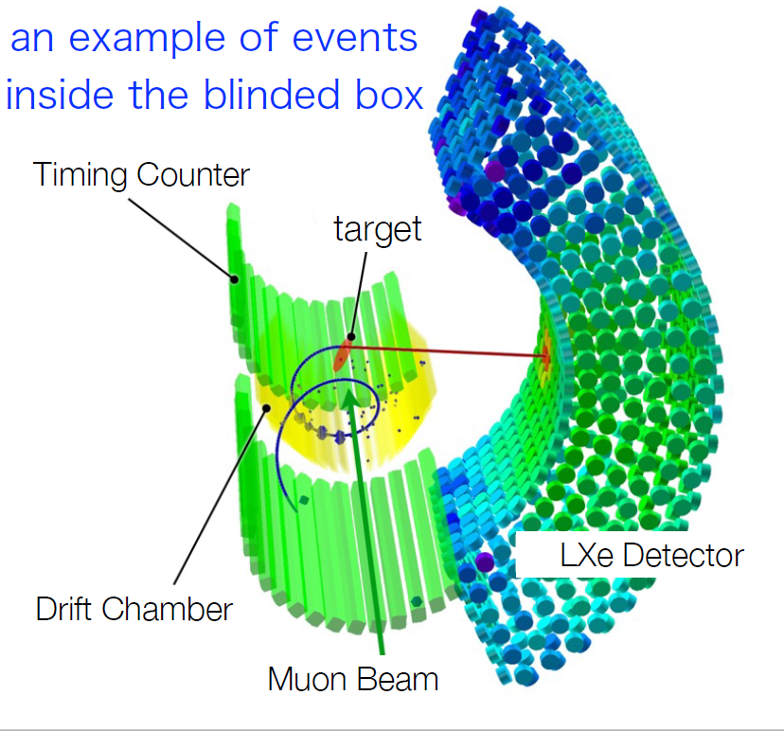
LFV
Experiment: MEG

Slide 28

LFV
Experiment: mu2e
  A search for Charged-Lepton
  Flavor Violation
  LFV in the field of a nucleus (see COMET)
  Use current Fermilab accelerator complex to reach a sensitivity 10 000 better than world’s best
  Data taking 20/21
μ⁻ N  e⁻ N
  Mu2e plans to use aluminum
  Sensitivity goal requires ~10¹⁸ stopped muons
1,000,000,000,000,000,000
=number of stopped Mu2e muons
= number of grains of sand on earth’s beaches

Slide 29

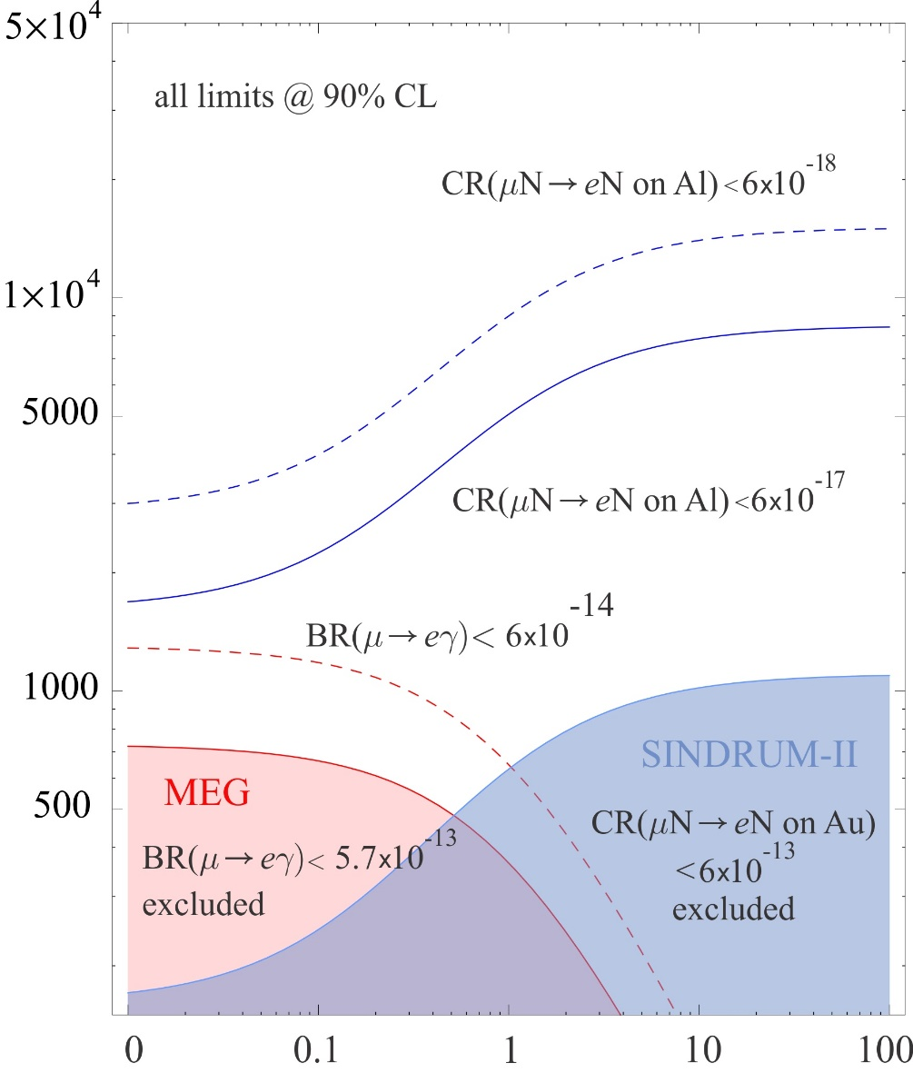
LFV
Experiment: mu2e
Magnetic moment op.
contact term
Λ
Mu2e extends beyond exisiting MEG for all BSM interaction types
and conversion process has sensitivity to non-dipole
BSM that MEG doesn’t.
TeV
κ

Slide 30
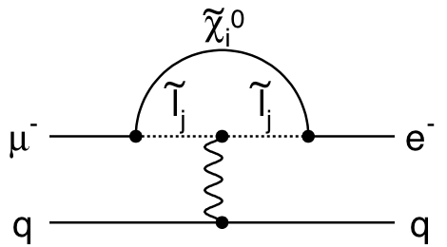
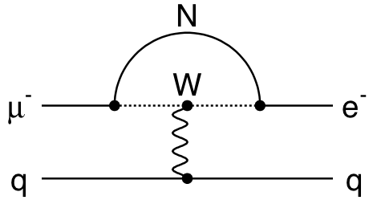
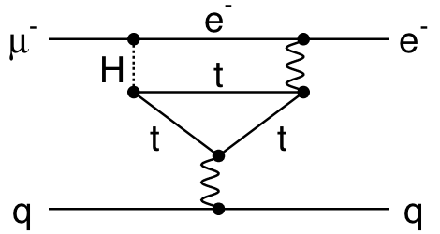
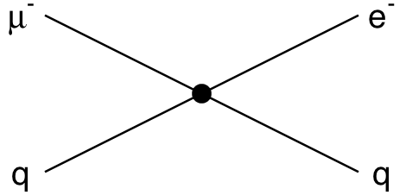
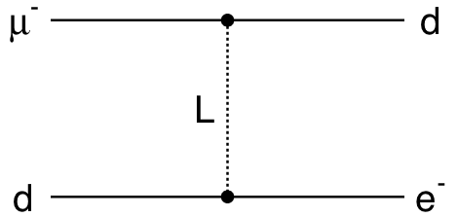
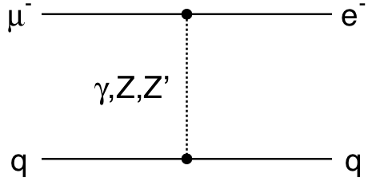
NP & μN  eN
LFV
Experiment: mu2e
Loops
Supersymmetry
Heavy Neutrinos
Two Higgs Doublets
Contact Terms
Compositeness
Leptoquarks
New Heavy Bosons /
Anomalous Couplings
μN  eN sensitive to wide array of New Physics models
Notes:
So I advertised earlier that Mu2e has a broad sensitivity and this slide is meant to illustrate some of the models to which Mu2e has discovery sensitivity.

Slide 31
LFV
Experiment: mu2e
scalar leptoquarks
not excluded by LHC
Split SUSY : Higgs mass
Sfermions not at TeV scale but:
100 – 1000 TeV with gauginos at a few TeV
Arnold et al, Phys. Rev D88 035009 (2013)
Scalar leptoquark mass [TeV]
Many of the CLFV models have:
- effects too weak to see at LHC e.g. non-standard h (e mu) coupling
- physics at a scale beyond LHC e.g. split SUSY and physics of neutrino masses
TeV-scale Left-right seesaw model

Slide 32
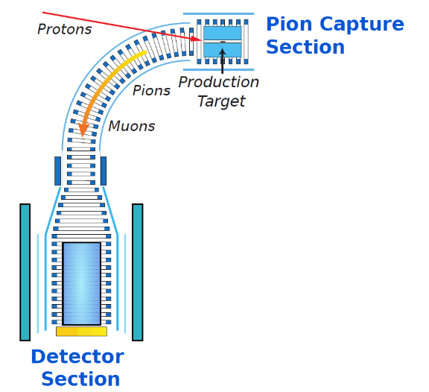
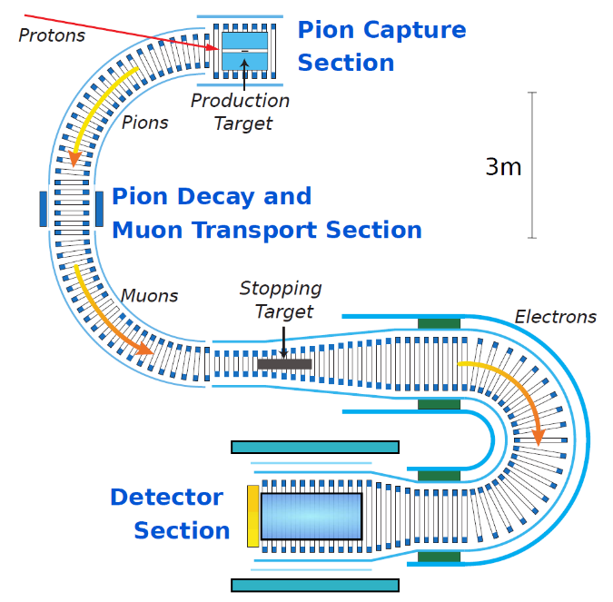
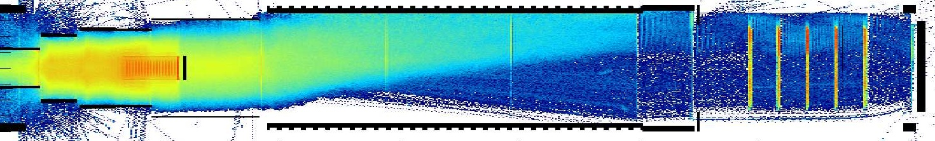
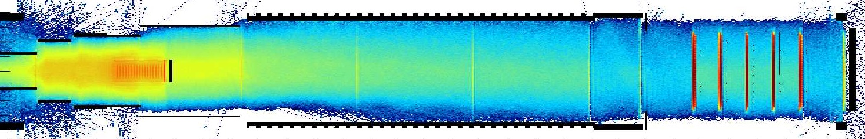
LFV
Experiment: Comet
COMET
Phase-I
Two-phase approach:
physics and background
studies with first 90° for
Phase-I, full O(10⁻¹⁷)
sensitivity for Phase-II
Adjustable charge & momentum selection with vertical B-fields
Trajectories
of 105 MeV
electrons
from the
muon-
stopping
target:
similar momentum selection for muon beam (both phases)
Intense 56 kW beam: full sensitivity after one year
Phase-II
Separate
muon-to-electron
conversion and
background study
detectors
Weak (0.08 T) Vertical Field
Phase-II Stopping Target Electron Spectrometer Detector Section
Nominal (0.22T) Vertical Field

Slide 33
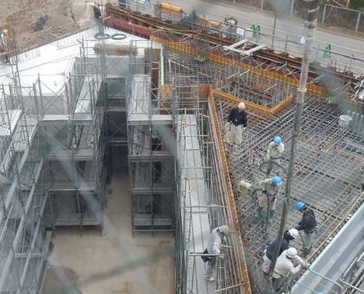
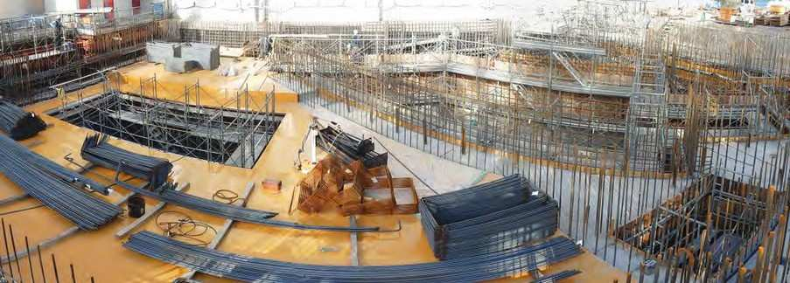
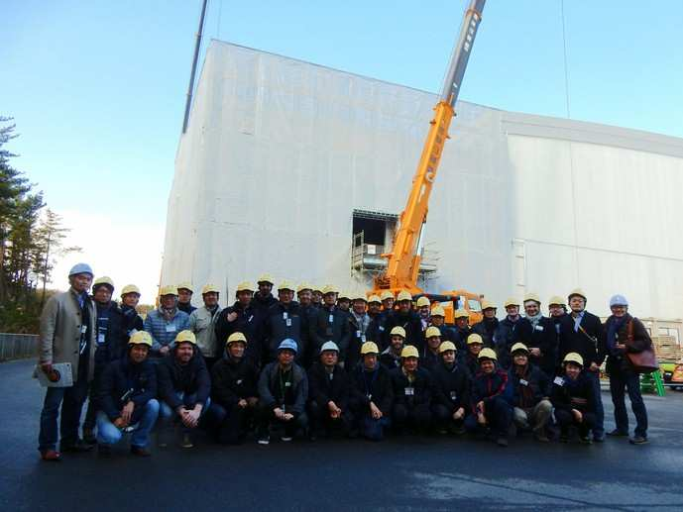
LFV
Experiment: Comet
COMET Facility at J-PARC
June 2014
October 2014
January 2015
March 2015
October 2015
COMET Building and Hall, Counting Rooms completed
Phase-I Bent Solenoid installed and undergoing testing, detector solenoid almost complete
System integration work ongoing

Slide 34
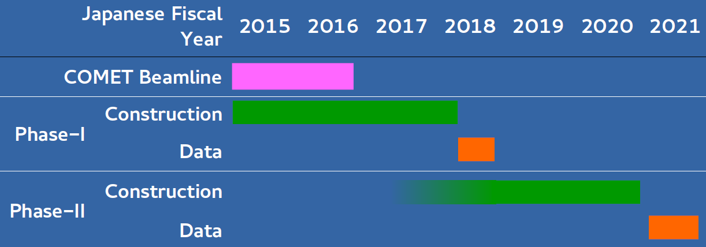
LFV
Experiment: Comet
COMET: Schedule
Phase-II construction concurrently
with Phase-I running

Slide 35
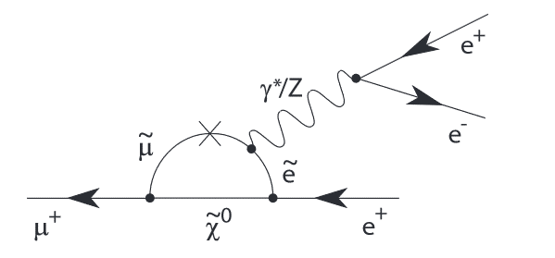
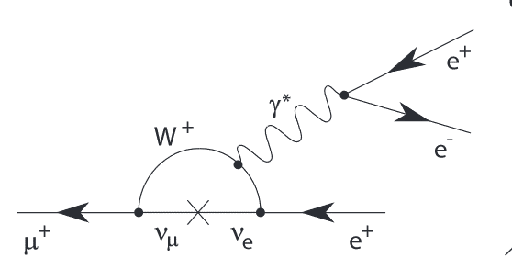
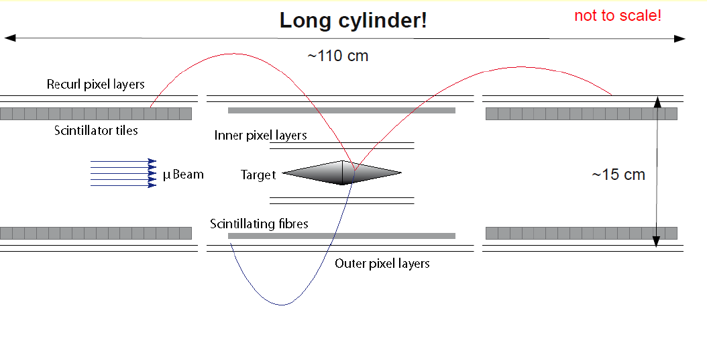
mu3e
LFV
Experiment: mu3e
CFLV with μeee
Look at 1 in 10¹⁶ decays
Heavily suppress μeeeνν
(over 16 orders magnitude
with kinematic cuts)

Slide 36
mu3e v mu2e
LFV
Experiment: mu3e
leptogenesis models (with cLFV) there are big variations in the expected rates of the μN→eN and the μ→eee decays.
  If inverted neutrino mass hierarchy enhancement of μ→eee decays
If NP couples more strongly to leptons than to quarks, mu3e has unique sensitivity.
More than event counting – if signal
  Full reconstructed 3 electron state
Access to dark photons (10 to 100 MeV)

Slide 37
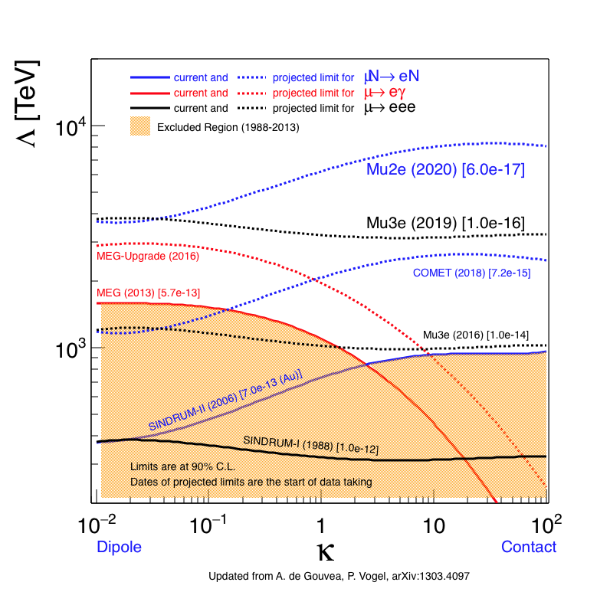
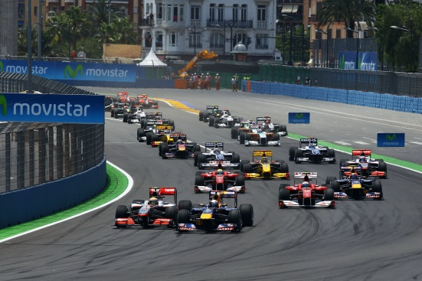
LFV
Experiment: all
Putting it all together ….
Race
We need all the results!
If you measure one (meg/muN-eN), m3e (e.g.) needed combination of λ,κ. Need to measure more than one

Slide 38
LFV
Experiment: all
Even sensitivity to non-standard Higgs couplings
(new Higgs bosons)
^{Harnik et al JHEP 3, 26 (2013)}
Sensitive down to BR ( ) of 10⁻¹⁰ (cf current LHC limit of 3 x 10⁻⁴)

Slide 39
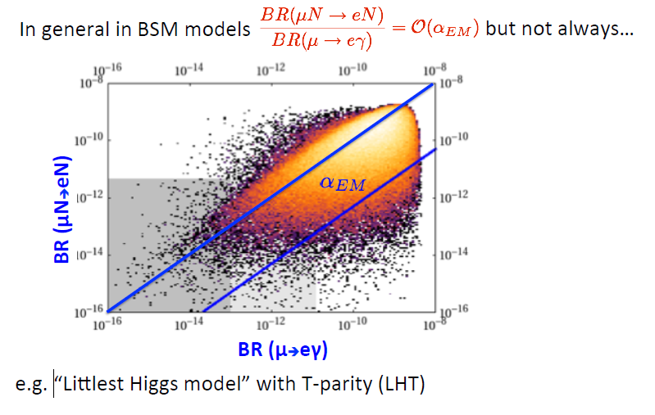
LFV
Leptons
Many Model Dependent Relationships between observables

Slide 40
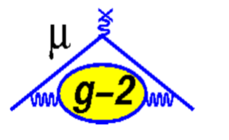
Experiment: g-2

Slide 41
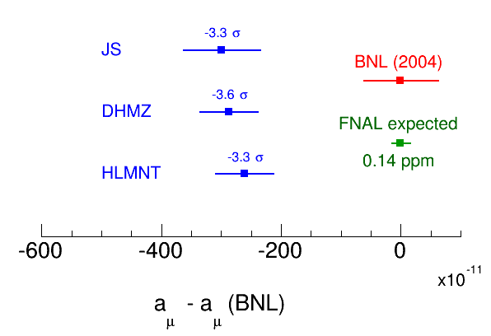
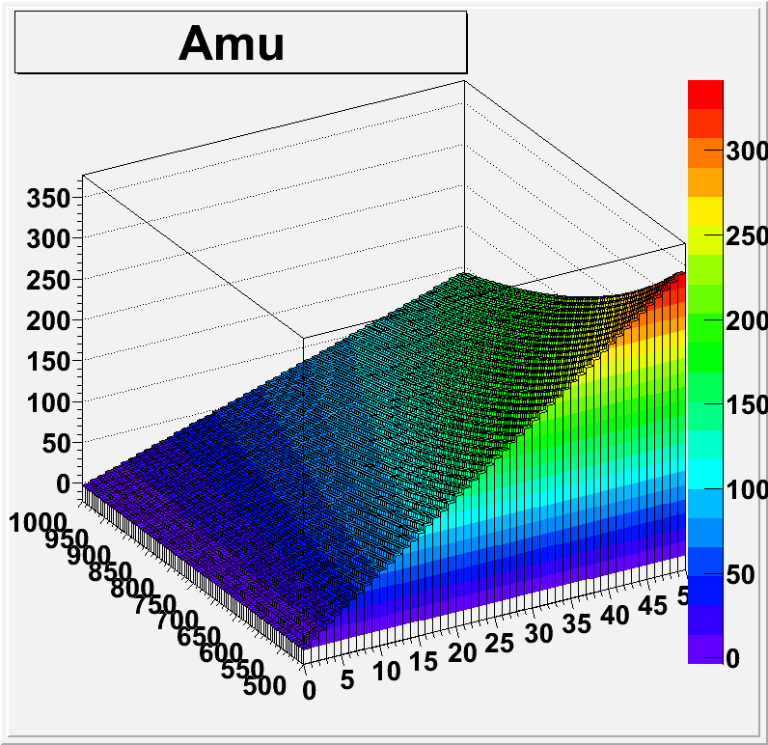
NP
Experiment: g-2
g-2 does not probe flavour changing interactions but NP in loops….
Can address models: technicolor, SUSY, 2HDM, LHT, W’, Z’ (TeV range)
Neutralino mass = 500 GeV
Smuon mass (Gev)
tanβ
By 2019 (First Data 2017)
5.5σ significance from the experimental improvement becomes 9.7σ evidence of NP

Slide 42
Experiment: g-2
Improvements from BNL
  More muons/proton, less pions
  Improved detectors (3 trackers, Calorimeters)
  Better beam dynamics
  Improved field uniformity
  Improved modelling

Slide 43
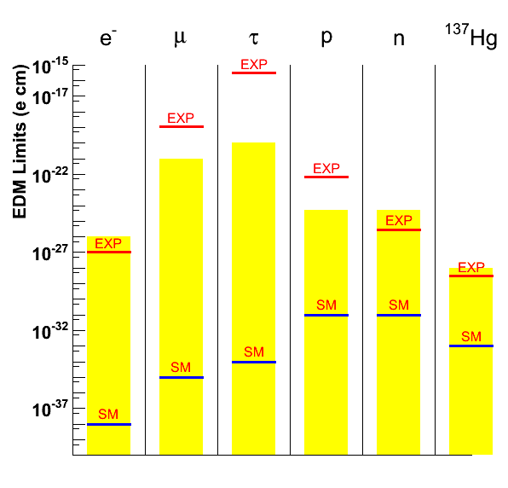
muEDM
EDM
Experiment: g-2
Phase-I Part of g-2 experiment (first measurement)
see anything in muons, sign of new physics
|d_{e}| < 10⁻²⁹ e cm, the current results, for 2nd generation muons 10 orders of magnitude worse, |d_{μ}| < 1.8 × 10⁻¹⁹ e cm
g-2@FNAL will get improve this by two orders of magnitude

Slide 44
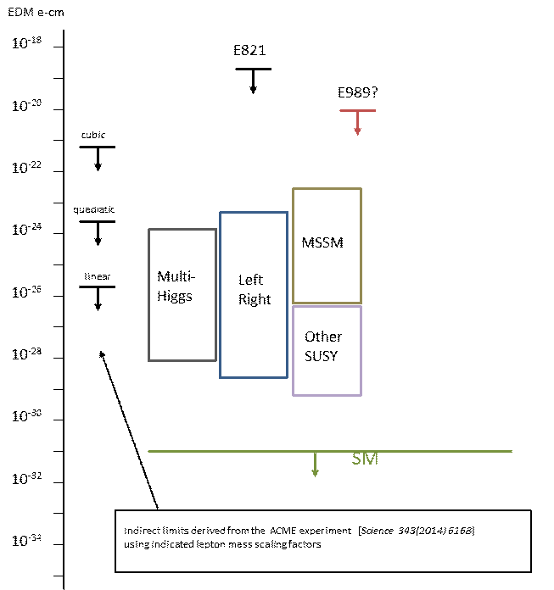
EDM
Experiment: g-2
Examples of a 4-loop diagram, the lowest order contributing to lepton EDMs in the Standard Model, and 5-loop diagram

Slide 45
e(p)EDM
EDM
Detector
Experiment: srEDM
proton
storage ring
EDM
Ideas from same original g-2 team
pEDM “like” g-2 but ALL electric
  Counter rotating beams enable huge cancellation of systematics
  Study polarization of protons
2014 received P5 support under all scenarios

Slide 46



Sensitivity to Rule on Several New Models
Physics
proton
storage ring
EDM
Gray: Neutron
Red: Electron
If found it could explain
Baryogenesis (p, d, n, ³He)
n current
e current
GUT SUSY
Electroweak
Baryogenises
n target
p, d target
e target
1st upgrade
Statistics limited
Electron EDM new physics reach: 1-3 TeV
high physics reach
Complementary to LHC
e-cm
J.M.Pendlebury and E.A. Hinds, NIMA 440 (2000) 471

Slide 47


Summary
Flavour (quark and lepton) provides wide vista onto possible NP up to PeV scale
Charged leptons provide especially clean signals for NP
  Need multiple experiments to interpret signals
Fertile ground for theory
Involvement for all: specialized experiments to GPD
  Think creatively – its inspirational
Exciting time competition to find new physics
Thanks…

