Slide 1


The COherent Muon to Electron Transition (COMET) Experiment
IOP HEPP Conference
Ajit Kurup for the COMET Collaboration
23rd March 2016

Slide 2
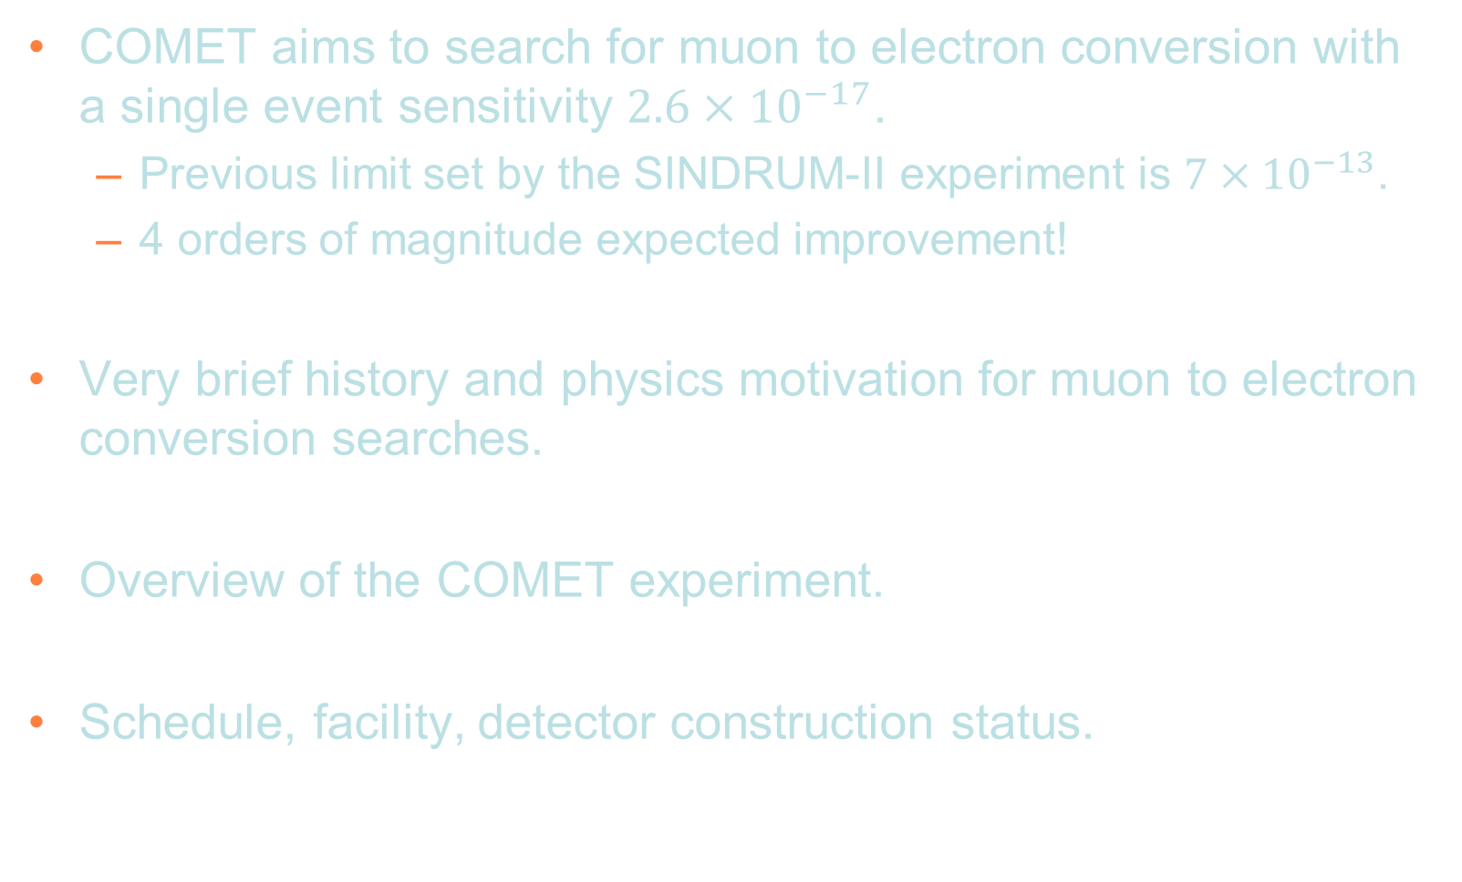
Introduction
COMET aims to search for muon to electron conversion with a single event sensitivity $2.6×{10}^{−17}$.
  Previous limit set by the SINDRUM-II experiment is $7×{10}^{−13}$.
  4 orders of magnitude expected improvement!
Very brief history and physics motivation for muon to electron conversion searches.
Overview of the COMET experiment.
Schedule, facility, detector construction status.

Slide 3
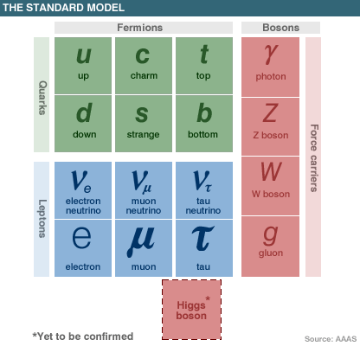
Why Charged Lepton Flavour Violation?
We know the SM is at best incomplete.
  Does not include gravity.
  Certain predictions diverge with energy.
Neutrinos in the SM are massless but observation of neutrino oscillations is direct evidence that neutrinos have mass.
  First observation from Super Kamiokande, proof of
  non-conservation of neutral lepton flavour number.
  → Possibility of Charged Lepton Flavour Violation.
Some muon processes that could be studied
  μ⁻ → e⁻ γ
  μ⁻ → e⁻ e⁺ e⁻
  μ⁻ (A,Z) → e⁻ (A,Z)
Single particle final state can make best use of high intensity muon beams.
?
?
  Muon to electron conversion.
Notes:
alpha_s blows up at low energies (or at large distances)

Slide 4
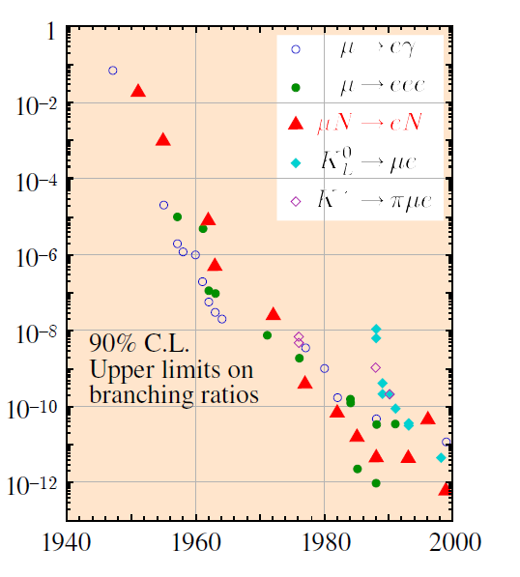
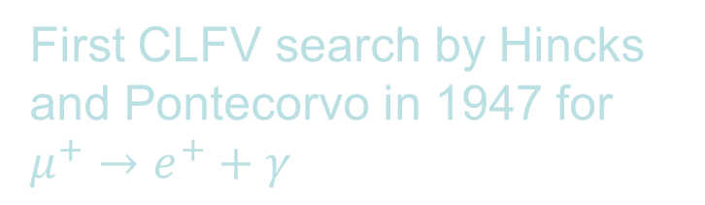
Brief History of CLFV Searches
First CLFV search by Hincks and Pontecorvo in 1947 for $μ^{+}→e^{+}+γ$
World’s best limit on the muon to electron conversion branching ratio is 7x10⁻¹³ by the SINDRUM II collaboration.
Single event sensitivity of COMET is 2.6x10⁻¹⁷.

Slide 5
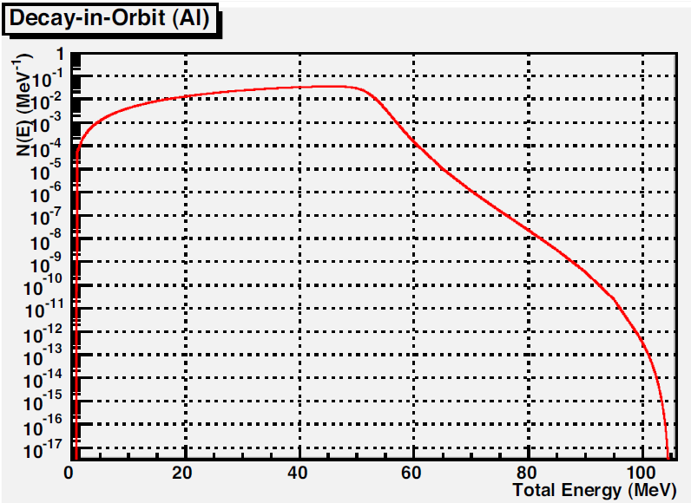

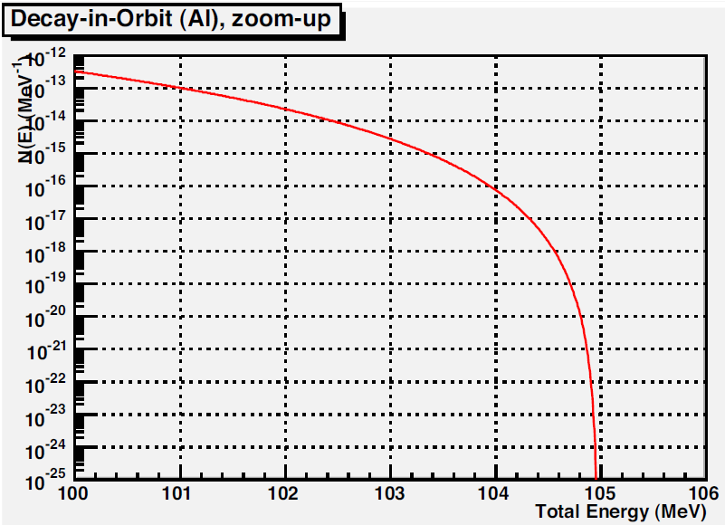


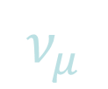





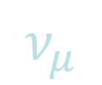
Searching for Muon to Electron Conversion
Look for neutrino-less conversion of a muon into an electron in the presence of a nucleus.
Stop muons in a Al target → muonic atoms.
  Bound muon lifetime depends on Z (for Al 864ns)
  SM processes produce intrinsic backgrounds.
  Nucleus coherently recoils off outgoing electron, no breakup.
  BSM processes can lead to conversion.
  Electron energy depends on Z (for Al, E_{e} = 105 MeV)
$$e^{−}$$
Al
$$ν_{μ}$$
DECAY IN
ORBIT
Decay in orbit
BR~40%
$${\overline{ν}}_{e}$$
$$μ^{−}$$
Al
Al
$$e^{−}$$
CONVERSION
SIGNAL
Muon to electron conversion. BR<10⁻¹³
$$γ$$
$$n$$
DECAY IN
ORBIT
Mg*
Nuclear capture
BR~ 60%
$$p$$
$$ν_{μ}$$

Slide 6
Sensitivity to Different Mechanisms
If we include neutrino mixing in the SM, the probability for muon to electron conversion is <10⁻⁵²
  Sensitive to physics beyond the SM.
mixing
Q(m_{ν} /m_{W})⁴
ν_{μ}
ν_{e}
μ
e
W
Notes:
Different models. Different predictions. SM value very small, clear indication of new physics. In order to achieve this we need …

Slide 7
The COherent Muon to Electron Transition (COMET) Experiment

Slide 8


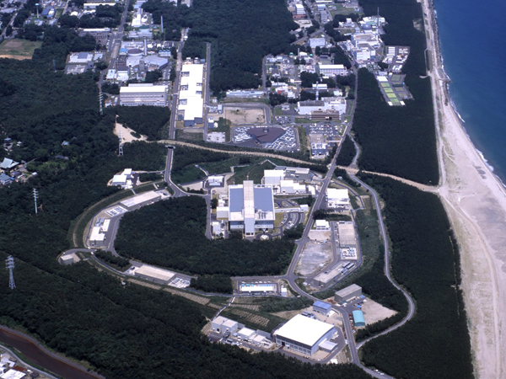











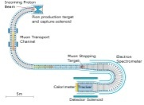



COMET
Accelerator-Driven Transmutation Experimental Facility
Linac
Neutrino Facility
3 GeV Synchrotron
Materials and Life Science Facility
Main Ring (30 GeV Synchrotron)
Hadron Experimental Facility
COMET
Based at J-PARC, Japan.
176 Collaborators, 33 Institutes, 15 Countries.

Slide 9
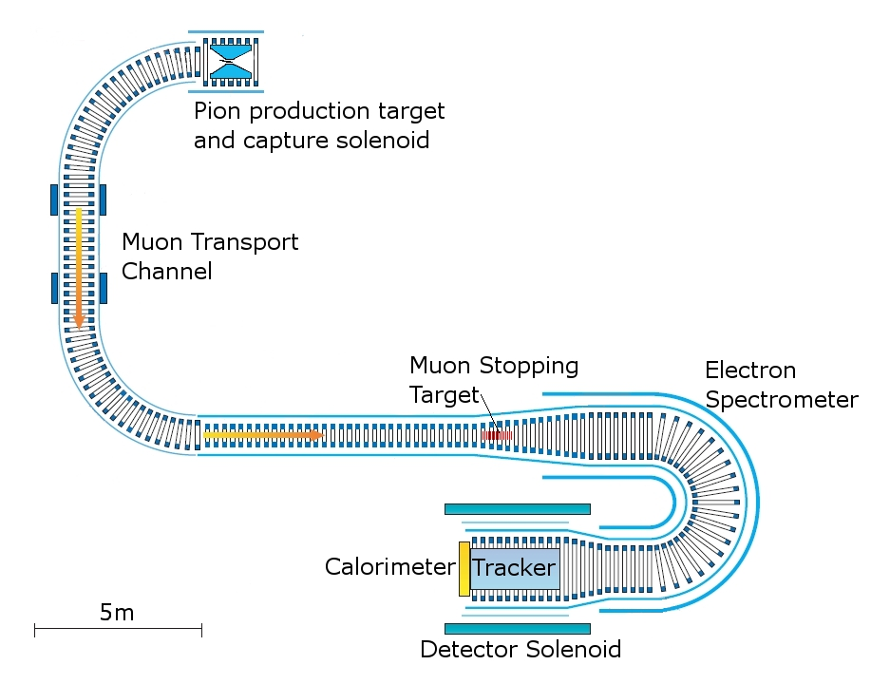
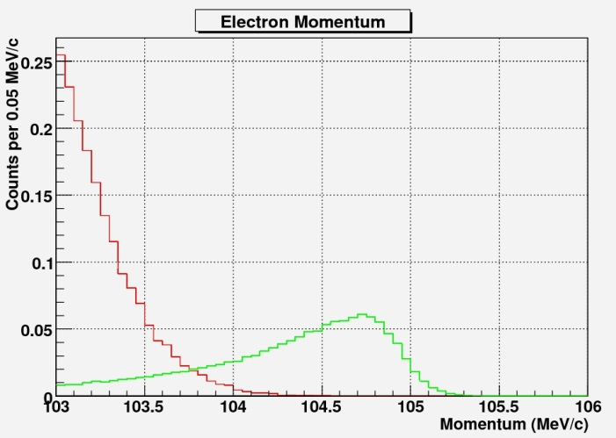
COMET
8GeV Proton beam
Pions
Muons
Electrons

Slide 10
Two Stage approach
Allows beam characterisation.
  COMET has a long continuous solenoid channel with little space for beam diagnostic devices.
    Beam emittance.
    Particle composition is very important for understanding backgrounds.
  Potential field bumps can lead to late arriving particles.
    Look at arrival time distribution.
Simulation validation.
  Large variations of the pion and muon yield depending on hadron production model.
  Field map tracking.
    Compare tracking field maps with measurements
      Effect of adjusting fields on beam composition.
Detector prototype testing with high intensity, large emittance muon beam.

Slide 11
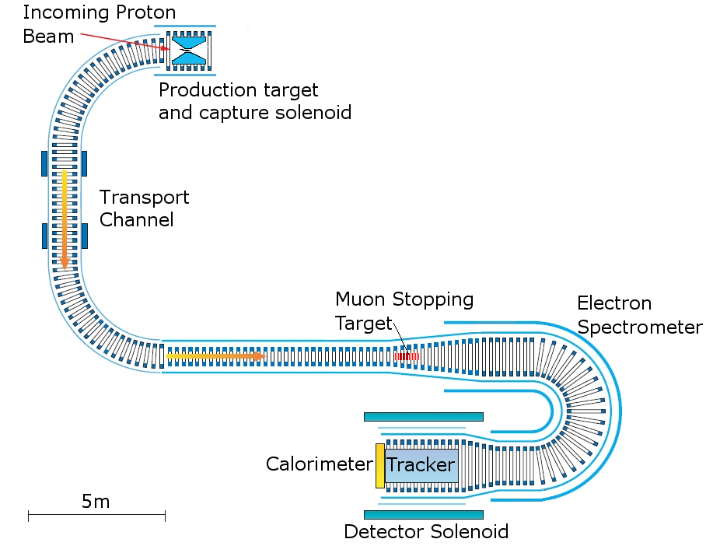
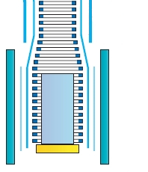
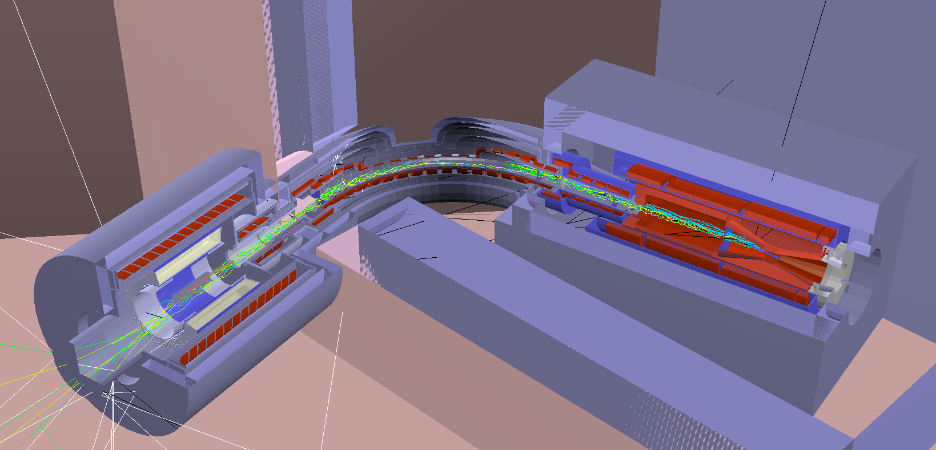
COMET Phase-I
3kW, 8GeV proton beam. Graphite target.
Allows for testing experimental method.
Sensitivity of 3x10⁻¹⁵
  90 days running.
Detector

Slide 12
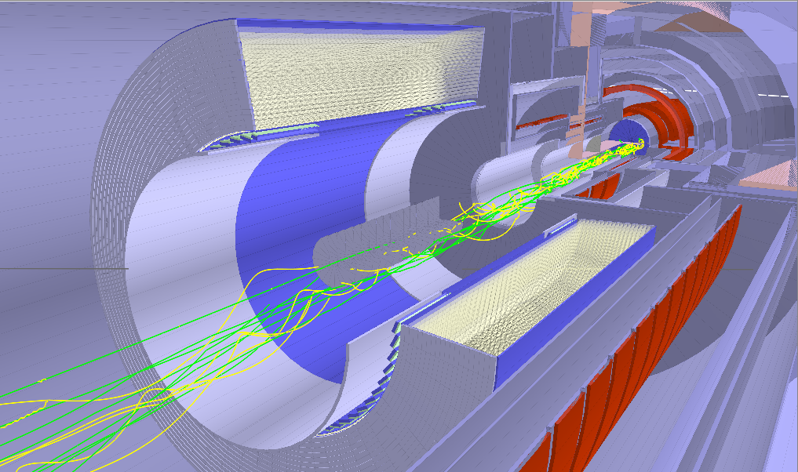
COMET Phase-I
Muon to electron conversion search using a cylindrical drift chamber.
Detector
Stopping
target
Cylindrical drift chamber

Slide 13
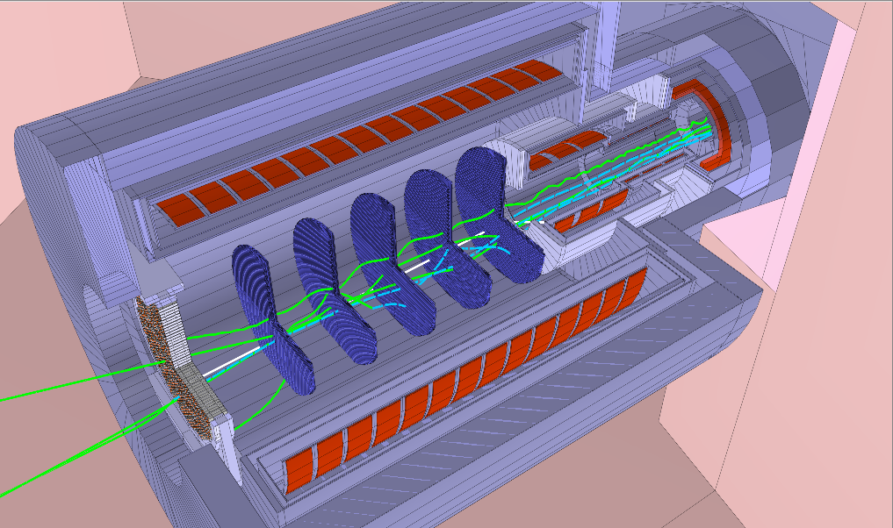
COMET Phase-I
Straw tracker and calorimeter (Phase-II detector) test.
Beam characterisation.
Detector
Straw tracker
plane
Crystal
Calorimeter

Slide 14
COMET Phase-II
56kW, 8GeV proton beam. Tungsten target.
Sensitivity of 2.6x10⁻¹⁷
  2x10⁷s running.
Electron spectrometer reduces rate in the detectors.
Longer transport channel reduces pion rate.

Slide 15
Backgrounds and How They are Minimised

Slide 16
Background Sources
Intrinsic backgrounds
  Muon decay in orbit.
    Electron recoil off nucleus → endpoint is near 105MeV.
  Radiative muon capture
    μ- +A → A’ + ν + γ
    μ- +A → A’ + ν + n
    μ- +A → A’ + ν + p
Prompt, beam related backgrounds.
  Muon decay in flight.
    If P>75MeV/c can yield signal like electron.
  Radiative pion capture
    π- + A → A’ + γ
  Electrons, neutrons, anti-protons.
Scattered electrons, cosmic rays and neutron induced backgrounds.

Slide 17
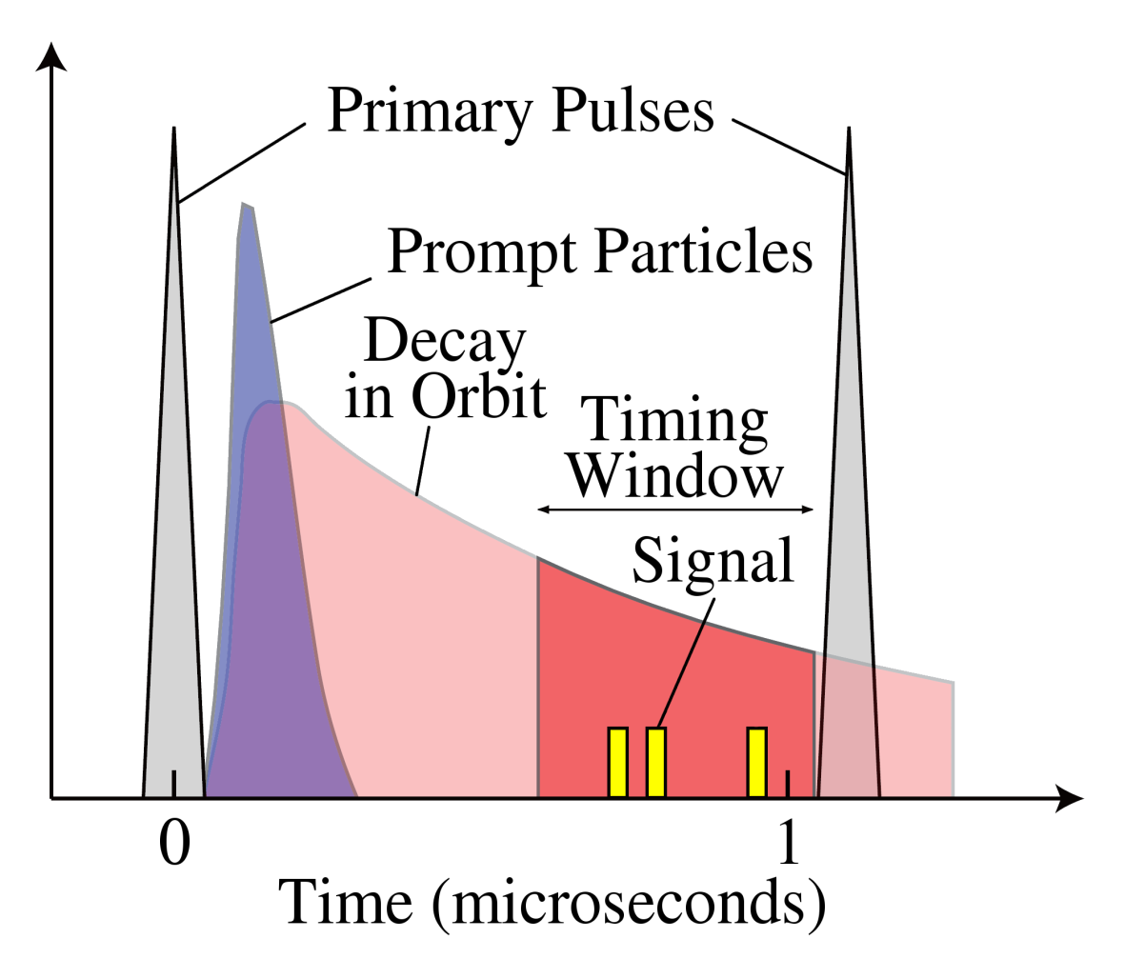
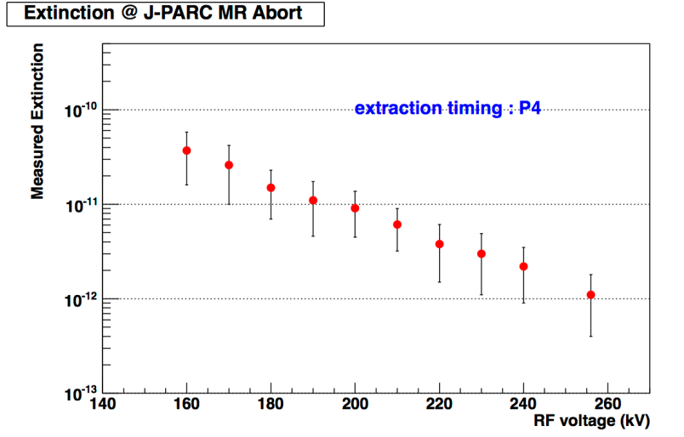
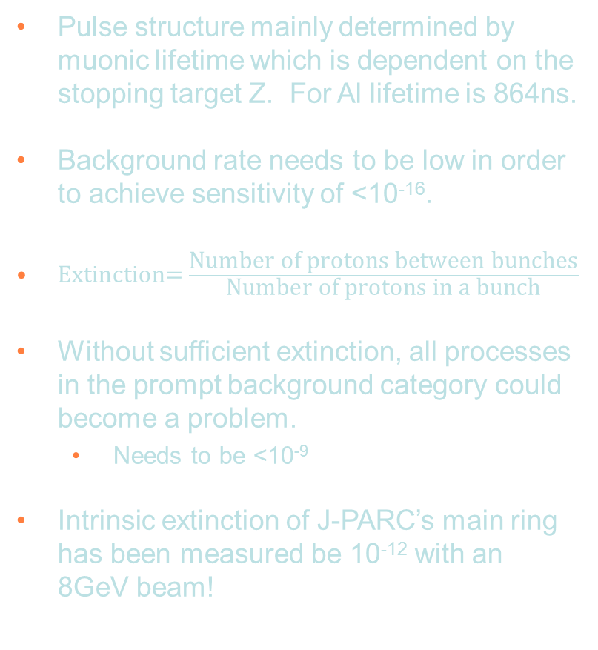
Pulsed Proton Beam
Pulse structure mainly determined by muonic lifetime which is dependent on the stopping target Z. For Al lifetime is 864ns.
Background rate needs to be low in order to achieve sensitivity of <10⁻¹⁶.
$\text{Extinction}\text{=}\frac{\text{Number} \text{of} \text{protons} \text{between} \text{bunches}}{\text{Number} \text{of} \text{protons} \text{in} \text{a} \text{bunch}}$
Without sufficient extinction, all processes in the prompt background category could become a problem.
  Needs to be <10⁻⁹
Intrinsic extinction of J-PARC’s main ring has been measured be 10⁻¹² with an 8GeV beam!
100ns

Slide 18
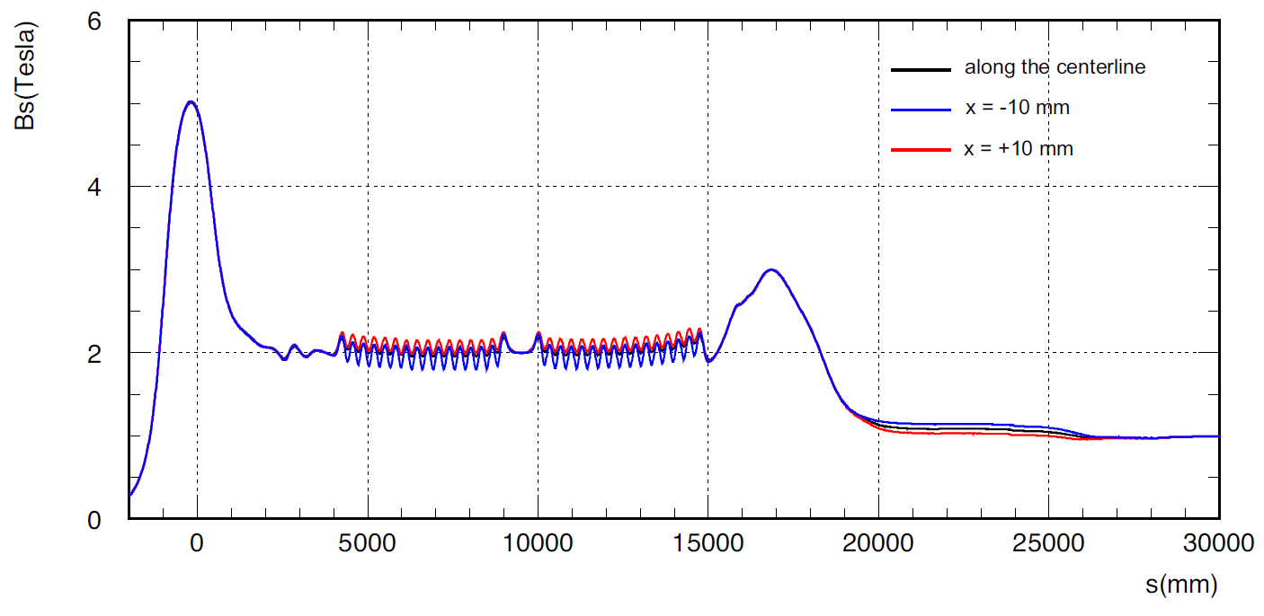
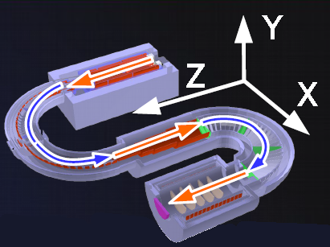
Charge and Momentum Selection
Continuous superconducting solenoid channel from 5T to 1T.
Bent solenoid allows selection of charge and momentum.
  $$drift= \frac{1}{qB}\left(\frac{s}{R}\right)\frac{P_{L}^{2}+\frac{1}{2}P_{T}^{2}}{P_{L}}$$

Slide 19
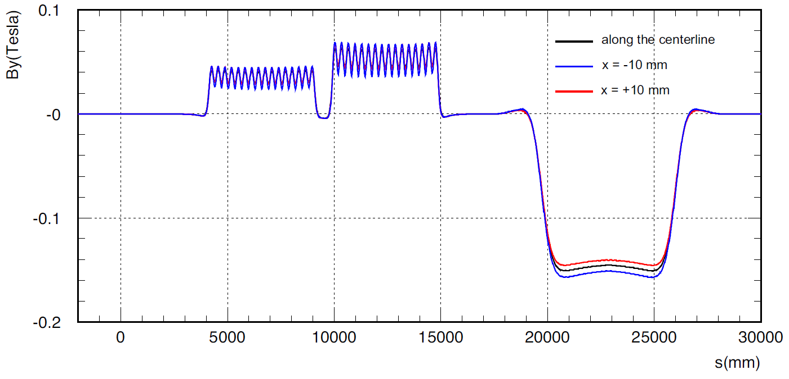

Charge and Momentum Selection
Use a vertical dipole field to keep P=40MeV/c muons on axis.
  $$B_{comp}= \frac{1}{qR}\frac{P_{L}^{2}+\frac{1}{2}P_{T}^{2}}{P_{L}}$$

Slide 20
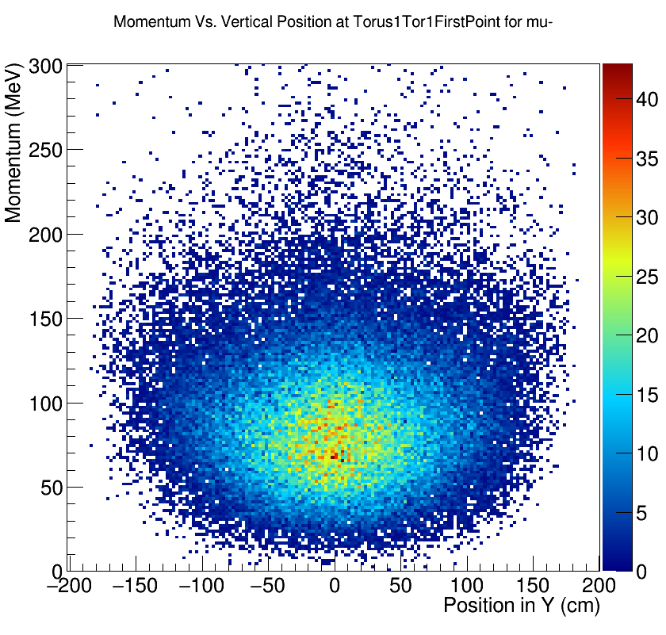
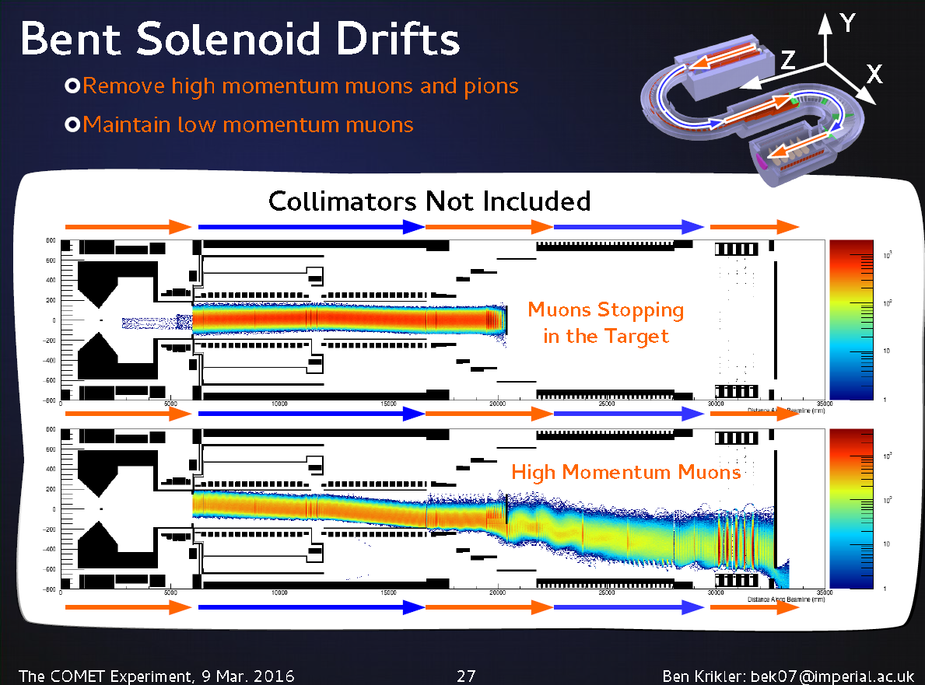
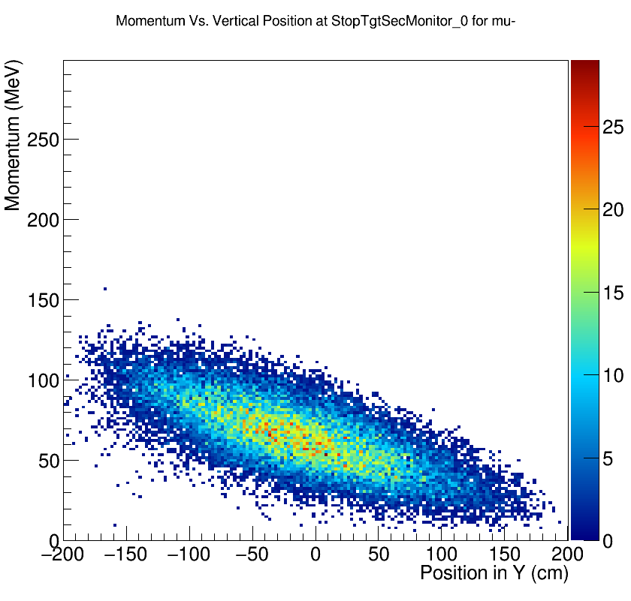
Charge and Momentum Selection
At the entrance of the bent solenoid
At the exit of the bent solenoid

Slide 21
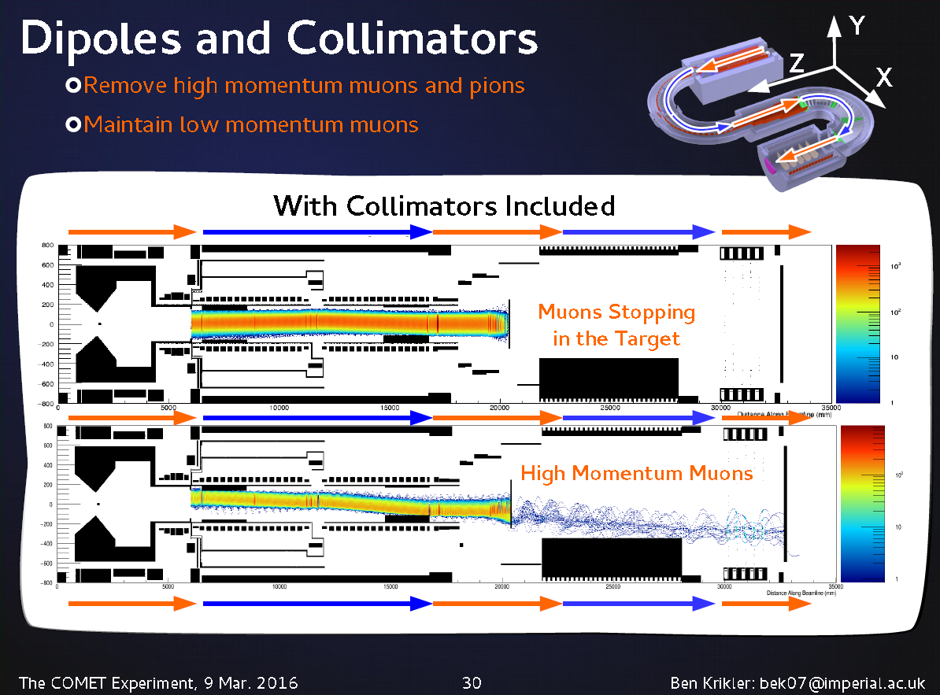
Charge and Momentum Selection

Slide 22
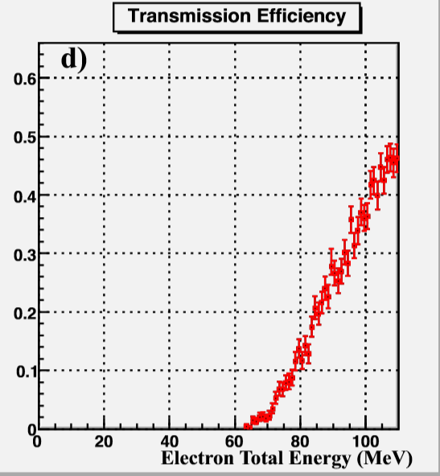
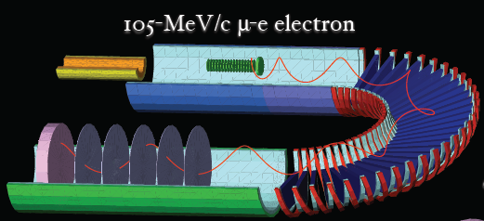
Electron Spectrometer
180$°$ bent 1T solenoid with a 0.17T dipole field.
Vertical dispersion of toroidal field allows electrons with P<60MeV/c to be removed.
  reduces trigger rate to ~1kHz.

Slide 23
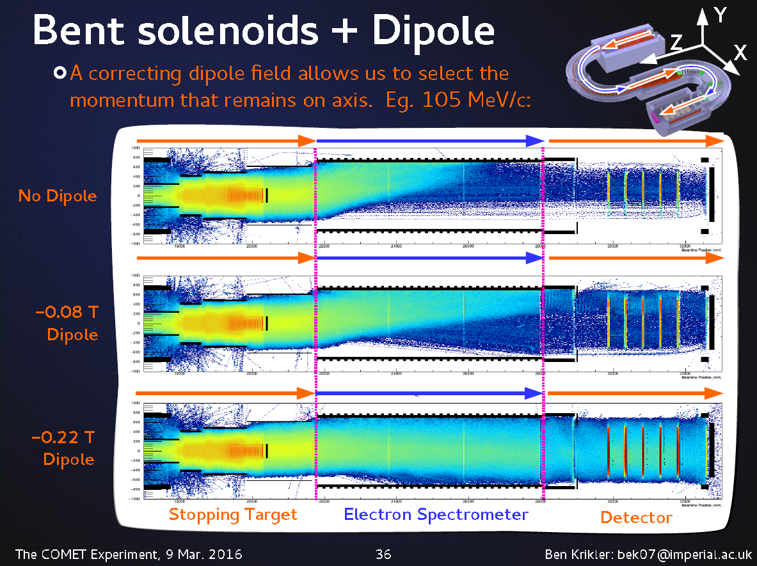
Electron Spectrometer

Slide 24
Facility and Detector Construction Status

Slide 25
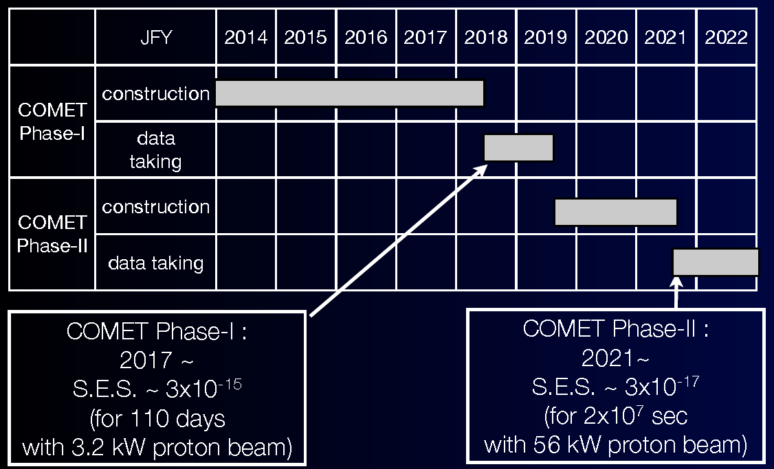
Schedule

Slide 26
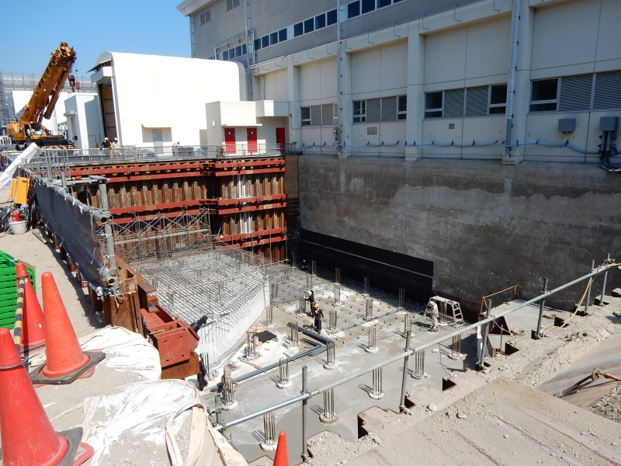
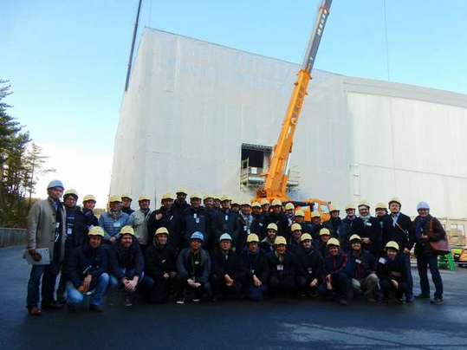
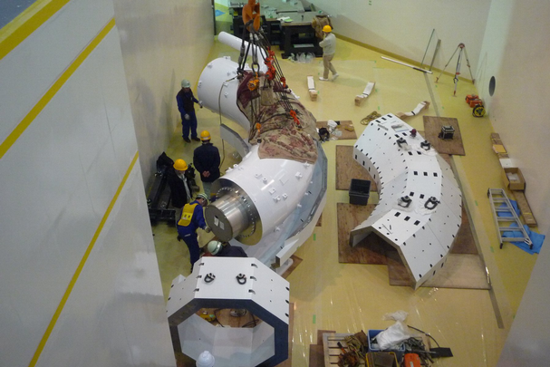
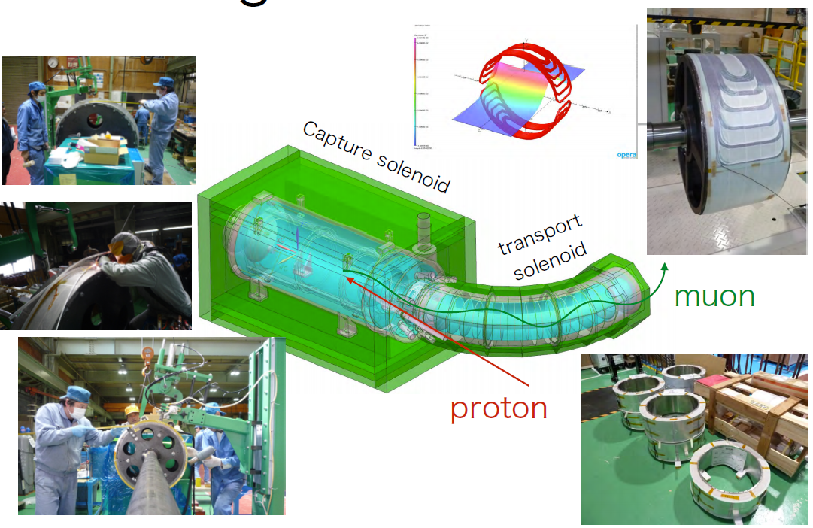
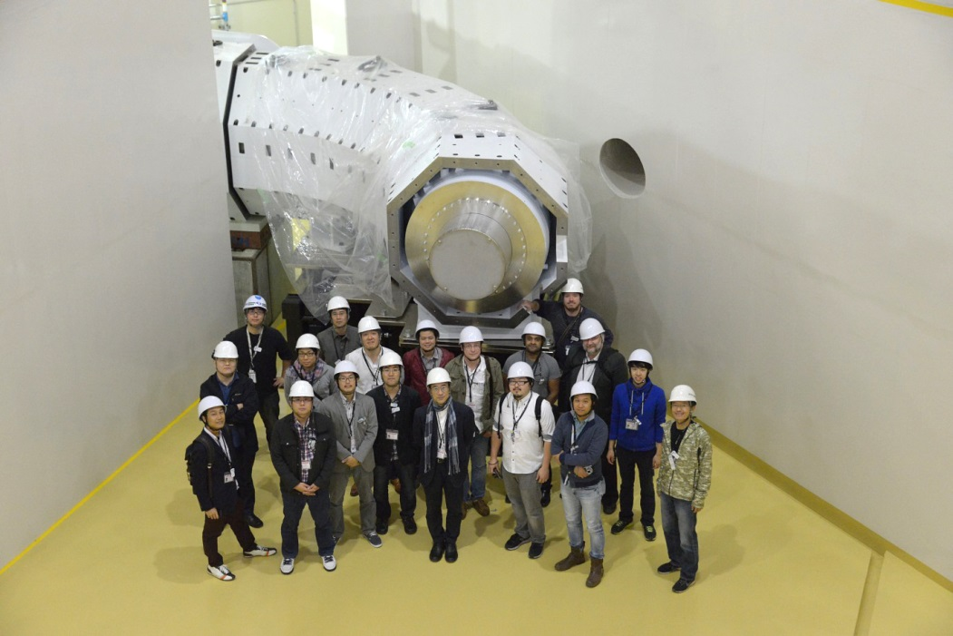
Facility and Magnet Construction
AUGUST 2014
MARCH 2015
JANUARY 2015
Integration Workshop October 2015

Slide 27
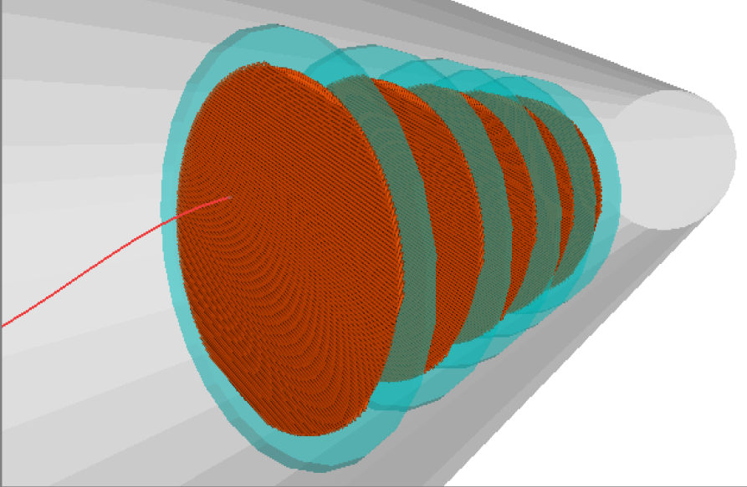
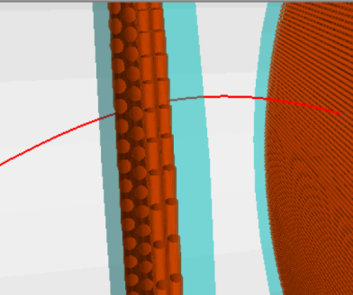
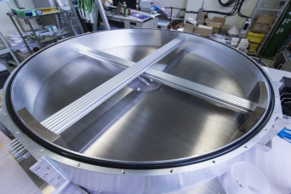
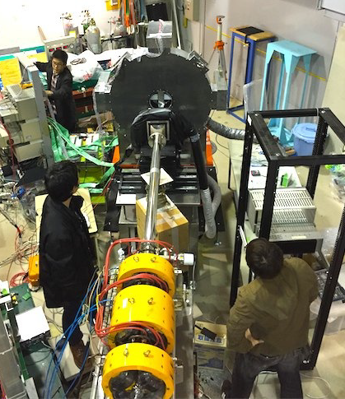
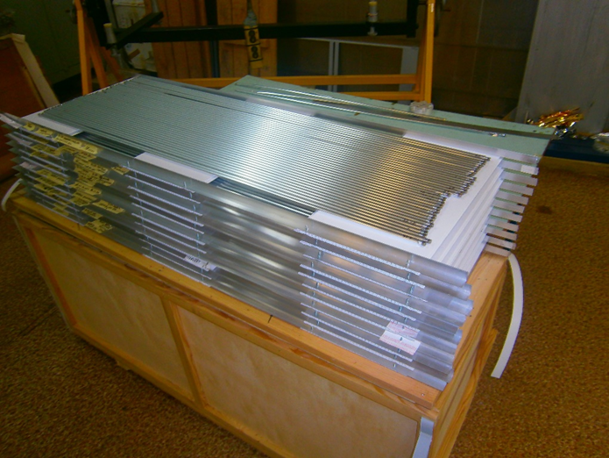
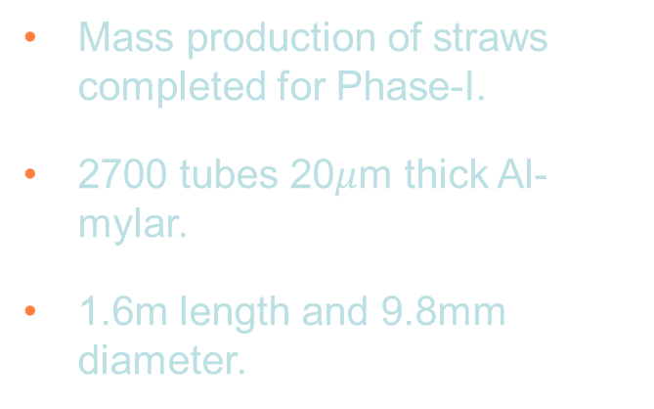
Straw Tracker Prototyping and Testing
Requirements
  operate in a 1T solenoid field.
  operate in vacuum (to reduce multiple scattering of electrons).
  800kHz charged particle rate and 8MHz gamma rates.
  0.4% momentum and 700μm spatial resolution.
5 planes 48cm apart with 2 views (x and y) per plane and 2 layers per view (staggered by one straw radius).
Gas filled straw tubes made from metalised polyimide with a gold coated tungsten anode wire.
Mass production of straws completed for Phase-I.
2700 tubes 20$μ$m thick Al-mylar.
1.6m length and 9.8mm diameter.
Prototype tests in December 2015

Slide 28
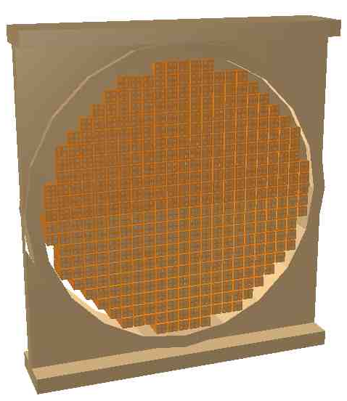
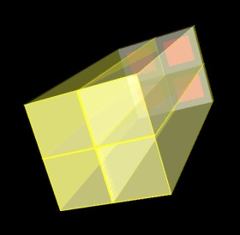
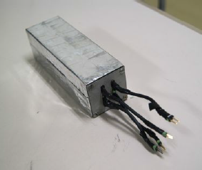
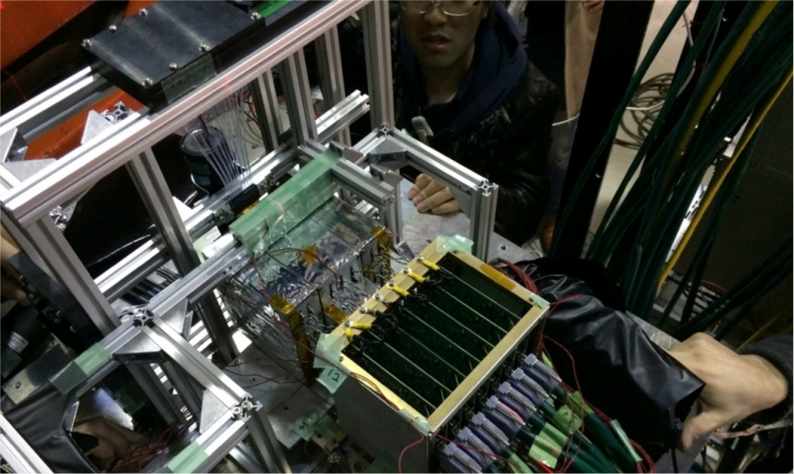
Calorimeter
Prototype 2x2 crystal module wrapped with teflon and Al-mylar and 4 APDs.
2x2 crystal module
Requirements
  Measure energy, PID and give additional position information. Can be used to make a trigger decision.
  5% energy and 1cm spatial resolution at 100MeV.
  Operation in 1T magnetic field.
Inorganic scintillator Lutetium Yttrium Orthosilicate (LYSO).
APD photo detector with a custom pre-amp.
Beam tests in Tohoku March 2014.
Prototype module built including vacuum vessel and feedthroughs for readout.
Integrated beam test with the straw tracker March 2016.
e⁻
Crystals
APDs
PreAmps

Slide 29
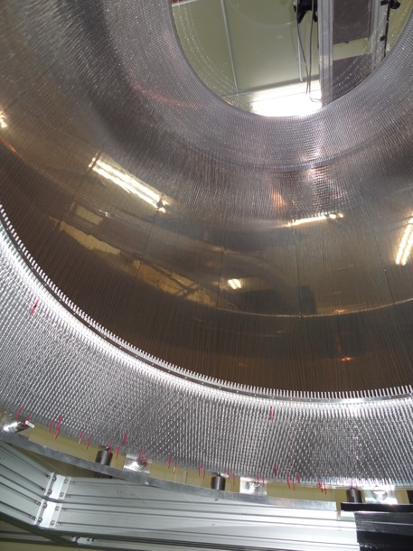
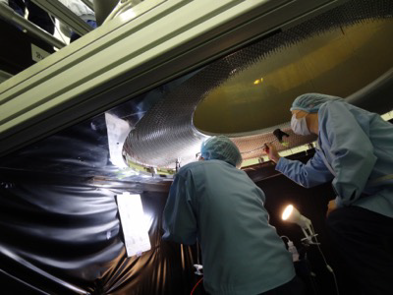
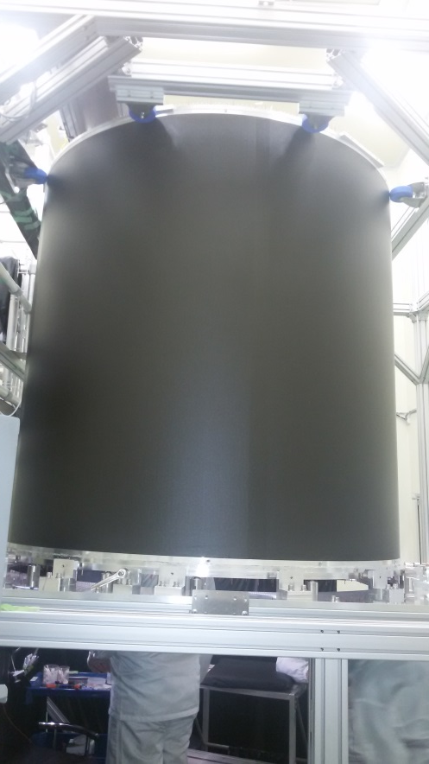

CDC Construction
DECEMBER 2015
Stringing complete.
Tensioning tests ongoing.
Mass production of the front-end boards completed.

Slide 30
Summary
COMET will search for muon to electron conversion with a single event sensitivity 10⁴ better than the current limit!
  Model independent probe of BSM physics.
The COMET facility and detector construction is well underway with data taking to start in 2018.
  Phase-I will search for muon to electron conversion with a single event sensitivity of 3x10⁻¹⁵.
  Phase-I will be the World’s most intense muon beam facility and is the best place to test the Phase-II detector prototypes.
  Experience with Phase-I (especially beam and beam line characterisation) will be used to fine tune Phase-II (if needed!).
  Phase-II will start data taking in 2021.

