Slide 1



Boosting Higgs Pair Production in the $b\overline{b}b\overline{b}$ Final State with Multivariate Techniques
Çiğdem İşsever
based on Behr, Bortoletto, Frost, Issever, Hartland, Rojo, arxiv:1512.08928

Slide 2
Probing electroweak symmetry breaking
Higgs mechanism
  Postulated shape of potential completely ad-hoc, no first principles
  It works, but highly unsatisfactory
  Other EWSB mechanisms conceivable
Current measurements
Di-Higgs production
Arkani-Hamed, Han, Mangano, Wang, arxiv:1511.06495
Notes:
Current measurements probe Higgs potential close to minimum
2H-production essential to probe full potential and clarify EWSB

Slide 3
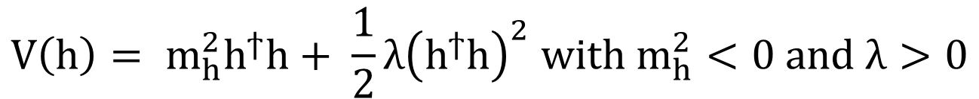
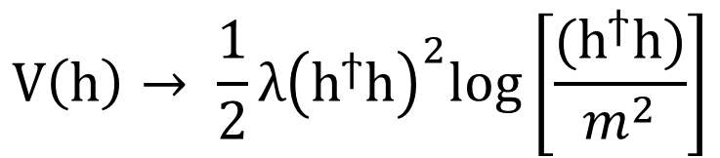
Alternative EWSB Mechanisms
Higgs mechanism:
Alternative: negative quadric ↔ positive sextic
Alternative: Coleman-Weinberg
$$V\left(h\right)= m_{h}^{2}h^{ϯ}h+ \frac{1}{2}λ{\left(h^{ϯ}h\right)}^{2} with m_{h}^{2}<0 and λ>0$$
Arkani-Hamed, Han, Mangano, Wang, arxiv:1511.06495
$$V\left(h\right)→ m_{h}^{2}h^{ϯ}h+ \frac{1}{2}λ{\left(h^{ϯ}h\right)}^{2}+ \frac{1}{3!Λ^{2}}{\left(h^{ϯ}h\right)}^{3} with λ<0$$
$$V\left(h\right)→ \frac{1}{2}λ{\left(h^{ϯ}h\right)}^{2}log\left[\frac{{(h}^{ϯ}h)}{m^{2}}\right]$$
Each leads to different EWSB mechanism,
with crucial implications for the hierarchy problem,
the structure of quantum field theory,
and New Physics at the EW scale

Slide 4


Alternative EWSB Mechanisms
Higgs mechanism:
Alternative: negative quadric ↔ positive sextic
Alternative: Coleman-Weinberg
Leading differences show up in the cubic Higgs self-coupling
$$λ_{HHH}^{SM}=3\left(m_{H}^{2}/v\right)$$
Arkani-Hamed, Han, Mangano, Wang, arxiv:1511.06495
$$λ_{HHH}=7\left(m_{H}^{2}/v\right)=\left(7/3\right)λ_{HHH}^{SM}$$
$$λ_{HHH}=\left(5/3\right)λ_{HHH}^{SM}$$

Slide 5
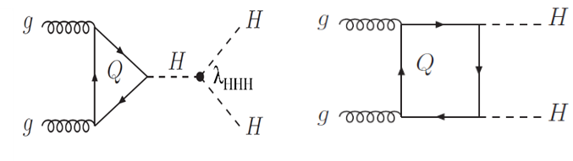
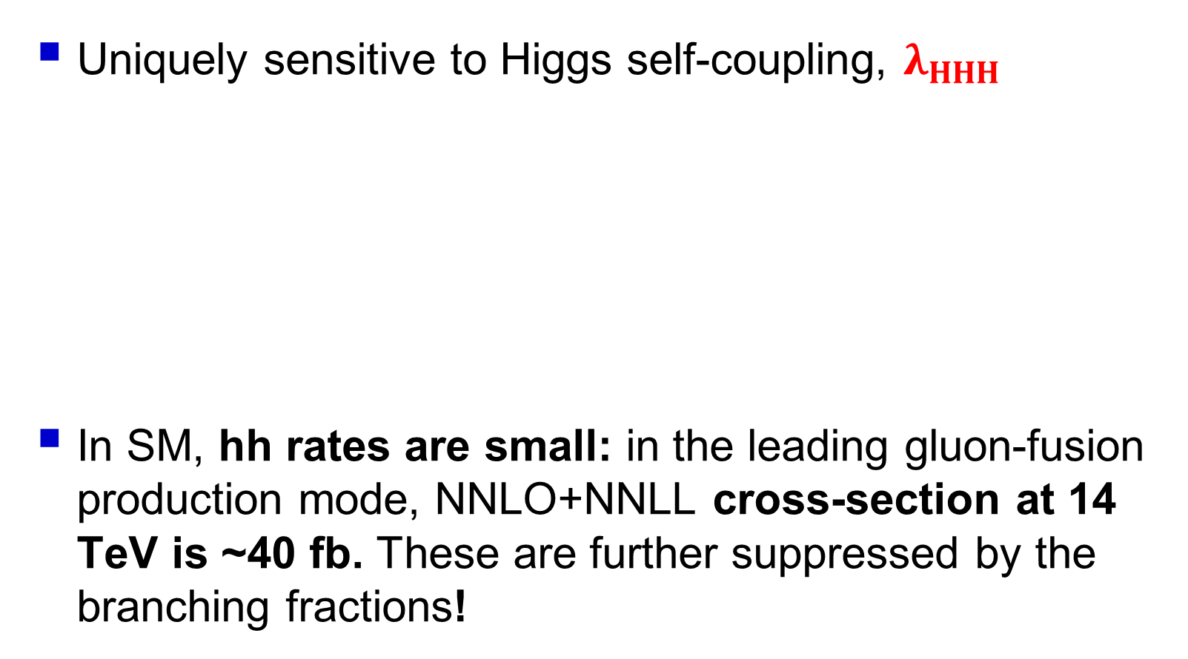
Importance of Higgs Pair Production
Uniquely sensitive to Higgs self-coupling, $λ_{HHH}$
In SM, hh rates are small: in the leading gluon-fusion production mode, NNLO+NNLL cross-section at 14 TeV is ~40 fb. These are further suppressed by the branching fractions!

Slide 6
Pros and Cons of $b\overline{b}b\overline{b}$ final state
Pros: largest branching ratio: BR(H → bb) ~ 0.57
Cons: Huge QCD multi-jets background
  Previous studies: S/√B ~ 2 @ HL-LHC (no PU, missing relevant backgrounds)
arXiv:1307.1347 and
PDG

Slide 7
Analysis Strategy
[arxiv:1512.08928], submitted to EPJC
Multivariate + loose cut based analysis techniques
Use all di-Higgs decay topologies
Model pile-up (PU) effects: 80 (baseline) and 150
Include all relevant backgrounds, esp. 2b2j

Slide 8

Higgs identification (tagging)
Separation of b-jets shrinks: $∆R(b,\overline{b)}\sim 2m^{H}/p_{T}^{H}$
  → Single large-R jet for $p_{T}^{H}>250 GeV$
Resolved Higgs
2 AKT4 jets p_{T} > 40 GeV and |η| < 2.5
Merged Higgs
1 AKT10 jet p_{T} > 200 GeV, |η| < 2.5 Higgs tagging: BDRS mass-drop tagger [arxiv:0802:2470]
b-tagging efficiencies
b-jet: f_{b}=0.8 c-jet: f_{c}=0.1 light-jet: f_{l}=0.01
Large-R jet b-tagged if two associated b-tagged small-R jets
Notes:
Sub-jets of the large-R jets are AKT3 which are ghost associated to large-R jet. With pT > 50 GeV and |eta| < 2.5
BDRS mass-drop tagger uses mu_mdt = 0.67 and y_mdt = 0.09, default fastjet settings. Constituents of large R jets are re-clustered with CA 1.0 before MDT.

Slide 9
Higgs Topologies
≥ 4 b-tagged small-R jets | =1 large-R jet (b- and Higgs tagged) ≥ 2 b-tagged AKT4 jets ΔR>1.2 w.r.t large-R jet | ≥ 2 b- and Higgs tagged large-R jets
Di-Higgs reconstructed from 4 leading jets | Higgs reconstructed from 2 leading small-R jets | Leading 2 jets taken as Higgs candidates
Minimize mass difference between dijet systems | Minimize mass difference between dijet system and large-R jet
Notes:
Resolved, intermediate: We attempt to b-tag the four (two) hardest small-R jets in the resolved (intermediate) regime. Attempting to b-tag all of the small-R jets that satisfy the acceptance cuts worsens the overall performance as the probability of fake b-tags increases substantially.

Slide 10

Higgs Topologies
Rank categories by S/√B to make them exclusive: Resolved < Intermediate < Boosted Loose mass cut: $\left|m_{H}−125 GeV\right|<40 GeV$
Notes:
Resolved, intermediate: We attempt to b-tag the four (two) hardest small-R jets in the resolved (intermediate) regime. Attempting to b-tag all of the small-R jets that satisfy the acceptance cuts worsens the overall performance as the probability of fake b-tags increases substantially.

Slide 11
Pre-MVA distributions
Resolved, no PU
Boosted, no PU
Low threshold triggers needed
0 100 200
200 400 600
akt4 p_{T} [GeV]
akt10 p_{T} [GeV]
60 100 140 m_{H} [GeV]
60 100 140 m_{H} [GeV]

Slide 12
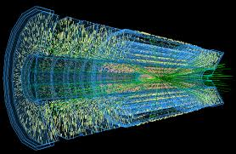
Pile-Up modelling
Up to 150 interactions per bunch-crossing @ HL-LHC
Impact on signal significance:
  Additional (hard) jets in reconstruction
  Affects mass and substructure of large-R jets
Not taken into account in previous studies
~140 collisions/bunch crossing

Slide 13
Pile-Up modelling and mitigation
Superimpose n(PU) = 80 Minimum Bias events on each signal/background event
  Similar results for PU = 150
Pile-up mitigation
  Event level: Remove soft particles using SoftKiller [arXiv:1407.0408]
  Jet level: Apply trimming [arXiv:0912.1342] (large-R jets only)
R_{sub}=0.2
f_{cut}=5%

Slide 14
Impact of Pile-up on Higgs mass reconstruction
No PU:
~ 9 GeV
80 PU:
~ 11 GeV
No PU:
~ 9 GeV
80 PU:
~ 9 GeV

Slide 15
Boosted with 80 PU + Softkiller + Trimming
Leading large-R jet p_{T}
Leading akt03 jet p_{T}
200 350 450 p_{T} [GeV]
100 200 300 400 p_{T} [GeV]
Leading Higgs subjettiness ratio
0.0 0.2 0.4 0.6 0.8 τ_{2/1}
0.0 40 80 √d₁₂ [GeV]

Slide 16
Pre-MVA 2b2j background -- BIG
4b 2b2j 4j
b-quark radiation in parton shower
→ non-negligible fraction of 2b2j events with ≥ 2 b-jets
Additional light jets from parton shower
→ Not all of the 4 leading jets in 4b events are b-jets
Good control of light and charm jet fake rates impotant!

Slide 17
Multivariate Analysis Techniques
Multi-layer feed-forward artifical neural net (ANN) - perceptron
ANN for boosted category,
heat map after training: red (dark) high (low) weight
Input variables
13 resolved
17 intermediate
21 boosted
5 x 3 x 1
Background
Signal
Trained on signal & background
Separately for the 3 categories

Slide 18
Signal, resolved, no PU
QCD 4b, resolved, no PU
Leading akt04 b-jet p_{T}
M_{H} leading Higgs

Slide 19
S/√B post-MVA results
S/√B
ANN output cut

Slide 20
Post-MVA results for HL-LHC (3 ab⁻¹)
1) Combination of ALL categories important
2) 2b2j background has significant impact

Slide 21
Post-MVA results for HL-LHC (3 ab⁻¹)
Observation with just 4b channel seems possible!

Slide 22
Conclusions
Di-Higgs production corner stone of LHC program
Presented new feasibility study of 2H → bbbb
  MVA based and combination of all di-Higgs topologies
  1st time:
    pile-up modelled (PU = 80 and PU = 150)
      Results are stable under PU with mitigation
    2b2j and 4j backgrounds included
      Light and charm quark fake rate reduction important
    Low pt trigger thresholds important for resolved regime
  4b final state alone enough to claim evidence for 2H process at HL-LHC
  If experimental performance improved 2H process observation with just 200 – 300 fb⁻¹ possible.

Slide 23
Outlook
Include Z→bb, ttH and HZ backgrounds
Add more statistics to QCD backgrounds
Estimation of accuracy of Higgs self-coupling measurement at LHC, HL-LHC, 100 TeV FCC collider

Slide 24
Backup Slides

Slide 25
Pre-MVA cut-flow

Slide 26
Pre-MVA 2b2j background -- BIG

Slide 27
Background and signal relative fractions

Slide 30
Post-MVA ROC curve and number of events

Slide 31
MVA Analysis

Slide 32
MVA

Slide 33
Pre-MVA distributions

