Slide 1

Monitoring and Data Acquisition for Future Linear Collider Experiments
Fabrizio Salvatore, University of Sussex

Slide 2
Outline
Moving towards the future of High Energy Collider Physics
  Linear Collider projects – ILC and CLIC
  Circular Collider Projects – FCC (ee, he, ee) and CEPC
  Generic R&D for future collider experiments
    CALICE calorimeter prototypes
Monitoring & DAQ for future colliders – the DQM4hep project

Slide 3
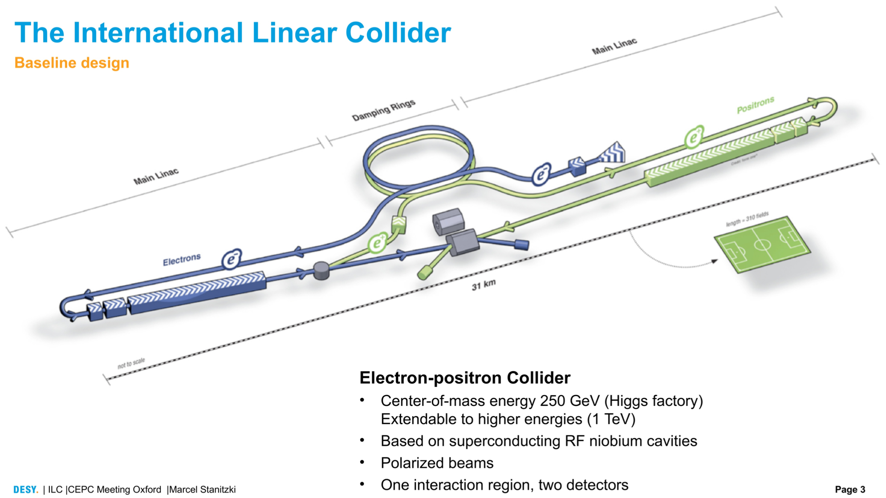
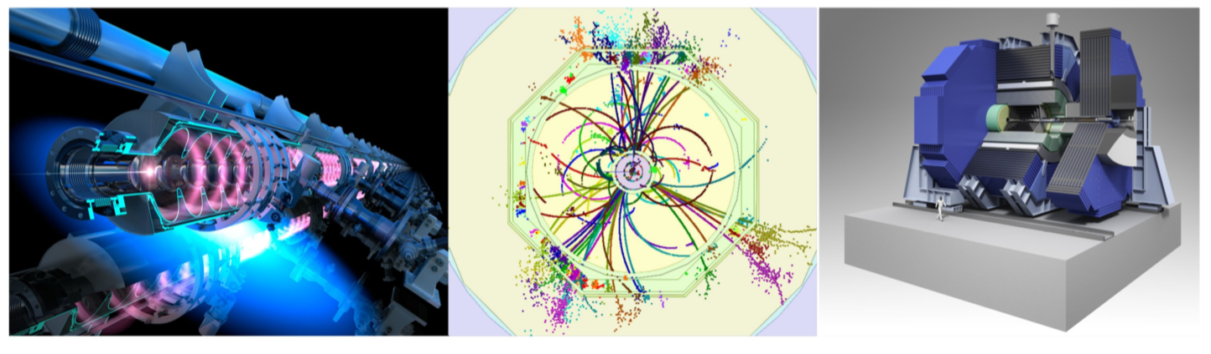

Slide 4
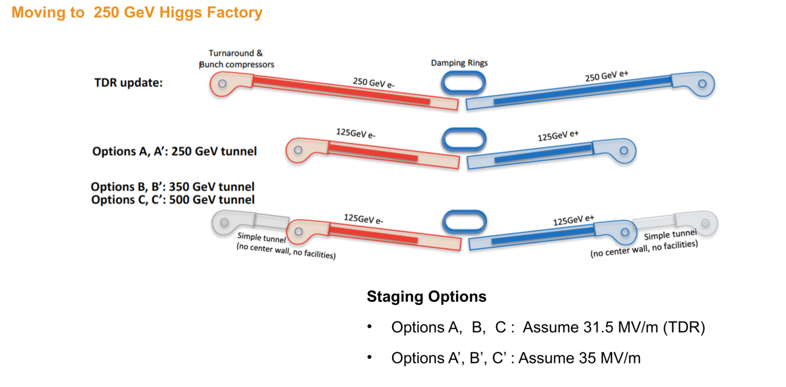

Slide 5
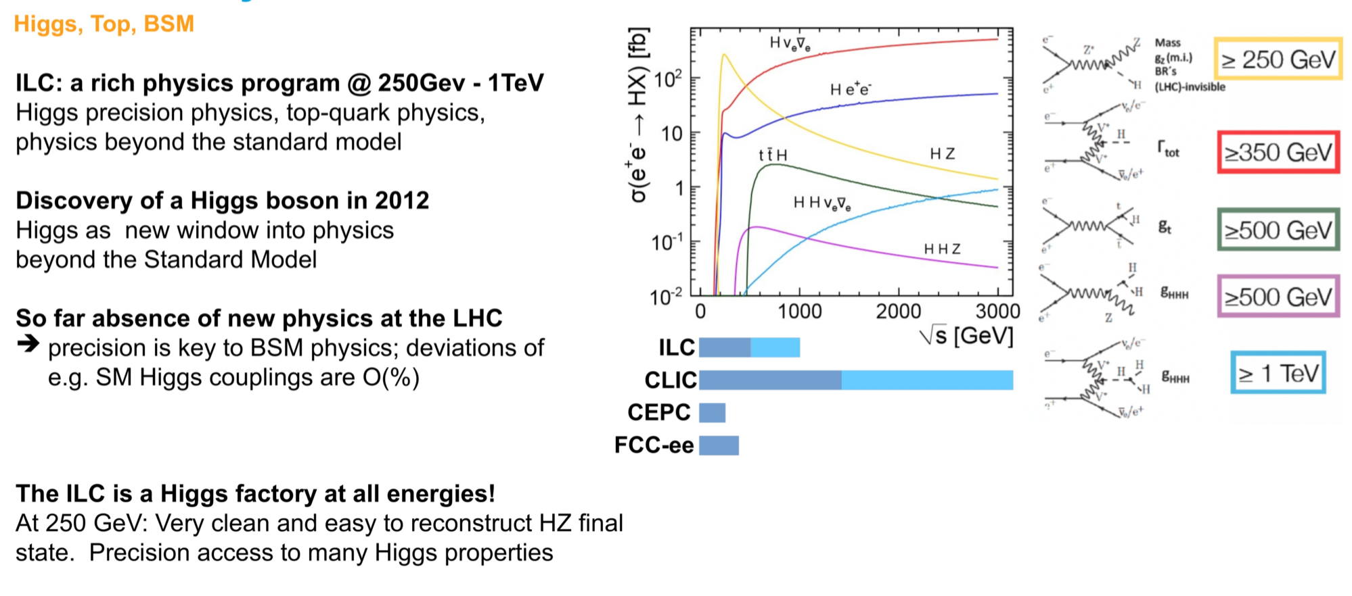
The ILC Physics Case

Slide 6
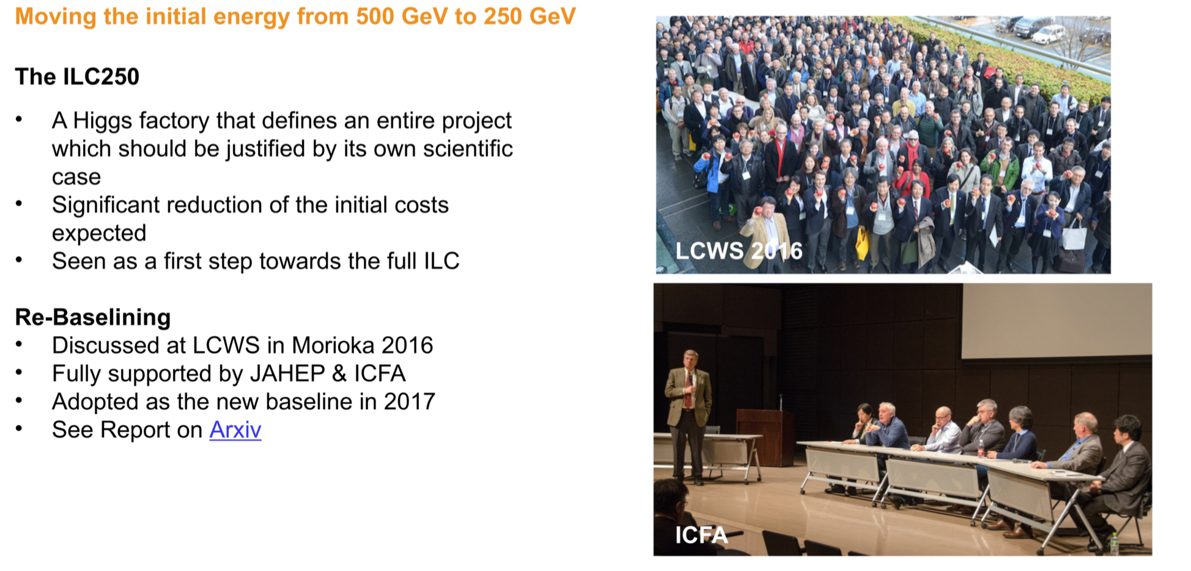
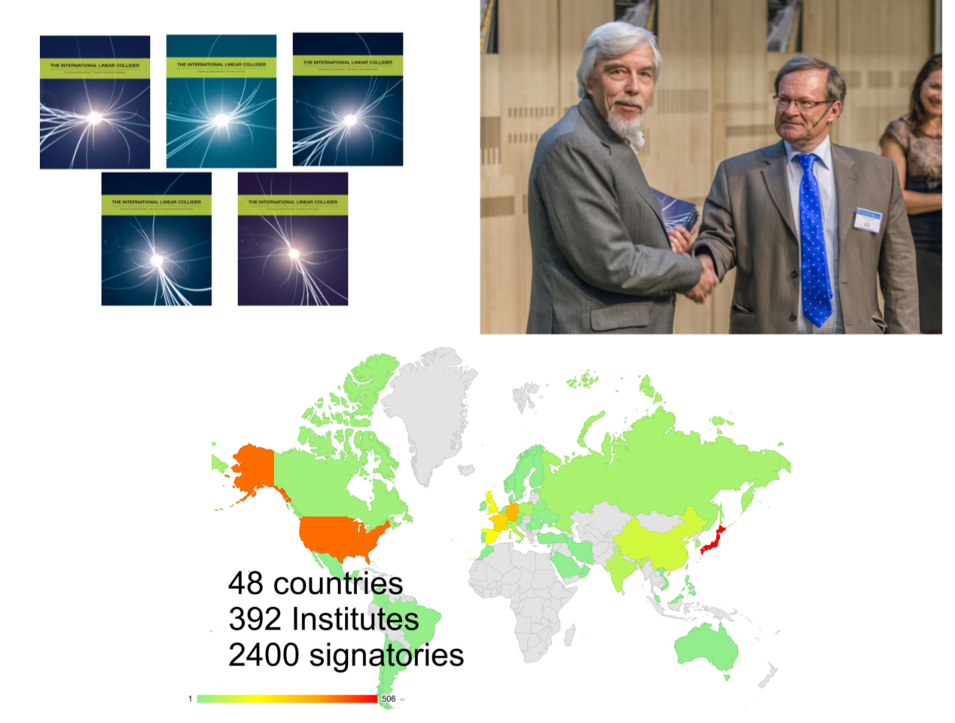
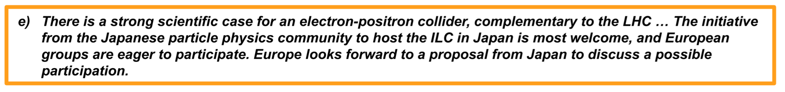
The ILC Strategy

Slide 7
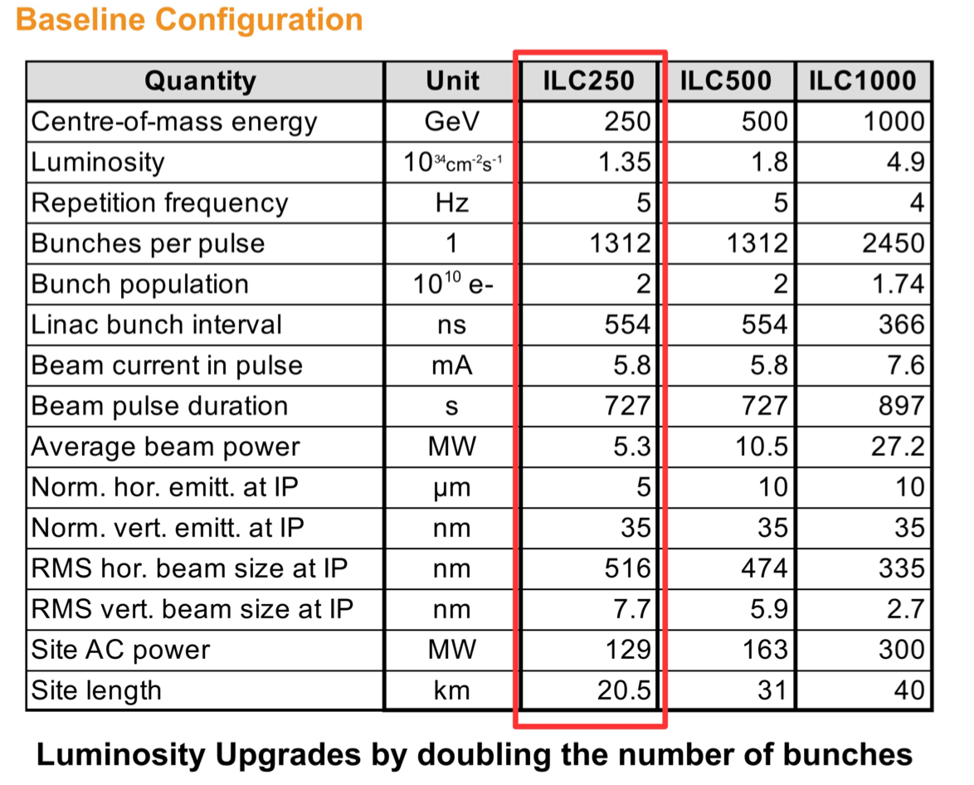
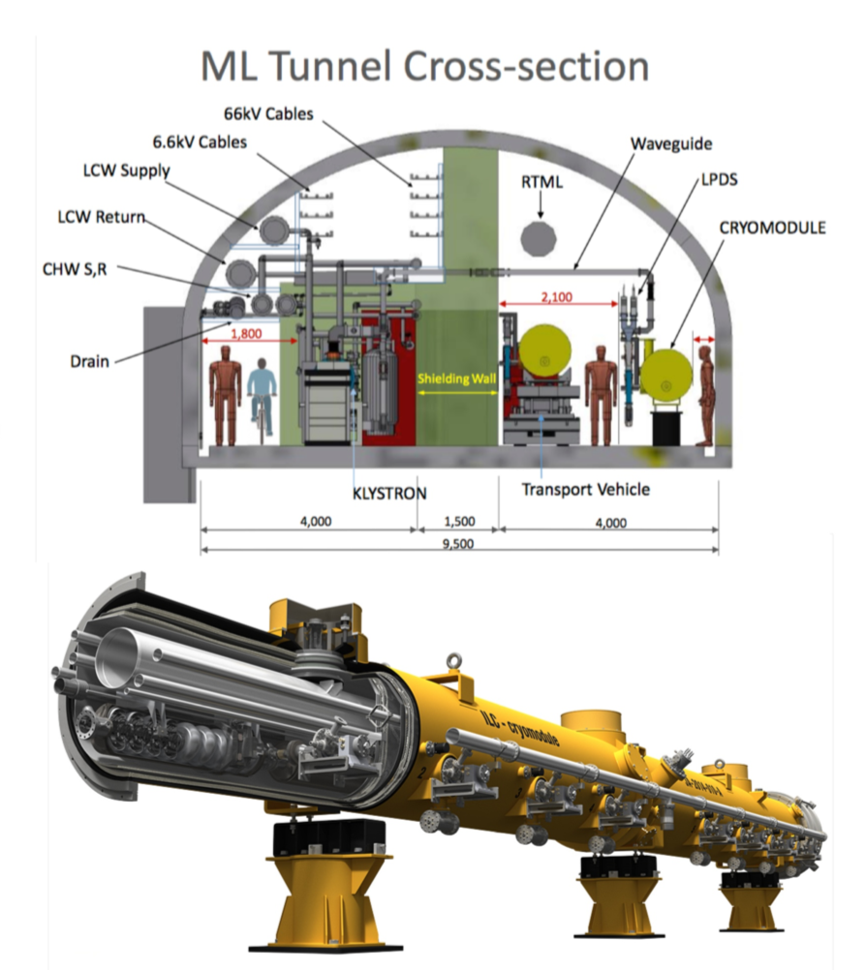
The Accelerator Design

Slide 8
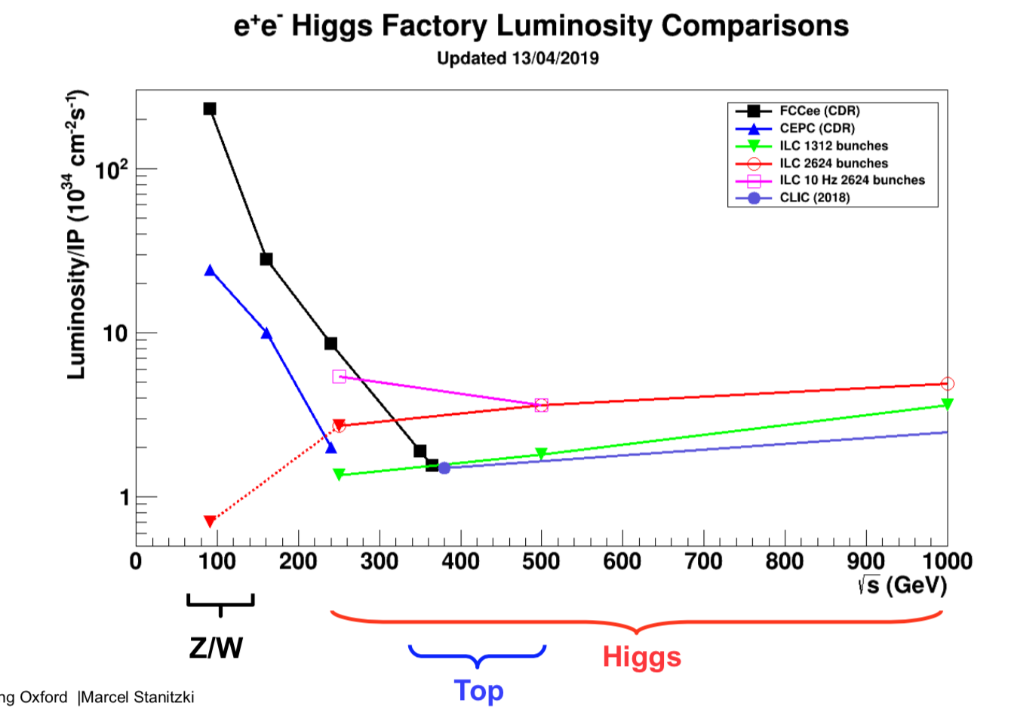
Luminosity vs Physics Reach

Slide 9
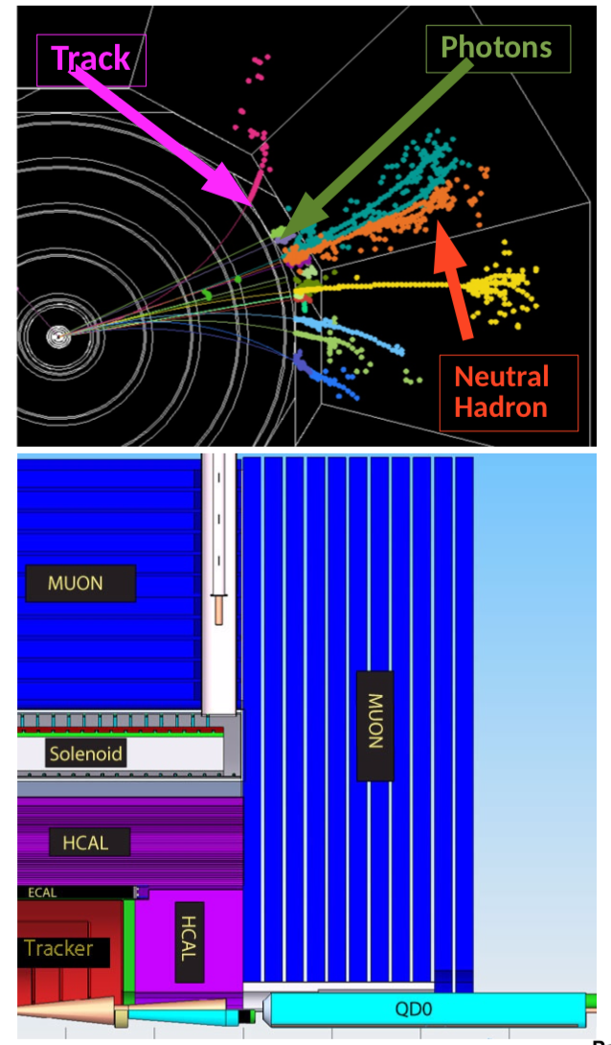
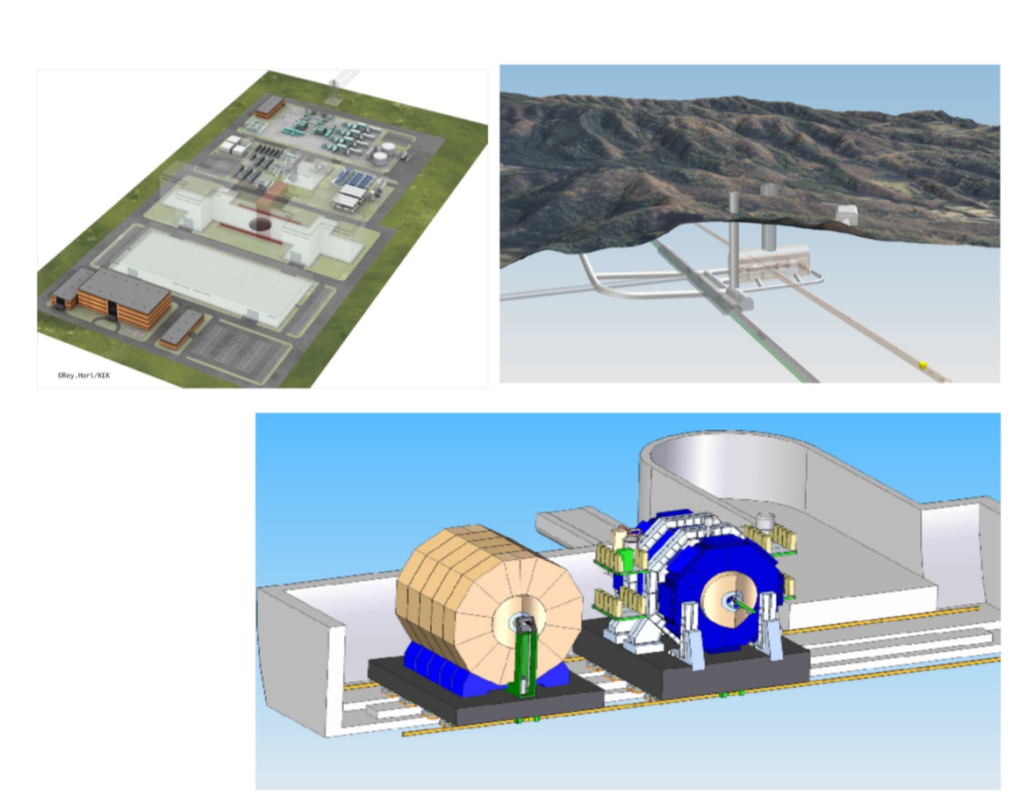
Particle Flow Detectors

Slide 10
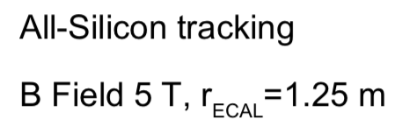
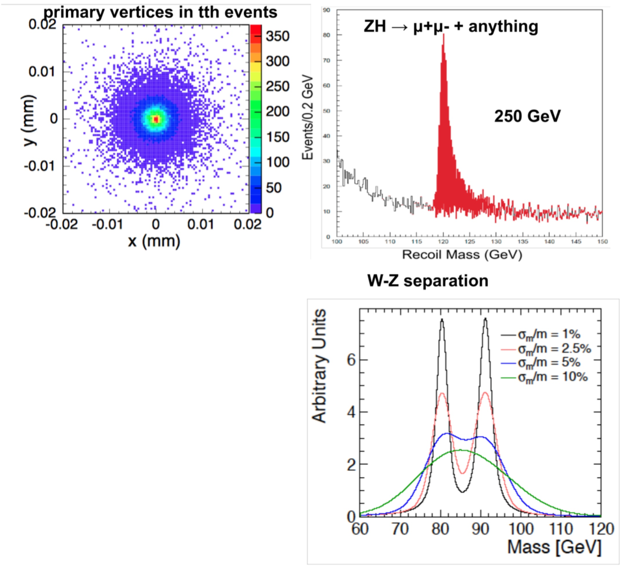
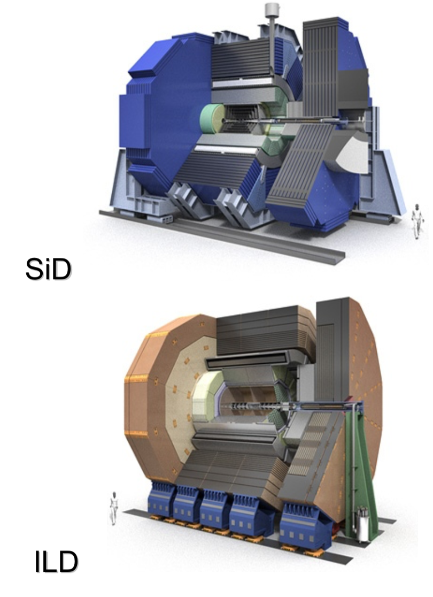
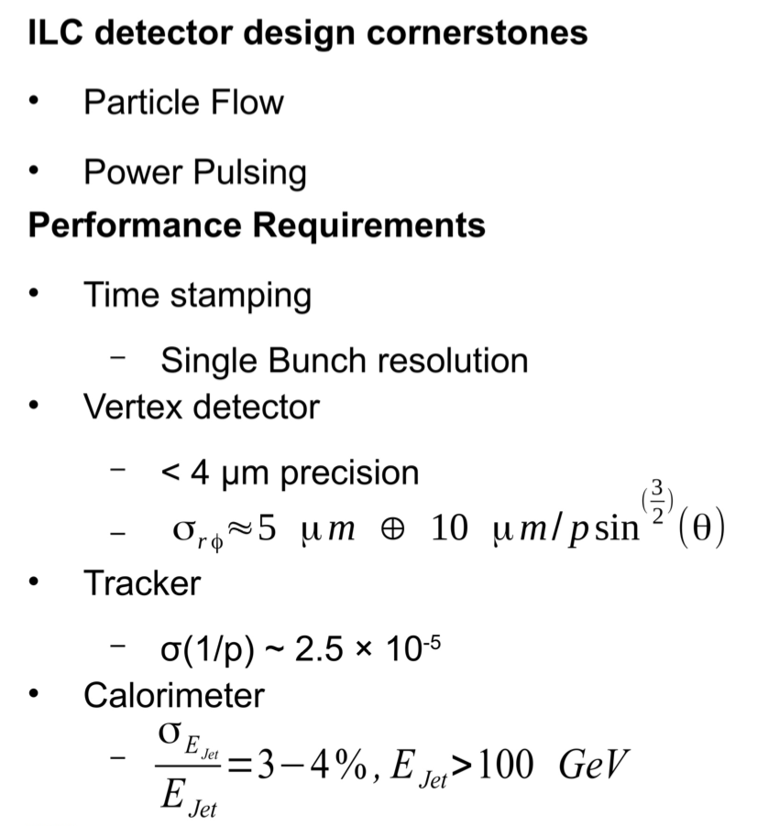
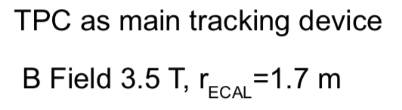
Detector Requirements

Slide 11
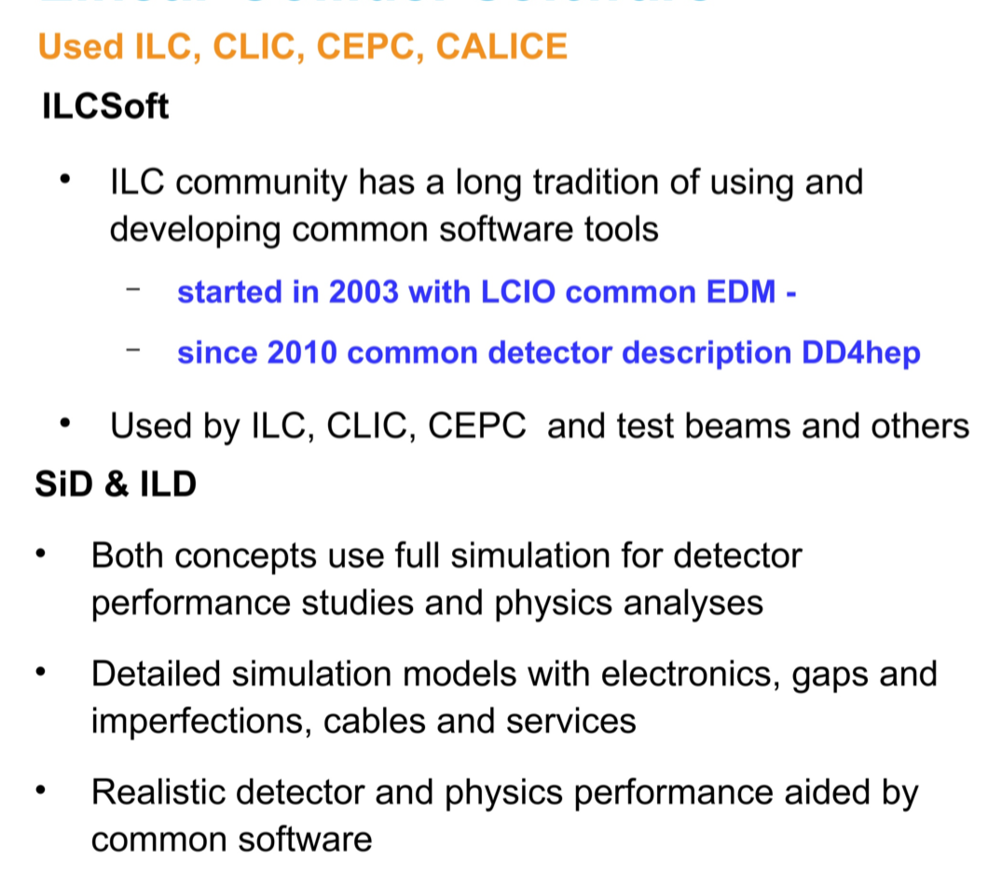
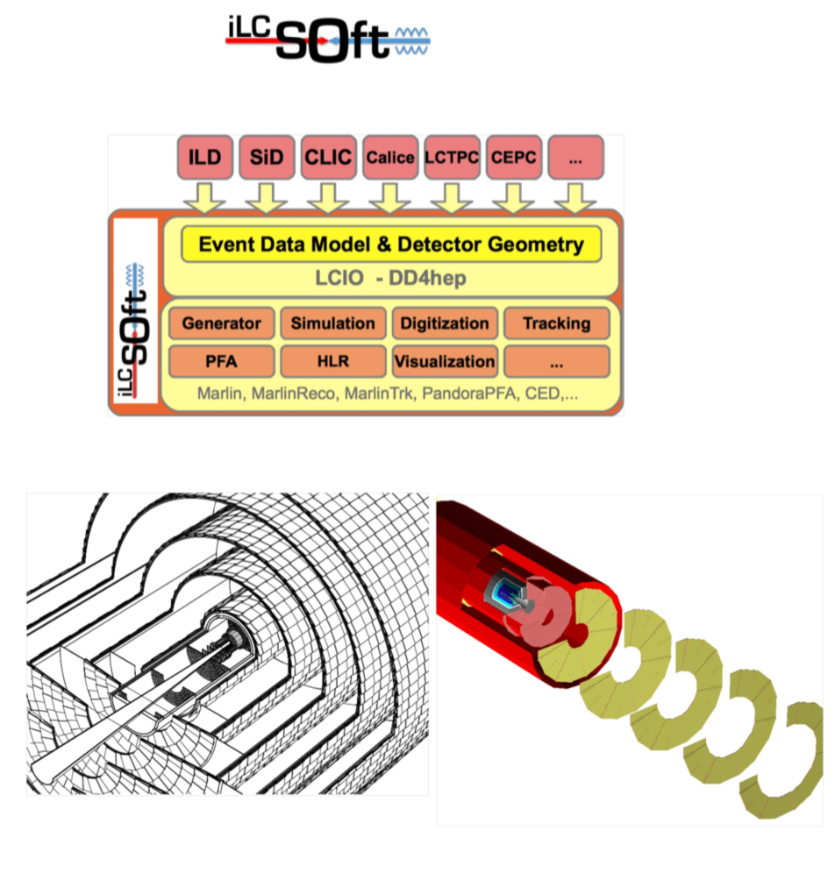
ILC Software & Computing

Slide 12
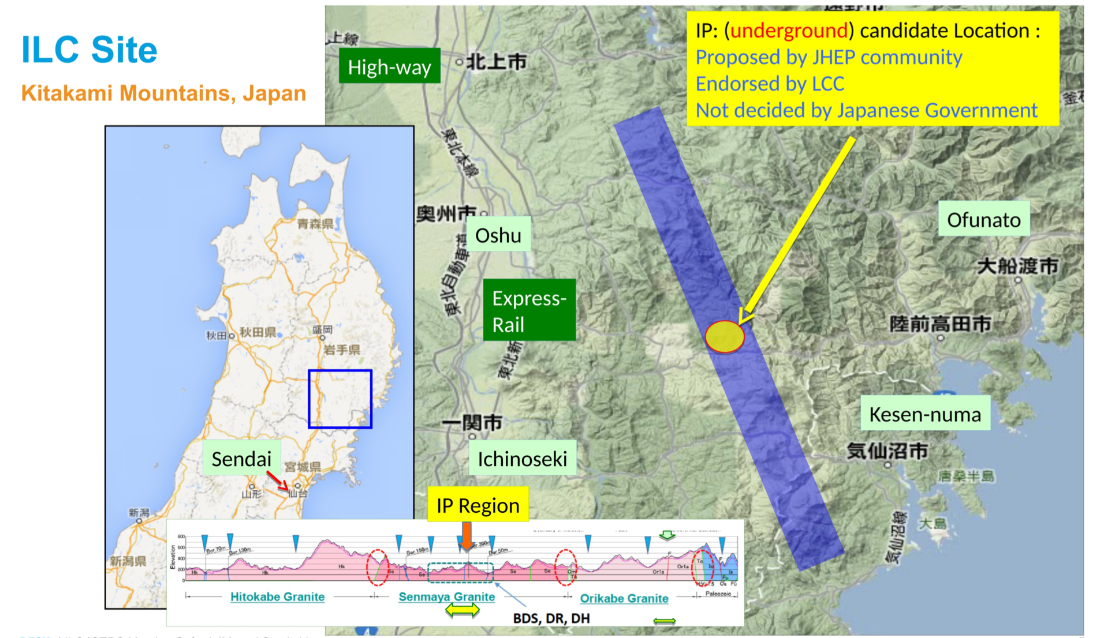

Slide 13
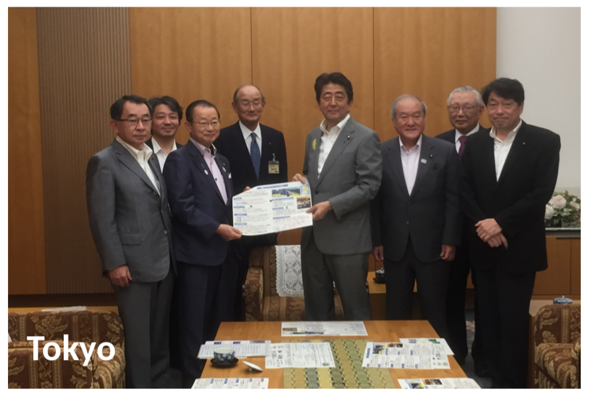
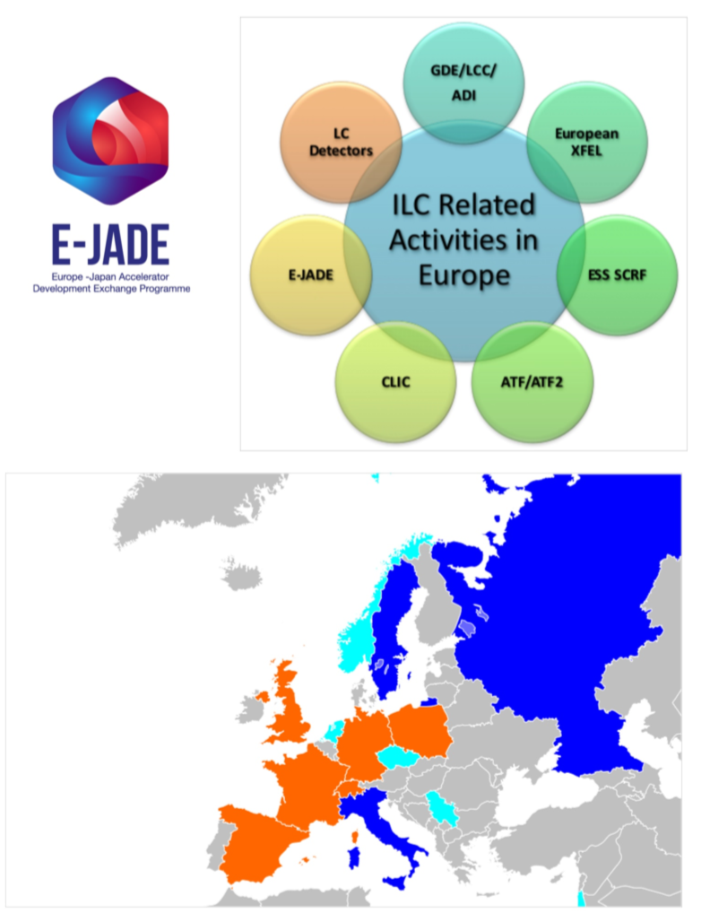
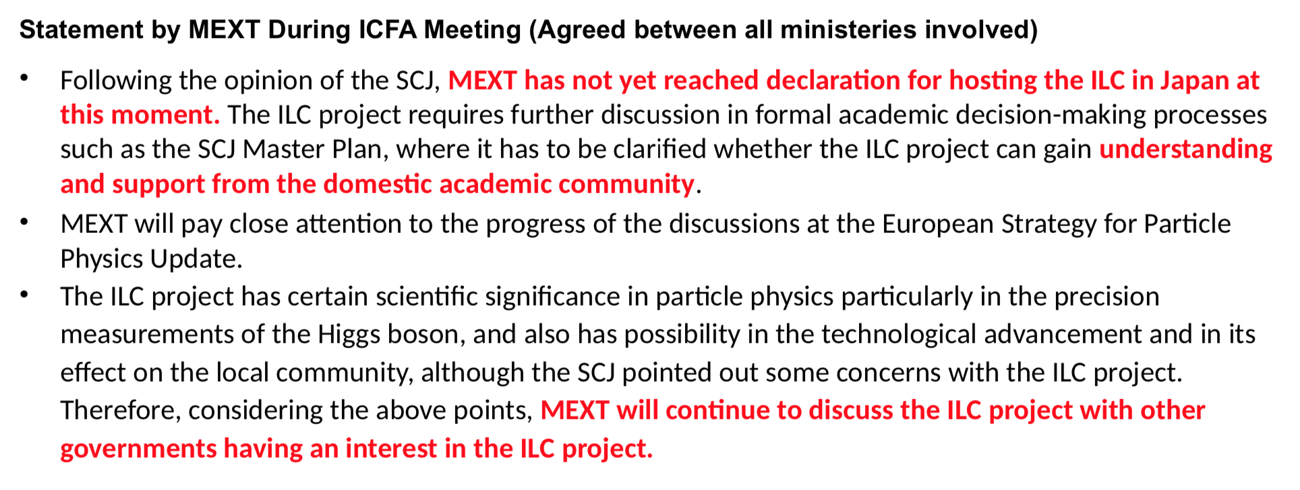
ILC Status

Slide 14
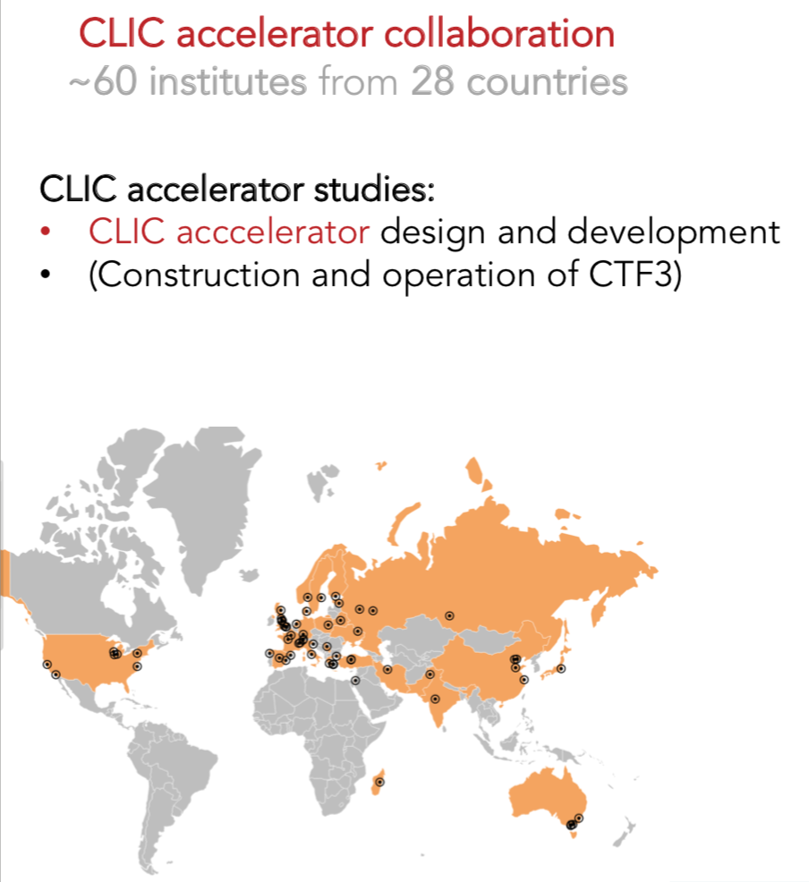
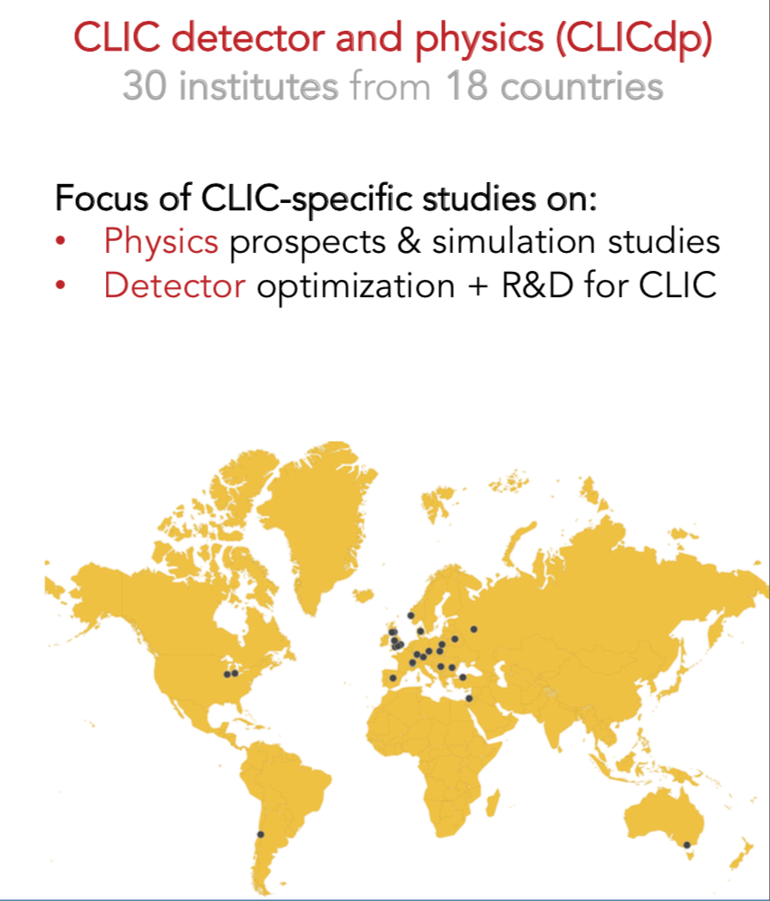
Compact LInear Collider

Slide 15
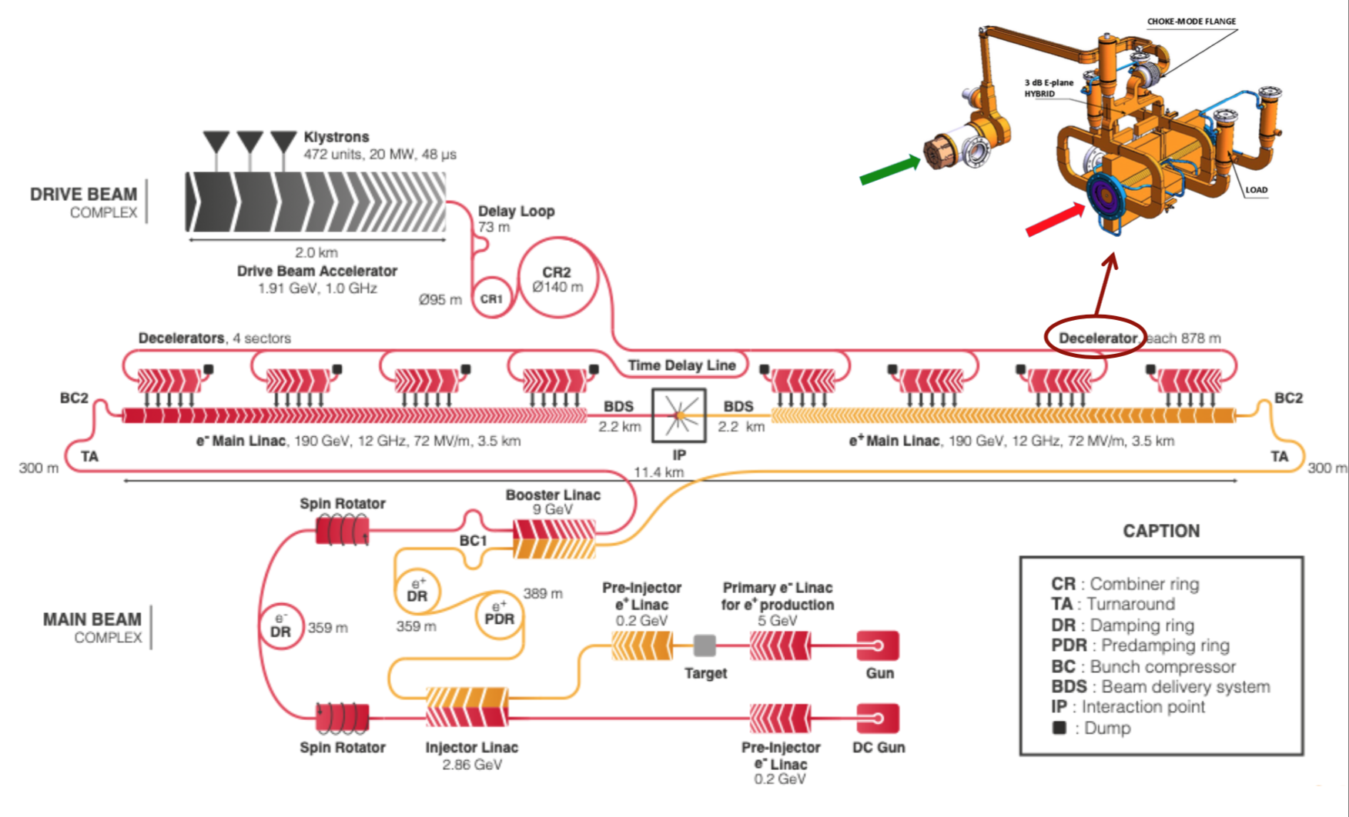
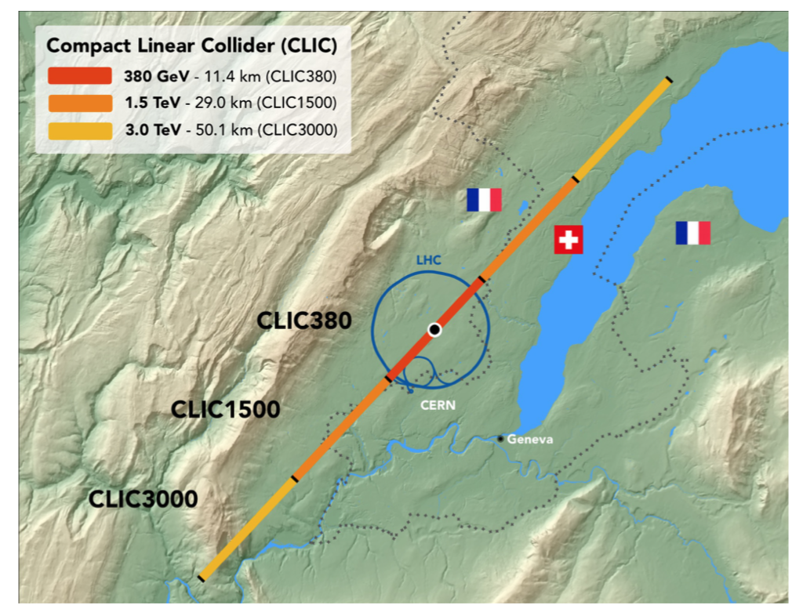
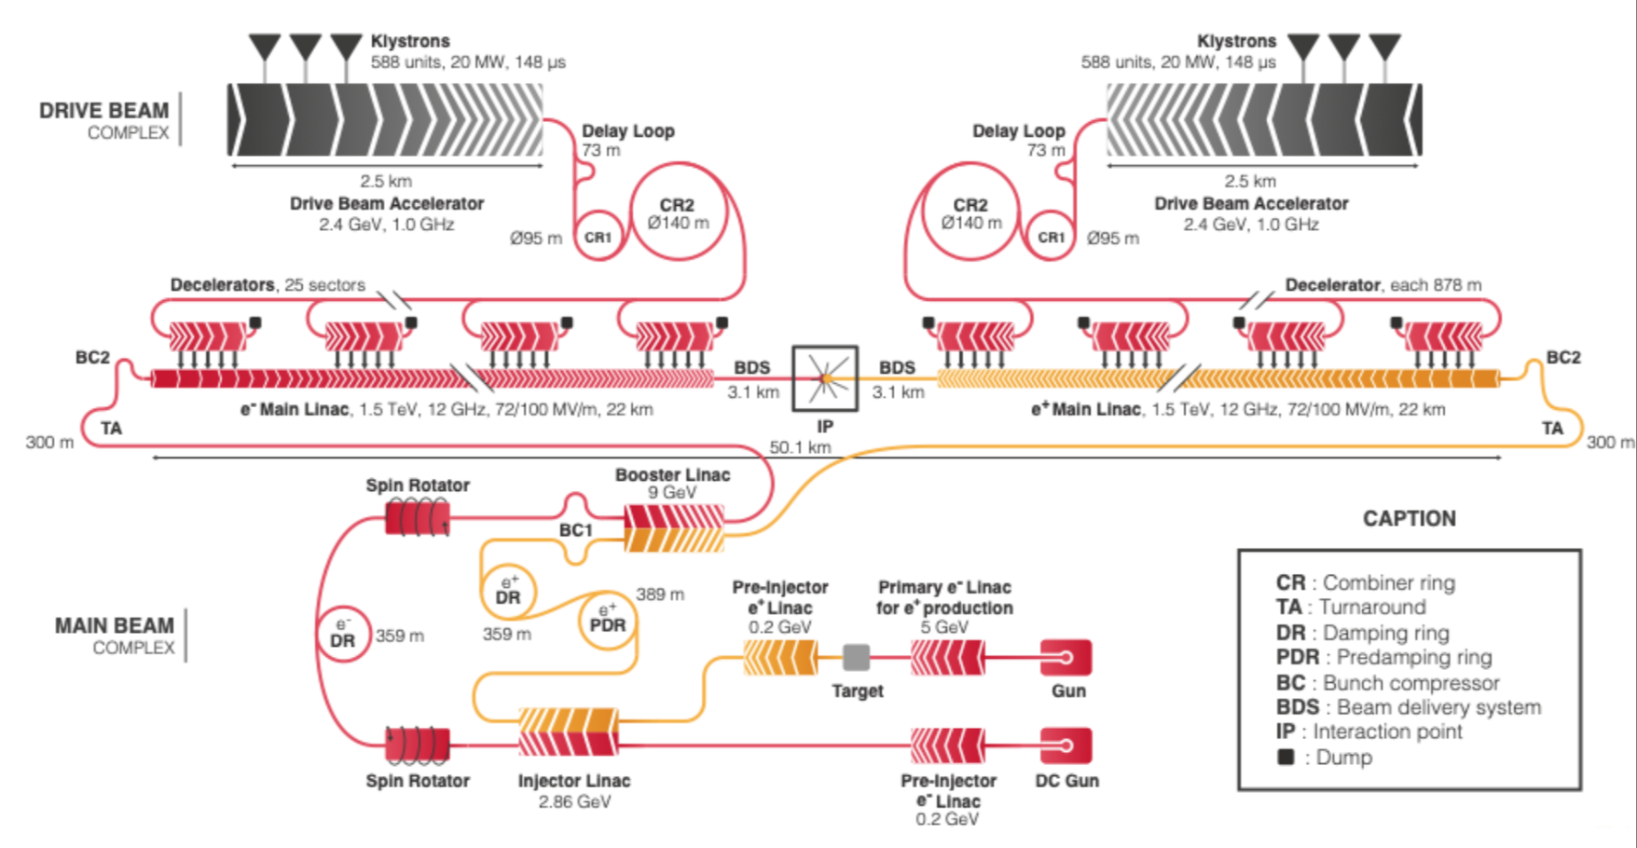
Compact LInear Collider

Slide 16
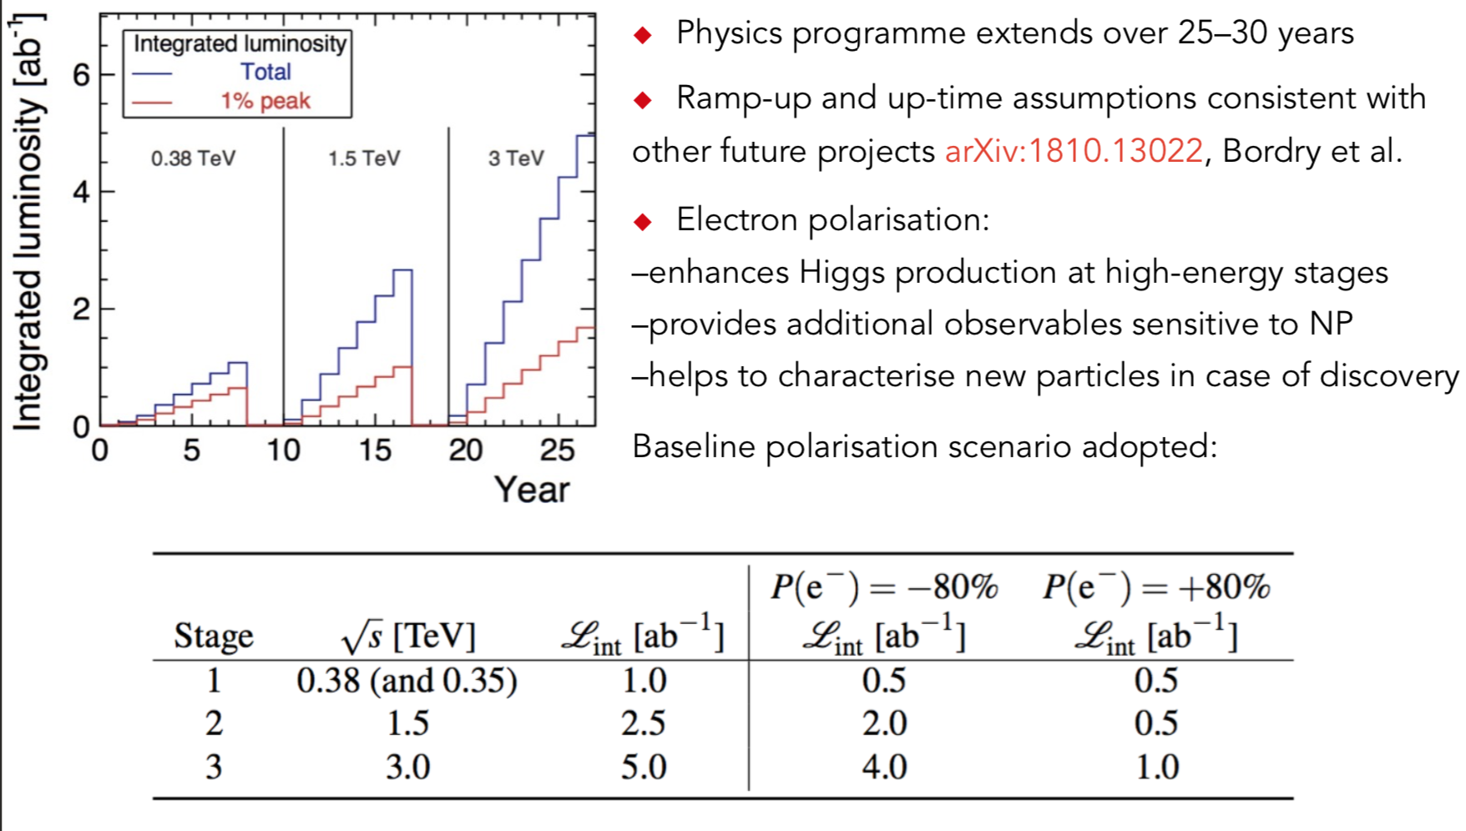
Compact LInear Collider

Slide 17
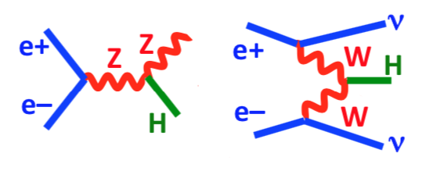
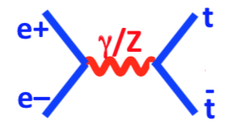
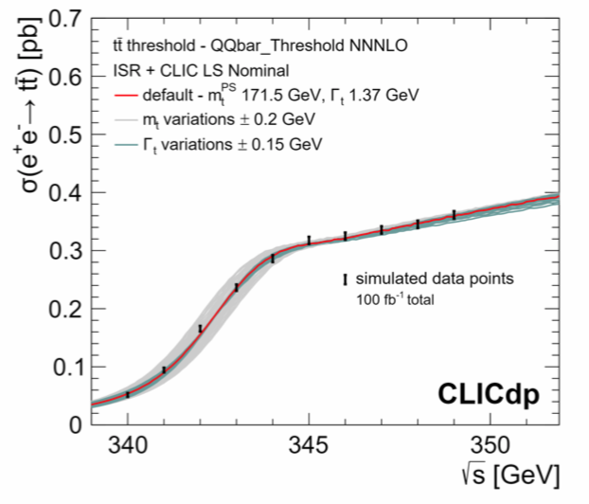
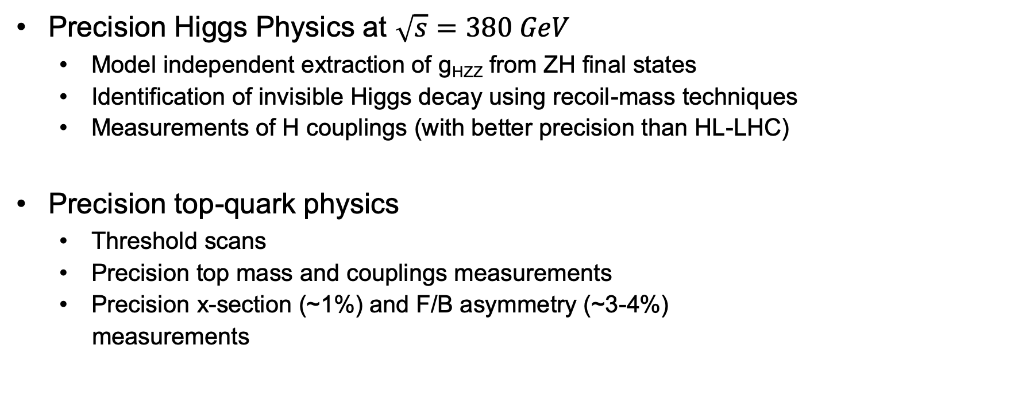
CLIC Physics Potential
Precision Higgs Physics at $\sqrt{s}=380 GeV$
  Model independent extraction of g_{HZZ} from ZH final states
  Identification of invisible Higgs decay using recoil-mass techniques
  Measurements of H couplings (with better precision than HL-LHC)
Precision top-quark physics
  Threshold scans
  Precision top mass and couplings measurements
  Precision x-section (~1%) and F/B asymmetry (~3-4%)
  measurements

Slide 18
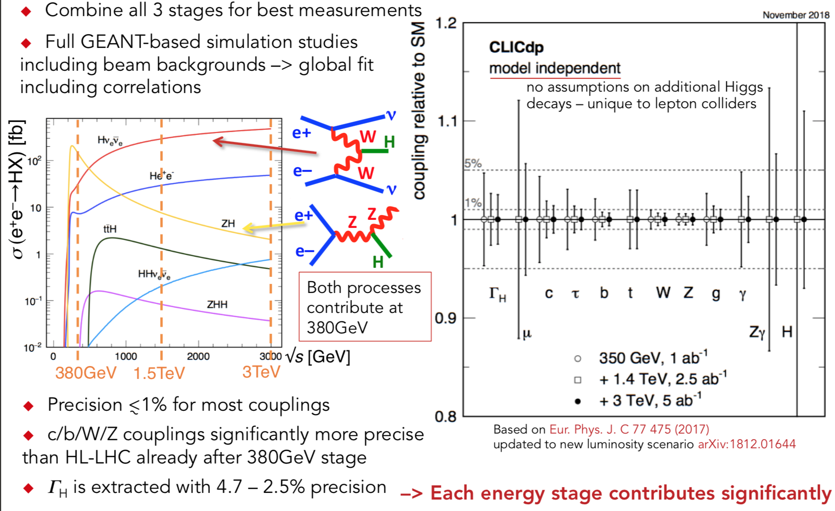
Higgs Coupling Sensitivity

Slide 19
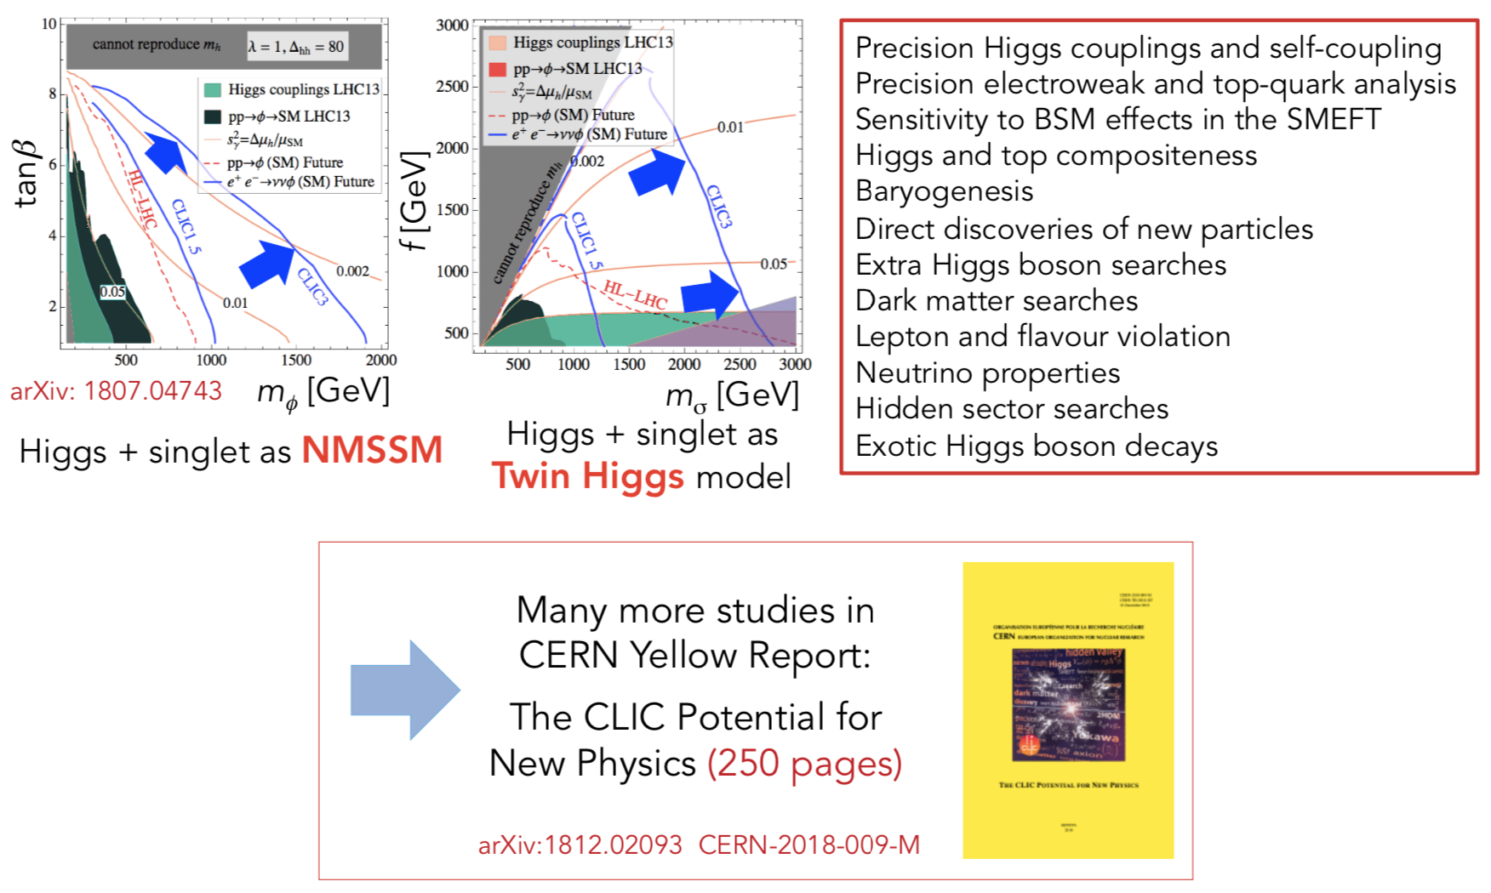
Full CLIC Physics Programme

Slide 20
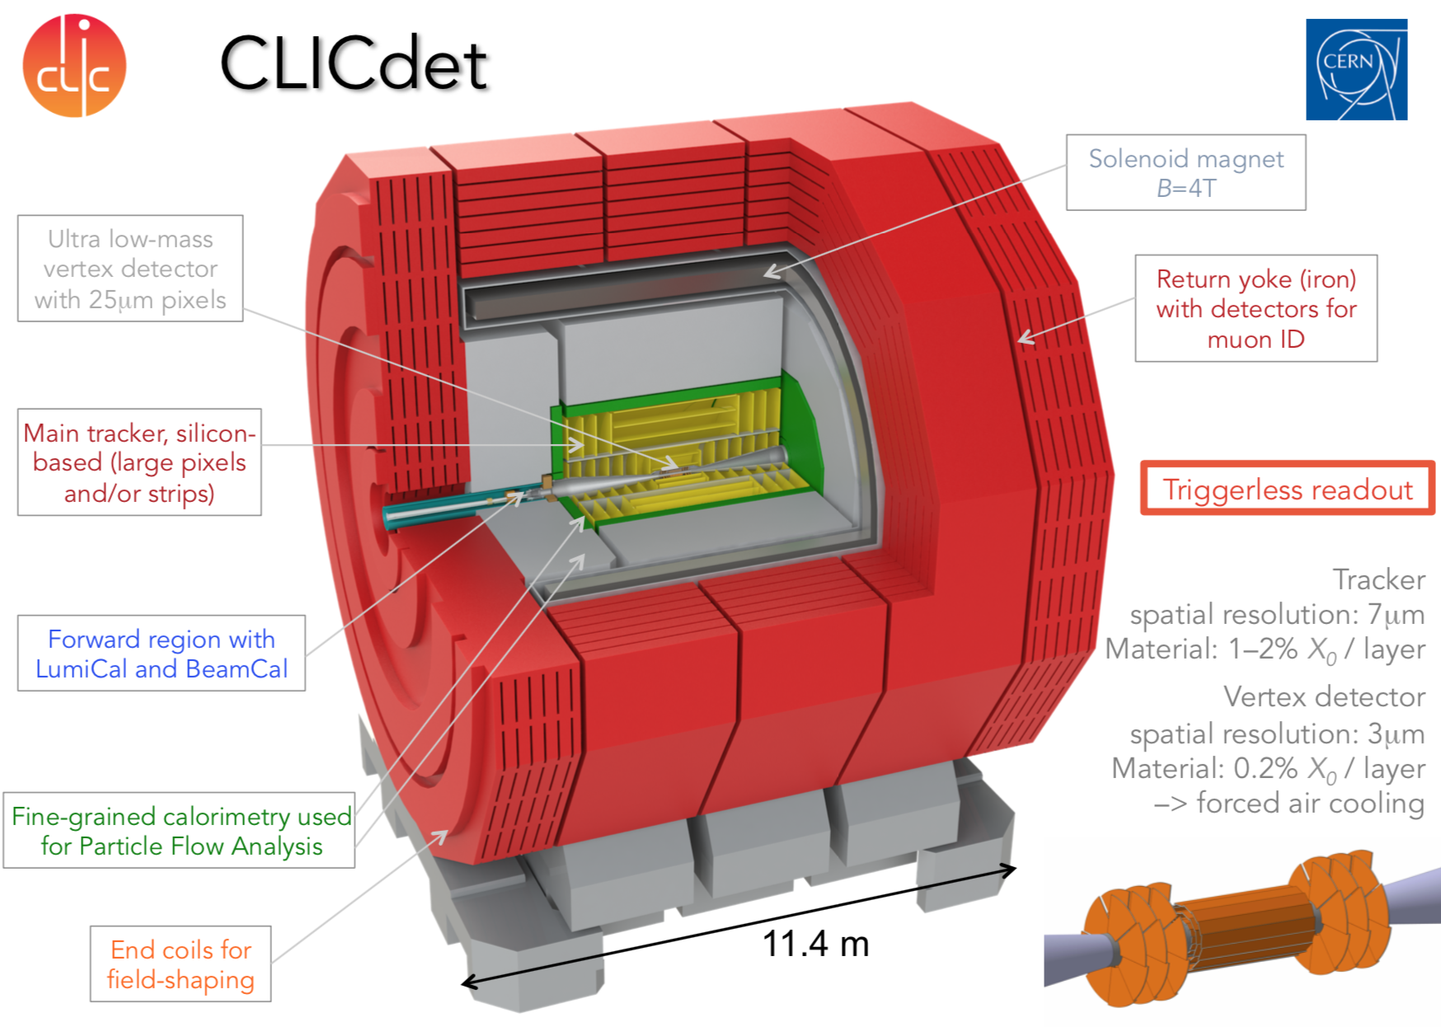
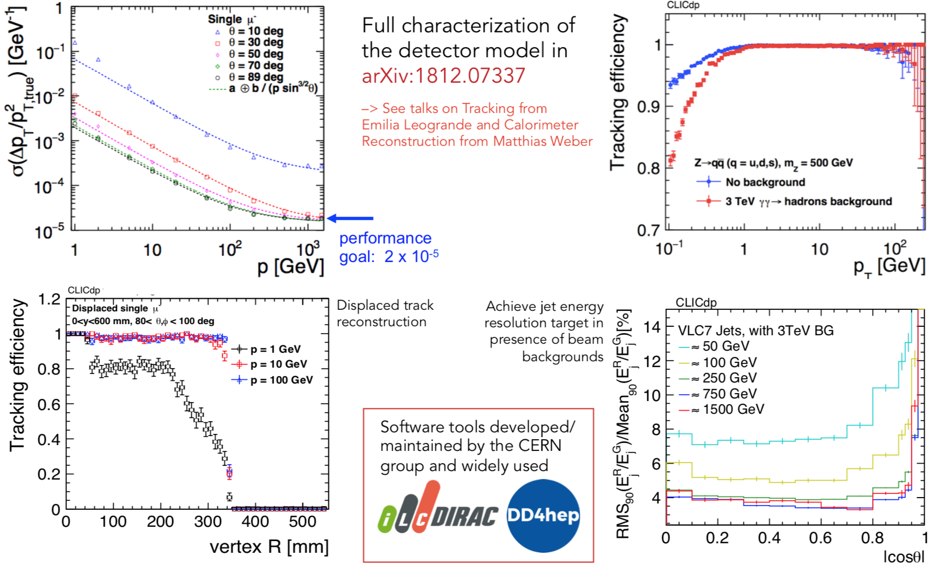
CLIC Detectors
Similar layout as for ILC detectors
Share much of the computing structure and detector R&D studies with ILC

Slide 21
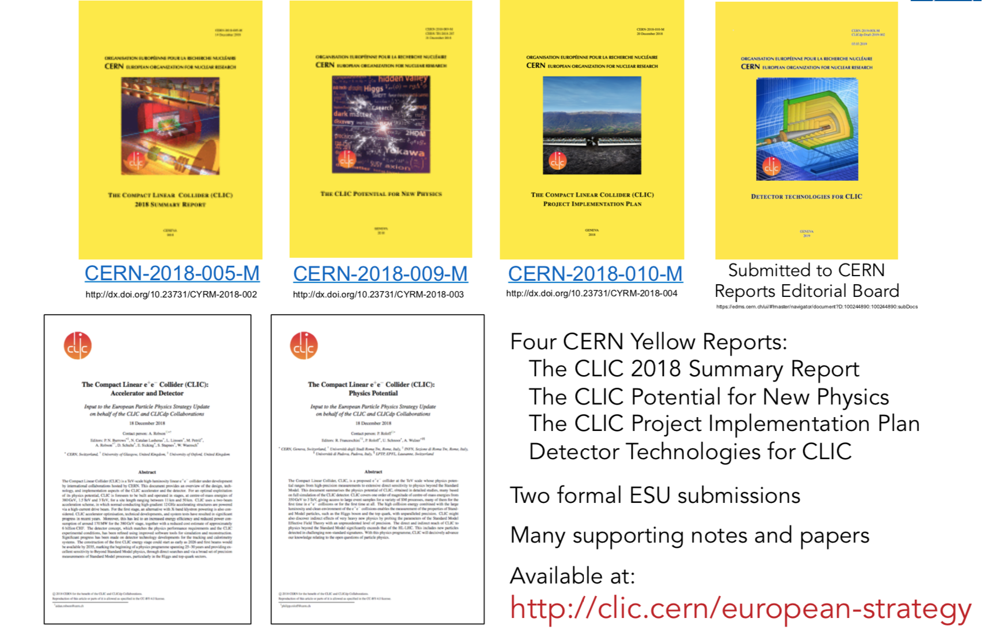
CLIC Reports

Slide 22
The CALICE R&D Project
CALICE is a collaboration with 59 institutes and 360 people from 4 continents.
Born in 2005 to provide the needed environment to develop a new generation of calorimeters for the new linear e⁺ e⁻ experiments for which new techniques are proposed: the Particle Flow Algorithms (PFA)
The PFA techniques try to separate the contribution of each of the produced particles in a collision and then use the right sub-detector for the right energy/momentum measurement. This leads to an optimal Jet Energy Resolution(JER)
and an optimal reconstruction of the event.

Slide 23
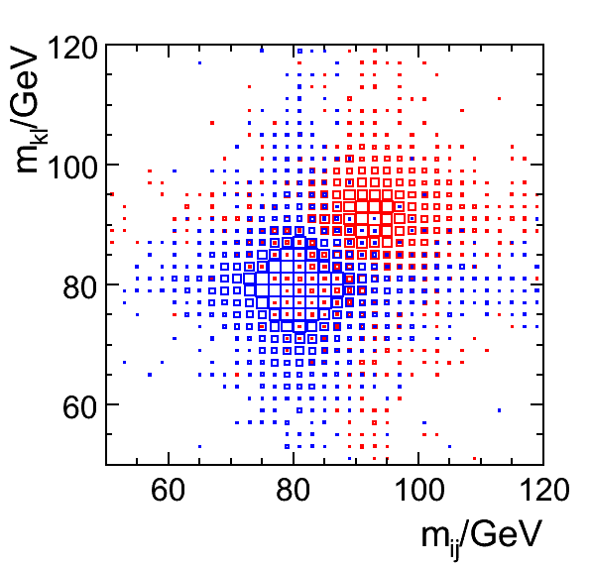
High Granular Detector
30%/√E

Slide 24
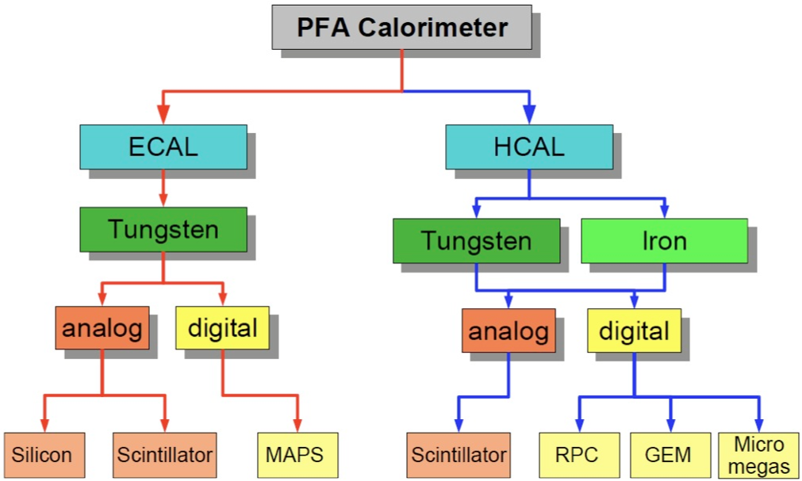
PFA Calorimeters
Common readout electronics, common DAQ

Slide 25
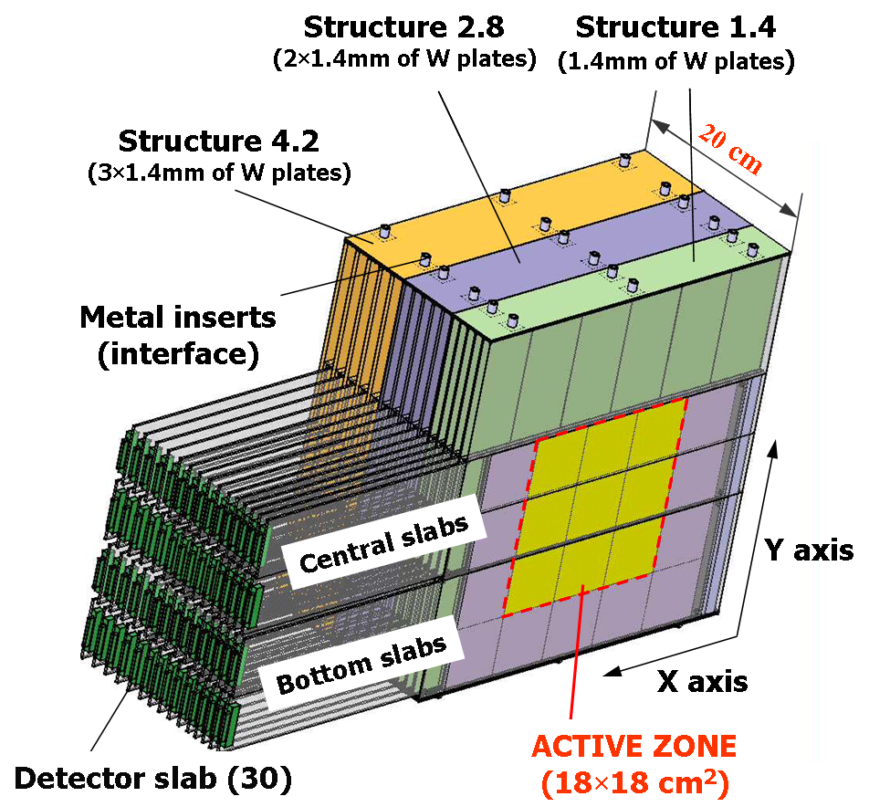
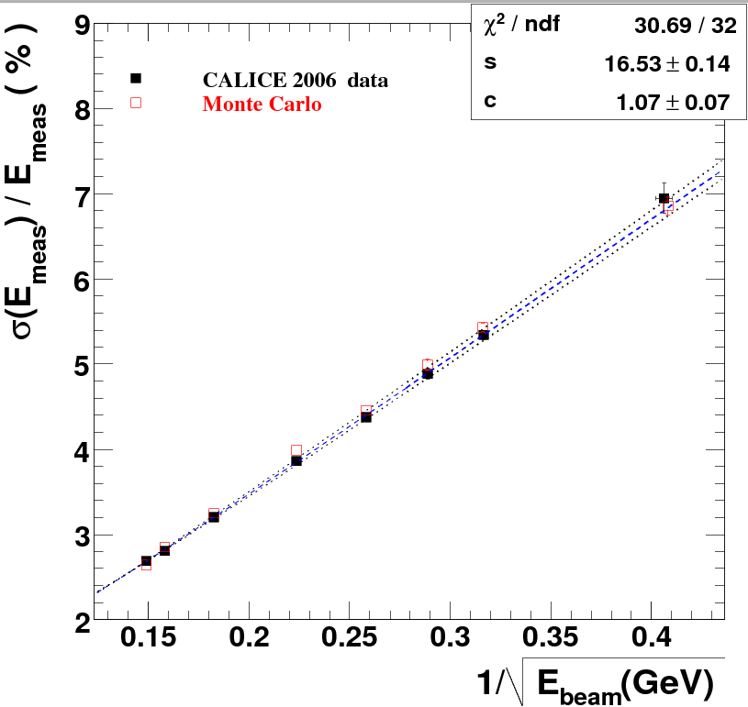
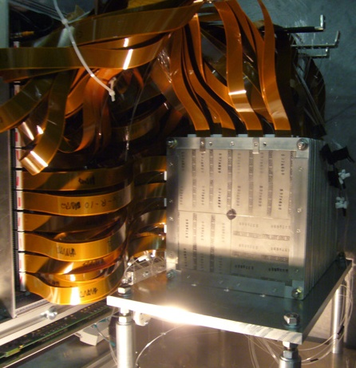
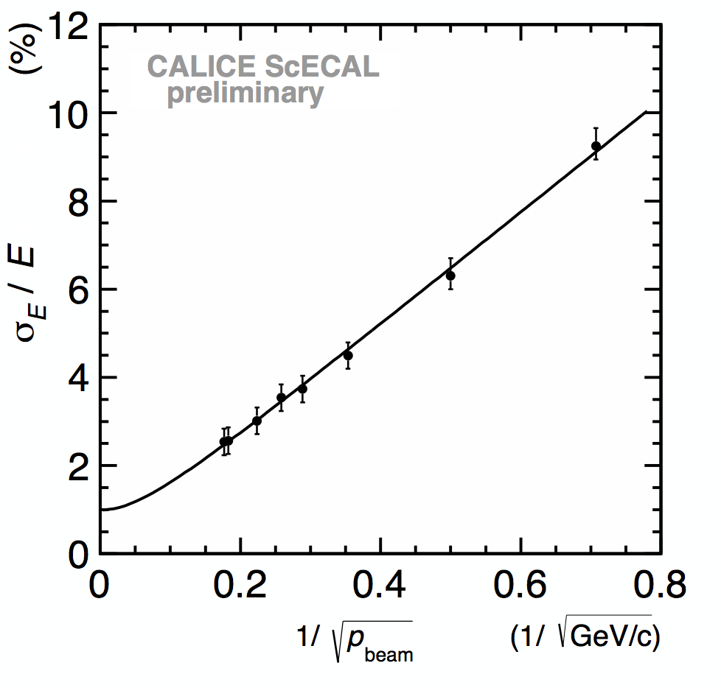
ECAL Prototypes
SiW ECAL
Energy resolution =
16.5/sqrt(E)+1.1%
30 layer (24X₀) silicon-tungsten physics prototype
(1x1 cm² cell size) with a deported electronics
was built and successfully tested.
Linearity <1%
Scint-W ECAL
30 layers of tungsten (24X₀) interleaved with
of 5x45 mm² scintillator strip with alternating
Direction layers (X&Y) → equivalent of 5x5 mm²
(SSA) read out by SiPM. A physics prototype with
a deported electronics was built and successfully
tested
Energy resolution
12.8%/√E ⊕ 1.0%
Linearity <1.5%

Slide 26
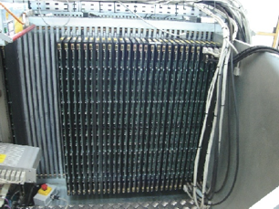
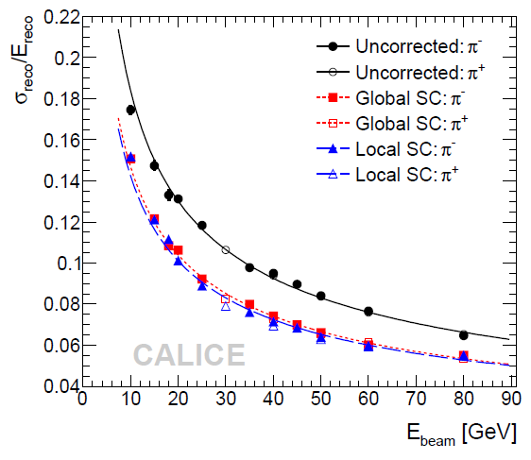
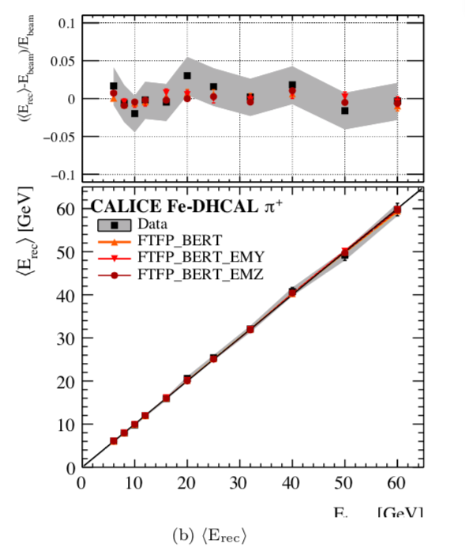
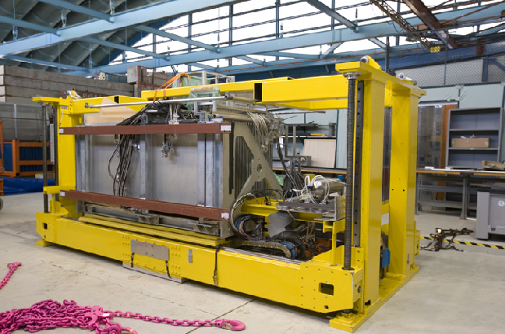
HCAL Prototypes
AHCAL
48 layers of 2 cm stainless steel interleaved with
planes made of 3x3 cm² tiles, read out directly
by SiPM and embedded electronics.
A physical prototype of 38 layers of 1 m²,
totalizing (5.3 λ_{I}) accompanied by a tail catcher
(6 λ_{I}) with deported electronics was built and
Successfully tested.
SC –based energy reconstruction improves on the resolution
DHCAL
A prototype of 50 layers each made of 3 RPC
covering 1 m² and read out by 1 cm² pads
With embedded electronics was successfully
tested.

Slide 27
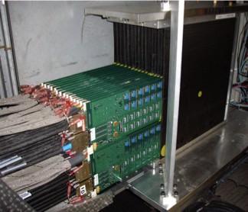
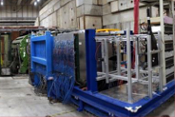





Testing of Prototypes
SDHCAL was operated also by adding 4 Micromegas layers in 2012
DHCAL and AHCAL were operated with tungsten absorber in 2012
Devices to measure timing were added to AHCAL, SDHCAL to study shower time evolution
FOCAL (MAPS technology) was tested in 2016
Granularity
Proof of principal
Power-pulsed
Embedded electronics
compactness
Physics
Technological
Si-W
DHCAL
SDHCAL
Si-W →
2005
2007
2010
2011
2012
2018
Scint-W
AHCAL
AHCAL

Slide 28
DQM software in a nutshell
Main goals of DQM systems in HEP
Evaluate data quality and alert users of possible anomalies
  Is the detector working fine?
  Are the data what we expect?
  Are they comparable to some baseline set of data?
(quasi-)Online and offline monitoring
  Distributed systems (TCP/IP)
  Q-test automation
  Event display
  Interface to desktop/WEB systems
Data is the central concept in such systems. But ....
Existing frameworks are highly dependent on the event data model
Leads to duplication of software
In test beam setups tend to use an ad-hoc software solution
Want to develop a generic DQM software for any HEP experiment/test beam setup

Slide 29
The Framework
Plugin system
User’s logic is encapsulated in Plugins
Plugin libraries are loaded at runtime
  ‘plug’ user’s login in the framework during run
Plugins are not ‘intrusive’
  No ‘class inheritance’ structure
Abstract event data model (EDM)
No pre-defined EDM → abstracted and user defined
Event streamer also implemented as Plugin
Analysis framework fully based on abstract EDM and plugin system

Slide 30
The Framework
Online
Interface to DAQ system
  DAQ data transfer
  DAQ run control commands/state/config
Online data processing
  DAQ data monitoring
  Slow control monitoring
  DAQ data re-processing from file
Offline
General purpose data monitoring
  Data quality assertion and reporting (Q-test, Q-report)
  Comparison with reference data (Chi2, Kolmogorov, etc)
+ Visualization Tools

Slide 31
The DAQ Data Monitoring Architecture
Generic DAQ Architecture

Slide 32
The DAQ Slow Control Architecture
Generic DAQ Architecture

Slide 33
The DAQ quasi-Online Architecture
Generic DAQ Architecture

Slide 34

AIDA2020: DQM4hep
CALICE AHCAL Data Monitoring
First prototype: DQM4hep
CALICE SDHCAL online system
  Hit maps, GRPC HV/current, beam analysis, electronics performance
CALICE AHCAL (quasi-)online system
  Hit correlations, hit maps, SiPM currents, electronics performance
  Standard tool for monitoring and DQM
  Completely integrated into test beam and shifters workflow

Slide 35
Future Plans
Future planned integrations
Develop monitoring within the EUDAQ framework (+ beam telescopes)
  Aim of the AIDAInnova project

