Slide 1
b→sl⁺l⁻ anomalies &
ATLAS B physics
Sebastian Jäger (University of Sussex)
ATLAS B-physics meeting
06 May 2021
.

Slide 2
ATLAS analyses
Analysis | Expected/plausible BSM scale | theory | current BSM significance
B(s,d) -> mu mu | (few) TeV (nat’lness) | excellent | 2-3 σ
RK(*) | (few) TeV (nat’lness) | excellent | 3-4 σ
B->K*mu mu (ee?) angular | (few) TeV (nat’lness) | good (P5’) to excellent (rh current) | unclear
Tau->3 mu | GUT scale or below | excellent | none
B->J/psi phi etc | (few) TeV | depends | none
B lifetimes | (few) TeV | depends | none
4 muons searches
Bc/Bc(2S)
Pentaquark/Zc
CPV in b from ttbar
}
Outside scope of what I can discuss in this talk

Slide 3
Outline
In the following I will focus about two topics which I have worked on
The b->s l l anomalies, with emphasis on theoretically controlled obervables
A possible connection with lifetime/mixing observables

Slide 4
SM(EFT) theory

Slide 5
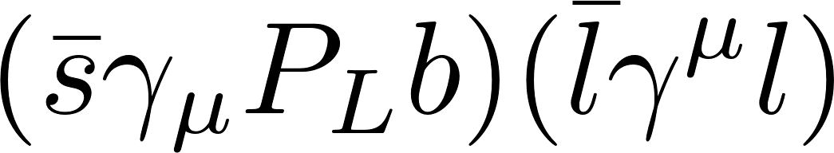
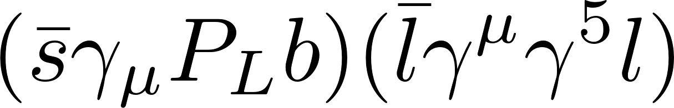
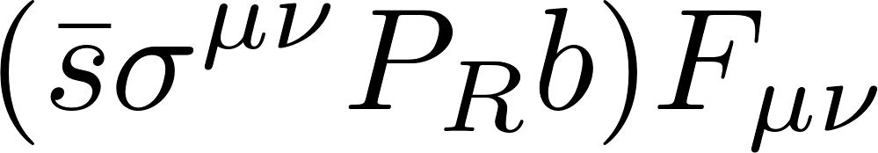
Rare B-decay: short-distance
BSM (and SM weak interactions) enter flavour physics through effective contact interactions (SMEFT/H_{weak})
C₉: dilepton from vector current
C₁₀: dilepton from axial current
C₇: dilepton from dipole
+parity conjugate “right-handed currents” - C₇’, C₉’, C₁₀’
suppressed by m_{s}/m_{b} in SM
Alternative basis with chiral leptons l_{L}, l_{R}
C_{L} = (C₉-C₁₀)/2 C_{R} = (C₉ + C₁₀)/2
(
)
Can also have
real photon

Slide 6
Importance of virtual charm
Also purely hadronic operators enter, in SM primarily:
RG mixes these into C₉ and C₇
At μ=m_{b}: C₇^{eff} ~ -0.3 , C_{L} ~ 4 , C_{R} ≈ 0
- SM: accidentally almost left-chiral muon interactions
- Long-distance virtual charm important theory uncertainty
+ dipole
SM: O(50%) of total in both cases!

Slide 7
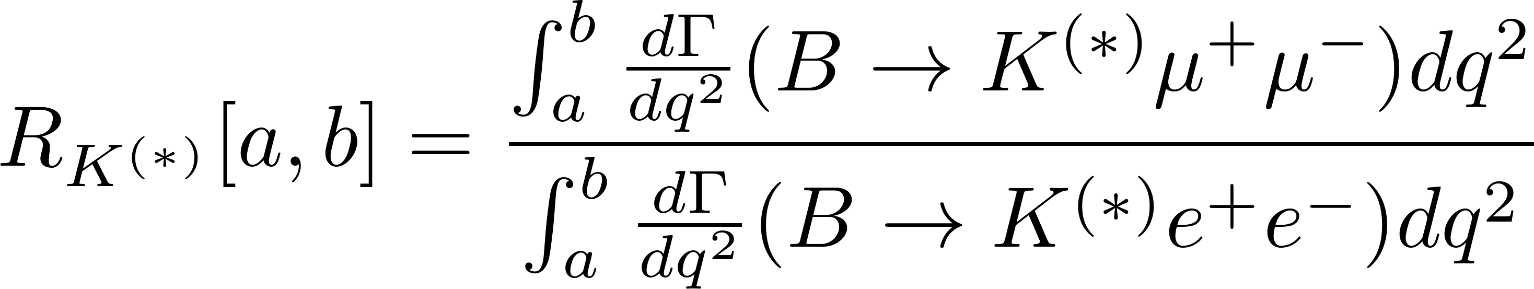
Rare B-decay: observables
Branching ratios
leptonic (differential in dilepton mass)
B_{s}→μμ, B_{d}→μμ,
semileptonic (differential in dilepton mass)
B→K^{(*)}μμ, B→K^{(*)}ee, B_{s}→ϕμμ
Lepton universality ratios
differential angular distribution for B->Vll :
3 angles, dilepton mass q²
7 angular differential observables:
(A_{FB}, P₅’, etc)
Nonperturbative QCD fully controlled (decay constant from lattice)
Form factors, 4-quark operator contributions, QED radiation cancel out to ~% level (relative to LHCb treatment)
eg Bordone,Isidori,Pattori arXiv:1605.07633

Slide 8
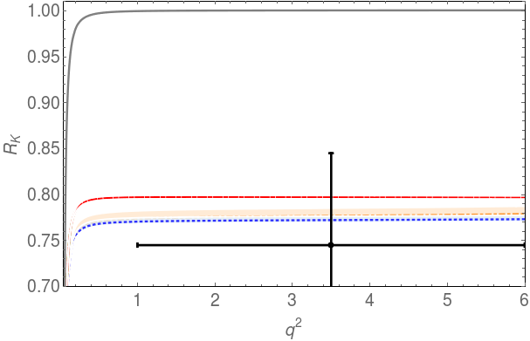
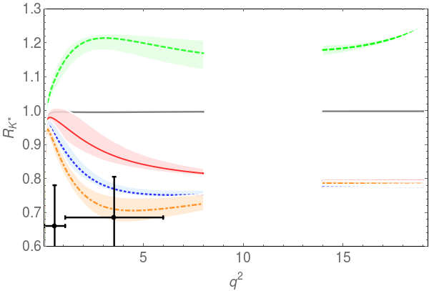
Lepton-flavour ratios at LHCb
Theory uncertainties largely cancel out, negligible relative to experiment.
leading is QED: net effect <1% after experimental corrections
Bordone, Isidori, Pattori 2016; Isidori, Nabeebaccus, Zwicky 2020
Situation in 2017 (first RK* measurement):
LHCb 2017
LHCb 2014
R.h. current
C₉
C_{L}
C₁₀
Geng, Grinstein, SJ, Martin Camalich, Ren, Shi arxiv:1704.05446

Slide 9
BSM fit

Slide 10
Observables in the fit
Basic idea: use only observables which are sensitive to b->s l l but independent of hadronic form factors, long-distance charm etc.
I.e. R_{K(*)} and B_{s} -> mu mu.
This is a well-defined set of observables, first employed in 2017, with several data updates since then. No “look-elsewhere effect” to take into account.
In the following I describe the fit in arXiv:2103.12738
(Geng, Grinstein, SJ, Li, Martin Camalich, Shi); see also work by Altmannshofer & Stangl

Slide 11
A note on the B_{s}→μμ input
Together with the R_{K*} update, LHCb presented a significant update to BR(B_{s}→μμ)
ATLAS and CMS have also measured this
Measurements show non-negligible correlations with BR(B_{d}→μμ) (biggest in ATLAS).
Hence to obtain a BR(B_{s}→μμ) average first combine the 3x2 measurements.
Then profile over BR(B_{d}→μμ).

Slide 12
B_{q}→μμ world combination
Geng, Grinstein, SJ, Li, Martin Camalich, Shi arXiv:2103.12738
From this:
BR(B_{s}→μμ)=(2.8±0.3)10⁻⁹
χ²_{min}= 3.75 (5 d.o.f.)

Slide 13
Input data
Self-consistency of dataset: χ²_{min}= 4.61 (8 d.o.f.) / p = 0.80
(counting 6 BR(B_{q}→μμ) measurements)
SM p-value is 5.4 x 10⁻⁵ (4.0σ) [counting BR(B_{s}→μμ) average]
reduces to 3.5σ when counting the 6 BR(B_{q}→μμ) measurements separately

Slide 14
Clean fit: results: 2-parameter BSM fit
Geng, Grinstein, SJ, Li, Martin Camalich, Shi arXiv:2103.12738
2021
2017
[1σ,3σ]
[1σ,3σ,5σ]

Slide 15
Clean fits: numerical results
Geng, Grinstein, SJ, Li, Martin Camalich, Shi arXiv:2103.12738
Fit three 1-parameter scenario (vectorial, axial, left-handed coupling to muons)
Note that C_{L} is well-determined in both the left-handed and the two-parameter scenario, with consistent values. Not true for C₉. Pure C₉ model also much worse fit (p=1/50).

Slide 16
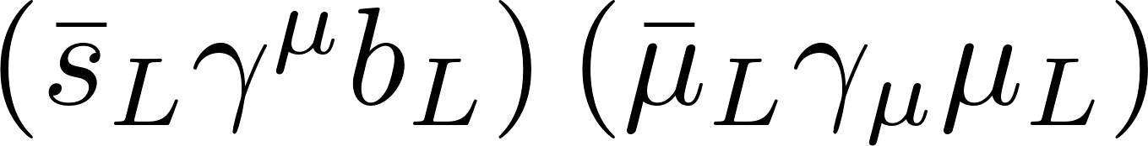
R_{K}⁽*⁾ and C_{L}
Assume here that the BSM effect is in the muonic mode, and no right-handed currents.
Because in the SM, |C_{R}|, |C₇|<< |C_{L}|,
BR ≈ const |C_{L}SM + C_{L}^{BSM}|² + … ≈ const |4 + C_{L}^{BSM}|² +positive
Only C_{L}^{BSM} can interfere
destructively: R_{K}⁽*⁾ point to
purely left-handed coupling
with ~ -(10-15)% of SM value
C_{R}
BR(B->K(*)μμ) = SM value
C_{L}

Slide 17
Adding B→K*μμ angular data
Geng, Grinstein, SJ, Li, Martin Camalich, Shi arXiv:2103.12738
Left plot: extra data pulls fit approx. along the C_{R} direction.
C_{L}=0 remains excluded at high confidence.
p(SM) up at 0.02
Right plot: effect of increasing hadronic uncertainties

Slide 18
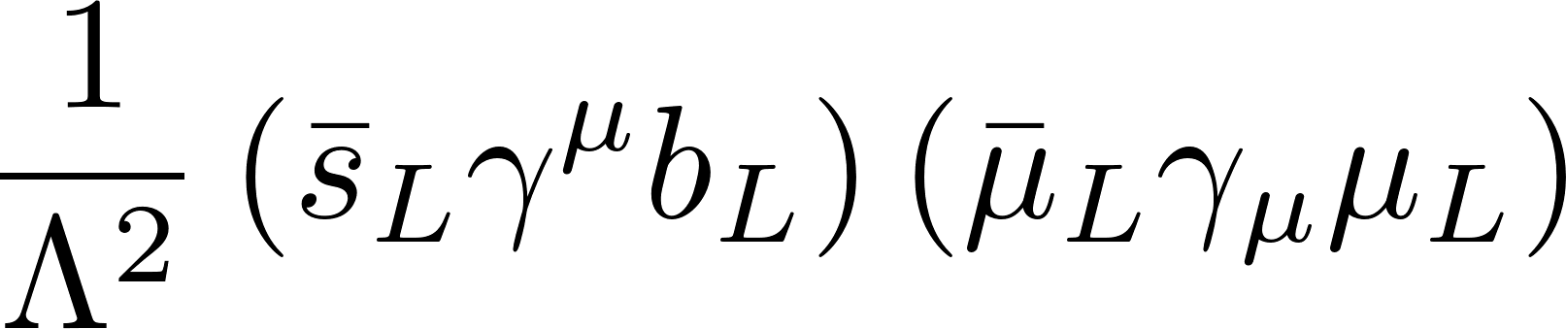
Minimal contact interaction
In summary, the B-decay anomalies suggest at a minimum the interaction
numerically Λ ~ 40 TeV
Small enough to be a loop effect even BSM (as it is in SM!)

Slide 19
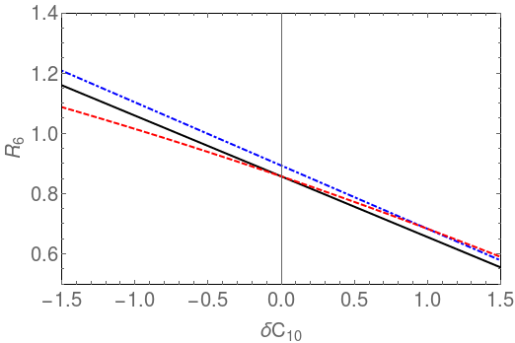
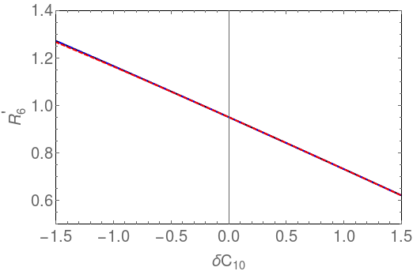
Determining CR (break C9/C10 degeneracy)
Geng, Grinstein, SJ, Martin Camalich, Ren, Shi arxiv:1704.05446
Propose to measure observable
and/or
Remains very clean in presence of new physics.
Probes a LUV C10 precisely, irrespective of values of C9e, C9mu

Slide 20
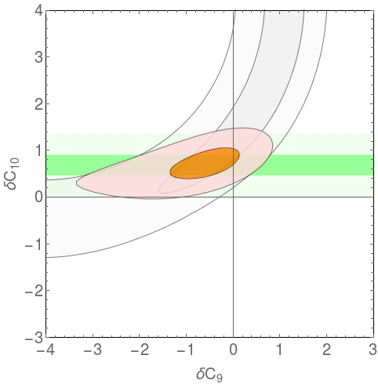
Prospective fit with LUV obs. only
Geng, Grinstein, SJ, Martin Camalich, Ren, Shi arxiv:1704.05446
Consider a hypothetical experimental result R6’ = 0.80(5) [other data from 2017 – not updated!]

Slide 21
Charming new B-physics

Slide 22
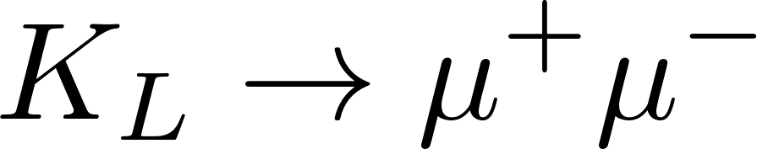

Charm and new physics
Postulated to explain non-observation of (GIM)
Discovery key to establishing SM
In B physics, charm appears in leading decays through a partonic transition. Large CKM factor.
Usually one assumes BSM corrections to be negligible.
Is this assumption well grounded in data (or theory)?

Slide 23


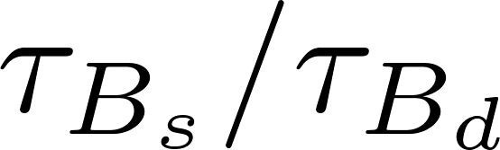
Observables
rare semileptonic (P5’ etc)
radiative (B→X_{s}ɣ)
width/lifetime differences
exclusive charmful: BR, A_{CP}, S_{CP}
precisely measured
- not calculable (HQE is 1/(m_{c} alpha_{s})) )
will show a data-driven method
All calculable
in heavy-quark
expansion (1/mb)

Slide 24
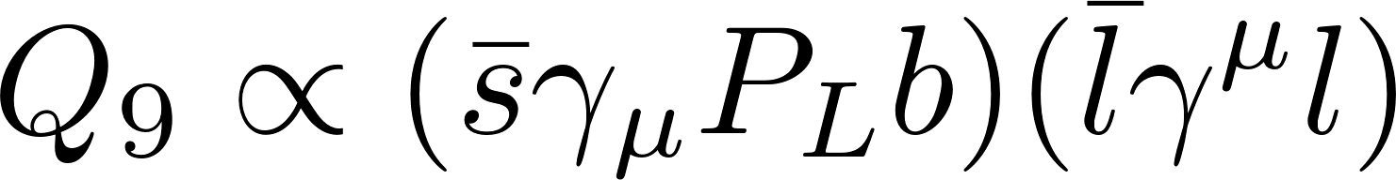
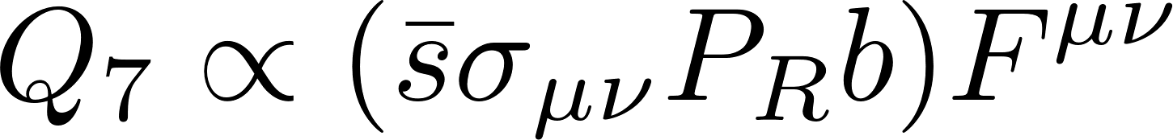
Rare & radiative decays
Standard Model: tree-level W exchange
RG evolution:
In SM: O(50%) in both cases comes from virtual charm

Slide 25
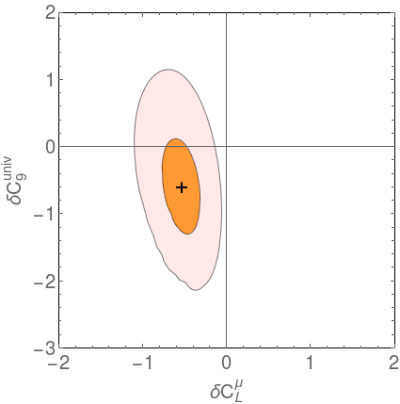
Rare & radiative decays: experiment
Rare B-decay data shows tensions with SM
1) Lepton-universality breaking - needs lepton-flavour specific effect
2) B_{s}→μμ
3) angular distribution (P₅’) - could be lepton-universal C₉-type effect
[2) could be either, but not via C₉]
A UV model may well give both.
2017
2021
Geng, Grinstein, SJ, Martin Camalich,
Ren, Shi PRD96 (2017) 093006
Geng, Grinstein, SJ, Martin Camalich,
Ren, Shi , arXiv:2103.12738

Slide 26

Charming BSM scenario
SJ, Kirk, Lenz, Leslie arxiv:1701.09183
As long as NP mass scale M is >(>) mb, most general BSM in
model-independently captured by an effective Hamiltonian with 20 operators/Wilson coefficients (including SM)
+ parity conjugates

Slide 27
RG evolution - numerical
SJ, Kirk, Lenz, Leslie, arxiv:1701.09183 and arXiv:1910.12924,
Some elements first arise at two loops – still give important constraints.
Enormous RG effects - can accommodate P₅’
SJ, Kirk, Lenz, Leslie arxiv:1701.09183
RH(primed) 4-quark ops constrained by both C₇’ and C₉’

Slide 28

Observables/constraints
Lifetime ratio
Width difference
Inclusive radiative decay
‘Pseudo-observables:’ fitted Wilson coefficients from (mainly) exclusive radiative and semileptonic decay
Aebischer et al arXiv:1903.10434
Paul & Straub arXiv:1608.02556

Slide 29
Global analysis
SJ, Kirk, Lenz, Leslie, arXiv:1910.12924
‘LH currents’ – strong mixing into C₉
Blue – radiative decay, green – lifetime ratio, brown – width difference
_{Dashed/solid black: C9(BSM)}

Slide 30
Global analysis
SJ, Kirk, Lenz, Leslie, arXiv:1910.12924
‘LH currents’ – strong mixing into dipole
Blue – radiative decay, green – lifetime ratio, brown – width difference

Slide 31
Global analysis
SJ, Kirk, Lenz, Leslie, arXiv:1910.12924
‘RH currents’ – strong mixing into dipole
Blue – radiative decay, green – lifetime ratio, brown – lifetime difference

Slide 32
Lower bounds on NP scale
Delta C<0
Delta C>0
SJ, Kirk, Lenz, Leslie, arXiv:1910.12924

Slide 33
B→J/ψ K_{S} & CP violation
If new physics in is CP-violating, it will impact on the precisely measured exclusive B→J/ψ K_{S} decays.
Three precisely observables:
Note: The impact on the semileptonic asymmetry turns out to be comparably small (will show).

Slide 34
Exclusive B-decay
Exclusive charmful hadronic B-decays suffer from large hadronic uncertainties
e.g data suggests corrections to (calculable) naïve factorisation O(100%)
Weak sensitivity to BSM contributions, especially if CP-conserving

Slide 35
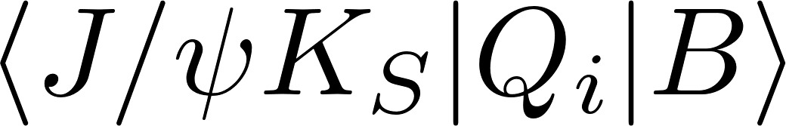
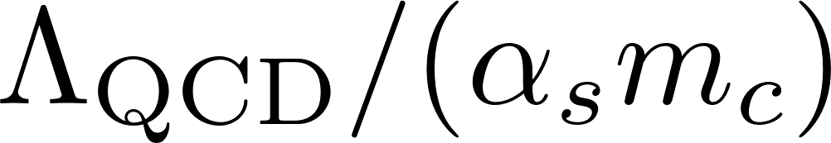
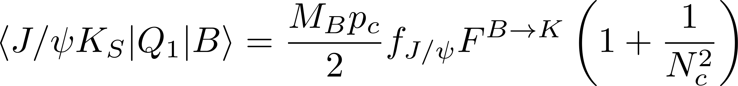
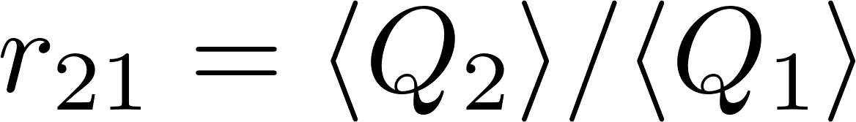
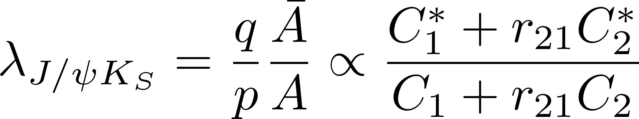
B→J/ψ K_{S} : theory
Problem: hadronic matrix elements
Heavy-quark expansion uncontrolled
expansion parameter is
But
factorizes naively, up to colour-suppressed corrections.
If new physics only affects C₁ or C₂, the incalculable hadronic dynamics is largely contained in a single complex ratio
e.g.
4 unknowns (Re C, Im C, Re r₂₁, Im r₂₁) : fit to data !

Slide 36
Global analysis: CP-violating case
SJ, Kirk, Lenz, Leslie, arXiv:1910.12924
Fitted r₂₁ agrees with naïve (!) factorisation

Slide 37
Future prospects for mixing
SJ, Kirk, Lenz, Leslie arxiv:1701.09183
Brown – width difference, green -- lifetime ratio
solid – SM central value
spacing of contours – projected half-width of a 1-σ band
Grey – current BR(B→X_{s}ɣ)
Assumptions: 5% combined (th/exp) error on width difference
0.001 combined error on lifetime ratio

Slide 38
Conclusions
The LHCb updates on R_{K*} and on BR(B_{s}→μμ) have increased the tension with the SM to 4.0σ. ATLAS contribution is and will be important.
The leptonic decay itself is more than 2σ off and plays an important role in pinning down a region in the 2-parameter BSM fit [always assuming left-handed quark interactions]
In my opinion, this is unlikely to be a statistical fluctuation and very unlikely to be a theoretical issue.
BSM involving charm quarks may contribute to P5’ anomaly (not RK(*)) and provide connection with theoretically controlled hadronic observables (lifetime differences/ratios, CPV in B->J/psi K etc).

Slide 39
BACKUP

Slide 40

Leptonic decay
Quark current annihilating
the meson
No QCD final-state interactions
μ⁺
s-bar
confining
colour force field
b
parameterised by a decay constant
not calculable in perturbation theory
quantum electrodynamics only
very well controlled theoretically
μ⁻
Very small long-distance QED corrections Beneke, Bobeth, Szafron 2019
leading theory uncertainty are CKM parameters & decay constant

Slide 41
B->V l l: rate (schematic)

Slide 42
Decay amplitude structure
Natural, systematic discussion in terms of helicity amplitudes
Photon pole absent for helicity-0 (form factor rescaling)
C10
C7, C9, hadronic hamiltonian
SJ, Martin Camalich 2012, 2014

Slide 43
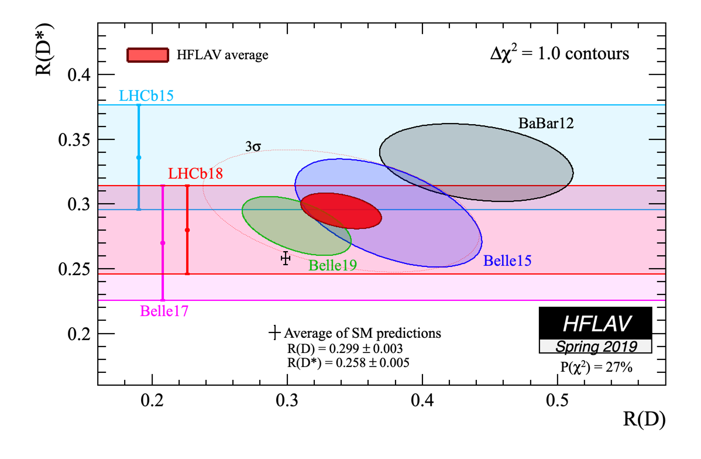
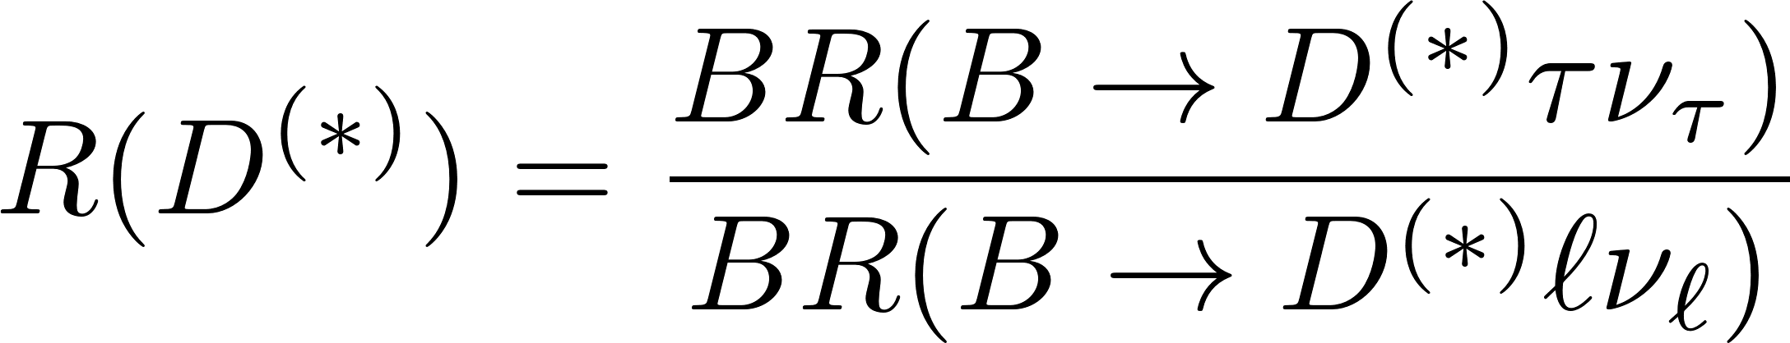
Non-rare semileptonic decays
SM tree-level
large effect; theory error still (almost) negligible

Slide 44
Possible BSM
ε_{R}^{l} flavour-universal by SU(2) x U(1) invariance (no dim-6 SMEFT operator)
Best fit value moved
substantially closer to SM
with Belle 2019 update
Different BSM operators
imply different correlations
between shifts to RD, RD*

Slide 45
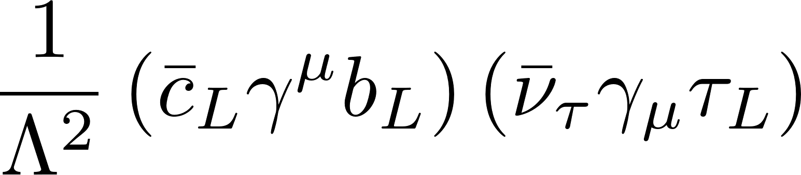
Scale of new physics & no-lose theorem
Di Luzio, Nardecchia 2017
The B-decay anomalies point to (at least) the interactions
numerically Λ ~ 30 TeV and Λ ~ 3 TeV, respectively
(The latter operator is suggested by the R_{D(*)} anomalies, which I did not discuss.)
- Recall in the case of the Fermi theory, G_{F} ~ g²/M_{W}²
- Redoing the calculation here, M_{NP} = g_{NP} Λ ≤ 4π Λ.
For the rare decay anomalies, at most 300-400 TeV.
Partial-wave unitarity: maximal NP scale below 100 TeV.
If the NP is less than maximally flavour-violating, or the NP is weakly coupled, the scale will be 1-2 orders of magnitudes lower.
While the bounds are (so far) high, the fact that there are any at all should be encouraging, further refinements may be possible.

Slide 46
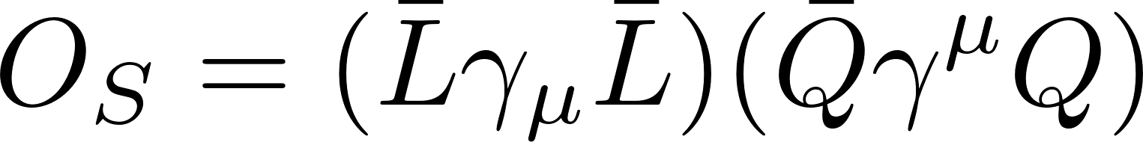

SU(2)_{W} & model-independent constraints
Two purely left-handed SU(2) invariants once doublet structure of fermions considered (for each choice of generation indices)
Both operators contribute to further processes that are experimentally constrained, in particular:
B → K* νν → C_{T,3323} ≈ C_{S,3323}
at one loop:
Z → ττ , Z→νν
τ →Z*μ, W* ν (→ 3 leptons)
Problematic for very low Λ
Feruglio, Paradisi, Pattori arXiv:1606.00524, arXiv:1705.00929

Slide 47
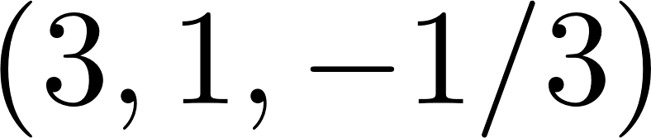
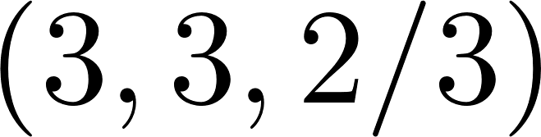
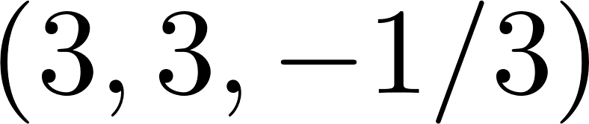
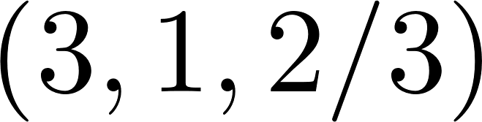
Tree-level mediators: leptoquarks
Scalar or vector leptoquarks can generate interactions
(more possibilities at loop level )
Eg Gripaios, Nardecchia, Renner, …
(Hiller, Nisandzic 2017)
or
or
or
Eg Bauer,Neubert; Becirevic et al

Slide 48
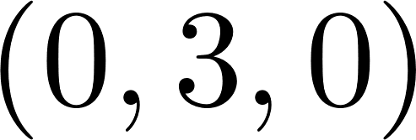
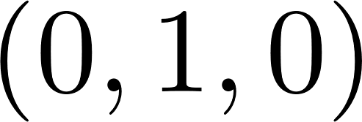
Tree-level mediators: W’, Z’
- appear as resonances in composite models (KK excitations in RS)
- Z’ exchange contributes to B_{s} mixing at tree-level (unlike leptoquarks)
or
Isidori et al, Quiros et al, Ligeti et al, Becirevic et al, Crivellin et al, …

Slide 49
A Z’ model for R_{K(*)}
Accommodating all b->s l l anomalies requires a muon-specific C_{L} –type interaction
with Λ ~ 30 TeV
However, C_{R} is weakly constrained and can also be present.
Anomaly-free Z’ model with gauged L_{μ} - L_{τ} , nonminimal (dim-6) coupling to quarks, can eg come from heavy vectorlike quarks:
The small coupling to quarks suppresses contributions to Bs mixing
Altmannshofer et al 2014
Also Crivellin et al, …

Slide 50
Global fit & single mediators
Global fit to anomalies, previously mentioned constraints, and the coefficients of the two purely left-handed operators
Compare to pattern predicted by a single mediator
(Axis scales depend
on flavour structure
of mediator couplings,
fitted simultaneously.)
vector
leptoquark
Buttazzo, Greljo, Isidori, Marzoca arXiv:1706.07808

Slide 51
Future collider direct searches
- Consider simplified Z’ and LQ models of R_{K(*)}
FCC-hh 100 TeV 1 ab⁻¹ covers all of viable Z’ parameter space, 33 TeV LHC “most”,
Leptoquark coverage slightly less perfect
Allanach, Gripaios, You arXiv:1710.06363

Slide 52
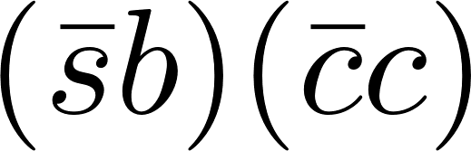
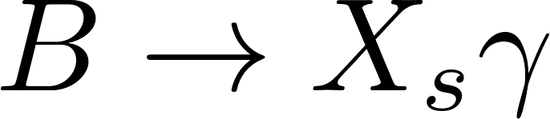
C₉ from BSM operators
SJ, Kirk, Lenz, Leslie arxiv:1701.09183
SJ, Kirk, Lenz, Leslie w.i.p.
Evolution from M_{W} to 4.6 GeV: [ ]
- Setting Delta C₂ to 1 and rest to zero, reproduce the (large) SM charm contribution to C₉(4.6 GeV).
But C₁ and C₃ are even more effective in generating C₉!
- C₂ and C₄ feed strongly into C₇^{eff}, hence .
But C₁ and C₃ are practically irrelevant for radiative decay!
Interesting interconnections between rare decays and B-lifetime (difference) observables
&

Slide 53
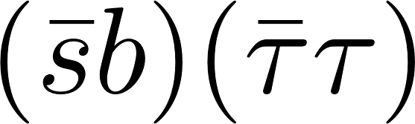
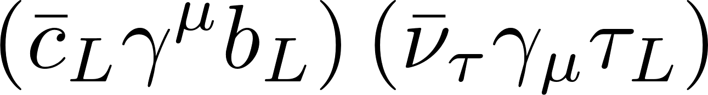
C₉ from BSM operators
Bobeth, Haisch arXiv:1109.1826
Crivellin et al arXiv:1807.02068
Similarly strong RG mixing into C₉ as in charming BSM case
This operator is automatically present for “left-handed” R_{D(*)} explanations via
This is a consequence of SU(2)_{W} symmetry and the
experimental bound on B → K*νν
Radiatively generated C₉ is again O(1) and negative (and lepton-universal)
Buras et al arXiv:1409.4557
τ

