Slide 1
HEPP/APP Town Meeting
Dr Brian R Bowsher
STFC Chief Executive
27 March 2018

Slide 2

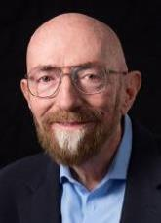
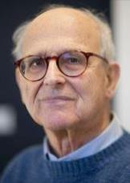
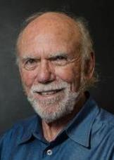
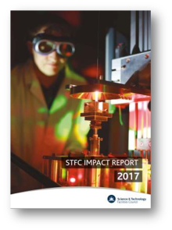
Recent Highlights
The UK continues to achieve scientific success on the global stage
Our Impact Report 2017 showcases impact on the UK research and innovation landscape over the past decade and marks 10 years of operation at Diamond Light Source, 40 years at the Central Laser Facility, 50 years at Chilbolton Observatory and 60 years at Rutherford Appleton Laboratory
Notes:
The 2017 Nobel Prize in Physics was awarded to Professors Kip Thorne, Barry Barish and Rainer Weiss for their work on detecting gravitational waves for the very first time. This work was made possible by Advanced LIGO (aLIGO), which relied heavily on initial UK capital funding and on expertise from UK universities and our own laboratories.
The 2017 Nobel Prize in Chemistry was awarded to British biochemist Professor Richard Henderson “for developing cryo-electron microscopy for the high-resolution structure determination of biomolecules in solution”, alongside Professors Jacques Dubochet and Joachim Frank. Professor Henderson and STFC have collaborated for the past decade on the development of sensors for the cryo-electron microscopy that he pioneered.
The Impact Report 2017 showcases STFC’s impact on the UK’s science and innovation landscape in the 10 years since our establishment, and celebrates the 10th anniversary of the Diamond Light Source, the 40th anniversary of our Central Laser facility, and the 50th anniversary of STFC’s Chilbolton Observatory.
STFC-funded researchers are amongst the leading nations in particle physics, nuclear physics and astronomy, according to our analysis of citations for the period 2014-2016. We invested around £165 million in support to university programmes in these areas in 2015/16, supporting a community of more than 1,000 academics in 86 universities.

Slide 3
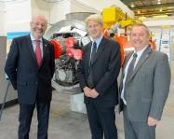
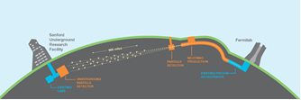
DUNE/LBNF investment
The US-led DUNE/LBNF project will undertake a game-changing programme of neutrino physics targeting big science challenges
  STFC is investing £65 million as part of the $500 million international project
UK has secured key leadership roles
  Stefan Soldner-Rembold (UoM) appointed co-spokesman, succeeding Mark Thomson
Notes:
This investment is a significant step which will secure future access for UK scientists to the international DUNE experiment. Investing in the next generation of detectors, like DUNE, helps the UK to maintain its world-leading position in science research and continue to develop skills in new cutting-edge technologies.
STFC will manage the UK’s investment in the international facility, giving UK scientists and engineers the chance to take a leading role in the management and development of the DUNE far detector and the LBNF beam line and associated PIP-II accelerator development.
Accompanying Jo Johnson on the visit to the US, Chief Executive Designate at UK Research and Innovation, Sir Mark Walport said: “Research and innovation are global endeavours. Agreements like the one signed today by the United Kingdom and the United States set the framework for the great discoveries of the future, whether that be furthering our understanding of neutrinos or improving the accessibility of museum collections.
Agreements like this also send a clear signal that UK researchers are outward looking and ready to work with the best talent wherever that may be. UK Research and Innovation is looking forward to extending partnerships in science and innovation around the world.”
The UK research community is already a major contributor to the DUNE collaboration, with 14 UK universities and two STFC laboratories providing essential expertise and components to the experiment and facility. This ranges from the high-power neutrino production target, the readout planes and data acquisitions systems to the reconstruction software.

Slide 4


APPEC Roadmap
The Roadmap makes 21 strategic recommendations for the astroparticle physics community ranging from multi-messenger astronomy and neutrino physics to dark matter and gender balance.
Successful launch of APPEC European Astroparticle Physics Roadmap in Brussels
Hard copies of the roadmap and shorter versions available
Contribute APPEC news or announcements and sign up for updates Corinne.Mosese@stfc.ac.uk
@astroparticle

Slide 5
UK Research and Innovation
UK Research and Innovation starts 1 April 2018 as the new funding organisation for research and innovation in the UK.
It brings together the seven UK research councils including STFC, Innovate UK and a new organisation, Research England which will work closely with its partner organisations in the devolved administrations.
Wider Scientific community:
Universities, Businesses, Institutes, Charities,
National Academies, Strategic/Business Partners
EPSRC
ESRC
Scottish Funding Council
MRC
BBSRC
UKRI Board and Corporate functions
Research England
HEFCW
AHRC
Northern Ireland Executive
Innovate UK
NERC
STFC

Slide 6







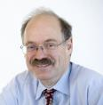




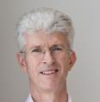



UKRI Board
Sir Peter Bazalgette
Sir Harpal Kumar
Professor Julia Black
Professor Max Lu
Sir John Kingman
Chair, UKRI
Professor Sir
Leszek Borysiewicz
Vivienne Parry
Lord John Browne
Mustafa Suleyman
Professor Sir Mark Walport
Chief Executive Officer
Professor Sir
Ian Diamond
Lord David Willetts
Fiona Driscoll
Professor Dame
Sally Davies
Professor Alice Gast
Ian Kenyon
Chief Finance Officer

Slide 7
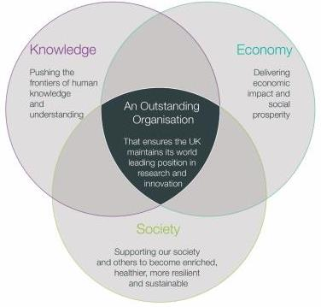

Preparation for UKRI
Strengthened strategic approach to future challenges
Unified voice for the UK’s research and innovation system
Smoother pathway for innovation
More time for research and innovation leaders to focus on strategic leadership
Improved quality of evidence on the UK’s research and innovation landscape
Immediate Priorities:
  Finalise detail and commence successful delivery of additional R&D funding starting from 18/19
  Engaging stakeholders to create a well informed roadmap to reaching 2.4% of GDP investment in R&D by 2027
Notes:
To stress
It will be business as usual for our communities and the expectation is they see only constructive changes and improvements

Slide 8

Financial landscape
Overall funding for research and innovation is seeing a significant uplift
Autumn Statement 2016 provided an extra £4.7bn in total from 2017 to 2021
  Budget increase of £2b from 2020/21
Autumn Budget 2017 added a further £2.3 billion for 2021/22, effectively ‘baselining’ this uplift
Commitment to increase total share of GDP spent on R&D to 2.4% by 2027 could translate to £10 billion pa by 2027/28

Slide 9




2017/18 finance
International subscriptions:
Currency fluctuations recognised and funded (~£30m pa)
Major Facilities:
Review recognised international leadership and efficiency of operation (Diamond, ISIS, CLF) – uplift of £10m p.a. to reverse previously expected savings
Talent:
Launch of Data-Intensive CDTs (£10m)
Support for Impact Acceleration Accounts (£2.2m in 2017/18)
Capital Investment:
Reversal of 40% cuts to World-class Labs
National Satellite Test Facility (£99m), Rosalind Franklin Institute (£100m), Faraday Institute (£55m), DUNE (£65m)
Core :
Urgent e-infrastructure funding (£3m) in 2017/18

Slide 10
Immediate Pressures
    The new budget investment is being made through directed funds
  STFC allocation remains flat-cash from 2016/17 to 2019/20
  We are continuing to make the case for an uplift
  Requires a joint effort to ensure we can seize new opportunities
    Annual £12.3 million resource gap and £17.6 million capital gap by 2020/21
  Potential additional allocation of £5m in 2018/19 and 2019/20 to protect international commitments and early R&D
  Capital bids for urgent e-infrastructure for 2018/19 and 2019/20, CLARA FEL test facility and reversal of reduced capital allocations for 2019/20 and 2020/21 under consideration by UKRI/BEIS

Slide 11
Programme pressures
Our Programme has survived largely by big projects moving downstream (E-ELT, LHC upgrades), but can’t continue forever
  Strategic reviews to tension the programme (LHC Upgrades, Neutrinos, Phenomenology)
  Sub-optimal funding , PRD cancelled
Need to increase our success in ISCF and GCRF
BEIS and UKRI understand our flexibility is now very low

Slide 12
Financial opportunities
Global Challenges Research Fund (GCRF)
  Up to £200m of the £1.5bn total collective fund unallocated
Industrial Strategy Challenge Fund (ISCF)
  Wave 2 challenges launched, open call for Wave 3 ideas
Strategic Priorities Fund (SPF)
  £755m over three years, bids from any BEIS-funded R&D organisation
Talent Fund
  950 AI studentships available over five years from 2019
  UKRI call for CDTs issued by EPSRC closes tomorrow
Strength in Places Fund
  £115m over three years for collaborative bids between research organisations and business to support regional growth
More announcements expected
Notes:
Successful GCRF supported projects include the interdisciplinary GCRF activity to develop innovative, robust radiotherapy linacs with CERN and the International Cancer Expert Corps (ICEC). An STFC-funded workshop. “Burying the Complexity: Re-engineering for the Next Generation of Medical Linear Accelerators for Use in Challenging Environments”, took place March 22/23. It is the second of what we hope will be a series of workshops that brings together expert accelerator physicists, clinicians, medical physicists and engineers, including representatives from ODA countries. It builds on the outcome of the joint technical workshop held in CERN last October that considered radical re-designs rather than small engineering improvement, to take the system back to the physics in order to see what might be done differently.
ISCF Wave 3 EoI is to identify the main challenges faced by industry and society in the UK.
Need to be industry-led consortia.
EoI is not a competition for funding in itself but a way to identify the main challenges which may then be addressed by ISCF.
No New newton calls at present

Slide 13
STFC additional calls
Opportunities Call
  To pump prime activities that will position university groups to participate in interdisciplinary science that align with GCRF, ISCF and other funding schemes arising from UKRI
  Support for 4-6 month projects that enable the university group or consortia to undertake seed corn type projects
Capital Call
  Capital equipment to support the PPAN programme and to develop its External Innovation capabilities.
  Available to support programme activities, proof of concept type research, early prototyping and laboratory demonstrations etc.
Opening Date: 10th April 2018 Closing Date: 12th June 2018
www.stfc.ac.uk/funding/research-grants/funding-opportunities/funding-calls/
Notes:
The Opportunities call in 2018 aims to pump prime activities that will position university groups to participate in interdisciplinary science that align with GCRF, ISCF and other funding schemes arising from UKRI. This call will exploit approximately £500k of resource funds and will support short-term (4-6 month) projects that enable the university group or consortia to undertake seed corn type projects intended for early partnerships, creating effective pathways across science areas or industry.
As noted in the 2016 Balance of Programmes review, STFC’s capital budget will remain flat until 2019 at least. And beyond 2019 a decrease in STFC’s capital allocation is currently under consideration. With such tight capital funding constraints, it is imperative that STFC is able to utilise and optimise its entire funding envelope. This capital call aims to optimise the use of any headroom available in FY 2018/19. Presently it is anticipated that £2M-£3M will be available for this call. The call will benefit PD’s R&D activities within the PPAN programme as well as our External Innovation capabilities. Therefore, the call will invite two types of proposals, one to augment the current PPAN programme and one to develop external innovation. The call will help to support Consolidated Grant activities, which were identified as the highest priority in the BoP review, and provide External Innovation support through supporting proof of concept type research, early prototyping or a laboratory demonstration with a focus on the challenge areas identified in the ISCF.
The Calls will both open on the 10th April 2018 and close on the 12th June 2018, and will be reviewed by PPRP. Further information can be found on STFC’s webpages.

Slide 14

Brexit
Real concerns over funding and skills
  Refining for Government a comprehensive view of the importance of EU Framework programme funding for PPAN communities
  Importance of international collaborations are recognised
The government has issued a document to clarify the UK’s eligibility to participate in Horizon 2020 and its commitment to underwrite bids
  The full document and Q&A available at www.ukro.ac.uk
Notes:
A sample of 26 of our major funded departments showed;
In particle physics 22.6% of the total funding received from H2020 and STFC over the last 3 years came from H2020.
In astronomy this was 40.9% and in nuclear physics it was 19.7%

Slide 15

Research Infrastructures Roadmap
Sponsored for UKRI by STFC Executive Chair
Roadmap will:
  Identify research and innovation capability needs (to ~2030) and existing gaps responding to changing R&D and socio-economic demands
  Assess duplication and areas of reduced priority
  Develop strategic priorities envisaged for funding
  Support international negotiations
Timeframe:
  Launched in Jan 2018
  Production of draft roadmap: Oct 2018
  Event to review draft roadmap: Nov 2018
  Formal issue of roadmap: April 2019

Slide 16
STFC Appointments
New Council announced 23 March
Legacy Council
  Existing Research Councils continue as legal entities to 31 October 2018 to support closure of accounts and provide contingency for transition
Panel opportunities
  We have vacancies for outstanding individuals to become members of our committees and panels
  Details on website www.stfc.ac.uk/panels
  Closing date is Monday, 9 April

Slide 17
New STFC Council
Professor Isabelle Baraffe - Chair in Astrophysics, University of Exeter
Professor Mike Dunne - Director LCLS, SLAC (former Director CLF)
Mr Dick Elsy - CEO, High Value Manufacturing Catapult
Professor Karen Holford^ - Deputy Vice-Chancellor, University of Cardiff
Professor Richard Kenway^ -Vice-Principal, High Performance Computing, University of Edinburgh (Senior Independent Member)
Professor Anupam Ojha – Director, Education and Space Communications, National Space Academy, National Space Centre
Professor David Price^ - Vice-Provost (Research) & Professor of Mineral Physics, UCL
Professor Sheila Rowan – Director, Institute for Gravitational Research, University of Glasgow & Chief Scientific Adviser to the Scottish Government
Professor David Rugg - Senior Research Manager, Rolls-Royce
Professor Tony Ryan^ - Professor of Physical Chemistry and Director of Grantham Centre for Sustainable Futures, University of Sheffield
Dr Frances Saunders – Former CEO Defence Science and Technology Laboratory & Ex-President Institute of Physics
^ member of current STFC Council

Slide 18
Particle Physics Update
Highest priority to fully exploit LHC investment at CERN
  Investment in ATLAS, CMS and LHCb (also ALICE) exploitation
  LHC performance in RUN2 has been outstanding
  LHC experiment upgrades strongly supported
Meeting massive computing requirements for next generation of experiments (e.g. HL-LHC) requires new joint approach
  UK-T0 consortium creating a more joined-up approach to e-infrastructure provision in STFC and its science communities
  STFC also engaged with other Research Councils to develop a National e-Infrastructure strategy
Notes:
LHC experiment upgrades strongly supported
LHCb and ALICE upgrades funded and on track
ATLAS and CMS Phase-1 upgrades construction and R&D for Phase-2 funded and on track
ATLAS and CMS Phase 2 upgrades supported but at significantly reduced level due to impact of continuing flat cash on programme
New approach needed to meet Computing requirements for data intensive science. Needs common solution(s) with areas beyond PP, using both HPC and HTC platforms and with strong focus on software performance

Slide 19
Particle Physics Strategy
European Strategy for Particle Physics Update 2019 now underway
  Jon Butterworth as UK delegate on ESG, Mark Thomson as UK Lab rep
  PPAP community meeting in summer 2018 will provide opportunity for community wide consultation
    UK community consultation starting with IPPP-hosted workshop (16-18 April)
  Deadline for international community input is 18 December 2018
HEP Summer School took place in September 2017
  slight increase in graduate student numbers on last year and feedback on the school has been very positive
  From next year the summer school will be overseen by the ETCC alongside STFC’s other schools
Notes:
ESPP. Following 2017 PPAP community meeting, a set of early career academics has been given the task of organising UK wide meetings during 2018 to discuss the UK’s position. The PPAP community meeting in 2018 will also provide one community wide consultation opportunity. By the end of 2018 the PPAP and the committee will produce a document on the UK communities’ input to the update of the European Particle Physics Strategy

Slide 20
Reviews
Programme Evaluations
  Particle Astrophysics Evaluation underway
  Particle Physics Evaluation due to begin in Autumn 2018
  Inter-dependencies between areas to be managed (e.g. PA and PP)
  Each review to explore consequence of +/- 10% funding over the next 5yrs
Detectors & Instrumentation Strategy
  Will consider the D&I opportunities, in the UK and internationally, for incremental and novel developments and recommend the priorities for future STFC D&I developments, highlighting synergistic opportunities and the actions needed.
  Community consultation is underway
  Inputs can be submitted to STRATEGIES@stfc.ac.uk until end of April
  Further information on the STFC website
Notes:
Sean Freeman will cover the Programme Evaluations in his Report from Science Board presentation

Slide 21
Particle astrophysics
Strong support for UK gravitational waves (GW) community
  UK had critical development role in LIGO detections
  UK institutes working on a $12M Proposal to contribute to upgrade of the two LIGO detectors in the US
Direct dark matter searches with LUX-ZEPLIN
  UK is the major partner in construction phase of this US-led project
  Delivery of the UK designed and built titanium cryostat, marks a key milestone in the project’s construction phase
Cherenkov Telescope Array (CTA) project
  Currently in pre-production phase, but close to securing construction funding
  CTA-UK collaboration remains in a good position to secure its goal of providing the novel camera systems for the SST
  Funding level subject to STFC Programme evaluation
Notes:
Gravitational Waves is our highest priority in Particle Astrophysics and UK institutes had critical development role in first LIGO detection. Detection included close collaboration with astronomers using other astronomy observatories to combine multi-messenger observations of a single event. The UK consortium of universities involved in ALIGO are now working on a $12M proposal to contribute to the planned upgrade of the two LIGO detectors in the US. Funding will be subject the outcome of the PA Evaluation, and will need additional capital funding from BEIS
CTA is close to securing the funding commitments needed from shareholders for the 250M€ Threshold (i.e. minimal) Array construction phase. UK will not be able to confirm its funding until late 2018, following the outcome of the programme evaluation reviews. The CTA-UK collaboration remains in a good position to secure its goal of providing the novel camera systems for the SST with the initial performance of its CHEC-S camera looking good and on-telescope tests for the ASTRI and GCT prototype SSTs planned next year. The construction phase SoI for CTA-UK was considered by Science Board at its December meeting and invited to proceed with the full case for support, subject to clarification on a number of points (e.g. what if the UK camera is not chosen in the final technology down-select). Targeted site infrastructure work will begin in 2018 to avoid introducing delays to construction; this will be time and costs limited within the GmbH pre-production phase. The Italian government (as hosts of the international CTA-O HQ) has now initiated the legal process towards the final legal entity. As this is almost certainly to be in the form of an ERIC, BEIS are leading the UK legal negotiations.

Slide 22
Skills and Training
Skills Balance of Programme
  STFC’s skills programme has been reviewed by an external panel in a 3-yearly exercise
  Input gathered from STFC’s community and campus partners
  Council endorsed the panel report; publication to follow
220 doctoral training partnership studentships for 2018 starts allocated in December. Process for 2019 starts is underway and allocations will be announced by the end of the year
25 additional studentships from the national productivity investment fund enable all our data science CDTs a second cohort
Notes:
Could verbally mention we expect announcement of Future Leadership Fellowships soon?

Slide 23
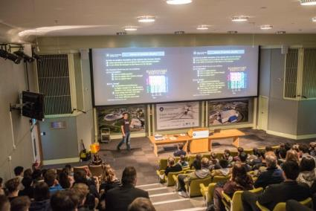
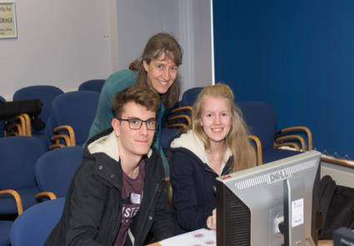
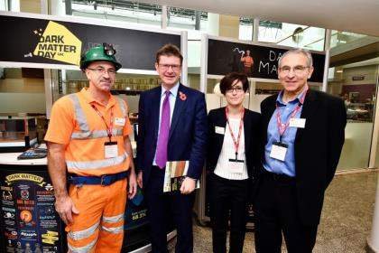
Dark Matter Day and Masterclasses
2018 Particle Physics Masterclasses attended by more than 1000 students and teachers
On 31 October STFC community engaged stakeholders, press and the public with the intriguing science on Dark Matter Day
Professor Carlos Frenk was guest of honour at STFC’s activities in Westminster, meeting Greg Clark with exhibitions in BEIS and Parliament

Slide 24
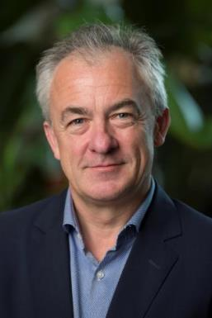
STFC Executive Chair: Mark Thomson
Professor Mark Thomson takes up the role of STFC Executive Chair in April
Professor of Experimental Particle Physics and has held national and international research leadership roles
He was the co-leader of the Deep Underground Neutrino Experiment (DUNE), a collaboration of over 1000 scientists, working towards the construction of a major new project in the US
In addition to his own research, Professor Thomson has held numerous research oversight roles both in the UK and abroad
Notes:
Mark Thomson is Professor of Experimental Particle Physics at the University of Cambridge. He is an author on over 1000 publications. He obtained a degree in physics (1988) and doctorate (1992) in particle physics, both from the University of Oxford. He then spent two years as a Research Fellow at University College London, before being employed by CERN for six years, first as Fellow then as a staff research scientist. At CERN he played a leading role in the precision measurements of the properties of the W and Z bosons with the OPAL experiment at the Large Electron Positron collider.
In 2000 he moved to the University of Cambridge to take up a lectureship at the Cavendish Laboratory and a Fellowship at Emmanuel College. Since moving to Cambridge, his research has spanned a number of areas, including neutrino physics (MINOS, MicroBooNE and DUNE) and physics at future colliders. He is one of the pioneers of high-granularity particle flow calorimetry, demonstrating the potential significant gains in jet energy resolution compared to traditional techniques.
Professor Thomson has held national and international research leadership roles at the forefront of particle physics in both neutrino physics and collider physics. Most recently, he has been the co-leader of the Deep Underground Neutrino Experiment (DUNE), a collaboration of over 1000 scientists, working towards the construction of a major new project in the US. He was the scientific lead for the recent £65M UK investment in DUNE, which has secured the UK’s leading role in the construction of DUNE.
Beyond his own research, he has held numerous research oversight roles in the UK and abroad. He has worked closely with STFC in various capacities, including chairing its main peer review body. In 2013, he published “Modern Particle Physics”, a textbook that has been widely adopted for undergraduate courses at universities around the globe.
He has been married for almost 25 years to Sophie, and they have two teenage children. In his spare time, Mark is a keen skier, with an interest in wine and cooking.

Slide 25

Questions?

