Slide 1
ATLAS inner detector decommissioning
Tolerance study of robotic components for use in high radiation environment
Alice Cryer, University of Sheffield

Slide 2
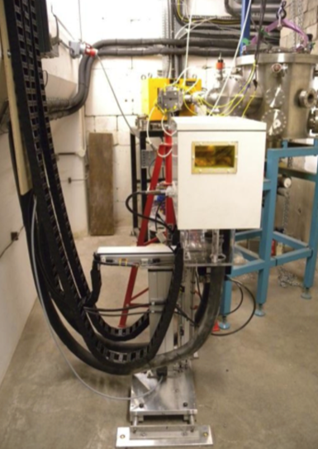
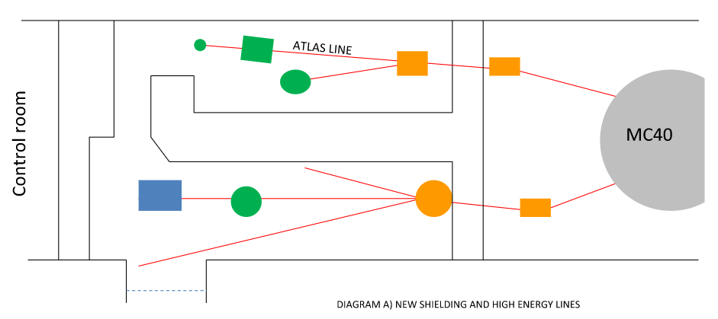
Birmingham Irradiation facility
Revised radiation estimates less than previous simulations
Future high luminosity colliders will have high radiation -> need remote tooling
Also has Industry applications
Cyclotron beam of 23MeV protons focussed to 1cm²

Slide 3
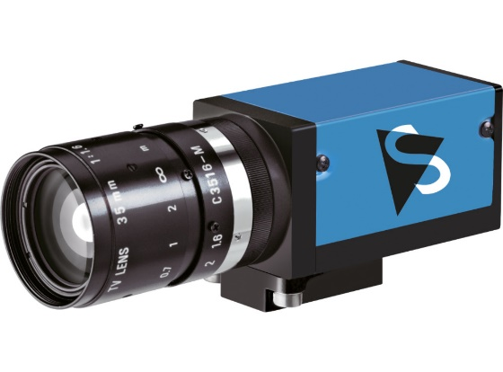
ImagingSource GigE camera
Irradiation Facility
First irradiation was an ImagingSource GigE camera
The camera was irradiated by scanning the beam over its profile
Moved by a "Cartesian Robot" scanning system
23MeV proton beam @10nA
Source: ImagingSource

Slide 4
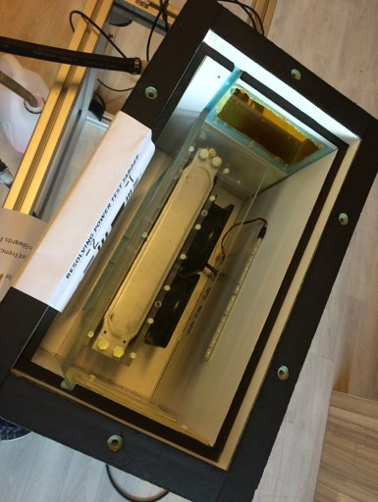
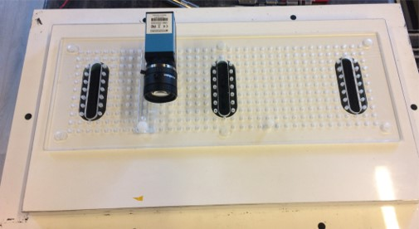
ImagingSource GigE camera
Experimental Setup
Camera uses Ethernet for both power and data
Camera is monochrome
Camera was live during irradiation, sending 1 picture/second
Glycol chiller set to 10°C
Camera mounted
on the lid of the box

Slide 5


ImagingSource GigE camera
Results
Minor pixel degradation before failing
It recovered after a period of inactivity
Ethernet used as both power and data: design is a significant radiation weakness
First picture
During the irradiation showing hot pixels
Ultimate cause of failure inconclusive

Slide 6
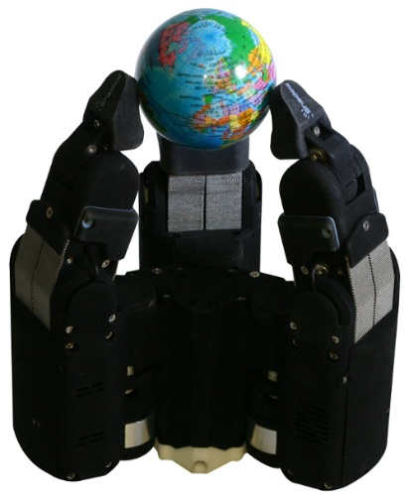
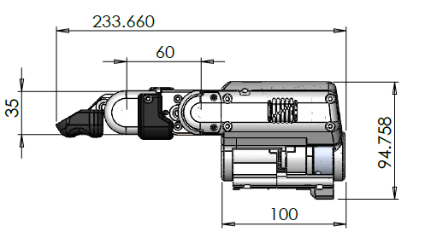
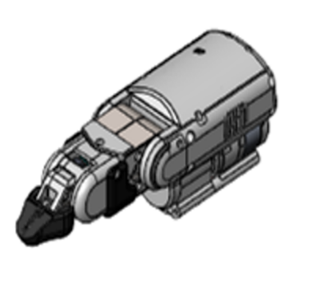
Shadow Robot manipulator
Experimental Setup
The robotic manipulator was one of the three fingers from Shadow Robot company’s Smart Grasping System
It was programmed to perform a set of repetitive tasks, moving itself in and out of the beam
It was irradiated with a static beam
Source: Shadow Robot
Source: Shadow Robot
Source: Shadow Robot

Slide 7
Shadow Robot manipulator
The Robotic manipulator
Source: Shadow Robot
3 driver chips, 3 motors and a sensor on the finger tip

Slide 8
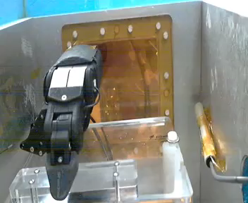
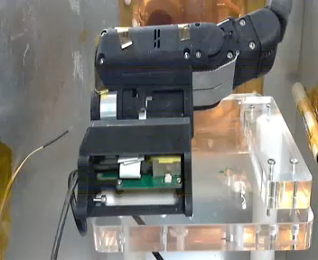
Shadow Robot manipulator
The Irradiation
The finger in the first orientation was significantly resistant to radiation
23MeV proton beam @10nA
Second orientation placed the beam directly above a driver chip
23MeV proton beam @5nA (beam drift)
First orientation
Second orientation

Slide 9
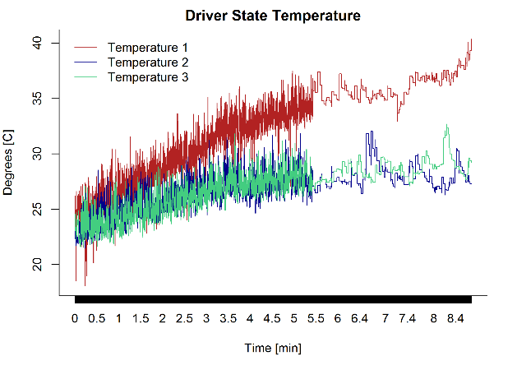
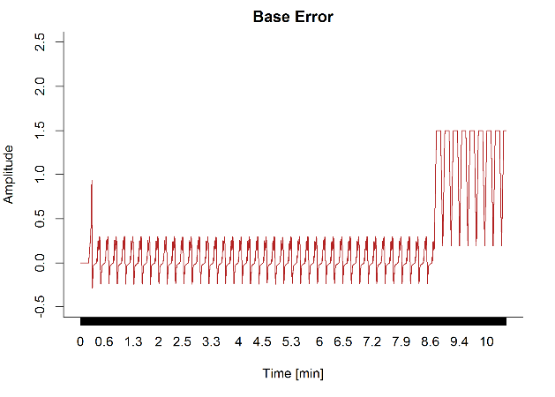
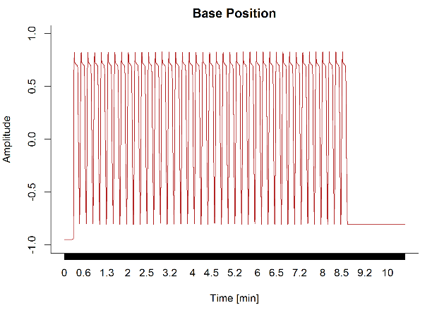
Shadow Robot manipulator
Results
Data readout from the finger show where and when it failed
Program movement incomplete:
driver failure
2 other drivers still working
Program fail conditions creates weakness to radiation

Slide 10
Shadow Robot manipulator
Analysis
The manipulator proved to be significantly resistant to radiation:
  Would be suitable for use in radioactive environments
A second irradiation experiment within the cyclotron vault has been proposed
Inside the vault there is much broader range of radiation:
  More comparable with industrial nuclear decommissioning

Slide 11
Thank you for listening
Any questions?

