Slide 1


3D Printing Gaseous Radiation Detectors
Sam Fargher¹
Jon Burns²
Lee Thompson¹
Physics and Astronomy, The University of Sheffield
AWE, plc
IOP APP - HEPP 2018
© Crown Owned Copyright 2017, AWE/MoD
Notes:
Fused Deposition Modelling has been used to produce a single wire Iarocci-style drift tube to demonstrate the feasibility of using the Additive Manufacturing technique to produce cheap detectors, quickly. Recent developments have extended the scope of Additive Manufacturing, or “3D printing”, to the possibility of fabricating Gaseous Radiation Detectors, such as Single Wire Proportional Counters and Time Projection Chambers, allowing for the production of customizable, modular detectors, that can be easily created and replaced. The 3D printed drift tube has been found to be operational proving Additive Manufacturing could be a viable production method, and giving rise to the possibility that more complex detectors can also be 3D printed.

Slide 2
Motivation

Creation

Operation

Overview
Motivation
Creation
Operation
Future Plans
The Technology
The ‘Grand Challenge’
The Possibilities
Quick Introduction to Rapid Prototyping
Introduction to Fused Deposition Modelling (FDM)
The Prototype
The Process
The Tracker
The Setup
Tube 1 Results
Tube 2 Results
3D Tracker
© Crown Owned Copyright 2017, AWE/MoD
IOP APP - HEPP 2018 March 26-28 2/19

Slide 3
Motivation
  The Technology
  The ‘Grand Challenge’
  The Possibilities
© Crown Owned Copyright 2017, AWE/MoD

Slide 4
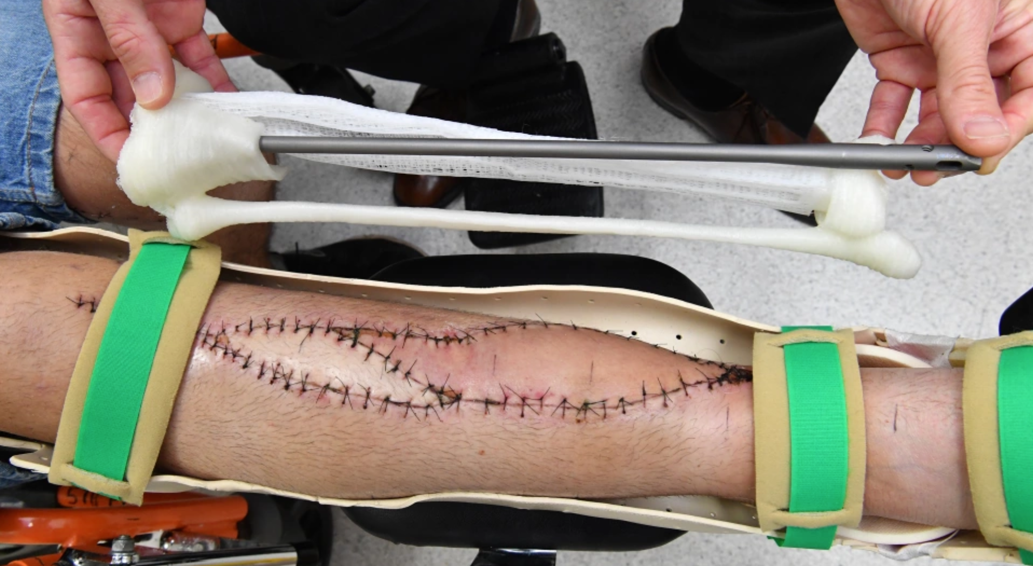
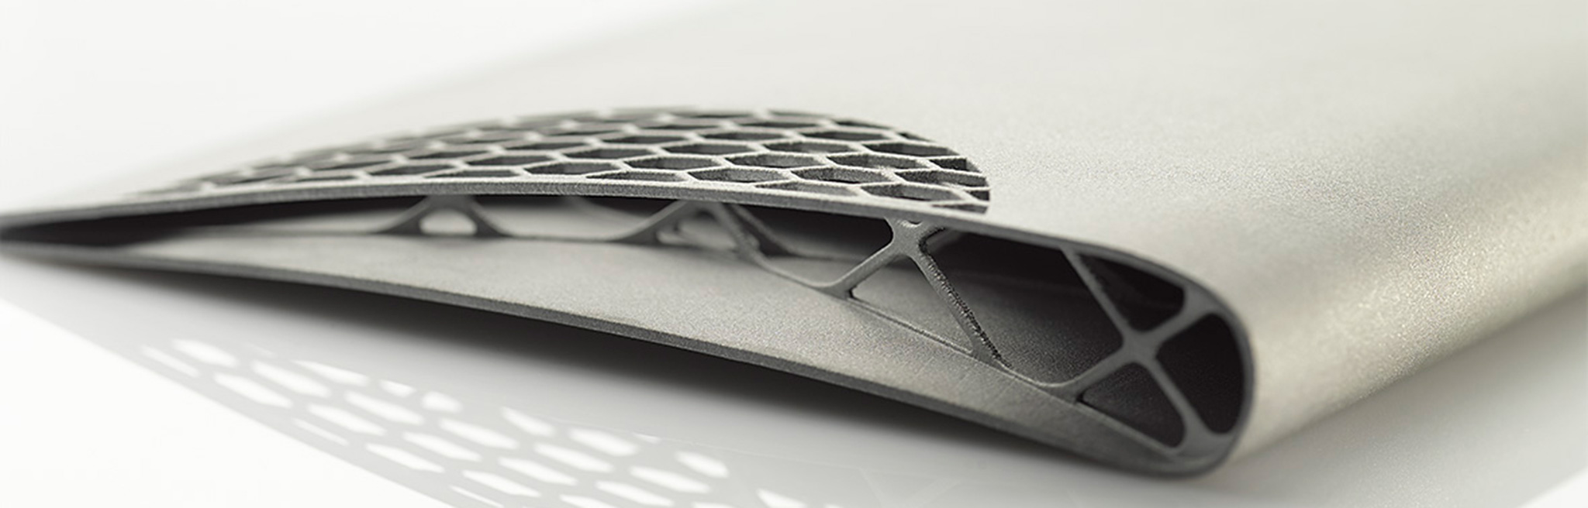
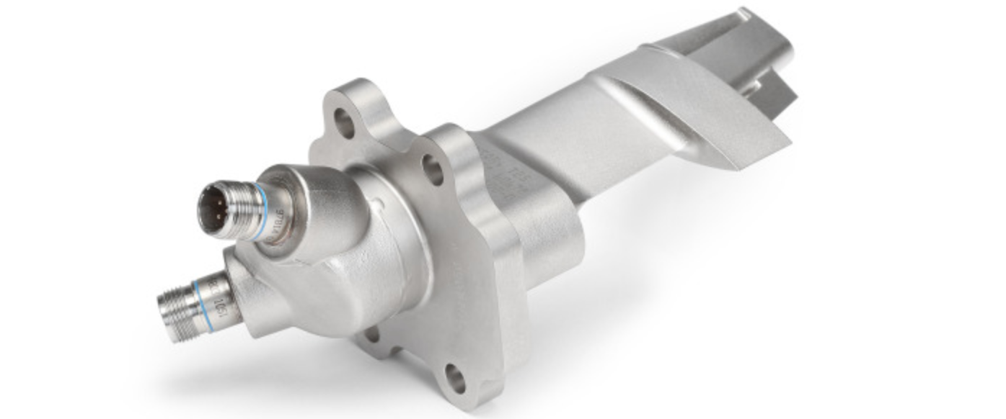
Motivation

Creation

Operation

The Technology
Rapidly growing technology, with increases in print speed, print size and feature resolution.
Decreasing cost of printers and inexpensive build materials, with costs likely to continue decreasing.
Build materials are durable, strong, relatively heat, chemical and moisture resistant.
Constantly growing market (predicted 300% growth in next decade).
© Crown Owned Copyright 2017, AWE/MoD
[Image: Darren England/AAP]
[Source: RSC Engineering GmbH]
[Source: GE Aviation]
IOP APP - HEPP 2018 March 26-28 4/19
Notes:
Machine shapes that are extremely difficult or impossible with conventional manufacturing method
Automotive $1.1B 2019
[Image: Darren England/AAP]

Slide 5
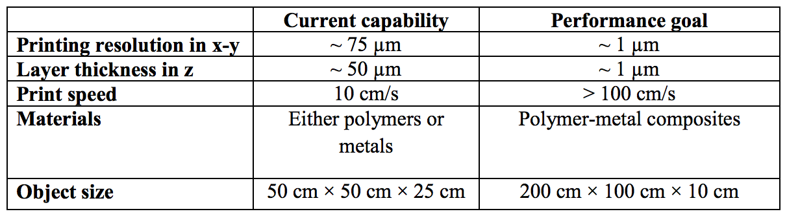
Motivation

Creation

Operation

The ‘Grand Challenge’
Table comparing commercial Additive Manufacturing (AM) capabilities to the performance needed to 3D print complete MPGCs, containing GEMs, for high spatial resolution detectors required in HEP experiments [Hohlmann, 2013].
Current capabilities ≠ Performance Goals
But we can still use it!
© Crown Owned Copyright 2017, AWE/MoD
IOP APP - HEPP 2018 March 26-28 5/19

Slide 6
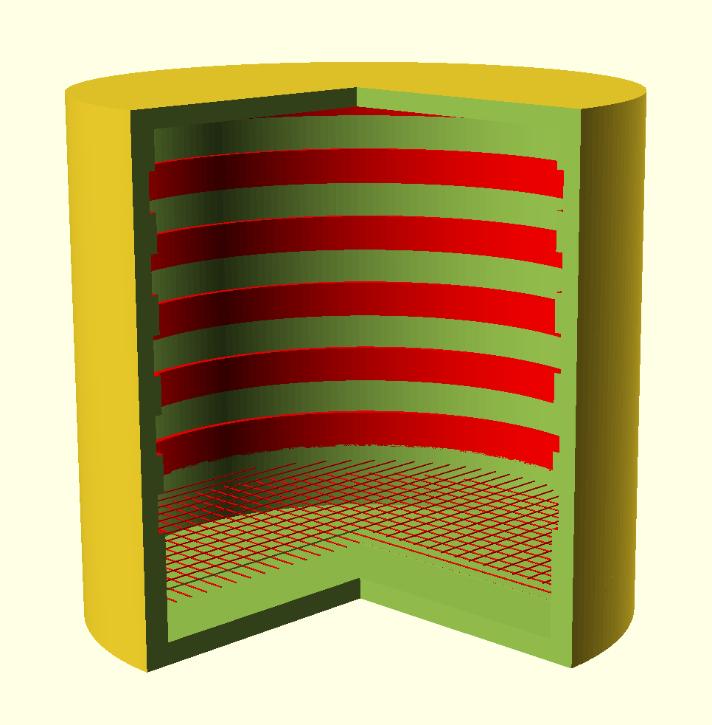
Motivation

Creation

Operation

The Possibilities
Produce modular detector arrays that can have broken modules easily replaced.
Possibility of biodegradable materials; giving the detectors significant longevity without compromising the environment.
Ease of design alteration allows customizability and scalability.
Produce prototype detectors to test electronics.
Print detectors in remote locations.
Investigate new geometries of detectors.
Easily print detectors for Outreach.
Low radioactivity of build materials minimizes background.
© Crown Owned Copyright 2017, AWE/MoD
IOP APP - HEPP 2018 March 26-28 6/19

Slide 7
Creation
  Quick Introduction to Rapid Prototyping
  Introduction to Fused Deposition Modelling (FDM)
  The Prototype
  The Process
  The Tracker
© Crown Owned Copyright 2017, AWE/MoD

Slide 8
Motivation

Creation

Operation

Quick Introduction to Rapid Prototyping
(Re-)Design Model
Print Prototype
Test Prototype
© Crown Owned Copyright 2017, AWE/MoD
IOP APP - HEPP 2018 March 26-28 8/19

Slide 9
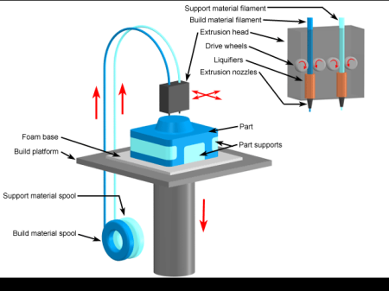
Motivation

Creation

Operation

Introduction to Fused Deposition Modelling (FDM)
3D models are constructed layer by layer from CAD file.
Each layer is created by extruding molten thermoplastic in the x-y plane.
The base plate moves in the z-axis to build up layers.
The layers are thermally fused on contact to create a solid structure.
[Source: 3D Parts]
© Crown Owned Copyright 2017, AWE/MoD
IOP APP - HEPP 2018 March 26-28 9/19
Notes:
http://www.3dparts.co.uk/

Slide 10
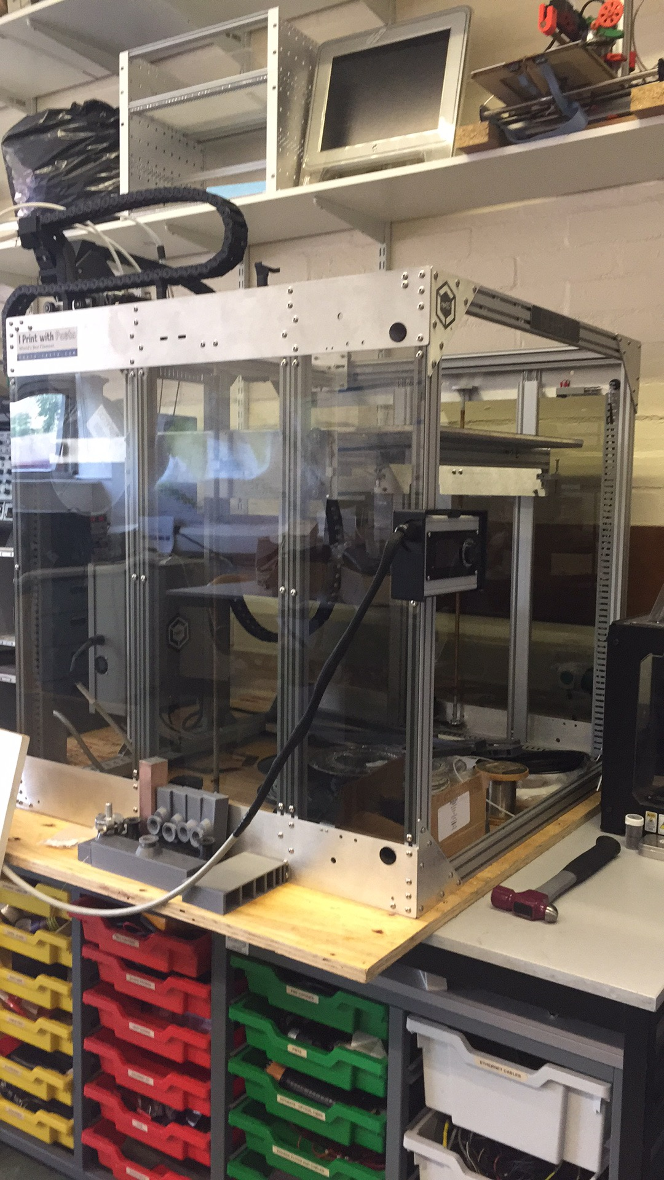
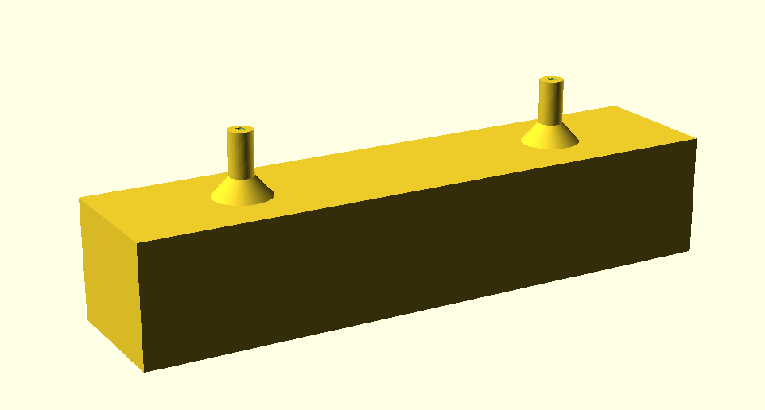
Motivation

Creation

Operation

The Prototype
Iarocci tubes are of the simplest in design and function:
OpenSCAD to create CAD model.
Gigabot to print:
PLA as print material
Consists of a central tube, anode wire (high tension) and highly resistive cathode coating.
Triangular prism shaped volume
142 mm × 24 mm × 28 mm (x × y × z)
Large scale FDM printer.
Build size 600 mm x 600 mm x 600 mm.
Polylactic Acid, (C₃H₄O₂)_{n}
Low warping
Low Outgassing (TML: 0.56%, CVCM: 0.01%,
WVR: 0.03%)
© Crown Owned Copyright 2017, AWE/MoD
IOP APP - HEPP 2018 March 26-28 10/19
Notes:
Total Mass Loss
Collectable Volatile Condensable Material
Water Vapor Regained

Slide 11
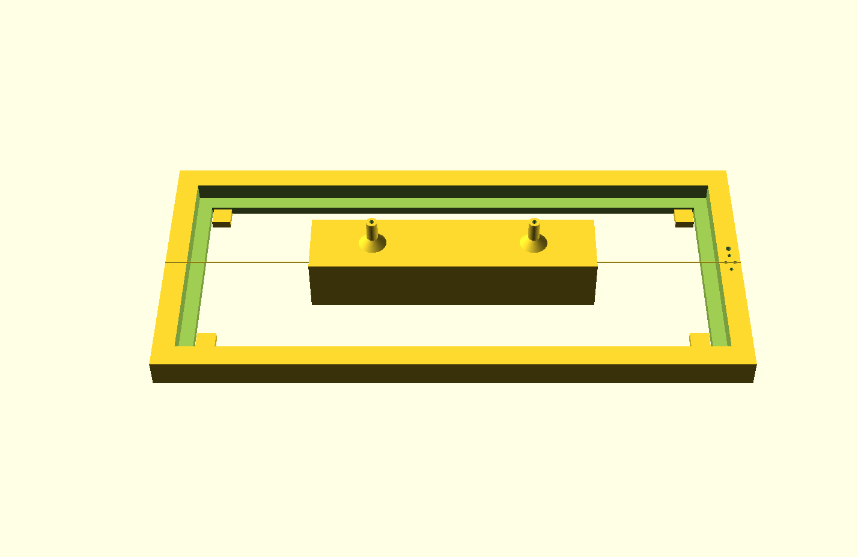
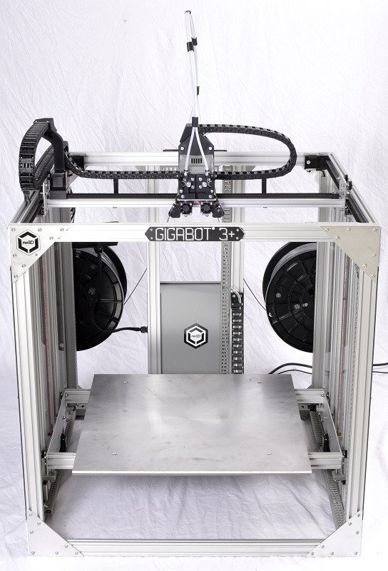
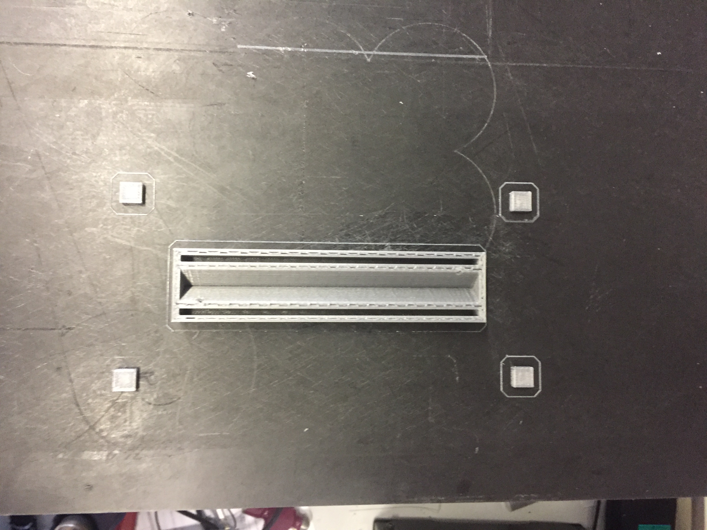
Motivation

Creation

Operation

The Process
Wire frame 3D printed to hold anode wire at high tension.
Hollow tube designed and the GCODE edited:
Tube coated in copper shielding spray (to act as grounded cathode).
End caps 3D printed to protect anode wire.
Percentage infill investigated to provide sufficient friction.
Stainless Steel Wire (r_{a}~50 μm)
Pause print at midway point to allow the introduction of the anode wire.
Deposit more molten plastic in layers closest to wire, to ensure sufficient grip.
© Crown Owned Copyright 2017, AWE/MoD
[Source: re:3D]
IOP APP - HEPP 2018 March 26-28 11/19

Slide 12
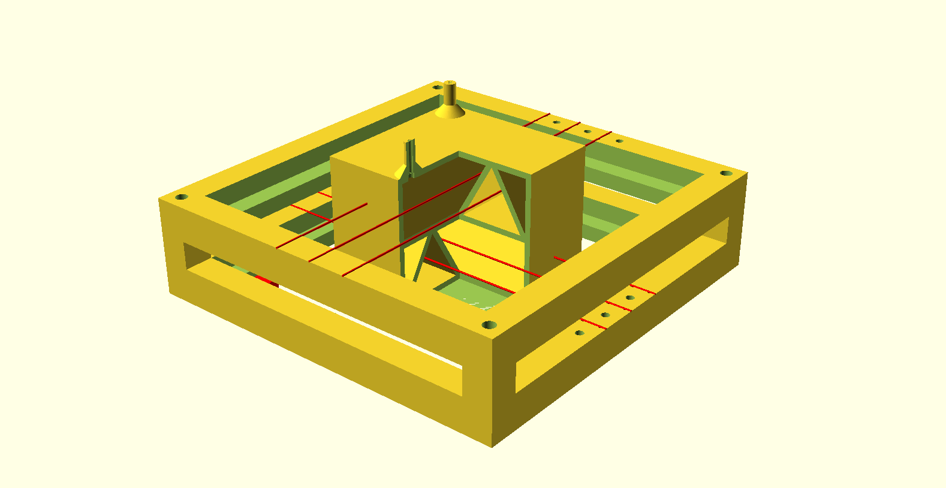
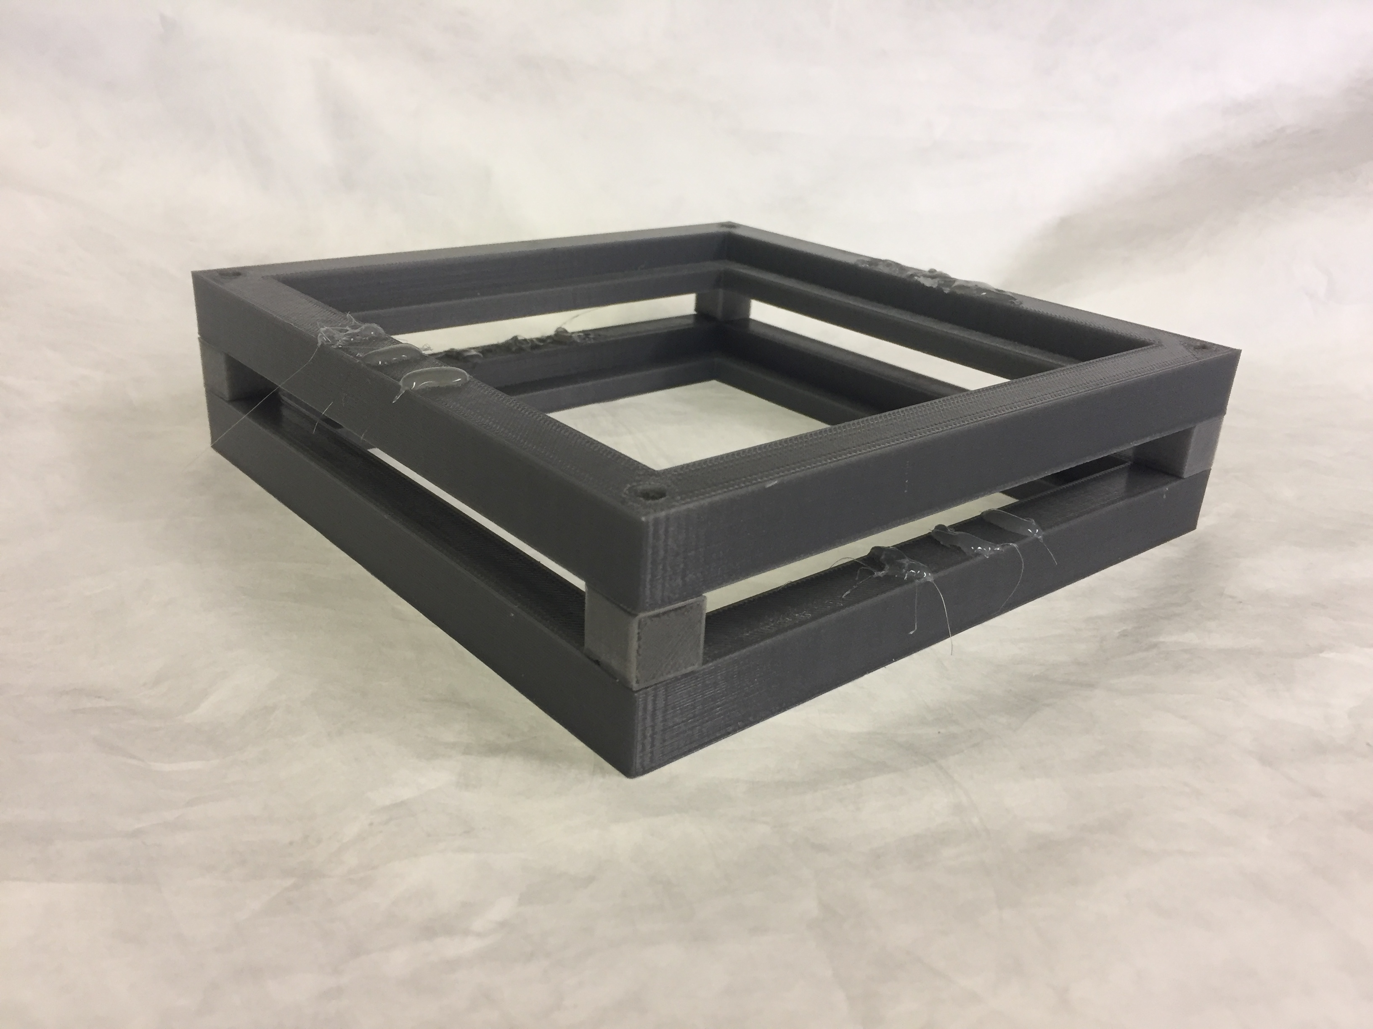
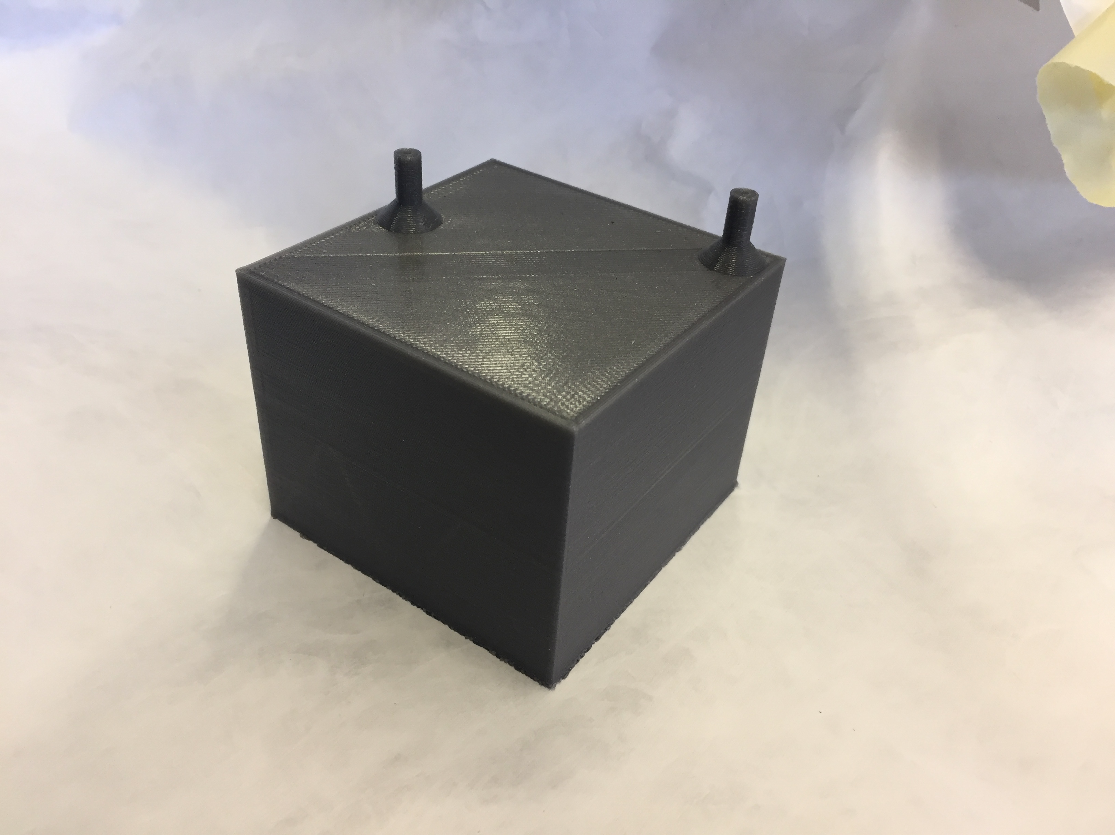
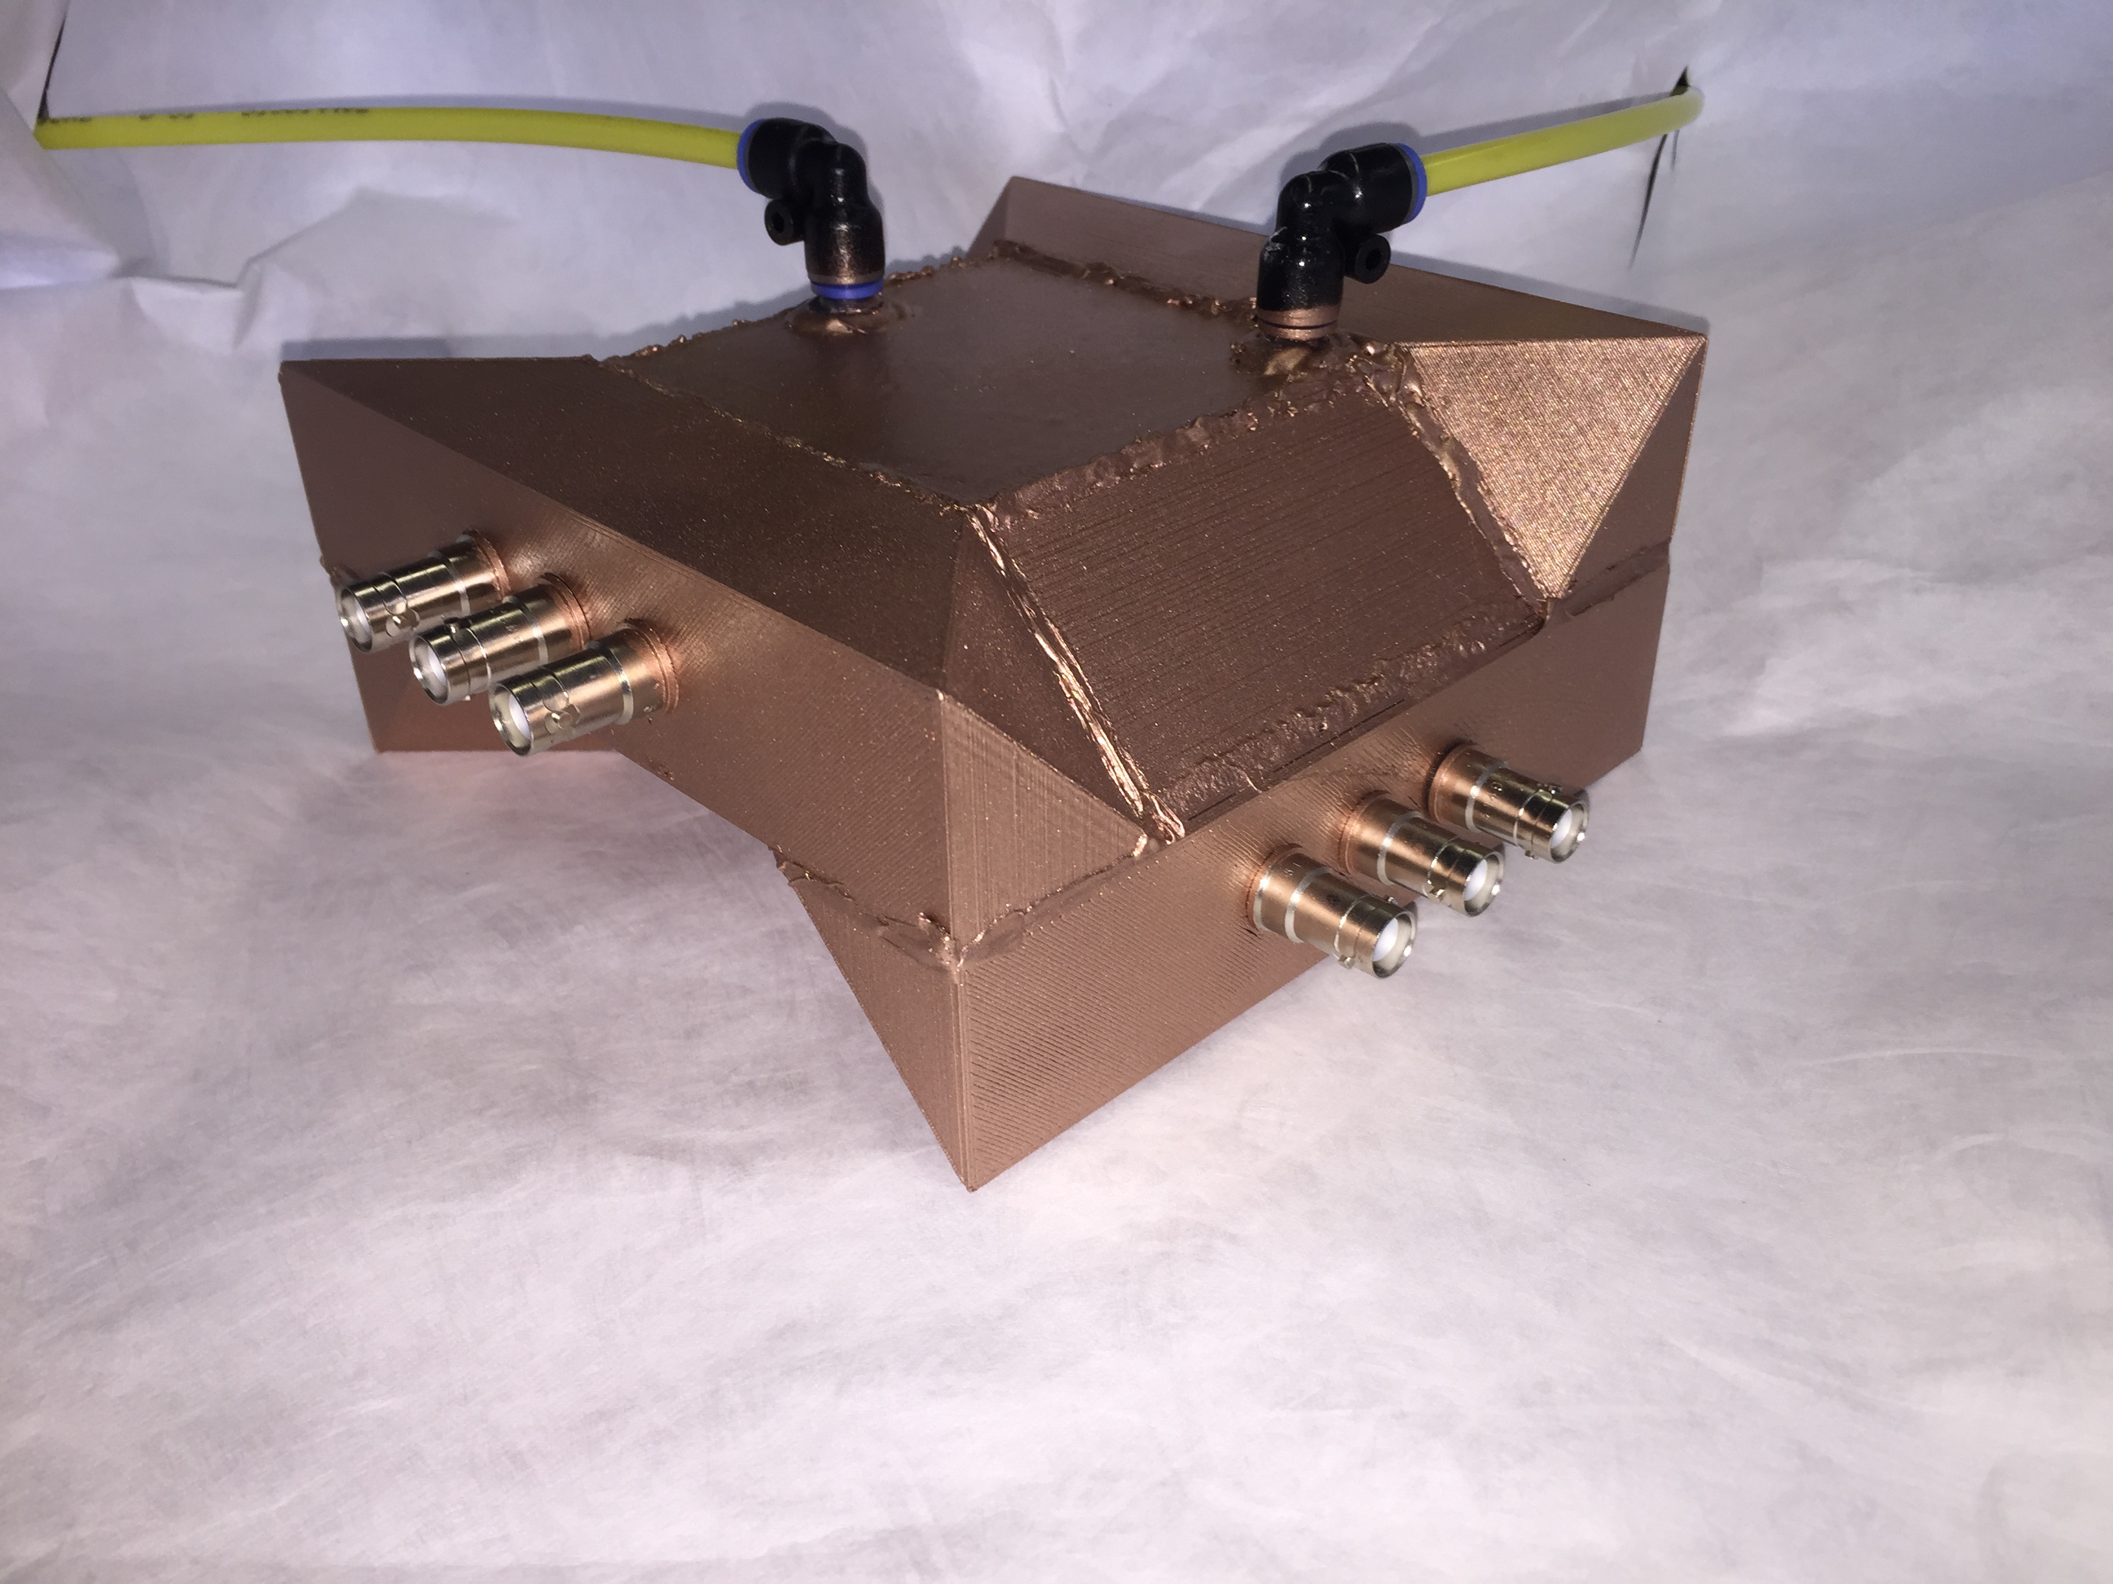
Motivation

Creation

Operation

The Tracker
© Crown Owned Copyright 2017, AWE/MoD
IOP APP - HEPP 2018 March 26-28 12/19

Slide 13
Operation
  The Setup
  Tube 1 Results
  Tube 2 Results
  3D Tracker
© Crown Owned Copyright 2017, AWE/MoD

Slide 14
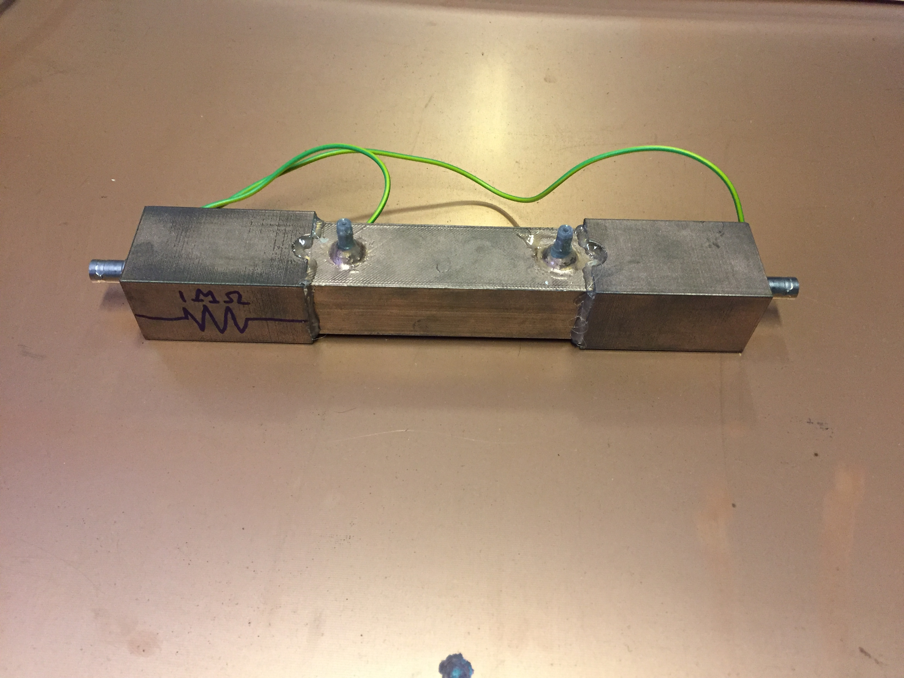
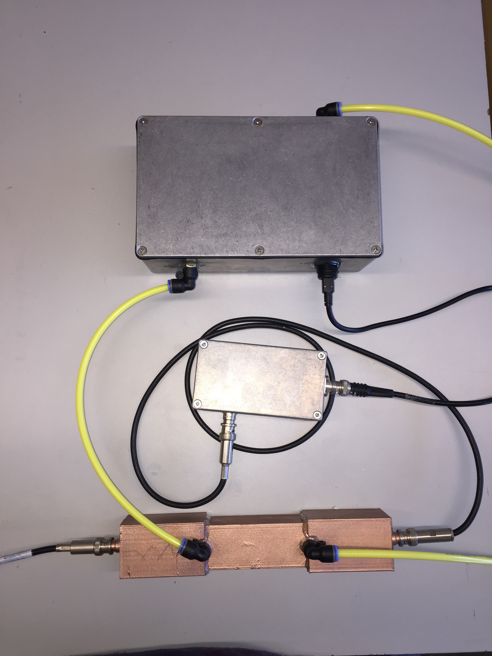
Motivation

Creation

Operation

The Setup
Two tubes produced by similar methods.
Argon-Methane (95:5) gas mixture flowed through tube at constant flow rate:
Temperature kept constant at 299 ± 1 K.
Cosmic Ray Muons main source of signal.
Pulse height and rate measured.
< 0.09 liters/min
Oxygen level monitored and maintained below 250ppm.
© Crown Owned Copyright 2017, AWE/MoD
IOP APP - HEPP 2018 March 26-28 14/19

Slide 15
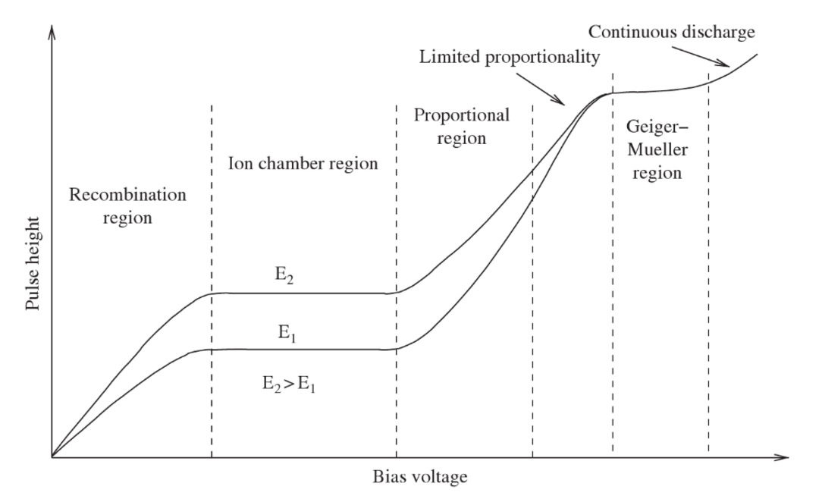
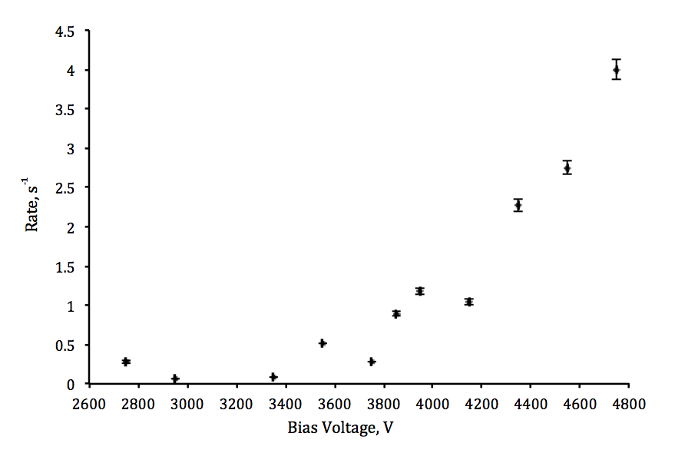
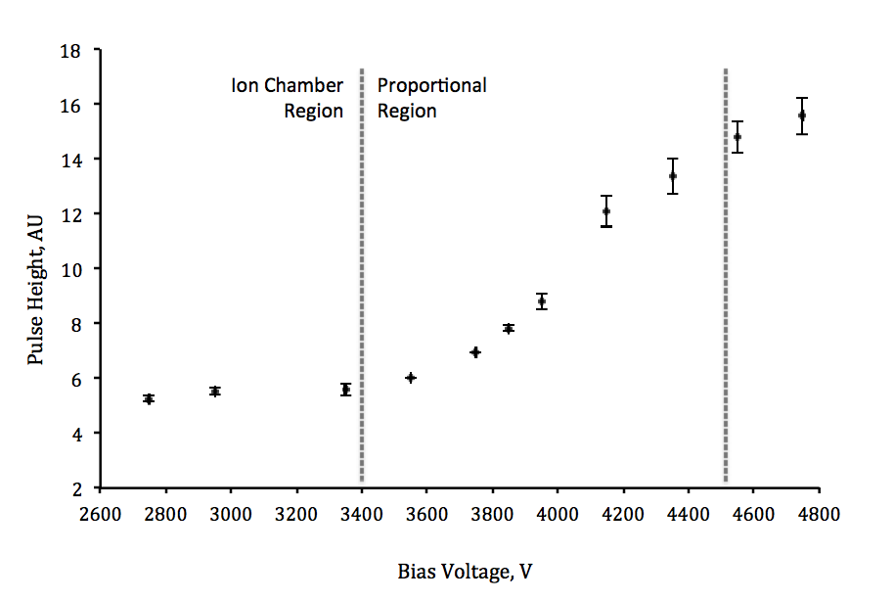
Motivation

Creation

Operation

Tube 1 Results
Pulse height plotted against bias voltage.
Rate of pulses plotted against bias voltage.
Graph appears to take characteristic form over range of bias voltages applied.
Correlation between rate and bias voltage.
© Crown Owned Copyright 2017, AWE/MoD
IOP APP - HEPP 2018 March 26-28 15/19

Slide 16
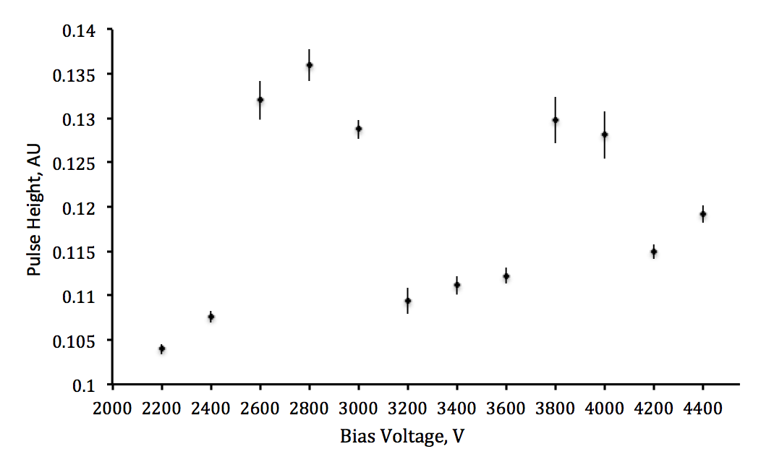
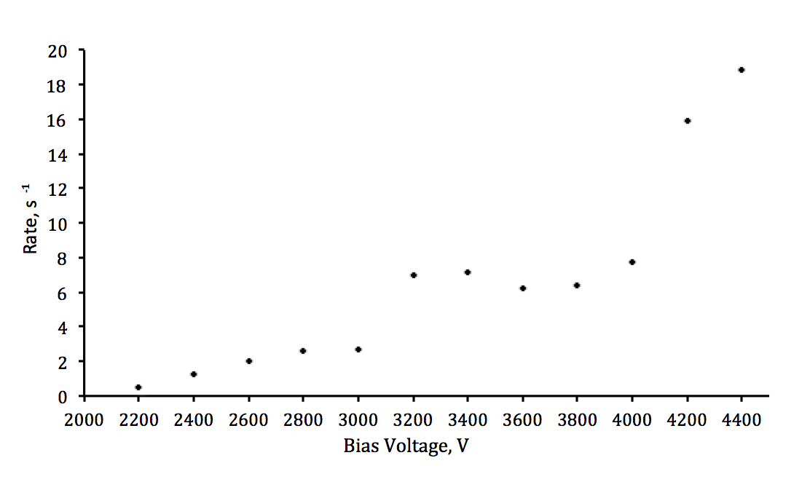
Motivation

Creation

Operation

Tube 2 Results
Pulse height plotted against bias voltage.
Rate of pulses plotted against bias voltage.
Difference in operation between tubes possibly due to moisture in tube or charge buildup due to lack of cathode.
Not as expected.
Some correlation between rate and bias voltage.
Check data with oxygen monitor data
Currently retaking data in humidity controlled environment.
Next stage to print tube with cathode.
© Crown Owned Copyright 2017, AWE/MoD
IOP APP - HEPP 2018 March 26-28 16/19

Slide 17
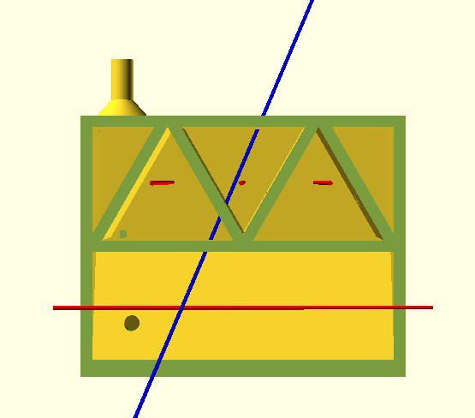
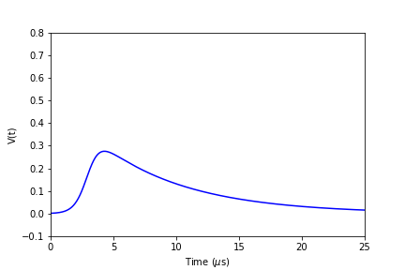
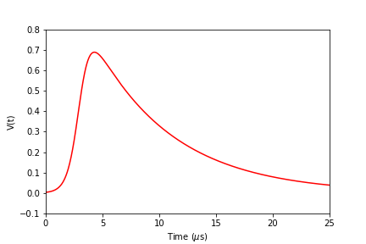
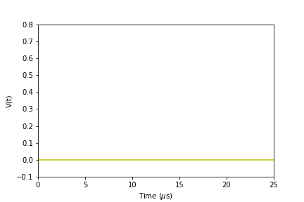
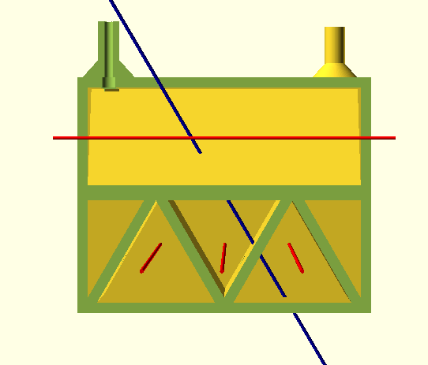
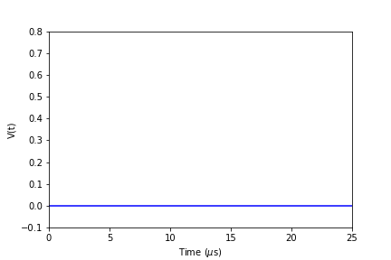
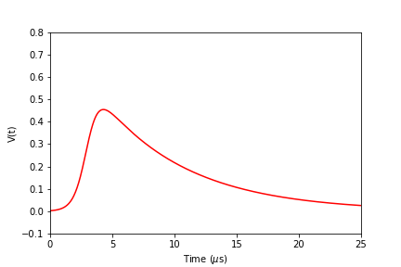
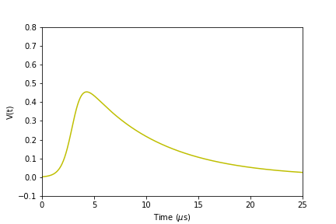
Motivation

Creation

Operation

Operation
3D Tracker
L M R
L M R
L M R
© Crown Owned Copyright 2017, AWE/MoD
IOP APP - HEPP 2018 March 26-28 17/19

Slide 18
Motivation

Creation

Operation

Future Plans
Print more tubes to optimise print process reliability and to investigate repeatability.
Print tubes containing cathode structure using either conductive filament or conductive pastes.
New printer just arrived with these capabilities
Advance onto TPCs and MPGCs using Conductive Inkjet Printing for electrode structures.
Develop method of printing plastic scintillator.
Silver nanoparticles suspended in ink in standard Inkjet Printer
© Crown Owned Copyright 2017, AWE/MoD
IOP APP-HEPP 2018 March 26-28 18/19
Notes:
Front end electronics

Slide 19
References
Hohlmann M. Printing out Particle Detectors with 3D-Printers – a Potentially Transformational Advance for HEP Instrumentation. 2013
Outgassing Search and Report Help [Internet]. Outgassing.nasa.gov. Available from: https://outgassing.nasa.gov/help/og_help.html
Ahmed S. Physics and engineering of radiation detection. Amsterdam: Aca- demic Press; 2007
© Crown Owned Copyright 2017, AWE/MoD

