Slide 1

Positivity Constraints on
Self-interacting Dark Matter
IoP APP & HEP 26 Mar 2018
Scott Melville

Slide 2
Positivity Constraints on
Self-interacting Dark Matter
IoP APP & HEP 26 Mar 2018
Scott Melville
1. Only some non-renormalizable theories have UV completions
2. Only some dark matter interactions have UV completions

Slide 3

Positivity Constraints on SIDM
Scott Melville
Self-Interactions
Effective Field Theory
Constraining SIDM
Resolution to small scale issues with CDM
Low energy theories are non-renormalizable
Not all DM interactions have UV completions
Tulin, Yu, 1705.02358
Dark Matter Self-Interaction and Small Scale Structure
Babichev et al, 1607.03497
Heavy spin-2 dark matter
Adams et al., hep-th/0602178
Causality, Analyticity and an IR Obstruction to UV Completion
SM, de Rham, Tolley, Zhou 1702.06134, 1706.02712
Positivity Bounds for Effective Field Theories
Layout

Slide 4
Positivity Constraints on SIDM
Scott Melville
Self Interactions

Slide 5
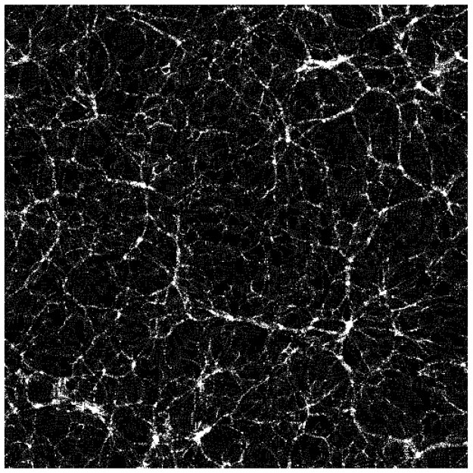
Positivity Constraints on SIDM
Scott Melville
Dark Matter on Small Scales
cusp-core
missing satellite
too-big-to-fail
diversity problem
[see 1705.02358 for review]
Self Interactions

Slide 6
Positivity Constraints on SIDM
Scott Melville
Dark Matter on Small Scales
Better Simulations
of known physics
[see 1606.07790 for review]
cusp-core
missing satellite
too-big-to-fail
diversity problem
[see 1705.02358 for review]
Self Interactions

Slide 7
Positivity Constraints on SIDM
Scott Melville
Dark Matter on Small Scales
Better Simulations
of known physics
[see 1606.07790 for review]
Dark Matter
Self-Interactions!
cusp-core
missing satellite
too-big-to-fail
diversity problem
[astro-ph/9909386]
[see 1705.02358 for review]
Self Interactions

Slide 8
Positivity Constraints on SIDM
Scott Melville
Dark Matter on Small Scales
Better Simulations
of known physics
[see 1606.07790 for review]
Dark Matter
Self-Interactions!
cusp-core
missing satellite
too-big-to-fail
diversity problem
[astro-ph/9909386]
[see 1705.02358 for review]
Self Interactions

Slide 9


Positivity Constraints on SIDM
Scott Melville
Self-Interacting Dark Matter
Standard Model +
+
Self Interactions

Slide 10
Positivity Constraints on SIDM
Scott Melville
Self-Interacting Dark Matter
Standard Model +
+
Massive Spin-1
Massive Spin-3/2
Massive Spin-2
Combinations
[1510.08063, …]
[1704.01904, …]
[1607.03497, 1708.06764, …]
[1701.07747, 1709.05128, 1803.01866, …]
Self Interactions

Slide 11
Positivity Constraints on SIDM
Scott Melville
Self-Interacting Dark Matter
Standard Model +
+
Massive Spin-1
Massive Spin-3/2
Massive Spin-2
Combinations
[1510.08063, …]
[1704.01904, …]
[1607.03497, 1708.06764, …]
[1701.07747, 1709.05128, 1803.01866, …]
Massive spinning particles have
broken gauge invariance at low energies,
and are described by Effective Field Theory
Self Interactions

Slide 12
Positivity Constraints on SIDM
Scott Melville
Effective Field Theory

Slide 13









Positivity Constraints on SIDM
Scott Melville
Low Energy EFT
E
$$⋮$$
$$⋮$$
$$M_{3}$$
$$H_{3}$$
$$M_{2}$$
$$H_{2}$$
$$M_{1}$$
$$H_{1}$$
$$m$$
L
Effective Field Theory

Slide 14




Positivity Constraints on SIDM
Scott Melville
Low Energy EFT
E
L
$$H_{1}$$
$$H_{2}$$
$$H_{3}$$
$$⋮$$
$$⋮$$
$$M_{3}$$
$$H_{3}$$
$$ℒ_{UV}[L,H_{1},H_{2},…]$$
$$M_{2}$$
$$H_{2}$$
$$M_{1}$$
$$H_{1}$$
$$m$$
L
Effective Field Theory

Slide 15


Positivity Constraints on SIDM
Scott Melville
Low Energy EFT
E
L
$$H_{1}$$
$$H_{2}$$
$$H_{3}$$
$$⋮$$
$$⋮$$
$$M_{3}$$
$$H_{3}$$
$$ℒ_{UV}[L,H_{1},H_{2},…]$$
$$M_{2}$$
$$H_{2}$$
$$M_{1}$$
$$H_{1}$$
$$ℒ_{EFT}[L,H_{1}]$$
$$(E≪M_{2})$$
$$m$$
L
Effective Field Theory

Slide 16


Positivity Constraints on SIDM
Scott Melville
Low Energy EFT
E
L
$$H_{1}$$
$$H_{2}$$
$$H_{3}$$
$$⋮$$
$$⋮$$
$$M_{3}$$
$$H_{3}$$
$$ℒ_{UV}[L,H_{1},H_{2},…]$$
$$M_{2}$$
$$H_{2}$$
$$M_{1}$$
$$H_{1}$$
$$ℒ_{EFT}[L,H_{1}]$$
$$(E≪M_{2})$$
$$m$$
L
$$ℒ_{EFT}[L]$$
$$(E≪M_{1})$$
Effective Field Theory

Slide 17
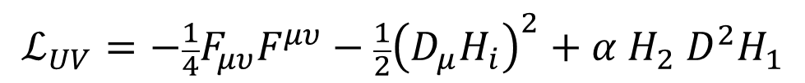

Positivity Constraints on SIDM
Scott Melville
Low Energy EFT
E
L
$$H_{1}$$
$$H_{2}$$
$$H_{3}$$
$$ℒ_{UV}=−\frac{1}{4}F_{μυ}F^{μυ}−\frac{1}{2}{\left(D_{μ}H_{i}\right)}^{2}+α H_{2} D^{2}H_{1}$$
$$ℒ_{UV}[L,H_{1},H_{2},…]$$
$$ℒ_{EFT}[L,H_{1}]$$
$$(E≪M_{2})$$
$$ℒ_{IR}=−\frac{1}{4}F_{μυ}F^{μυ} − \frac{1}{2}m^{2}A^{2} + λ A^{4}+…$$
$$ℒ_{EFT}[L]$$
$$(E≪M_{1})$$
$$m^{2}$$
Effective Field Theory

Slide 18
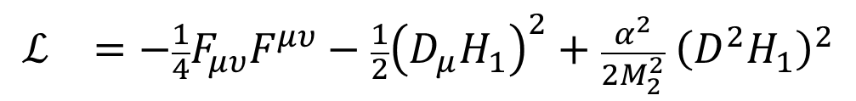
Positivity Constraints on SIDM
Scott Melville
Low Energy EFT
E
L
$$H_{1}$$
$$H_{2}$$
$$H_{3}$$
$$ℒ_{UV}=−\frac{1}{4}F_{μυ}F^{μυ}−\frac{1}{2}{\left(D_{μ}H_{i}\right)}^{2}+α H_{2} D^{2}H_{1}$$
$$ℒ_{UV}[L,H_{1},H_{2},…]$$
$$ℒ_{}=−\frac{1}{4}F_{μυ}F^{μυ}−\frac{1}{2}{\left(D_{μ}H_{1}\right)}^{2}+\frac{α^{2}}{2M_{2}^{2}} {\left(D^{2}H_{1}\right)}^{2}$$
$$ℒ_{EFT}[L,H_{1}]$$
$$(E≪M_{2})$$
$$ℒ_{IR}=−\frac{1}{4}F_{μυ}F^{μυ} − \frac{1}{2}m^{2}A^{2} + λ A^{4}+…$$
$$ℒ_{EFT}[L]$$
$$(E≪M_{1})$$
$$m^{2}$$
Effective Field Theory

Slide 19
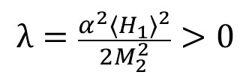
Positivity Constraints on SIDM
Scott Melville
Low Energy EFT
E
L
$$H_{1}$$
$$H_{2}$$
$$H_{3}$$
$$ℒ_{UV}=−\frac{1}{4}F_{μυ}F^{μυ}−\frac{1}{2}{\left(D_{μ}H_{i}\right)}^{2}+α H_{2} D^{2}H_{1}$$
$$ℒ_{UV}[L,H_{1},H_{2},…]$$
$$ℒ_{}=−\frac{1}{4}F_{μυ}F^{μυ}−\frac{1}{2}{\left(D_{μ}H_{1}\right)}^{2}+\frac{α^{2}}{2M_{2}^{2}} {\left(D^{2}H_{1}\right)}^{2}$$
$$ℒ_{EFT}[L,H_{1}]$$
+ ??
$$(E≪M_{2})$$
$$ℒ_{IR}=−\frac{1}{4}F_{μυ}F^{μυ} − \frac{1}{2}m^{2}A^{2} + λ A^{4}+…$$
$$ℒ_{EFT}[L]$$
$$(E≪M_{1})$$
$$λ=\frac{α^{2}{〈H_{1}〉}^{2}}{2M_{2}^{2}}>0$$
$$m^{2}$$
Effective Field Theory

Slide 20
Positivity Constraints on SIDM
Scott Melville
Low Energy EFT
E
$$ℒ_{UV}=−\frac{1}{4}F_{μυ}F^{μυ}−\frac{1}{2}{\left(D_{μ}H_{i}\right)}^{2}+α H_{2} D^{2}H_{1}$$
$$ℒ_{UV}[L,H_{1},H_{2},…]$$
$$ℒ_{}=−\frac{1}{4}F_{μυ}F^{μυ}−\frac{1}{2}{\left(D_{μ}H_{1}\right)}^{2}+\frac{α^{2}}{2M_{2}^{2}} {\left(D^{2}H_{1}\right)}^{2}$$
$$ℒ_{EFT}[L,H_{1}]$$
$$(E≪M_{2})$$
$$ℒ_{IR}=−\frac{1}{4}F_{μυ}F^{μυ} − \frac{1}{2}m^{2}A^{2} + λ A^{4}+…$$
$$ℒ_{EFT}[L]$$
$$(E≪M_{1})$$
$$λ=\frac{α^{2}{〈H_{1}〉}^{2}}{2M_{2}^{2}}>0$$
$$m^{2}$$
Effective Field Theory

Slide 21
Positivity Constraints on SIDM
Scott Melville
Low Energy EFT
E
$$ℒ_{UV}=−\frac{1}{4}F_{μυ}F^{μυ}−\frac{1}{2}{\left(D_{μ}H_{i}\right)}^{2}+α H_{2} D^{2}H_{1}$$
$$ℒ_{UV}[L,H_{1},H_{2},…]$$
$$ℒ_{}=−\frac{1}{4}F_{μυ}F^{μυ}−\frac{1}{2}{\left(D_{μ}H_{1}\right)}^{2}+\frac{α^{2}}{2M_{2}^{2}} {\left(D^{2}H_{1}\right)}^{2}$$
$$ℒ_{EFT}[L,H_{1}]$$
$$(E≪M_{2})$$
$$ℒ_{IR}=−\frac{1}{4}F_{μυ}F^{μυ} − \frac{1}{2}m^{2}A^{2} + λ A^{4}+…$$
$$ℒ_{EFT}[L]$$
$$(E≪M_{1})$$
$$λ=\frac{α^{2}{〈H_{1}〉}^{2}}{2M_{2}^{2}}>0$$
$$m^{2}$$
Effective Field Theory

Slide 22
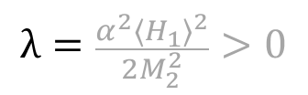
Positivity Constraints on SIDM
Scott Melville
Low Energy EFT
E
$$ℒ_{UV}=−\frac{1}{4}F_{μυ}F^{μυ}−\frac{1}{2}{\left(D_{μ}H_{i}\right)}^{2}+α H_{2} D^{2}H_{1}$$
???
$$ℒ_{IR}=−\frac{1}{4}F_{μυ}F^{μυ} − \frac{1}{2}m^{2}A^{2} + λ A^{4}+…$$
$$λ=\frac{α^{2}{〈H_{1}〉}^{2}}{2M_{2}^{2}}>0$$
??
$$m^{2}$$
Effective Field Theory

Slide 23
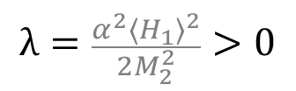
Positivity Constraints on SIDM
Scott Melville
Low Energy EFT
E
$$ℒ_{UV}=−\frac{1}{4}F_{μυ}F^{μυ}−\frac{1}{2}{\left(D_{μ}H_{i}\right)}^{2}+α H_{2} D^{2}H_{1}$$
???
Unitarity, Causality, Locality
$$ℒ_{IR}=−\frac{1}{4}F_{μυ}F^{μυ} − \frac{1}{2}m^{2}A^{2} + λ A^{4}+…$$
$$λ=\frac{α^{2}{〈H_{1}〉}^{2}}{2M_{2}^{2}}>0$$
??
$$m^{2}$$
Effective Field Theory

Slide 24

Positivity Constraints on SIDM
Scott Melville
Positivity Bounds
[hep-th/0602178, 1702.06134, 1706.02712]
E
$$ℒ_{UV}=−\frac{1}{4}F_{μυ}F^{μυ}−\frac{1}{2}{\left(D_{μ}H_{i}\right)}^{2}+α H_{2} D^{2}H_{1}$$
???
Unitarity, Causality, Locality
$$\sum{\frac{c_{n}}{Λ^{n}}{\text{𝓞}}_{n}}$$
$$ℒ_{IR}=−\frac{1}{4}F_{μυ}F^{μυ} − \frac{1}{2}m^{2}A^{2} + λ A^{4}+…$$
Effective Field Theory

Slide 25


Positivity Constraints on SIDM
Scott Melville
Positivity Bounds
[hep-th/0602178, 1702.06134, 1706.02712]
E
$$ℒ_{UV}=−\frac{1}{4}F_{μυ}F^{μυ}−\frac{1}{2}{\left(D_{μ}H_{i}\right)}^{2}+α H_{2} D^{2}H_{1}$$
???
Unitarity, Causality, Locality
$$c_{j}$$
$$\sum{\frac{c_{n}}{Λ^{n}}{\text{𝓞}}_{n}}$$
$$ℒ_{IR}=−\frac{1}{4}F_{μυ}F^{μυ} − \frac{1}{2}m^{2}A^{2} + λ A^{4}+…$$
$$c_{i}$$
Effective Field Theory

Slide 26
Positivity Constraints on SIDM
Scott Melville
Positivity Bounds
[hep-th/0602178, 1702.06134, 1706.02712]
E
$$ℒ_{UV}=−\frac{1}{4}F_{μυ}F^{μυ}−\frac{1}{2}{\left(D_{μ}H_{i}\right)}^{2}+α H_{2} D^{2}H_{1}$$
???
Unitarity, Causality, Locality
$$c_{j}$$
$$\sum{\frac{c_{n}}{Λ^{n}}{\text{𝓞}}_{n}}$$
$$ℒ_{IR}=−\frac{1}{4}F_{μυ}F^{μυ} − \frac{1}{2}m^{2}A^{2} + λ A^{4}+…$$
$$c_{i}$$
Effective Field Theory

Slide 27
Positivity Constraints on SIDM
Scott Melville
Positivity Bounds
[hep-th/0602178, 1702.06134, 1706.02712]
E
$$ℒ_{UV}=−\frac{1}{4}F_{μυ}F^{μυ}−\frac{1}{2}{\left(D_{μ}H_{i}\right)}^{2}+α H_{2} D^{2}H_{1}$$
???
Unitarity, Causality, Locality
$$c_{j}$$
$$\sum{\frac{c_{n}}{Λ^{n}}{\text{𝓞}}_{n}}$$
$$ℒ_{IR}=−\frac{1}{4}F_{μυ}F^{μυ} − \frac{1}{2}m^{2}A^{2} + λ A^{4}+…$$
$$c_{i}$$
Effective Field Theory

Slide 28
Positivity Constraints on SIDM
Scott Melville
Positivity Bounds
[hep-th/0602178, 1702.06134, 1706.02712]
E
$$ℒ_{UV}=−\frac{1}{4}F_{μυ}F^{μυ}−\frac{1}{2}{\left(D_{μ}H_{i}\right)}^{2}+α H_{2} D^{2}H_{1}$$
???
Unitarity, Causality, Locality
$$c_{j}$$
$$\sum{\frac{c_{n}}{Λ^{n}}{\text{𝓞}}_{n}}$$
$$ℒ_{IR}=−\frac{1}{4}F_{μυ}F^{μυ} − \frac{1}{2}m^{2}A^{2} + λ A^{4}+…$$
$$c_{i}$$
Effective Field Theory

Slide 29
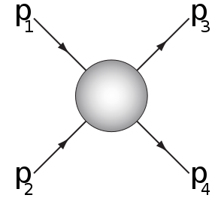

Positivity Constraints on SIDM
Scott Melville
Positivity Bounds
[hep-th/0602178, 1702.06134, 1706.02712]
E
$$ℒ_{UV}=−\frac{1}{4}F_{μυ}F^{μυ}−\frac{1}{2}{\left(D_{μ}H_{i}\right)}^{2}+α H_{2} D^{2}H_{1}$$
???
Unitarity, Causality, Locality
$$c_{j}$$
$$\sum{\frac{c_{n}}{Λ^{n}}{\text{𝓞}}_{n}}$$
$$ℒ_{IR}=−\frac{1}{4}F_{μυ}F^{μυ} − \frac{1}{2}m^{2}A^{2} + λ A^{4}+…$$
$$∂_{s}^{a}∂_{t}^{b}A_{4}\left(s,t;c_{n}\right)>0$$
$$c_{i}$$
Effective Field Theory

Slide 30
Positivity Constraints on SIDM
Scott Melville
Positivity Bounds
[hep-th/0602178, 1702.06134, 1706.02712]
E
$$ℒ_{UV}=−\frac{1}{4}F_{μυ}F^{μυ}−\frac{1}{2}{\left(D_{μ}H_{i}\right)}^{2}+α H_{2} D^{2}H_{1}$$
???
Unitarity, Causality, Locality
$$c_{j}$$
$$\sum{\frac{c_{n}}{Λ^{n}}{\text{𝓞}}_{n}}$$
$$ℒ_{IR}=−\frac{1}{4}F_{μυ}F^{μυ} − \frac{1}{2}m^{2}A^{2} + λ A^{4}+…$$
$$∂_{s}^{a}∂_{t}^{b}A_{4}\left(s,t;c_{n}\right)>0$$
$$c_{i}$$
Effective Field Theory

Slide 31
Positivity Constraints on SIDM
Scott Melville
Constraining
Dark Matter

Slide 32
Positivity Constraints on SIDM
Scott Melville
Self-Interacting Dark Matter
[1705.02358]
cusp-core
missing satellite
too-big-to-fail
diversity problem
Applications

Slide 33

Positivity Constraints on SIDM
Scott Melville
Self-Interacting Dark Matter
[1705.02358]
to resolve small
scale problems
in simulations
$$0.1cm^{2}/g<\frac{σ}{m}<1cm^{2}/g$$
cusp-core
missing satellite
too-big-to-fail
diversity problem
Applications

Slide 34
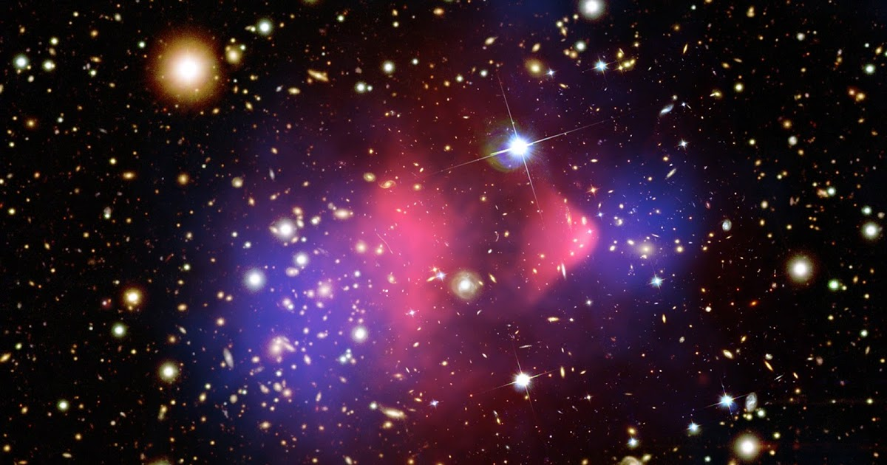
Positivity Constraints on SIDM
Scott Melville
Self-Interacting Dark Matter
[1705.02358]
to resolve small
scale problems
in simulations
$$0.1cm^{2}/g<\frac{σ}{m}<1cm^{2}/g$$
to match observations
cusp-core
missing satellite
too-big-to-fail
diversity problem
bullet cluster
halo ellipticity
substructure mergers
merging clusters
Applications
Notes:
I won’t give the positivity constraints on all spinning SIDM models – partly because I don’t have time, and partly because I haven’t actually computed them all. But to demonstrate that this is useful tool for constraining models, let’s focus on spin-2.

Slide 35


Positivity Constraints on SIDM
Scott Melville
Self-Interacting Dark Matter
[1705.02358]
to resolve small
scale problems
in simulations
$$0.1cm^{2}/g<\frac{σ}{m}<1cm^{2}/g$$
to match observations
Massive Spin-2
[1607.03497, 1708.06764]
$$m^{2}$$
$$λ$$
Applications

Slide 36
Positivity Constraints on SIDM
Scott Melville
Self-Interacting Dark Matter
[1705.02358]
to resolve small
scale problems
in simulations
$$0.1cm^{2}/g<\frac{σ}{m}<1cm^{2}/g$$
to match observations
Massive Spin-2
[1607.03497, 1708.06764]
$$m^{2}$$
$$λ$$
Applications

Slide 37
Positivity Constraints on SIDM
Scott Melville
Self-Interacting Dark Matter
[1705.02358]
to resolve small
scale problems
in simulations
$$0.1cm^{2}/g<\frac{σ}{m}<1cm^{2}/g$$
to match observations
Massive Spin-2
[1607.03497, 1708.06764]
$$m^{2}$$
$$λ$$
Applications

Slide 38
Positivity Constraints on SIDM
Scott Melville
Self-Interacting Dark Matter
[1705.02358]
to resolve small
scale problems
in simulations
$$0.1cm^{2}/g<\frac{σ}{m}<1cm^{2}/g$$
to match observations
Massive Spin-2
[1607.03497, 1708.06764]
$$m^{2}$$
$$λ$$
Applications

Slide 39
Positivity Constraints on SIDM
Scott Melville
Self-Interacting Dark Matter
[1705.02358]
to resolve small
scale problems
in simulations
$$0.1cm^{2}/g<\frac{σ}{m}<1cm^{2}/g$$
to match observations
Massive Spin-2
[1607.03497, 1708.06764]
$$m^{2}$$
$$λ$$
Sufficiently self-interacting
spin-2 particle with a
UV completion cannot
be dark matter today
Applications

Slide 40
Positivity Constraints on SIDM
Scott Melville
Summary
Only some Effective Fields Theories have UV Completions
Summary

Slide 41

Positivity Constraints on SIDM
Scott Melville
Summary
Only some Effective Fields Theories have UV Completions
$∂_{s}^{a}∂_{t}^{b} A_{IR}(s,t;c_{n})> 0 <= A_{UV}$ exists
Energy
Summary

Slide 42

Positivity Constraints on SIDM
Scott Melville
Summary
Only some Effective Fields Theories have UV Completions
$∂_{s}^{a}∂_{t}^{b} A_{IR}(s,t;c_{n})> 0 <= A_{UV}$ exists
Energy
to resolve small
scale problems
$$0.1cm^{2}/g<\frac{σ}{m}<1cm^{2}/g$$
to match observations
Only some DM Interactions
have UV Completions
Summary

Slide 43
Positivity Constraints on SIDM
Scott Melville
Summary
Only some Effective Fields Theories have UV Completions
$∂_{s}^{a}∂_{t}^{b} A_{IR}(s,t;c_{n})> 0 <= A_{UV}$ exists
Energy
to resolve small
scale problems
Spin-2 DM
$$0.1cm^{2}/g<\frac{σ}{m}<1cm^{2}/g$$
to match observations
Only some DM Interactions
have UV Completions
Summary

