Slide 1


Strongly-interacting dark matter and CNO neutrinos with low-threshold detectors
Based on:
J. H. Davis, Phys.Rev.Lett. 119 (2017) 211302
D. G. Cerdeño, J. H. Davis, M. Fairbairn and A. C. Vincent, arXiv:1712.06522
Jonathan Davis
King’s College London
jonathan.davis@kcl.ac.uk
DMUK Meeting – Bristol - 17 January 2018

Slide 2
Direct detection
Dark Matter
Nucleus
Before
Dark Matter
Nucleus
After

Slide 3
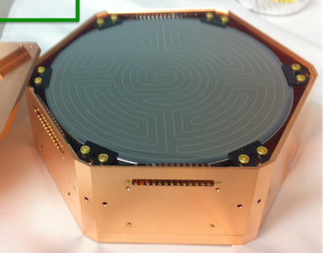
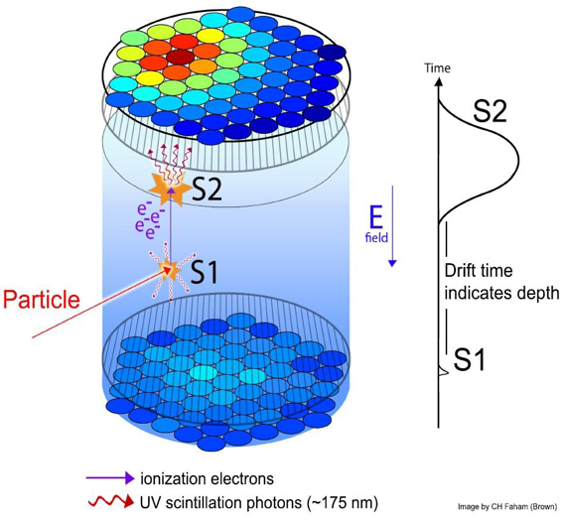
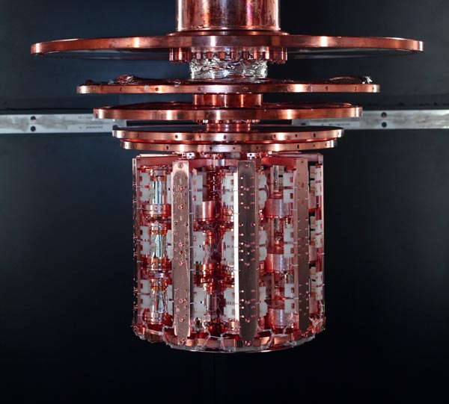
Direct detection experiments
Cryogenic Detectors
Liquid Noble Detectors
SuperCDMS
Looking for
ionization
and phonons
CRESST
Looking for
tiny temperature
changes

Slide 4
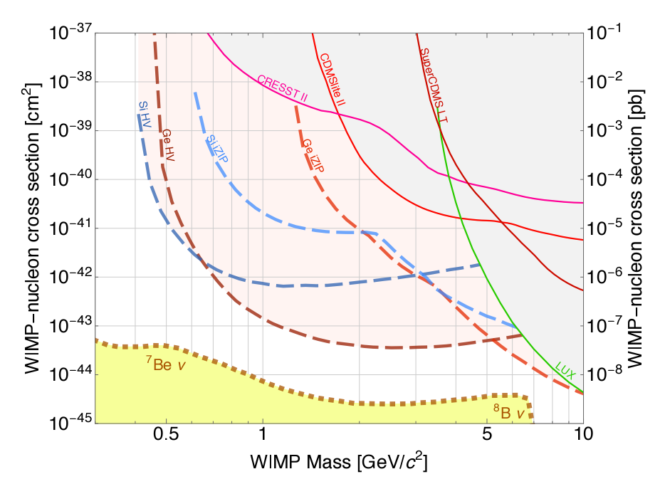
Dark matter with low-threshold detectors
Detectors which are sensitive to energies below a keV can detect sub-GeV mass dark matter, and more exotic models too.
1 GeV
mass
pb
SuperCDMS-SNOLAB, arXiv:1610.00006

Slide 5
Strongly-interacting dark matter
Increasing the DM-nucleon cross section leads to a larger expected recoil rate, until the cross section enters the SIMP-regime.
Beyond this point the SIMPs lose energy due to interactions in the Earth or atmosphere, leading to lower-energy recoils in the detector.
Could be dark atoms (astro-ph/0406355) or other composite states with e.g. a magnetic moment (arXiv;1201.4858).
pb

Slide 6
Detecting WIMPs
WIMP
Weakly-inteacting dark matter should pass unimpeded through
the Earth and atmosphere on its way to the underground detector.
WIMP
Direct Detection
Experiment e.g. LUX
WIMP

Slide 7
Detecting SIMPs
SIMP
Strongly-interacting dark matter will lose energy through scattering
with the Earth, such that it reaches the detector without enough energy
to produce an observable signal.
SIMP
Direct Detection
Experiment e.g. LUX
SIMP

Slide 8
Detecting SIMPs on the surface
A surface-based direct detection experiment will have a larger background,
but will have increased sensitivity to SIMP dark matter.
SIMP
Surface
experiment
SIMP
SIMP

Slide 9
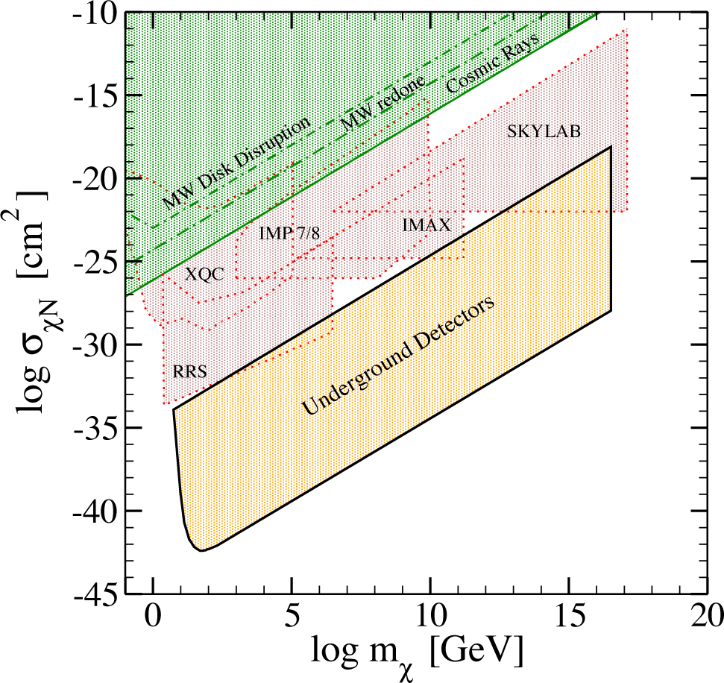
SIMP direct detection
Even larger cross sections are ruled out by astrophysical constraints.
At larger cross sections constraints come from balloon and rocket-borne experiments.
Direct detection experiments are not sensitive to larger DM-nucleon cross sections, in the so-called SIMP region.
Mack, Beacom and Bertone, arXiv:0705.4298

Slide 10
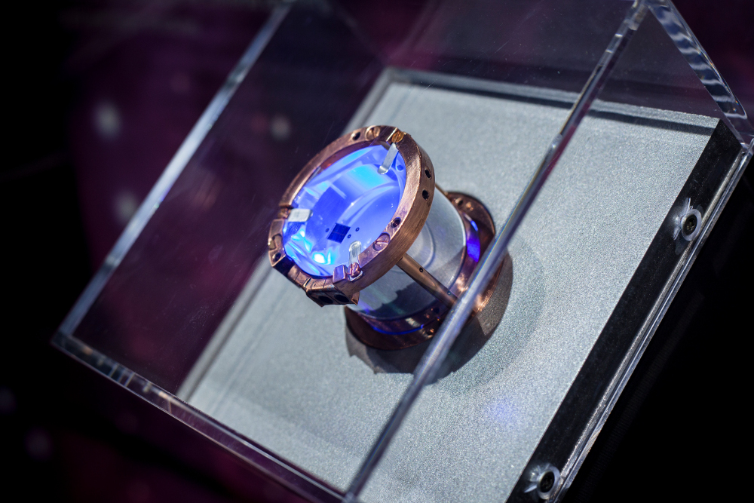
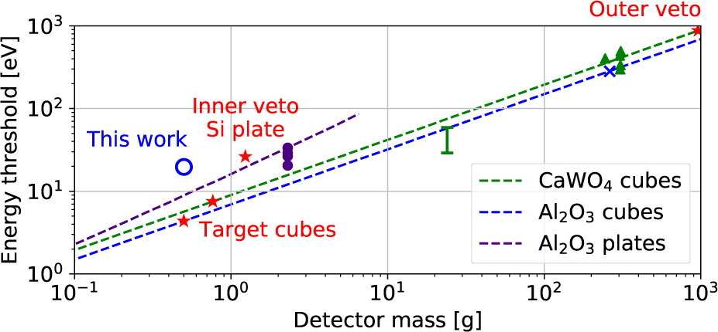
New results from a surface-based cryogenic detector
Gram-scale crystals mean that the experiment has an extremely low energy threshold, but at the expense of a smaller exposure.
R. Strauss, Eur.Phys.J. C77 (2017) 506, arXiv:1704.04320

Slide 11
SIMPs in a surface-based cryogenic experiment
The rate of events expected from SIMPs is far larger than the observed rate.
Sensitivity to SIMPs is lost when the spectrum drops below the 20eV threshold due to SIMPs scattering in the shielding and atmosphere.
Data from: Results on MeV-scale dark matter from a gram-scale cryogenic calorimeter operated above ground, Eur.Phys.J. C77 (2017) no.9, 637 , arXiv:1707.067

Slide 12
New constraints on SIMP dark matter
The red region shows SIMP cross sections and masses which can be ruled out with the data from this surface run.
The blue dashed line shows projections for a surface-based detector with a 4eV threshold.

Slide 13
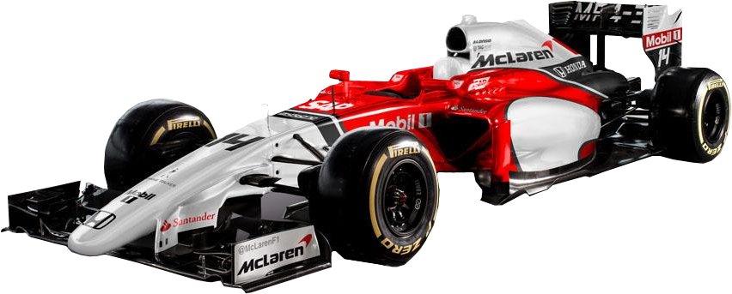
CNO Neutrino Grand Prix: The race to solve the solar metallicity problem

Slide 14
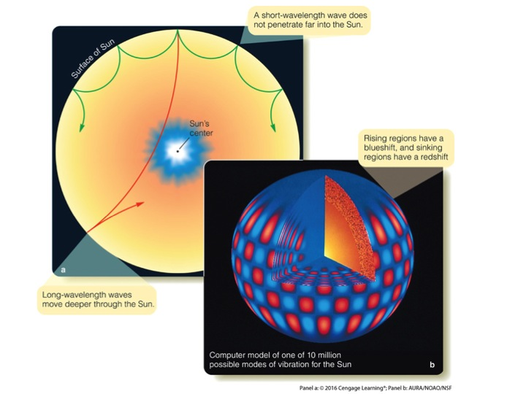
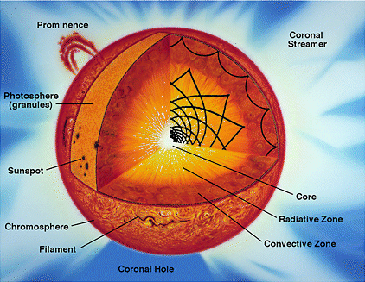
The solar metallicity problem
Our knowledge of the Sun’s composition comes from comparing simulations to data from probes such as helioseismology and electromagnetic emission from the photosphere.
Helioseismology depends on the whole Sun.
The photospheric abundances depend on the solar surface and are inferred by comparing absorption line measurements to models of the solar atmosphere.

Slide 15
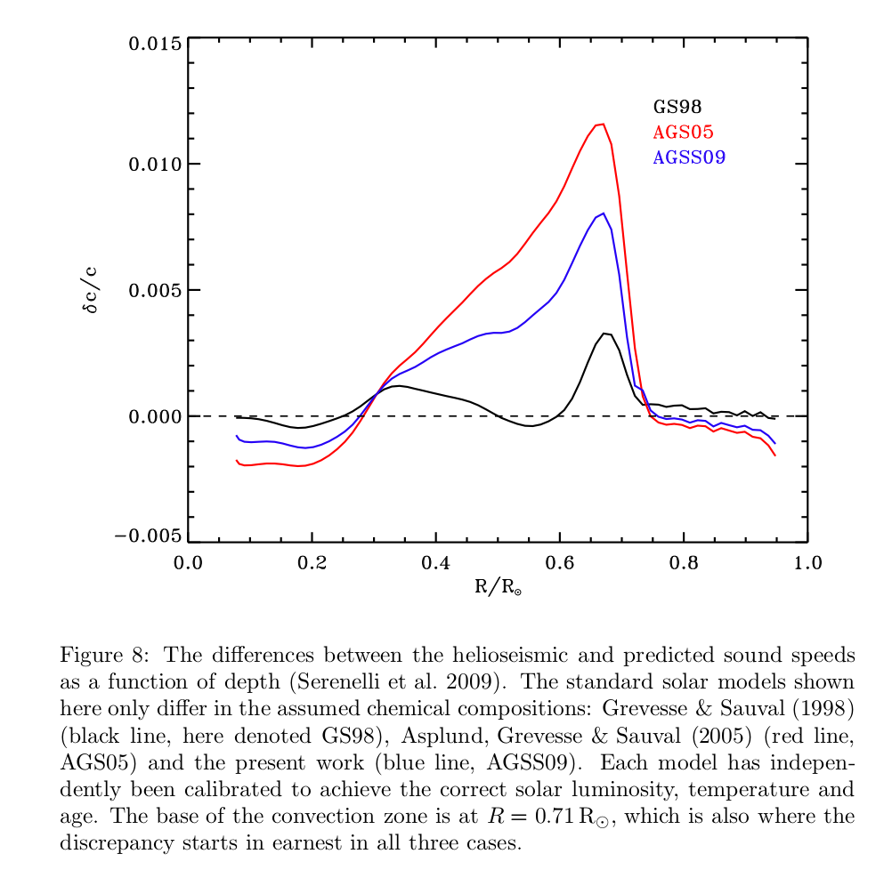
Helioseismology and the photosphere disagree
Metallicity (C, N and O) measurements from the photosphere are consistent with the low-metallicity model.
But, in order to fit to helioseismic data the surface metallicity needs to be larger i.e. the high-metallicity models.
So models can fit either the photosphere metal abundances or helioseismic data but not both.
We need more data.
Black = high metallicity
Asplund et al., Ann.Rev.Astron.Astrophys. 47 (2009) 481-522

Slide 16
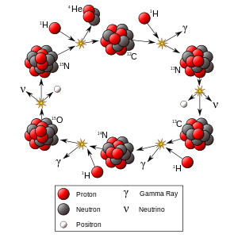
CNO Neutrinos – a solution
A crucial extra measurement would be the metallicity in the solar core. One potential solution to the metallicity problem is that we do not understand conductivity and diffusion in the Sun. Changing this would lead to a different metal content in the core.
The CNO neutrino flux depends sensitively on the metallicity of the solar core.

Slide 17
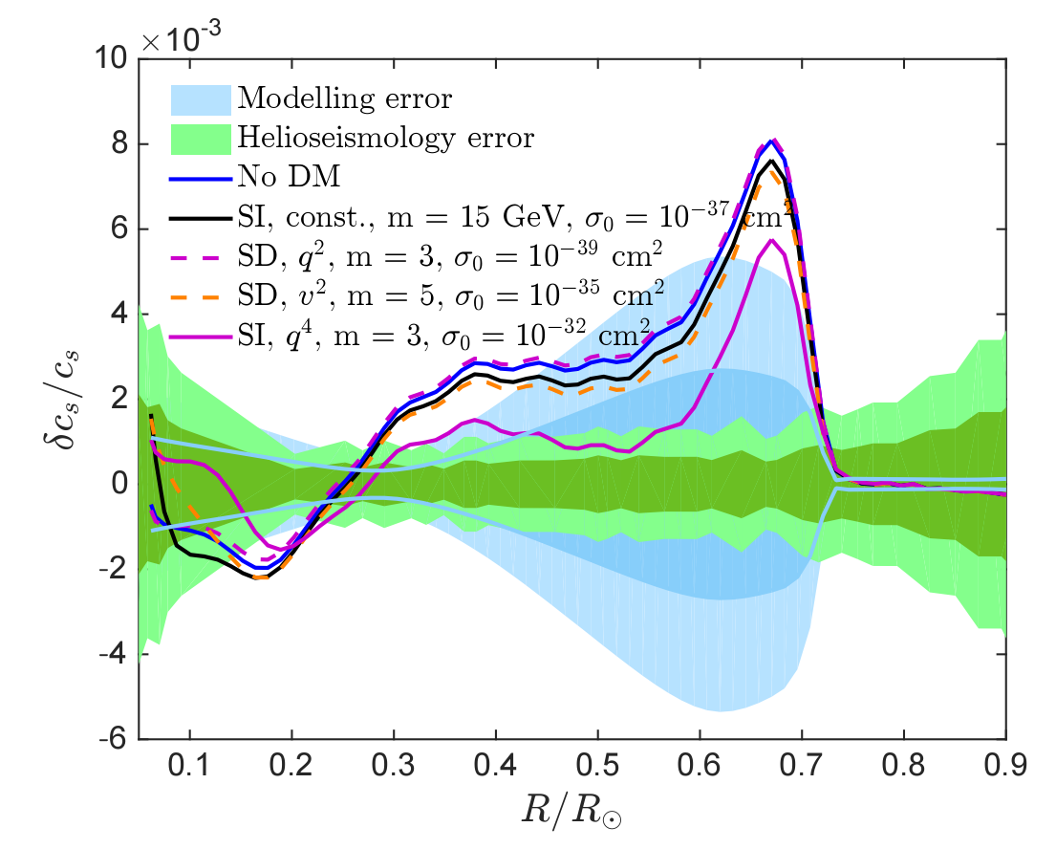
CNO neutrinos and new physics?
Measuring the CNO flux will tell us if the diffusion model is wrong, or whether something else is causing the discrepancy, potentially even dark matter (e.g. Frandsen and Sarkar, arXiv:1003.4505 or Vincent, Scott, and Serenelli, arXiv:1411.6626).
1605.06502

Slide 18
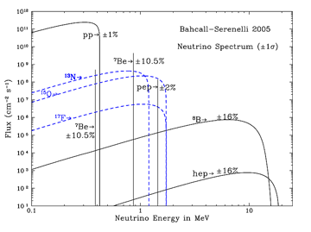
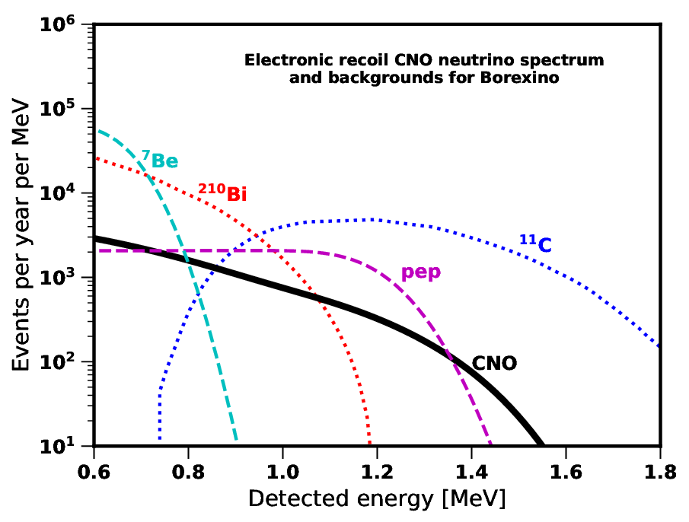
Detecting CNO Neutrinos
Measuring the CNO flux is extremely difficult as their spectrum is sub-dominant compared to the other solar neutrino sources e.g. berylium-7 or pep.

Slide 19
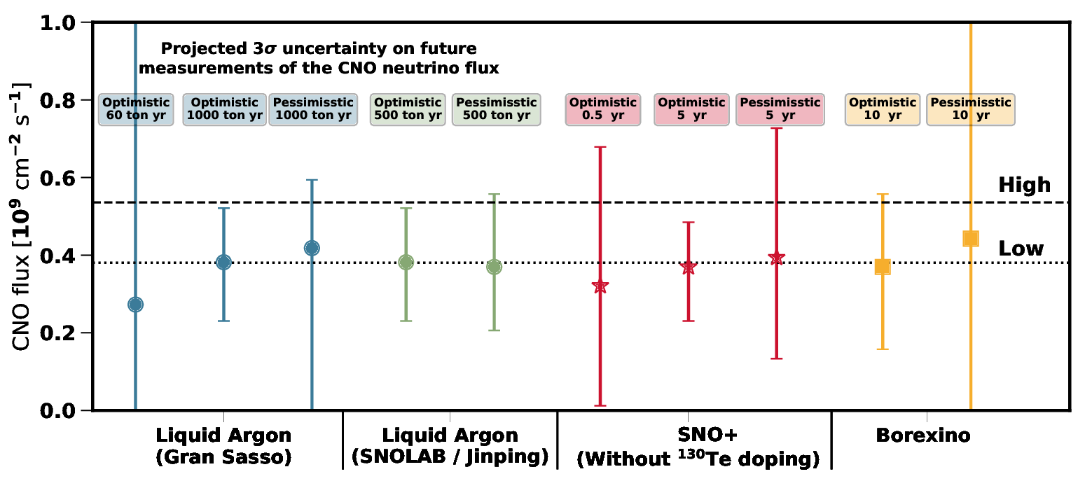
Measuring the CNO flux with electron-recoil experiments
CNO neutrinos scattering with electrons lead to signals with energies up to around 1.4 MeV, which can be observed e.g. in liquid scintillator detectors. These tend to have large signal rates but also difficult backgrounds (e.g. beta-decay).

Slide 20
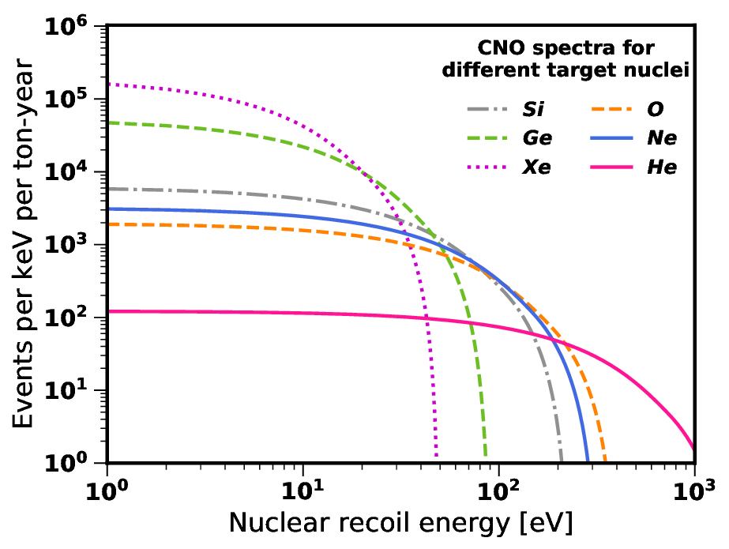
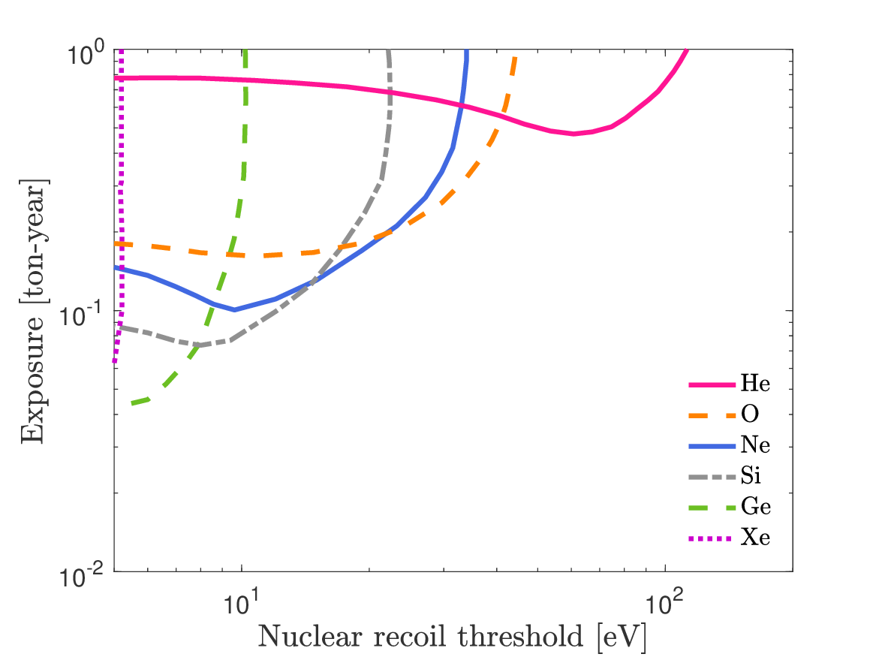
Measuring the CNO flux with nuclear-recoil experiments
Looking for nuclear-recoils could be a viable alternative, but experiments will need both a low threshold and a large exposure.
Above line = will measure
CNO flux in high-Z case

Slide 21
Technologies for CNO-NR observation
CRESST with its 0.5g sapphire crystal can get the required threshold with oxygen, but the exposure is far too small.
SuperCDMS in
SNOLAB looks to be the best hope with germanium.
Above line = will measure
CNO flux in high-Z case

Slide 22

Conclusion
Looking for nuclear-recoils with energies below a keV opens up new regions of dark matter parameter space towards low masses and also high cross sections.
Such technology could also be used to measure the CNO neutrino flux, which would help towards solving the solar metallicity problem.
This will require large exposures to be obtained by around the latter part of the next decade, at which point SNO+ will likely have got to a CNO flux measurement first.
Jonathan Davis – jonathan.davis@kcl.ac.uk

