Slide 1
Secondment with Danske Bank
Stefan Kretzer

Slide 2
Outline
Introducing myself
Introducing Danske Bank
What do quants (Quantitative Analysts) do?
What do quants do at Danske Bank?
What can you do during your secondment with us? (And beyond …)
Q & A

Slide 3
Stefan Kretzer skre@danskebank.dk
Ph.D. in theoretical physics (particle phenomenology) in Germany
Postdoctorial research in the US (Brookhaven National Laboratory)
Perturbative QCD phenomenology
”Strategist” at Goldman Sachs, London
With Danske Bank Markets since February 2009
Head of Quantitative Risk Analytics within SuperFly Analytics
Reporting to the head of the department: Ove Scavenius

Slide 4

Danske Bank
Integrated (Retail & Investment)
Nordic Bank with headquarters in
Copenhagen
About 20K employees in total
About 10% thereof in Investment
Banking (aka ”C&I”).
Of those, about 50 (monotonically increasing since 2007) are ”Quants” with mathematical and technological focus (mainly) in the areas
  Trading in the Financial Markets (classical)
  Digital Financial Services (fashionable)
More than 50% of our quants are physicists
Strong focus on corporate values and (scandinavian) working culture
Is there an elephant in this room?

Slide 5

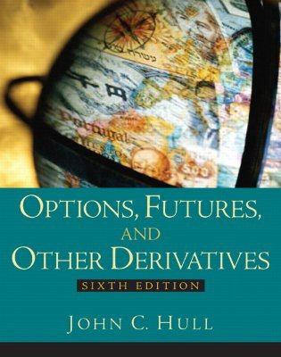
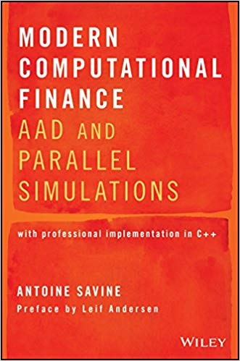
What do Quants do?

Slide 6
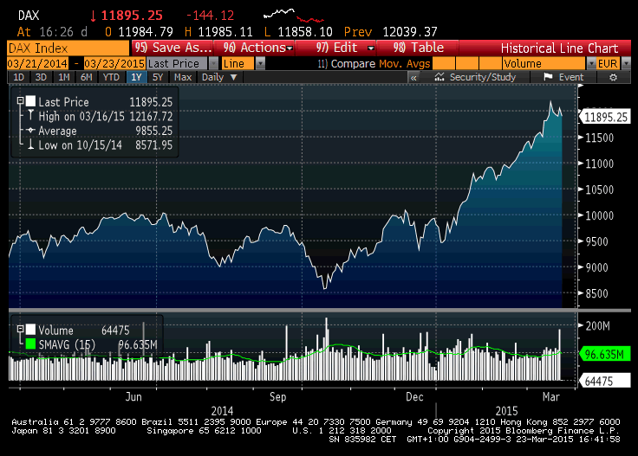
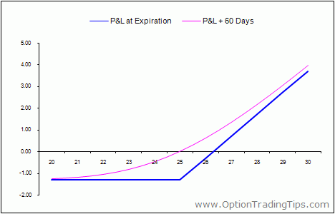
Origins: Black Sholes
)
)
)
Contract:
Martingale:
Distribution:

Slide 7
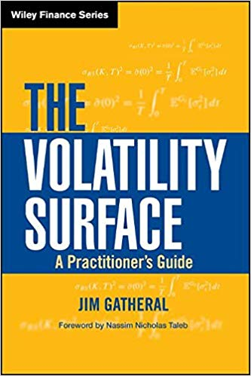
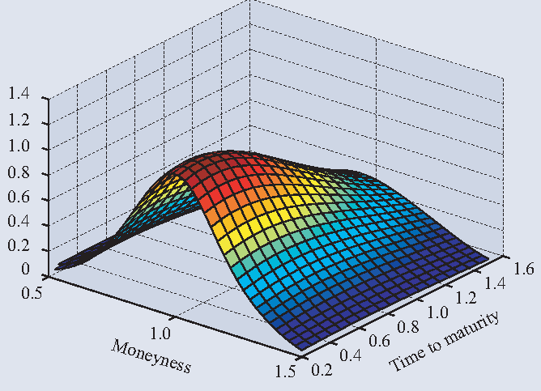
What do quants do today?
Classical (since 1980s):
  Derivatives
  Statistical (Stochastic Calculus)
  modeling and model implementation
Inevitable
  Regulation
Fashionable
  Machine learning
  Big data
  Digital services
I will judicously select example cases from the next slides

Slide 8
Sell Side Quants
Derivatives trading
  Hedging and positioning
  (flow and proprietary trading)
  Trade opportunities (e.g. convertible arbitrage ~2000)
Sales Quants :
  Quoting tools
Automated Market Making
Collateral optimization
3rd party services
Most of these areas require high numeric precision

Slide 9
Buy Side Quants
Algorithmid Trading / Statistical Arbitrage:
  Pairs trading
  Algorithms for dynamic capital allocation to multiple strategies
Investment analytics:
  Distressed investments (e.g. 2009 crisis aftermath)
  Rich / cheap analysis
Investment Management:
  Typically of more qualitative nature then market neutral strategies

Slide 10
Quants in controlling functions
Risk management (as a back office function)
Global risk controls of risk taking profit centers
Model validation

Slide 11
Jobs are a mixture of:
Modeling and concepts
Development (models, libraries, …)
Business intelligence
Business support
Alphabet soup of role names:
Model quant, quant developer, desk quant, front office quant, quant trader, strategist, …
There are almost no jobs where coding in a serious language (C++) is not a sine qua non requirement

Slide 12
Quant Backgrounds
Physics
Math
Physics
Statistics
Physics
Computer Science
Physics
Financial Engineering
Did I already say ”Physics”?

Slide 13
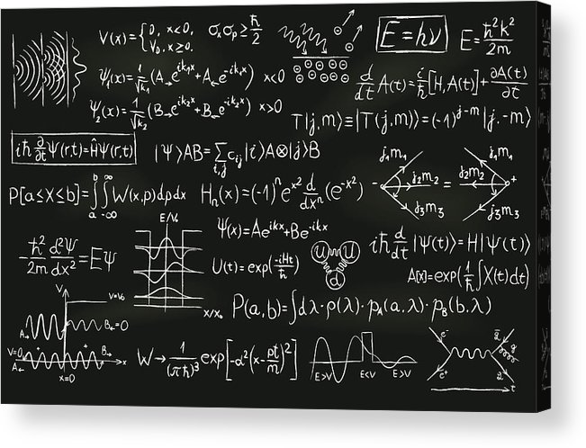
Why do we love physicists?

Slide 14
Why are physicists so succesful as quants
Mathematical quantitative background including
  Analysis
  Statistics
  Numerics
Pragmatism: The fine art of ”misusing math” and applying the KISS (”Keep it simple, stupid”) paradigm
”Creativity in a straightjacket”
Quants are modelers. Physicists distinguish models from theories.
They have a good understanding of model scope restrictions.
Structured, synoptical thinkink and problem solving.
A rare breed of ”red blooded nerds”

Slide 15
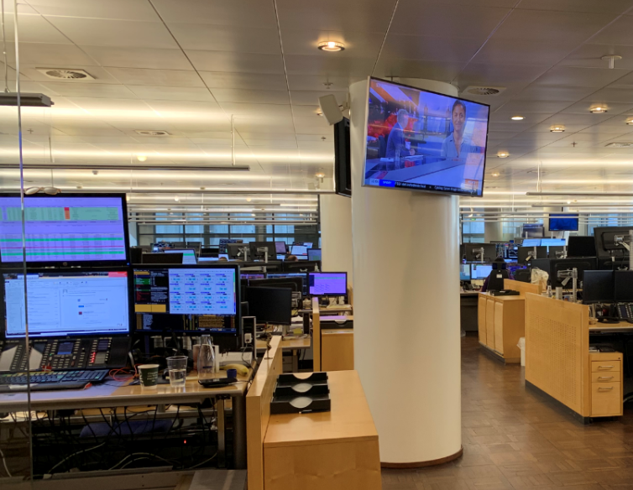
What do Quants do at Danske Bank?

Slide 16
The Vision :
The Danske Bank single source of risk and data platform – the route from simple data to derived data and applications
Derived data: prices/risk, capital/regulator, KYC, AML detect,.
Inside digital channels:
InteGate/DistrictPro (e.g. swapPricer, SuperFox etc)
Outside digital channels :
District and District Pro (e.g. LoanCrystal)
API
Internal functionality :
Back Office (payments, cashflows etc), Accounting, Regulatory reporting etc
Universal Service Architecture
Universal Service Architecture
Electronic trading:
RFQs, Algo trading, auto hedging,
SuperFly One Calculation Engine
API
API
API
Simple data in Golden Sources:
Market data, static data, product data, trade data etc
Universal Service Architecture
Grand Unification:
Application cloud around the One calculation engine

Slide 17
Credentials
Risk magazine’s ”in house system of the year 2015”
  AAD fired xVA system
Risk magazine’s ”Quant(s) of the year 2012”
Text book by Antoine Savine
Many of us came from prestigeous academic positions
and / or jobs with London tier 1 banks
We are a very diverse department of about 50 Quants
from a dozen or so nations and both sexes
(alas, more men than women).

Slide 18
What can you do at Danske Bank?

Slide 19
Possibilities for your secondment
Quant projects don’t sit on the shelf for long, so these are typical present day examples only
Theoretical (by practical standards)
  Equity proxy hedges
  Spread option modeling
Industry Standard Code Development
  Work with us on the platform vision
  Implement metric templates to a C++ API (exposed to .NET)
Hands-on practical
  Working with traders day to day to understand their market risk exposure
  Talking to senior management and risk managers to understang the controlling aspect
We are open to all those possibilities, also in combination.

Slide 20

Summary
Despite crises driven changes to the
financial industry, opportunities to make
a good life as a Quant remain
Physicists make for excellent Quants
A secondment with Danske Bank offers you
  A close up experience of the financial industry. (”Is it for me?”)
  A broad bandwitdth of interesting work lines during your secondment
    With a world class team
    Within a working culture that is not as cut throat as the industry is infamous for (and in a city top ranked for quality of life).
  A significant edge in landing a permanent job after your Ph.D. (with us or elsewhere)
Stay in touch (also on possible topics for your secondment):
    OVS@danskebank.dk (my boss Ove Scavenius) and SKRE@danskebank.dk (me)

Slide 21
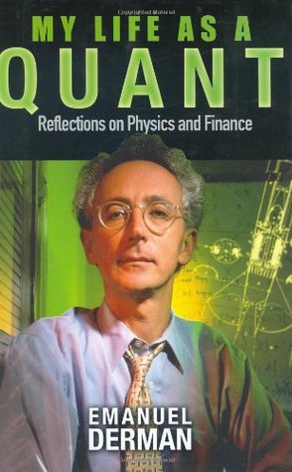
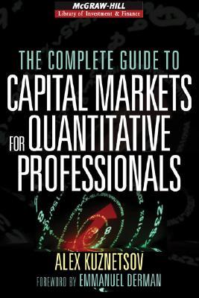
Non-quantitative quant books

