Slide 1


How to Survive in Research
Dr Simon Rees
Head of Researcher Development
Durham University
simon.rees@durham.ac.uk
14.30 – 16.30 2nd April 2019
This project has received funding from the European Union’s Horizon 2020 research and innovation programme under the Marie Skłodowska-Curie grant agreement No. 764850’

Slide 2
Session outline
Motivations and attributes of a successful researcher
Student/Supervisor relationships
Mentors and second supervisors
Challenges
Career planning
Horizon scanning
Work-life balance / external pressures
An opportunity to reflect and discuss

Slide 3
What things would you like to discuss?
www.menti.com

Slide 4
Motivations and attributes of a successful researcher

Slide 5
Why are you interested in pursuing a career in research?
Or why are you undertaking this research?
Discuss with the person next to you and then share reasons with the rest of the group.

Slide 6
Activity:
Attributes of a successful researcher.

Slide 7
On the post-it notes, write down an important attribute of a successful researcher.
On the flip chart paper, rank the attributes with the most important at the top going down to the least.
After 10 mins we will compare with the rest of the group.

Slide 8
Passionate about his or her career.
Resilient.
Detail-oriented but yet visionary.
A creative thinker.
Determined.
Knowledgeable (an expert).
A team player.
Self-motivated.
An effective communicator.
Capable of thinking “outside the box”.
Stull and Ciappo (2014)
https://doi.org/10.3945/an.114.007179

Slide 9
student / supervisor relationships

Slide 10
Department
Discipline
Doctoral Researcher
Academic Integration

Slide 11
Problem Areas
 | Discipline
Mismatch | Does not fit with conventional ways of being a researcher or scholar in the discipline Research practices not matched with student’s strengths
Isolation | Marginalized from the discipline
Golde 2005, 681-693
https://www.jstor.org/stable/pdf/3838782.pdf
Notes:
This is one of the key factors.
It boils down to not matching strengths and the practice not being as meaningful as we need it to be to sustain interest.
Isolation, having to stay focussed on details and being such a specialist and sticking with things even when, experiments are failing. Isolation is something we tend to think about as relating solely to our proximity to other people, but in the context of a discipline, what you often find that it is ‘the discipline’ itself that serves as the unifying factor, if you are having doubts about whether it is the best environment for someone with your strengths, you can feel very isolated.
If you feel like this, or are concerned, address it early with your supervisor. It may be that your perception, or self-perception, is wrong.

Slide 12
Problem Areas
 | Department
Mismatch | Does not fit with ways of being a student or junior scholar in the department Poor fit of expectations between student and department: inaccurate expectations about nature of graduate life Academically under-prepared Mismatch between student and supervisor
Isolation | Marginalized from the departmental community Structural isolation of student
Golde 2005, 681-693
Notes:
When this is a problem, some students switch to other institutions or supervisors/ supervisory teams.
Academically unprepared – it is a different way of thinking
Work/ life balance – the demands on your time
In terms of your supervisor – it is important to think about their research interests and their style.
Structural isolation – within your department, academic and social integration are intertwined. You can be physically isolated because of where you have to work. Isolation can diminish enthusiasm.
Take advantage of the opportunities to come together and if there are not any, create some.

Slide 13
Problem Areas
 | Discipline Filtered Through Department
Mismatch | Does not fit with ways of being a researcher or scholar as portrayed by those in the department Student perceives research faculty life is incompatible with personal goals Student perceives job market to be poor Research practices not matched with student’s strengths
Isolation | Marginalized from the discipline
Golde 2005, 681-693
Notes:
Assumptions about appropriate careers in particular disciplines permeate departments – because they are composed of people who have followed particular research/academic routes. As an undergraduate, your interactions with academics and researchers are limited and it is only as a PGR that you really get to see the breadth of what it is to be an academic or researcher. For some, this further motivates them as they like what they see, but other people can become disheartened because they think this is the PhD career route, and if they don’t follow it, what is the point of doing a PhD.
Remember, the PhD is about personal and professional development and is a valuable process in its own right.
Beware the ‘Grand Narrative’ of the academic career.

Slide 14
What are your supervisor’s responsibilities?
What are your responsibilities?
Notes:
List; then look at Durham policy for ideas.
1 hr 25 minutes

Slide 15
Working with Your Supervisor(s)
How would you describe your supervisor’s personality and way of supervising?
How would you describe your personality and preferred way of working?

Slide 16
Relationship with Supervisor
SUPERVISORS
DOMINANT
-expert who wants things their own way
INTERACTIVE
-give & take in discussions to agree
INDEPENDENT
-believes it’s the student’s project
Best
OK
Could have problems
X
X
SELF-MOTIVATED
-wants minimum interference
ENJOYS INTERACTION
-as part of the learning process
NEEDS DIRECTION
-willing to act as assistant to supervisor
RESEARCHER
Notes:
Write down 3 words to describe your current relationship with your supervisor. (think privately – no need to disclose anything you wish to keep private, however it may be useful to discuss the issues) What are the current strengths and weaknesses of your supervisory relationship? Now here’s one model – where would you place yourself and your supervisor now? Draw onto handout and date it. In 6mths, a year, two years, how is it different?

Slide 17
Second supervisors and mentors

Slide 18
What is the role of your second supervisor?
What is the role of your mentor?

Slide 19
Mentors
A leading scientist at a different SAGEX node, with complementary academic expertise to you.
Novel insights: might offer an alternative view on your research project.
Might find the relationship develops over time as you gain more experience
Be proactive: the mentors are busy academics, so expect to put in effort to develop the relationship.

Slide 20


It is crucial during your training that you develop confidence in your insight and learn to think independently of your mentor (in the wise words of my first mentor, “the outcome of the perfect training experience is that you leave the laboratory thinking that your mentor is a good person, but a bit dumb”).
(Yewdell, 2008)

Slide 21
Challenges for a scientist.

Slide 22
Early career
- Imposter syndrome.
- Lack of confidence.
- Less knowledge.
- Feel constrained.
Established career
Feel you have exhausted the area.
Lose interest.
Dug so deep in one hole that you can’t see over the sides.
Feel constrained.

Slide 23
Activity:
Developing research ideas.

Slide 24

Activity: How would you overcome struggling with coming up with research ideas.
In groups of three or four spend 5 minutes discussing strategies to deal with this challenge.
What would you do?
Where would you go?

Slide 25
Activity: Blue skies thinking
In pairs:
Imagine a perfect world.
In this perfect world what would you like to find out about?
Now focus on these thoughts to develop them into something feasible and practical.

Slide 26
Stepping back - decontextualisation
Read all the recent articles in your field.
Update your place in the field.
Read articles / attend seminars outside of your field.

Slide 27
Coping with rejection

Slide 28
Avoid taking it personally
View the feedback constructively
Embrace your feelings
You are not alone – share with others
http://makewritelearn.com/rejection-letter

Slide 29
Working collaboratively
What part do you play in a team?
What are the other parts required for success?
What problems do you envisage and how can they be addressed?
Discuss in pairs and then share with the rest of the group.

Slide 30
Career planning and horizon scanning.

Slide 31
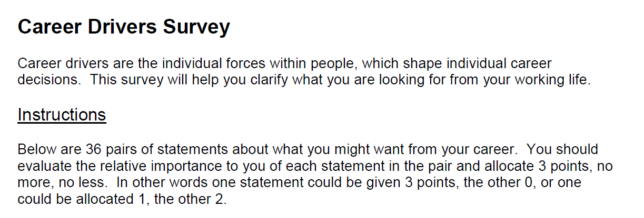

Slide 32
Activity:
Your career plan.

Slide 33
On the sheet provided, complete your own career timeline.
What are your aspirations?
When do you hope to achieve them?

Slide 34
Activity:
Horizon scanning.

Slide 35
In your groups, discuss these questions for five minutes:
What opportunities may be developing in your area?
How can you increase your awareness of possible opportunities?
How can you improve your chances?

Slide 36
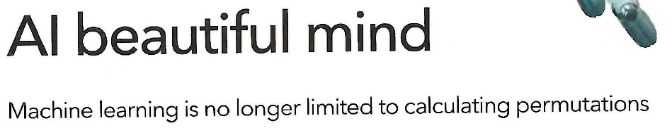
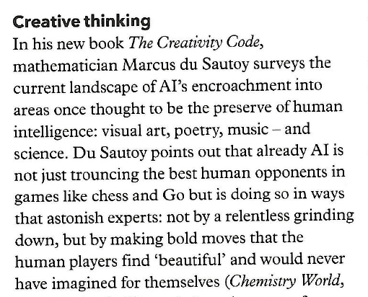
Ball, P. (2019)
Chemistry World. Vol 16(3)

Slide 37
Work life balance.

Slide 38
The importance of work-life balance
To maintain your mental health (reduce stress)
To ensure your physical health and wellbeing
It increases productivity
Become a more rounded individual
You only get one life!

Slide 39
What we covered today:
What are the qualities of a successful scientist?
We considered the recognised qualities of a successful scientist such as: resilience, creativity, team player.
Challenges of scientific research.
We considered some of the challenges of academic research such as: generating ideas and managing rejection.
The student / supervisor relationship
We considered the nature of the student/supervisor relationship and how best to manage this.
Career planning
We explored career drivers and future career planning.

