Slide 1
Gravity Amplitudes and General Relativity
N. Emil J. Bjerrum-Bohr
Niels Bohr Institute, Copenhagen University
Work together with: P. Damgaard, J. Donoghue,
G. Festuccia, B Holstein, L. Plante, P. Vanhove
(1806.04920; 1609.07477; 1410.4148)
1

Slide 2
Niels Bohr Institute (NBIA)
Senior:
  Poul Damgaard
  Emil Bjerrum-Bohr
  Jake Bourjaily
  Paolo Benincasa
  Mike Trott
  Junior:
  Andrew McLeod
  Matt von Hippel
  Matthias Wilhelm
  David McGady
  Humberto Gomez
  Carlos Cardona
PhD Students:
  Kays Haddad
  Andreas Helset
  Anagha Vasudevan
  Diego Hidalgo
  Matthias Volk
  MSc Students :
  David Damgaard
  Solvej Knudsen
  Johannes Sørensen

Slide 3
Outline
General Relativity as a perturbative effective field theory
New on-shell toolbox for computations
New applications for computation of observables in general relativity
  Scattering angles
  Light-by-light scattering
Outlook
3

Slide 4
General Relativity as an effective field theory
4

Slide 5
Traditional quantization of gravity
Known since the 1960ties that a particle version of General Relativity can be derived from the Einstein Hilbert Lagrangian (Feynman, DeWitt)
Expand Einstein-Hilbert Lagrangian :
Derive vertices as in a particle theory - compute amplitudes as Feynman diagrams!
5

Slide 6
Quantum theory for gravity
Gravity as a theory with self-interactions
Non-renormalisable theory! (‘t Hooft and Veltman)
Traditional belief : – no known symmetry can remove all UV-divergences
Dimensionful coupling:
G_{N}=1/M²_{planck}
String theory can by introducing new length scales
6
6

Slide 7


Quantum gravity as an effective field theory
(Weinberg) proposed to view the quantization of general relativity from the viewpoint of effective field theory
(Donoghue) and (NEJB, Donoghue, Holstein) did the first one-loop concrete computation in such a framework
7
7

Slide 8
Effective field theory for gravity
Consistent quantization
  Working low energy version of quantum gravity
New point of view:
  General relativity hbar-> 0 limit of multi-loop expansion
  Classical pieces comes from loop diagrams!
  Explanation: contributions appear in loop diagrams feature a cancellation of the loop diagram hbar factor
    (mass/hbar) expansion.
(Donoghue, Holstein)
Gravity Amplitudes and General Relativity

Slide 9
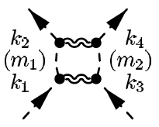
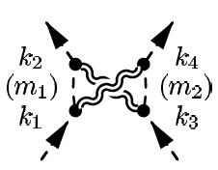
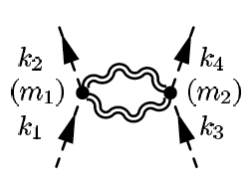
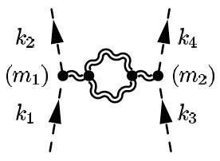
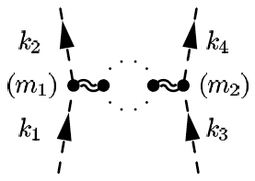
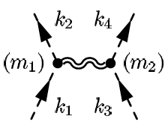
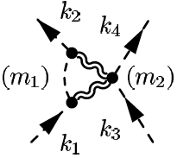
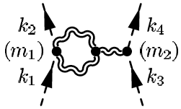
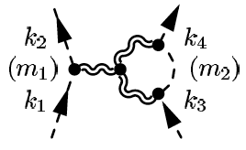
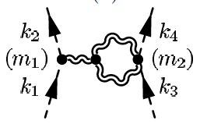
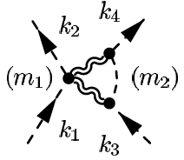
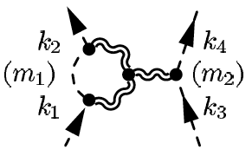
One-loop (off-shell) gravity computation
Boxes
Bubbles
Triangles
Tree
(NEJB, Donoghue, Holstein)
9
9

Slide 10
One-loop (off-shell) gravity computation
Boxes
Bubbles
Triangles
Tree
(NEJB, Donoghue, Holstein)
10
10

Slide 11
One-loop (off-shell) gravity computation
Boxes
Bubbles
Triangles
Tree
(NEJB, Donoghue, Holstein)
11
11

Slide 12
One-loop (off-shell) gravity computation
Boxes
Bubbles
Triangles
Tree
(NEJB, Donoghue, Holstein)
12
12

Slide 13

One-loop result for gravity
Four point amplitude can be deduced to take the form
Focus on deriving these ~>
Long-range behavior
(no higher derivative
contributions)
Short range behaviour
(NEJB, Donoghue, Holstein)
13

Slide 14

One-loop result for gravity
The result for the amplitude (in coordinate space) after summing all diagrams is (leading in small momentum transfer contribution):
Post-Newtonian New quantum term term
Post-Newtonian term in complete accordance with general relativity: (Iwasaki, Holstein and Ross, Neill and Rothstein, NEJB, Damgaard, Festuccia, Plante, Vanhove)
(NEJB, Donoghue, Holstein)
14

Slide 15
Gravity as an EFT
Suggest general relativity augmented by higher derivative operators – the most general modified theory
  Tiny consequences for most observables – since curvature is really small. Interesting connection between observed bounds and theory
Quantum theory -> classical limit general relativity
  Post-Newtonian corrections, Hamiltonians for gravitational systems and Post-Minkowskian observables
15

Slide 16
New on-shell toolbox for computations
16

Slide 17
Off-shell gravity amplitudes
Vertices: 3pt, 4pt, 5pt,..n-pt
Complicated expressions
Expand Lagrangian, tedious process….
(DeWitt;Sannan)
45 terms + sym
17

Slide 18
Concrete computation gravity
Featuring a number of unpleasant features
  Complicated Feynman rules (infinitely many vertices)
  Numerous double contractions
  Factorial growth in number of legs
  Feynman diagram topologies: no ordering!
  Loop order: complicated tensor integrals
18

Slide 19
Key: String theory inspiration
  Different form for amplitude
    Feynman diagrams sums separate kinematic poles
    String theory adds channels up..
    <->
2
1
M
x
3
1
1
x
x
1
2
s₁₂
s_{1M}
s₁₂₃
x
=
+
+
...
.
2
3
M
.
19
19

Slide 20

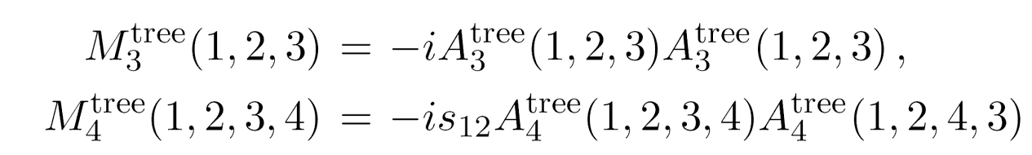
Gravity Amplitudes
KLT relationship (Kawai, Lewellen and Tye) relates open and closed strings (Bern, Dixon, Dunbar, Perelstein, Rozowsky)
KLT not manifestly crossing symmetric – explicit representation :
Momentum prefactors cancel double poles

Slide 21
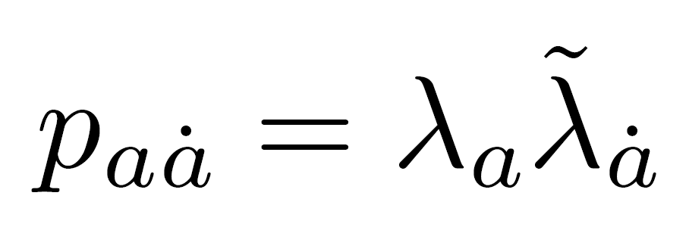
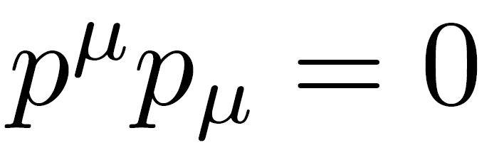
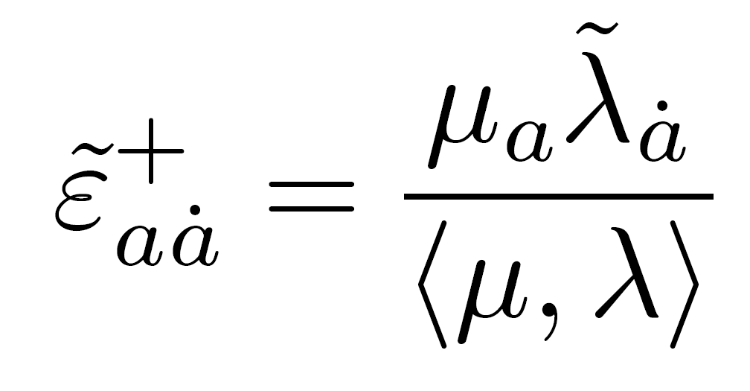
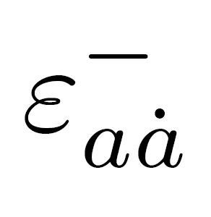

Key: on-shell states formalism
Spinor products :
Different representations of
the Lorentz group
Momentum parts of amplitudes:
Spin-2 polarisation tensors in terms of helicities, (squares of those of YM):
(Xu, Zhang,
Chang)
21
Notes:
Perhaps include polisation tensor gravity…

Slide 22
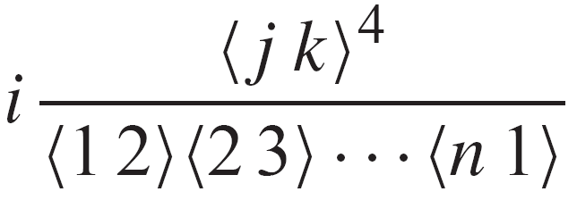
Yang-Mills MHV-amplitudes
(n) same helicities vanishes
A^{tree}(1⁺,2⁺,3⁺,4⁺,..) = 0
(n-1) same helicities vanishes
A^{tree}(1⁺,2⁺,..,j⁻,..) = 0
(n-2) same helicities:
A^{tree}(1⁺,2⁺,..,j⁻,..,k⁻,..)
  A^{tree MHV} Given by the formula
  (Parke and Taylor) and proven
  by (Berends and Giele)
    First non-trivial example,
    (M)aximally
    (H)elicity (V)iolating (MHV) amplitudes
One single term!!
General Relativity from Particle Scattering
22

Slide 23
Simplifications from Spinor-Helicity
Huge simplifications
45 terms + sym
Vanish in spinor helicity formalism
Gravity:
Contractions
23
23

Slide 24
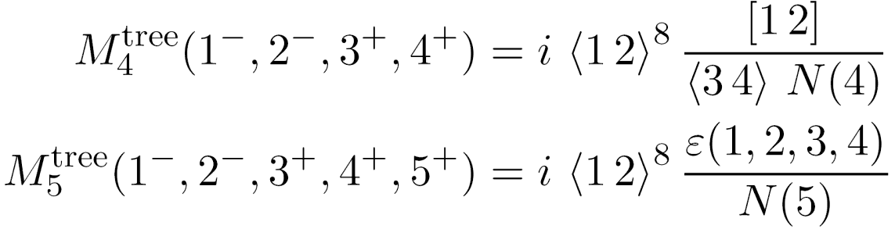
Gravity MHV amplitudes
Can be generated from KLT via YM MHV amplitudes.
(Berends-Giele-Kuijf) recursion formula
Anti holomorphic
Contributions
– feature in gravity
24

Slide 25
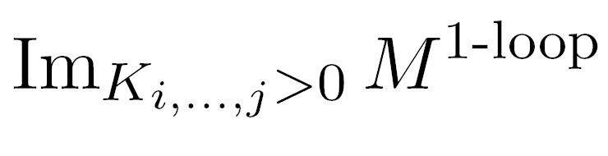

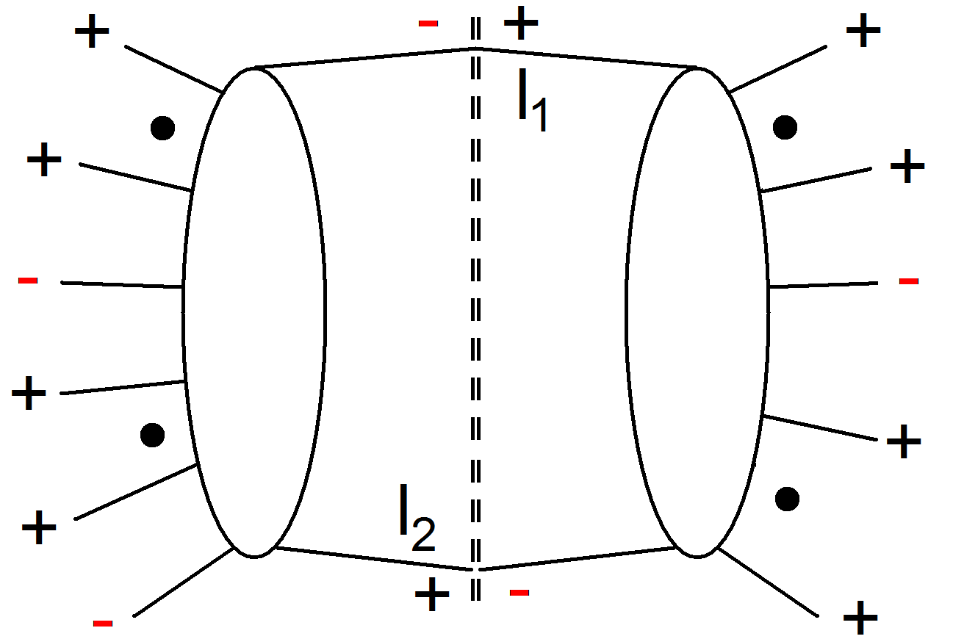
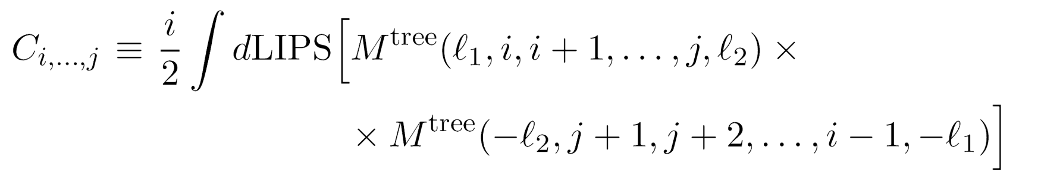
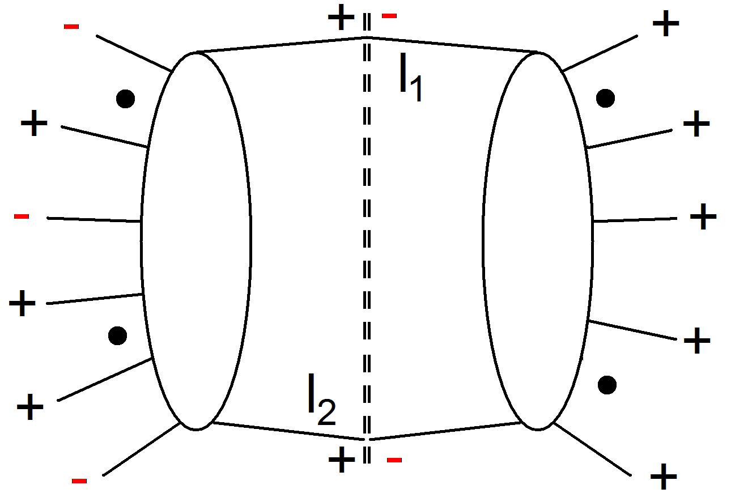
Unitarity cuts
Helicity formalism require unitarity methods
Singlet
Non-Singlet

Slide 26


New results: massless matter
As an example we will consider scattering of massless matter
Bending of light/massless matter around the Sun
New features: mass-less external fields ~> IR singularities
New test of universality of matter
26

Slide 27




Trees and the cut
We have the Lagrangian
where
27

Slide 28
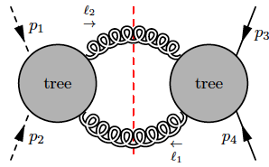
Trees and the cut
We have the Lagrangian
We want to compute the cut
28

Slide 29
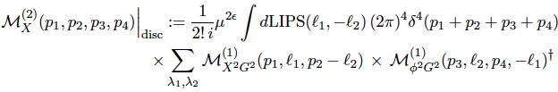
Trees and the cut
We have the Lagrangian
We want to compute the cut
29

Slide 30

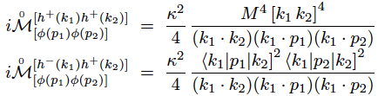
Photons and scalars
For photons we have
While for scalars
Super compact compared to Feynman diagram results
30

Slide 31
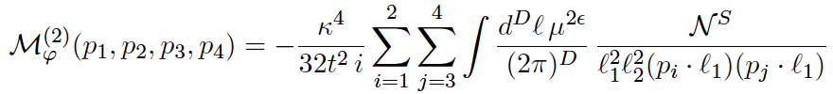



Result for the amplitude
We can rewrite
where
Scalar
case
Fermion
case
Photon
case
Combine spinor expressions into traces
31

Slide 32
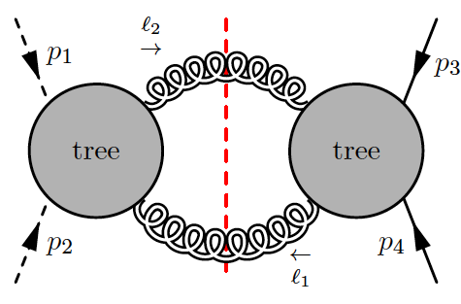
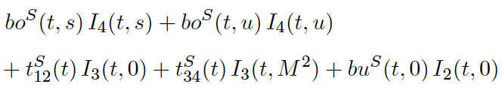
Result for the amplitude
Expand out traces
Reduce to scalar basis of integrals
Isolate coefficients
(Bern, Dixon, Dunbar, Kosower)
32

Slide 33



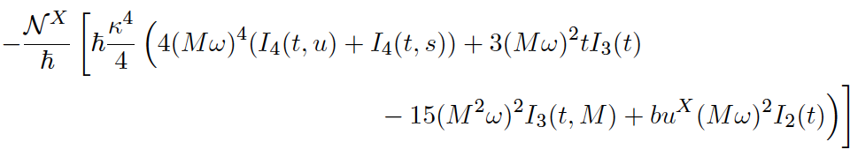
Result for the amplitude
33

Slide 34



Result for the amplitude
Taking the post-Newtonian
non-relativistic low energy limit
(NEJB, Donoghue, Holstein,
Plante, Vanhove)
34
34

Slide 35




Making connection to general relativity
General metric
Schwarzschild
Can we reproduce?
General Relativity from Particle Scattering
35

Slide 36



Stationary phase method
We apply a Fourier transformation to impact parameter space and exponentiate into eikonal phases, so that a stationary phase method can be applied.
(See e.g. Akhoury, Saotome and Sterman)
36

Slide 37
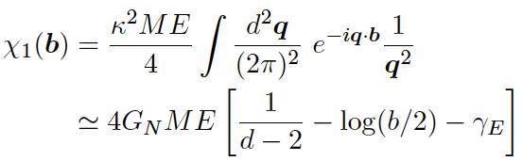

Stationary phase method
Now we can compute
37

Slide 38



Stationary phase method
Leading to static phase when:
Using that
We arrive at:
38

Slide 39
Stationary phase method
Leading to static phase when:
Using that
Or:
39

Slide 40



Bending of light
Interpreted as a bending angle (eikonal approximation) we have:
plus a quantum effect of the order of magnitude:
We see that we have universality between scalars, fermions and photons only for the ‘Newton’ and ‘post-Newtonian’ contributions
40

Slide 41
New applications for computation of observables in general relativity
41

Slide 42
Classical contributions from perturbative computations
Use of perturbative framework to compute observables in general relativity
Truncation to only classical terms
Only non-analytical piece corresponding to long-distance interactions -> Unitarity cuts useful
Gravitational wave applications: (Blanchet review)
  Some modern type amplitude computations of post-Newtonian potentials (NEJB, Donoghue, Holstein; Holstein and Ross; Holstein; Neill and Rothstein; NEJB, Donoghue, Vanhove) (Guevara and Cachazo; Guevara; Damour; NEJB, Damgaard, Festuccia, Plante, Vanhove; Cheung, Rothstein, Solon)
  Some modern approaches to the scattering angle in post-Minkowskian formalism (Westpfahl; Damour; Vines; NEJB, Damgaard, Festuccia, Plante, Vanhove)
42

Slide 43




Classical contributions from perturbative computations
In classical gravity the long-distance terms that are related to the post-Newtonian effects are triangle diagrams (at one-loop)
Such contributions have cancellations of and lead to purely classical terms
~
43

Slide 44
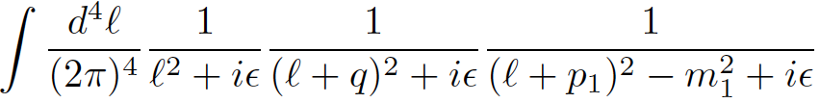
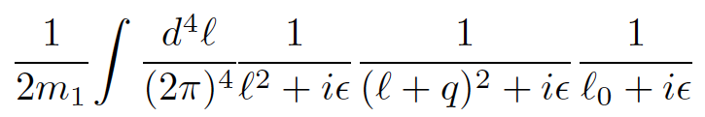
General relativity from loops
New derivation
General Relativity from Particle Scattering
44

Slide 45
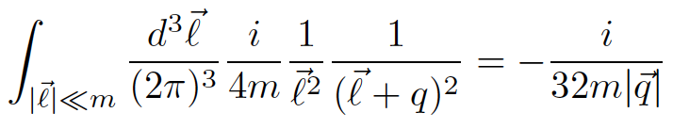
General relativity from loops
Close contour
(NEJB, Damgaard, Festuccia, Plante, Vanhove)
General Relativity from Particle Scattering
45

Slide 46
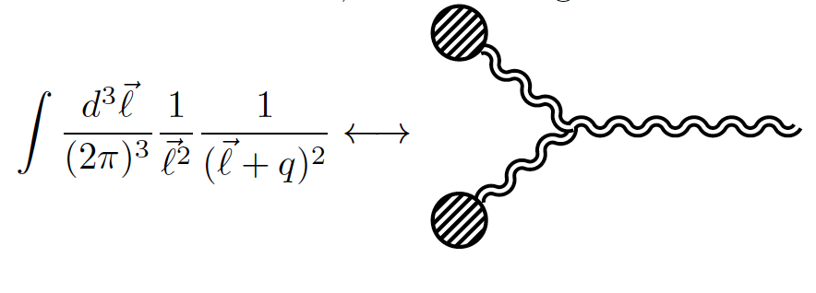
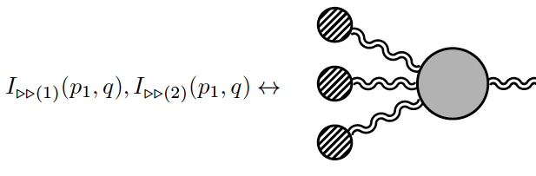
Interpretation
Integration of classical
sources on
tree graphs
– no loops!
Picture extends to higher loops
Explains the metric
computation by
(Duff)
(NEJB, Damgaard, Festuccia, Plante, Vanhove)
General Relativity from Particle Scattering
46

Slide 47
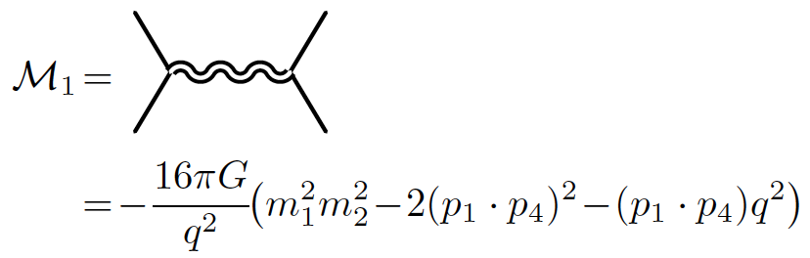
Scalar interaction potentials (tree)
Tree level
General Relativity from Particle Scattering
47

Slide 48
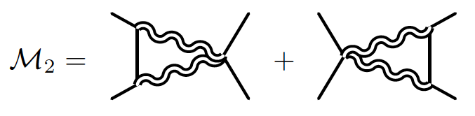

Scalar interaction potentials (one-loop)
One-loop level
General Relativity from Particle Scattering
48

Slide 49
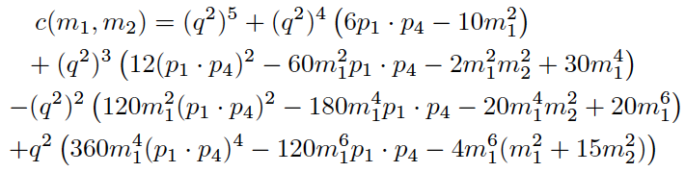

Classical contribution from one-loop amplitude
General relativity encoded in triangle
coefficients
(NEJB, Damgaard, Festuccia, Plante, Vanhove)
General Relativity from Particle Scattering
49

Slide 50
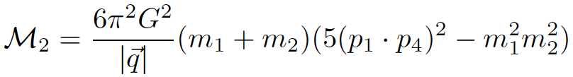

Post-Newtonian potentials
Leading order in q
All momenta provided at infinity, contractions are done using flat space metric (Minkowski), no reference to coordinates. Gauge invariant expression – to derive potential we have to introduce coordinates, Fourier transform and expand subleading terms in .
General Relativity from Particle Scattering
50

Slide 51
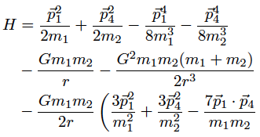

post-Newtonian interaction potentials
(Einstein-Infeld-Hoffman)
Subtraction of tree-level Born term to in order to get the correct potential (3 – 7/2 -> -1/2 )
General Relativity from Particle Scattering
51

Slide 52


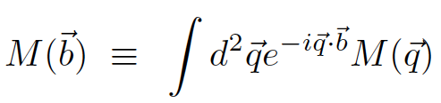

post-Minkowskian expansion
Will use similar eikonal setup as for bending of light (extended to massive case):
b orthogonal and
Amplitude computed
Eikonal phase
General Relativity from Particle Scattering
52

Slide 53
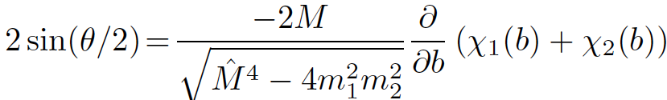
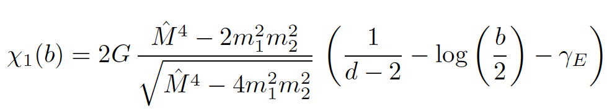
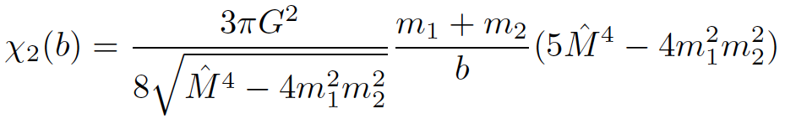
post-Minkowskian expansion
Stationary phase condition (leading order in q)
General Relativity from Particle Scattering
53

Slide 54
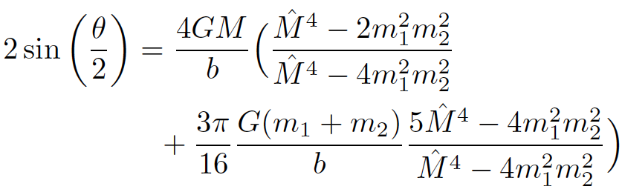

post-Minkowskian expansion
Final result becomes
Agrees with (Westpfahl)
Light-like limit
General Relativity from Particle Scattering
54

Slide 55
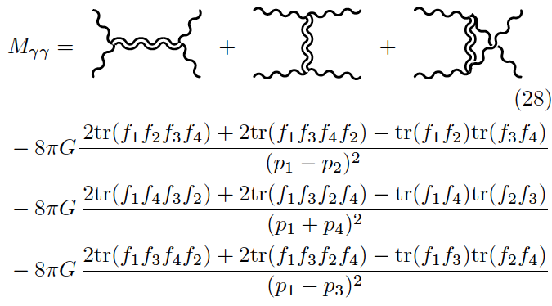

post-Minkowskian expansion
Exact result light-by-light scattering:
No triangles!
(NEJB, Damgaard, Festuccia, Plante, Vanhove)
General Relativity from Particle Scattering
55

Slide 56
Outlook
Amplitude toolbox for computations provides efficient new methods.
New applications can be used to increase precision for classical general relativity computations.
Good prospects for further theoretical and practical breakthroughs
    Much progress in short time – practical implementation still lags behind
56

