Slide 1
CERN-UA1, Calorimetry and Thoughts on the Search for the Higgs Boson at LHC
Michael Albrow, Fermilab, Chicago, USA
Scientist Emeritus
Presented on the occasion of the 70th Birthday of
Tejinder Virdee, FRS
Part 1: 1984 & following years
Calorimeter read-out with wavelength-shifting fibres

Slide 2
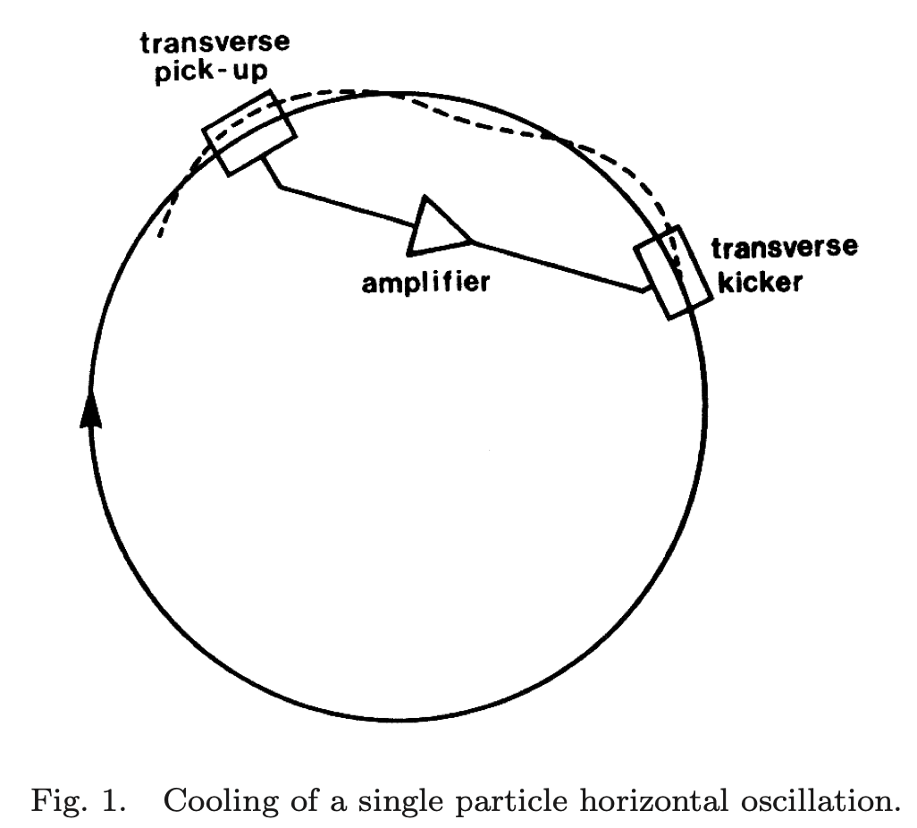
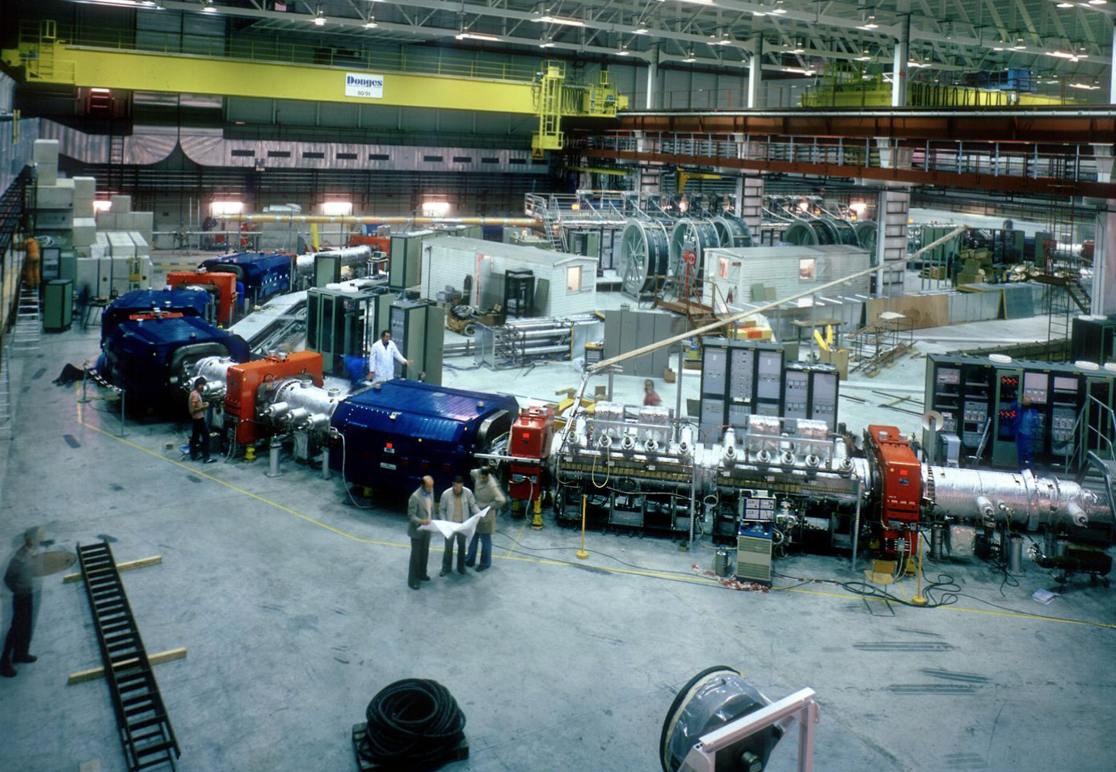
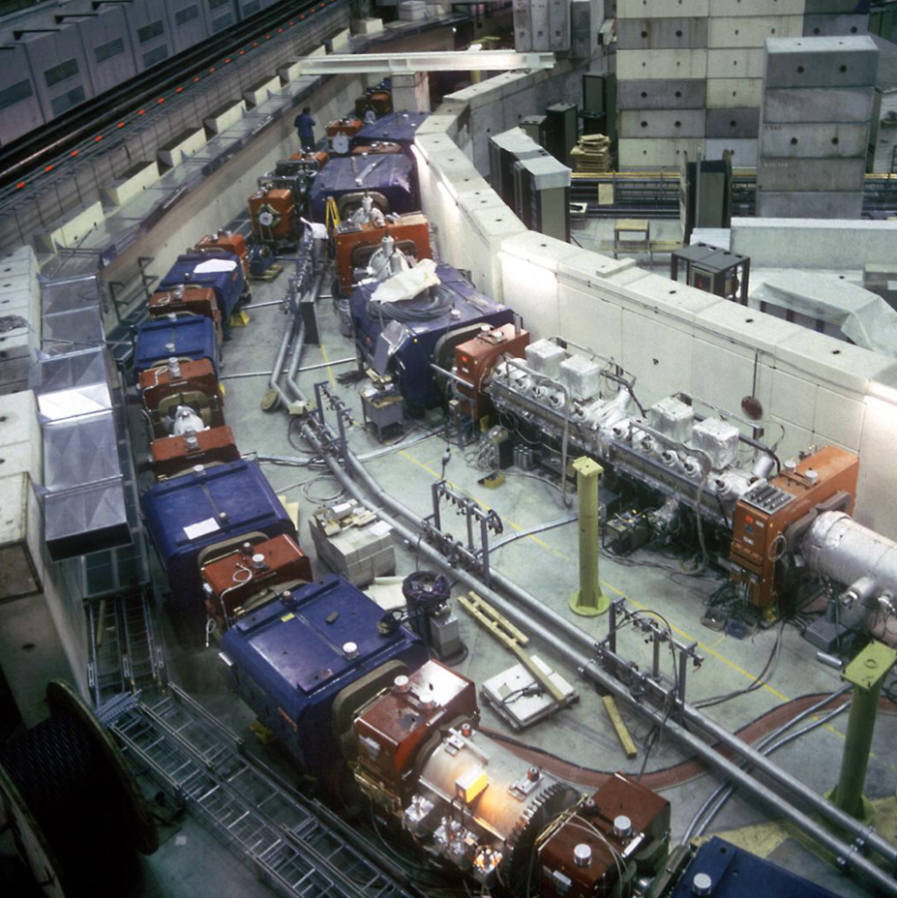
Making and collecting beams of antiprotons at CERN
”Stochastic cooling” invented by Simon Van der Meer (NP)
Enabled conversion of SPS accelerator to SppS collider
Tested at the CERN Intersecting Storage Rings, ISR
_
Antiproton Accumulator during construction
Antiproton Collector surrounding the Antiproton Accumulator

Slide 3
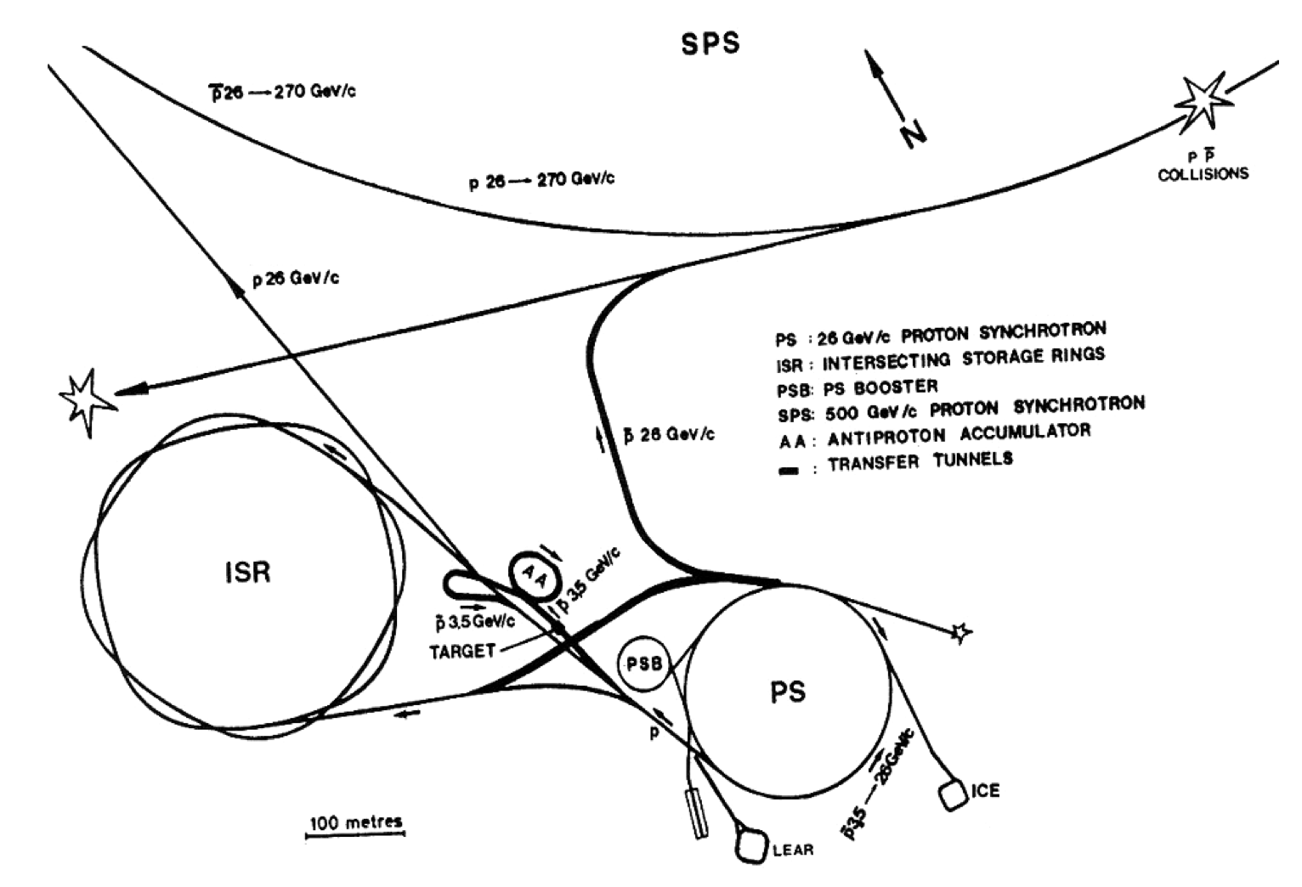
1984:
UA1
SCISR idea 1976
90 TeV + 90 TeV
High luminosity pp
CERN accelerator complex early 1980’s.
Clever idea: In Super Proton Synchrotron (SPS) send antiproton beam in the other direction
Collide p + p(bar) bunches at two locations. Enough collision energy to make W and Z bosons,
theoretical quanta of the weak force – e.g. neutron decay d --> u

Slide 4
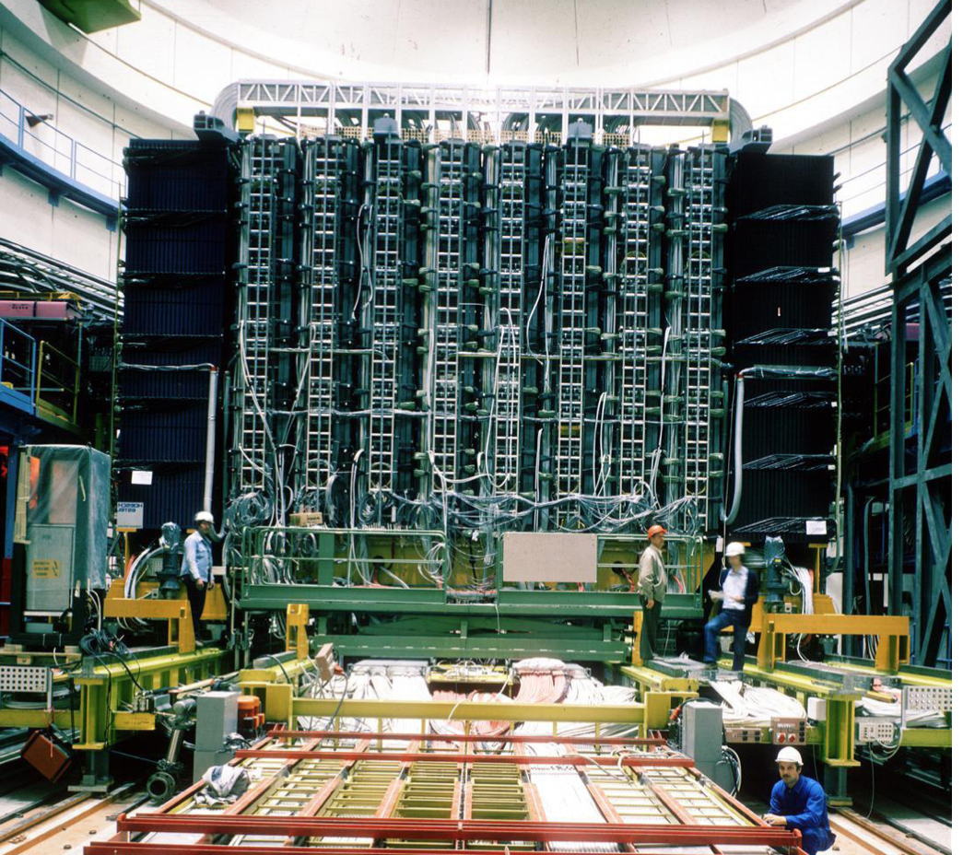
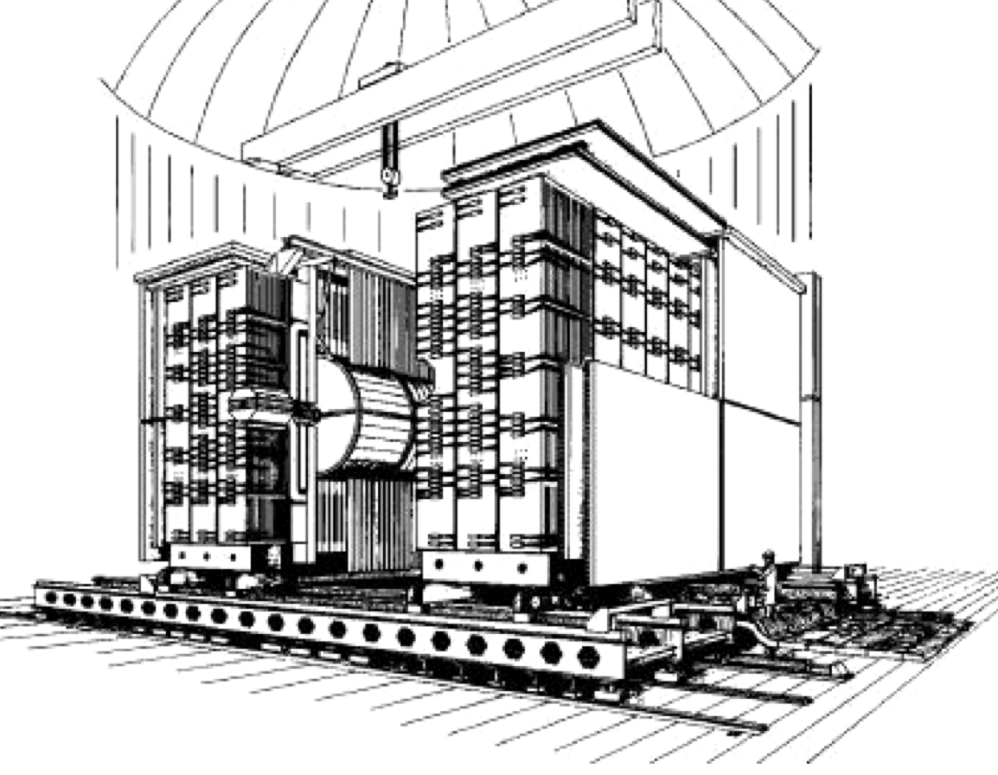
UA1 (Underground Area) and UA2: Massive particle detectors at two collision points
where bunches of protons and antiprotons collide. About 200 physicists/project.
“Calorimeter” of lead sheets and iron
sheets interspersed with plastic scintillator:
Fluorescent, particle showers --> light
Measured with photomultiplier tubes.
The UA1 detector during assembly
Project led by Carlo Rubbia

Slide 5
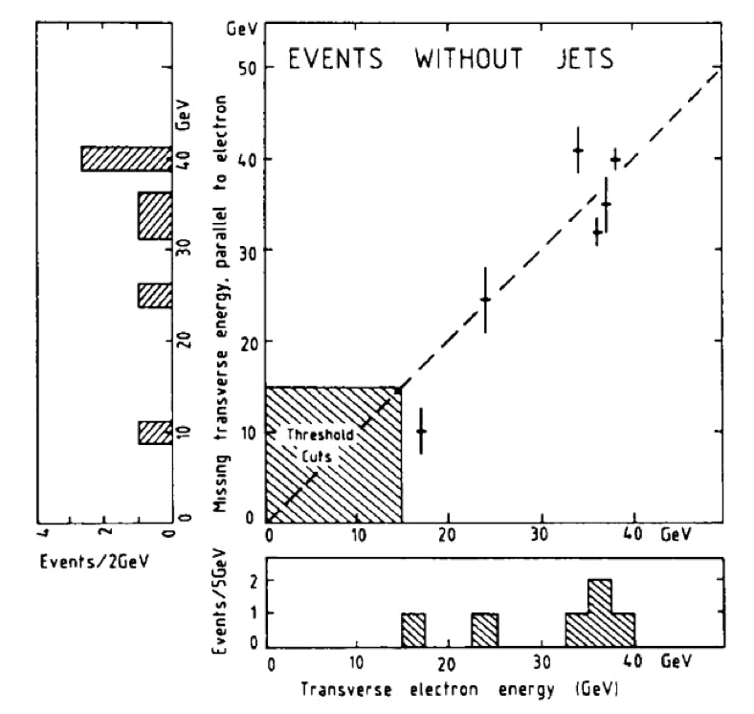
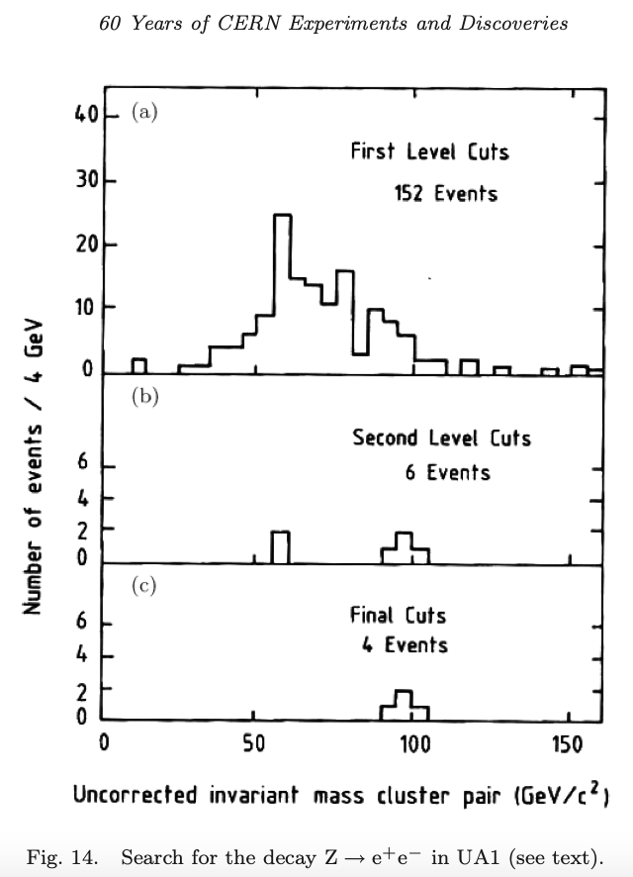
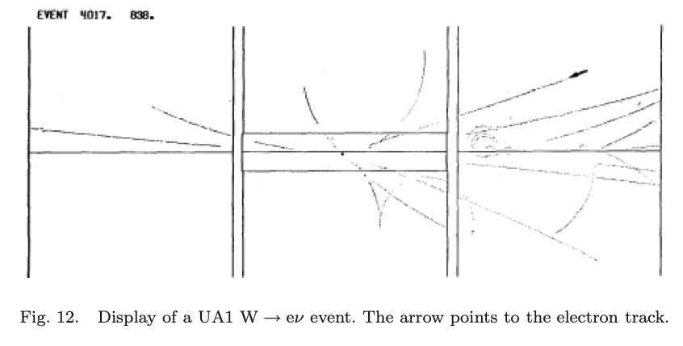
Discovery of W --> e v and Z --> e⁺e⁻ bosons. Predicted quanta of the weak force.
Nobel Prize for Carlo Rubbia and Van der Meer
electron
Later CERN built LEP collider 27 km circumference
e⁺
Z
e⁻
making millions & studying decays

Slide 6
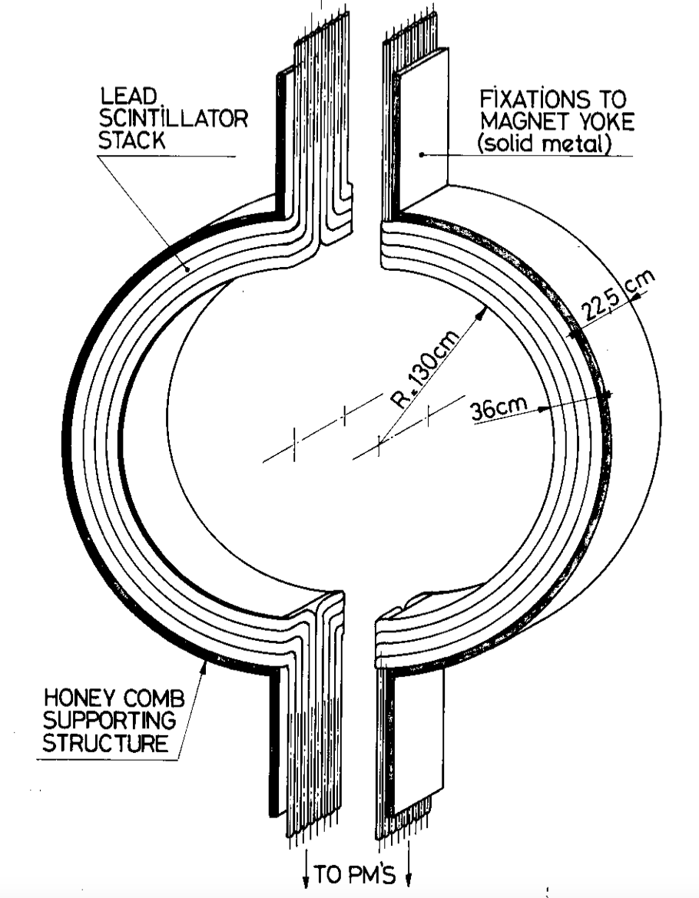
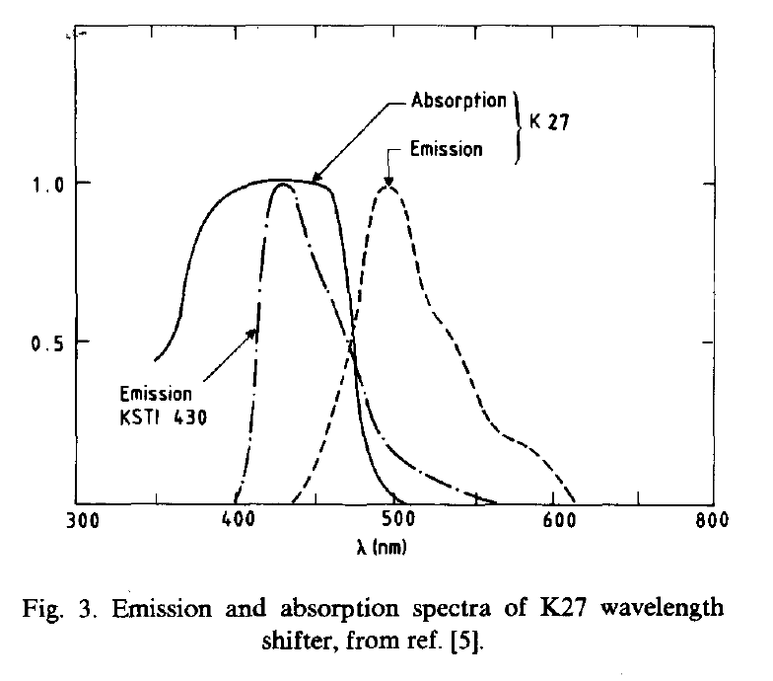
UA1 Electromagnetic Calorimeter module
Half-moons or “gondolas”
No azimuthal segmentation – 180º Good enough for W & Z, not for more complex events.
UA1 Hadron calorimeter, and Axial Field Spectrometer
at ISR collected light from scintillator plates with WLS
rods and side plates. “Cracks” and non-uniformity.

Slide 7
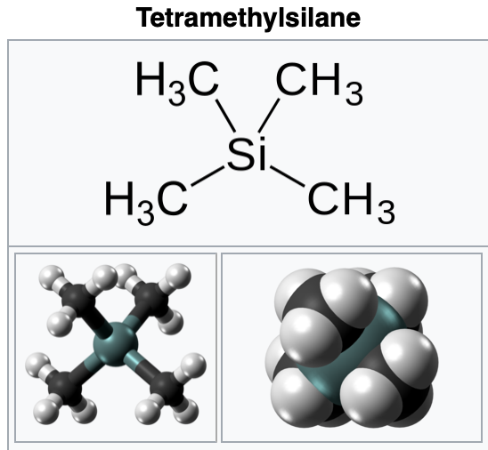
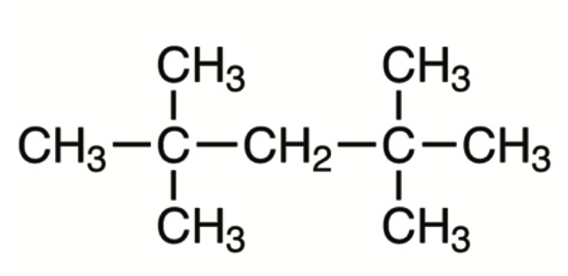


Measure ionization in liquid cells. Liquid argon used, cryogenics.
”Warm” liquid calorimeter?
With uranium plates! Hazardous, but Rubbia’s hope!
Tetramethylpentane
Trace impurities!
1984: Needed viable alternatives

Slide 8
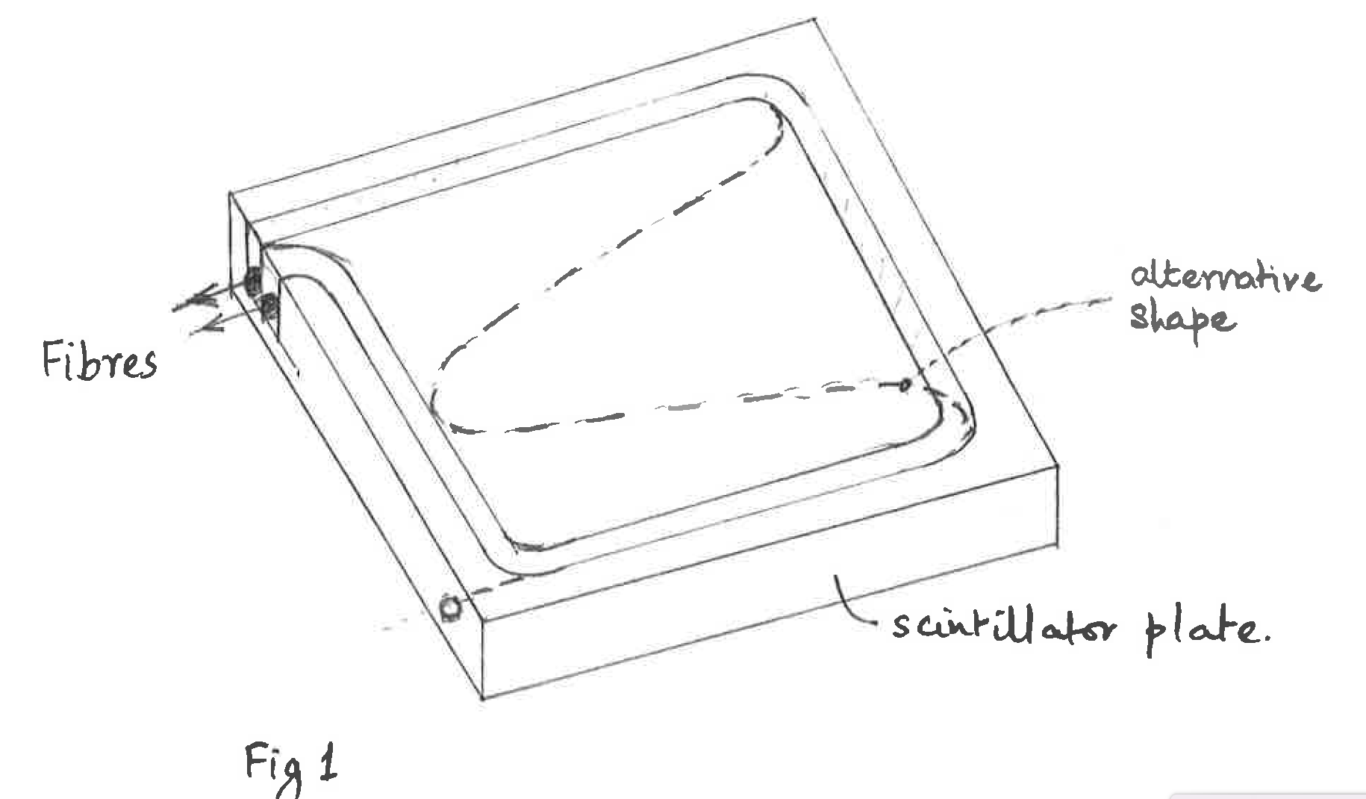
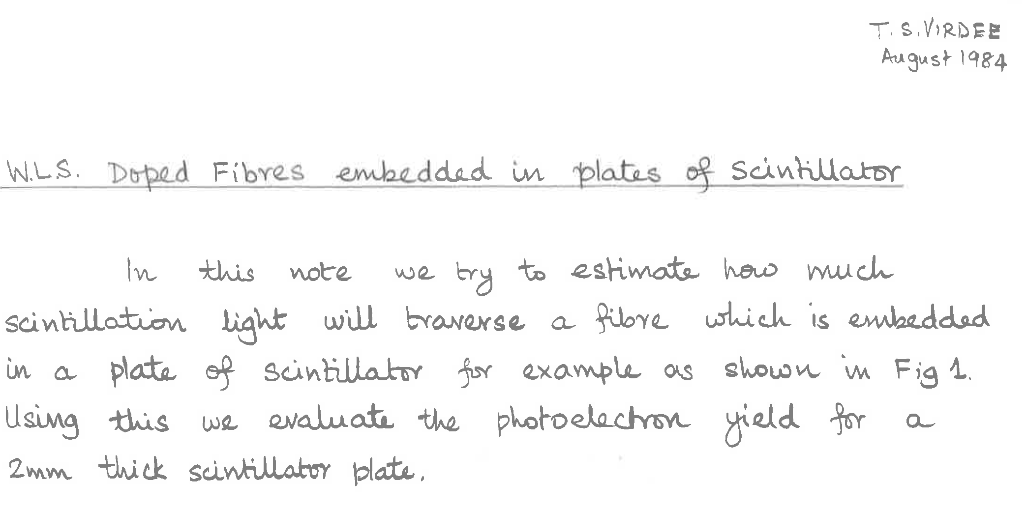
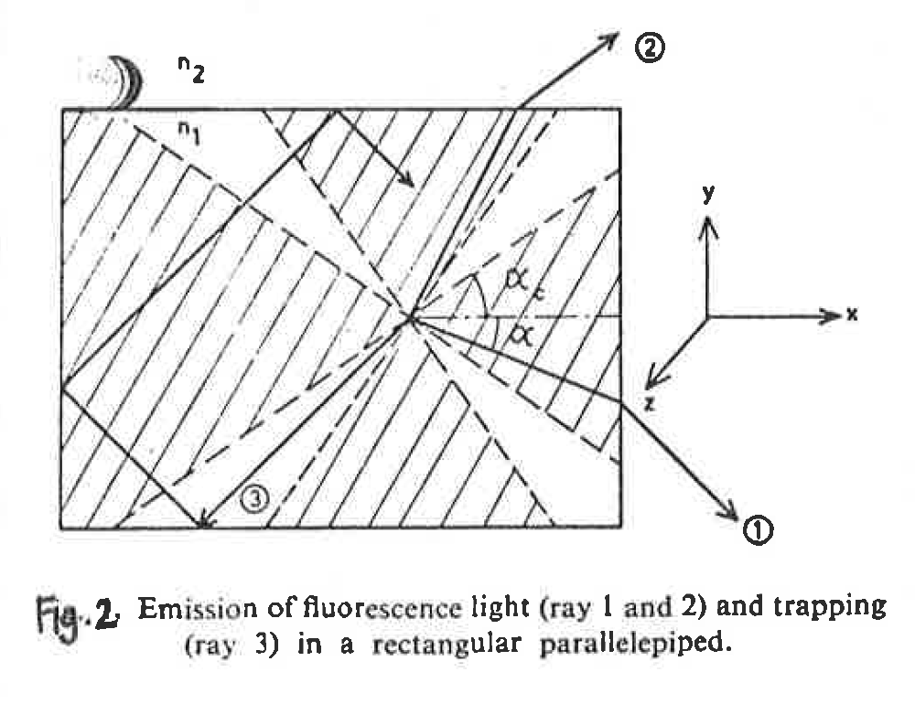
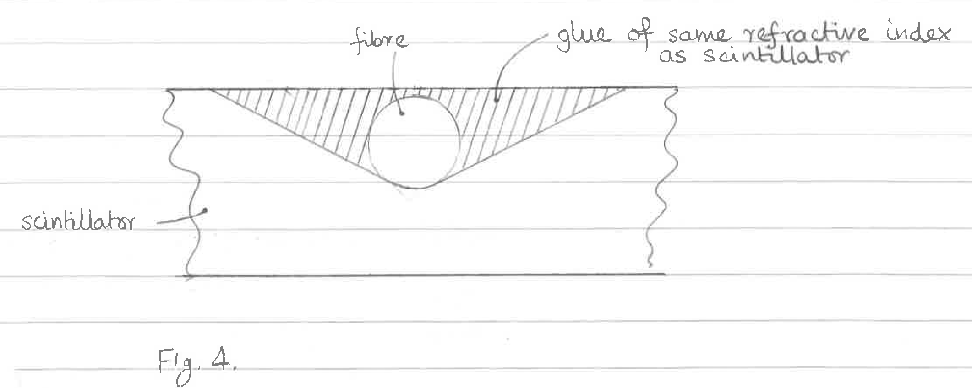
1984: Needed new EM calorimeter with good segmentation
In both directions: 𝜽 and 𝜙
Scintillator? How to extract the light without dead spaces?

Slide 9
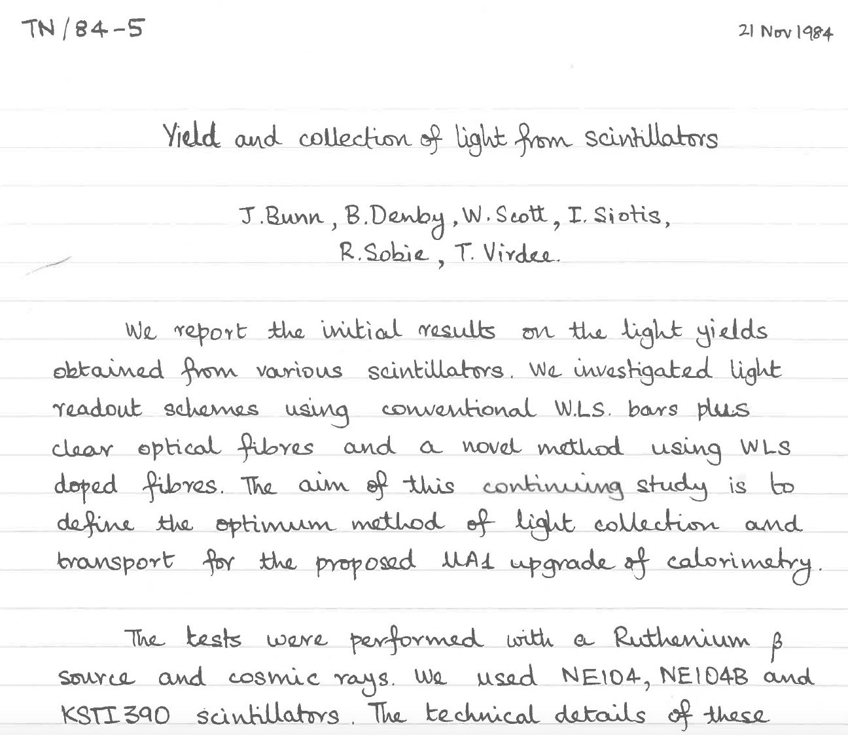
Autumn 1984: Lab tests of WLS bars and fibres. Virdee with Imperial College and Rutherford Lab groups

Slide 10
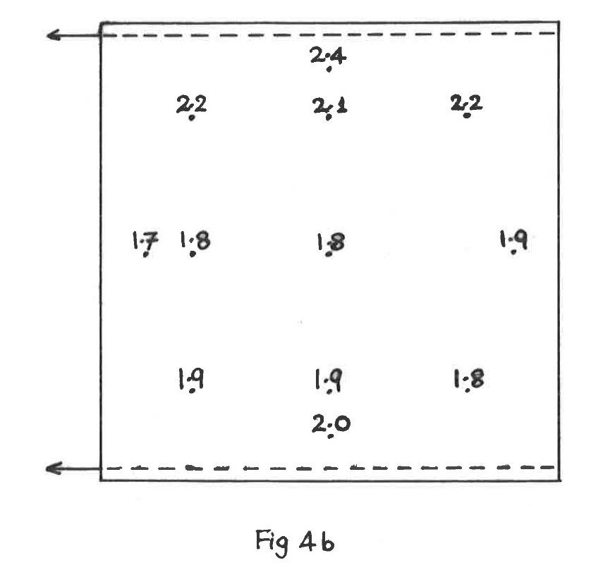
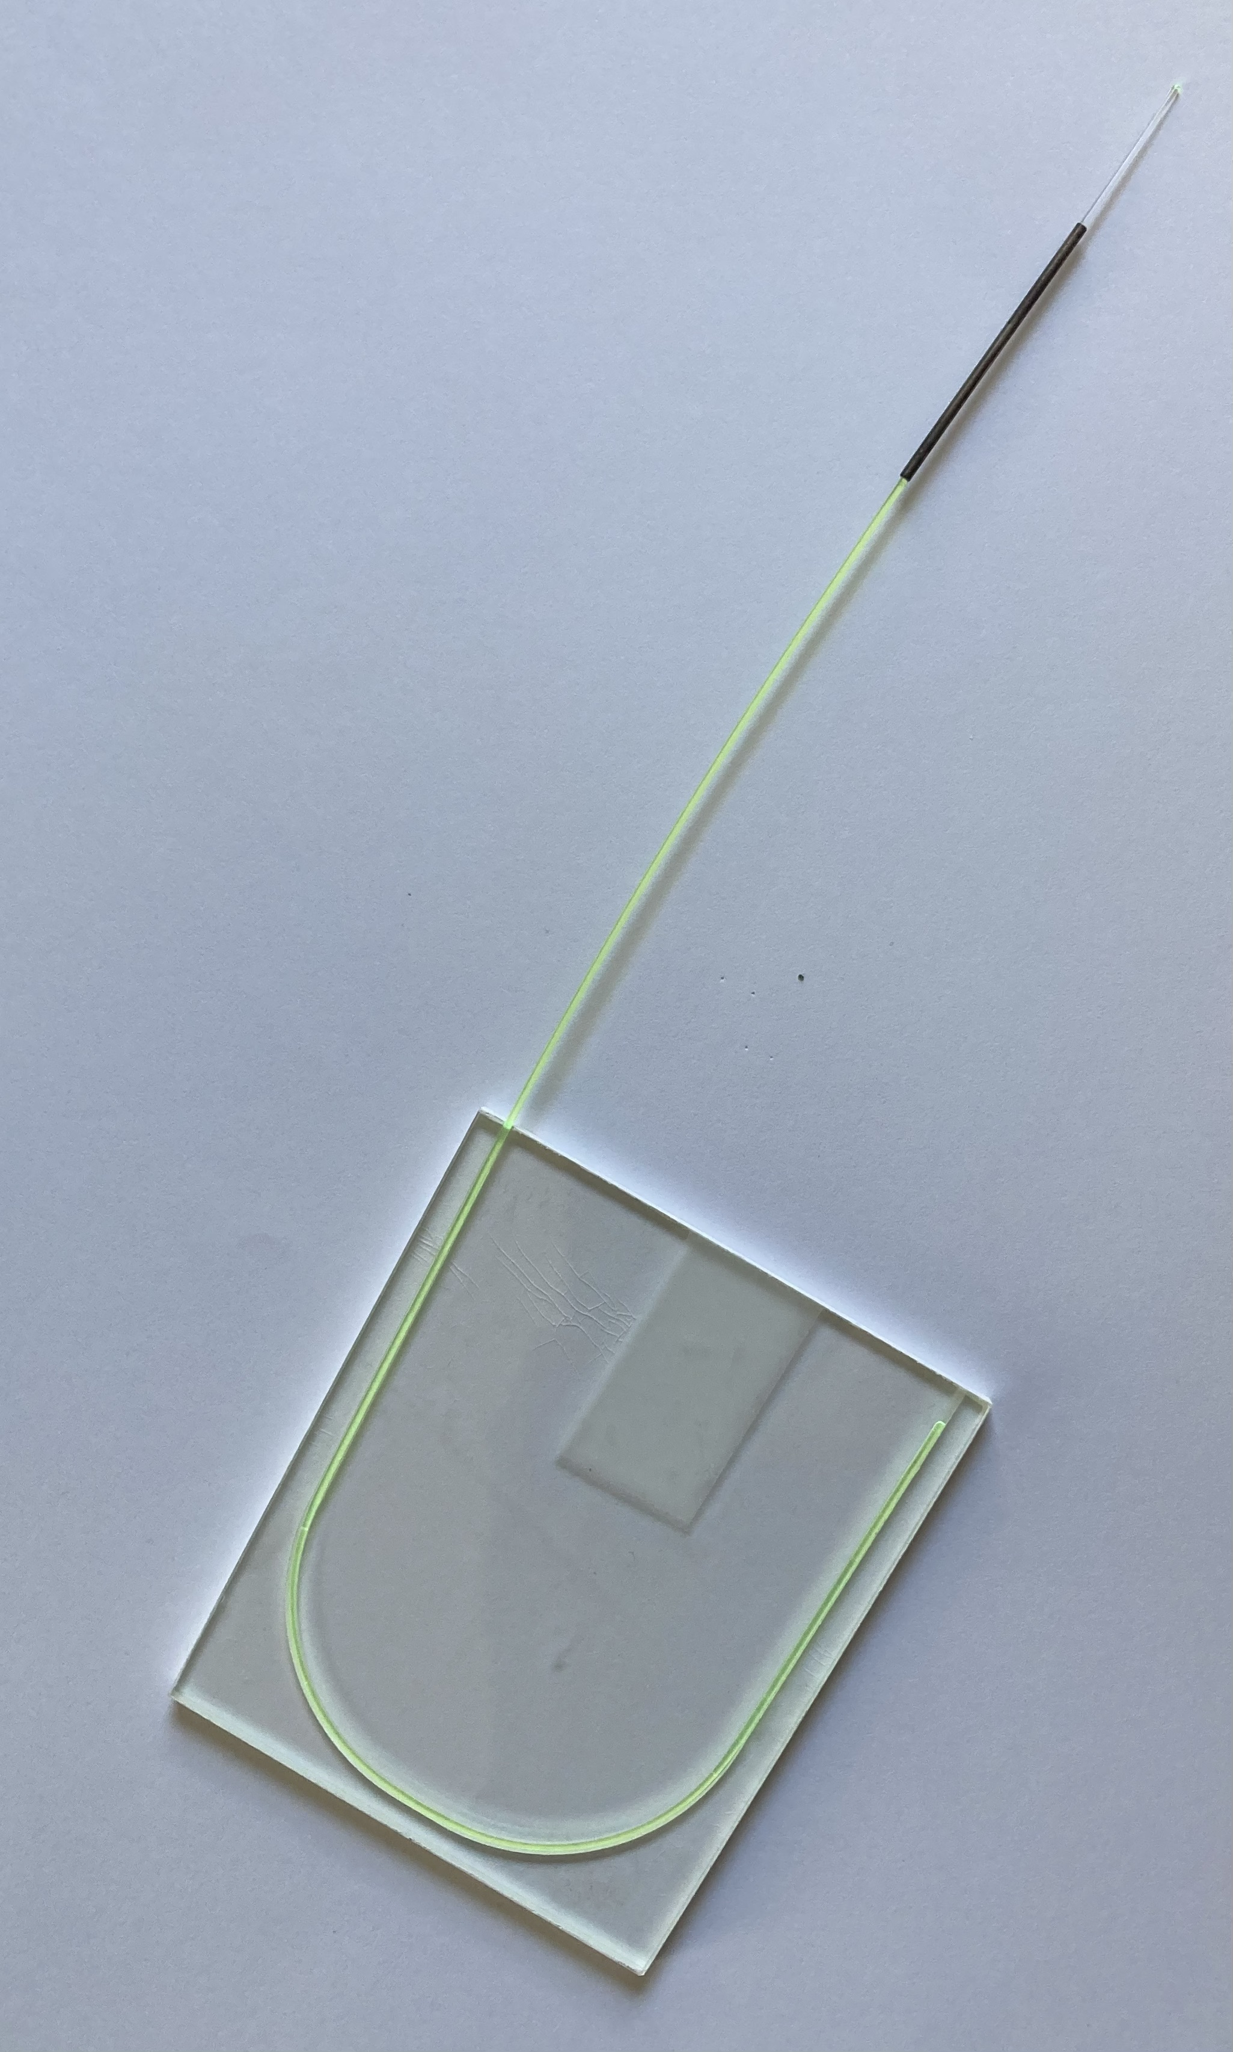
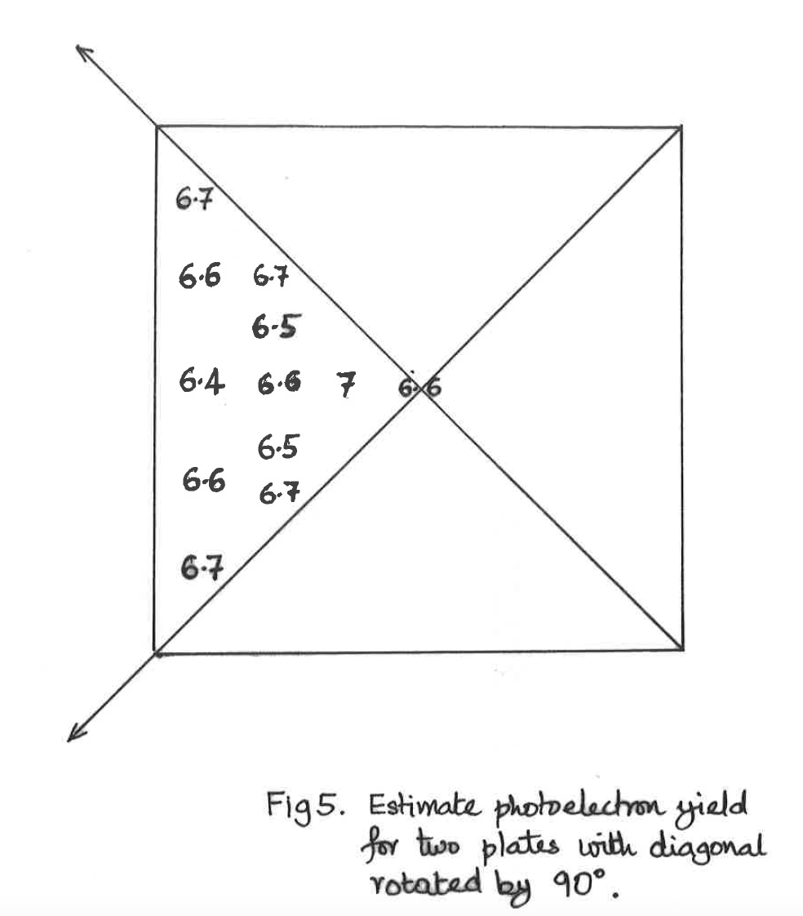
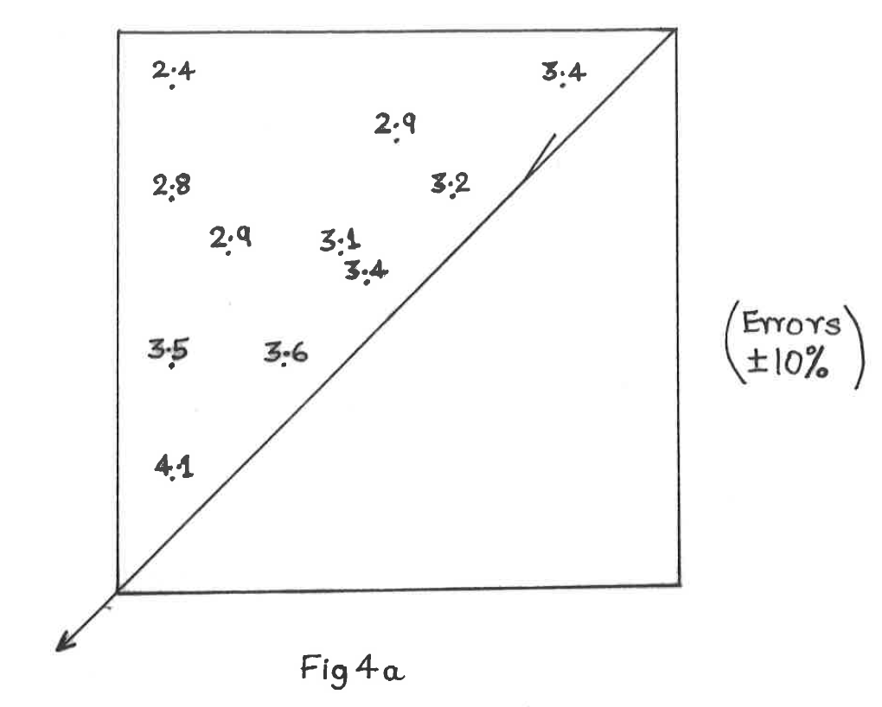
Various options for fiber geometry calculated and tested
7cm x 8cm plate with U-form

Slide 11
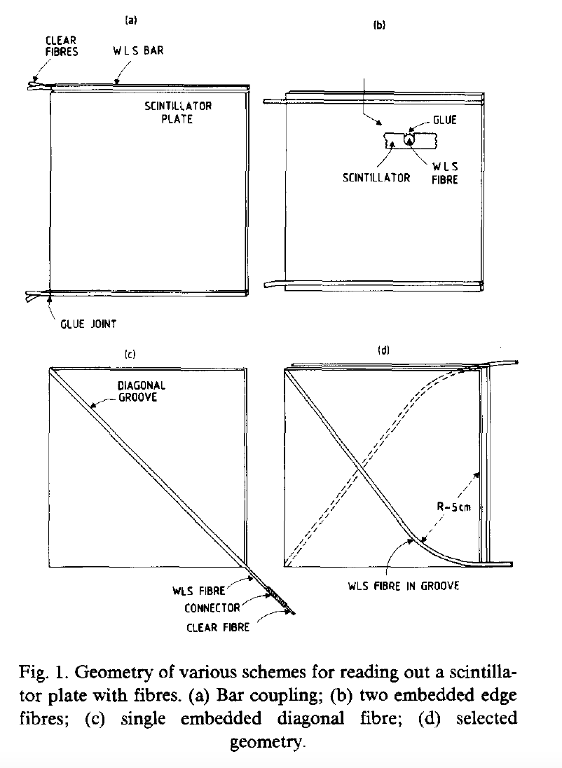
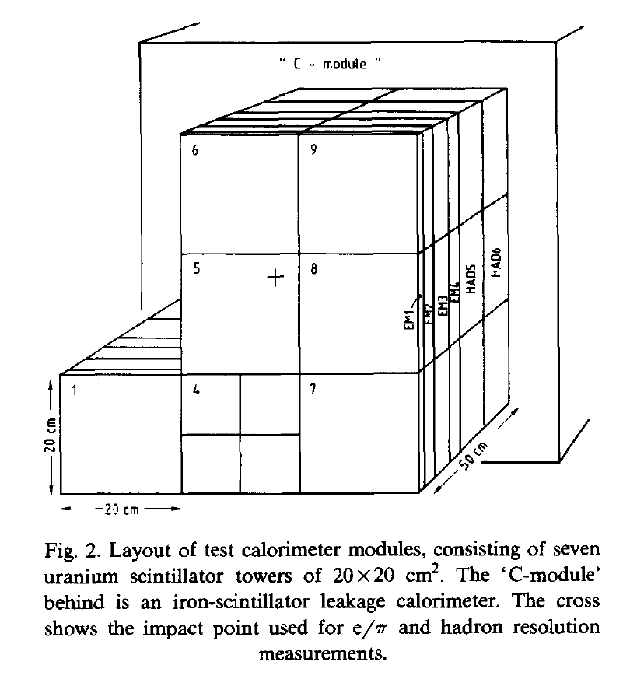
1985-1986 Built a test beam module with uranium plates,
tested at CERN PS and SPS beams (--> 80 GeV) with electrons, muons, & hadrons

Slide 12
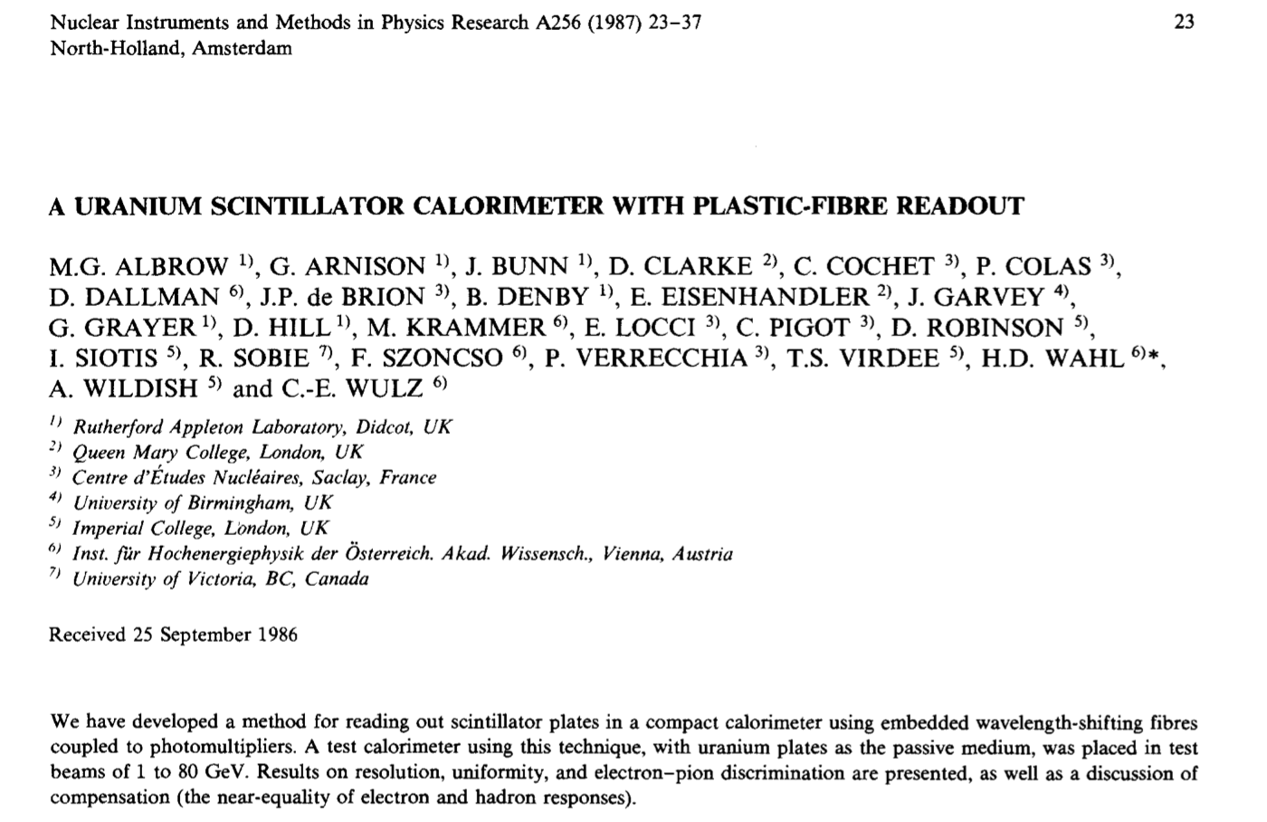

Slide 13
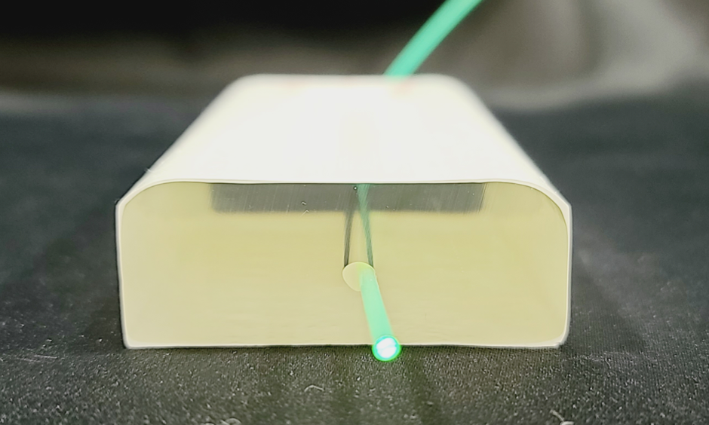
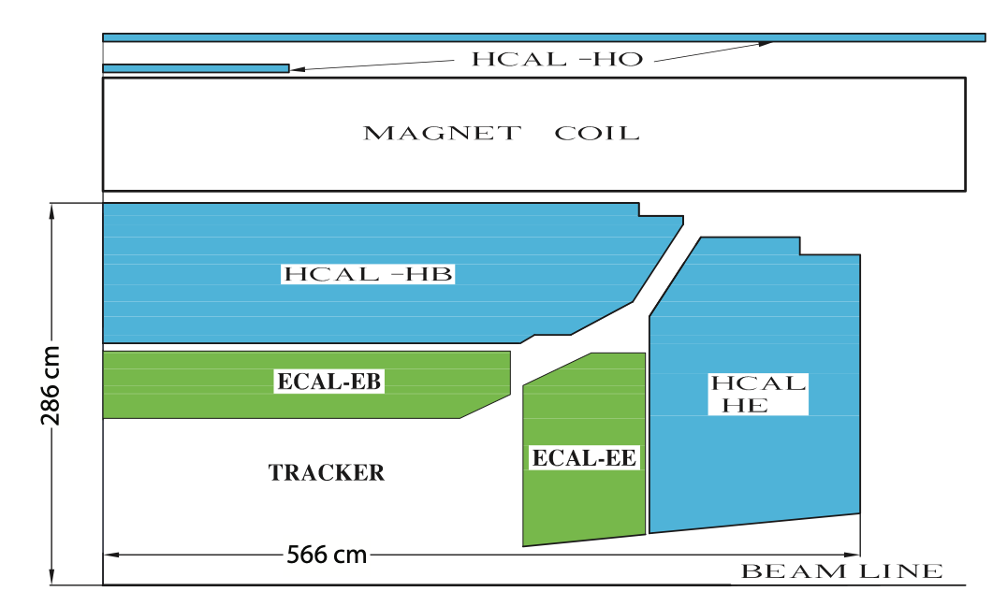
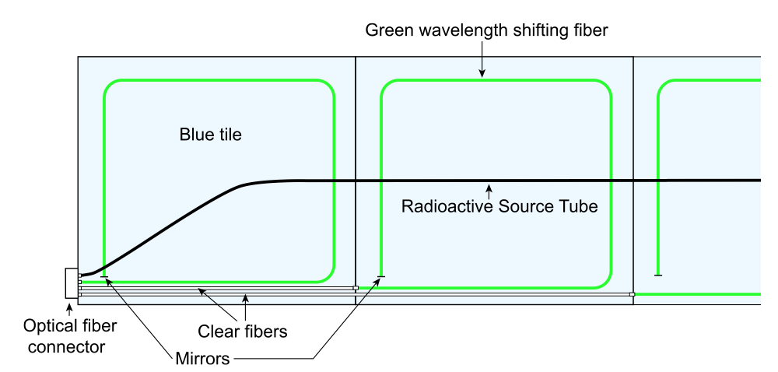
What happened:
Rubbia did not accept this solution to the problem of fine segmentation with minimal dead spaces.
The ”gondolas” with two 180º azimuthal sections were removed. The final runs at CERN p+pbar had only hadronic
calorimetry – segmented but with poor E(e) and E(𝛾) resolution. Sought but did not find the top quark and/or Supersymmetry.
Top quark discovered at Fermilab’s Tevatron p-pbar collider in 1995 … mass = 174 GeV (too high for CERN’s p+pbar)
Scintillator tiles + WLS fiber adopted at very many major projects, among others:
HERA experiments at DESY
CDF at Tevatron (Fermilab)
All major LHC experiments: ATLAS, CMS, LHCb, ALICE (shashlik) at LHC
NOVA – neutrino detector at Fermilab – Liquid scintillator in PVC boxes
Etc etc…
MATHUSLA at LHC
(Proposed)
100m x 100m x 30 m
CMS

Slide 14
Part 2 – 1988 & 1989:
Higgs --> 𝛾𝛾 and Z Z*
How Jim and I thought an intermediate mass Higgs boson
might be discoverable with Higgs --> 𝛾𝛾 and Z Z* with a very high resolution
electromagnetic calorimeter at the LHC – even with lower √s.
It happened 23 years later!

Slide 15
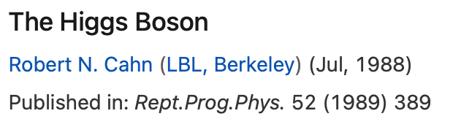
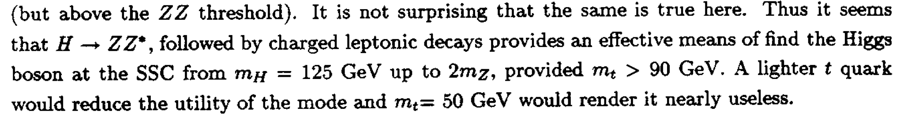
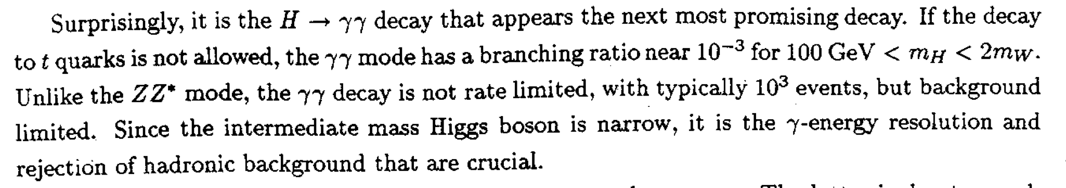
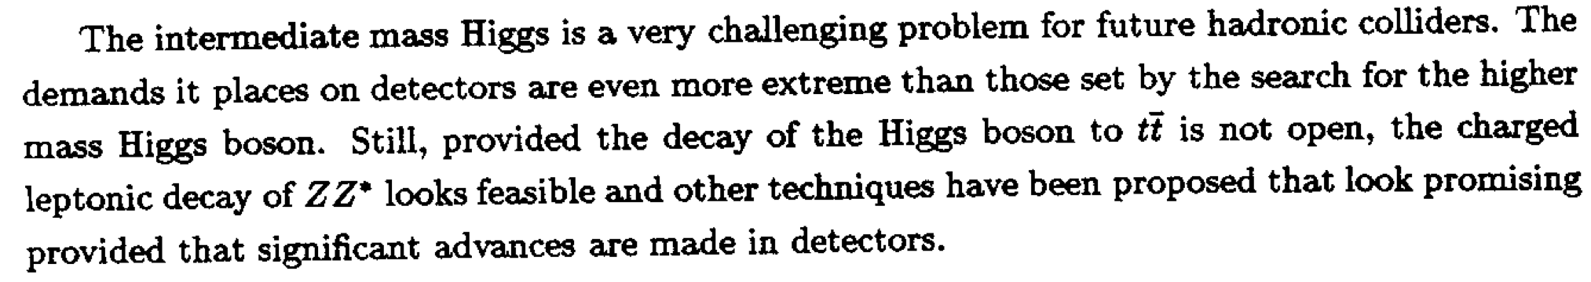
Major review article, 50 pages
Mass of top quark yet not known, excluded < 70 GeV (1989)

Slide 16
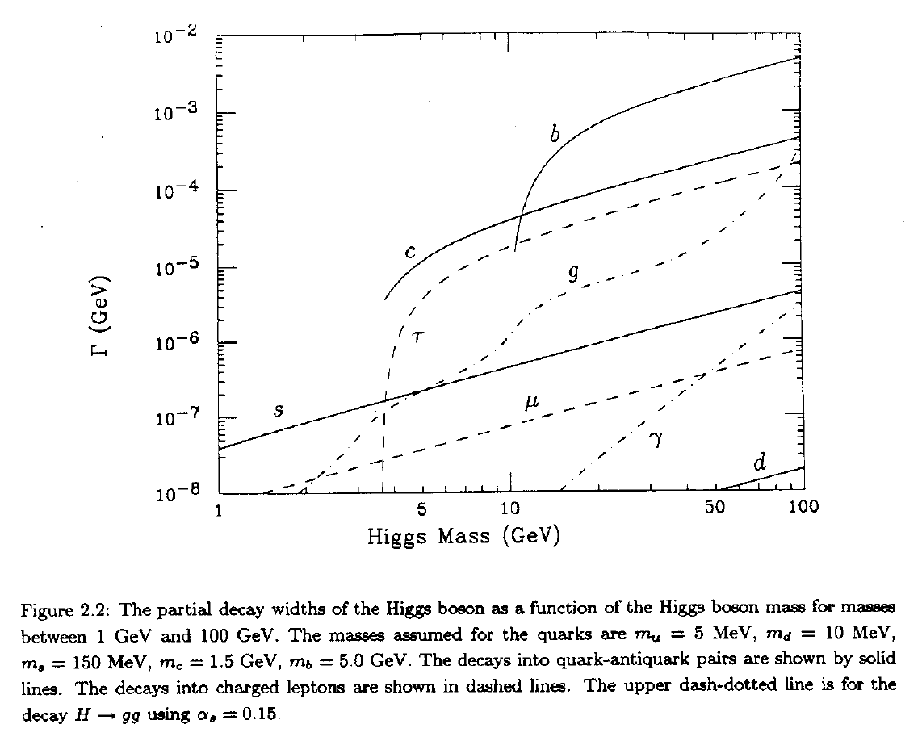
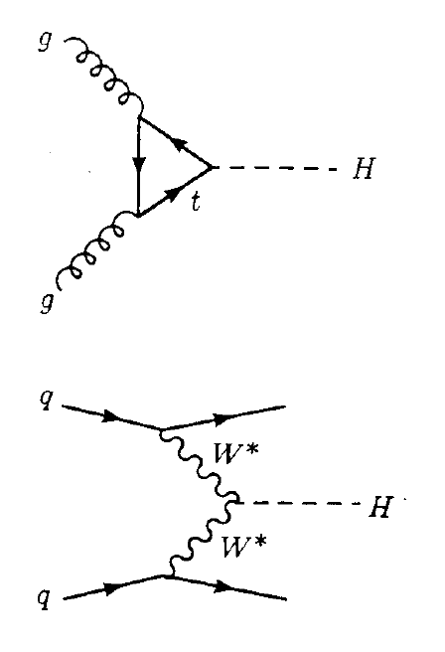
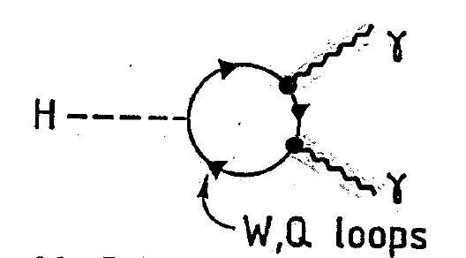
10 MeV
10⁻³
2 M_{W}

Slide 17
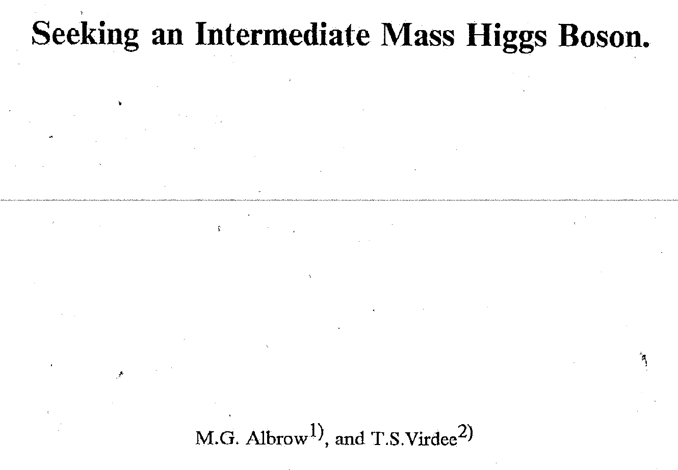
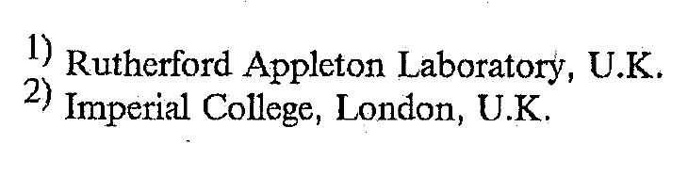
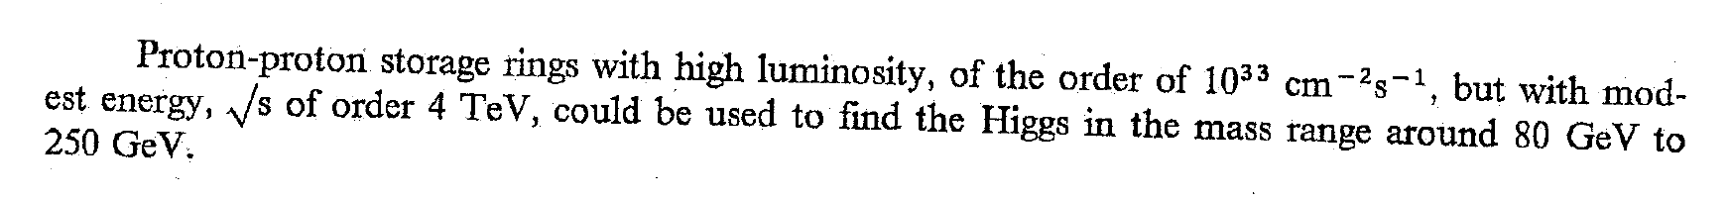
15-3-1989 (unpublished note, not submitted)
Abstract
?
!

Slide 18
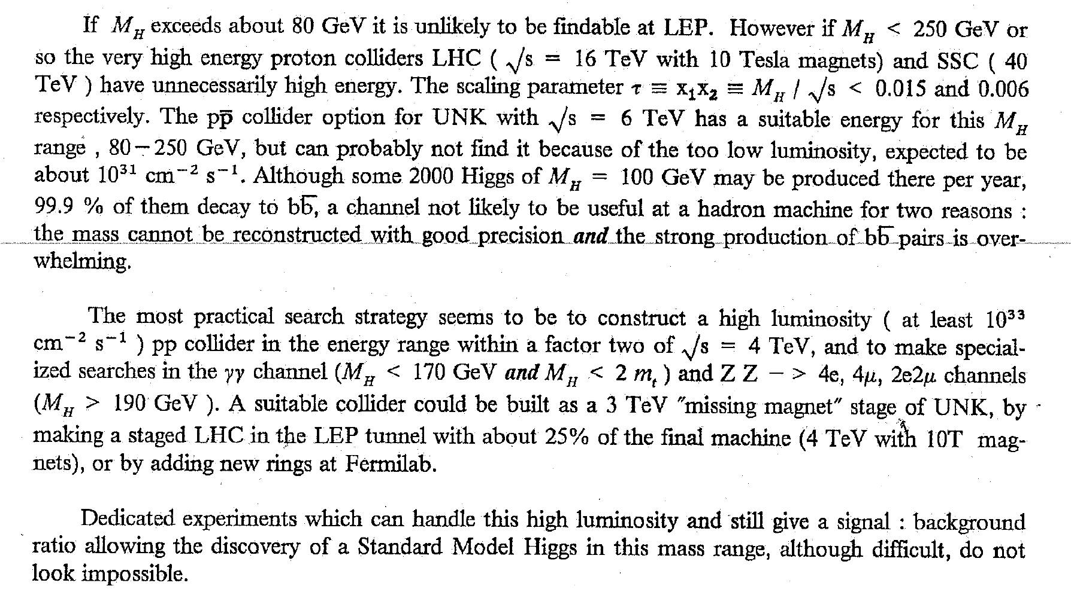

Slide 19
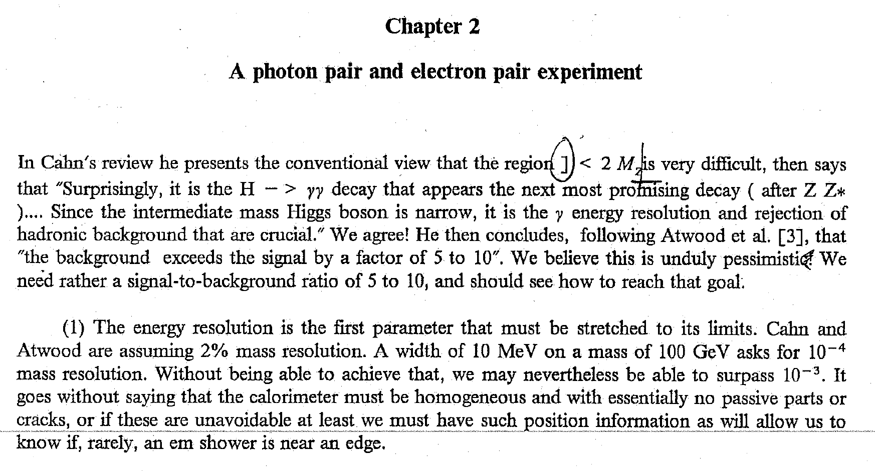
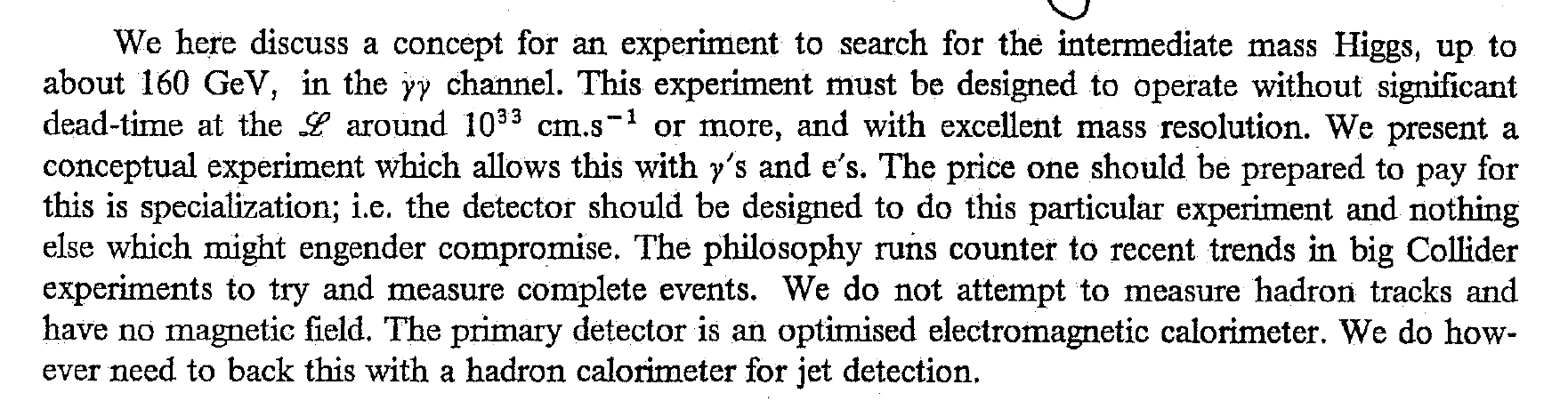
Draft paper at 15-03-1989. Not finished, not submitted
OPTIMISTIC!!!

Slide 20
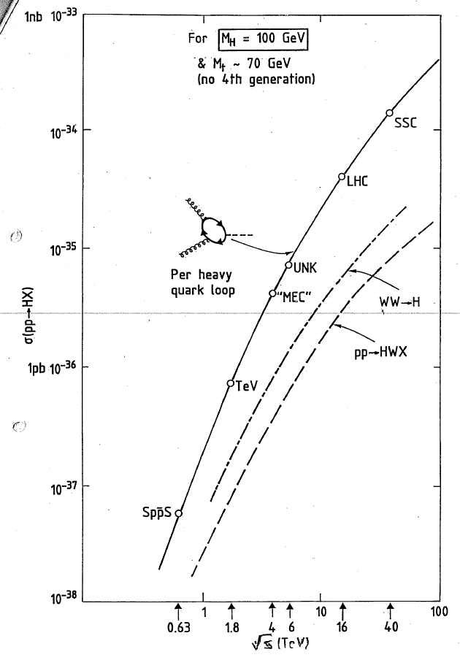
If M(H) is as low as 100 GeV, a factor of 10 in luminosity
more than compensates for the lower energy of
Large Hadron Collider LHC
Cf.
Superconducting Super Collider SSC in Texas
20 TeV + 20 TeV, L = 10³³ cm⁻²s⁻¹
Energy, Luminosity, Mass resolution …. & Backgrounds
Figure from Albrow & Virdee

Slide 21
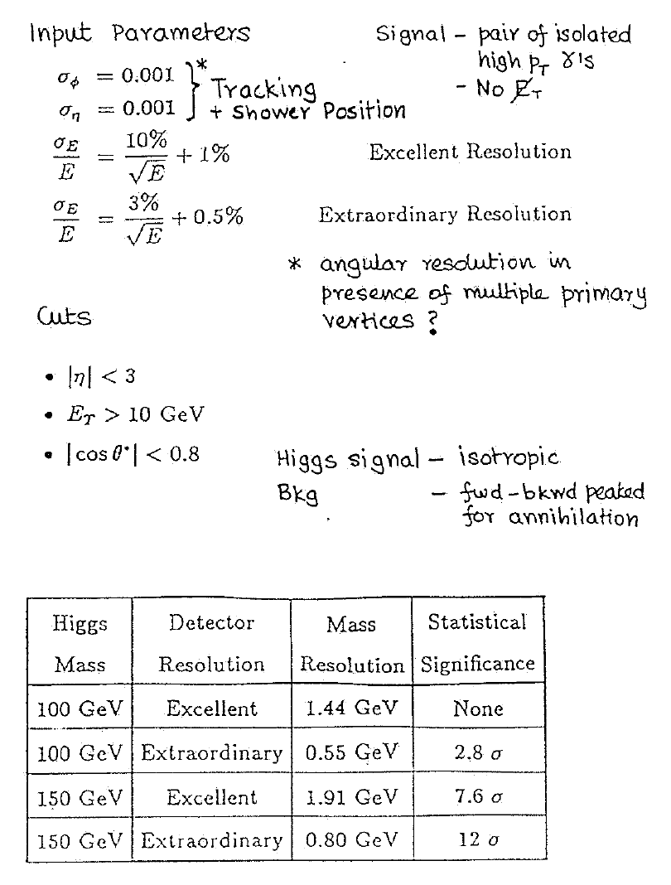
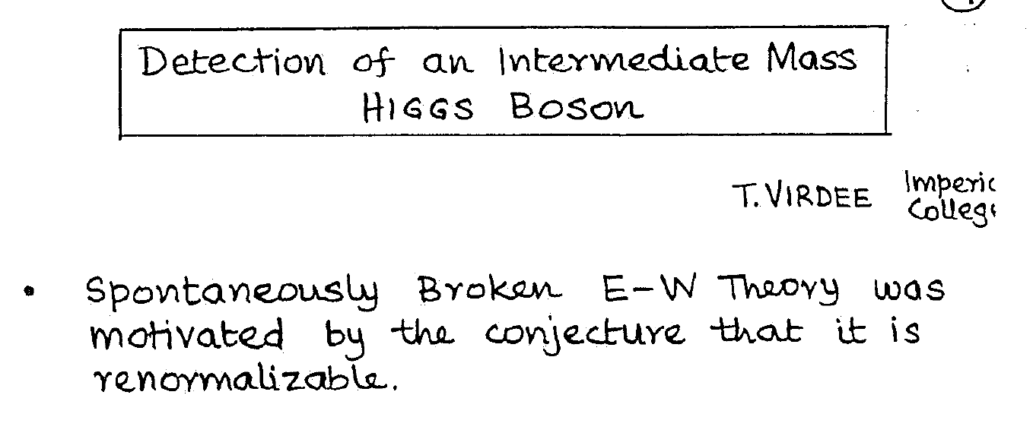
Summer 1989 I moved to Stockholm and organized the
“Sigtuna conference on very high resolution
electromagnetic calorimetry” November 10th 1989
Jim gave a talk on Higgs boson --> 𝛾𝛾 or ZZ(*)
Etc.
“Proceedings” only copies of transparencies
I show three

Slide 22
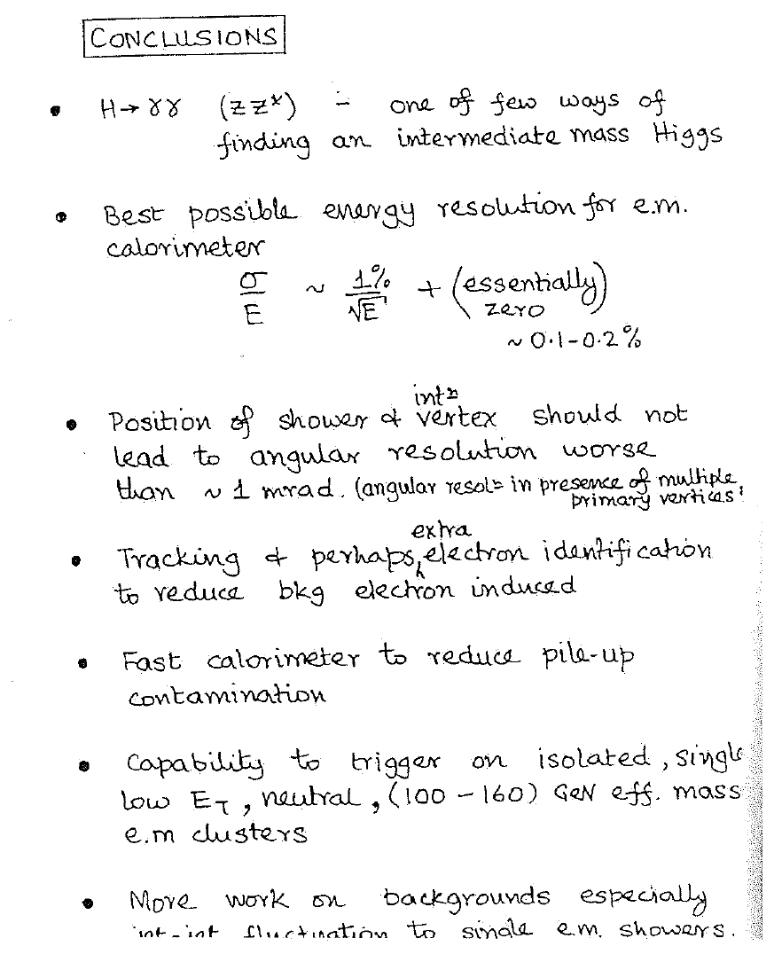
From Virdee’s talk at Sigtuna, Sweden, November 1989
Right on all counts: but experiments CMS and ATLAS
(still in the future) did have compromises to be more
general purpose, including muons and hadronic jets.

Slide 23
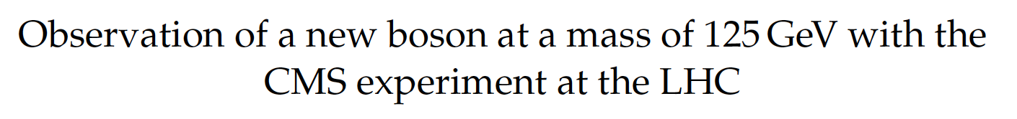
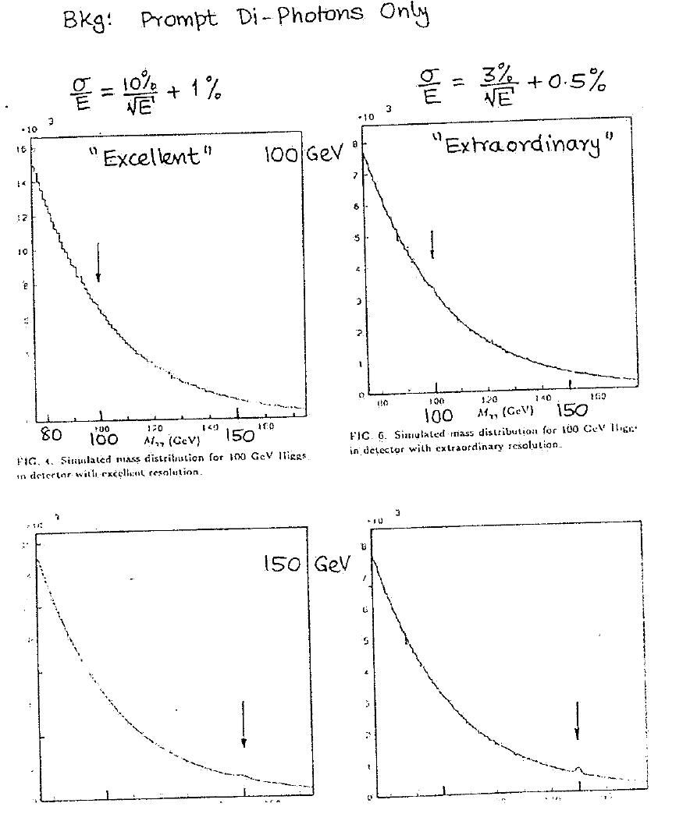
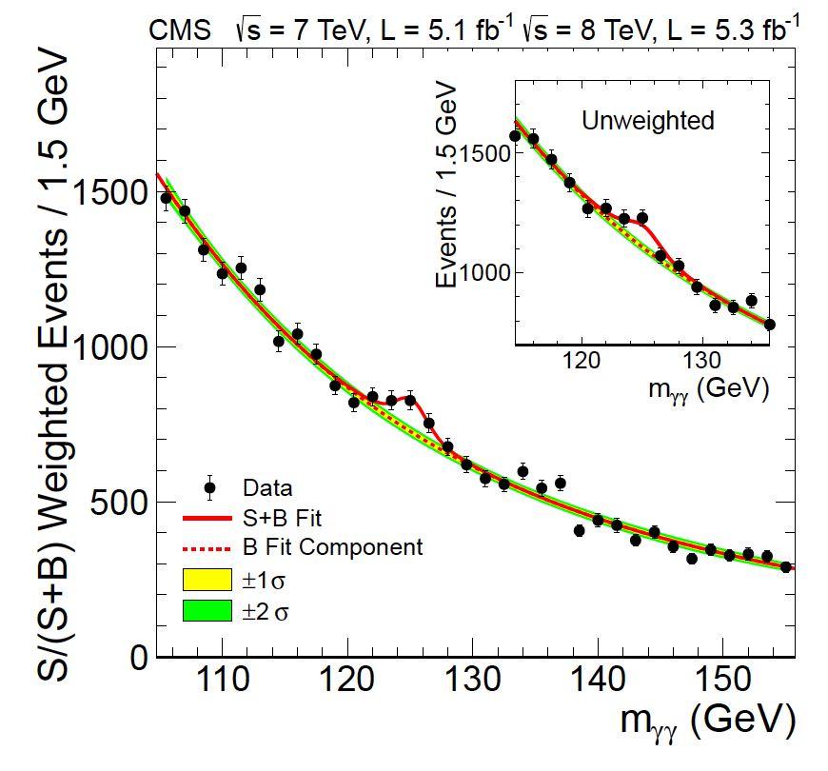
From Virdee’s talk at Sigtuna, Sweden, November 1989
Higgs discovery paper CMS February 2013
M(H) = 100 GeV
VERY CHALLENGING!
M(H) = 150 GeV

Slide 24
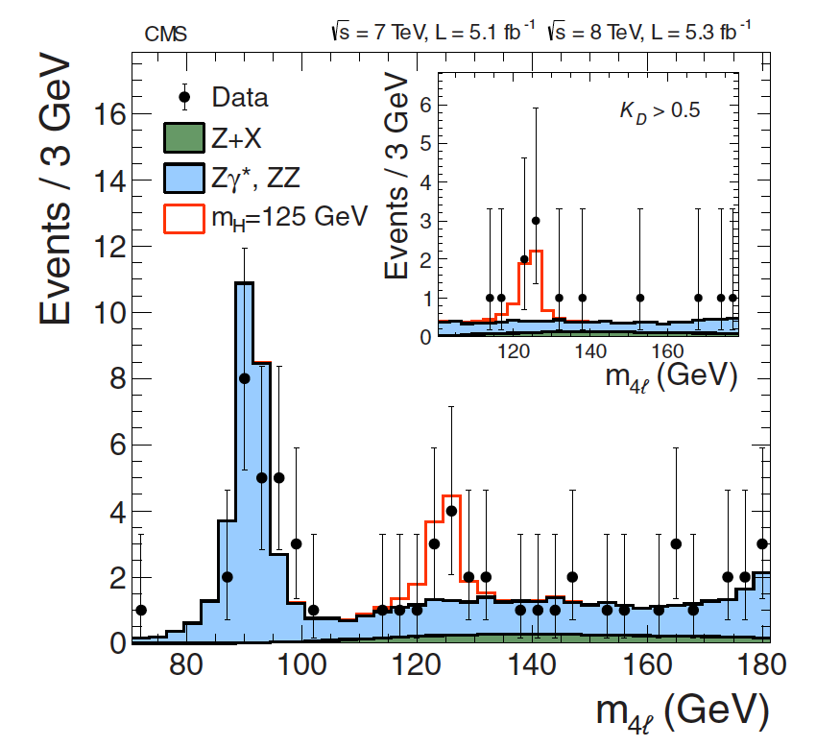
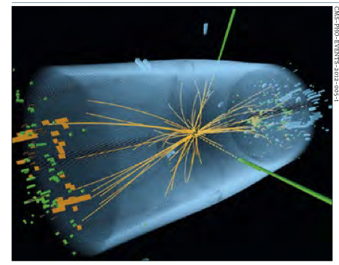
Primary evidence for Higgs is excess
in Mass(𝛾𝛾) distribution at 125 GeV
on big continuum background.
Z Z* --> 4 leptons also showed excess
Tracks from a proton+proton collision in CMS at the LHC
with two high energy photons (green)
Next talk by Paris Sphicas

Slide 25
So: In the five years 1984 – 1989 Jim and I were together at CERN
at least two major initiatives:
Jim’s idea to read out scintillator plates in a calorimeter with
wavelength-shifting plastic fibers. Built and tested one.
Adopted by too many major detectors to list.
Extremely good EM calorimeter might discover
an intermediate mass Higgs boson --> 𝛾𝛾 or ZZ(*)
That’s how it happened 23 years later.
Thanks Jim!

