Slide 1
Seminar in honor of
Prof. Sir T.S. Virdee
14 October 2022
The Kohn Centre, the Royal Society.
Talk given by Jos Engelen,
Professor emeritus University of Amsterdam / Nikhef
Writeup: www.nikhef/~h02/talk.pdf

Slide 2
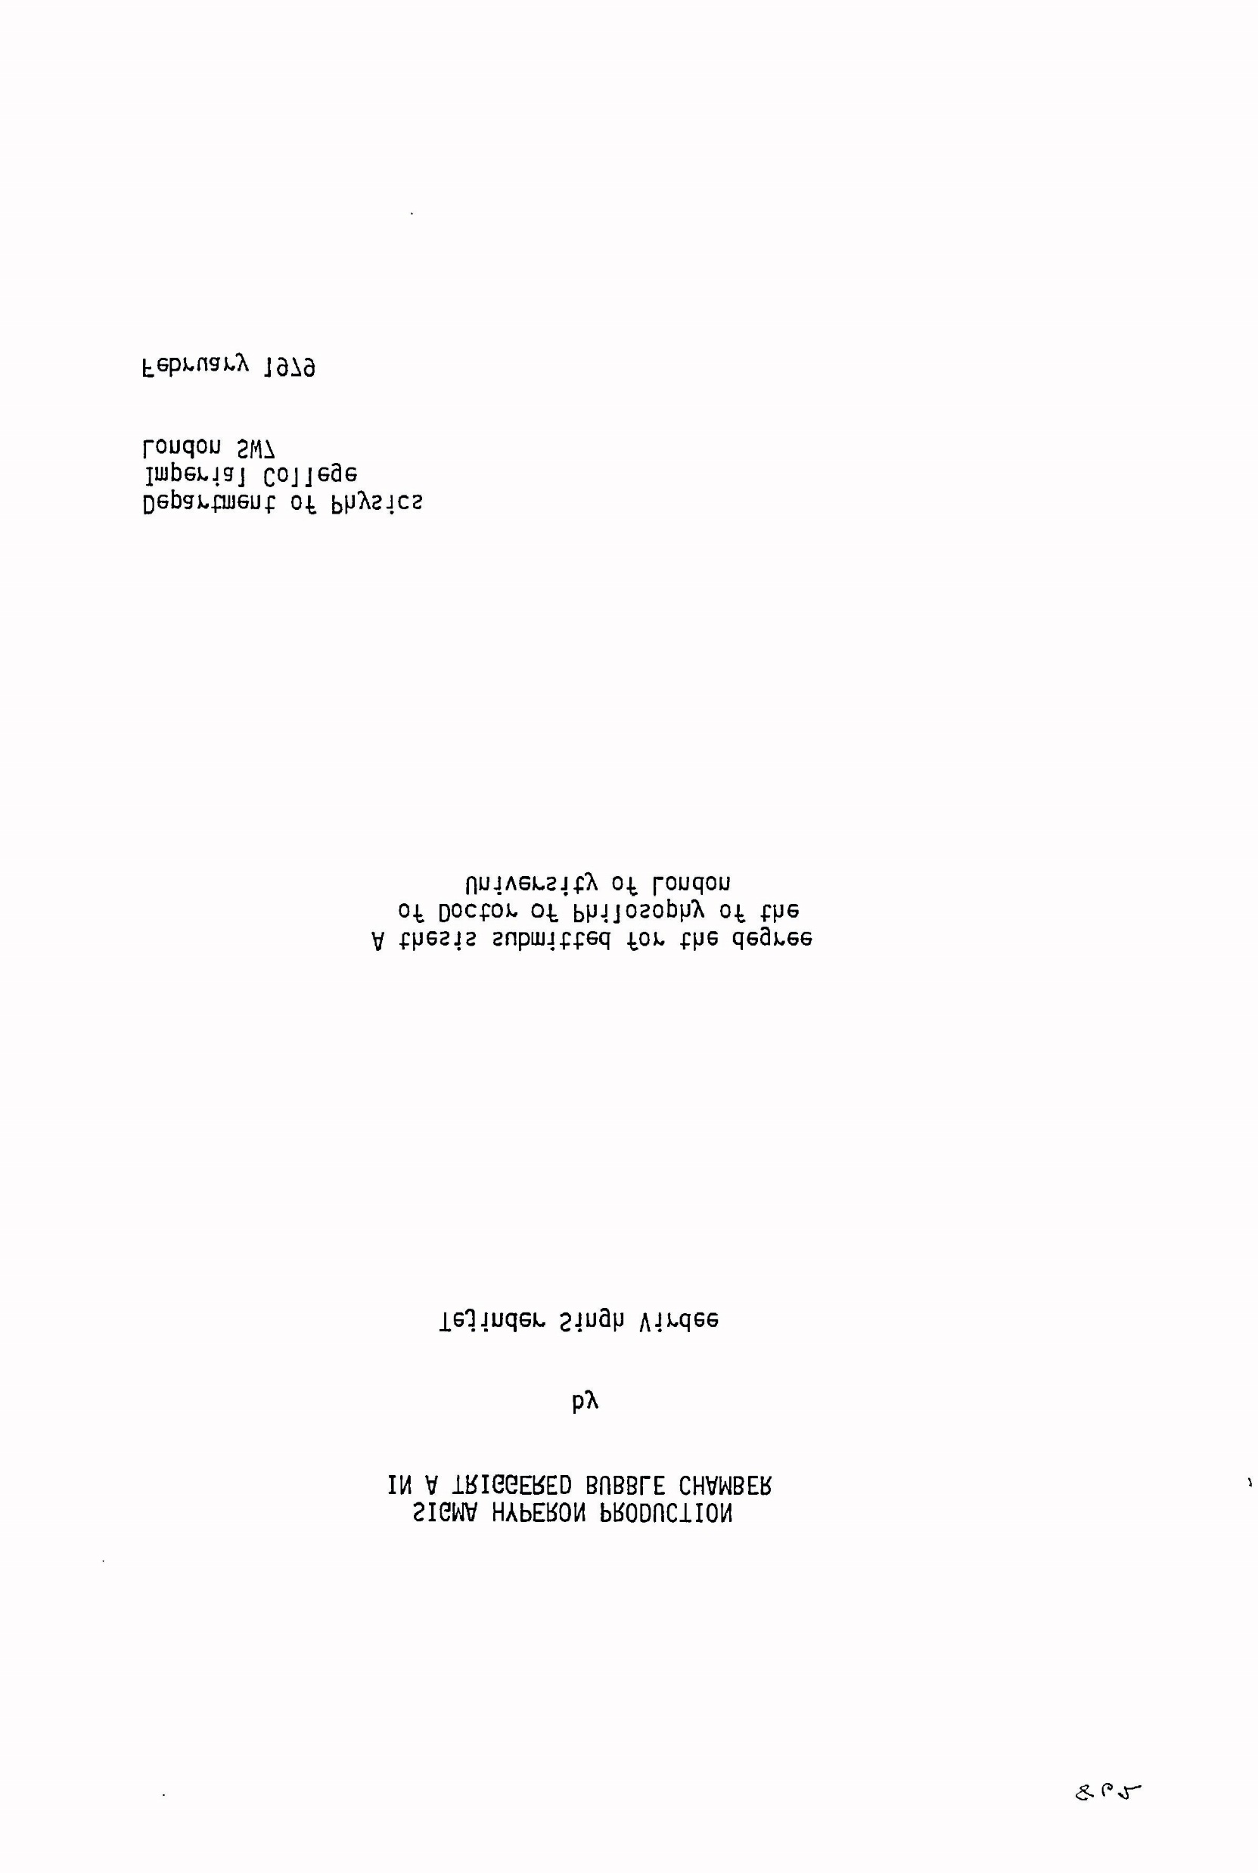
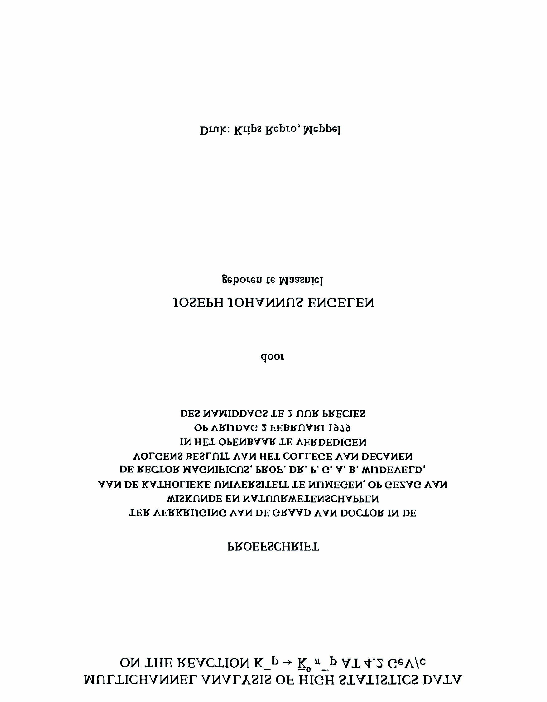
February 1979
Soft strong interaction physics using bubble chambers, the latter years
SIGMA HYPERON PRODUCTION
IN A TRIGGERED BUBBLE CHAMBER

Slide 3
NA14: 1979 – 1985 (NA14/2)
Hard scattering of real photons <90 GeV>
⁶Li isoscalar target

Slide 4
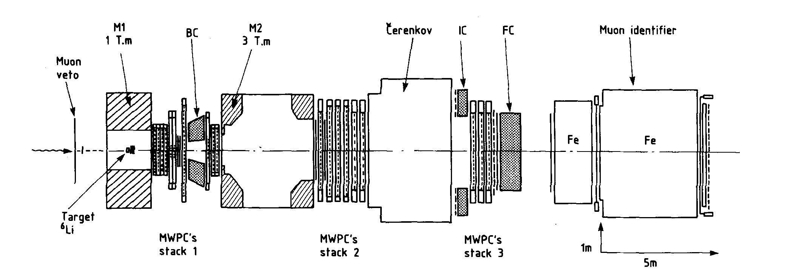
La Couronne
AEG magnet
Goliath
ILSA
OLGA
NA14 spectrometer. Two dipoles, three e.m. calorimeters, Cerenkov, PWC’s, muon filter

Slide 5
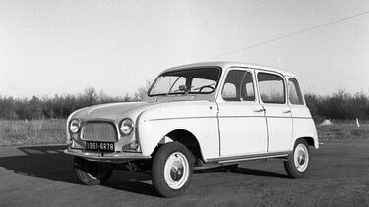
Learning how to drive
La ‘quatrelle’
Renault 4L

Slide 6
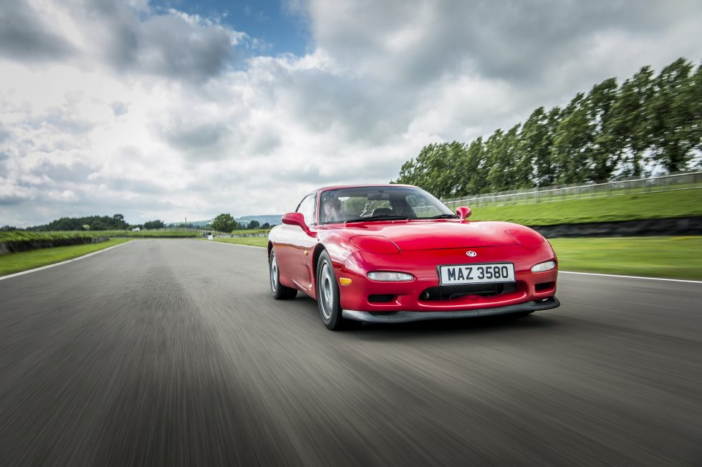
Learning how to race
Jongens waren we – maar aardige jongens (Nescio in ‘Titaantjes’ (1915)
‘Boys we were – but nice boys’

Slide 7
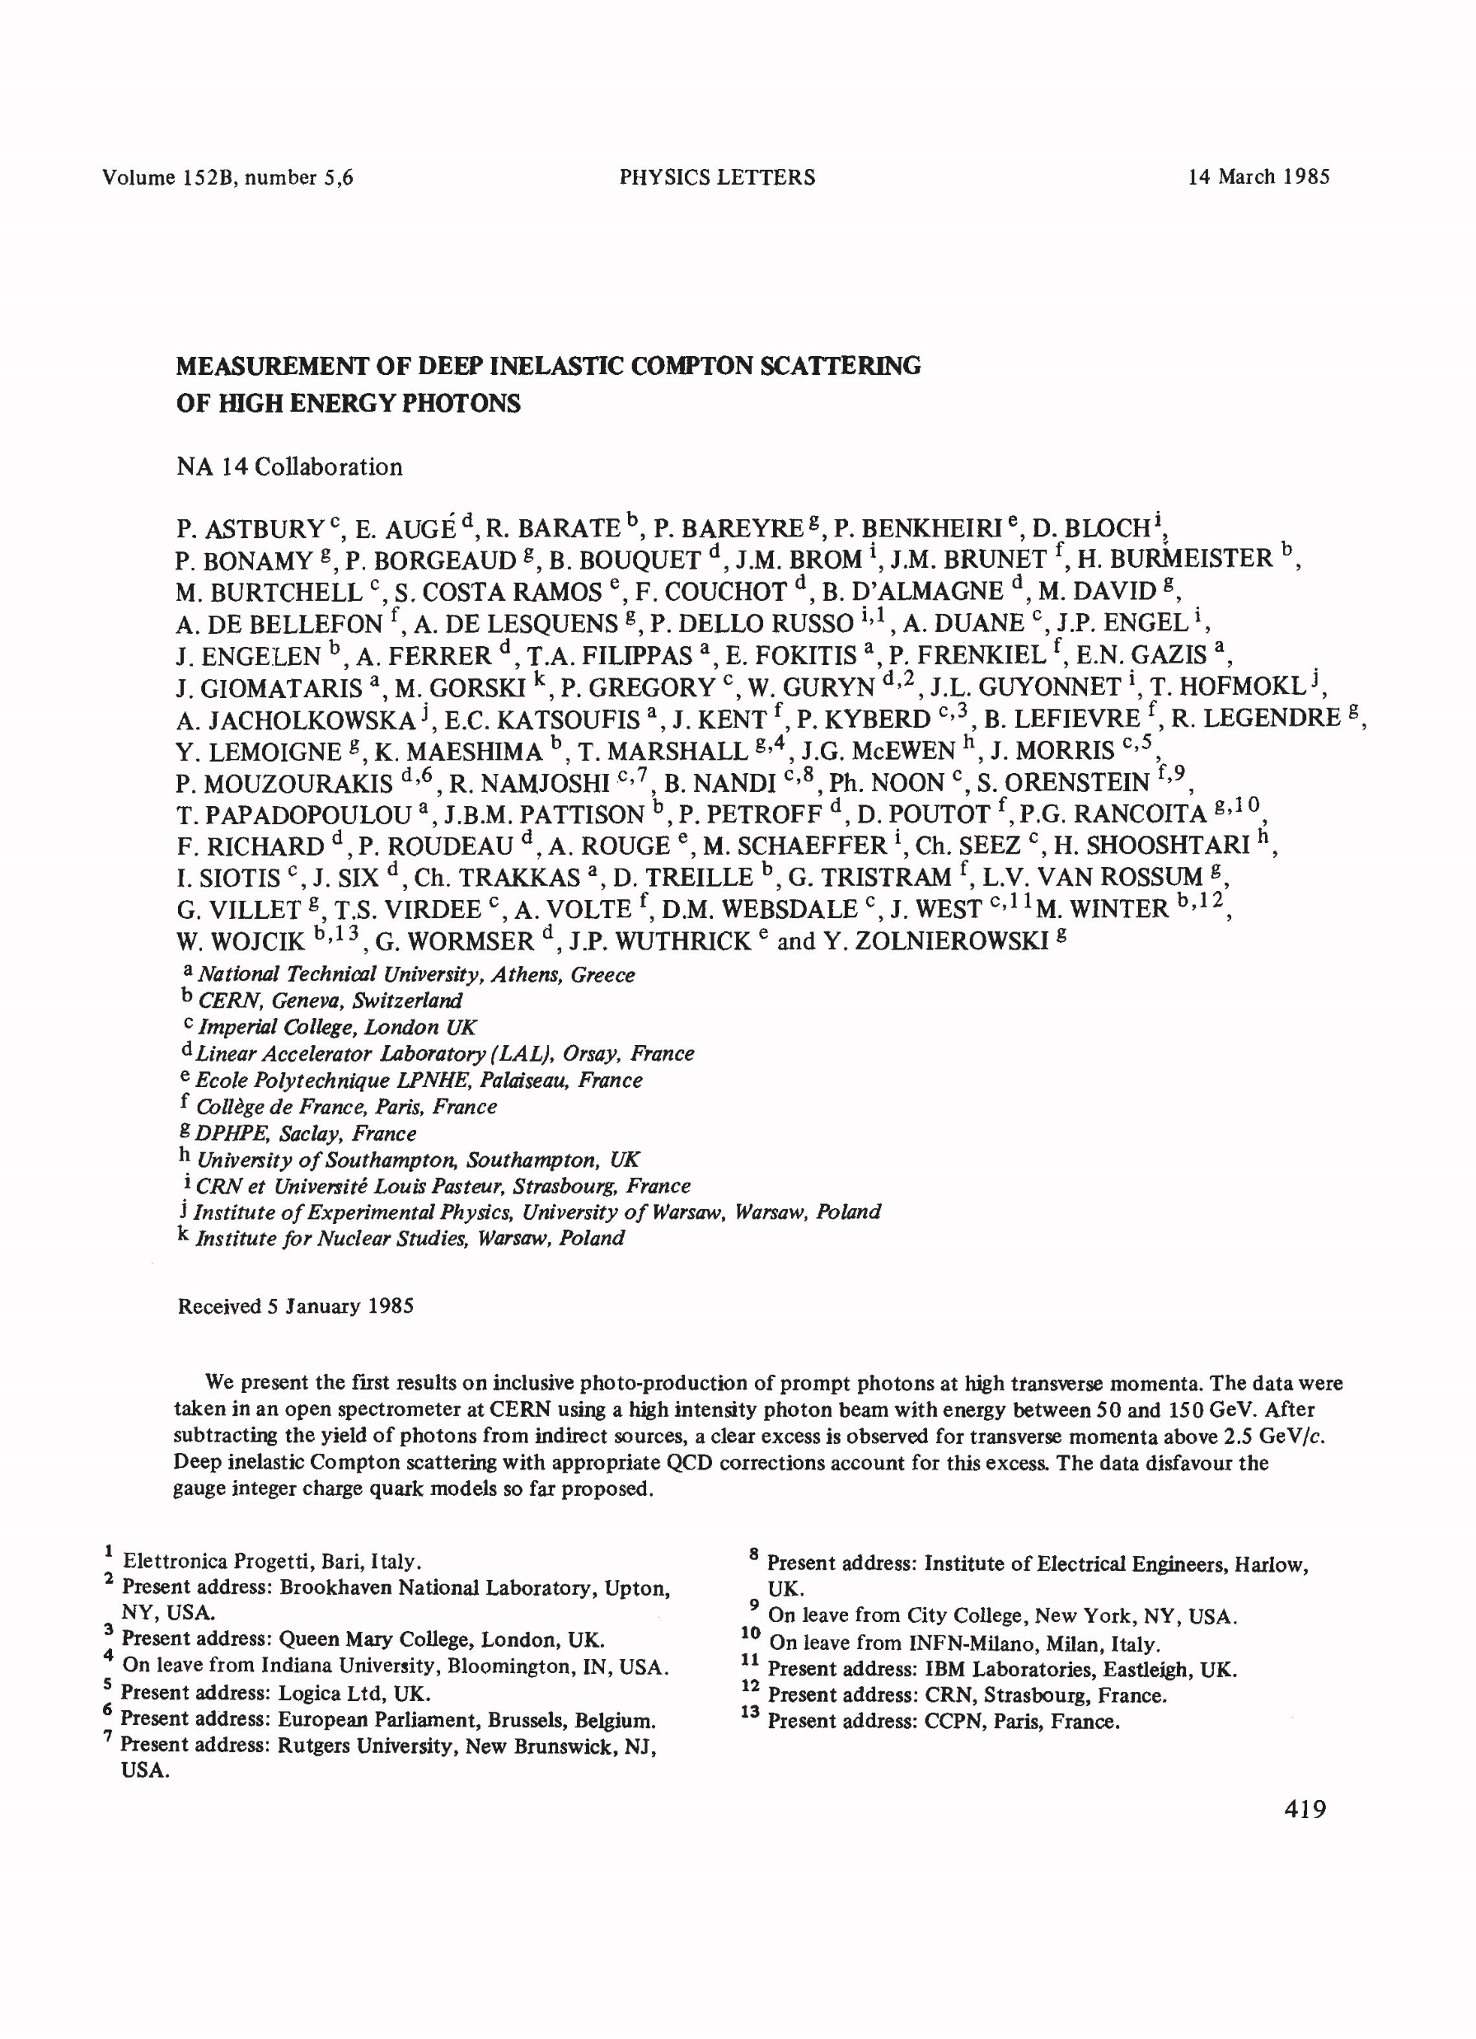
The first NA14 paper.
Written by TSV
γq → γq
Sensitive to 4th power of
quark charge
HO perturbative QCD calculations of inclusive
γ signal

Slide 8
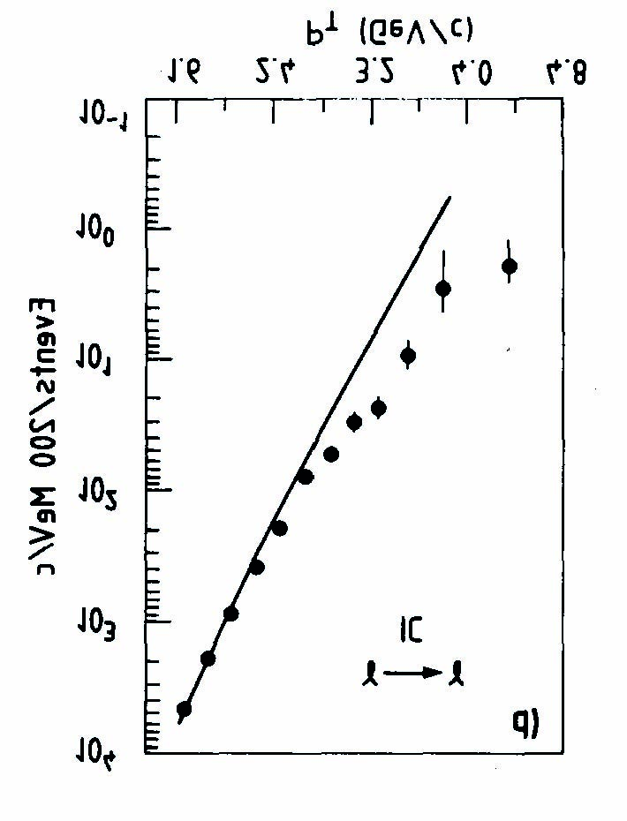
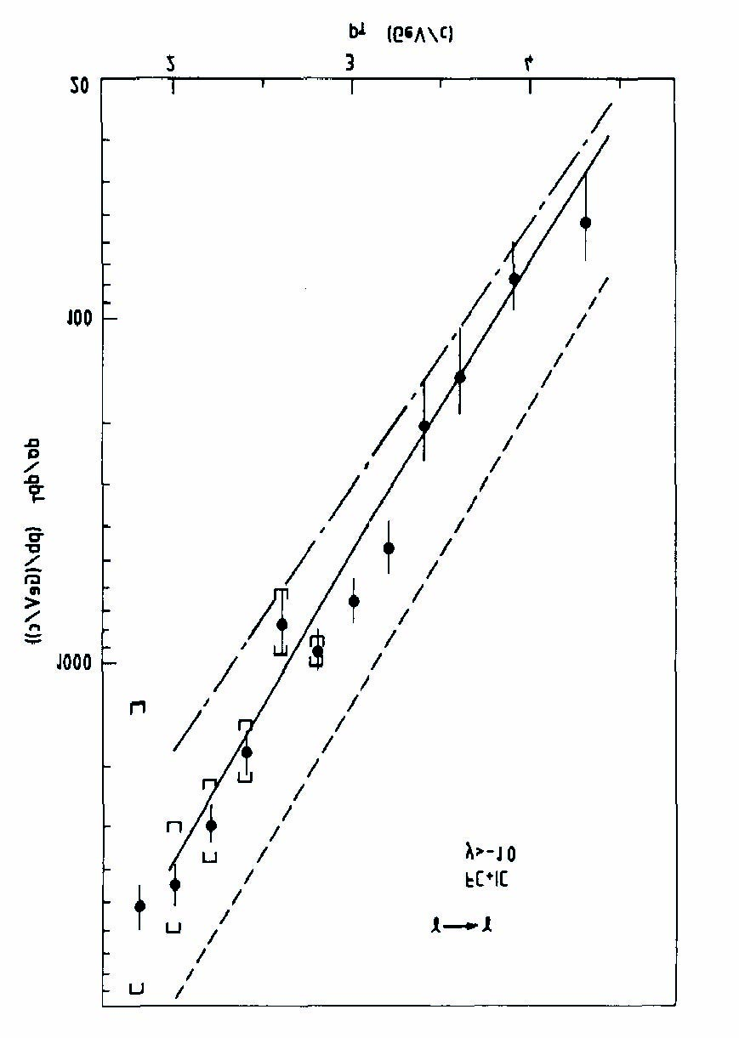
Direct photons

Slide 9
> 1985: UA1 + R&D (warm liquid calorimetry), PbWO4, H→ 2 gamma, CMS
Important workshops: Aachen 1990
Evian 1992
LHCC < - - > CMS
CERN management < - - > CMS
Resources Review Boards < - - > CMS

Slide 10
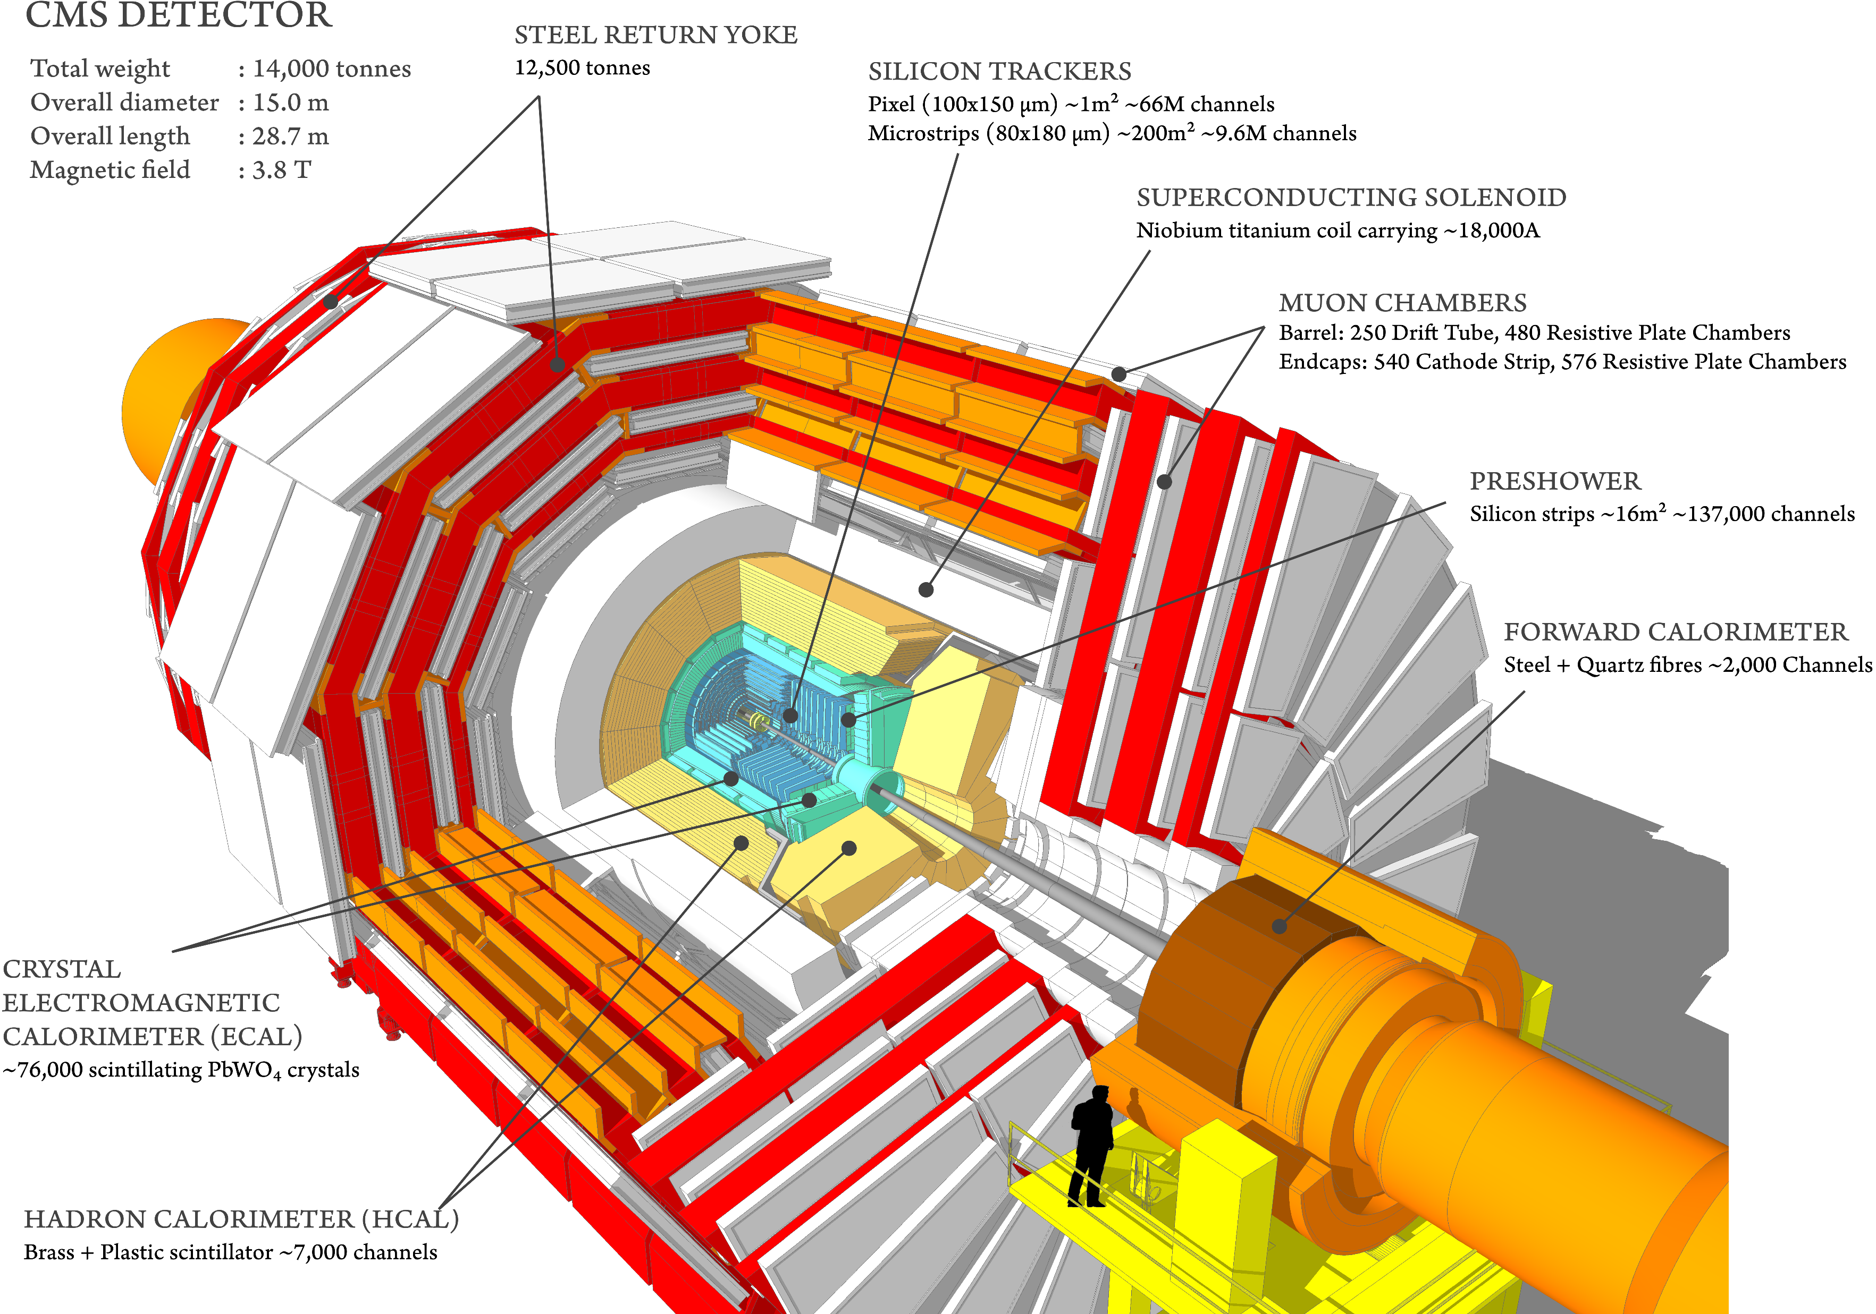
The Compact Muon Solenoid

Slide 11
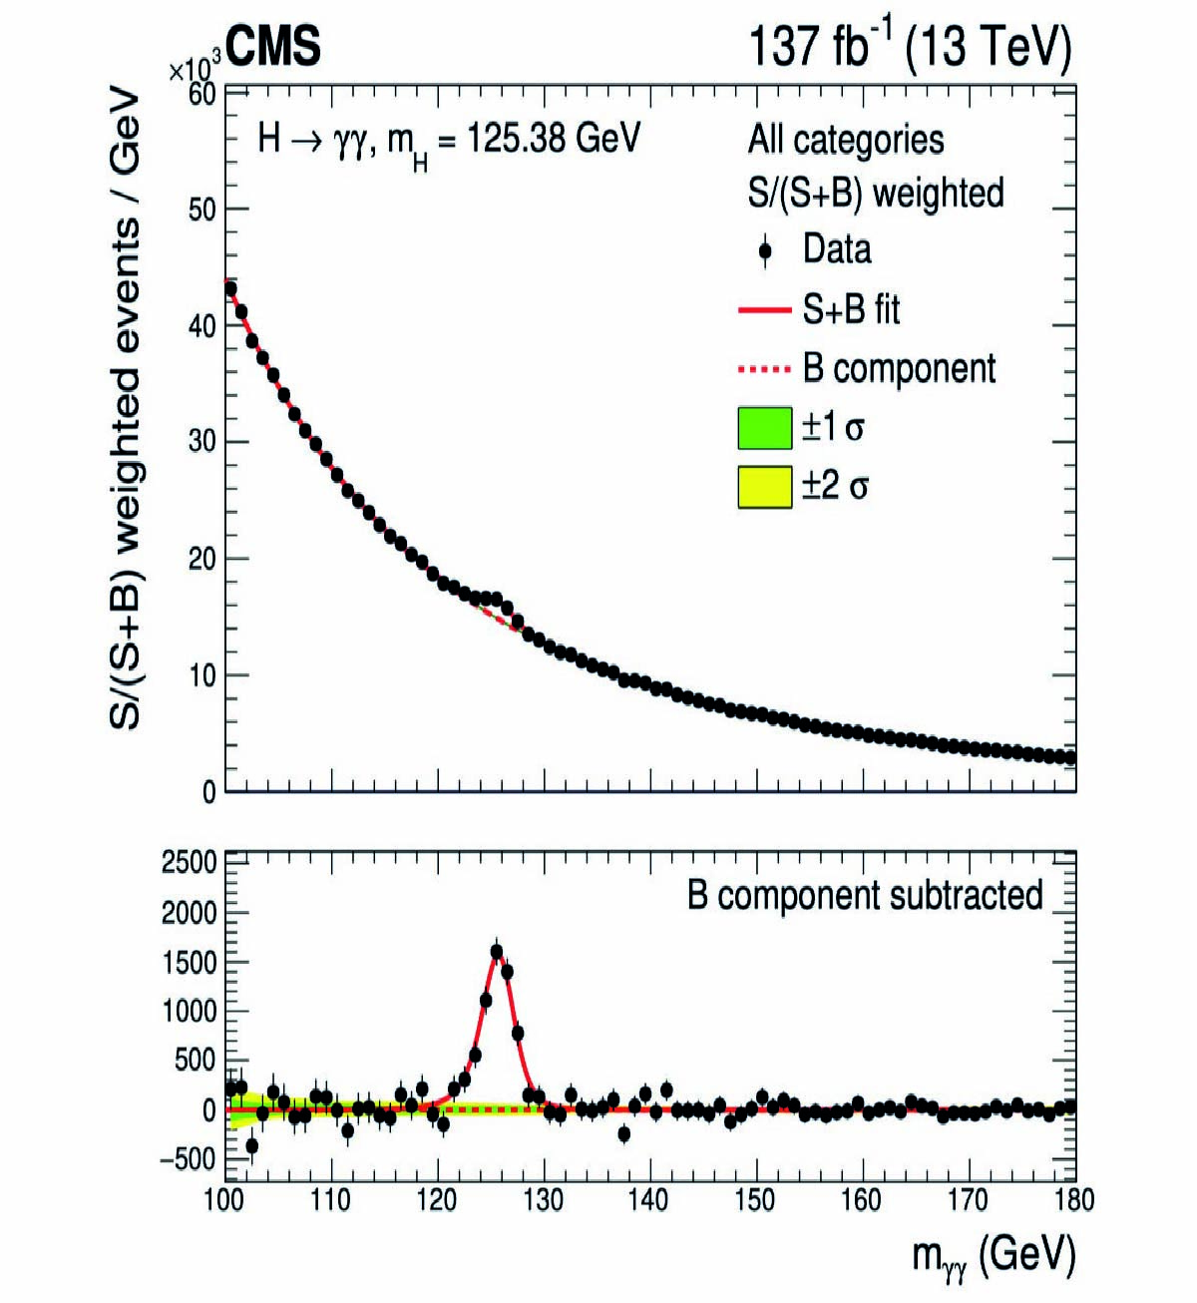
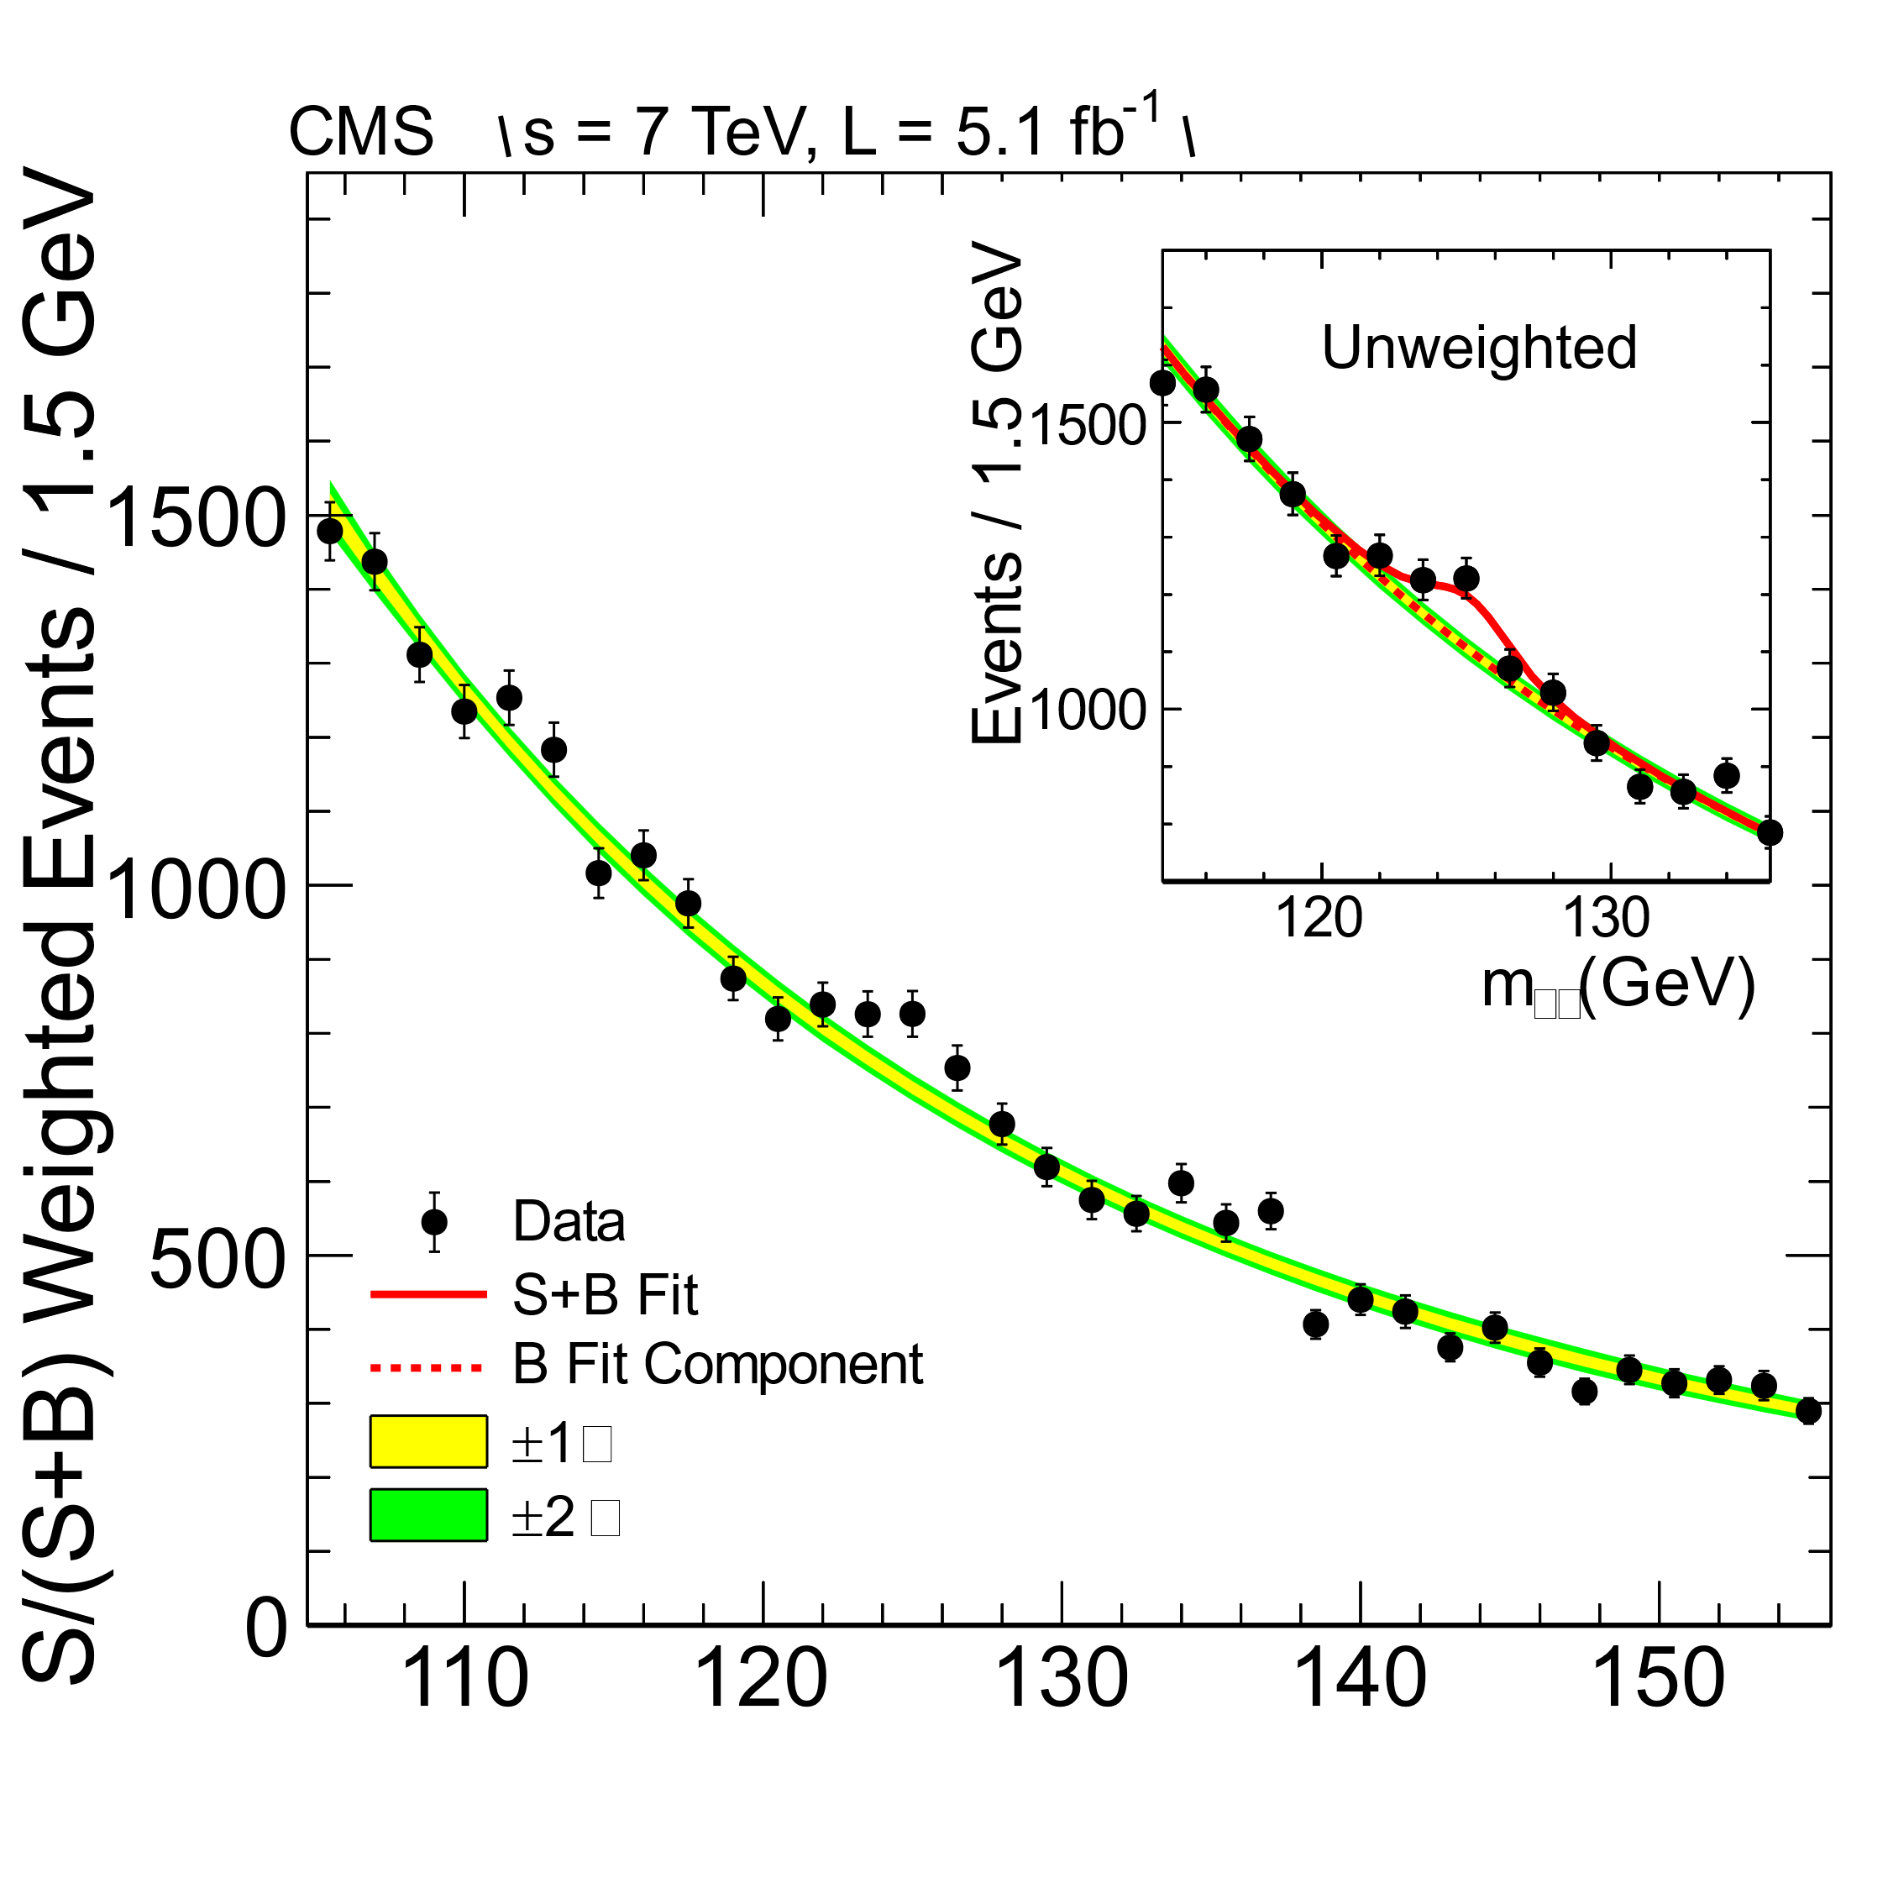
2021, 25 x statistics:
Discovery – 2012:

Slide 12
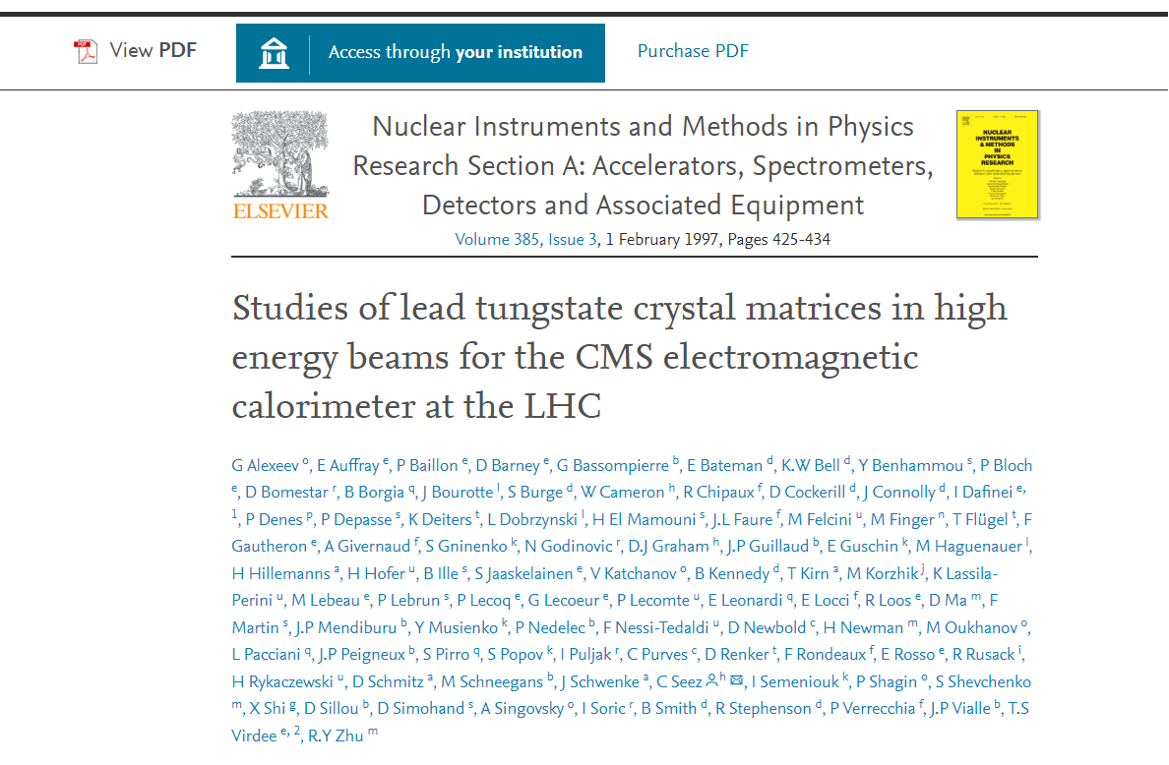


Crystals R&D

Slide 13
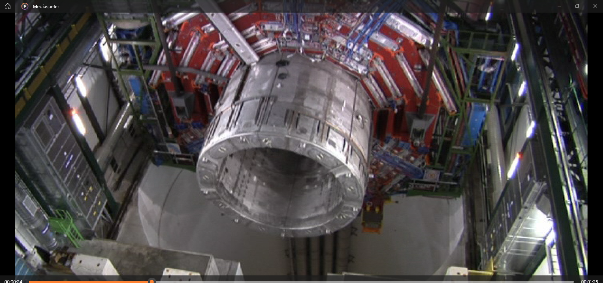

Slide 14
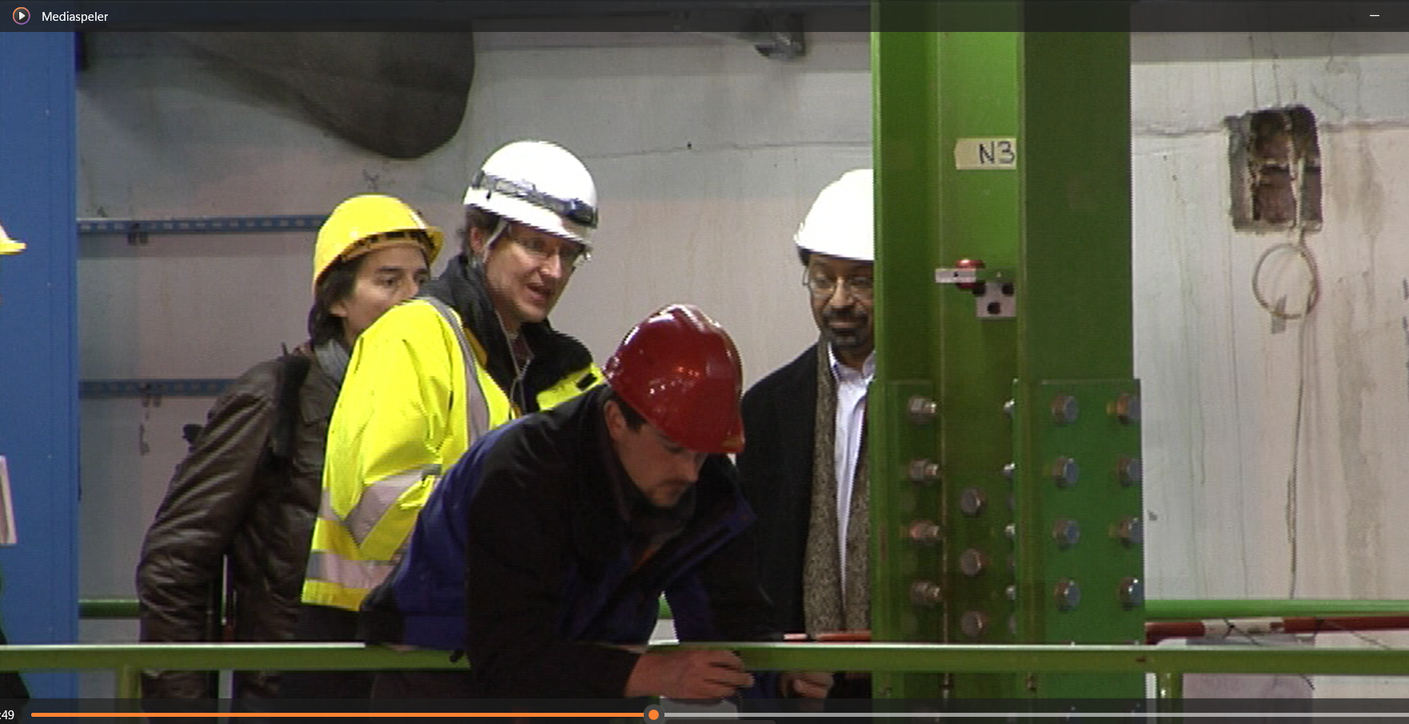

Slide 15
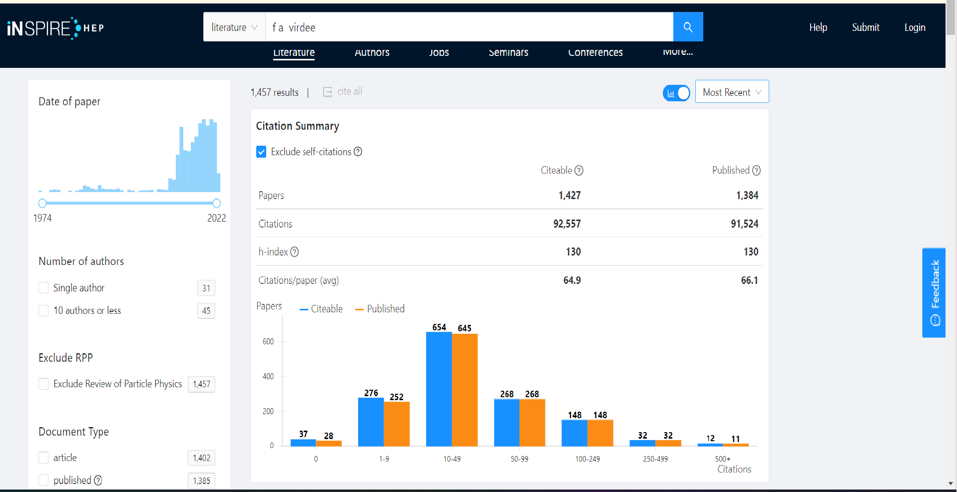
‘find author virdee’ (= Jim + Jas)

Slide 16
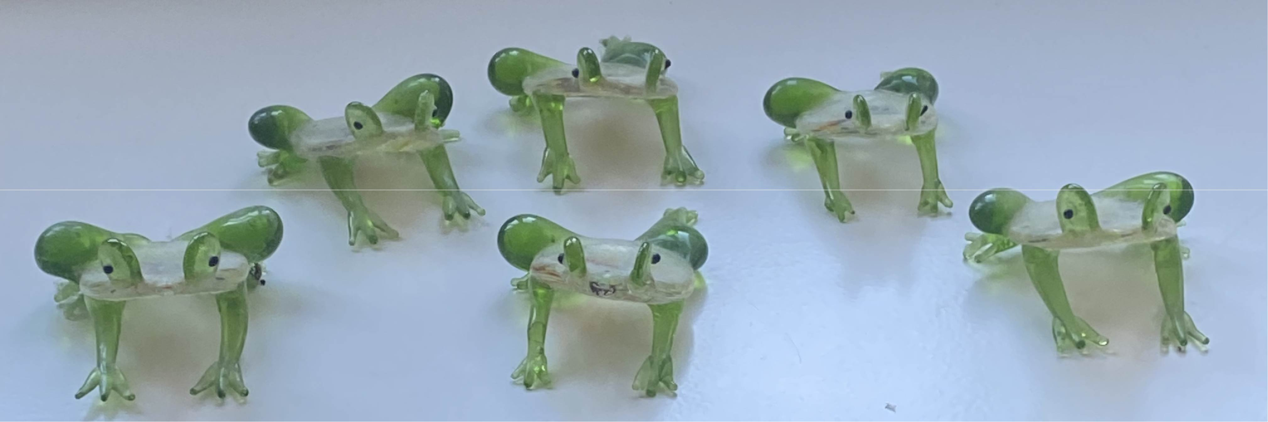
Happy birthday Jim!
And:
‘I know you are not quite there yet, but even during partial re-
tirement, enjoy the freedom it brings, together with your loved ones,
together with your friends!’

