Slide 1


ICST&M in CMS @ the CERN LHC
A Unique Adventure in Space and Time
ICST&M @ CMS LHC
One Decade On
John Dainton
The Cockcroft Institute and
Lancaster University, UK
1999-2004: CERN LHCC CMS reviewer
1999-2017: STFC CMS Oversight Committee
?
?

Slide 2
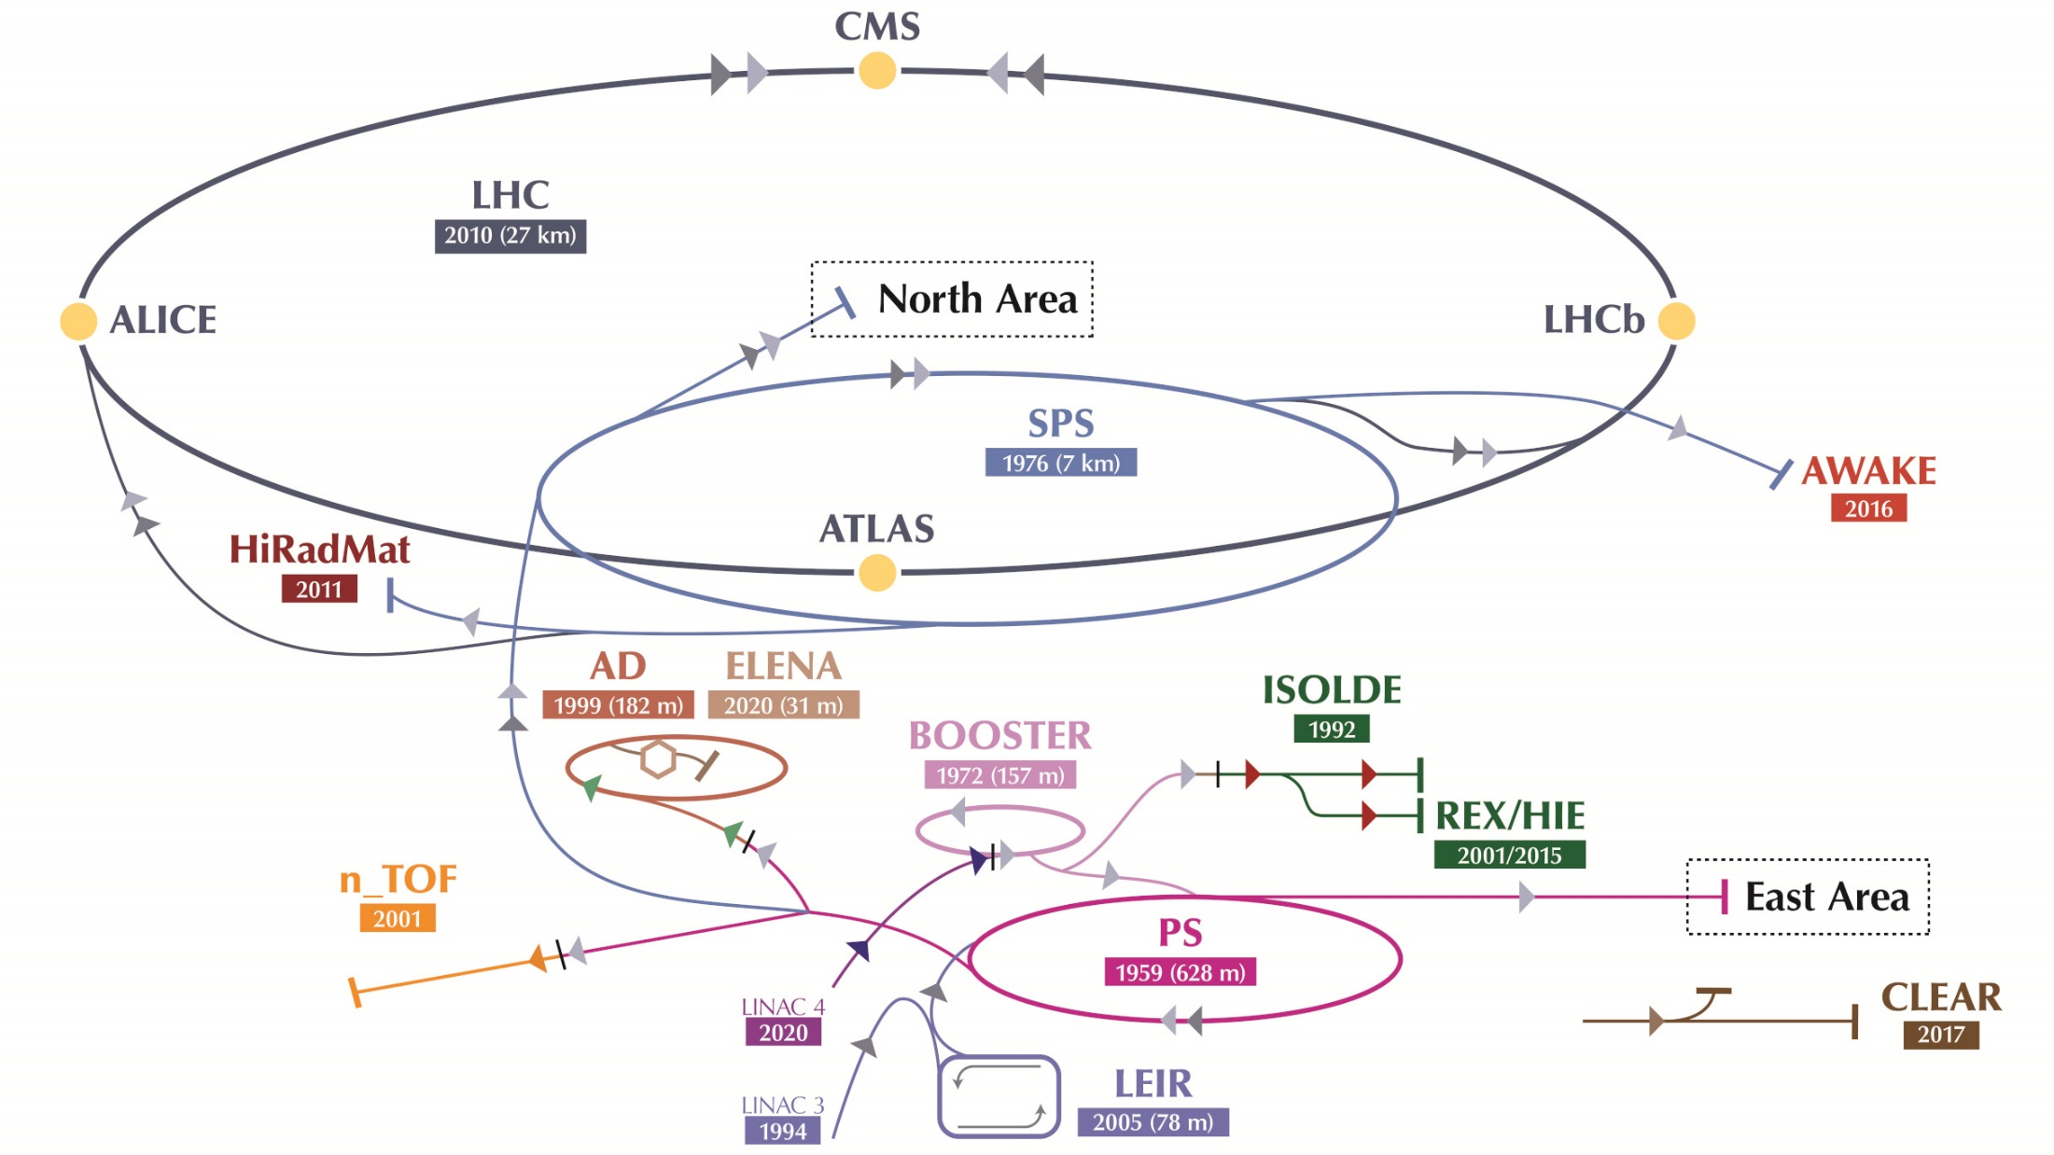
CERN
ICST&M @ CMS LHC
One Decade On
• 1959 $→$2022: $>$ 60 years of sub-nuclear physics
2022

Slide 3
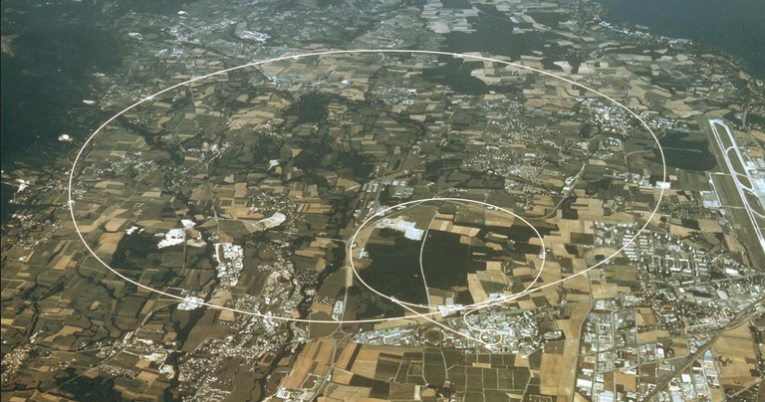
CERN
ICST&M @ CMS LHC
One Decade On
• 1959 $→$2021: $>$ 60 years of (sub-)nuclear physics

Slide 4

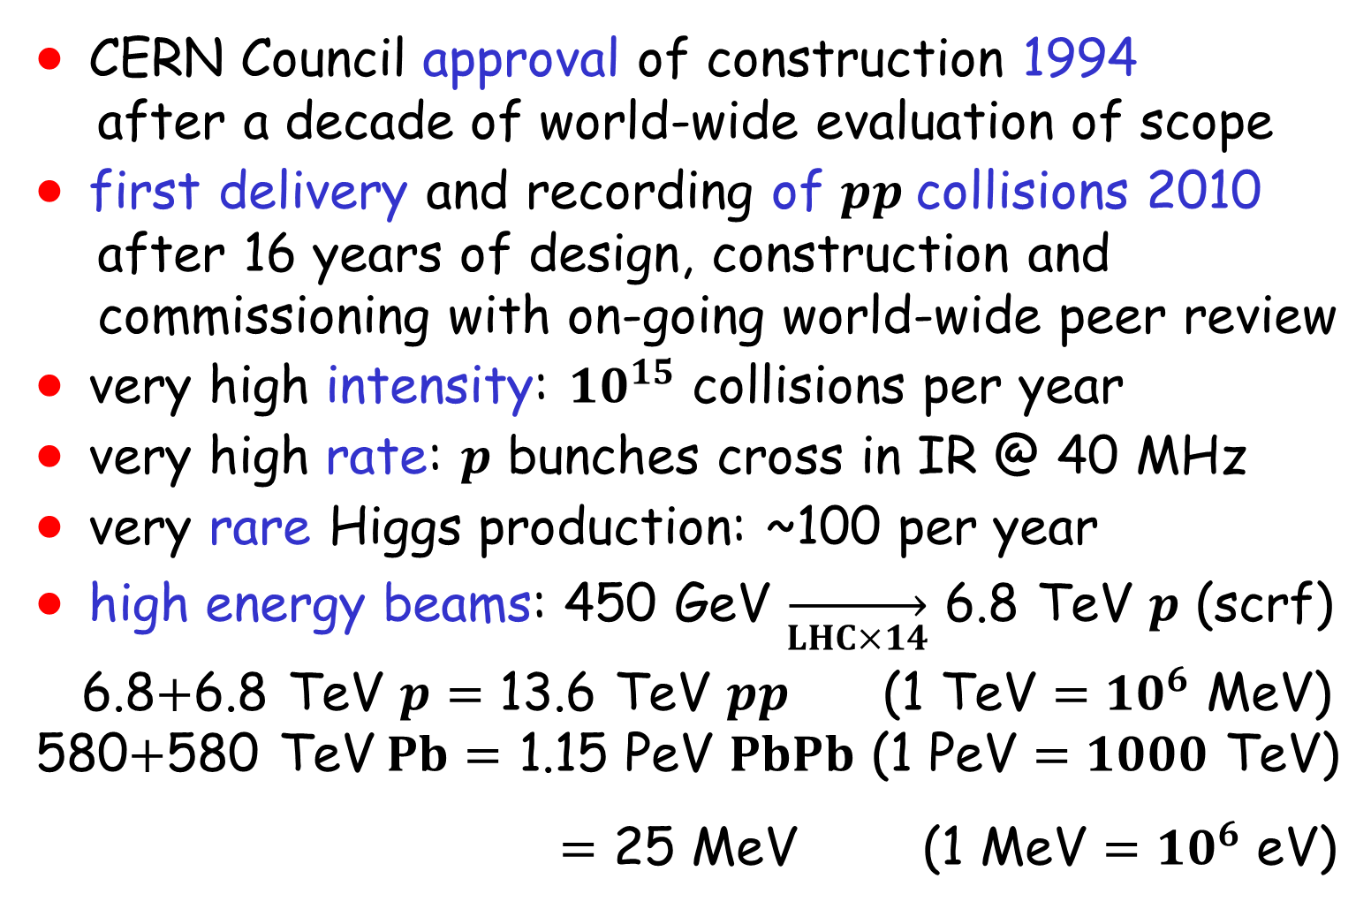
CERN’s Large Hadron Collider
ICST&M @ CMS LHC
One Decade On
• CERN Council approval of construction 1994
after a decade of world-wide evaluation of scope
• first delivery and recording of $pp$collisions 2010
after 16 years of design, construction and
commissioning with on-going world-wide peer review
• very high intensity: ${10}^{15}$ collisions per year
• very high rate: $p$ bunches cross in IR @ 40 MHz
• very rare Higgs production: ~100 per year
• high energy beams: 450 GeV $\overset{→}{LHC×14}$ 6.8 TeV $p$ (scrf)
6.8$+$6.8 TeV $p=$ 13.6 TeV $pp$ (1 TeV ${=10}^{6}$ MeV)
580$+$580 TeV$Pb=$ 1.15 PeV $PbPb$ (1 PeV $=1000$ TeV)
$=$ 25 MeV (1 MeV ${=10}^{6}$ eV)

Slide 5
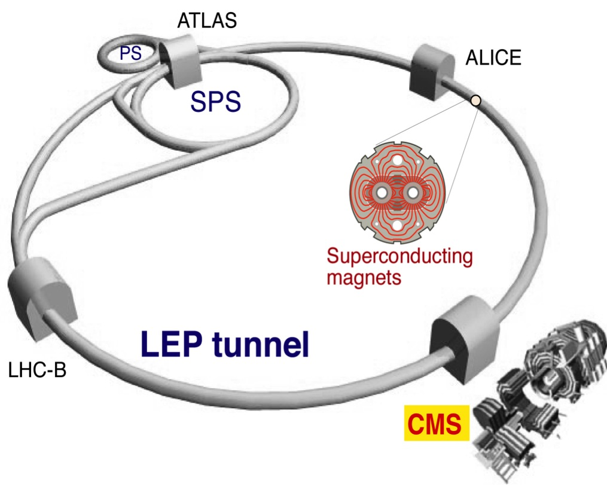
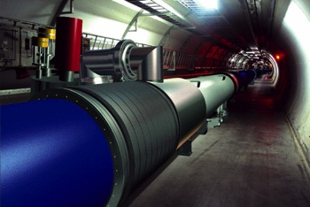
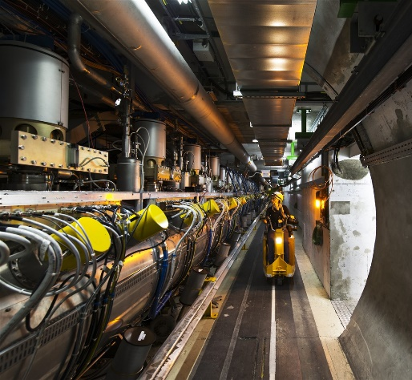
LHC @ CERN
ICST&M @ CMS LHC
One Decade On
• circumference 26 km
Superconducting cavities

Slide 6
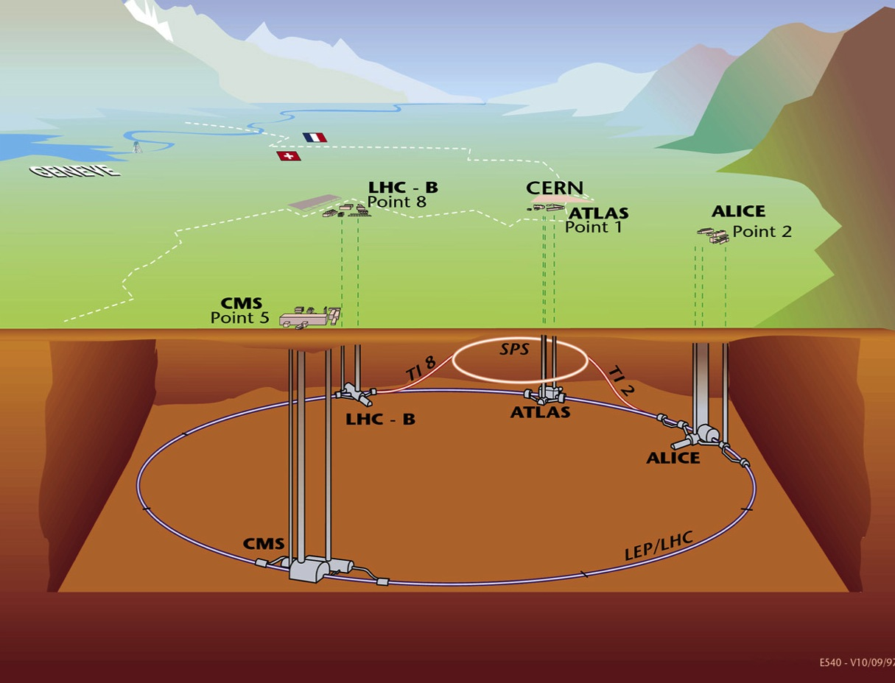
LHC @ CERN
ICST&M @ CMS LHC
One Decade On
Alps
Jura
~100m
Geoff Hall

Slide 7




Needle in the LHC Haystack
ICST&M @ CMS LHC
One Decade On
• “bunches” of 6.8 TeV $p$ “cross” every $25=\frac{1}{40 MHz}$ ns
~20 6.8 TeV $pp$ interactions every $25$ ns
$\overset{→}{trigger+data analysis}100$ $pp→$ Higgs/year $\sim {10}^{−5}$/s
$$γ$$
“transverse
activity”
$$pp→H+…$$
$↳γγ$
$γ=$ photon
$$γ$$

Slide 8
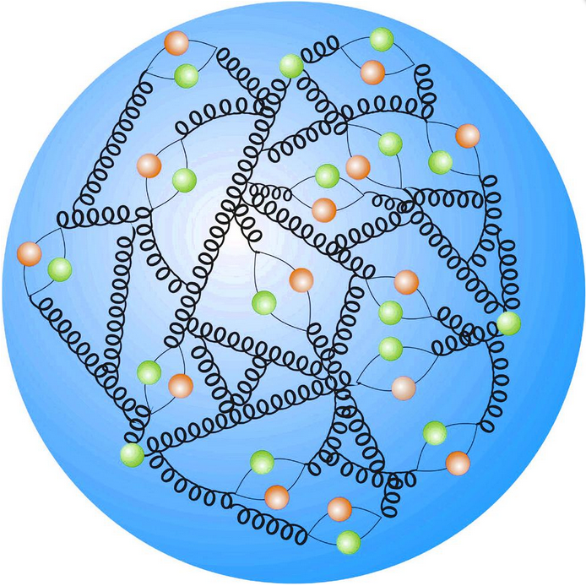
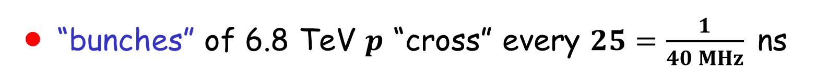

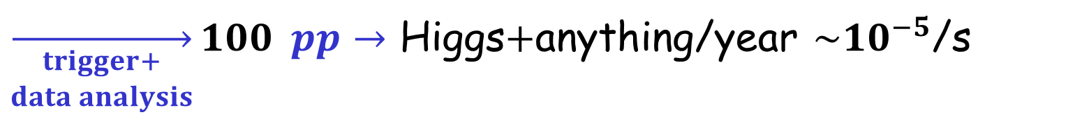
Needles in the LHC Haystack
ICST&M @ CMS LHC
One Decade On
• “bunches” of 6.8 TeV $p$ “cross” every $25=\frac{1}{40 MHz}$ ns
~20 6.8 TeV $pp$ interactions every $25$ ns
$\overset{→}{\begin{aligned}trigger+ \\ data analysis\end{aligned}}100$ $pp→$ Higgs$+$anything/year $\sim {10}^{−5}$/s
$$γ$$
proton
uud
d
d
uud
proton
u
u
u

Slide 9

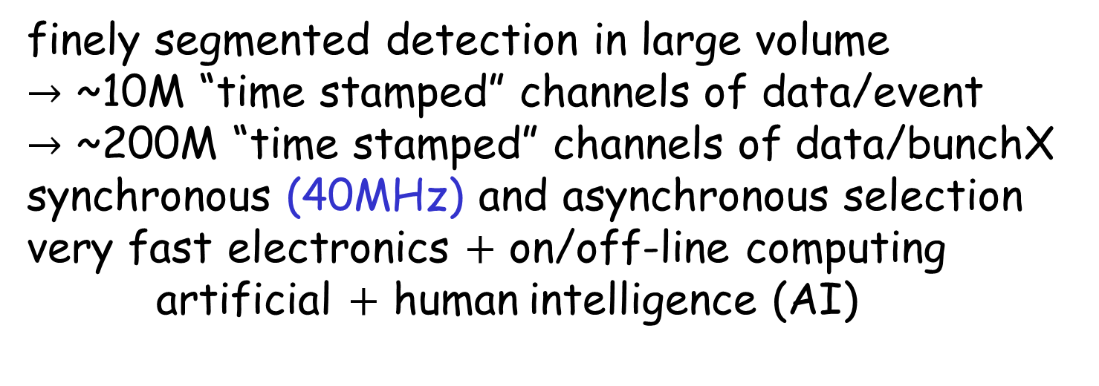
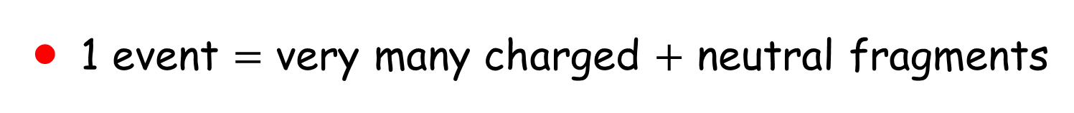
Interaction Point in the LHC
ICST&M @ CMS LHC
One Decade On
• > 1 “event” per bunch crossing every 25 ns (40MHz)
• 1 event $=$ very many charged $+$ neutral fragments
finely segmented detection in large volume
$→$ ~10M “time stamped” channels of data/event
$→$ ~200M “time stamped” channels of data/bunchX synchronous (40MHz) and asynchronous selection very fast electronics $+$ on/off-line computing
artificial $+$ human intelligence (AI)
• environment ~ nuclear reactor $→$ ”rad hard”
R [cm] | Fast hadron fluence [cm⁻²] | Dose [kGy] | Dose [Mrad]
4.3 | 246 10¹³ | 830 | 83
22 | 16 10¹³ | 67 | 6.7
115 | 2 10¹³ | 2 | 0.2

Slide 10
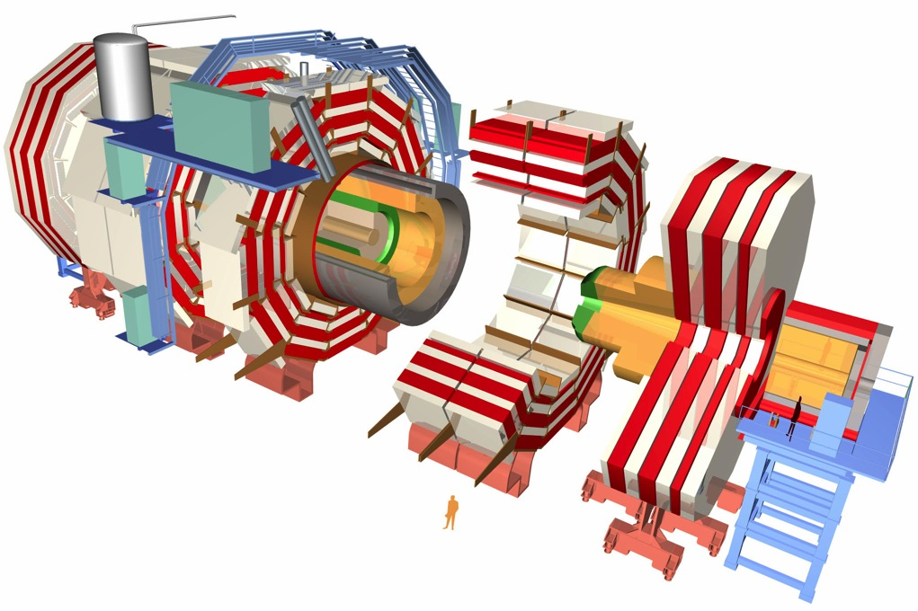

Compact Muon Solenoid CMS
ICST&M @ CMS LHC
One Decade On
• CMS @ IR in LHC (pulled apart!) concept $≿1990$s
HCAL
Muon chambers
Tracker
ECAL
4T solenoid
Total weight: 12,500 t
Overall diameter: 15 m
Overall length 21.6 m
Magnetic field 4 T
constructed as a series of layered sub-detectors, each with a specific purpose
Courtesy Geoff Hall
10

Slide 11
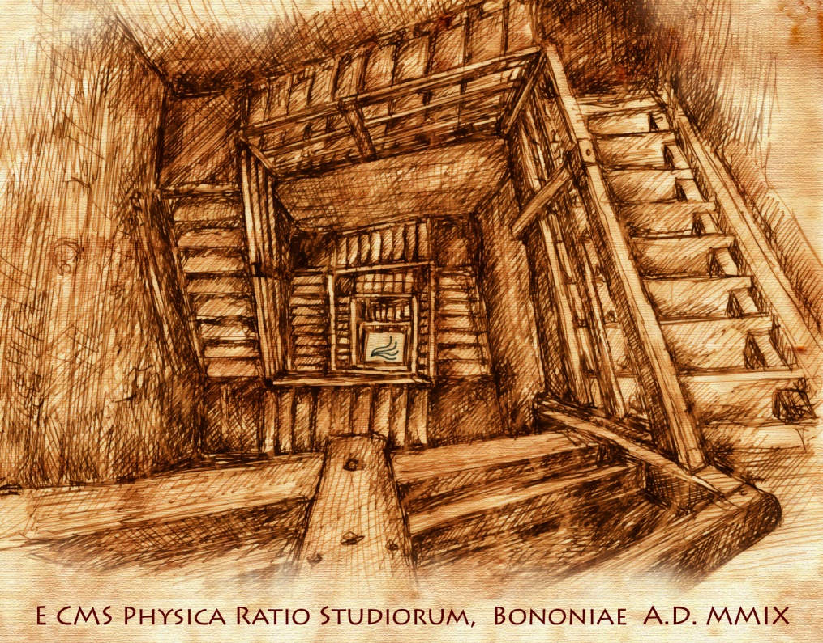
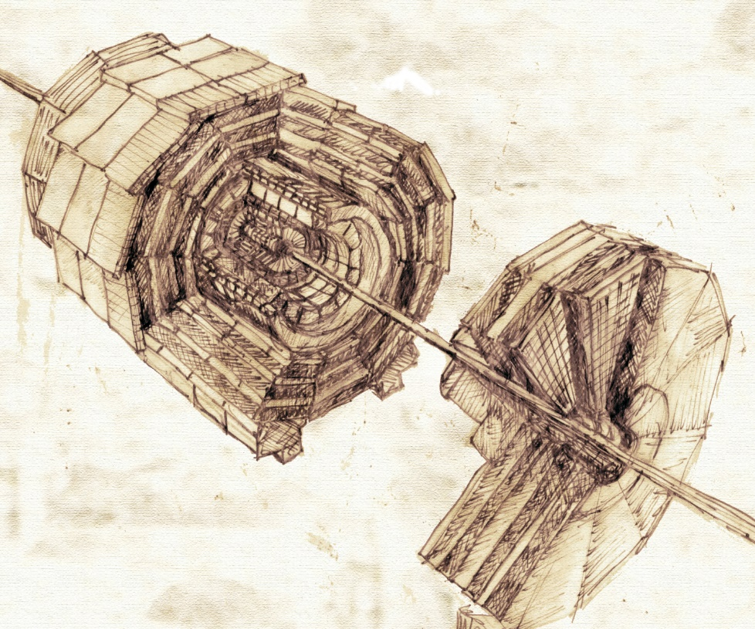

Leonardo and CMS
ICST&M @ CMS LHC
One Decade On
• conceptual design complete late 1990s
… but did Leonardo get there first ?
$$\overset{↔}{?}$$
http://cds.cern.ch/record/1157741
Cittolin

Slide 12
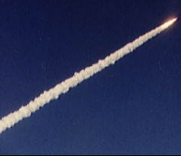
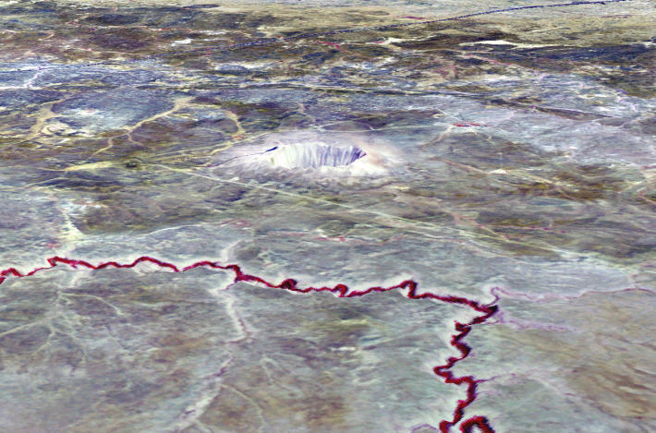
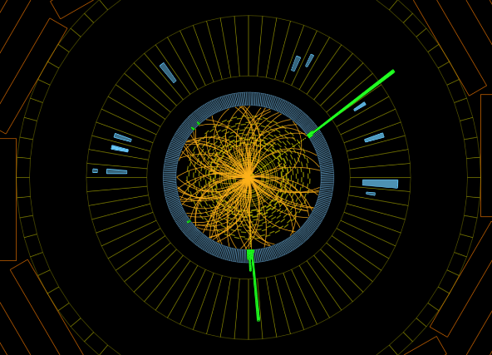
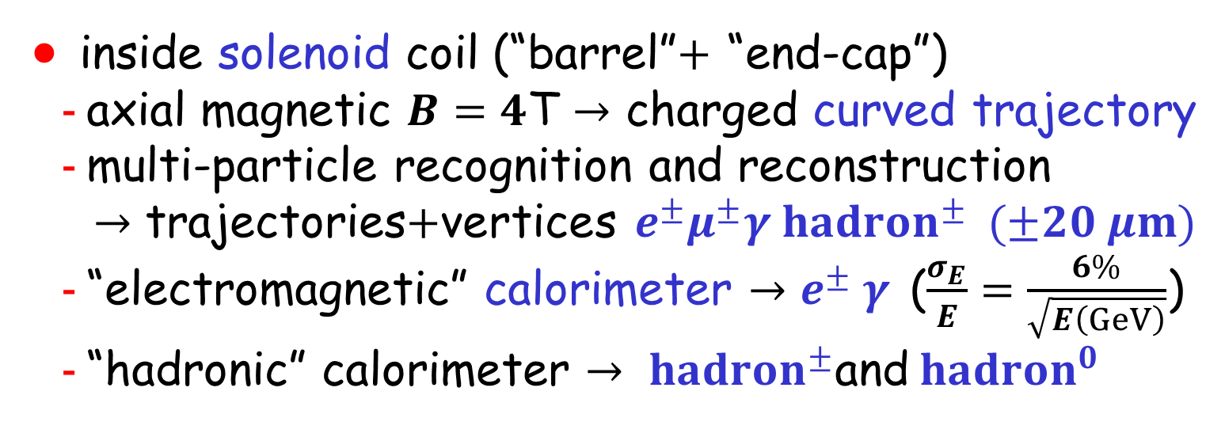
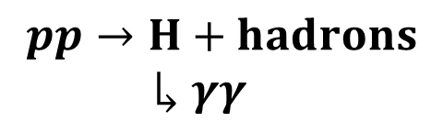
Inner Design
ICST&M @ CMS LHC
One Decade On
• inside solenoid coil (“barrel”$+$ “end-cap”)
- axial magnetic $B=4$T $→$ charged curved trajectory
- multi-particle recognition and reconstruction
$→$ trajectories$+$vertices $e^{±}μ^{±}γ{ hadron}^{±}$ $(±20 μm)$
- “electromagnetic” calorimeter $→e^{±} γ$ ($\frac{σ_{E}}{E}=\frac{6\%}{\sqrt{E\left(GeV\right)}}$)
- “hadronic” calorimeter $→$ ${ hadron}^{±}$and${ hadron}^{0}$
beam’s “eye” view
trajectory
energy deposition
in “calorimeter”
$$pp→H+hadrons$$
$↳γγ$

Slide 13
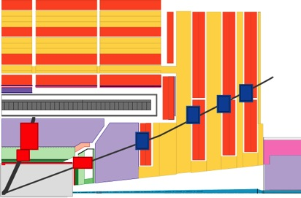
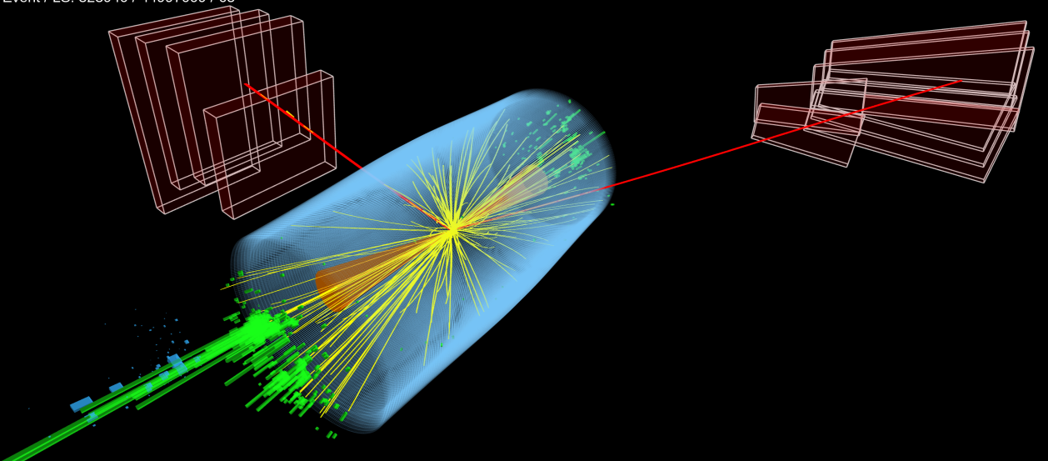

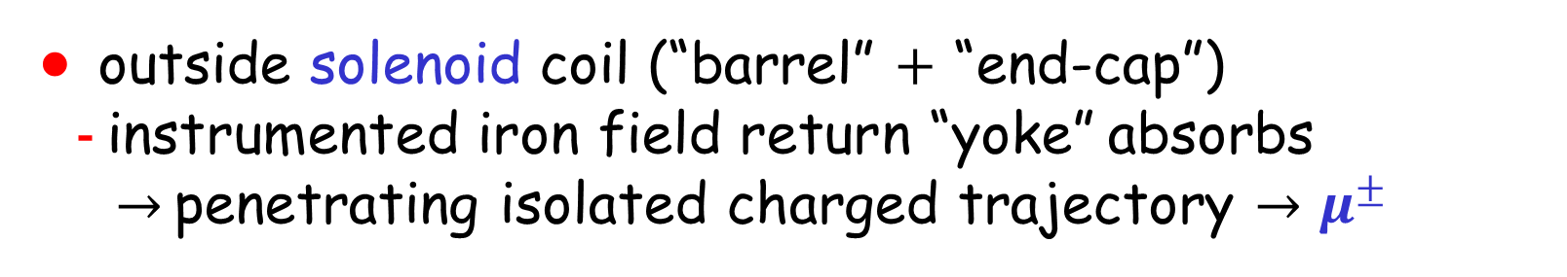
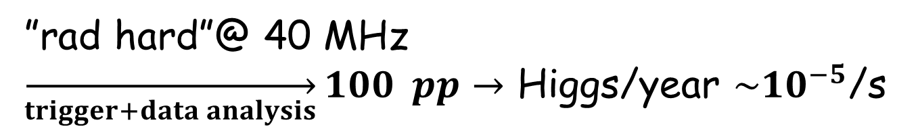
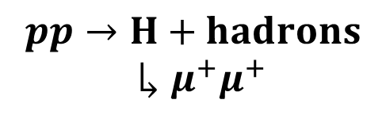

Outer Design
ICST&M @ CMS LHC
One Decade On
• outside solenoid coil (“barrel” $+$ “end-cap”)
- $\text{i}\text{nstrumented} \text{iron} \text{field} \text{return}\text{ “}\text{yoke}\text{”}$absorbs
$→$penetrating isolated charged trajectory $→μ^{±}$
$←$ instrumented iron $→$
overview
$μ$ penetration
$$pp→H+hadrons$$
$↳μ^{+}μ^{+}$
”rad hard”@ 40 MHz
$\overset{→}{trigger+data analysis}100$ $pp→$ Higgs/year $\sim {10}^{−5}$/s

Slide 14
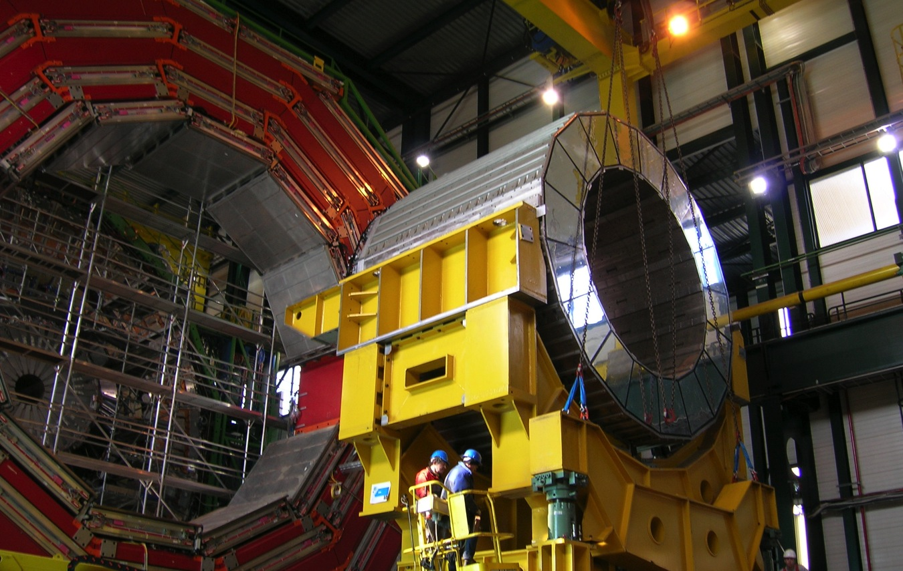
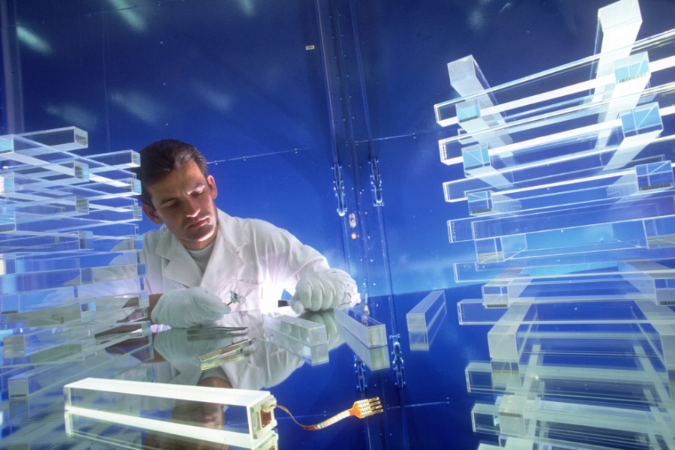
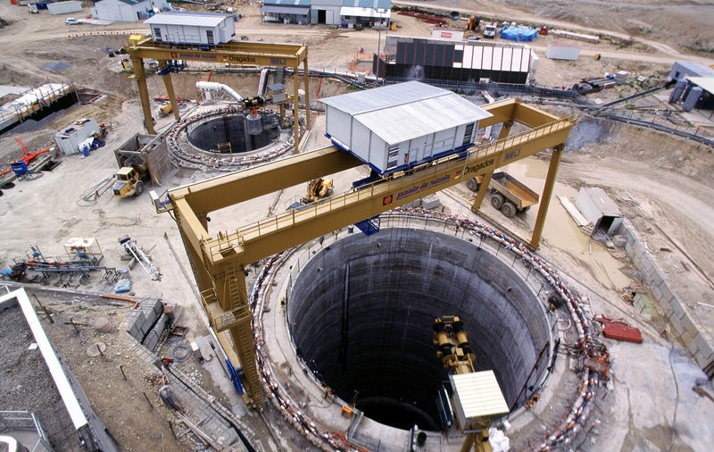
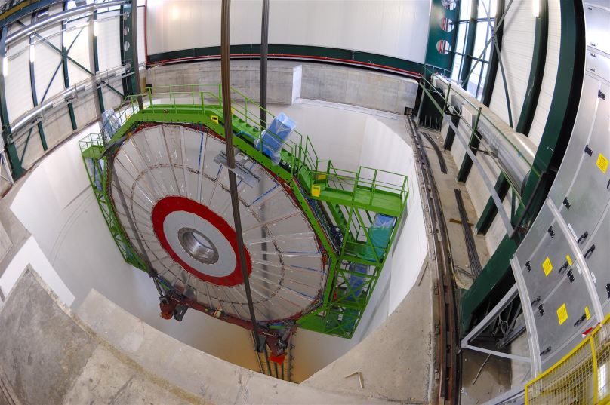
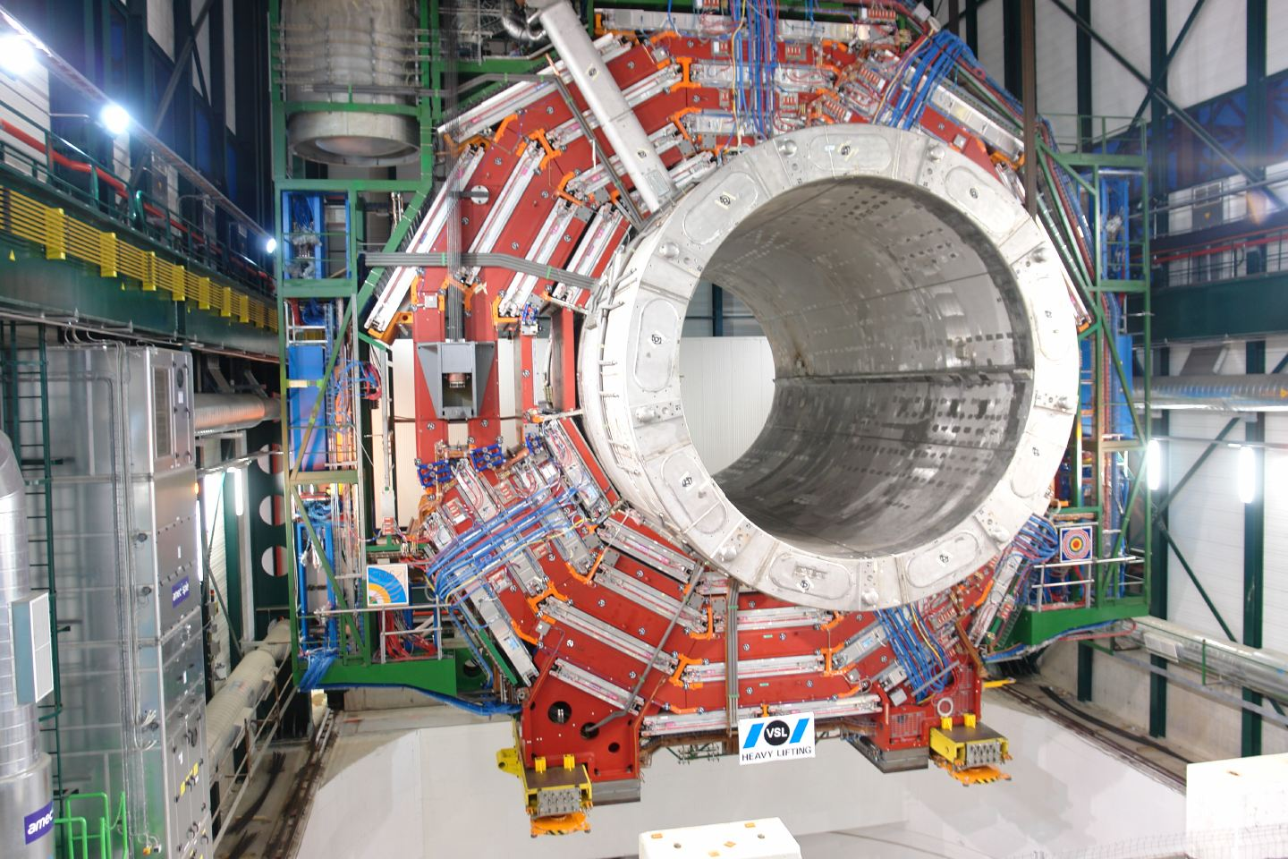
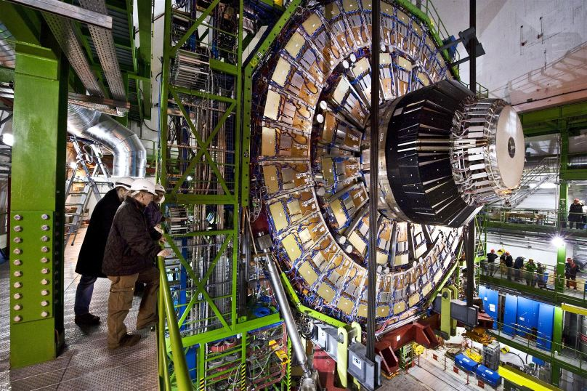
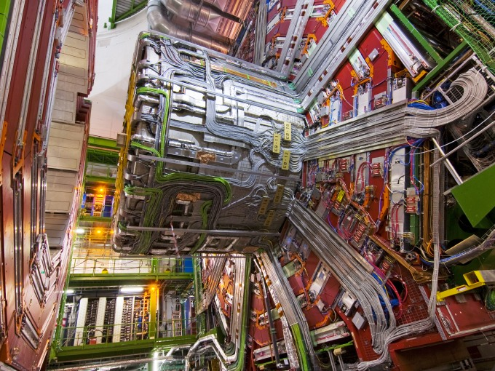



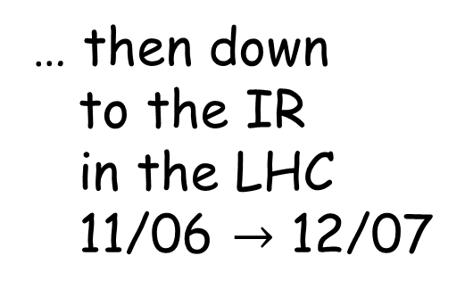



Big into Bigger
ICST&M @ CMS LHC
One Decade On
• surface: R&D $≳$ 1996 $→$ construction $≳$ 2000
barrel xstals
xstal assembly
civil engineering
… then down
to the IR
in the LHC
11/06 $→$ 12/07
solenoid+instrumented yoke
+barrel xstals $↓$
end cap xstals $↓$
11/06
c$harged particle detector ↓$
e$nd cap xstals+muon↓$
s$ervices↓$
12/07

Slide 15
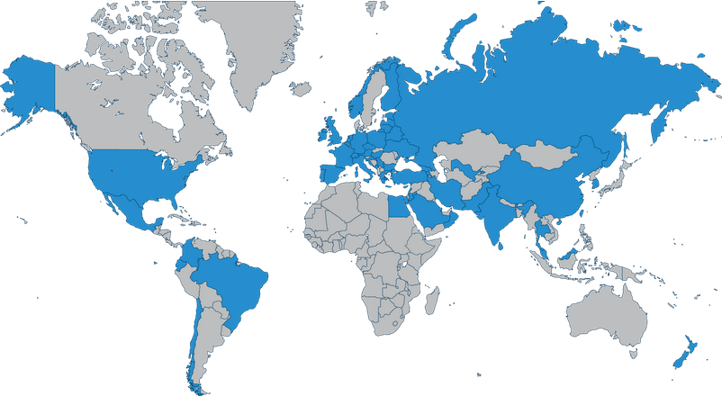

International Collaboration
ICST&M @ CMS LHC
One Decade On
• CMS on every continent encompasses the planet
physicists (~3000) $≪$ engineers $≪$ technicians !
•CERN
thanx to global taxpayers !

Slide 16

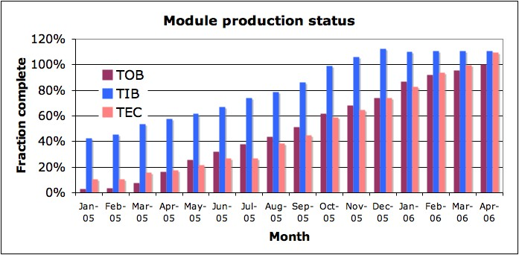

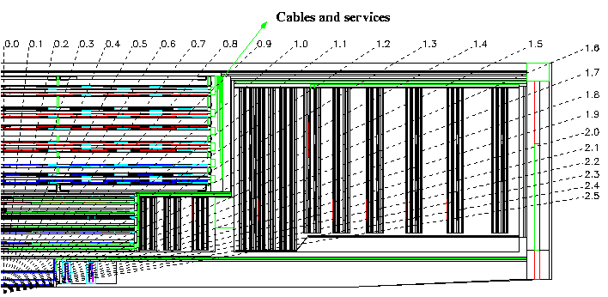
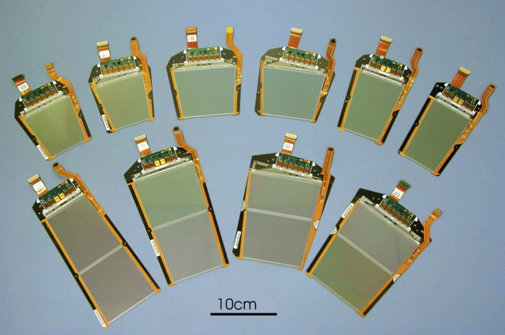
Multi-particle Detection
ICST&M @ CMS LHC
One Decade On
• “silicon strip tracker”: precision module assembly
• silicon pixels: inside assembly around bunch cross
Microstrip tracker
~210 m² of silicon, 9.3M channels
73k APV25s, 38k optical links, 440 FEDs
27 module types
~34kW
TOB
TOB
TEC
TEC
TIB
TIB
TID
TID
PD
PD

Slide 17
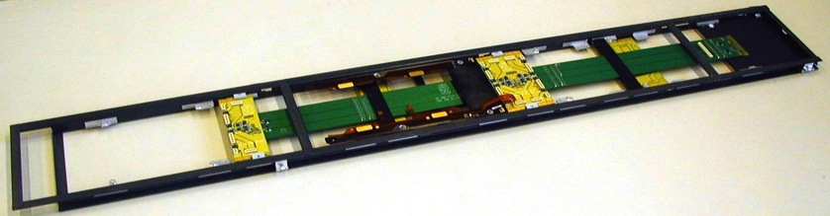
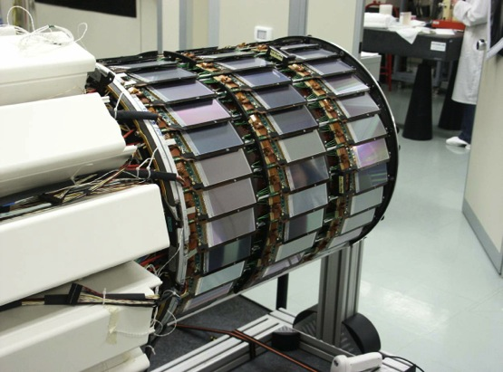
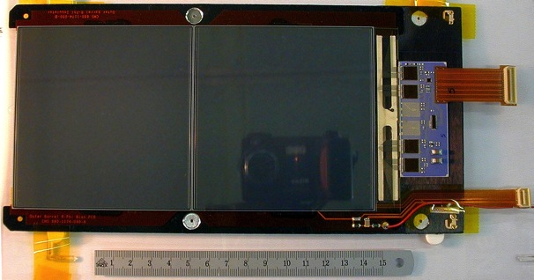
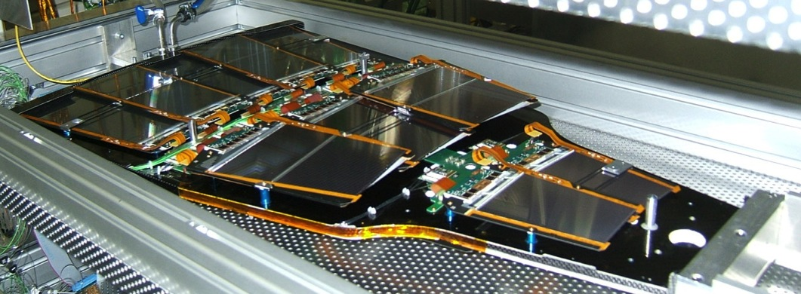
Multi-particle Detection
ICST&M @ CMS LHC
One Decade On
• “silicon strip tracker”: module$+$sub-system assembly
Inner barrel shells (Italy)
TOB modules and Rods
(US, CERN)
Hybrids (industry)
Endcap petals
(Au, Ge, Be, Fr)

Slide 18
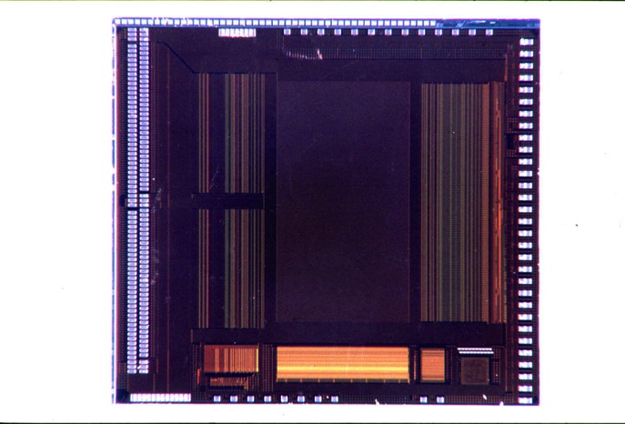

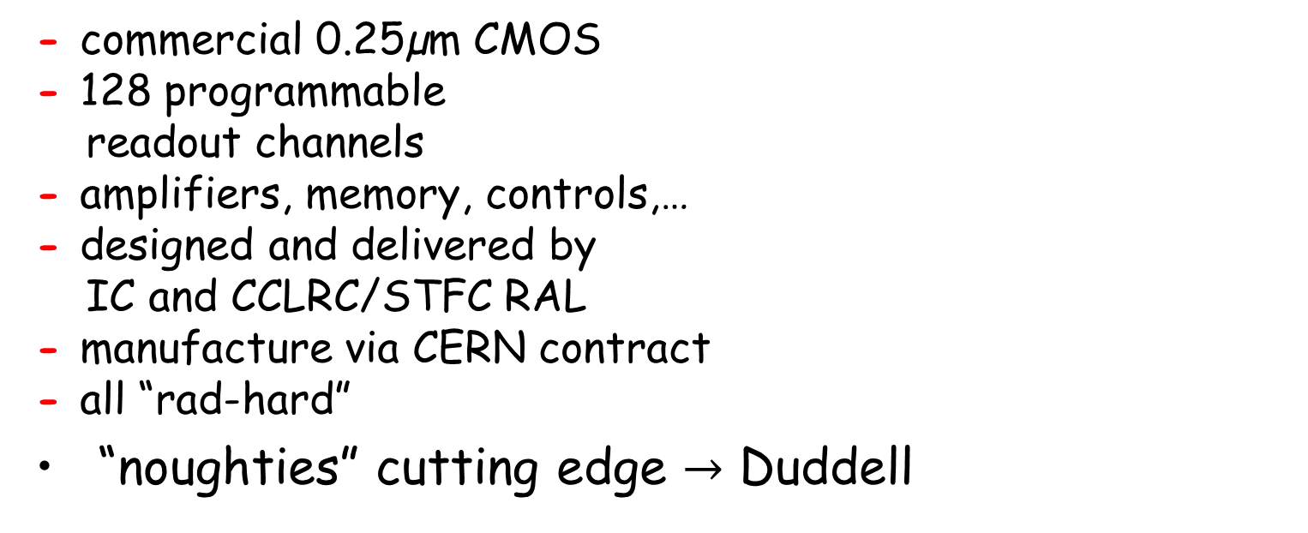
Multi-particle Detection
ICST&M @ CMS LHC
One Decade On
• “silicon strip tracker”: channel functionality
  - commercial 0.25µm CMOS
  - 128 programmable
  readout channels
  - amplifiers, memory, controls,…
- designed and delivered by
IC and CCLRC/STFC RAL
- manufacture via CERN contract
  - all “rad-hard”
“noughties” cutting edge $→$ Duddell
pipeline
128x192
128 x preamp/shaper
APSP + 128:1 MUX
7.1mm
bias gen.
control
logic
FIFO
CAL
pipe logic
8.1 mm
Peak
Decon.
APV O/P Frame
digital header
128 analogue samples

Slide 19
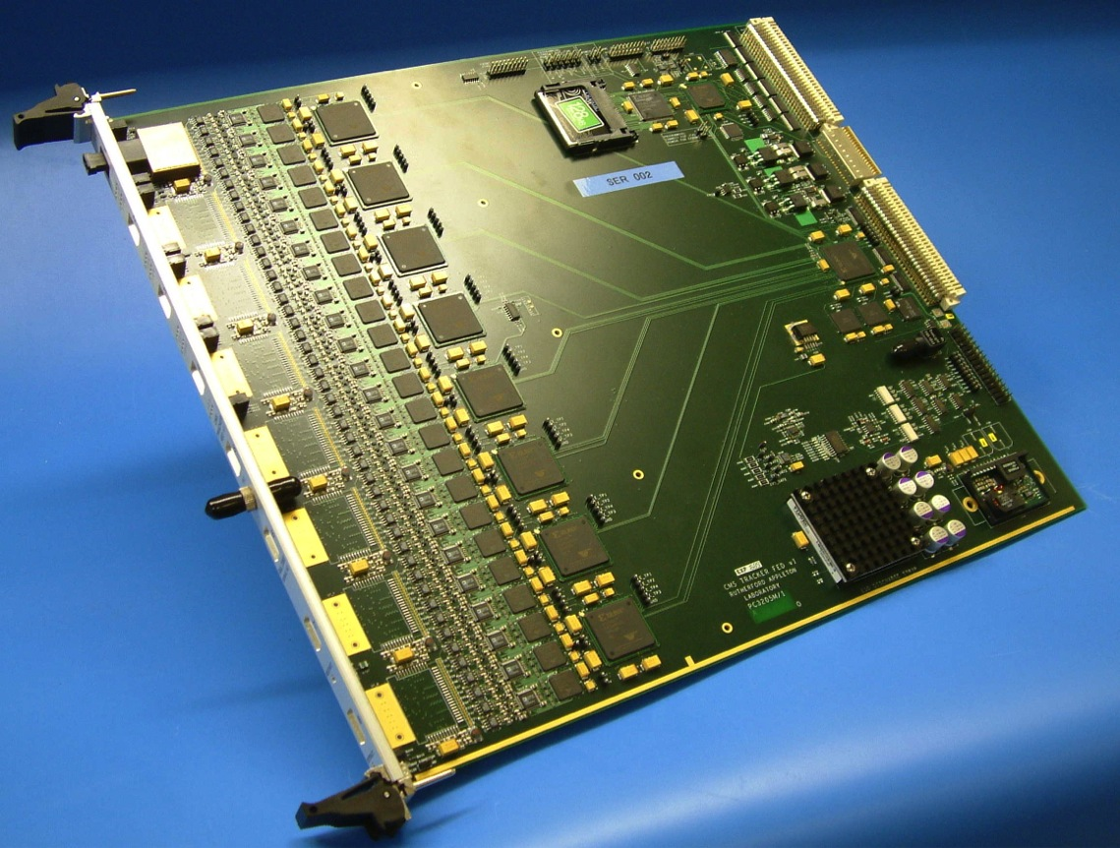
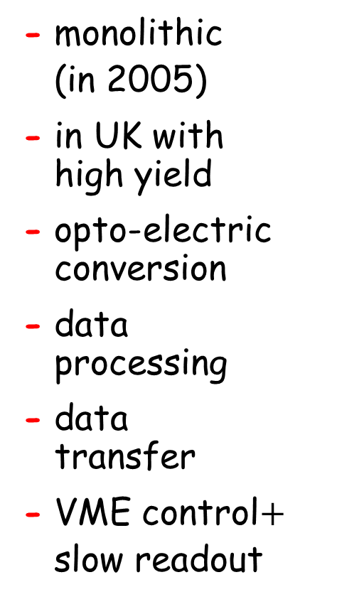
Multi-particle Detection
ICST&M @ CMS LHC
One Decade On
• tracker front-end “driver
- monolithic
(in 2005)
- in UK with
high yield
- opto-electric
conversion
- data
processing
- data
transfer
- VME control$+$
slow readout
JTAG
OptoRx
VME64x
9U board
CFlash
34 x
FPGAs
96 channels
memories
analogue
TTC
power
FE Unit
“Primary” Side

Slide 20
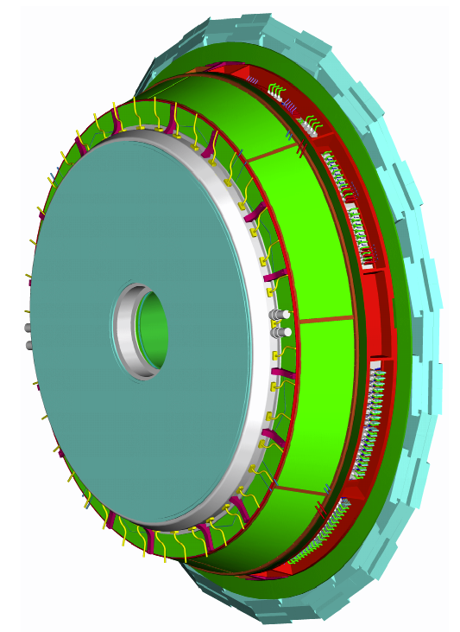
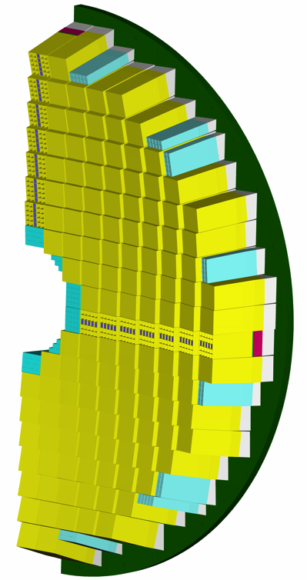
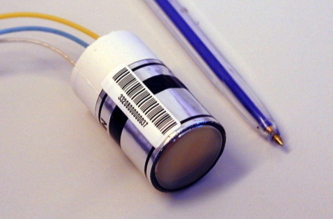

Electromagnetic Calorimeter
ICST&M @ CMS LHC
One Decade On
• end-cap assembly: xstals $+$ phototubes $+$ read-out
$→$ localised electron/positron $e^{±}$ and photon $γ$
- 80,000 $PbWO_{4}$ xstals
barrel: APD
end-cap: VPT
$→$ procurement … ?
- mechanical
- fast electronics
- read-out $+$ services
25.4 mm

Slide 21
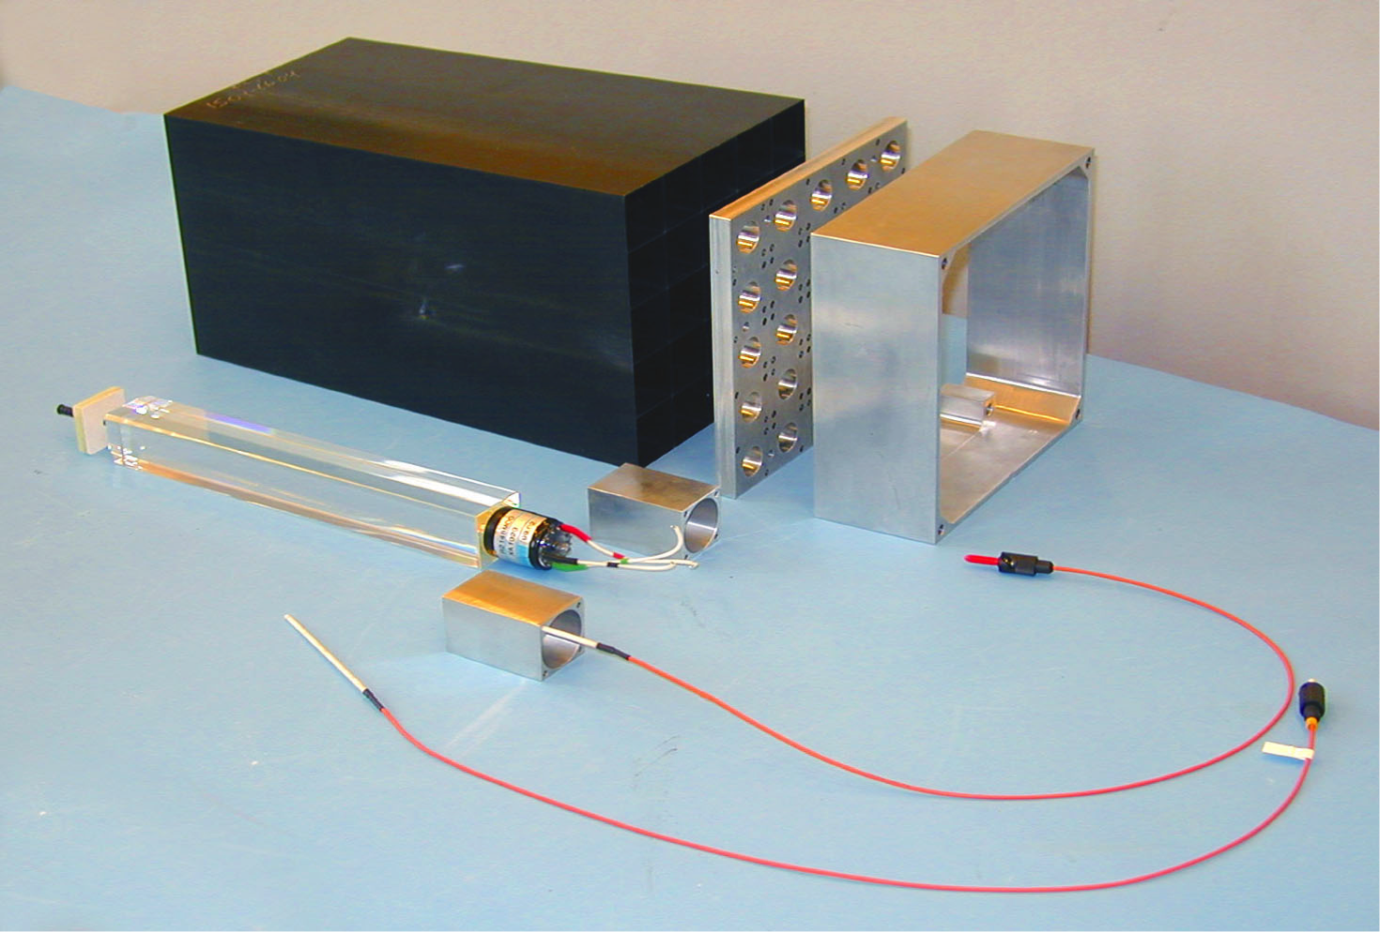

EC electromagnetic Calorimeter
ICST&M @ CMS LHC
One Decade On
• end-cap VPT channel ( $+$ RAL)
- very dense xstal $→$ weighty, precision ECs
- large dynamic range of analogue signal
- low noise
- linearity
- stability
- L1 trigger
object $→$ fast
• $\frac{σ_{E}}{E}=\frac{6\%}{\sqrt{E\left(GeV\right)}}$
$\sim 1×1$ inch
$×$ 80,000 !
single endcap
xstal with VPT

Slide 22


L1 Trigger Processor
ICST&M @ CMS LHC
One Decade On
• L1 $→$@ 40 MHz: VME $\overset{→}{upgrade}$“custom” boards
- “raw” data $→$ “FEP” $≤160$ bunch-X $≤$ 4$μ$s for L1
- inputs: $μ+$ calorimeter “bits”
segments $+$ $e/γ$ $+$jets $+$energy sums

Slide 23


L1 Trigger Processor
ICST&M @ CMS LHC
One Decade On
• CMS upgrades: L1 $→$@ 40 MHz: HL-LHC

Slide 24

Pedigree and Commitment
ICST&M @ CMS LHC
One Decade On
• “In the second half of the 1980s I [GH] was working with a few students on silicon detector R&D, after the first UK experiment ever to use silicon detectors, NA14, was cancelled by the Nuclear Physics subcommittee of SERC (?). … I [GH] had been working with Micron Semiconductor as they delivered primitive diodes, small microstrips and finally full size detectors” …
• “[At the time] Jim [JV] was working on UA1 and had become interested in high resolution calorimeters for the future. … [He] went on to promote various crystals as alternatives to the lead-scintillator shashlik calorimeter … the original baseline for CMS … Lead Tungstate was … a potential candidate ….”
• “… forgotten (and some … weren’t even born when we built the experiment) is how difficult and challenging it was, and how close we came to disasters (even if failure was forbidden).”
• “… years [1980 $→$ 1994] spent in R&D and building were quite lonely in a sense. Developments were appreciated of course but quickly taken for granted.”
”but when first, and after all, it works …” !

Slide 25


Sub-nuclear Physics
ICST&M @ CMS LHC
One Decade On
• 2010: 60 years of physics in 40pb⁻¹ at LHC!
Alvarez
LBL
Richter
SLAC
Ting
BNL
Lederman
Fermilab
Higgs
+more
?
@ LHC
Rubbia
Van der Meer
CERN
1960s
1970s
1980s

Slide 26
Discovery 2012
ICST&M @ CMS LHC
One Decade On
• SM physics @ the Fermi scale (~100$m_{p}$) “complete”

Slide 27
Summa cum Laude !
ICST&M @ CMS LHC
One Decade On
2005 IOP Duddell Medal Geoff Hall
with Alessandro Marchioro (CERN) and Peter Sharp (RAL, CERN)
2009 IOP Chadwick Medal and Prize Tejinder Virdee
2013 Special Breakthrough Prize for Fundamental Physics
Tejinder Virdee with Peter Jenni, Fabiola Gianotti, Michel Della Negra, Guido Tonelli, Lynn Evans (CERN) and Joe Incandela (UCSB)
2013 EPS High Energy and Particle Physics Prize
Tejinder Virdee with Michel Della Negra, Peter Jenni and the ATLAS and CMS collaborations
2015 IOP Glazebrook Medal and Prize Tejinder Virdee
2017 APS W.K.H. Panofsky Prize in Experimental Particle Physics Tejinder Virdee with Michel Della Negra (Imperial College London and CERN), Peter Jenni (Albert-Ludwigs-Universität Freiburg and CERN)
2020 IOP Chadwick Medal and Prize Geoff Hall

Slide 28
Discovery+10: 2022
ICST&M @ CMS LHC
One Decade On
• precision physics @ Fermi scale (~100$m_{p}$) advances

Slide 29

Discovery+10: 2022
ICST&M @ CMS LHC
One Decade On
• precision physics @ Fermi scale (~100$m_{p}$) advances
… and beyond ?
$→$ Discovery+20: 2032 ?

Slide 30



Some of the ICSTM CMS Team
ICST&M @ CMS LHC
One Decade On
… but certainly not all !
Particle Physics ICSTM
JV
GH
JV

