Slide 1



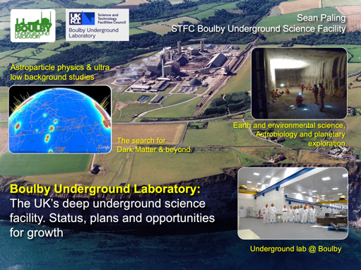
Boulby Development Project Overview
Plans and preparations for a major new multi-disciplinary Deep Underground Science Facility in the UK.
Sean Paling
Jonathan Burns
Science and Technology Facilities Council

Slide 2

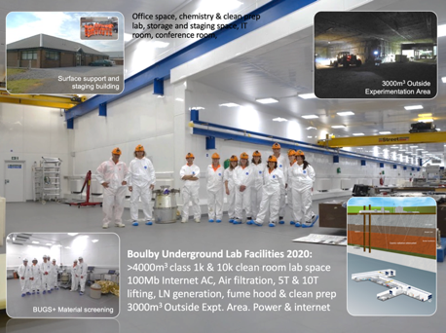
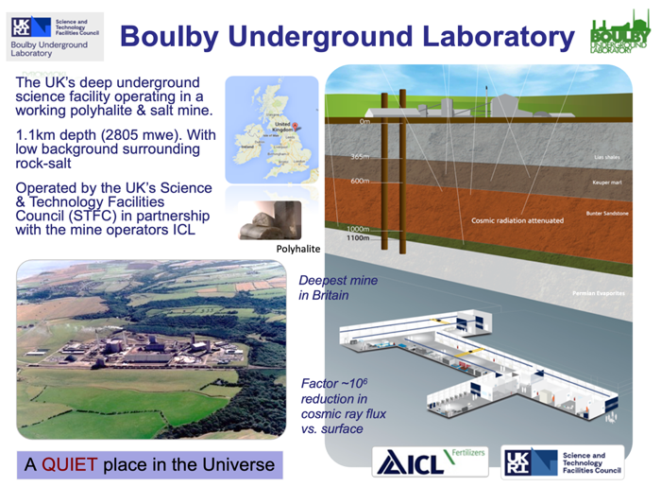
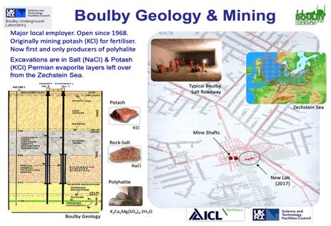
Boulby Underground Laboratory (UK)

Slide 3
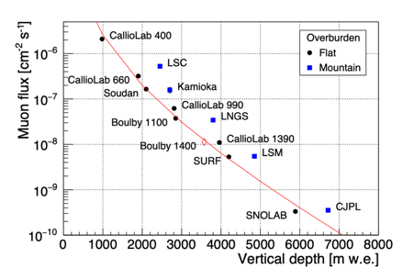



Boulby Underground Laboratory (UK)

Slide 4
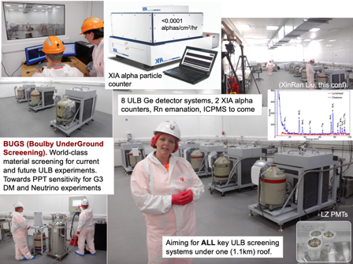
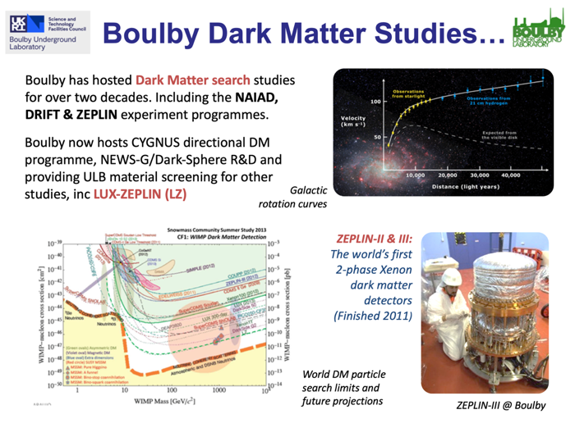
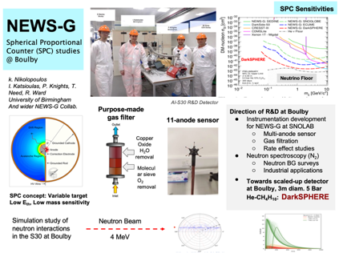
Boulby Science Now & Future
Particle physics and ultra-low background studies

Slide 5
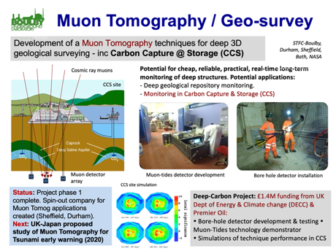
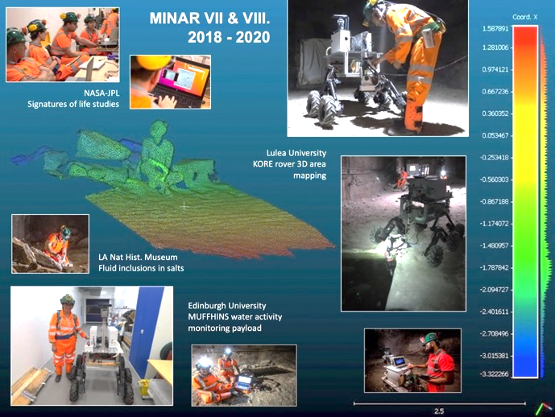
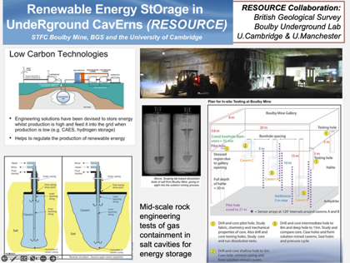
Multidisciplinary Science
Applied low background particle physics, Earth and Environmental science, Astrobiology & Planetary Exploration Technology Development.

Slide 6
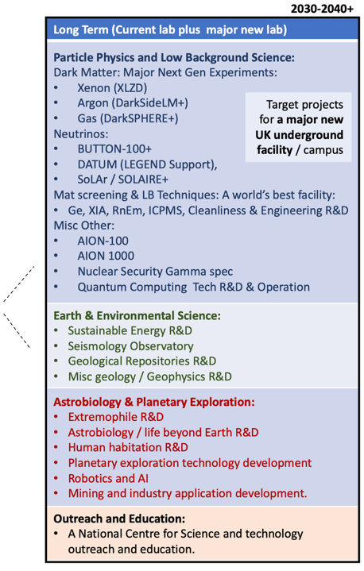
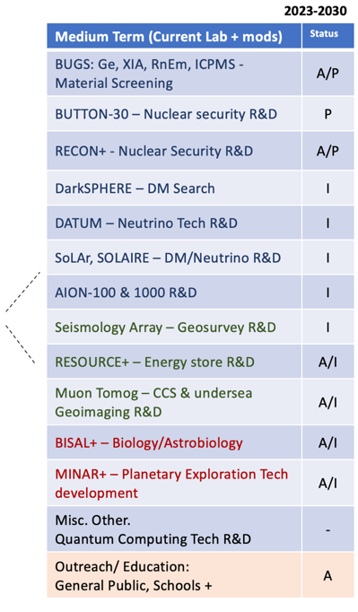
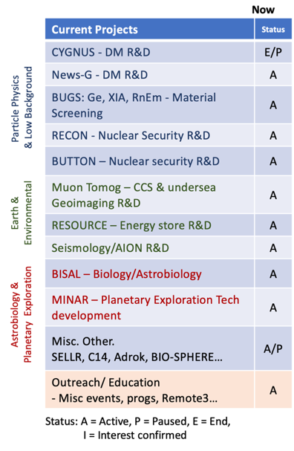
Boulby Activities Now and Potential Future

Slide 7


UK Underground Science Facilities. Now and the Future…
What Boulby Is:
An internationally-important centre for pure & applied multi-disciplinary science.
A local (North East) and national asset for science, technology and outreach/education.
A successful and proud example of science and industry partnership
A UKRI/UK facility with potential, opportunity and support for wide-ranging growth.
STFC/Boulby now looking to: continue to develop the UK underground science facilities to further enable truly internationally-important astro-particle physics and pure and applied multi-disciplinary science.
Short term: Maximally exploit the current Boulby facility to host world class Astro-particle Physics & Low Background Science, Earth & Environmental Science, Astrobiology & Planetary Exploration Studies
Medium-to long term: Prepare to build a major new deep underground science facility in the UK to host next-generation world-leading science projects coming 2030+
Boulby Development Project:
Plans & preparations for a major new multi-disciplinary Deep Underground Science Facility in the UK

Slide 8

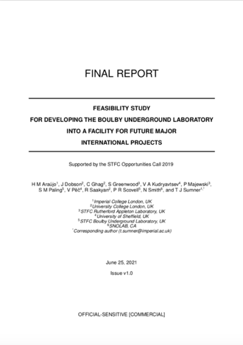
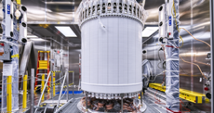
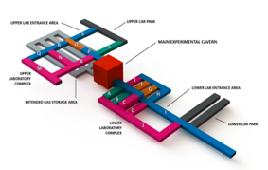
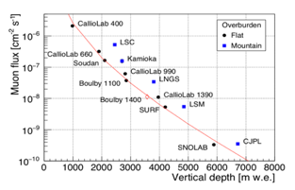
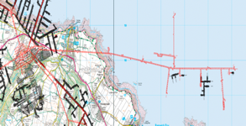
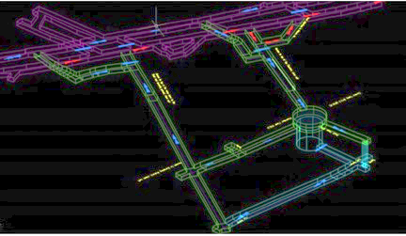
Boulby Feasibility Study (Boulby-FS)
Boulby-FS (2020-21) Overview:
Community-led study of motivation, context and practicalities of creating a major new deep underground science facility in UK
Infrastructure specifications for potential projects (Dark Matter, Neutrinos & more).
Conceptual designs for excavations and outfitting laboratories in 1.1km (Salt) and 1.4km (Polyhalite) layers
Staffing and surface facility needs.
Detailed costs and schedules.
LZ @ SURF.
Next generation in the UK?
Submitted to STFC June 2021
10 T Liquid Xenon
New lab specifications & designs
New lab in Salt?
New lab in Poly?
Government ‘fit’: Levelling Up, Strength in Places, Build Back Better, UK Science Superpower…
Results: It IS feasible, well motivated and timely.
Outfitted facility: £100-200m (Inc contingency, VAT)

Slide 9
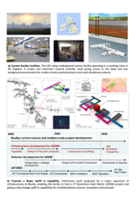
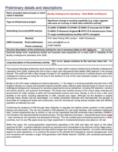
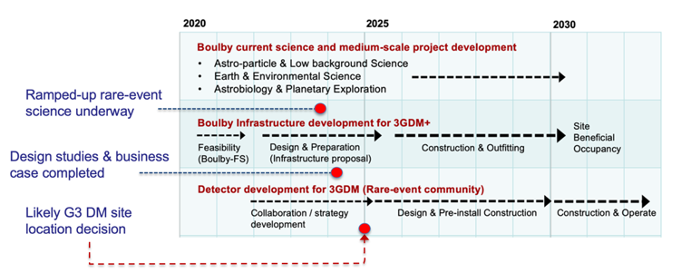
Next (Current) Steps: Boulby Development Project (BDP)
Next level planning and preparing for a…
“… greatly expanded underground science facility in the North East, with the potential to host a major international science infrastructure, such as a next generation dark matter experiment.” (STFC strategic delivery plan (2022-2025)
BDP Project Goal:
UKRI Preliminary Infrastructure Funding
£2.84M, 3 year project (2022/3-2024/5).
Tasks / Deliverables:
Facility design development (for sites at various depths and locations)
Science programme development
Business case(s), economic impact studies, risks → Submission to Gov.
Stakeholder engagement: Local, National & International:
  Public & Partners
  Government
  Science communities & funders
Boulby Development Project Infrastructure Bid: 2022-2025
Boulby Development Timeline
XLZD Detector Build
XLZD Facility Occupy

Slide 10
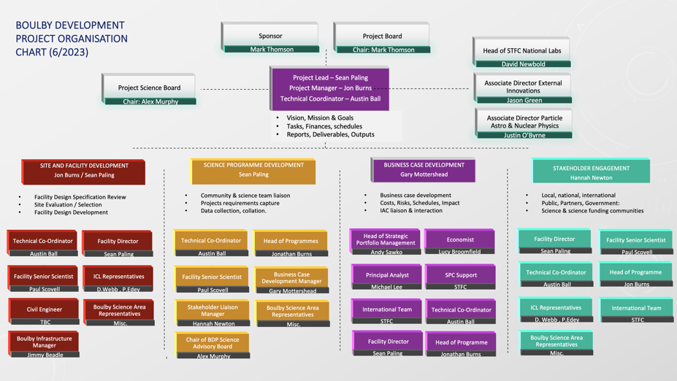
Boulby Development Project (BDP)
Project Governance & Organisation:

Slide 11
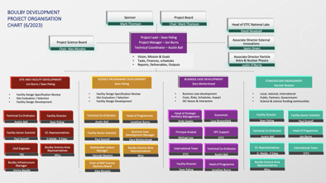


Boulby Development Project (BDP)
Project Governance & Organisation:
Project Sponsor: Mark Thomson
Project Board: Mark Thomson (Chair)
Paul Monks
Peter Knight
Andrea Casson
Nigel Smith
Alex Murphy
BDP Science Advisory Board Alex Murphy (Chair)
Project Advisors:
STFC PPD Director Dave Newbold
STFC Associate Director
- External Innovations Jason Green
STFC Associate Director
- Particle Astro & Nuclear Justin O’Byrne
STFC Boulby Lab Team
Director Sean Paling
Senior Scientist Paul Scovell
Facility Manager Emma Meehan
ES&H Manager Tony Murphy
Dep Facility Manager Ops Louise Yeoman
Dep Facility Manager Infrastructure Jimmy Beadle
Science Support Chris Toth
Science Support Ed Banks
Director / Facility PA Sue Armstrong
Facility Support Maria Wood
Facility Support George Currie
BDP Project Team:
Principle Investigator Sean Paling
Programme Manager Jon Burns
Technical Coordinator Austin Ball
Stakeholder Manager Hannah Newton
Business Case Development Gary Mottershead
STFC Strategy Support Andrzej Sawko
Business Case Development Support Lucy Broomfield
STFC Finance Sion Evans
STFC Estates Stuart Buxton
Programmes Support Matt Chisholm
ICL Boulby Team
Future facility design & logistics Duncan Webb
Future facility design & logistics Pete Edey

Slide 12

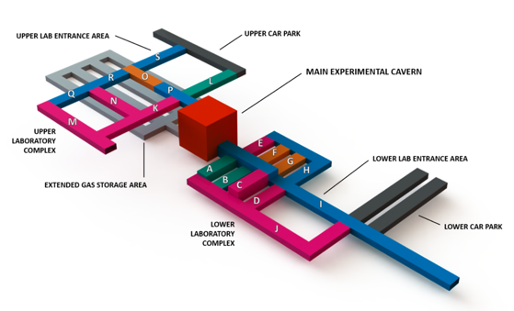
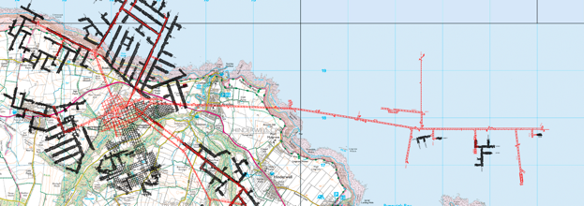
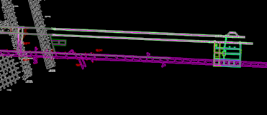
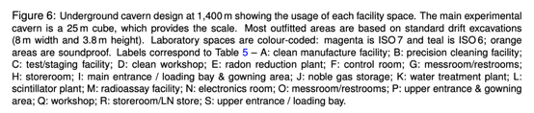
Task 1: Site and Facility Development
a) Next-Level review of new lab design required. Meeting needs of all possible experiments
b) Preferred site(s) to be selected – Salt &/or Polyhalite
Possible sites @ Boulby Mine
Salt
1.1km
Polyhalite
1.3 km
DRAFT
Possible lew lab sites in salt (1.1km) and/or Polyhalite (1.3km). Deeper site preferred for 0vBB capabality
Zone 2 6/23
Boulby Feasibility Study 2021
Phase 1
Phase 2
c) Next Level excavation and facility build plans to be developed…
Science community input/support needed…

Slide 13


Your Input Needed… Towards XLZD @ Boulby
a) Facility Design Requirements: We need to know XLZD facility space
requirements for us to work into a next stage facility design:
  Experimental Science Space: main experiment hall – 25x25x25?
  Support caverns: Clean build up bay, Xe capture, LS and H₂O treatment plants, control rooms, IT/data rooms, storage, offices etc.
  Environmental conditions: Cleanliness, temperature, humidity, Rn, vibration.
b) Facility Support Services Requirements: We need to know facility
support services requirements:
  Power requirements (maximum and stability)
  IT/ Internet
  Lifting, water, compressed air, cleaning, ventilation, disposal etc/
c) Governance, Management & Science Support: Work with us on:
  Facility governance & management details/requirements
  Local resource support (onsite support, project management etc)
  Schedules and logistics. What do you need and when?
We need to continue to talk about…

Slide 14

Boulby Development
Boulby Underground Laboratory Development Plan
4th July 2023
Jonathan Burns, Sean Paling
Head of Boulby Development Programme
Director Boulby Underground Laboratory
jonathan.burns@stfc.ukri.org
sean.paling@stfc.ac.uk

Slide 15
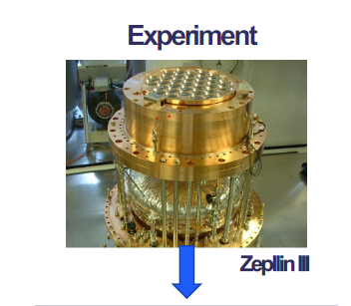
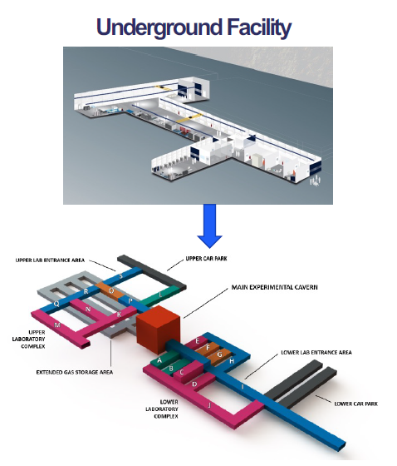
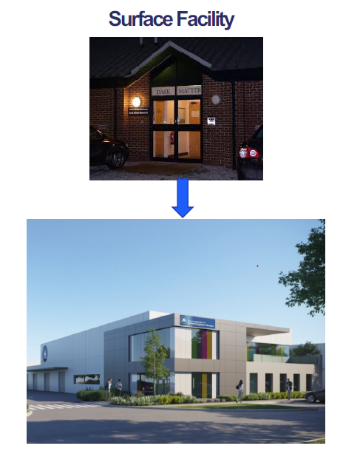

Overall Programme Aim

Slide 16

Strategic Delivery Plan
STFC’s new Strategic Delivery Plan was published, alongside other Council Delivery Plans, on 2nd September 2022
Sets out STFC’s exciting plans for the next three-year spending period
Many new activities and investments across all STFC areas
Explains the role STFC will play in delivering UKRI’s wider mission/vision
Structured around the six objectives of the UKRI Strategy
https://www.ukri.org/publications/stfc-strategic-delivery-plan/

Slide 17

Our ambitious plan: Ideas and Places
Major investment and activity across STFC, examples include
An increase of £19 million over the next three years for STFC-supported frontier research programmes
Enhancing UK scientific links globally, initially targeting new scientific collaborations with India, Japan and the US. Initially this will include funding the Hyper-Kamiokande neutrino experiment in Japan and the US Simons Observatory (located in Chile)
Delivery of a portfolio of infrastructure projects to provide the capability to enable the UK’s thriving research and innovation communities to address the most pressing industrial and societal challenges:
  Major investments in all our large multi-disciplinary facilities
  Funding to develop plans for Boulby area

Slide 18
STFC’s Strategic Delivery Plan
“Complete the design study for a greatly expanded underground science facility in the North East, with the potential to host a major international science infrastructure, such as a next generation dark matter experiment”

Slide 19
STFC’s Strategic Delivery Plan
Now exploring the feasibility of a new facility in the UK
  Boulby is acknowledged as a technically suitable site for the facility
  UK’s international reputation in the field makes this a credible prospect but the need to work with international partners is clear
The benefits
  Would underwrite the UK’s ‘scientific superpower’ aspirations. We strongly support international fundamental physics – but have no facilities in the UK
  Scale makes this a driver for the high-tech economy in North-East England
  Of course – supporting science
The challenges
  Requires a significant and rapid scale-up of facilities
  Buy-in needed from many parties in HMG, in the region, and in community
  Significant engineering and logistic challenges in delivering the project
  Needs to deliver in the long term (decades) – flexible design needed
  Requires a new strategic capital investment by government

Slide 20
Site and Facility Design and Planning - Boulby
ICL Boulby are currently considering polyhalite mining as part of their future mining activity
Two build sites have been identified at Boulby at -1.1km and -1.3km in salt and polyhalite layers respectively. Both sites could host the XLZD experiment but a depth of -1.3km may be required for part of the physics programme and is considered to be the optimum depth for Boulby to be competitive as an XLZD host site
Commercial activity at Boulby indicates that the salt site will be available for new laboratory construction from 2024 onwards. Note design studies at this site were completed as part of the AIT project
Boulby Development Programme aims to complete all design work in the 2022-2025 period and start work on the main laboratory in 2025.

Slide 21
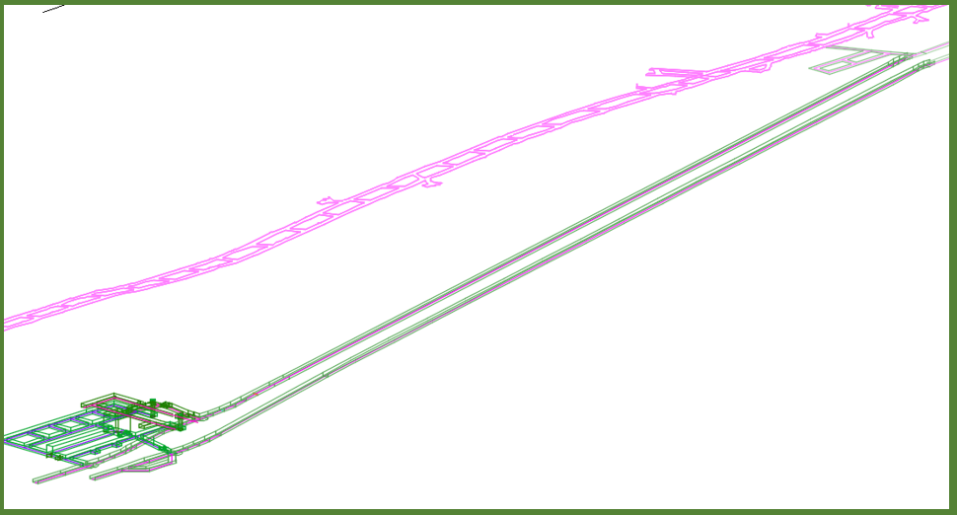
Site and Facility Design and Planning - Boulby
Stage 1 Manufacturing site
XLZD experiment aim to have access to underground laboratory site by 2030
BDP Team are exploring the option to split the new build into 2 phases
  Stage 1 – New manufacturing site by 2028
  Stage 2 – New underground laboratory by 2030
Preliminary estimate for build time
  Stage 1 - ~100wks to completion
  Stage 2 - ~296wks to completion (including roadways)
Stage 2 Laboratory

Slide 22
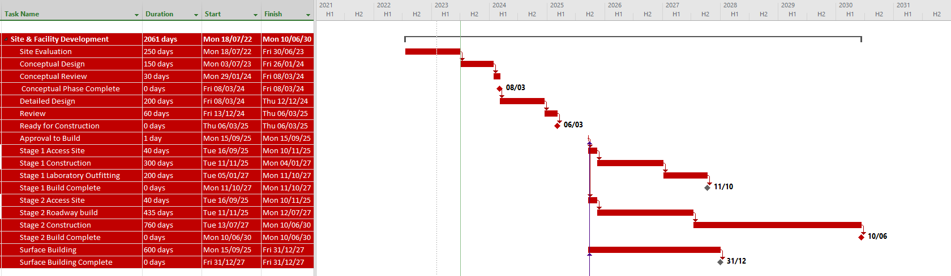
Site and Facility Design and Planning - Boulby 2025/26 Build Start
Complete Conceptual Phase March 2024*
Construction Ready Design March 2025*
Underground Laboratory Build Complete June 2030*
Manufacturing Facility Complete October 2027*
Surface Building Complete December 2027*
*Preliminary Estimates

Slide 23
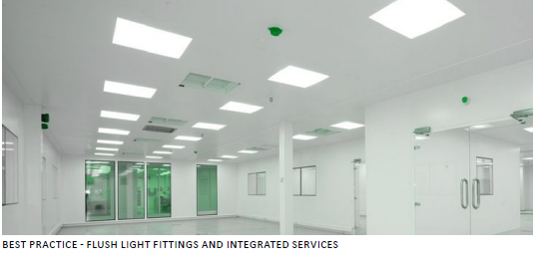
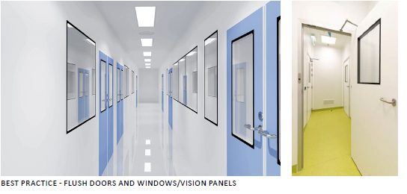
Site and Facility Design and Planning –
Laboratory Build Complete Status
Build complete status includes outfitting of the spaces, clean room barriers, roller doors, power and welfare facilities .

Slide 24
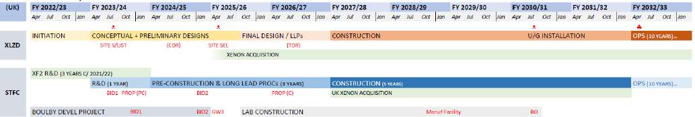
XLZD Experiment
A key milestone is site selection in 2025, associated with inter-agency agreements and IF investments decisions for both Boulby and XLZD construction: achieving investment decisions in 2025 is essential for a deployment at Boulby to remain competitive – Statement from XLZD SOI
Boulby Development Programme schedule meets the timescale put forward by XLZD team

Slide 25
Boulby Infrastructure Advisory Scheme
The aim of the scheme is to fund teams or individuals to support the development of the requirements for a new UK laboratory facility. Ensuring a broad range of underground science can be fully accommodated and supported in the facility.
Applicants needed to demonstrate that any project idea was aimed at supporting the working the development of a new underground laboratory.
Panel review has been completed and final written feedback is being prepared.
Successful applicants will be notified in the next ~2 weeks

Slide 26
Summary
The new laboratory construction project is planned to be completed by 2030 with a new manufacturing facility by 2028 with major construction started in 2025/26.
XLZD could be hosted in the UK within the timescales proposed by the XLZD consortium.
STFC supportive of the Boulby Development and XLZD@Boulby

Slide 27
Key Programme Contacts
Grahame Blair, Executive Director Programme Directorate
Jenny Hiscock, Acting Associate Director Particle Astrophysics and Nuclear Physics
Jamie Parkin, Head of Nuclear Physics and Particle Astrophysics
Sarah Verth, Associate Director for Particle Physics
Karen Clifford, Head of Particle Physics
Jonathan Burns, Head of Programme Boulby Development
Jason Green, Associate Director Cross Cutting and International Programmes
Other key people are Mel Kidd, Jane Long, Lindsay Clarke, Nicole Ashman, Doranne Fernandes, and Jess Atkinson

