Slide 1
Continual Learning for HEP
Marco Barbone
m.barbone19@imperial.ac.uk

Slide 2
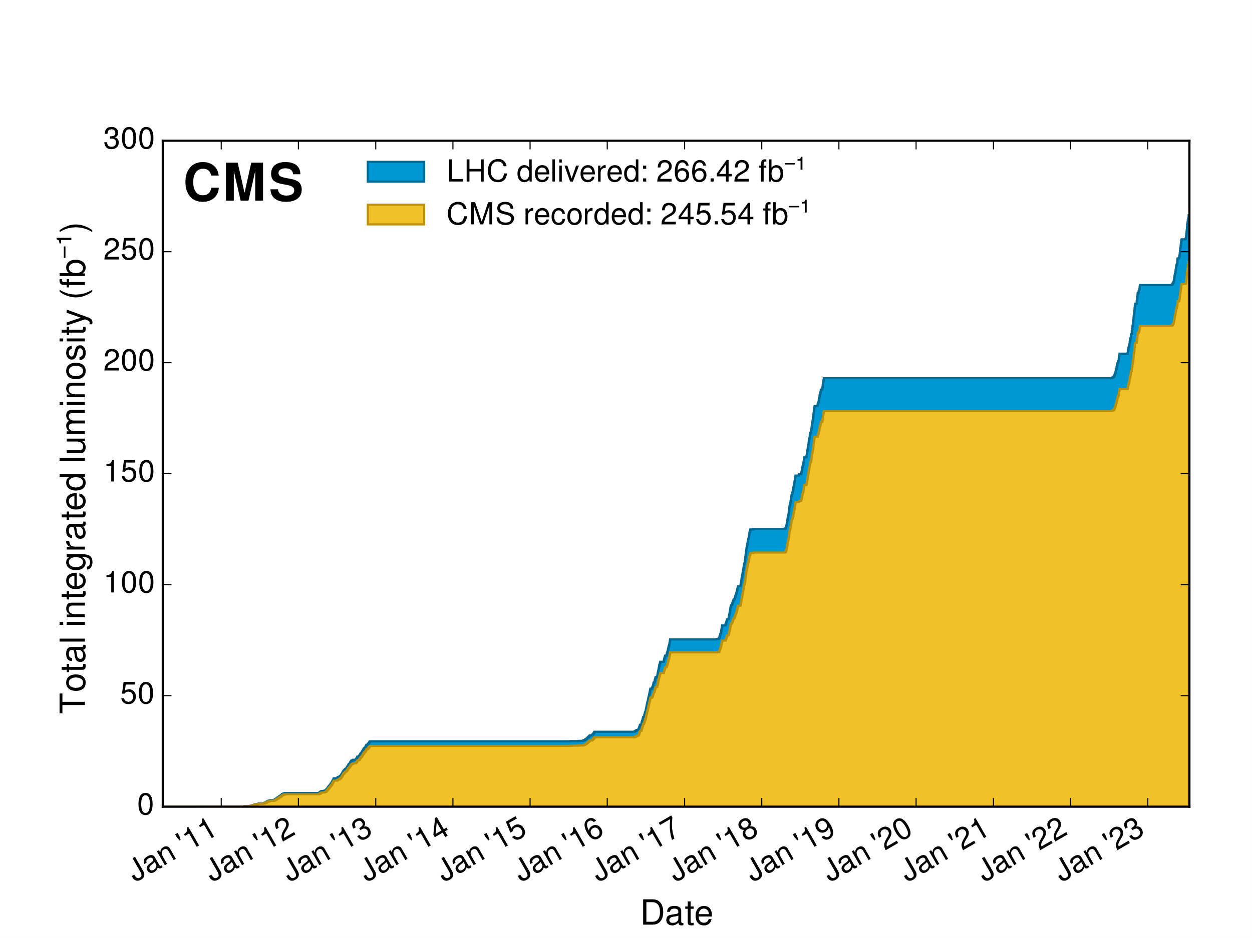
CMS detector degradation
Delivered and recoded luminosity
Radiation damages the sensors
https://twiki.cern.ch/twiki/bin/view/CMSPublic/LumiPublicResults

Slide 3
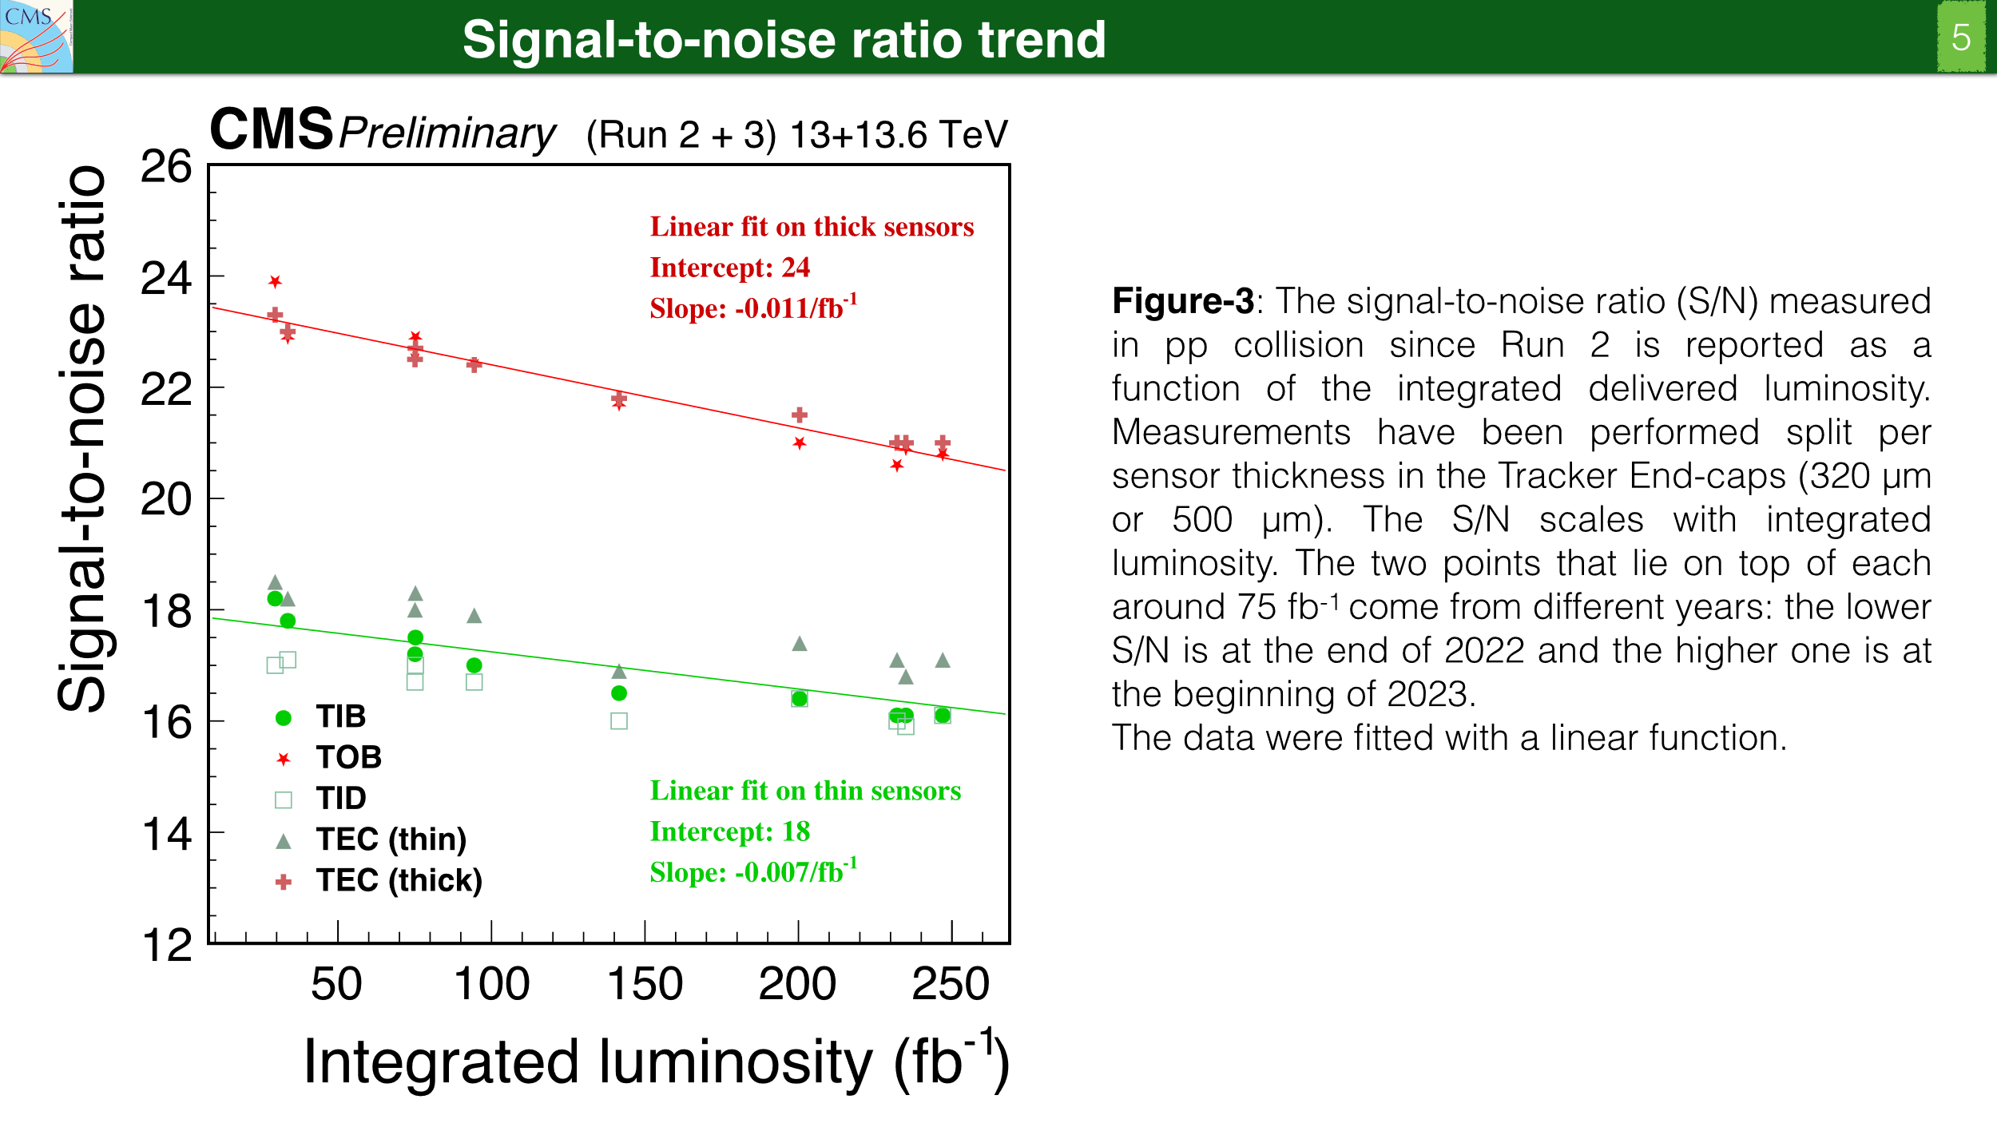
Source: https://cds.cern.ch/record/2865841/files/DP2023_040.pdf

Slide 4
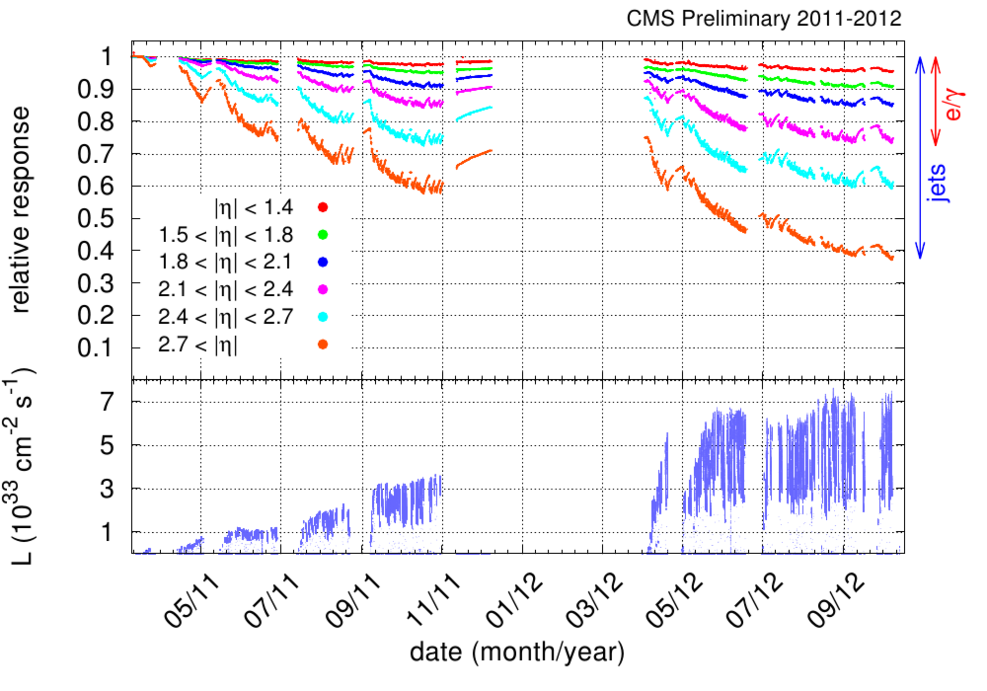
CMS ECAL relative response loss of response with time
CMS ECAL relative response to laser light (440 nm) versus time, averaged over all crystals in one given pseudorapidity bin, for the 2011 and 2012 data taking.
https://cds.cern.ch/record/1494093/plots

Slide 5
Continual learning
Continual learning (CL) is a particular machine learning paradigm where the data distribution and learning objective change through time, or where all the training data and objective criteria are never available at once.
The evolution of the learning process is modeled by a sequence of learning experiences where the goal is to be able to learn new skills all along the sequence without forgetting what has been previously learned.
https://arxiv.org/pdf/1907.00182.pdf

Slide 6
Motivation
Changes to the input distribution of a model can lead to a model being sub-optimal or invalid
Having to retrain a model offline means there is a loss of accuracy until the newly retrained model is online
Original training data might not be available anymore
Data is generated continuously and is impossible to store
Data cannot be generated:
  Simulation is too computationally expensive
  It is hard to predict the future

Slide 7
Online Learning
Online learning represents a family of machine learning methods, where a learner attempts to tackle some predictive (or any type of decision-making) task by learning from a sequence of data instances one by one at each time
https://www.sciencedirect.com/science/article/pii/S0925231221006706

Slide 8
Online Learning
It may suffer from catastrophic forgetting.
Catastrophic forgetting: the model abruptly forgets the information of the past when trained on new tasks.
https://arxiv.org/pdf/2202.00275.pdf

Slide 9
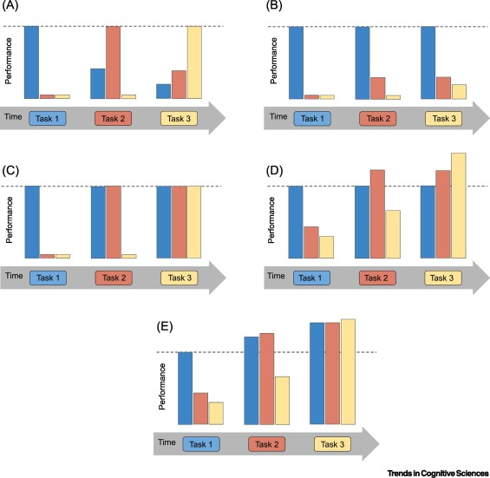
CL outcomes
Catastrophic forgetting
Too little plasticity
No forgetting
No forgetting + forward transfer
No forgetting + forward transfer + backward transfer
https://www.cell.com/trends/cognitive-sciences/fulltext/S1364-66132030219-9#secst0025

Slide 10
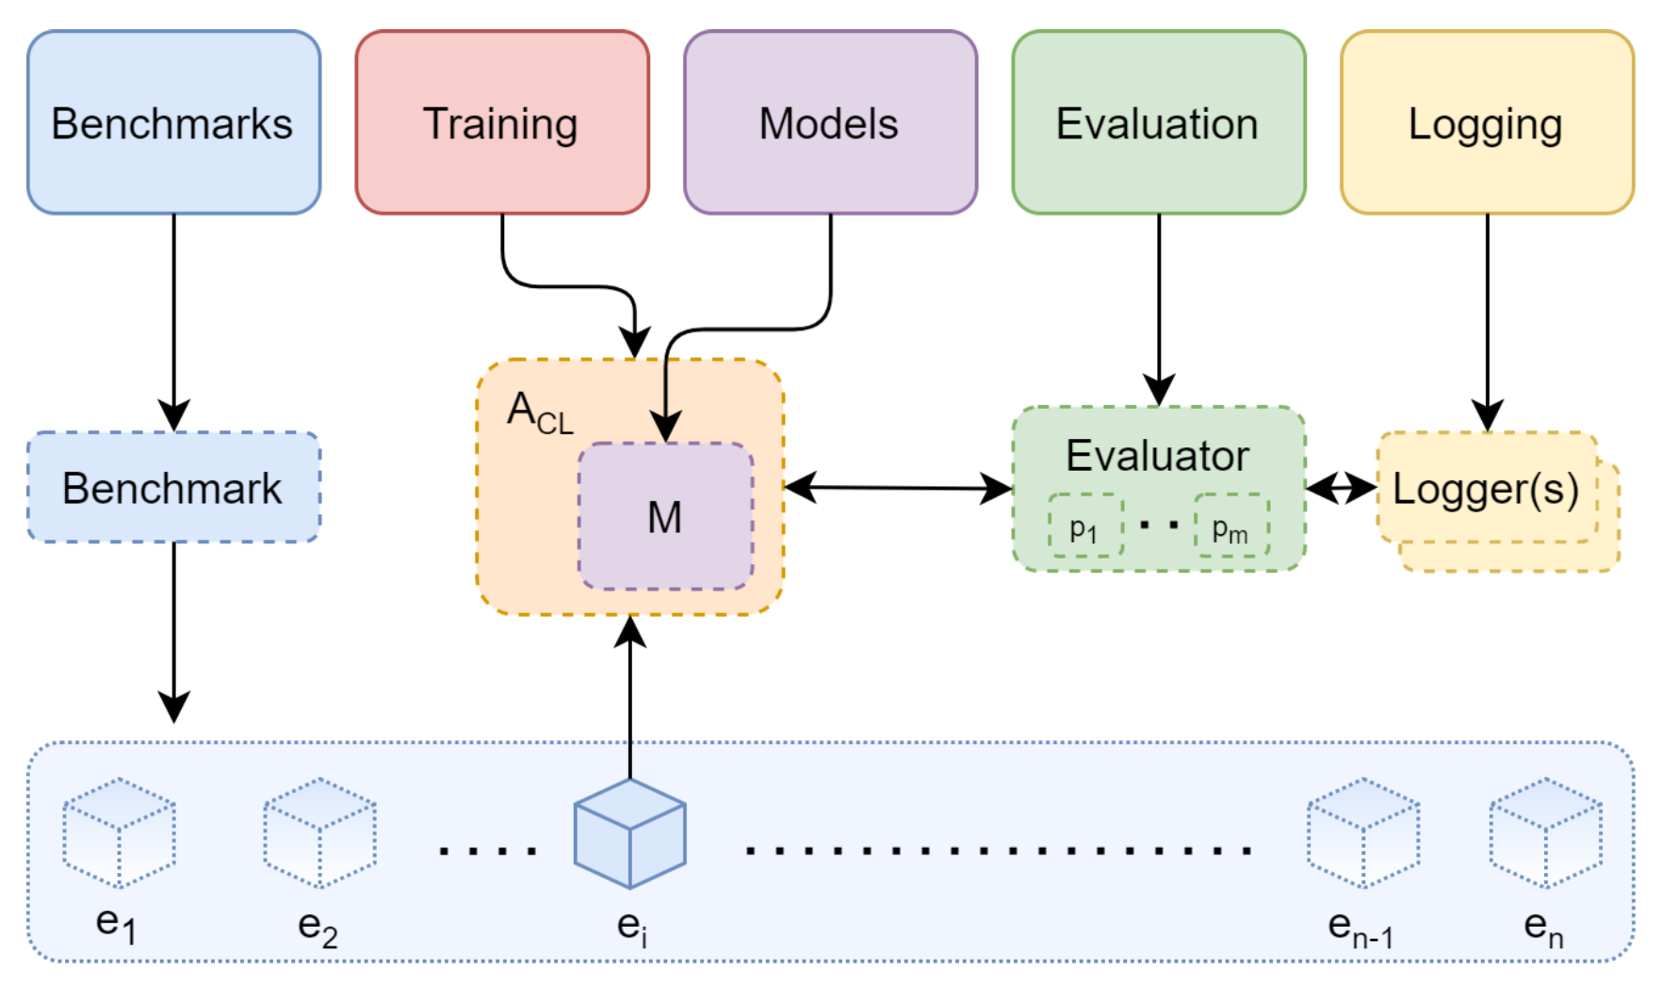
Continual Learning (CL)
CL Algorithm
[ref]
Concept: Train a model with a continuous stream of data
Learns from a sequence of partial experiences rather than all the data at once
Advantages:
Avoids catastrophic forgetting → initial training is not disregarded
Adapts to a changing data stream → don’t need to quantify how the environment changes
Don’t need to store previous training data or retrain model
Disadvantages:
For supervised learning need a ~continual stream of labelled data which might not be accessible
Inference is more expensive
Non-stationary stream of experiences
C. Brown Deployment of ML in Changing Environments
Notes:
Def: Catastrophic forgetting: nn forget old info when learning new

Slide 11
CL strategies
Dynamic architecture approaches:
  Explicit architecture modification
  Implicit architecture modification
  Dual architectures
Regularization Approaches:
  Penalty computing
  Knowledge Distillation
Replay
Generative Replay
Hybrid Approaches
https://arxiv.org/pdf/1907.00182.pdf

Slide 12
Explicit architecture modification
Progressive NNs [ref]: for each new task to be learned, a new model is created connected to all past ones.
  the growth of parameters is quadratic w.r.t. the number of tasks
Growing NNs [ref]: dynamically extend layers or deepen the network
Learning without Forgetting (LWF) [ref]: dynamically adding neurons for new tasks. Output layers can be added in order not to change output parameters from previous tasks.
Notes:
LWF similar to joint training but it does not train on old data. It is more like knowledge distillation where the new data is assigned a label with the old network. Then a new branch in the network is added with the correct label for the new data

Slide 13
Implicit Architecture Modification
Dynamically freezing weights that are not changed when learning a new task
Frozen weights are not changed by the backpropagation but are used in the forward pass
  Difficult to balance the number of frozen weights
Piggyback [ref]: learn binary masks to freeze weights
PackNet [ref]: iteratively pruning unimportant weights and fine-tuning them for learning new tasks

Slide 14
Dual networks
Emulates the human brain:
  Hippocampus = short term memory (STM)
  Neocortex = long term memory (LTM)
DGDMN [ref]:
  If a new task is learnt an STM is assigned to it
  When all the STM are exhausted, they are consolidated in LTM to be freed

Slide 15
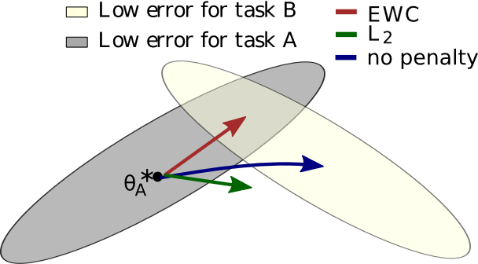
Penalty Computing
Elastic Weight Consolidation (EWC) [ref]: searching for important weights inside the models and protect them afterwards to prevent forgetting.

Slide 16
Penalty Computing (cont’d)
Synaptic Intelligence (SI) [ref]:
  endows each individual synapse with a local measure of “importance” in solving tasks the network has been trained on in the past;
  when training on a new task we penalize changes to important parameters to avoid old memories from being overwritten.

Slide 17
Knowledge distillation
After A has learned to solve a task, train B to solve the same task
Forward the same input to both A and B and impose B to have the same output as A
Distillation should be more efficient than retraining B because A produces a soft-target that helps B to learn faster
In continual learning, after network A learned to solve the old task, distill knowledge from A to B while B is learning a new task. B should learn how to solve both tasks.
https://arxiv.org/abs/1503.02531, https://arxiv.org/pdf/1907.00182.pdf

Slide 18
Pure Rehearsal (replay)
Save past samples as memory of past tasks
  Samples needs to be carefully chosen and sorted
Interleave previous data with new data as model is trained
Might require large storage
Privacy concerns
https://hal.science/hal-01951954/document

Slide 19
Generative Replay
Replay, but instead of storing samples, it trains a generative model on the data distribution
One example is to use dual networks:
  One frozen model generates samples from past experiences
  Another learns to generate and classify actual samples in addition to the regenerated ones.
  When a task is over, replace the frozen model by the actual one, freeze it, and initialize a new model to learn next task
https://arxiv.org/abs/1710.10368

Slide 20
Starting point
Replay with reservoir sampling

Slide 21
Tools and frameworks

Slide 22
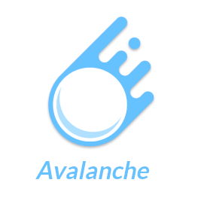

Tools and frameworks
https://pytorch.org/
https://avalanche.continualai.org/
https://arxiv.org/pdf/2104.00405.pdf

Slide 23
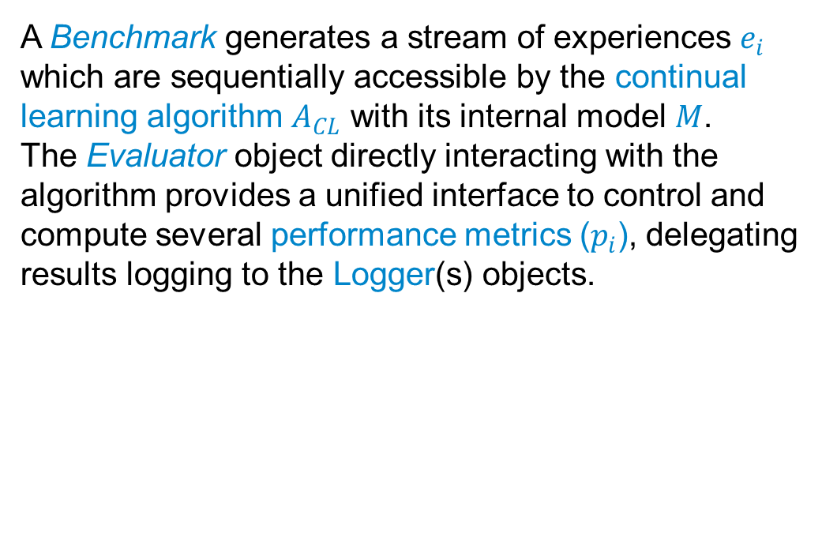
Avalanche
CL Algorithm
[ref]
A Benchmark generates a stream of experiences $e_{i}$ which are sequentially accessible by the continual learning algorithm $A_{CL}$ with its internal model $M$.
The Evaluator object directly interacting with the algorithm provides a unified interface to control and compute several performance metrics ($p_{i}$), delegating results logging to the Logger(s) objects.
Non-stationary stream of experiences
https://arxiv.org/pdf/2104.00405.pdf
Notes:
Def: Catastrophic forgetting: nn forget old info when learning new

Slide 24
Avalanche
CL Algorithm
[ref]
Benchmarks
Model architecture
CL strategy
Metrics
Logger
Non-stationary stream of experiences
https://arxiv.org/pdf/2104.00405.pdf
Notes:
Def: Catastrophic forgetting: nn forget old info when learning new

Slide 25
Benchmark
Dataset: collection of examples
Scenario: specificities about the continual stream of data, a continual learning algorithm will face
Benchmark: combination of a scenario with one or multiple datasets
Need to specify training and test experiences and task labels
The benchmark provides train stream and test stream
https://avalanche.continualai.org/from-zero-to-hero-tutorial/03_benchmarks

Slide 26
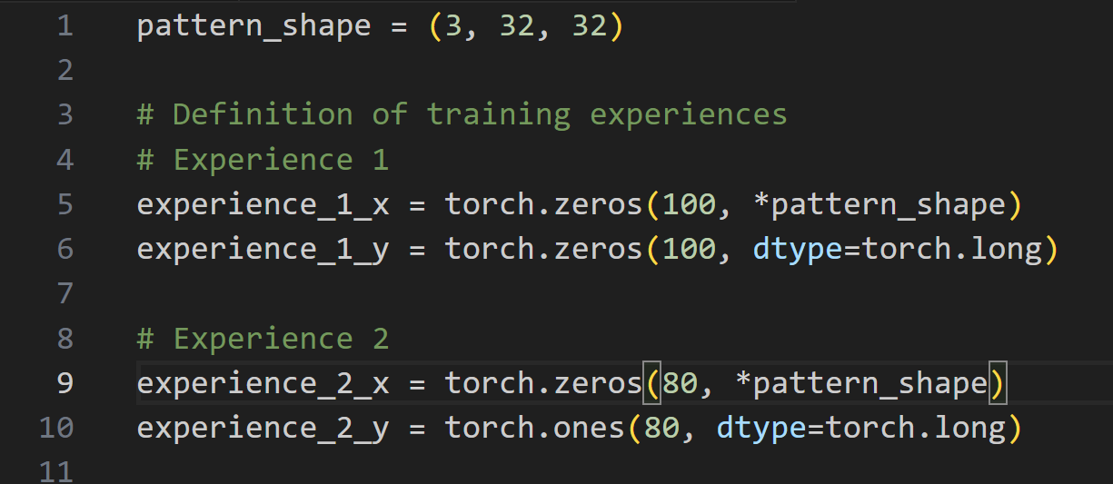
Benchmark
https://avalanche.continualai.org/from-zero-to-hero-tutorial/03_benchmarks

Slide 27
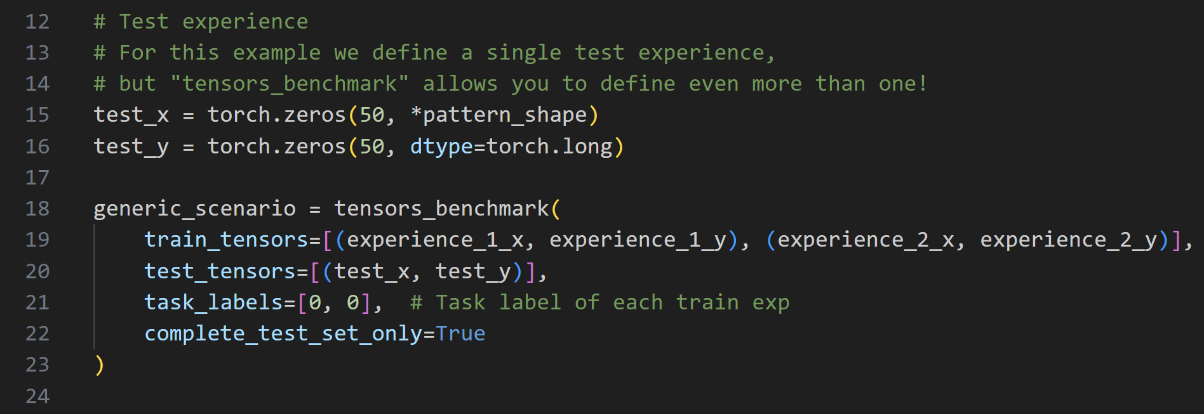
Benchmark
https://avalanche.continualai.org/from-zero-to-hero-tutorial/03_benchmarks

Slide 28
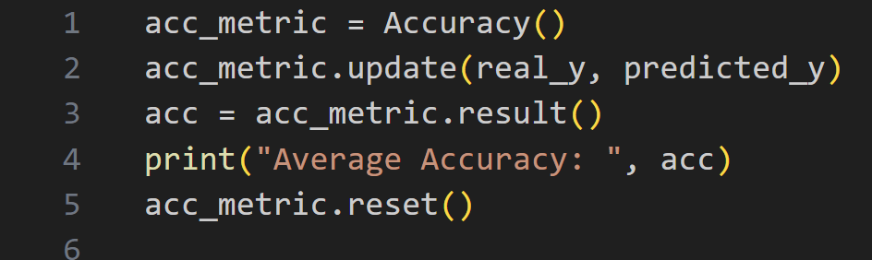
Standalone Metrics
https://avalanche.continualai.org/from-zero-to-hero-tutorial/05_evaluation

Slide 29
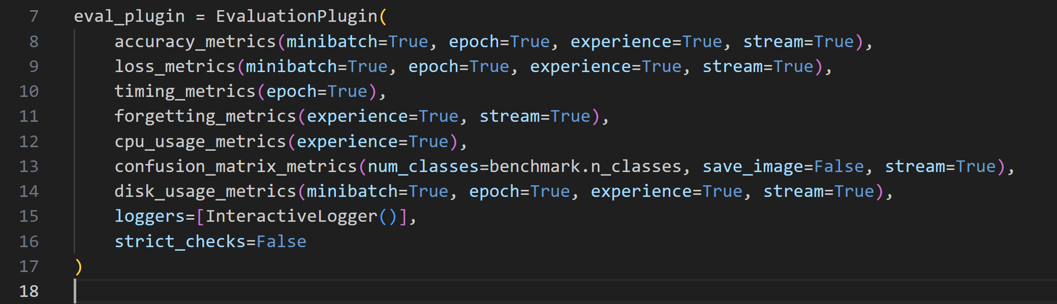
Plugin Metrics
https://avalanche.continualai.org/from-zero-to-hero-tutorial/05_evaluation

Slide 30
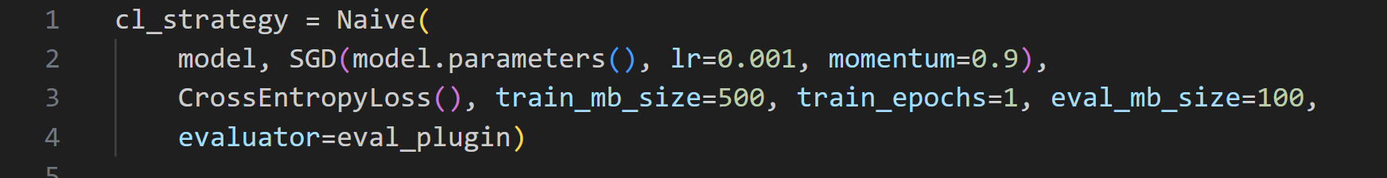
Strategy
They usually take only three parameters:
Model: this must be a torch.nn.Module.
Optimizer: torch.optim.Optimizer already initialized on your model.
Loss: a loss function such as those in torch.nn.functional.
Evaluator: computes performance metrics
https://avalanche.continualai.org/from-zero-to-hero-tutorial/04_training

Slide 31
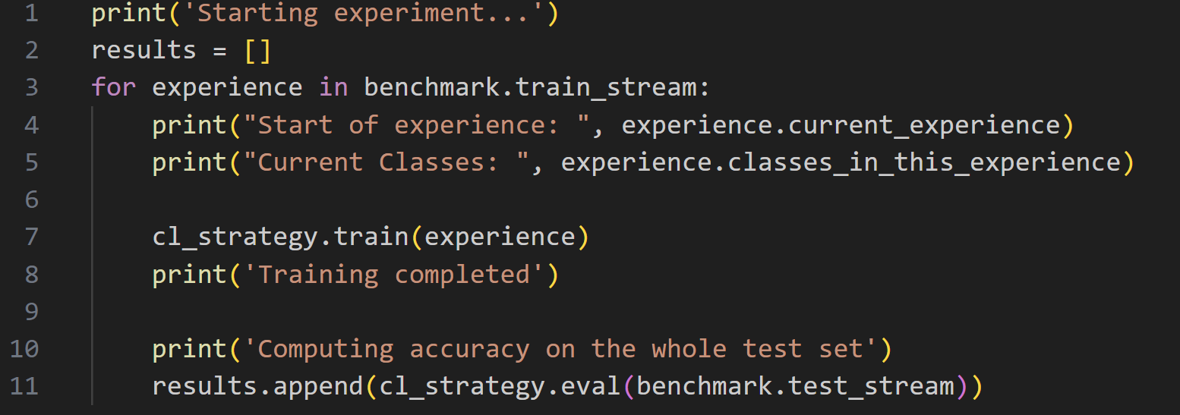
Training loop
https://avalanche.continualai.org/from-zero-to-hero-tutorial/04_training

Slide 32
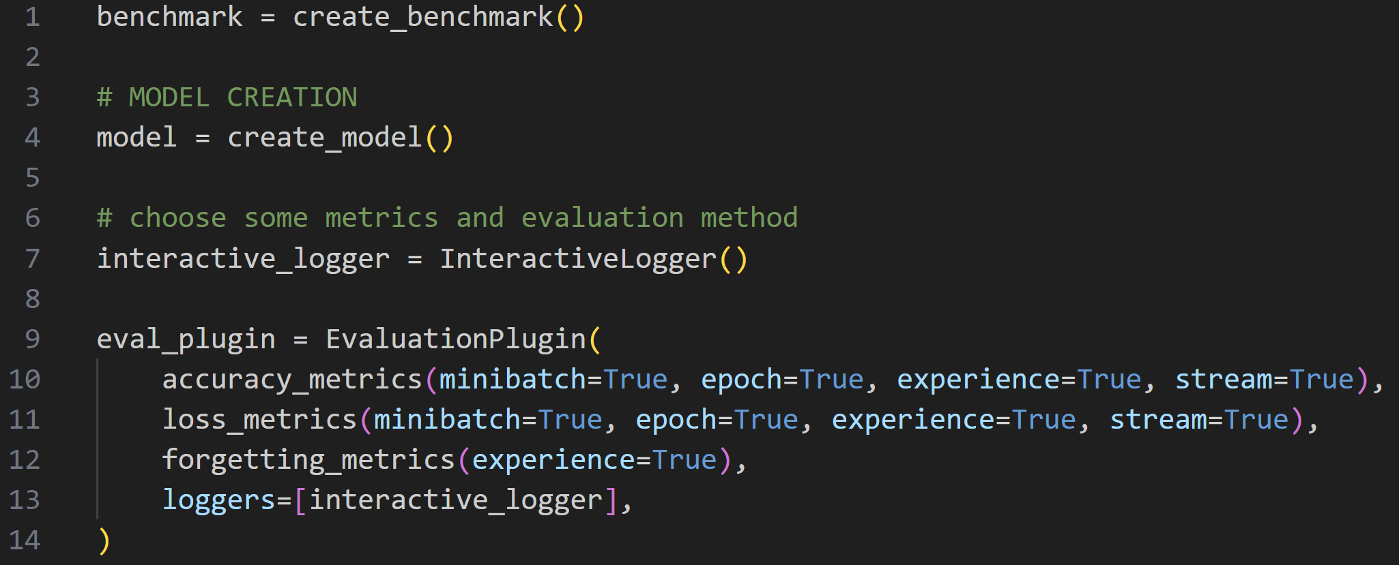
Full example – Metrics

Slide 33
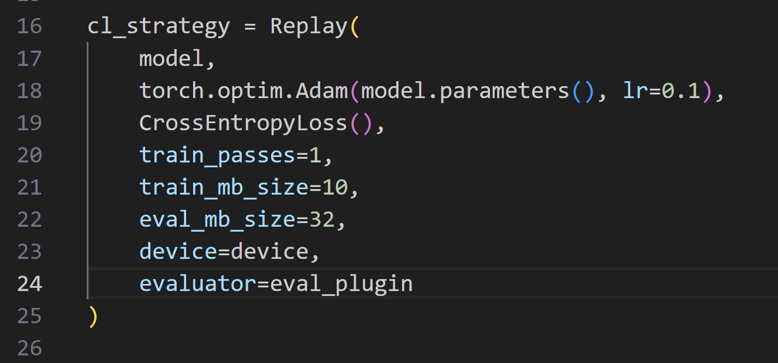
Full example – CL strategy

Slide 34
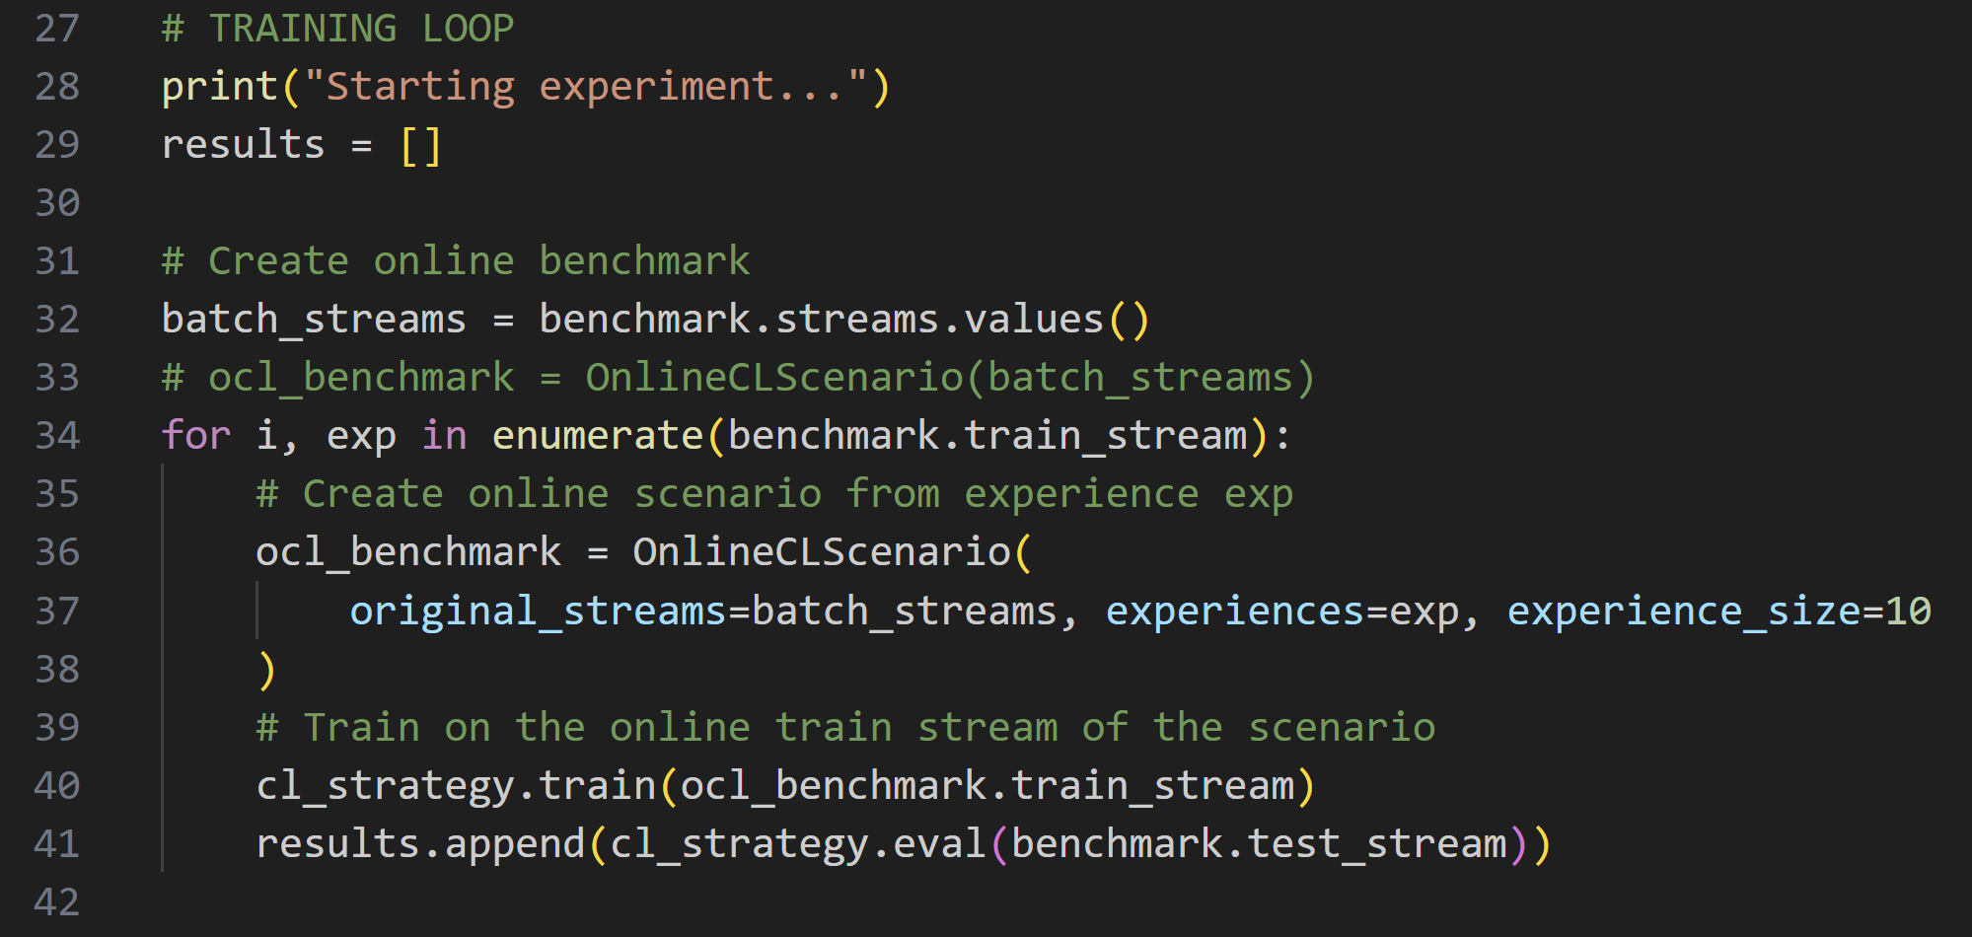
Full example – training loop

Slide 35
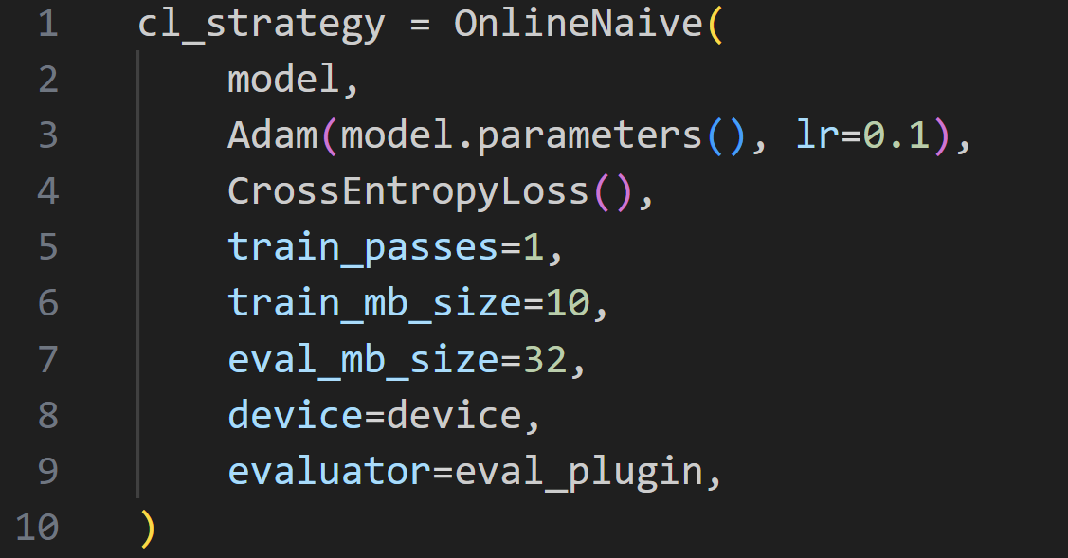
Full example – Naïve baseline

Slide 36
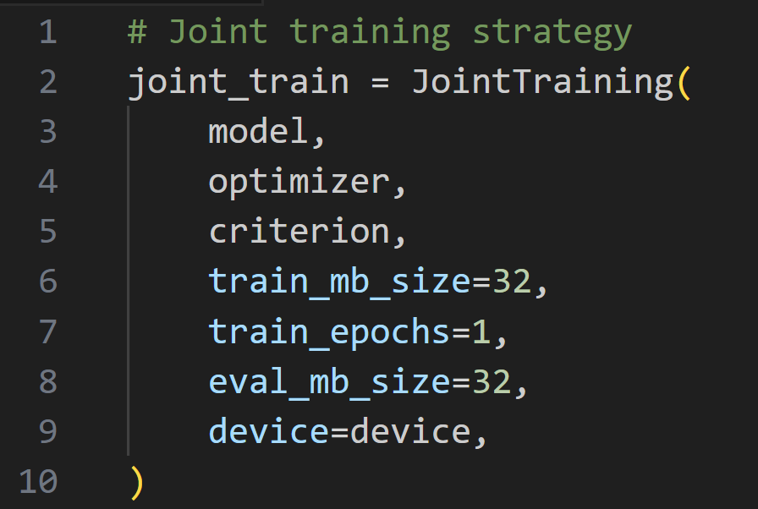
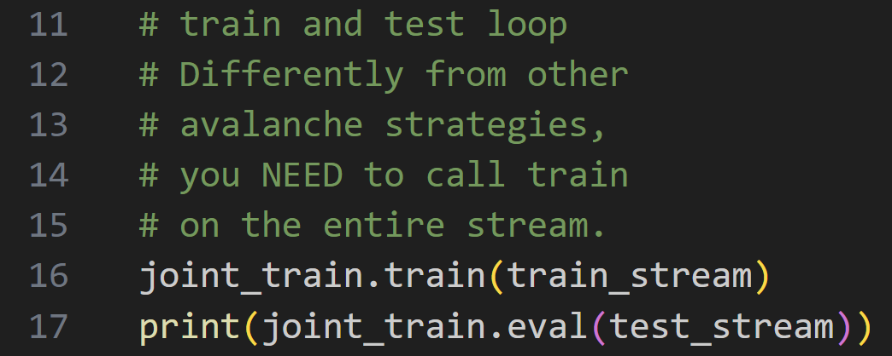
Full example – Joint

Slide 37
Thanks for the attention!

