Slide 1
GPU acceleration of MixMax RNG
(plus other improvements over other improvements)
Marco Barbone & Andy Rose

Slide 2
What is MixMax?
The MIXMAX generator is a family of pseudorandom number generators (PRNG) and is based on Anosov C-systems (Anosov diffeomorphism) and Kolmogorov K-systems (Kolmogorov automorphism).
(courtesy of Andy Rose)

Slide 3
What is MixMax?
The MIXMAX generator is a family of pseudorandom number generators (PRNG) and is based on Anosov C-systems (Anosov diffeomorphism) and Kolmogorov K-systems (Kolmogorov automorphism).
TLDR: It is apparently a very good PRNG
(Blatant plagiarism… I liked the joke)

Slide 4
The original code
Had some interesting stylistic choices.
This might confuse some compilers too.

Slide 5
Previously
MixMax has been cleaned up
It also improved performance on CPU

Slide 6
A software engineer approach
Some more cleanup.
“Portable optimizations”

Slide 7
Results
% vs original Compiler | Clean (Andy) | More clean (Andy) | Marco
clang 14 | 31 | 50 | -4
clang 13 | 33 | 51 | -6
gcc 12 | 25 | -18 | -17
gcc 11 | 25 | -17 | -16

Slide 8
Portability
Performance is consistently higher
Andy’s version remains the fastest on absolute term

Slide 9
Advanced Software engineering
Should I skip this part?

Slide 10
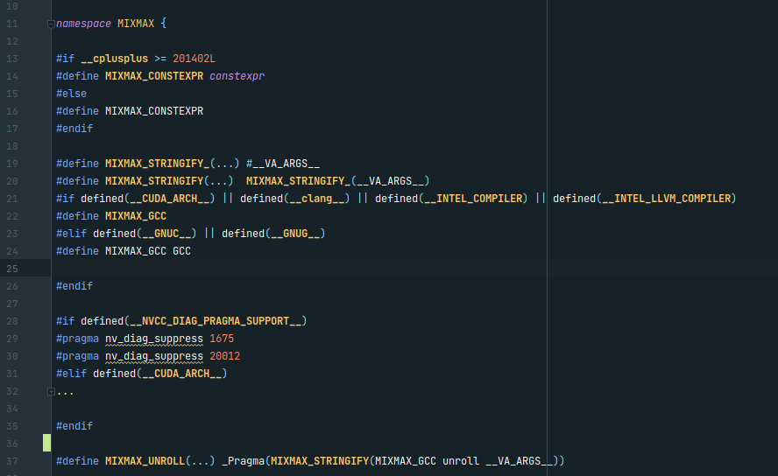
Pt 1: Macros & Pragmas

Slide 11
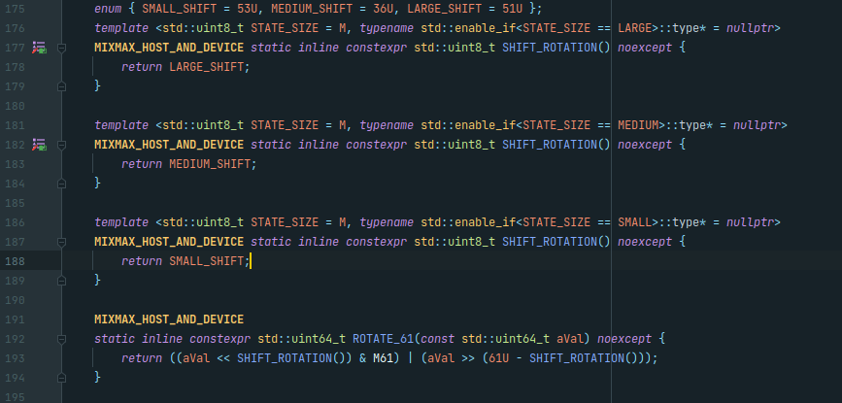
Pt2: sfinae

Slide 12
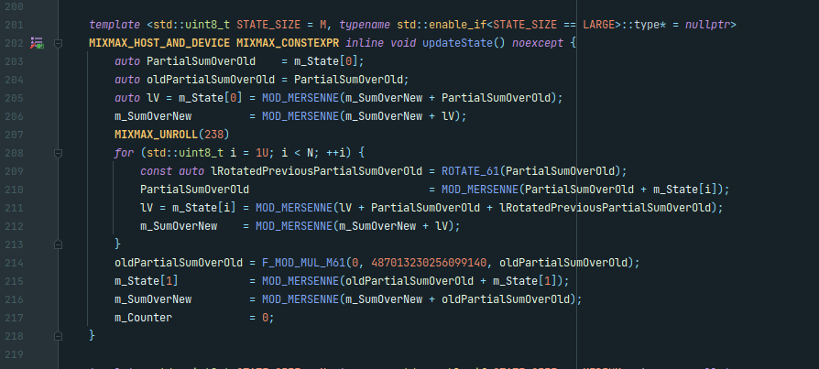
Unroll

Slide 13
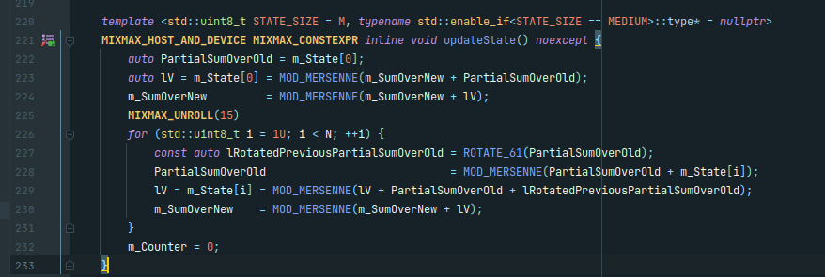
unroll + sfinae

Slide 14
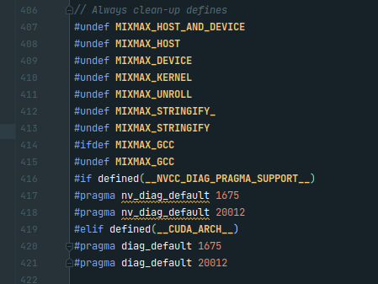
Cleanup

Slide 15
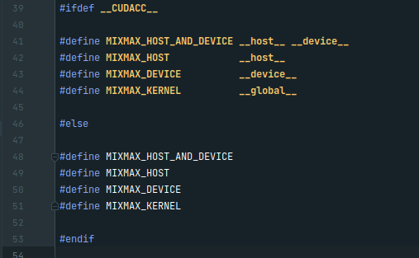
The GPU implementation?

Slide 16
Results
Parameters
Threads | Blocks | Parallelism | iterations | Total numbers | Total bits
128 | 984 | 125,952 | 2,147,483,648 | 270,479,860,432,896 | 17,310,711,067,705,300
Algorithm | time (ms) | time/iteration (ns) | % vs mixmax<8>
Philox4_32_10 | 23144 | 10.78 | -7.03
MRG32k3a | 15203 | 7.08 | -38.93
XORWOW | 23206 | 10.81 | -6.78
MixMaxGPU<240> | 55294 | 25.75 | 122.11
MixMaxGPU<17> | 30800 | 14.34 | 23.72
MixMaxGPU<8> | 24895 | 11.59 | 0
iteration = generating 125,952 numbers

Slide 17
Against Mersenne twister for GPU (MTGP32)
Parameters
Threads | Blocks | Parallelism | iterations | Total numbers | Total bits
256.00 | 128.00 | 32,768 | 2,147,483,648 | 70,368,744,177,664 | 4,503,599,627,370,500
Algorithm | time (ms) | time/iteration (ns) | % vs mixmax8 | Speedup
MTGP32 | 81161 | 37.79 | 1341.84 | 1
Philox4_32_10 | 7803 | 3.63 | 38.62 | 10
MRG32k3a | 5092 | 2.37 | -9.54 | 16
XORWOW | 7731 | 3.60 | 37.34 | 10
MixMaxGPU<240> | 15996 | 7.45 | 184.17 | 5
MixMaxGPU<17> | 6075 | 2.83 | 7.92 | 13
MixMaxGPU<8> | 5629 | 2.62 | 0 | 14
iteration = generating 32768 numbers

Slide 18
Conclusions
MixMax can be 14 times faster than MTGP32
It has comparable performance to low-quality generators while producing high-quality numbers
Possible improvements: state sharing

