Slide 1
MixMax for FPGA
(plus CPU improvements for good measure)
(and a GPU implementation while we were at it)
Andrew W. Rose
Marco Barbone

Slide 2
What is MixMax?
The MIXMAX generator is a family of pseudorandom number generators (PRNG) and is based on Anosov C-systems (Anosov diffeomorphism) and Kolmogorov K-systems (Kolmogorov automorphism).

Slide 3
What is MixMax?
The MIXMAX generator is a family of pseudorandom number generators (PRNG) and is based on Anosov C-systems (Anosov diffeomorphism) and Kolmogorov K-systems (Kolmogorov automorphism).
It is apparently a very good PRNG

Slide 4
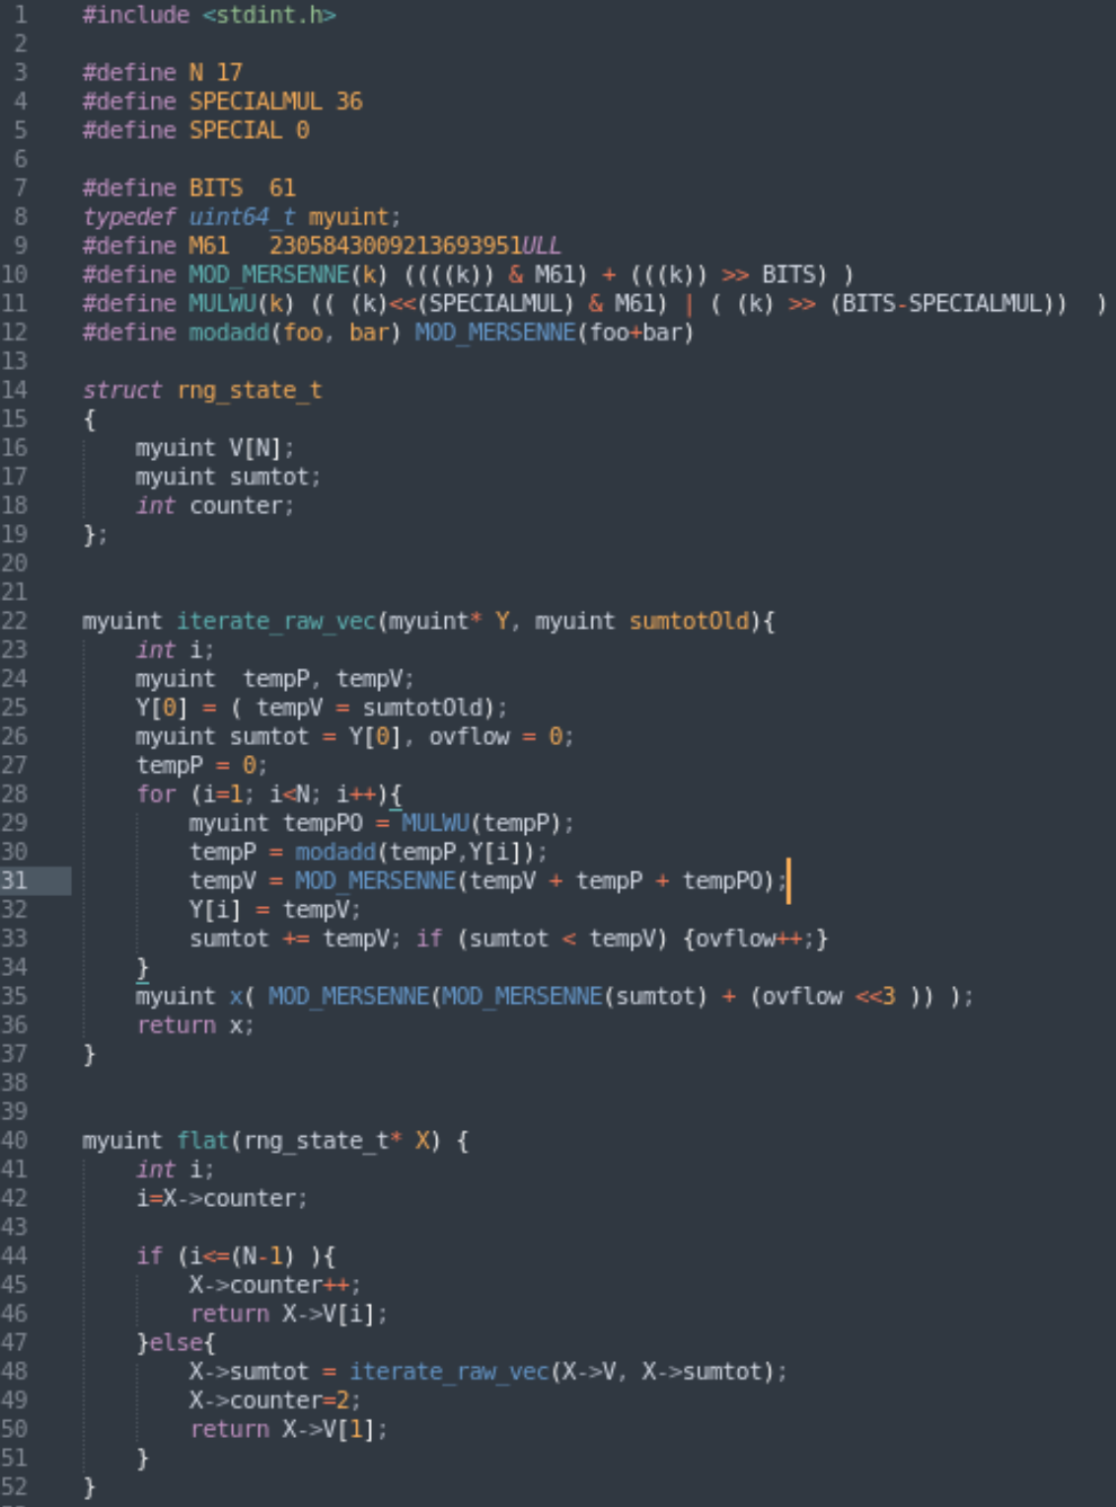

The original code
Like bad Fortran, only worse
Ludicrous pre-processor directives, typedefs
Functions separate to structs
Voodoo required to initialise the struct before first usage
  Marco found this the hard ways
Meaningless variable names
No comments

Slide 5
Can we use HLS to run this on an FPGA?

Slide 6
Can we use HLS to run this on an FPGA?
Errrr… No

Slide 7
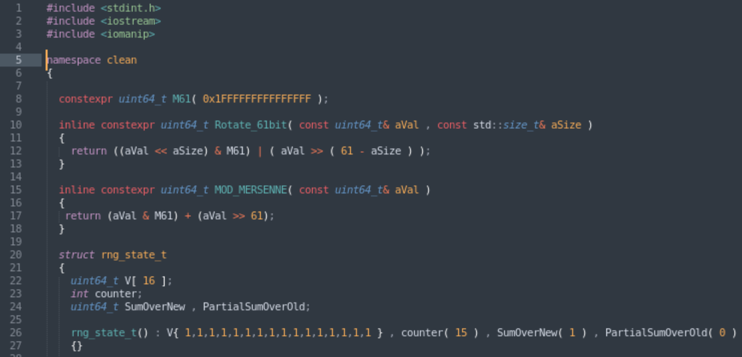
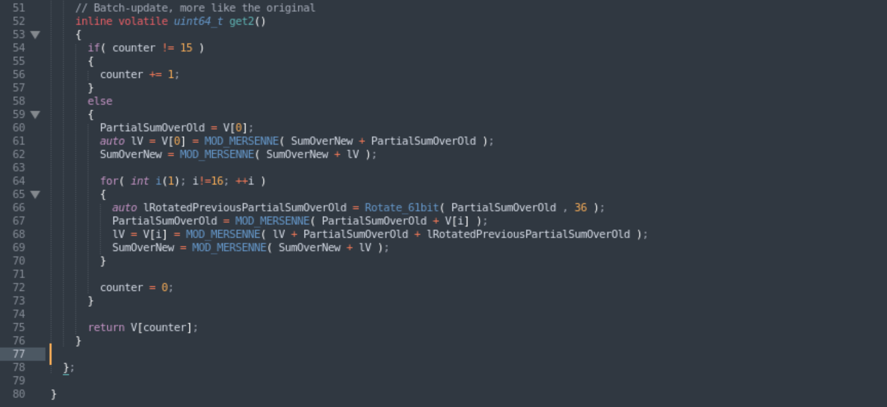
Tidying the code
Start with a nice clean C++11 implementation
Constructor ☺
No macros
Meaningful variable names
Probably better for GPU

Slide 8
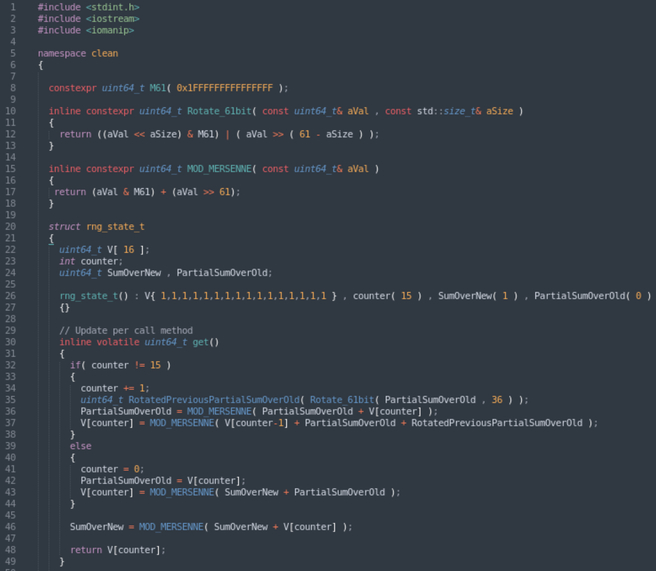
Tidying the code 2
Update on every clock, rather than batch-updating
Cleanest code

Slide 9
Performance
Compare original, clean1 (Cleanest code) and clean2 (GPU optimal)
10,000,000,000 iterations
Intel(R) Xeon(R) CPU E3-1240 v3 @ 3.40GHz
gcc (GCC) 4.8.5 20150623 (Red Hat 4.8.5-44) ← Centos 7 default, ancient
 | Runtime | Runtime/iteration | Speed-up
Original | 21,363,125,059ns | 2.13631ns/it | -
Clean 1 | 20,197,066,539ns | 2.01971ns/it | 5.77%
Clean 2 | 20,653,660,030ns | 2.06537ns/it | 3.44%

Slide 10
Tidying the code 3
Marco provided some pre-processor directives to speed things up
  No difference on gcc 4.8.5
Try a modern compiler
  gcc version 11.2.1 20220127 (Red Hat 11.2.1-9) (GCC)
Seems consistent over many tests
  Original implementation is SLOWER when built with modern compiler
  No speed-up on clean 1
 | Runtime | Runtime/iteration | Speed-up cf. Original | Speed-up cf. gcc 4.8.5
Original | 24,299,534,528ns | 2.42995ns/it | - | -14%
Clean 1 | 20,167,510,000ns | 2.01675ns/it | 20% | 0
Clean 2 | 18,405,493,905ns | 1.84055ns/it | 32% | 12%

Slide 11
Tidying the code 3a
Try also
  clang version 7.0.1 (tags/RELEASE_701/final)
  Part of LLVM toolset-7.0
Also ancient... Time to change distro's perhaps...
 | Runtime | Runtime/iteration
Original | 19,976,918,892ns | 1.99769ns/it
Clean 1 | 26,467,031,289ns | 2.6467ns/it
Clean 2 | 29,851,365,147ns | 2.98514ns/it
What the actual hell?!

Slide 12
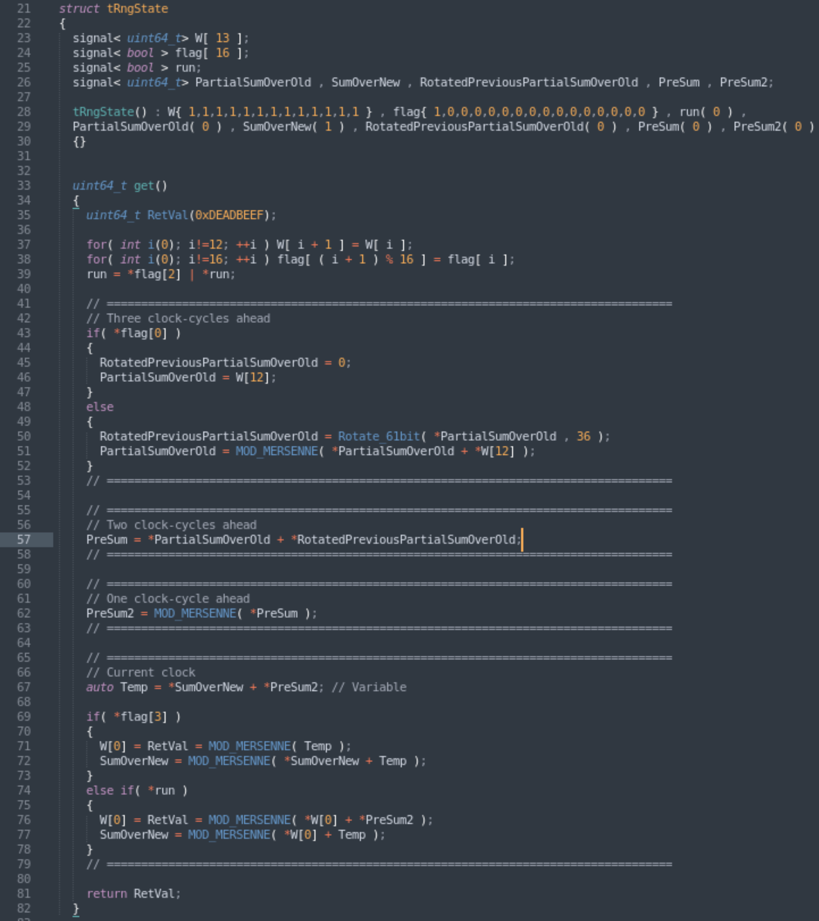
Tidying the code 4
Make a clock-cycle accurate model for simulating FPGA behaviour
Implements pipe-lining and look-ahead calculations
Not very efficient on CPU…

Slide 13
Tidying the code 4
Make a clock-cycle accurate model for simulating FPGA behaviour
Implements pipe-lining and look-ahead calculations
Not very efficient on CPU…
  but one-to-one translatable into VHDL

Slide 14
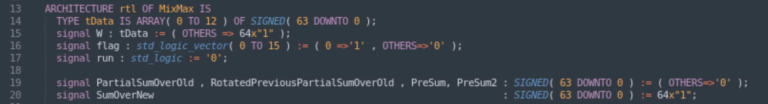
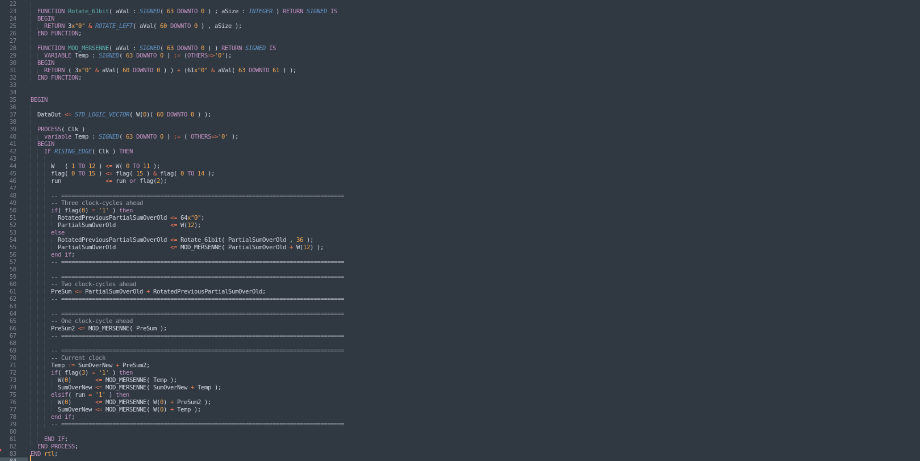
C++
VHDL

Slide 15
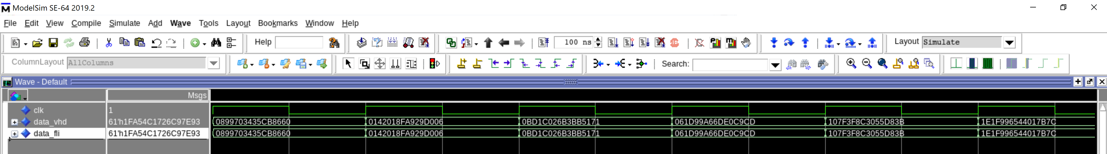
VHDL
A modelsim FLI module has been written to validate the VHDL against the C++
  Simulation will terminate upon mismatch
  Defaults to running for 2.5M clock-cycles (without error)

Slide 16
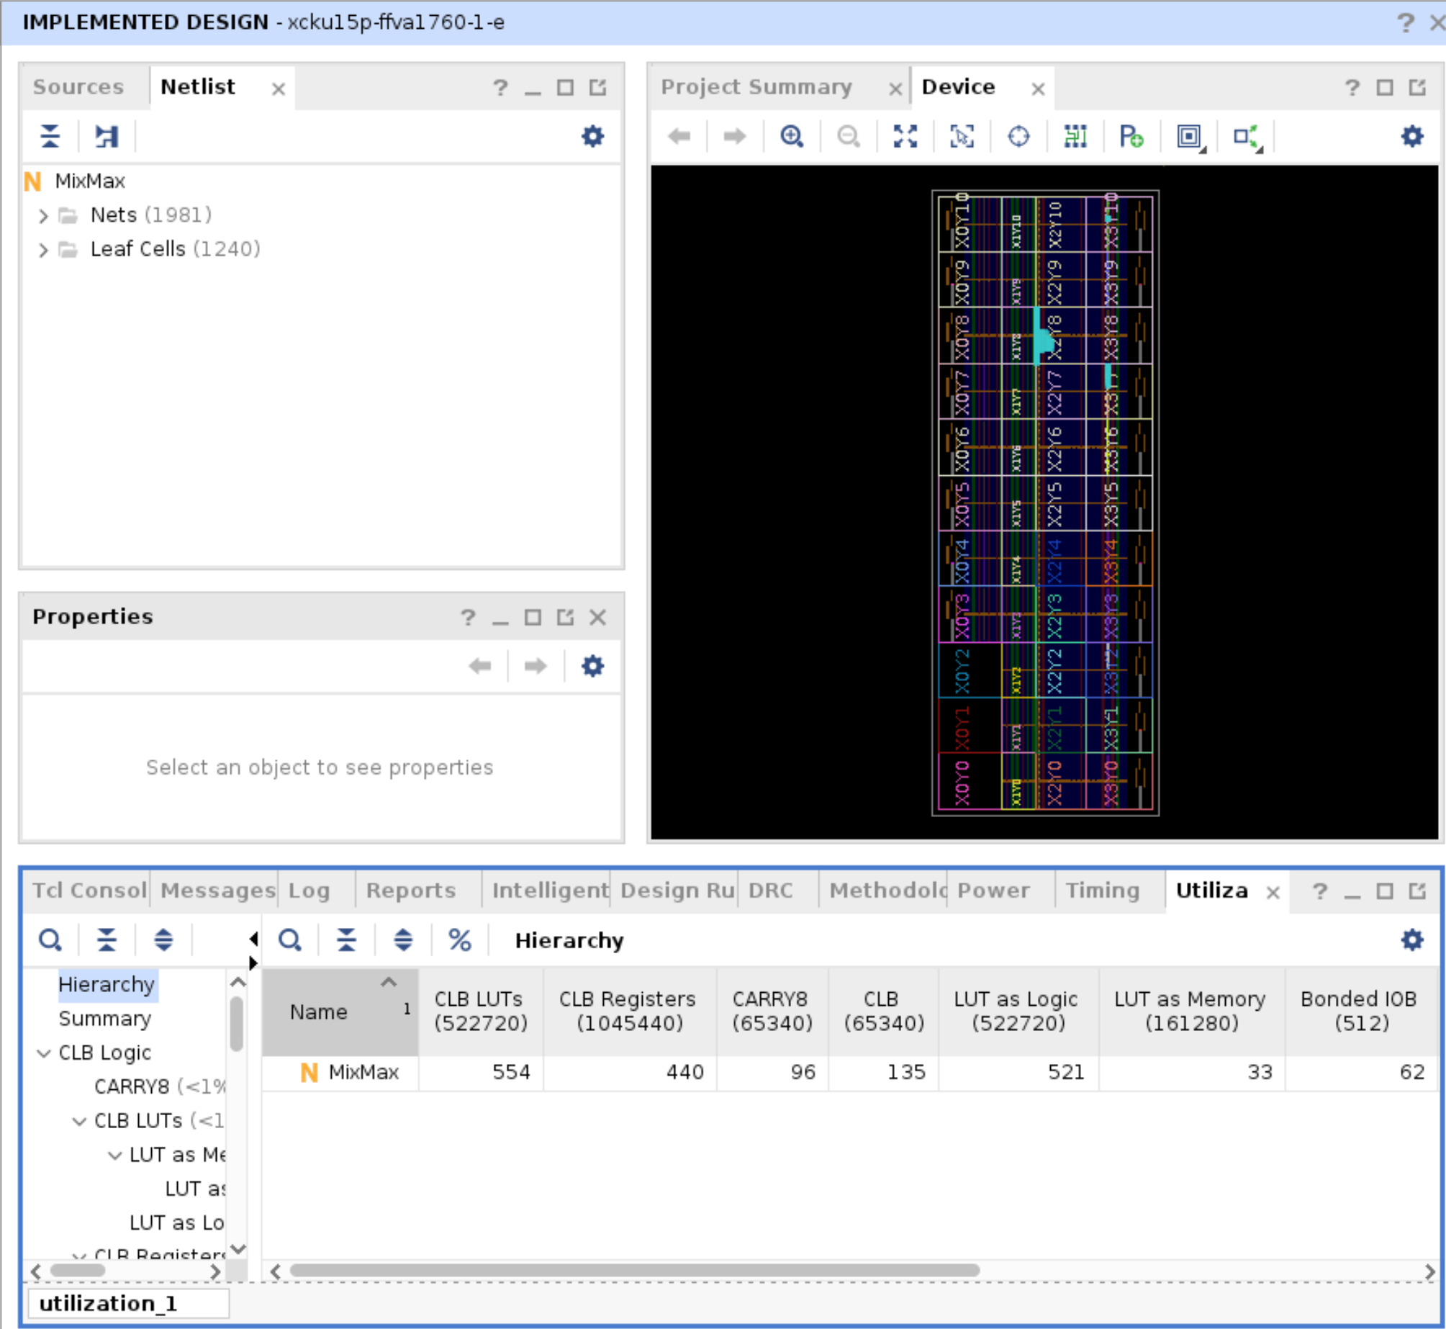
VHDL
Builds out-of-the-box
  Default Vivado settings
~550 LUTs
Meets timing at 300MHz

Slide 17
VHDL
Builds out-of-the-box
  Default Vivado settings
~550 LUTs
Meets timing at 300MHz
~10% endpoints fail to meet timing at 333MHz
Bottleneck is the fact that the code fundamentally uses a (non-trivial) accumulator structure
Can, *I BELIEVE*, use a look-ahead structure, but so gnarly that I have not yet got a working implementation. Worthwhile?

Slide 18
The magic makefile
“make” – builds all the standalone executable
“make modelsim” – launch and run the VHDL and FLI C++ in modelsim
“make vivado” – create a Vivado project and run implementation

Slide 19
How can I play with it
Publicly available on GitHub: https://github.com/Cefhalic/MixMax

Slide 20
GPU Preliminary results By Marco
C++ implementations Clean 1 and Clean 2 ported to CUDA
Timed against Curand
Clean 1 is expected to be slower on GPU as it has a branch
per-iteration!
 | Run 1 (ms) | Run 2 (ms) | Run 3 (ms) | Run 4 (ms) | Run 5 (ms)
CURAND | 245391 | 245980 | 245798 | 246094 | 245770
CLEAN 1 | 335664 | 335660 | 335523 | 335617 | 335612
CLEAN 2 | 189397 | 189437 | 189462 | 189549 | 189471
Preliminary

