Slide 1
Acceleration of a CMS DNN based Algorithm
N. Bhat, R. Bainbridge, M. Barbone, W. Luk, T. Ourida, A. Tapper
Notes:
Hello everyone, my name is Tarik Ourida and welcome to my presentation on the acceleration of a CMS DNN based algorithm.

Slide 2
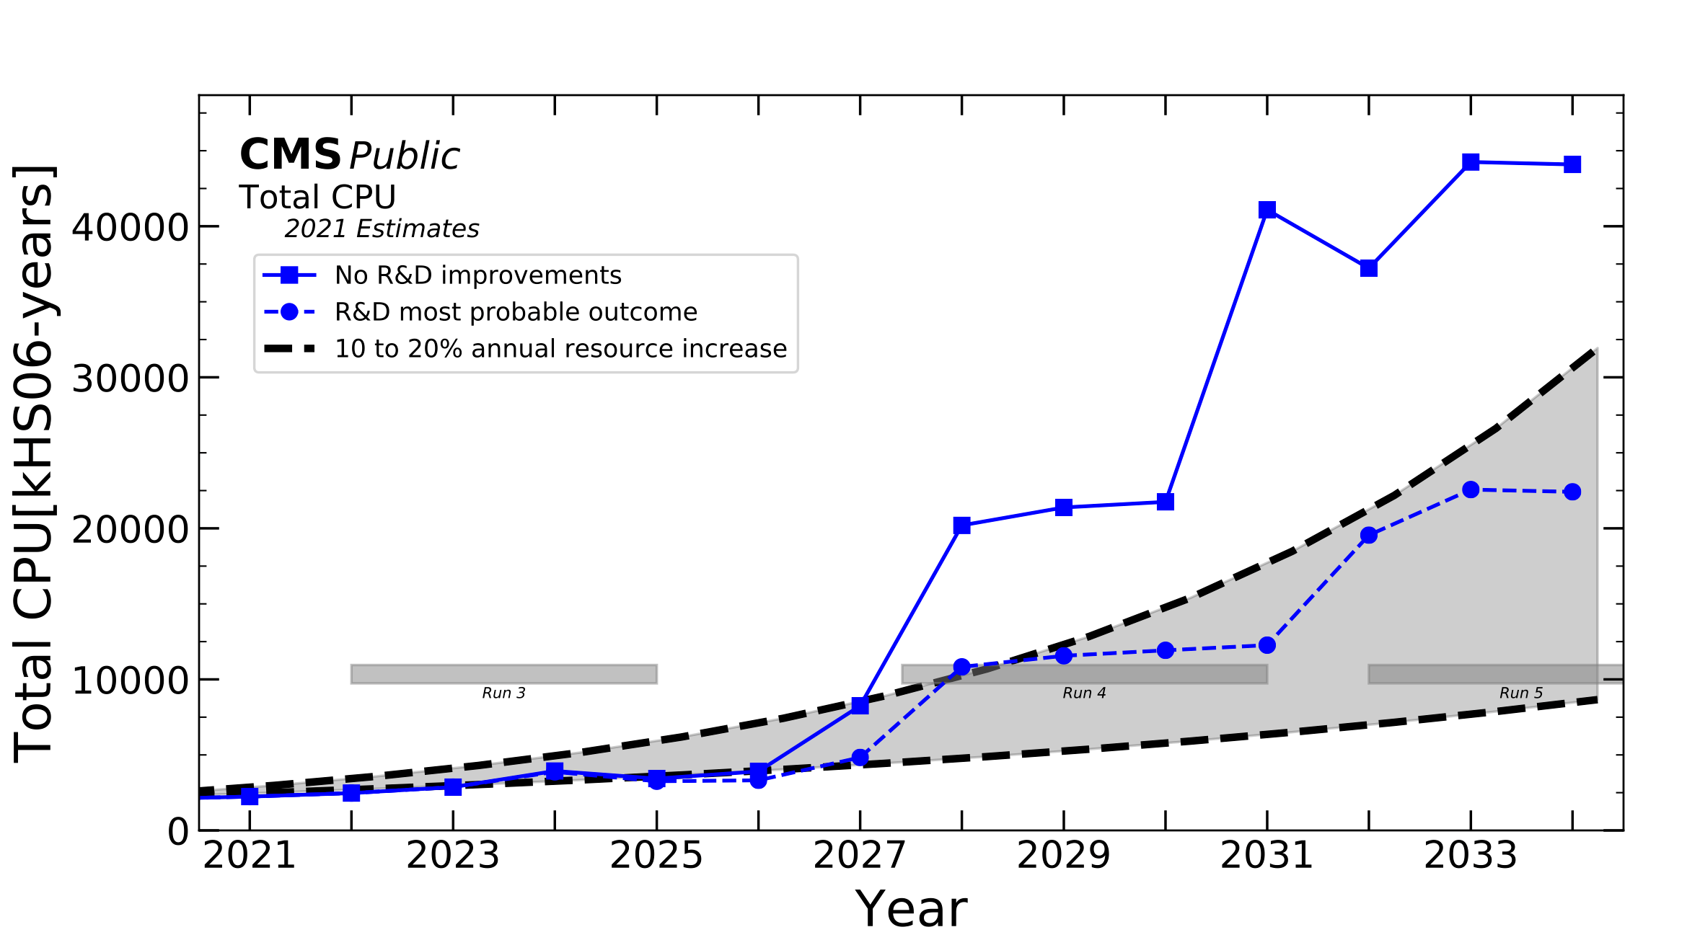
Motivation
Acceleration of a CMS DNN based Algorithm
Data rate set to increase with High-Luminosity LHC upgrade
Current approach not scalable to meet requirements of additional processing due to increased luminosity
https://twiki.cern.ch/twiki/bin/view/CMSPublic/CMSOfflineComputingResults
Notes:
With the approach of the high luminosity LHC upgrade, it is expected that the amount of data which is to be processed will increase in line with the increase in collision rate.
The current approach of duplicating CPU instances may not scale to meet the requirements of processing this additional data, hence why heterogeneous computational methods are to be explored.

Slide 3
Contributions
Acceleration of a CMS DNN based Algorithm
Transitioned to cyclic random access memories and reused multiply-accumulate operations
Transitioned to storing matrices distributed over many RAM memories, grouping elements by index
Performance estimation of FPGA prototype
Notes:
Implemented all kernels, and evaluated the individual performances of the compute heavy kernels relative to equivalent CPU implementations (see section \ref{results:kernels vs cpu}).
Transitioned to cyclic random access memories and reused multiply-accumulate operations as opposed to fully parallelised convolution implementations, and evaluated the corresponding performance gain (see section \ref{results:MAC}).
Transitioned to storing matrices distributed over many RAM memories, grouping elements by index, as opposed to standard methods of storing matrices in memory as per their traditional representations, and evaluated the corresponding performance gain (see section \ref{results:RAM}).
This work presents an FPGA acceleration of the LLP Jet Algorithm, exploring the use of kernelization to divide the algorithm into self-contained units, allowing simple orchestration of dataflow within the network and reuse of multiplication units enabling reduced hardware resource utilization, thus yielding performance enhancements by over an order of magnitude in the most computationally expensive sections of the network, with the additional benefit of eliminating high storage costs required for offline post processing of collision data.
The ability to compute in space and time allows for the use of parallelisation to increase the throughput of a computational unit and hence reduce the latency.

Slide 4
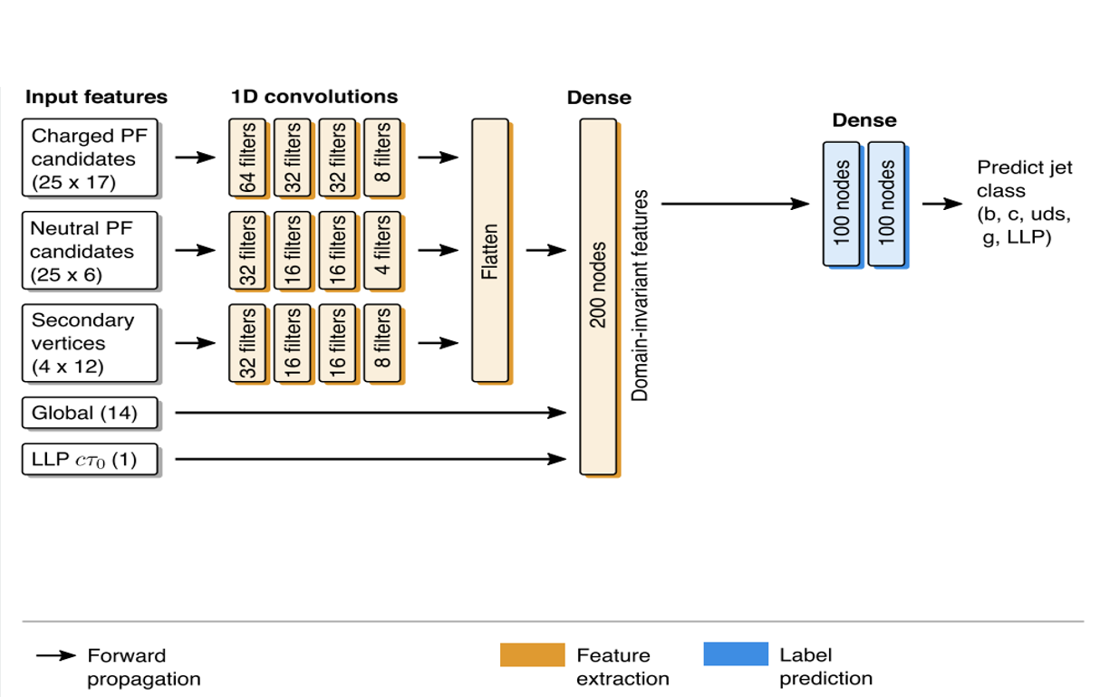
LLP Jet Tagging Algorithm
Acceleration of a CMS DNN based Algorithm
Multiclass classification
Jet class trained on 638 input features per labelled jet
  Charged and neutral particles, properties of secondary vertices and global jet variables …
Unsupervised domain adaptation via backpropagation
  Trained on data and Monte Carlo in
  control region
Architecture progressively compresses and extracts most discriminating features
Resample jet p_{T} and η to have same distribution for all classes – discrimination only via correlations with other features
Notes:
The forward inference stage, which is executed significantly more frequently than the backpropogation stage, which is only for training, was selected to be the subject explored in this work.
The jet tagging model’s forward inference stage employs 12 convolutional layers and 5 dense layers to produce predictions from these 638 input parameters, comprised of particle properties, global features and a decay length.
Convolutional layers are applied in a sequential order with a Leaky rectified linear unit activation function after each layer.
Dropout layers with a 10% dropout rate are interleaved throughout the DNN to prevent overfitting.
The output from the final convolutional layer is flattened and combined with the 14 global features and cTau0 to be given as input to the dense layers to predict jet labels using Softmax activation function at the output layer.
The LLP decay length cTau0 significantly affects experimental signature for a jet, and is hence introduced as a parameter to the dense network after the feature extractor.
A benefit of this is that it allows for hypothesis testing with a single DNN for values of cTau0 that span several orders of magnitude.
Output from the network is an array of numbers that assigns probabilities to each of the aforementioned target classes.
The LLP Jet Tagging algorithm’s DNN based architecture is highly computationally intensive, thus not meeting real-time latency constraints for data selection systems when implemented on a CPU; while a hardware accelerated FPGA implementation may meet real-time requirements.

Slide 5
Block Form
Acceleration of a CMS DNN based Algorithm
Dataflow computing requires fixed sized input/outputs
Adapt each stage of the algorithm using fixed size blocks of data
Each kernel may only ingest and output fixed sizes of data in each tick
Input and filter matrices must be divided into blocks of fixed size (e.g. 25x8)
Any rightmost and bottommost blocks may be undersized
Apply padding to achieve a padded matrix with dimensions that are integer multiples of the block dimensions
Notes:
Dataflow computing requires each stage of the algorithm to be adapted to use fixed size blocks of data, as each kernel may only ingest and output fixed sizes of data per tick.
This means that data that is being processed will also be consumed in blocks, which may require additional padding data to meet the size requirements.
For example, if we have a matrix of size 25x17, and a function that operates on 25x8 blocks of data, the given matrix would need to be padded, by adding 7 more columns (depicted in yellow), in order for the and the excess padding removed once all block outputs have been received.

Slide 6
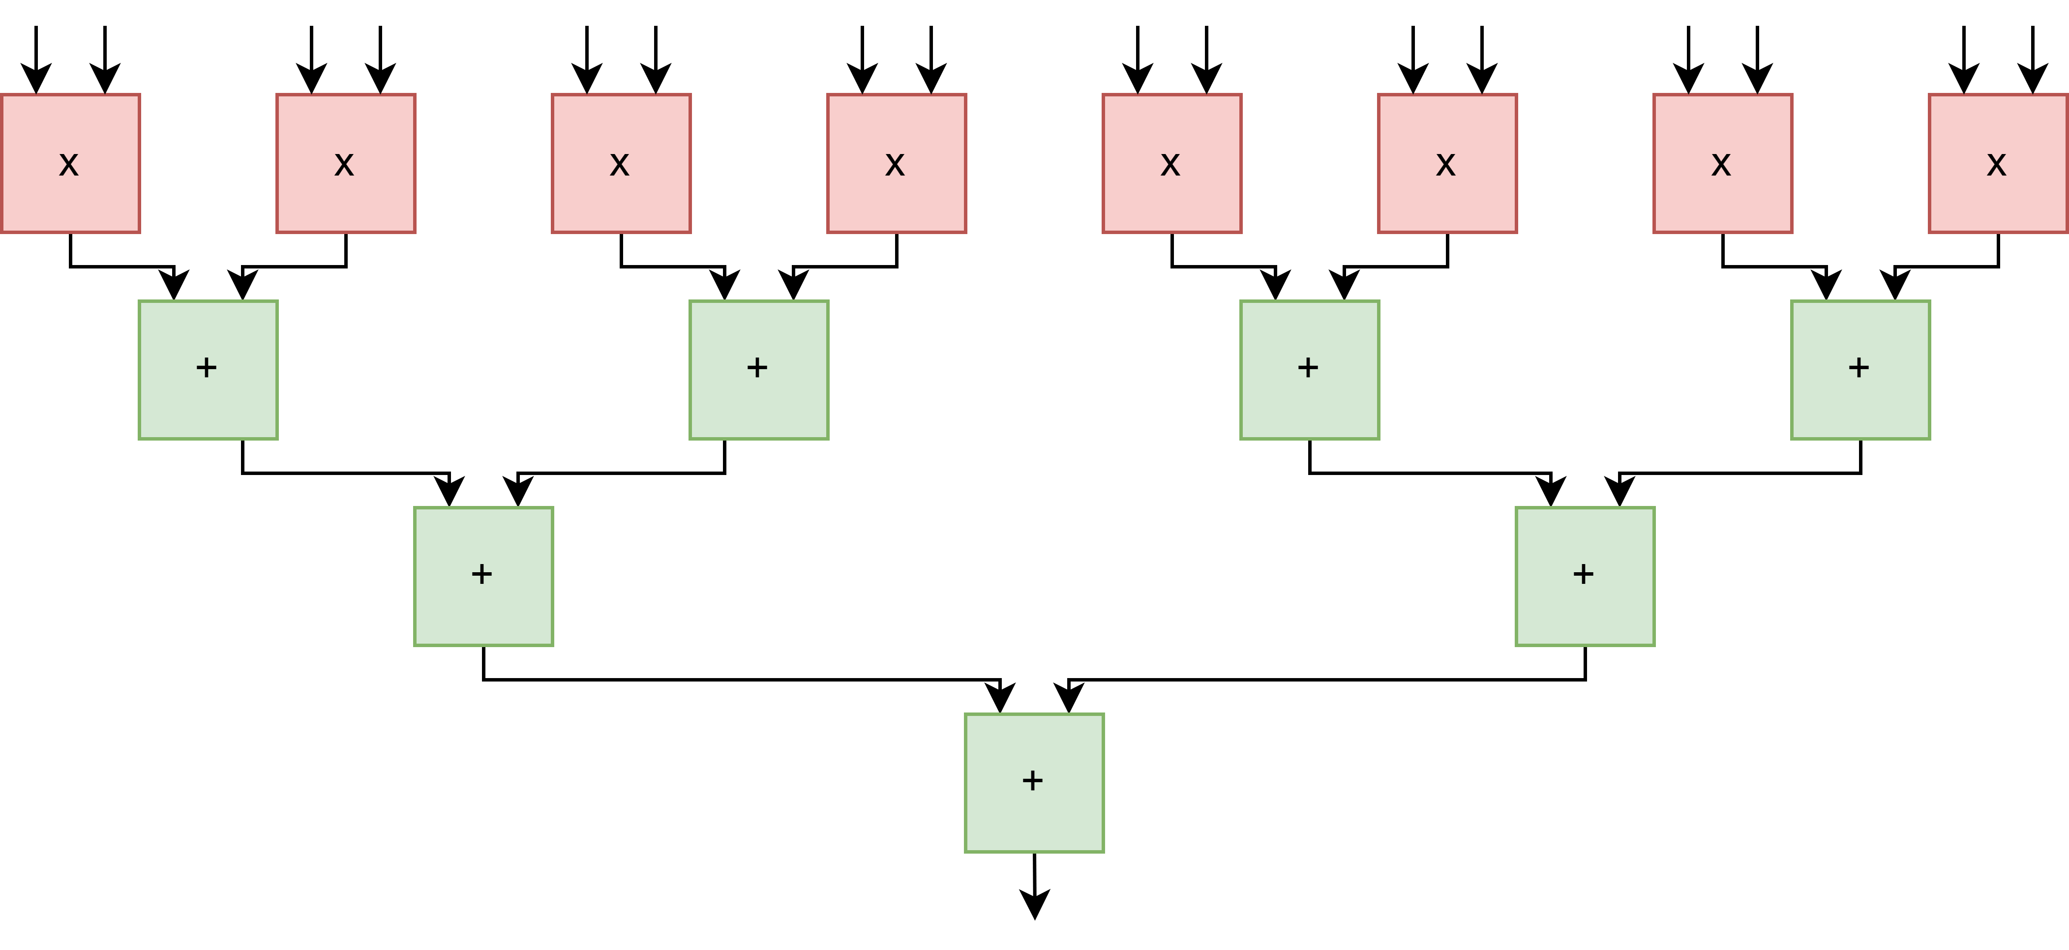
Fully Parallelised Convolution Implementation
Acceleration of a CMS DNN based Algorithm
A standard implementation is to instantiate a bank of multipliers, followed by an adder tree
Compute units can be instantiated multiple times such that the total convolution can be performed in parallel
The most unrolled implementation that exploits the maximum amount of parallelism does not achieve the lowest latency among the architectures
Notes:
Each convolutional kernel accepts two matrix inputs (input data and weight data) which are to be convolved to produce an output matrix.
A standard implementation is to instantiate a bank of multipliers, followed by an adder tree (see figure \ref{fig:parallelised}), to compute one output value from one input matrix row and one weight matrix row.
These compute units can be instantiated multiple times such that the total convolution can be performed in parallel, adhering to the "compute in space" paradigm associated with FPGA development.
The most unrolled implementation that exploits the maximum amount of parallelism does not achieve the lowest latency among the architectures considered due to the complex interconnects that cause higher propagation delays, thus severely limiting the maximum frequency in which the design can operate at, and thus its effective throughput.

Slide 7
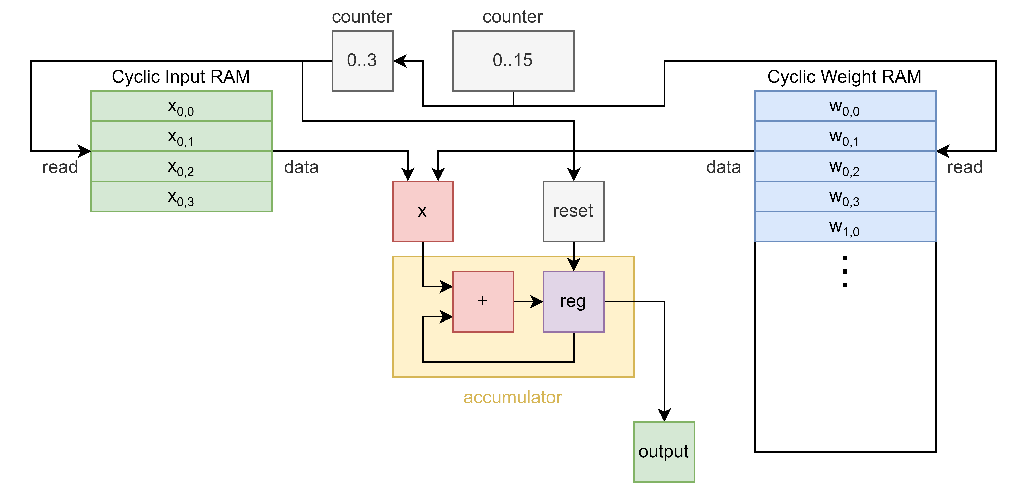
Single Multiply Accumulate Implementation
Acceleration of a CMS DNN based Algorithm
Interface reduced to a single word for the inputs
Cyclic RAM element: RAM with read address port connected to a repeating counter
Coupled with a floating point accumulator, preceded by two input multiplier
Weights remain constant and can therefore be stored in a constant valued cyclic RAM element (analogous to a ROM), negating the need for an input weight data port
Incorporate bias addition when resetting accumulator
Notes:
To circumvent the inherent issue of inputs fully connected to multiple compute units, the input interface was reduced to a single word for the inputs and weights.
By employing a cyclic RAM element (RAM with read address port connected to a repeating counter) for the input and weight data, as opposed to static buffers, the complexity in presenting contiguous memory locations is heavily reduced by making use of the built in indexing functionality of BRAM.
This data configuration is coupled with a floating point accumulator, preceded by a two input multiplier, which can encompassingly be rendered as a multiply-accumulate (MAC) operation.
In the case of the LLP Jet Tagging Algorithm, the weights are determined by training on a GPU, and for the purposes of forward inference, remain constant and can therefore be stored in a constant valued cyclic RAM element (analogous to a ROM), negating the need for an input weight data port.
The weights in a cyclic RAM can be read consecutively to the MAC unit, with a smaller cyclic RAM used to store only a single row of input data, which is repeatedly iterated over until the weight RAM outputs its final value, after which the process repeats with a new input row flushed to the input RAM.
Another advantage offered by the MAC unit is that bias addition can be incorporated into the unit for no additional latency cost.
An accumulator, when reset, defaults to storing zero in its accumulated value, but can instead be set to the corresponding bias associated with the input row index, prefetched from a BRAM block holding bias values.

Slide 8
Duplicated Multiply Accumulate Implementation
Acceleration of a CMS DNN based Algorithm
Single MAC implementation accepts an input row element by element to decrease the input interface width
Process is repeated for all input rows, no inter-dependency between any two input rows
Parallelised by instantiating a MAC unit for each row of the input, for each of the three input types
Implementation of each MAC being identical to one another, allowing for shared control logic
Row-wise MAC operations can be staggered by use of single element input interface (reduce bandwidth requirement)
Notes:
The single MAC implementation accepts an input row (element by element to decrease the input interface width), and convolves it with each weight row, in order to produce an output row.
This process is repeated for all input rows, with there being no inter-dependency between any computation between two different input rows.
Therefore, this design can be parallelised by instantiating a MAC unit for each row of the input, for each of the three input types, with the implementation of each MAC being identical to one another, allowing for shared control logic (see Figure \ref{fig:multiple MACs}).
This would, however, require the input matrix to be ingested one column at a time, unless a single element input interface is used, whereby the row-wise MAC operations can be staggered, marginally sacrificing latency for a reduced bandwidth requirement (to ensure the design is not bandwidth limited).

Slide 9
Traditional Matrix Storage Method
Acceleration of a CMS DNN based Algorithm
Partition two input matrices into smaller blocks of fixed size (with zero padding applied where necessary)
Buffer required to store matrix data and send blocks to their respective kernels
16x4 blocks derived from matrix as 4 consecutive elements across 16 consecutive columns
Reading block from BRAM module results in 16 bursts of 4 cycle reads
Inherently complex approach
Notes:
A common method of multiplying matrices of arbitrary size using fixed hardware is to partition the two input matrices into smaller blocks of fixed size (with zero padding applied where necessary), and passing these blocks to a convolver, after which the intermediary convolution results are summed and stitched back into the desired output matrix.
In order to reuse the convolution, bias addition and activation function kernels, it is required that a buffer of some sort exists to store matrix data and send blocks to their respective kernels.
Instantiating a two dimensional array of matrix elements will yield the employment of BRAM (Block RAM) modules, as opposed to LUT-based memories, except in the case where the matrix dimensions are very small.
The matrix may possibly be partitioned over many BRAMs, as their capacities are limited, incurring an additional processing overhead.
The nature in which (16x4) blocks are derived from a matrix is such that 4 consecutive elements are extracted across 16 consecutive columns.
If the matrix (when flattened), is stored in row major order, reading the block from a BRAM module would result in 16 bursts of 4 cycle reads.
This can be made slightly more efficient by selecting wide dimensions for the block size (e.g. 4x16), resulting in less read bursts, but of longer duration, for which the efficiency benefit is only obtainable if BRAM blocks are configured with larger widths, to allow for the effectively parallel acquisition of consecutive element data in one read cycle.
Nonetheless, this approach introduces additional complexities when extracting one block from the storage structure used for the matrix, which is a fundamental function required for the orchestrated marshalling of fixed size data throughout the design.

Slide 10
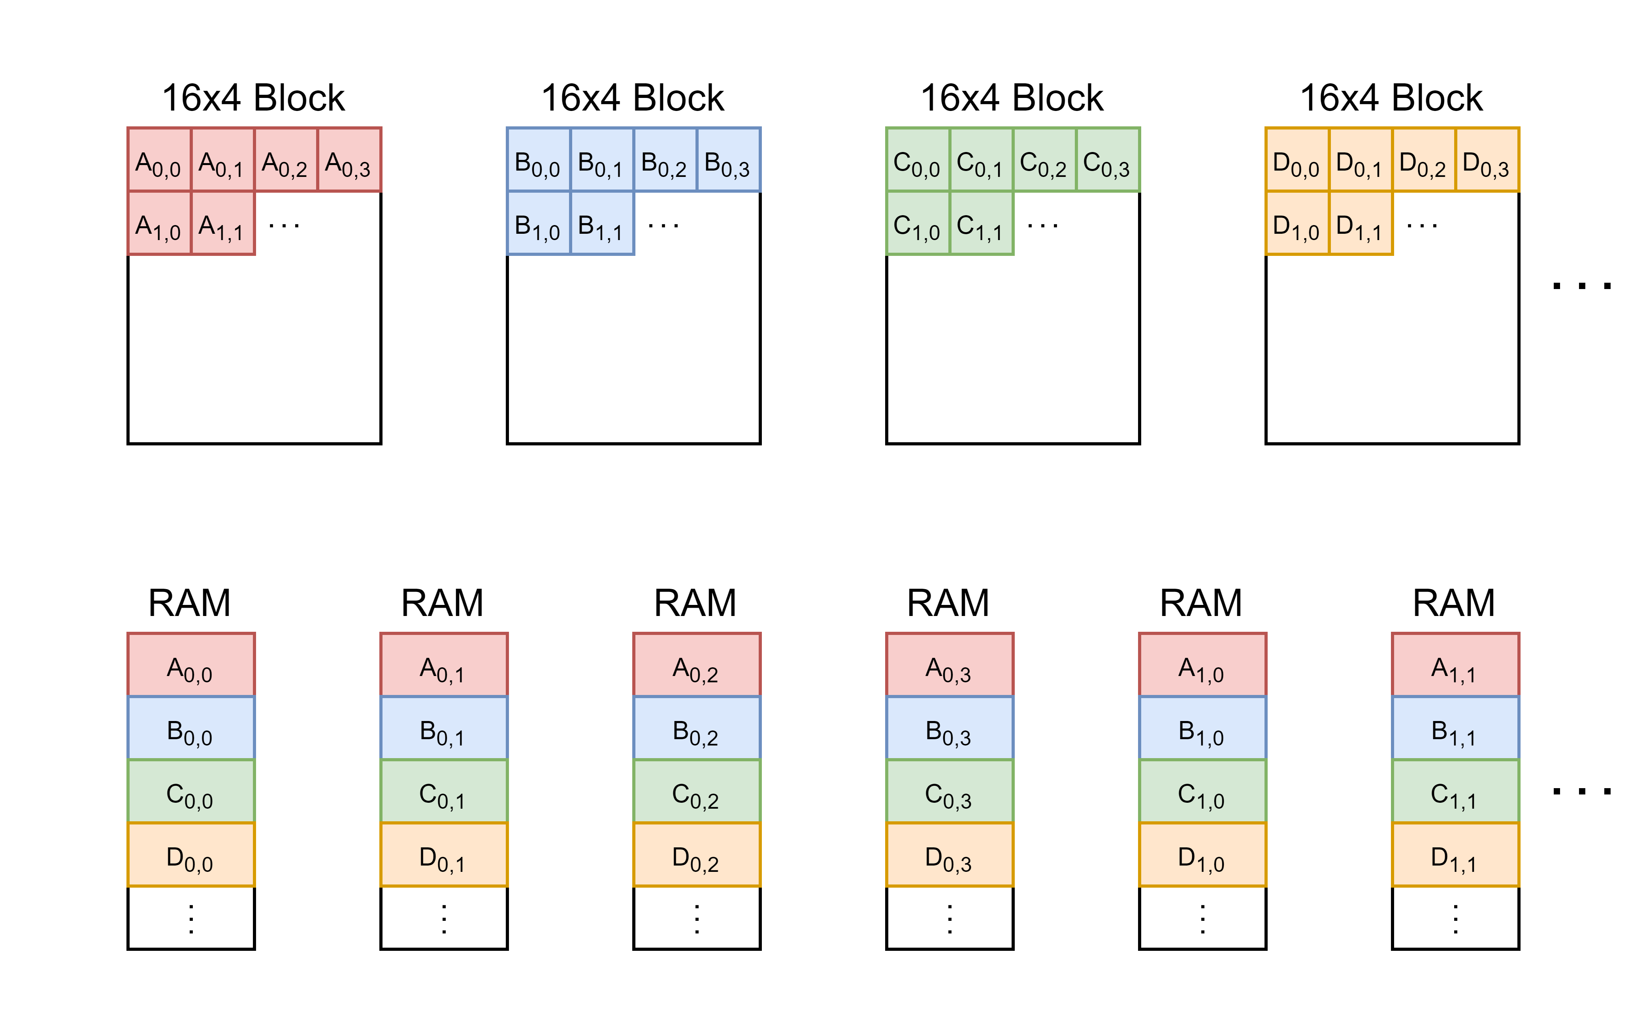
Elementwise RAM Implementation
Acceleration of a CMS DNN based Algorithm
Matrix elements grouped by position in block
Exactly 64 (16x4) RAM modules required, one for each of the index positions in a 16x4 block
Most valuable computational and resource saving derives from simplified read mechanism
All 64 RAMs addressed with same value
Contents of the block will be presented at the read data ports of the 64 RAM blocks
Notes:
The proposed method of elementwise RAM block indexing transposes the natural view which is taken upon the envision of a partitioned matrix.
As opposed to grouping elements based on proximity to one another (row wise, or even block wise), matrix elements can be grouped by position in their block (see Figure \ref{fig:ram grouping}).
In doing so, one would need to instantiate precisely 64 (16x4) RAM modules, one for each of the index positions in a 16x4 block.
One efficiency that arises is due to the number of storage elements remaining fixed between convolutional layers, irrespective of the dimensions of the input and weight matrices.
The most valuable computational and resource saving derives from the heavily simplified read mechanism.
In order to obtain a 16x4 block, all 64 RAMs should be addressed with the same value (block index) and the contents of the block will be presented at the read data ports of the 64 RAM blocks.
For convolution, there are only read operations to the RAM blocks, and only writes to the input data matrix for each execution of a forward inference, hence why simplification of the read mechanism presents significant computational and resource savings.

Slide 11
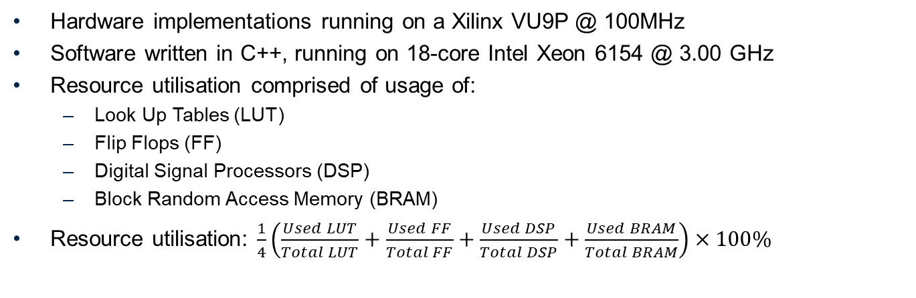
Results – Test Setup
Acceleration of a CMS DNN based Algorithm
Hardware implementations running on a Xilinx VU9P @ 100MHz
Software written in C++, running on 18-core Intel Xeon 6154 @ 3.00 GHz
Resource utilisation comprised of usage of:
  Look Up Tables (LUT)
  Flip Flops (FF)
  Digital Signal Processors (DSP)
  Block Random Access Memory (BRAM)
Resource utilisation: $\frac{1}{4}\left(\frac{Used LUT}{Total LUT}+\frac{Used FF}{Total FF}+\frac{Used DSP}{Total DSP}+\frac{Used BRAM}{Total BRAM}\right)×100\%$
Notes:
The methods outlined were evaluated for their latency and resource utilisation.
All implementations were written using MaxJ, a Java-like dataflow oriented HLS language by Maxeler Technologies.
All testing was performed on a Xilinx Virtex UltraScale+ VU9P, connected via a PCIe interface to a Intel Xeon Gold 6154 host CPU clocked at 3.00GHz.

Slide 12
Results – Convolution Compute Methods
Acceleration of a CMS DNN based Algorithm
Hardware Design | Fully Unrolled | Partial Unroll | Single MAC Unit | Column MAC Units
f (MHz) | 100 | 100 | 350 | 250
Latency (ns) | 80.00 | 210.00 | 140.00 | 24.00
LUT (%) | 26.86 | 13.24 | 1.08 | 17.31
FF (%) | 21.61 | 16.88 | 1.07 | 19.22
DSP (%) | 29.94 | 1.86 | 0.06 | 0.94
BRAM (%) | 8.24 | 3.11 | 2.36 | 2.98
RU (%) | 21.66 | 8.77 | 1.14 | 10.11
Notes:
A convolution kernel accepting two 16x4 inputs and yielding one 16x16 output was instantiated using each of the four methods shown in the table below.
All latency values are expressed as the time taken for output matrix to be obtained.
The implementations employing MAC units were able to meet timing for higher clock speeds than the unrolled implementations.
The increased latency for the partially unrolled implementation compared against the fully unrolled implementation arises from the serial fashion in which input rows are ingested; despite pipelining the design, the latency of the fully unrolled design cannot be matched.
The MAC based implementations both offer very low resource utilisation, especially DSP usage, as a single floating point MAC unit requires 2 DSPs.

Slide 13
Results – Matrix Storage Methods
Acceleration of a CMS DNN based Algorithm
Hardware Design | Single Buffer | Double Buffer | Elementwise RAM Storage
f (MHz) | 100 | 100 | 100
Latency (ns) | 100.00 | 80.00 | 20.00
LUT (%) | 1.65 | 3.38 | 0.71
FF (%) | 6.43 | 13.22 | 2.90
DSP (%) | 0.00 | 0.00 | 0.00
BRAM (%) (highest resource) | 9.28 | 18.56 | 8.12
RU (%) | 4.34 | 8.77 | 1.14
Notes:
A block marshalling kernel accepting 16x4 blocks as input, storing a 25x17 data matrix and outputting a selected 16x4 block was instantiated using each of the four methods shown in the table below. All latency values are expressed as the time taken to update region of data matrix with inputted 16x4 block, and output a 16x4 block, after the block index has been presented.
A latency reduction can be obtained by opting for a double buffer mechanism as opposed to a single buffer, as the write method for the inputted 16x4 block is simplified (write to secondary buffer) as opposed to the complex method used for the single buffer.
However, the latency for the elementwise RAM storage method significantly outperforms the other two, with a latency reduction by a factor of at least 4.
The most valuable advantage of the elementwise RAM storage method lies in the heavily reduced resource utilisation, deriving predominantly from the reduction in LUTs and FFs, attributable to the heavily simplified read mechanism.
The BRAM usage is only slightly less than the single buffer method, as the number of blocks required for a full forward pass is constant irrespective of the implementation choice, and cannot be further reduced.

Slide 14
Future Work
Acceleration of a CMS DNN based Algorithm
Investigation of duplicated MAC units for latency reduction (at the expense of increased resource utilisation)
Quantifying tradeoff between throughput and resource utilisation
Arbitrarily sized networks configured as to minimise latency by selecting design parameters derived from the matrix dimensions
Notes:
Future work involves investigation of the duplication of MAC units for latency reduction at the expense of increased resource utilisation, additionally investigating whether all input feature categories can be simultaneously ingested.
Quantifying the tradeoff between throughput and resource utilisation may be useful such that arbitrarily sized networks can be automatically configured as to minimise latency and/or maximise throughput by selecting design parameters derived from the matrix dimensions used in the network architecture, whilst ensuring designs fit on a single FPGA chip.
Bayesian Neural Networks have promising use in high energy physics, especially jet tagging algorithms.
The collective effort to search for new and undiscovered physics relies on the repeatability of conducted research, thus it is critical that findings remain true and false positives are disregarded. Use of neural networks that associate uncertainties with their predictions will allow for the automatic rejection of many results that may have otherwise been incorrectly regarded as meaningful, thus reducing the total data preserved for confidently assured predictions of interest.
This would consequently ease the data processing requirements of processes reliant on these predictions, which is of importance due to the projected increase in data collected at the CMS due to the HL-LHC upgrade.

Slide 15
Future Work
Acceleration of a CMS DNN based Algorithm
Bayesian Neural Networks have promising use in high energy physics, especially jet tagging algorithms.
Critical that findings remain true and false positives are disregarded
Use of neural networks that associate uncertainties with their predictions will allow for the automatic rejection of many results
Consequently would ease the data processing requirements of processes reliant on these predictions
Of importance due to the projected increase in data collected at the CMS due to the HL-LHC upgrade
Notes:
Bayesian Neural Networks have promising use in high energy physics, especially jet tagging algorithms.
The collective effort to search for new and undiscovered physics relies on the repeatability of conducted research, thus it is critical that findings remain true and false positives are disregarded. Use of neural networks that associate uncertainties with their predictions will allow for the automatic rejection of many results that may have otherwise been incorrectly regarded as meaningful, thus reducing the total data preserved for confidently assured predictions of interest.
This would consequently ease the data processing requirements of processes reliant on these predictions, which is of importance due to the projected increase in data collected at the CMS due to the HL-LHC upgrade.

Slide 16
Summary
Acceleration of a CMS DNN based Algorithm
Transitioned to cyclic random access memories and reused multiply-accumulate operations
Transitioned to storing matrices distributed over many RAM memories, grouping elements by index
Performance estimation of FPGA prototype
Notes:
SHOULD I SAY ANYTHING HERE, OR JUST OPEN FOR QUESTIONS, LEAVING THIS SLIDE UP?
This work presents an FPGA acceleration of the LLP Jet Algorithm, exploring the use of kernelization to divide the algorithm into self-contained units, allowing simple orchestration of dataflow within the network and reuse of multiplication units enabling reduced hardware resource utilization

