Slide 1

Accelerating MC simulations
Marco Barbone
m.barbone19@imperial.ac.uk

Slide 2
Project status
Develop a reliable MC simulator that:
Supports electrons, photons and positrons
Supports different materials
It is readable and extendable
Accelerator agnostic optimizations only
It is validated against experimental data

Slide 3
Optimization: Not uniform distributions
Rejection sampling
Inversion method
At compile time invert F
F(u) {
  u = generate (U);
  Return $F^{−1}\left(u\right);$
}
F(u) {
  do { generate (U) }
  while ( U > threshold);
  Return U;
}
No while loop!
Inversion method is the most efficient on FPGA (Thomas2006)
Since removing a while loop is equivalent to removing a branch, it is more efficient on GPU as well
Source: https://www.doc.ic.ac.uk/~wl/papers/iee07dt.pdf

Slide 4
Optimization: Ray-plane intersection
There are three main ways to compute the point where the particle (ray) enters the phantom:
  Creating an air phantom (slowest)
  Using trigonometry to compute the distance (slow)
  Using the dot-product (fastest)
Faster methods are less accurate but compered to the measurement accuracy dot-product is accuracy is sufficient.

Slide 5
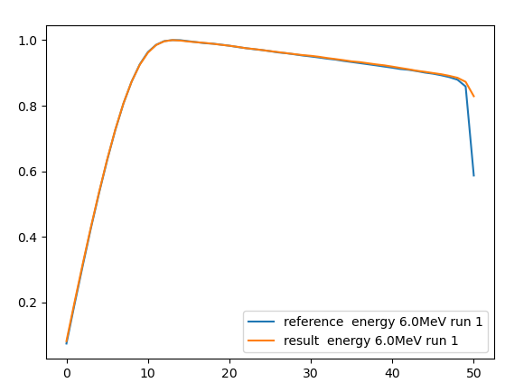
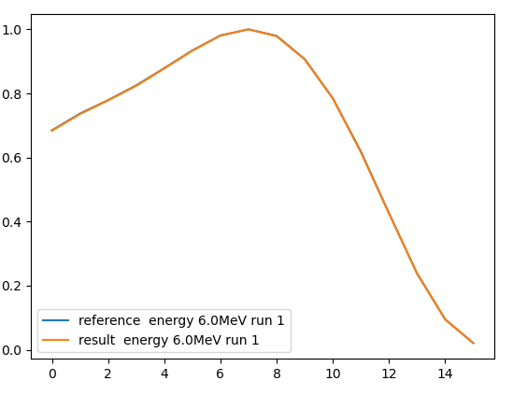
Validation against Dose Planning Method (DPM)
6 Mev Electrons
6 Mev Photons
https://pubmed.ncbi.nlm.nih.gov/10958194/

Slide 6
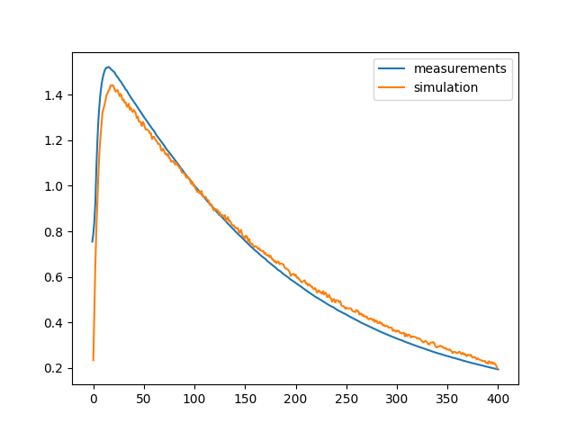
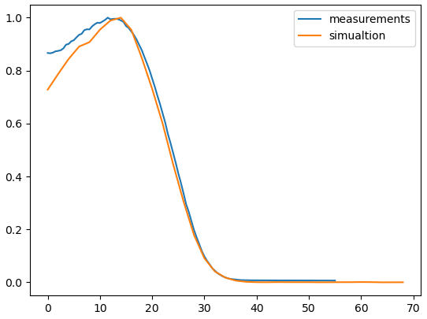
Validation against experimental data
6 Mev Electrons
6 Mev Photons

Slide 7
Future step: GPU vs FPGA

Slide 8
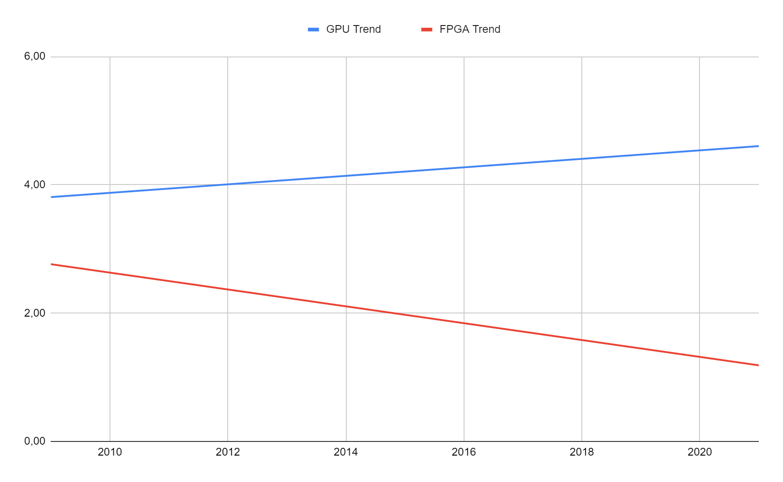
GPU CUDA cores vs FPGA CLBs
CLB and CUDA cores have similar impact on the throughput
GPU clock frequency tripled over the same period while FPGA frequency stayed constant

Slide 9
Changes to the simulation do not require
to re-develop the entire architecture
Development effort
 | CPU | GPU | FPGA
Engineering time | short | medium | very long
Compilation time | short | short | very long
Debugging | easy | medium | hard
Maintainability | easy | medium | hard

Slide 10
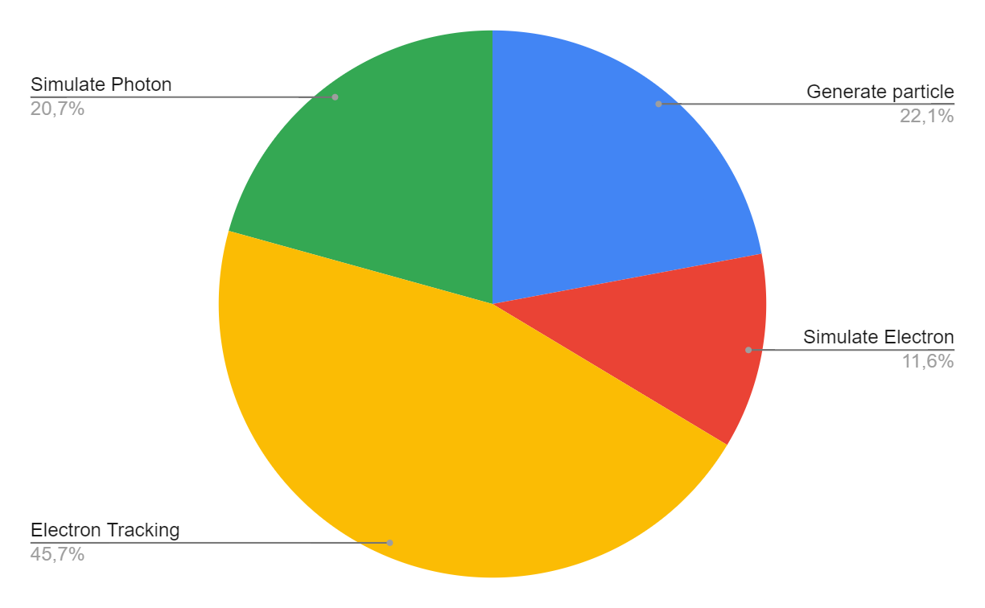
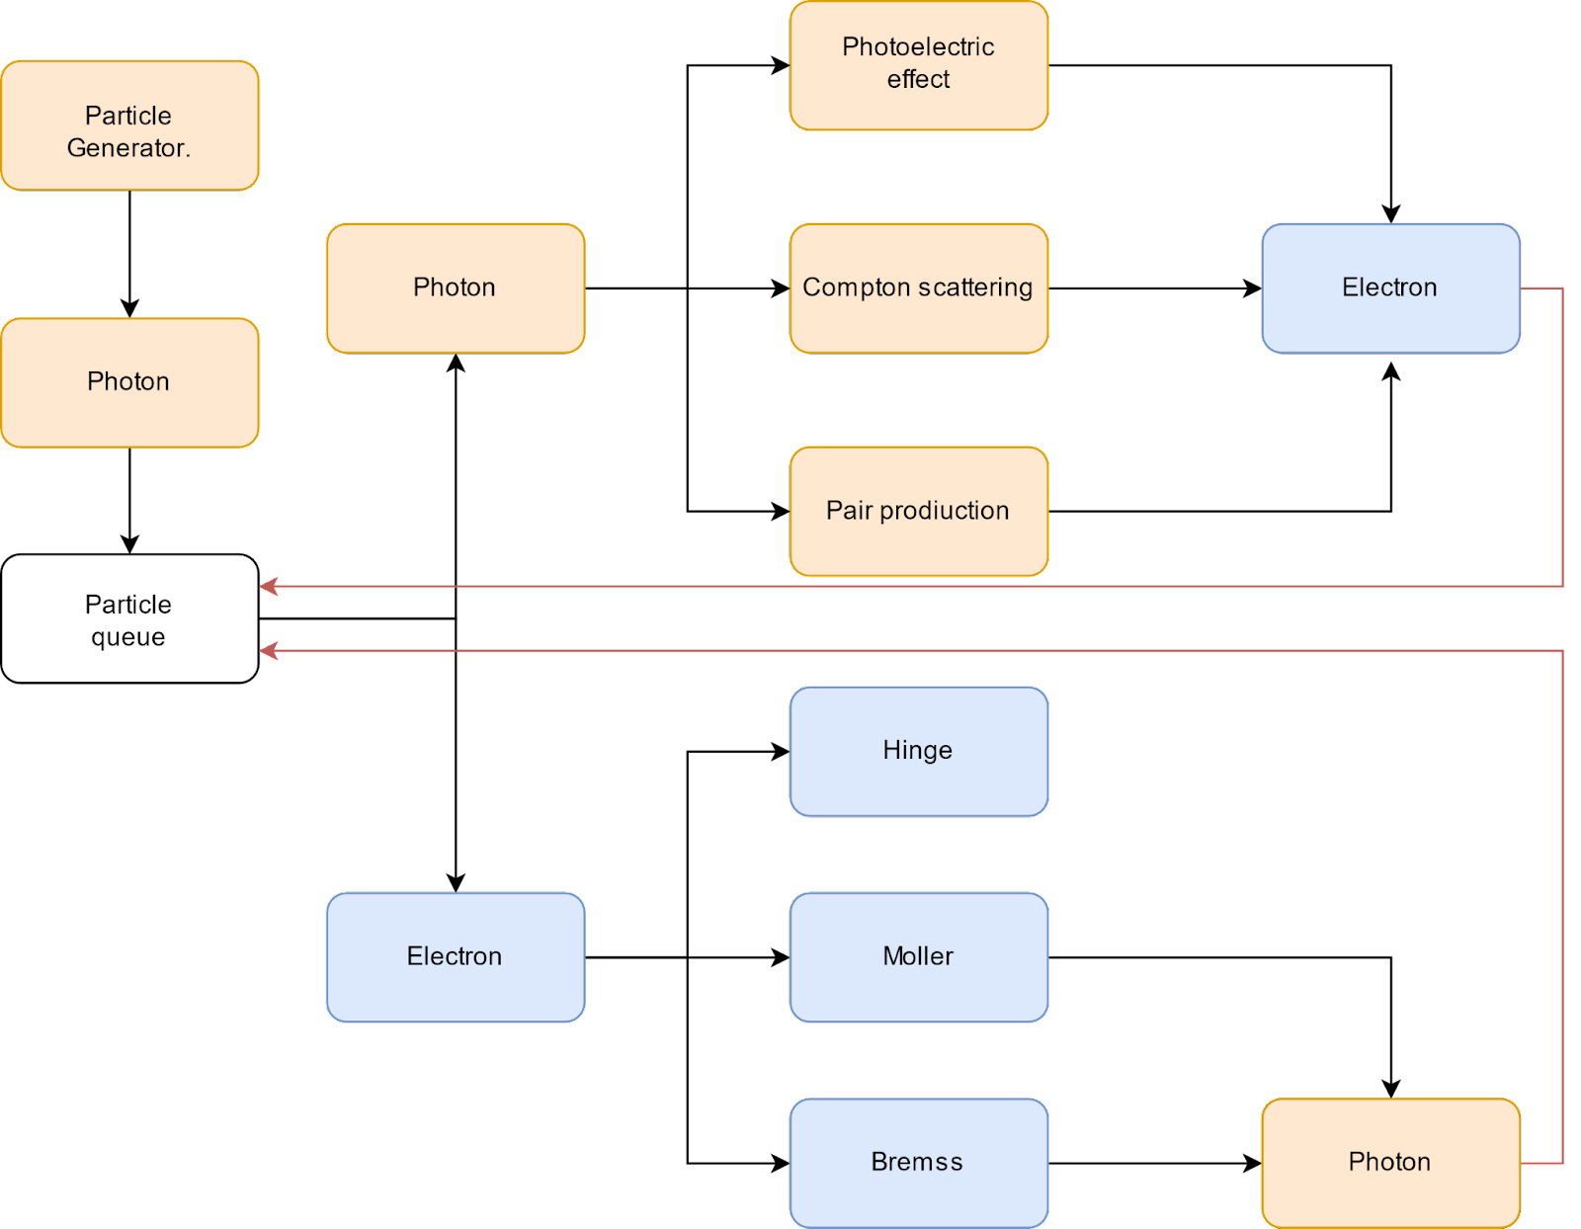
Execution time break-down

Slide 11
Possible Partitioning
Partition | Data Transfer Time (s) (PCIe3x16)
Beam on CPU | From 0.30s to 6.05s
Beam and Photon simulation on CPU | From 11.51s to 115.10s
Accelerating Electron tracking only | From 20.39s to 203.92s
Splitting the simulation will not allow to meet time requirements

Slide 12

(Voss 2019)
implemented features
https://pure.tudelft.nl/ws/portalfiles/portal/82584147/Voss2020_Article_TowardsRealTimeRadiotherapySim.pdf

Slide 13
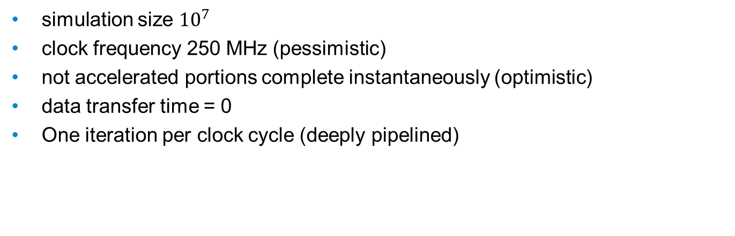
FPGA performance assumptions
simulation size ${10}^{7}$
clock frequency 250 MHz (pessimistic)
not accelerated portions complete instantaneously (optimistic)
data transfer time = 0
One iteration per clock cycle (deeply pipelined)

Slide 14
FPGA performance predictions
Implementation | Parallelism | Simulation Time
Voss2019 (imprecise) | 8 | 2,989 s
Beam on CPU | 2 | 522,15 s
Beam and Photon simulation on CPU | 4 | 261,08 s
Accelerating Electron tracking only | 8 | 130,54 s
https://pure.tudelft.nl/ws/portalfiles/portal/82584147/Voss2020_Article_TowardsRealTimeRadiotherapySim.pdf

Slide 15
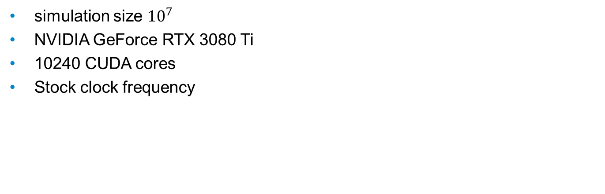
GPU performance assumptions
simulation size ${10}^{7}$
NVIDIA GeForce RTX 3080 Ti
10240 CUDA cores
Stock clock frequency

Slide 16
GPU performance predictions
# instructions (SPMD) | Efficiency | Compute Time
100000 | 1 | 0,59s
100000 | 0,5 | 1,17s
100000 | 0,1 | 5,87s
1000000 | 1 | 5,87s
1000000 | 0,5 | 11,73s
1000000 | 0,1 | 58,65s
500000 | 0,25 | 11,73s

Slide 17
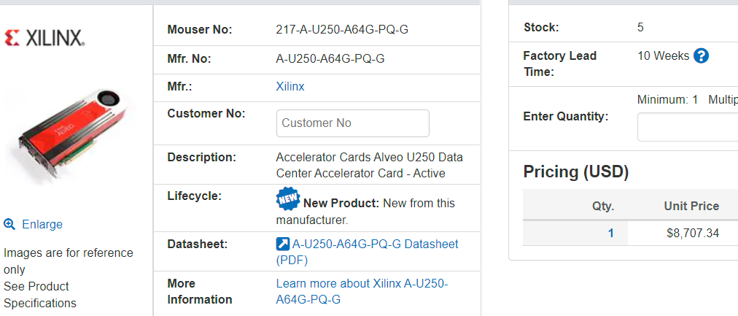
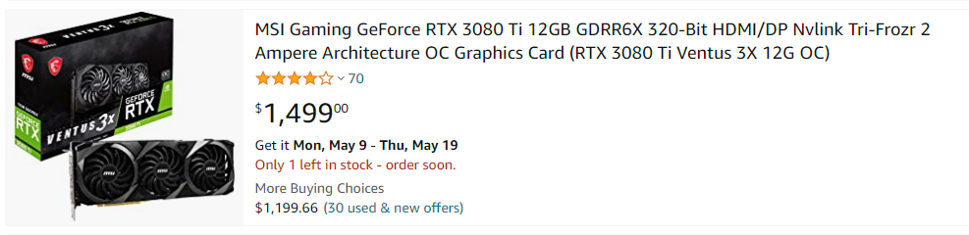
Price
FPGAs cost 5.80 times more than GPUs

Slide 18
Conclusions
GPU acceleration allows further improvements to the simulation
FPGAs do not allow to meet the time requirements
GPUs potentially meet time requirements, or they will likely meet it in the near future

