Slide 1
FPGA-friendly integer and floating-point PRNGs
Andrew W. Rose

Slide 2
Background
We have been asked in several settings whether we can speed up PRNG for intensive MC simulations
The assumption was to accelerate the MIXMAX generator†
  Terrible choice for FPGA optimization
  “Default” generator involves 240×240 matrix multiplication
† https://arxiv.org/abs/1403.5355

Slide 3
Optimal PRNG for FPGAs
In FPGAs, DSPs and BRAMs are precious resources
  Avoid if possible
Since FPGAs operate at the bit-level, bit-shuffling operations (including the traditional bit-shift and rotation operations) are available at no additional cost, neither in terms of resources nor latency.
The Xoshiro and Xoroshiro PRNGs† are an excellent fit for generating a stream of pseudo-random numbers in FPGAs
  Although the proposed shuffling-stages, which are based on 64-bit addition and multiplication, should not necessarily be expected to be so well suited.
† https://prng.di.unimi.it/

Slide 4
For the masochists
All firmware has been implemented in VHDL-2008
Simulation performed with Mentor/Siemens Modelsim
Synthesis and implementation using Vivado 2020.2
  A XCKU15P2 Kintex Ultrascale+ FPGA,
  FlattenHierarchy: None
  Strategy: AreaOptimized
  Nominal clock-speeds of 100MHz and 750MHz

Slide 5
Xoshiro256**

Slide 6
Testing bits with TestU01
Implemented a cycle-accurate C++ emulation of the pipelined Xoshiro256
  Matches the output from the firmware in Modelsim
  Matches the output from the author’s implementation
TestU01 expects 32-bit ints, not 64-bits
  Software supports testing of lower and upper words, plus reversed version since there may be lower sensitivity to low bits.
Passes SmallCrush and Crush in TestU01
  BigCrush still to be run (although unnecessary, given that it matches the original xoshiro implementation which does)

Slide 7
Floating-point PRNG

Slide 8
Procedure
Reuse the XOSHIRO256 generator and star-star scrambler described previously
  https://indico.cern.ch/event/1104287/contributions/4668980/attachments/2370875/4049137/DigiCentrePresentation.pdf
  Designed for 64-bit integers
Extend to calculate properly distributed exponents

Slide 9
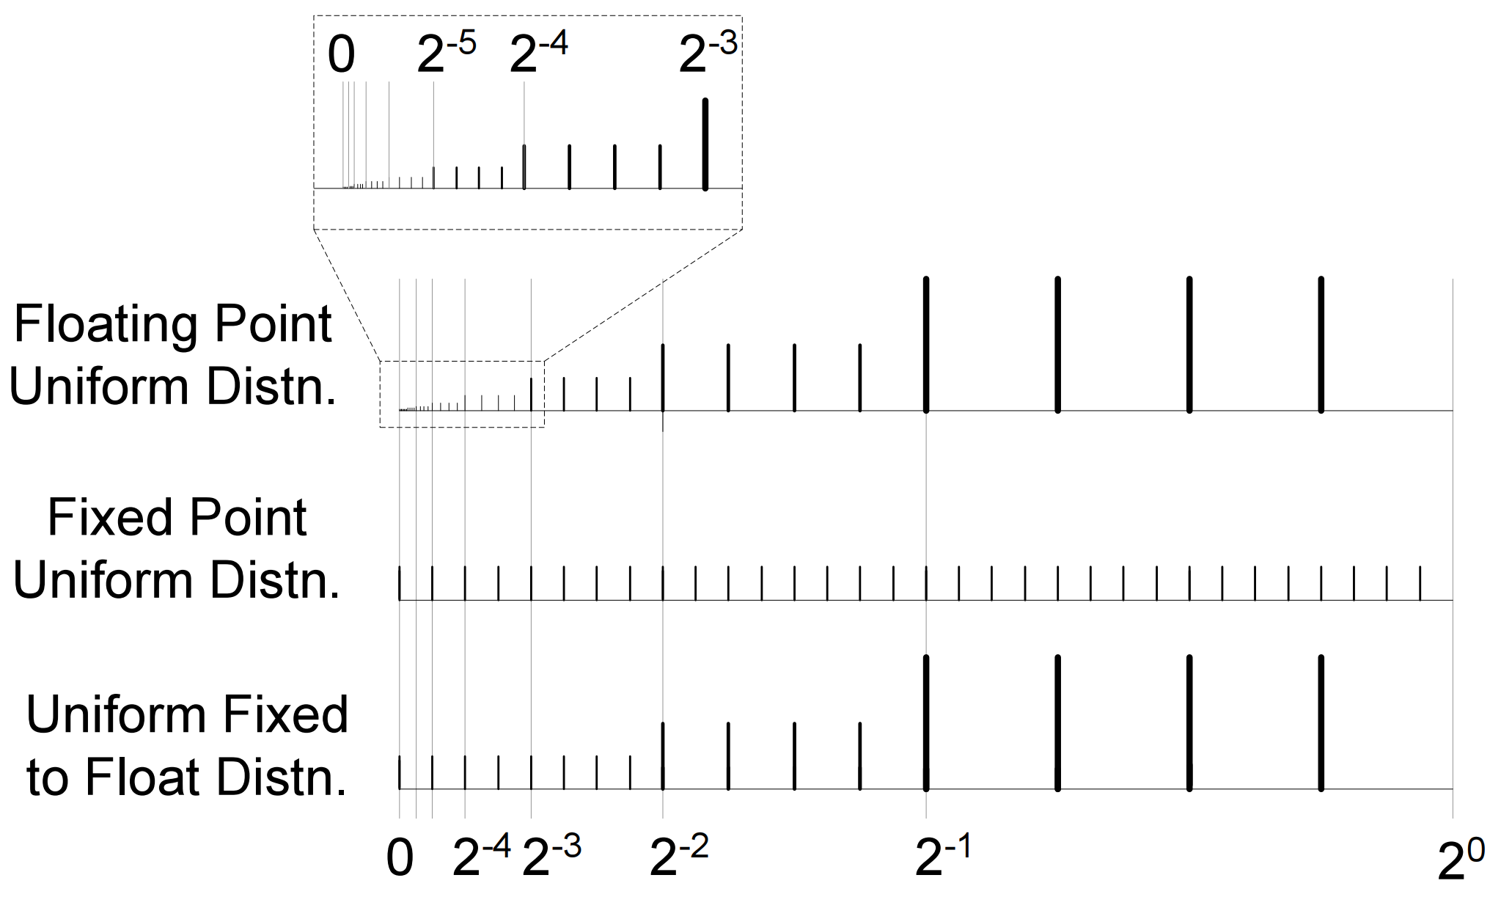
A note on exponents
The range of the number-line spanned by any exponent, x, is half that of exponent x+1, and twice that of exponent x-1.
For a uniform distribution, the probability of any given exponent, x, should be half that of exponent x+1, and twice that of exponent x-1.
Resource efficient generators for the floating-point uniform and exponential distributions
David B. Thomas; Wayne Luk
https://ieeexplore.ieee.org/document/4580162

Slide 10
A note on exponents
For a uniform distribution, the probability of any given exponent, x, should be half that of exponent x+1, and twice that of exponent x-1.
Think coin toss!
  Or many coin tosses in a row
How many heads in a row?
Count the leading 0’s on an N-bit random number
  Can we use bits within the Xoshiro state?

Slide 11
First pass: Schematic
Xoshiro
X[3]
X[2]
X[1]
X[0]
Assume negligible correlation between value of xoshiro state, 4 clock-cycles apart, when interpreted two different ways and scrambled
Shift + count (7clk)
Scambler (3clk)
Format to IEEE 754 floating-point

Slide 12
Testing with Modelsim
Generated 79,284,931 random digits
Rate of exponents drops as expected
Exponent | Occurances
10⁰ | 0 (Good ☺)
10⁻¹ | 71,355,539
10⁻² | 7,137,630
10⁻³ | 712,590
10⁻⁴ | 71,122
10⁻⁵ | 7233
10⁻⁶ | 742
10⁻⁷ | 66
10⁻⁸ | 9
10⁻⁹ | 0

Slide 13
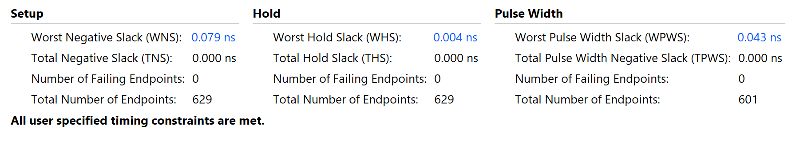
First pass: Resources and timing
↑KU15P ☺
↓750MHz

Slide 14
Testing floats with TestU01
Fails 96 tests… but something odd going on
TestU01 expects doubles, does not seem to play nicely with floats

Slide 15
Testing TestU01
Authors of xoshiro recommend this recipe for generating doubles:
  return (double)(lXoshiro() >> 11) * 0x1.0p-53;
  Passes CRUSH
Try casting to float then back to double
  float lVal = (double)(lXoshiro() >> 11) * 0x1.0p-53; return (double)( lVal );
  Fails CRUSH (96 tests)
Direct conversion to float (Thanks Marco for the idea)
  return (float)(lXoshiro() >> 40) * 0x1.0p-24;
  Also fails CRUSH (96 tests)

Slide 16
Testing doubles with TestU01
Modified Xoshiro256Float software to generate double directly
  Although minimum exponent is still 2⁻¹²⁶
Running CRUSH now…

Slide 17
Status
Integer PRNG implemented
  Very fast, very small
  Validated and rock solid
Floating-point PRNG implemented
  Also very fast and very small
  Have run into issues with TestU01 – work continues

Slide 18
Spares

Slide 19
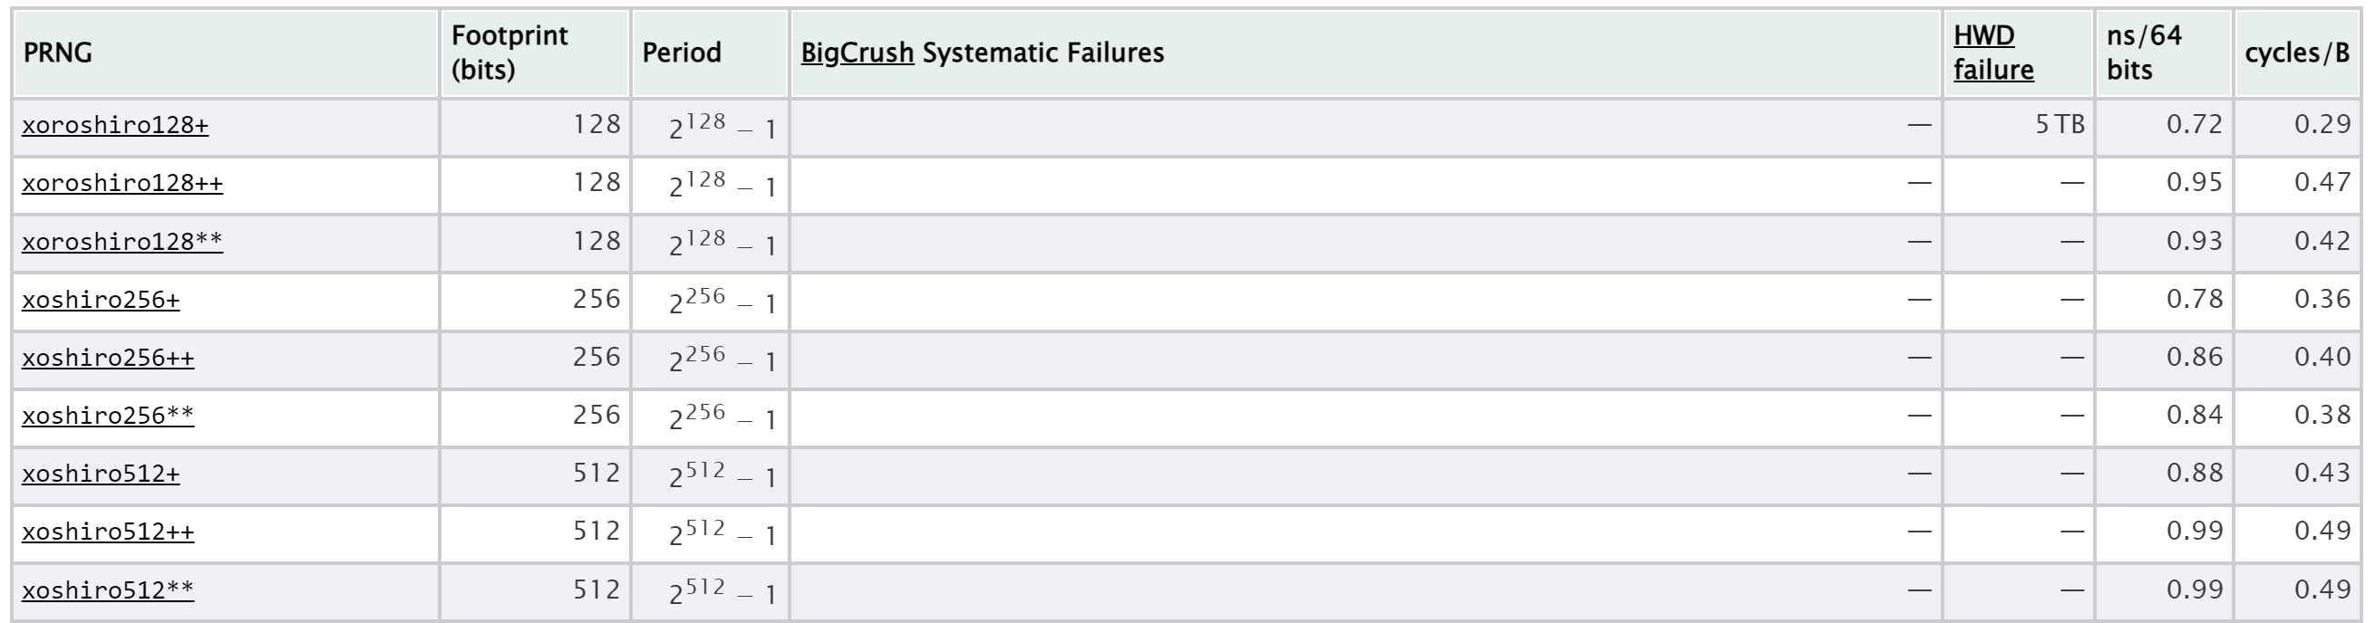
Xoshiro
From the authors:

Slide 20
A practical consideration
When designing for FPGAs, large “fanouts” of signals and long path-lengths invariably fail to meet the timing constraints at high clock-speeds or in congested designs
  Clocking outputs through word-wise shift-registers is a much more favourable paradigm!

Slide 21
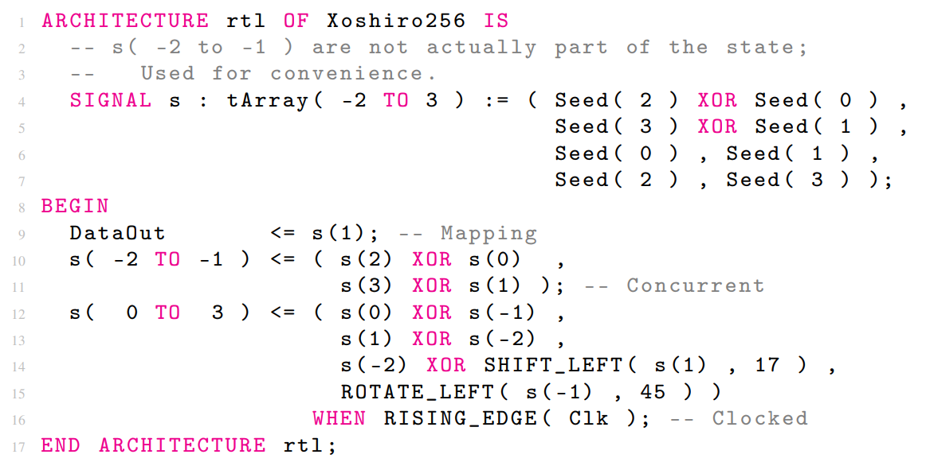
Implementing Xoshiro256
Two lines of functional VHDL
Produces a new random number on the output on every clock-cycle
Can close timing on nominal clock-frequencies of 750MHz

Slide 22
Scrambler blocks
The original authors present multiple output scramblers
  Favour the star-star scrambler
The plus-plus and star-star scramblers were compared, and shown to be functionally identical in an FPGA:
  Since x ∗ 5 = (x ∗ 4) + x = (x << 2) + x = x + y, and similarly for x ∗ 9
  Since shift operations have no cost in an FPGA
  The star-star scrambler, ((x ∗ 5) <<< 7) ∗ 9, is identical in computational complexity to the plus-plus scrambler, ((x + y) <<< 7)+y.

Slide 23
Scrambler blocks
However, these operations need to be pipelined
  Three steps for simplicity and clarity
For plus-plus, this also requires pipelining the final argument twice,
  increasing the register requirements
Thus only the star-star scrambler was implemented in VHDL

Slide 24
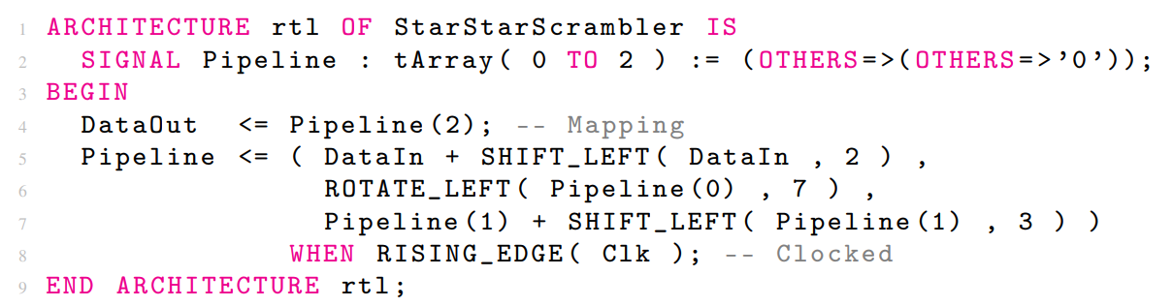
Scrambler blocks
One line of functional VHDL
Handles a new random number on the output on every clock-cycle
Can close timing on nominal clock-frequencies of 750MHz

Slide 25
Multiple Independent Streams of Random Numbers
Can we benefit more than once from each generator block?

Slide 26
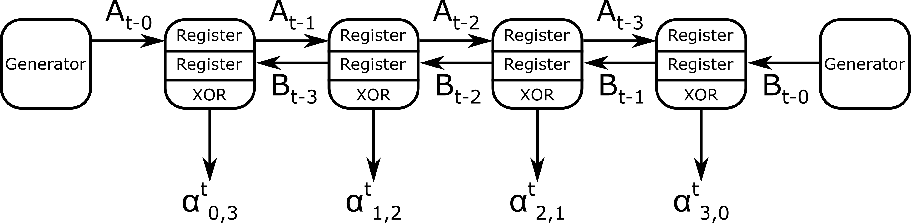
MISRN #1
Consider two generators A and B
Pipe the outputs into a pair of word-wise shift registers
Combine the streams via an XOR

Slide 27
MISRN #1
Each output mathematically proven to have a lower correlation than either generator

Slide 28
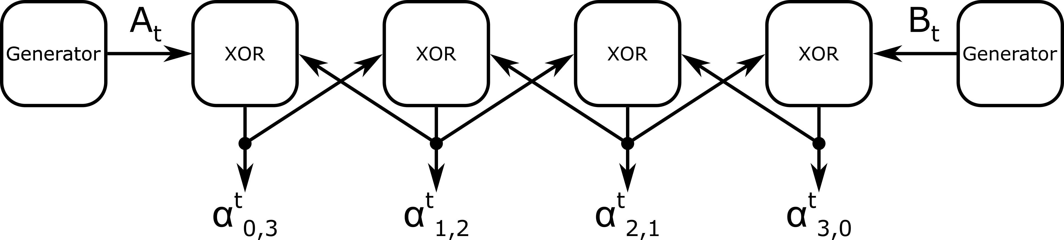
MISRN #2
Can we do away with the shift-register and move to a cross-connected XOR chain?
  Considerably lower resources
Looks good, but can’t prove mathematically
  Brute force instead
    C++ emulation written
    Test-U01 suite installed and running

Slide 29
Plan
BigCrush the MISRN schemes
Finish the paper :)

