Slide 1
A fast C++ implementation of the Bayesian Clustering algorithm
Andrew W. Rose

Slide 2
Algorithm
For a range of cluster radius (R) and cluster threshold (T) parameters
  Calculate the “localization score” for each datum under hypothesis R
  Label all data with localization score > T and which lie within 2R of another datum-over-threshold as one cluster
  Call any unclustered points background
  Calculate the Bayesian (log-) probability that the data matches the hypothesis

Slide 3
Aim
To be able to run the algorithm on a (old) high-end desktop
  3.4GHz 4-core/8-thread processor (Xeon E3-1240)
  64GB RAM
  Conventional Platter Hard Disk

Slide 4
Data preparation
Data files are large text file (>0.5GB)
  Can multi-thread the reading of the file
  Hand each thread an ~equal sized chunk
Data are read from file
  Predefined windows mean that objects are created only for data we will use
  Calculate and store polar coordinates relative to centre of window
Within each thread, data are sorted by radius
  Why? We’ll see
Sorted lists are merge-sorted into final list

Slide 5
Data preparation
For each datum, calculate the distance to all neighbours within distance 2R
  We sorted our data: We know that any datum after us is at larger radius and any datum before us is at smaller radius, can do instant cut on dR
  We can also do a quick cut on a precalculated dPhi
Only then do we calculate the (squared) Euclidean distance and cut
  No need to do the square-root to compare!
Store pointers to accepted neighbours and their Euclidean squared distance, sorted by distance
r-2R
r
r+2R

Slide 6
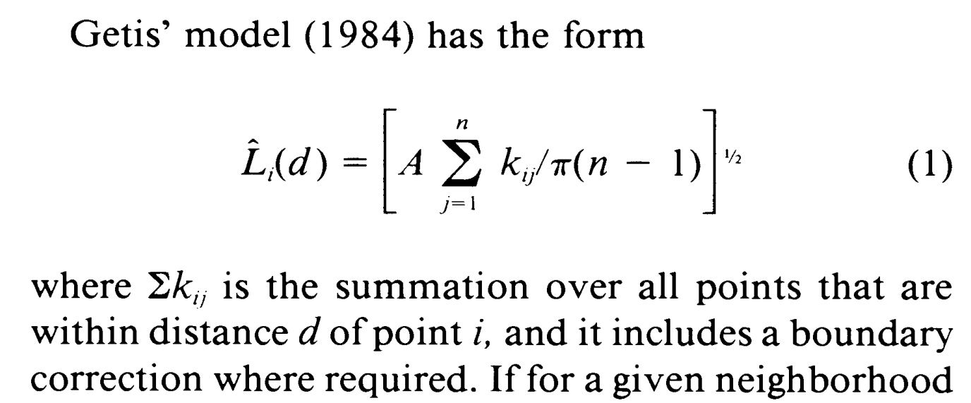
Localization score
Getis and Franklin measurement of density based
on deviation from Poisson distribution of points
Repetition in the summation can be avoided by noting that any point included in the summation up to d_{A} is also included in the summation up to d_{B}, where d_{B} > d_{A}
  Scan radius parameter UPWARDS for maximum reuse
  Since we pre-sorted our neighbours by distance, this is trivial
The boundary correction containing a trigonometric function and a reciprocal can be replaced with a 2-term polynomial approximation with a fractional error of less than 10⁻³
Score is calculated per datum: Trivially parallelizable
Can be done during RT scan or pre-calculated and stored for each R-value

Slide 7
Clustering
Repetition in clustering can be avoided by noting that any datum with localization over threshold T_{A} is also over threshold T_{B}, where T_{A} > T_{B}, any datum
  Any cluster for T_{A} is also valid for T_{B}, although for T_{B}, additional data may be added to the cluster or multiple clusters merged, relative to T_{A}
  Scan the threshold parameter DOWNWARDS for maximum reuse
Clustering itself is not obviously parallelizable
  Many approaches tried, cost of mutexing always exceeds any gain

Slide 8
Clustering
Instead, try parallelizing RT scan
  In principle, trivially parallelizable
  In practice, restricted by available memory
Can we share the memory-intensive read-only parts and only duplicate the stuff that actually with each scan?
  Still playing with this (when I get a chance!)

Slide 9
Log scores
Use CERN ROOT Maths libraries for
  Gaussian Cumulative Distribution Function
    Albeit noting that you can place a cut on the argument for when the result will exceed the precision of the result format and save a non-negligible amount of time
  Log-Gamma Function
  Numeric integration
High performance, thoroughly tested, had them to hand
Also using the ROOT implementation of Cubic spline interpolation for interpolating between sigma probabilities, and ROOT histograms for plotting results

Slide 10
Test sample
“1_un_red.csv”
  9,960,613 data points
  673MB
Region of interest
  677,907 data points
RT scan: 35 R-values and 35 T-values
  1,225 parameters total

Slide 11
Performance
File-loading and initial sorting : ~3.5s
  Will try on a machine with an SSD when I get a chance
Pre-processing : ~55s
  Neighbour distance calculation, storing and sorting
  No localization score calculation
3.4GHz 4-core/8-thread processor (Xeon E3-1240), 64GB RAM

Slide 12
Performance
RT-scan (sequential) : ~215s
  No parallelization of scan itself, nor cluster-finding
  Includes (parallelized) localization score calculation
RT-scan (parallelized, EXPERIMENTAL, WORK IN PROGRESS): ~66s
  But nearly doubles pre-processing time (why?)
  Possibly hitting the memory bandwidth limit (8-threads → 3.25× speed-up)
  All under investigation – take with the usual caveats
3.4GHz 4-core/8-thread processor (Xeon E3-1240), 64GB RAM

Slide 13
What next?
Good question
  A lot will depend on how much can be achieved with the parallelization studies
Can we push it further on a machine with more cores? With a GPU?
Can we off-load the pre-processing with its intensive sorting to an FPGA?

Slide 14
Questions?

Slide 15
Paradigm
Can we structure the data to optimise processing and minimize duplicated/repeated calculations?
I will, in fact, claim that the difference between a bad programmer and a good one is whether he considers his code or his data structures more important.
Bad programmers worry about the code.
Good programmers worry about data structures and their relationships.
Linus Torvalds, 2006

