Slide 1
Demonstration of FPGA Acceleration of Monte Carlo Simulation
Marco Barbone
m.barbone19@imperial.ac.uk

Slide 2

About me
M.Sc. in Computer Science and Networking Scuola superiore Sant’Anna & Università di Pisa
CERN OpenLab Summer student
Research Software Engineer, Maxeler Technologies
Ph.D. Student, Custom Computing research group, Imperial College London, Supervisor Prof. Wayne Luk
Member of Imperial College CMS group
Associate Ph.D. Student, The Institute of Cancer Research, London

Slide 3
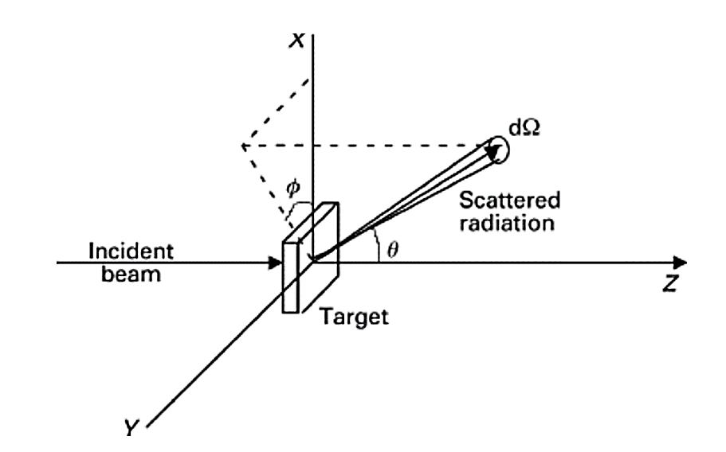
Elastic scattering
A simulation of e-/e+ transport considering only elastic scattering as possible interactions described by scattering of spin-less e-/e+ on an exponentially screened Coulomb potential
Source: Kotlarchyk M. Scattering theory. Encyclopedia of Spectroscopy and Spectrometry, 1999.

Slide 4
Monte Carlo Simulation
Scattered radiation
final position
Many particles are simulated to achieve statistical significance
Source: Kotlarchyk M. Scattering theory. Encyclopedia of Spectroscopy and Spectrometry, 1999.

Slide 5
FPGA acceleration

Slide 6
Methodology
No agile development! Compilation might take days
A methodology is needed to minimize unneeded compilations:
Application analysis
Performance and resource modelling
Decide the acceleration target
Model the target in software
FPGA programming

Slide 7
Workload selection
Not all workloads benefits from FPGA acceleration!
FPGA have higher throughput than CPUs (and GPUs) if the workload:
  Has many branch mispredictions
  Has many cache faults
  (optional) Embarrassingly parallel
  (optional) Independency
Monte Carlo fits all!

Slide 8
Workload partitioning -- Decide the acceleration target
Determine the acceleration potential accounting for the major factors that dictate performance when using compute co-processors:
  Bandwidths and latencies of the various interconnects
  The capacities of different memories
  Impact of data movements
  Accelerator specific properties, e.g., for FPGA
    Hardware/arithmetic operations space
    Clock frequency
    Fine-grain tunable numeric operations and their impact
    Other custom computing approaches, e.g., compression
Accelerator compute capabilities
Courtesy of Georgi Gaydadjiev, Advanced Parallel Programming 2019-20
8

Slide 9
FPGA Performance
FPGA Performance is predictable
There is no context switch, garbage collector or any background process
The bitstream will be executed the same number of clock cycles every time
The number of clock cycles needed can be computed easily
Further read: Nils Voss et al. (2021), On Predictable Reconfigurable System Design
https://doi.org/10.1145/3436995

Slide 10
Requirements
We assume that FPGA should achieve 10x speed-up (over a modern parallel CPU) to be worth the engineering-effort
The simulation of one particle requires 34.5 iterations on average
Assuming an FPGA architecture capable of computing 1 iteration per clock cycle to achieve a 10x speed-up the FGPA clock frequency should be 250Mhz
Alternatively, a parallelism > 1 at a lower clock frequency

Slide 11
Modelling
FPGA resources
Data requirements
Measured
limiting factor
Parallelism
Arithmetic operations

Slide 12
Model findings
Parallelism = 1
  DSP utilization = 127
  On-chip memory requirement = 10Mb
The VU9P FPGA used in this study has 6840 DSP and 345Mb on-chip memory
The architecture requires 1.86% DSPs and 3.35% on-chip resources
Theoretical parallelism while aiming at consuming at most 50% of the on-chip memory resources is 15
Limiting factor

Slide 13
Resulting architecture
FPGA
CPU
RNG (96bits/clk)
Particle
Particle simulator
Raw data
Parallel instances
Aggregation
RNG (96bits/clk)
Particle
Particle simulator
Raw data

Slide 14
Measurement results
Parallelism = 15
  DSP utilization = 1904 (27%)
  On-chip memory requirement = 300Mb (86%) (scheduling overhead)
Higher parallelism could limit the achievable clock frequency

Slide 15
Test configurations
Hardware:
AMD Ryzen 5900x 12-cores 3.7GHz (4.8GHz) CPU
Xilinx's Alveo U200 Data Center accelerator card Xilinx VU9P FPGA
Toolchain:
MaxCompiler 2021.1
Vivado 2019.2
OpenMP

Slide 16
Test configurations (continued)
Simulation configuration:
100M histories
6 MeV beam
Water
The FPGA clock frequency was limited to 200MHz

Slide 17
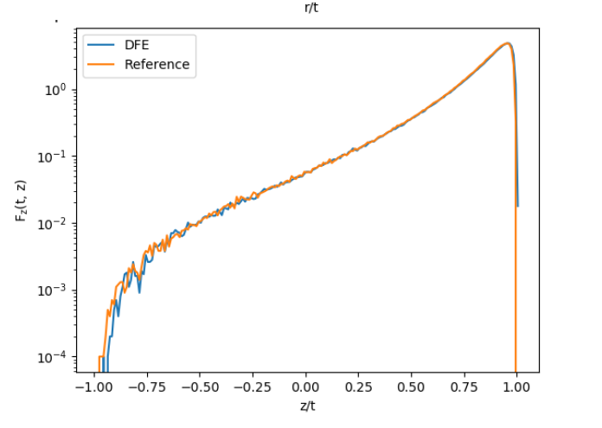
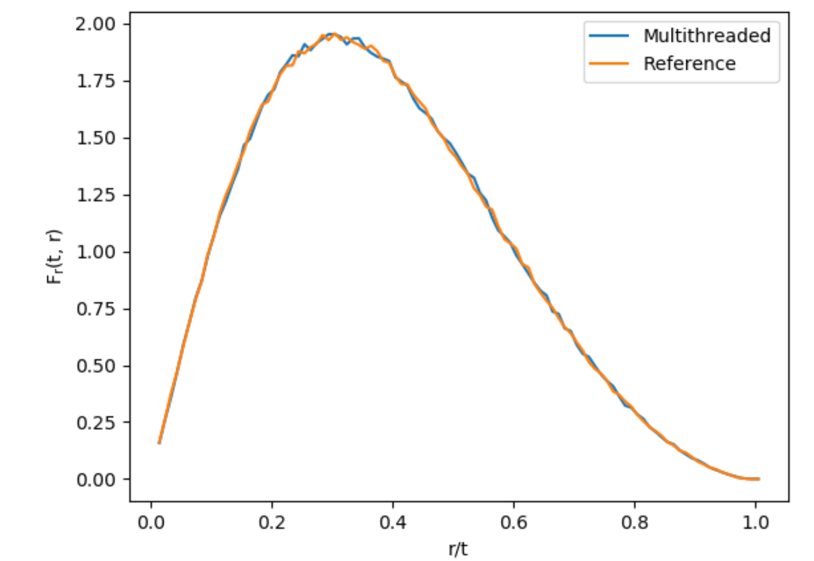
Histograms
It passes a KS-test

Slide 18
Performance measurements
The FPGA accelerated version is:
270x faster than an optimized single-core implementation
110x faster than multi-core implementation (12-cores)
10x cost-equivalent speedup
The theoretical 128x does not account for overhead and CPU data aggregation
Using MaxCompiler the architecture achieves 300Mhz resulting in a
160x speedup

Slide 19
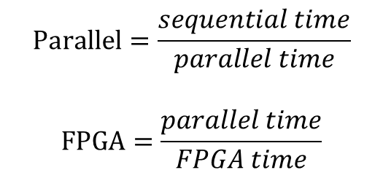
Performance measurements
$$Parallel=\frac{sequential time}{parallel time}$$
$$FPGA=\frac{parallel time}{FPGA time}$$

Slide 20
Conclusions
FPGAs can be multiple orders of magnitude faster than CPUs and GPUs when accelerating suitable workloads
Due to their stochastic nature Monte Carlo simulations greatly benefit from FPGA acceleration
The results shows 110x speedup compared to high-end multicore consumer CPUs
Following a formal methodology and HLS toolchains high performance can be achieved with no previous FPGA programming experience

Slide 21
Workload selection
Not all workloads benefits from FPGA acceleration!
FPGA have higher throughput than CPUs (and GPUs) if the workload:
  Has many branch mispredictions
  Has many cache faults
  (optional) Embarrassingly parallel
  (optional) Independency
Note: in the case of L1 trigger, latency is more important than throughput

Slide 22
Monte Carlo

Slide 23
Minimize data storage
Reduction
3D
2D
Source: Kotlarchyk M. Scattering theory. Encyclopedia of Spectroscopy and Spectrometry, 1999.

