Slide 1

Fortnightly Meeting
Tarik Ourida

Slide 2
Introduction
Studied MEng Electronic and Information Engineering at Imperial
Now undertaking a PhD under the joint supervision of Wayne Luk and Alex Tapper
Over the MEng, I covered many fields but found myself interested in computational acceleration by use of FPGAs
Current project involves CNN acceleration for particle trajectory tracking
Notes:
(1.5 min) Hi everyone. My name is Tarik, I studied electronic and information engineering here at imperial. Eie is like a cross between eee and computing. I have recently started my phd under the supervision of alex tapper and wayne luk. The way I ended up finding myself doing a phd derives from my interest in fpga acceleration which I gained throughout my undergraduate studies. Currently, I am working on a project regarding the acceleration of convolutional neural networks in the context of particle trajectory tracking at cern.

Slide 3
CNNs
Machine learning technique used for classification of a multidimensional input
Convolutional filters allow for dimension reduction
Common architectures make use of 2D convolutions (as well as pooling, activation functions and flattening)
Most common use case: image classification
Notes:
(1.5 min)
Cnns are a machine learning technique which is used for the classification of a multidimensional input. Unlike a fully connected multi layer perceptron, cnns use sliding convolving windows to obtain feature maps. An advantage of this, especially when coupled with pooling, is that the number of parameters and subsequent inputs to hidden layers are reduced, leading to an overall reduced computational complexity of the model. Additionally, fully connected multi layer perceptrons suffer from overfitting, and with the current tradeoffs considered with modern hardware, an algorithm which has an inherent reduced computational complexity will be desirable.

Slide 4
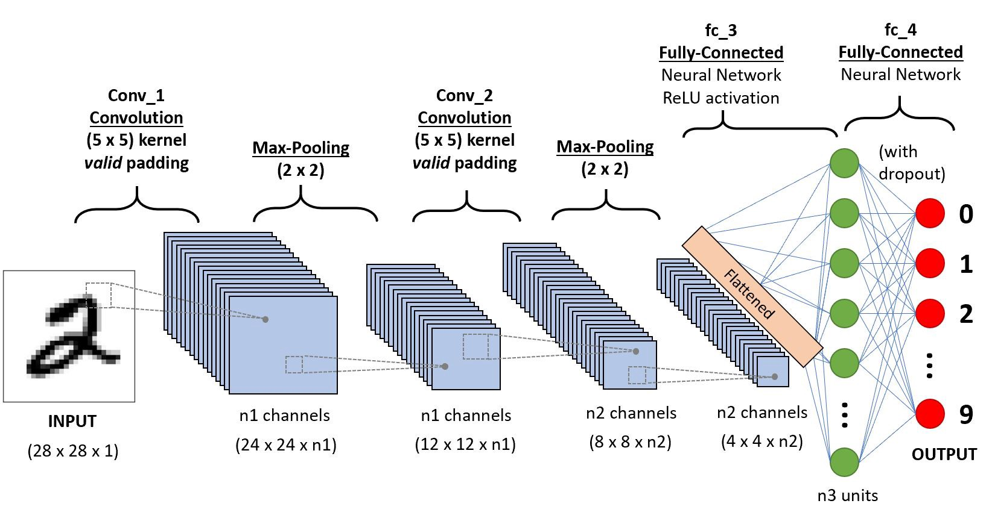
Typical CNN Architecture
Notes:
Sliding conv
Pooling to reduce feature map sizes

Slide 5
My Project
Familiarise
Familiarise self with existing project
Extend
Extend codebase to implement and verify CNN architectures using the MaxCompiler
Compare
Compare hardware and software latency for CNN section of LLP Jet Algorithm
Notes:
First took some time to read the existing report, and remind myself about some physics as I hadn’t studied any particle physics since my a levels.

Slide 6
End Milestones
Fully implement and test CNN part of trajectory algorithm
Implement parameterizable version
Software to bitstream CNN generator for any application
Training and architecture developed in software, subsequently implemented in hardware
Notes:
replace cnn part of deep network
Come up with parameterizable version
Software to bitstream for any application
Train in software, then impl in hw
Learn tools, methodologies, decision process for fgpa design

Slide 7
Future Research
FPGAs are of interest currently
Would like to explore other FPGA applications
PhD very undirected currently, as to be expected

Slide 8

Any Questions?

