Slide 1
Simulations
Simulations
14/04/2021
Marco Barbone
m.barbone19@imperial.ac.uk

Slide 2
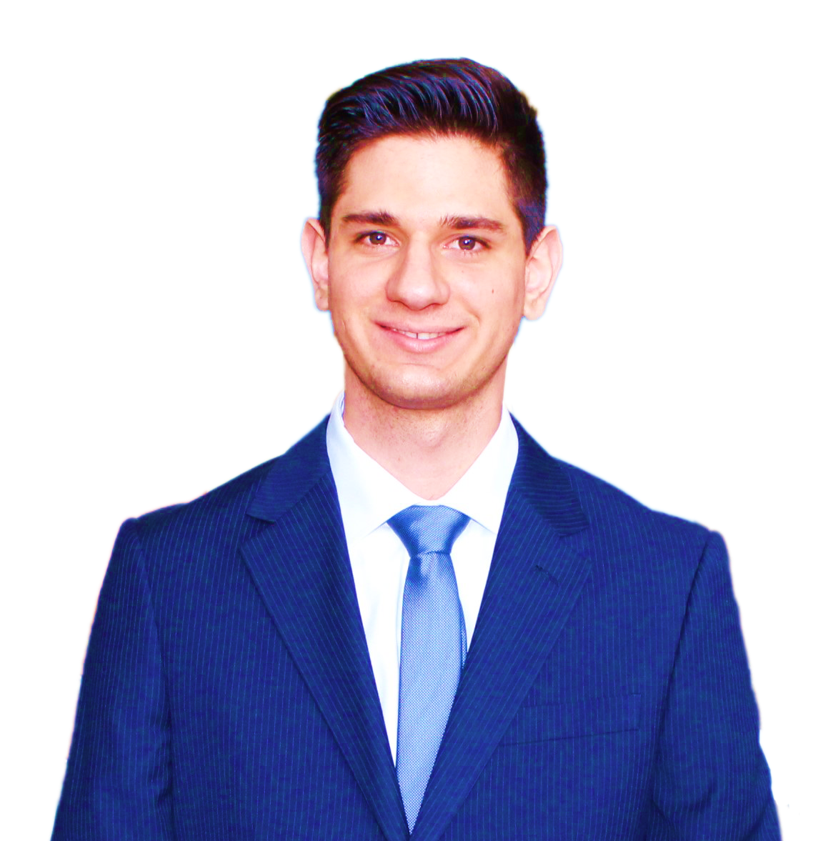
About me
M.Sc. in Computer Science and Networking Scuola superiore Sant’Anna & Università di Pisa
CERN OpenLab Summer student
Research Software Engineer, Maxeler Technologies
Ph.D. Student, Custom Computing research group, Imperial College London, Supervisor Prof. Wayne Luk
Member of Imperial College CMS group
Associate Ph.D. Student, The Institute of Cancer Research, London

Slide 3
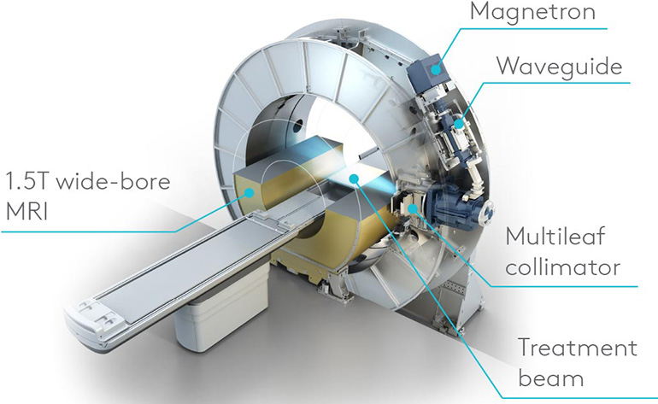



MR-Linac
combines an MRI scanner and a linear particle accelerator
Source: https://www.icr.ac.uk/news-features/mr-linac

Slide 4
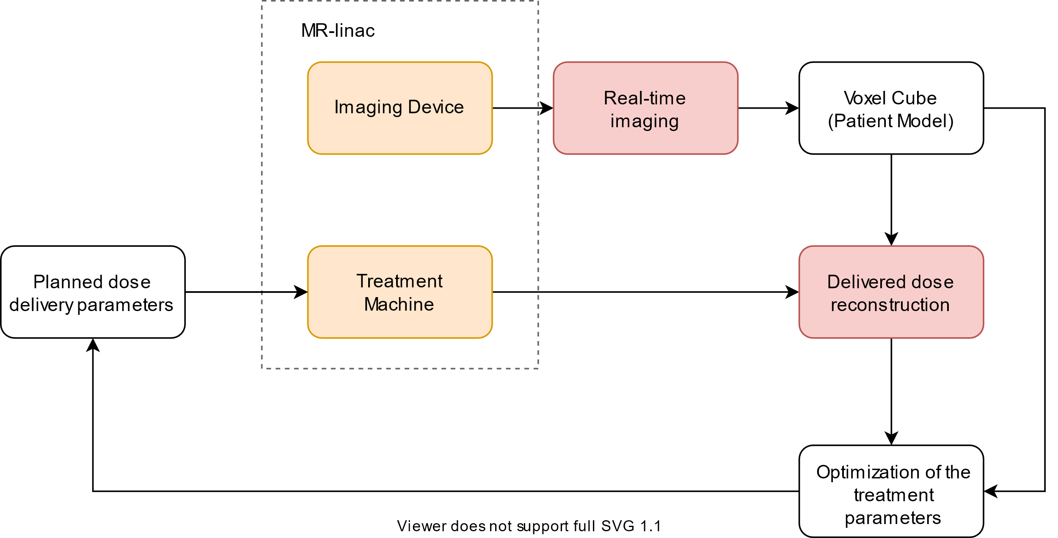
Real Time Adaptive Radiotherapy
New computing
challenges
Monte Carlo

Slide 5
Workflow
Clinicians
Physicists
Engineers
Monte Carlo
Simulator
Requirements
Modelling
Implementation

Slide 6
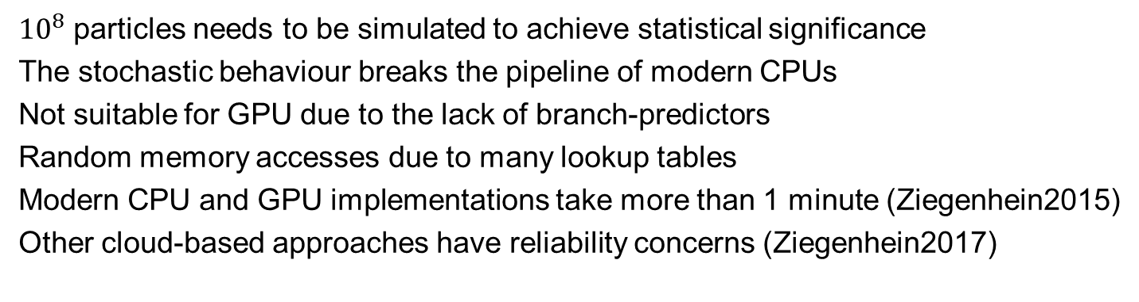
Expensive
${10}^{8}$ particles needs to be simulated to achieve statistical significance
The stochastic behaviour breaks the pipeline of modern CPUs
Not suitable for GPU due to the lack of branch-predictors
Random memory accesses due to many lookup tables
Modern CPU and GPU implementations take more than 1 minute (Ziegenhein2015)
Other cloud-based approaches have reliability concerns (Ziegenhein2017)
Source: https://iopscience.iop.org/article/10.1088/0031-9155/60/15/6097/meta https://iopscience.iop.org/article/10.1088/1361-6560/aa5d4e/meta

Slide 7
Worst-case for branch predictors
Assuming rng uniformly distributed:
if(rng.getRandom() < 0.5) then f(x) else g(y)
In the GPU case branches can significantly affect the instruction throughput by causing threads of the same warp to diverge.
The diverging branches are de-scheduled!

Slide 8
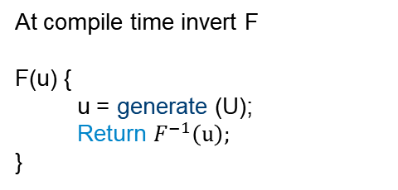
Rejection sampling
Inversion method
At compile time invert F
F(u) {
  u = generate (U);
  Return $F^{−1}\left(u\right);$
}
F(u) {
  do { generate (U) }
  while ( U > threshold);
  Return U;
}
No while loop!

Slide 9
Rejection sampling
Inversion method
RNG
Sample
RNG
Inverse
Stall
Stall
Value
Inversion method is the most efficient on FPGA (Thomas2006)
Source: https://www.doc.ic.ac.uk/~wl/papers/iee07dt.pdf

Slide 10
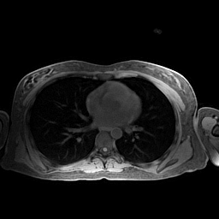
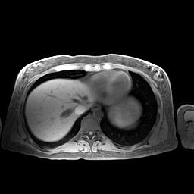

Breathing
$${FT}^{−1}$$
courtesy of Andreas Wetscherek

Slide 11
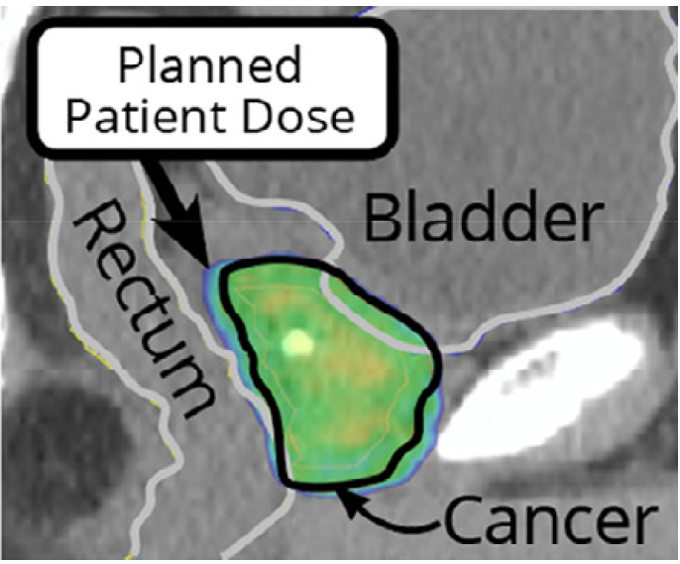
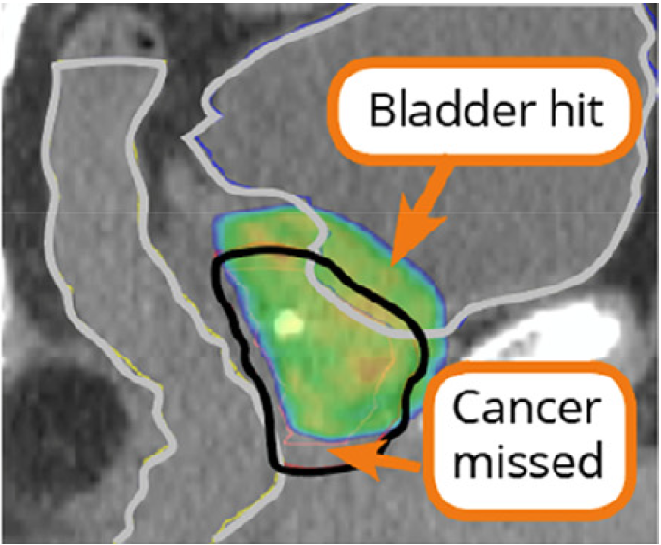
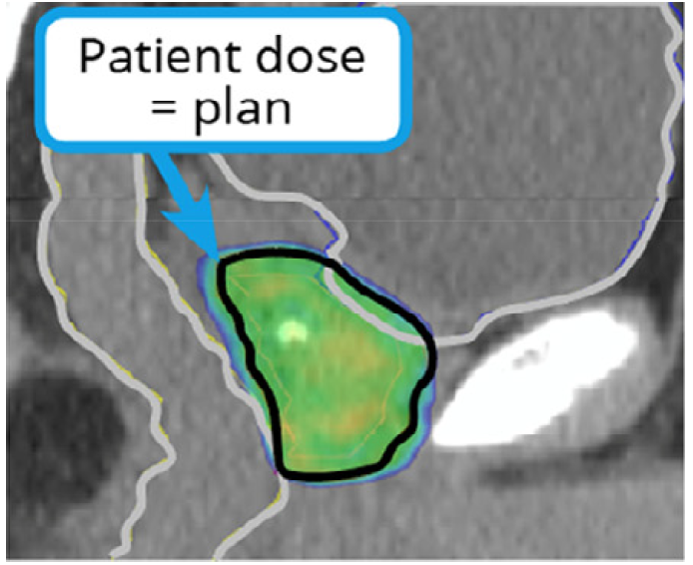
Radiotherapy
Planning
Outcome
Desired outcome
Source: https://doi.org/10.1016/j.semradonc.2019.02.005

Slide 12
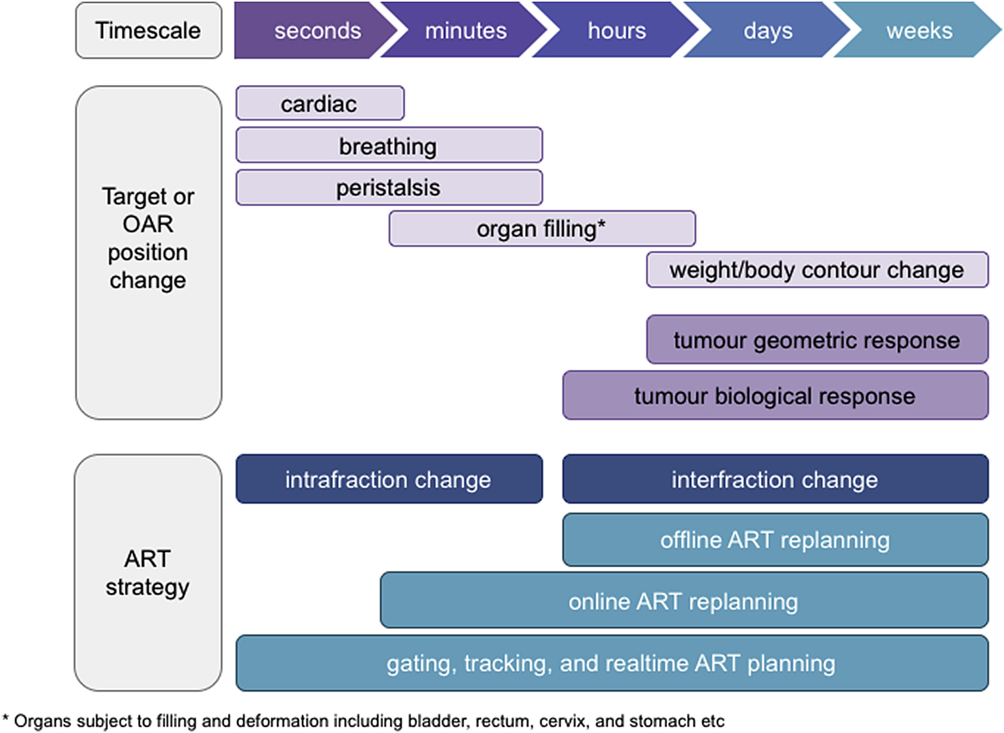
Adaptive Radiotherapy
Seconds
Minutes
Source: https://pubmed.ncbi.nlm.nih.gov/30201276/

