Slide 1

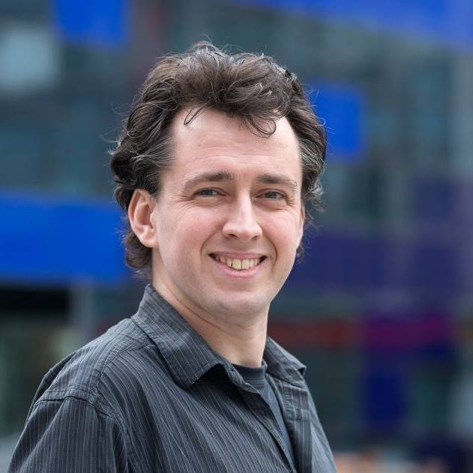
Introduction
Centre for
High-throughput Digital Electronics and Embedded Machine Learning
Andy Rose, Alex Tapper
HEP Group
Imperial College London
Alex Tapper
awr01@imperial.ac.uk
Andy Rose

Slide 2
Welcome!

Slide 3
Topics
ML
GNNs
CNNs
A very broad remit!
Hopefully something for everyone
LSTMs
DBscan
Track-finding
PRNGs
Particle-scattering simulations
Time-series analysis

Slide 4
House rules
Be honest – this is a working group, not a conference
  Show us your work-in-progress
  Say when you are stuck
  Ask for feedback on new ideas
  Ask questions if you don’t understand something
  Show off your brilliant technical insights and breakthroughs – we’re like-minded geeks and nerds who’ll appreciate it
If someone says something that is wrong, offer constructive advice, not criticism

Slide 5
The plan
We wanted to “start small” and, once established, work up
  Try to set up a pattern for collaboration and then invite other
Aiming for ~fortnightly formal meetings
  Although next meeting is in 3-weeks
There is a skype group which people should feel free to post questions and relevant conversation to between formal meetings
Any questions?

