Slide 1
Update from Science Board
What we do
(Computing related) updates + current issues
Tara Shears, for Science Board.
.

Slide 2
Science Board terms of reference:
“…to provide the STFC with a strategic scientific overview and assessment of, and science advice on, all of the programmes STFC supports.”
Reliant on:
Advisory panels
Peer review panels
Other (expert) review committees
You, the community.

Slide 3
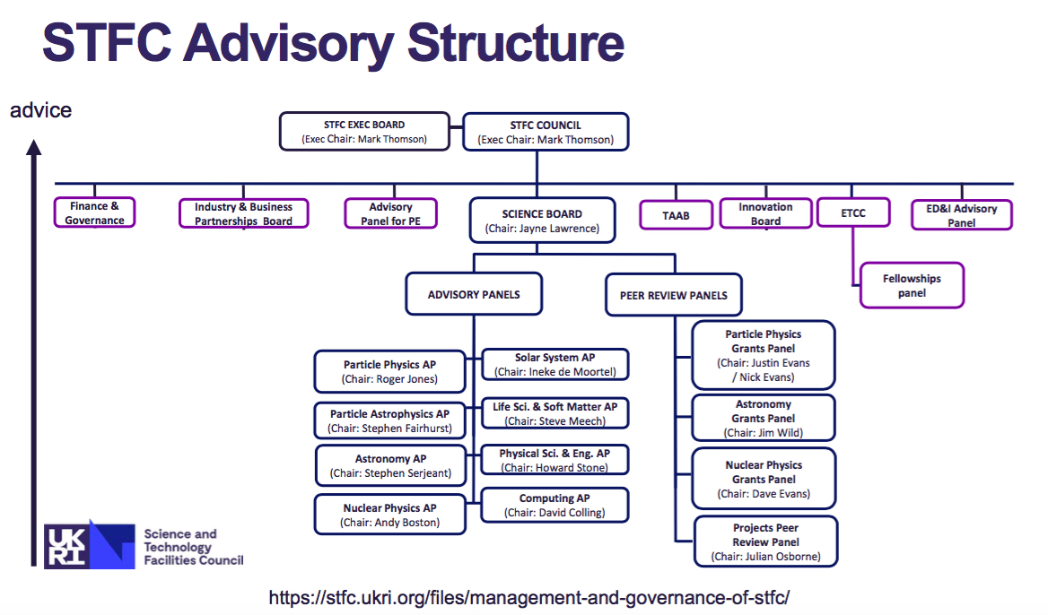

Slide 4
Science Board Membership:
Jayne Lawrence (Manchester) (Chair)
Tara Shears (Liverpool) (Deputy Chair)
Martin Bauer (Durham)
Andrew Beale (UCL)
Stewart Boogert (Royal Holloway)
Bill Chaplin (Birmingham)
Andrew Coates (UCL/Mullard)
Gavin Davies (Imperial)
Karen Edler (Bath)
Keith Grainge (Manchester)
Stephen Hayden (Bristol)
David Ireland (Glasgow)
Martin King (Royal Holloway)
Paul McKenna (Strathclyde)
Alex Murphy (Edinburgh)
Robin Perutz (York)
+ 14 non-core members
STFC Office: Karen Clifford
(new / changed)
https://stfc.ukri.org/about-us/how-we-are-governed/advisory-boards/science-board/

Slide 5
Updates and current issues
Advisory panel interactions:
CAP (+IRIS) in October
Strategic reports:
Programme evaluations
(Upcoming) Balance of Programmes 2
Projects:
GridPP 2020-24 (funded) - concerns about meeting capital costs
Dirac operations 2019-22 (funded) – concerns about electricity costs being met by government capital funding (STFC has insufficient funds).
  (both funded at the level permitted by programme funds)
Priority projects exercise

Slide 6
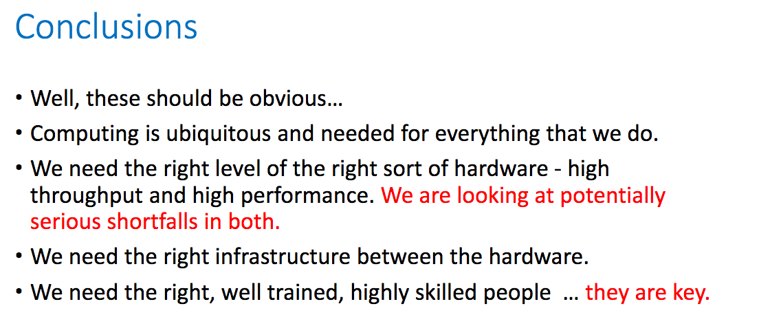
CAP (+IRIS) reports:
(from CAP report)
We have raised the impending significant shortfall in computing resources with Council
These points are also picked up in the programme evaluations

Slide 7
Programme evaluations:
Three year rolling programme to “define a balanced programme of excellent science within a realistic financial planning envelope” in each PPAN area, followed by a balance of programmes exercise:
Accelerator Science, Astronomy, Computing, Nuclear Physics, Particle Physics and Particle Astrophysics have been evaluated
All evaluation reports were made public in December 2019
https://stfc.ukri.org/about-us/our-purpose-and-priorities/planning-and-strategy/programme-evaluation/balance-of-programme-exercise-ppan/

Slide 8
Findings:
Recommendations:
Projects: ensure adequate computing provision for projects throughout lifespan, include costings at conception; improve DIRAC funding mechanism; encourage projects with common computing requirements to collaborate and share best practice
Partnerships: should enhance collaboration within discipline and UKRI; link with industry to improve skills development
Careers: Invest in more CDTS, early career fellowships, improve diversity and returner support
+ pay attention to hardware developments, effect of Brexit, support outreach …....
(All 16) recommendations fully supported by CAP.
https://stfc.ukri.org/about-us/our-purpose-and-priorities/planning-and-strategy/programme-evaluation/balance-of-programme-exercise-ppan/

Slide 9
Findings:
Particle Physics:
Recommendation 6: STFC should consider how it should provide resources to address the long term software and computing needs of the programme, especially in the context of the challenge of the HL-LHC and other large experiments.
Recommendation 7: STFC should examine the need and justification for a new initiative in computing efficiency and advanced techniques, focussed in the first instance on the needs of HL-LHC, and complementary to national projects in computing infrastructure

Slide 10
Findings:
Astronomy:
Recommendation 12: Large-scale computing is an integral part of modern-day astronomy, both for modelling and data analysis and should be funded as such. Large-scale computing needs a substantial uplift if we are to retain (or regain!) our international competitiveness as current provision is a long way below requirements. Support would have to be multi-tiered with local, regional and national facilities. Such a multi-scale structure would allow the most efficient use of computing facilities at each level. Hardware infrastructure needs to be accompanied by sufficient staff provision to give local support e.g. for data access issues, software compatibility etc. In addition, the Panel strongly recommends that STFC continues and preferably increases its support for DIRAC.
Recommendation 13: There is a growing need for more money to fund data and analysis needs that go hand in hand with being part of “Big Data” facilities such as LSST and SKA. This plan needs to be put in place early.
Recommendation 14: A clear career structure for astronomical software engineers should be established.

Slide 11
Balance of Programmes 2
Balance of Programmes 2 will take place in first half of 2020
  Panel = Science Board + programme evaluation chairs will be invited
  Financial scenarios to be defined (depends on future funding levels…)
  Final report to be made public.
We need:
  (Any) Updates in community priorities since the evaluation
  (Any) Updates in activities and future opportunities since the evaluation
  Comments on evaluation findings welcome
  Please give info to CAP (to give to us), or raise here
(request to advisory panels imminent)

Slide 12
Developing a World Class Research Programme /
“Priority projects”
CAP, along with other AP/similar bodies, submitted ideas for the Priority Projects/WCRP scheme.
Update process:
Major review of the ‘Developing a World Class Research Programme’ priority list every three years; next review in 2021;
Annual process for the advisory panels to consider any urgent developments; constant overall length of list
Science Board input; commenting on scientific case
Some projects have been submitted to UKRI funding calls (see Mark’s talk)
https://stfc.ukri.org/about-us/our-purpose-and-priorities/planning-and-strategy/stfc-reviews/research-programme/

Slide 13
Developing a World Class Research Programme /
“Priority projects”
Should the process evolve further?
Some issues have been identified:
Other Councils approach this a little differently (eg EPSRC Big Ideas scheme)
Priority project/WCRP list may not be the same as community roadmaps; tension
WCRP exercise has generated projects (by design)
Can we generate ideas for grand challenges as well as projects?
We are discussing the approach in Science Board.
Your views and input are welcome (here or email us).
https://stfc.ukri.org/about-us/our-purpose-and-priorities/planning-and-strategy/stfc-reviews/research-programme/

Slide 14
Summary of current issues:
Funding level – what will it be?
Considering Priority Projects approach
Main short term business: Balance of programmes 2

