Slide 1



White paper on software, skills
and training
Editors: Simon Hettrick, Alys Brett
Authors: Alys Brett, Neil Chue Hong,
James Hetherington, Simon
Hettrick, Barbara Montanari,
Christopher Woods

Slide 2
Vision for the UK
Research policy
Funding
Skills creation
A policy environment that
recognises and rewards software
Building a
globally unrivalled environment for the development of software to power research and innovation
A funding environment to
extract value from software
An environment to build
world-leading skills in software
Total budget: £615M

Slide 3

The Rationale for Software
Hard to envisage any research that will not need software over current decade
Research reproducibility relies on high-quality software
Software encapsulates knowledge
Also:
Software drives value extraction from investments such as hardware, instrumentation, researchers’ time, …
Embodiment of methods and algorithms, including AI, is software
Data pipeline relies on software (from instrument control to publication)
Even this presentation was done by software! (very “meta” of me…)

Slide 4
Software Lifecycle

Slide 5

Challenges
Software is highly diverse
Current research evaluation practices do not recognise software adequately
Software needs to be funded according to its infrastructure nature
Software is intangible and its essential role often goes unnoticed
Software needs an army of specialised and dedicated people, driven by research but focused on the software as an infrastructure, for development, maintenance, porting, user training and support, etc.
The rapid pace of research and technology requires a constant updating of skill and expertise as well as the nourishment of close relationships among software engineers, methods and algorithm developers, researchers, hardware and data experts, etc.

Slide 6
Recommendations
Change funding practices to reflect the importance of software:
  Fund software appropriately throughout its lifecycle
  Provide long-term cross-UKRI support for software maintenance and development which spans CSRs
  Provide researchers with greater access to expert RSEs through a nationally coordinated and funded service
Improve understanding of RoI in software:
  Increase evidence base used to direct future UKRI software funding strategy
  Support the recognition of software as a research output

Slide 7
Recommendations
Fully exploit investment in R&I by increasing access to software experts:
  Promote networking and sharing of expertise and resources in research
  Support existing software communities
  Attract and retain skilled software specialists
  Provide broadly required services centrally
  Investigate the usefulness of an audit/quality kite mark for software
Expand training to meet evolving requirement of research:
  Maintain UK leadership in research software
  Improve training at all career stages
  Support an analysis of software training

Slide 8
Goal-driven Interventions Logic: an example

Slide 9
Policy
Goals
Investments
Recognise that software is an essential, valuable and impactful part of research
Improve the effectiveness of funding invested into software use and development
Recommendations rely on changes to UKRI policy and, as such, will be costed by UKRI

Slide 10
Funding
Goals
Investments
Design investment to meet current and future research challenges
Extract full value from software throughout its lifetime
Novel algorithms and techniques: £25M
Software evidence: £2.5M
Maximising impact: £200M
Software product fund: £70M
Challenge fund:£2.5M

Slide 11
Skills
Goals
Investments
Attract and develop talent
Improve and expand training in software skills
Improve access to specialist skills
National facility of RSEs: £75M
Specialist networks: £900k
Computational research: £77M
Training analysis: £1M
Digital skills materials: £2.5M
Software communities: £155M
eCSE programme: see Supercomputing white paper

Slide 12
Software for STFC
Barbara Montanari
Head of the Computational Science and Engineering Division
Scientific Computing Department
STFC
Notes:
The abstract pattern can be removed or repositioned if required. Be careful to ‘Send to Back’ so that it does not obscure any important information.

Slide 13

Split Remits in STFC Software Activities?
STFC Research and Innovation
Beyond STFC Research and Innovation
National experimental facilities
Hartree Centre
Scientific Computing Dept for STFC R&I
Particle physics, nuclear physics and astronomy
Etc.
JASMIN
Activities funded by external grants
Etc.

Slide 14

CoSeC enables researchers do more and better science
It has done so for over 45 years
Today CoSeC supports over 20,000 researchers across a broad range of areas
Notes:
There are a few key messages that I want to put across. The headline is that …
Standing in front of you today for me is an opportunity to show you what in my opinion are the key elements for its longevity and sustained success.

Slide 15
1973: Collaborative Computational Projects
“Primary aim is to bring together scientists to:
Provide for the rapid interchange of information on theory, algorithms, and computer codes
Collect, maintain and develop relevant items of software
Encourage basic research by providing facilities for rapid computer implementation of new methods and techniques
Assess and advice on associated computational needs
Disseminate information among scientists”
Computer Physics Communications 114 (1998) xii-xvii
Notes:
Let’s start with a history lesson. How many people here have heard about the Collaborative Computational Projects, CCP for short?
Even people who have heard about the CCPs, don’t know that the conception of the CCPs dates back to 1973 – that’s 44 years ago!! An eternity when it comes to computing. And yet already then people realised the important of joining together researcher and the e-infrastructure. This is from a paper about the history of the CCPs

Slide 16
1973: Collaborative Computational Projects
“To assist the CCPs, the Science Research Council will provide support as follows:
Support from staff from the Research Council’s Laboratories
Short term appointments of Senior Visiting Fellows
Longer term Research Assistantships
Funding for networking events”
Computer Physics Communications 114 (1998) xii-xvii

Slide 17
Research Areas Currently Supported
Plasma Physics
Biomolecular Chemistry
Structural Biology
Quantum mechanical
Simulation
Molecular Simulation
Atomic and Molecular Physics
Computational
Engineering
Imaging
Materials Chemistry
Notes:
The infrastructure word is crucial here. We in CoSeC are driven by the science but focussed on the infrastructure we need to deliver. So we don’t work simply to generate the next paper but to build and maintain a long-term, large scale capability, which is composed of the methods and software, the expertise of our staff and the deep and strong network of our relationships with the communities we support.

Slide 18
CoSeC Infrastructure Ethos
CoSeC supports research communities to share knowledge and expertise rapidly and effectively, encapsulating it in community software, developed and maintained as a research infrastructure for the benefit of all researchers.
CoSeC people are specialist RSEs, i.e., scientists who combine the science domain expertise with the software engineering expertise
Skills pools built over decades and non-transferable

Slide 19
What CoSeC People Do
Science domain expertise
Software performance, optimization & porting
Build community
Develop software
Maintain, license & distribute software
Develop theories & methods
Validate & consolidate methods
Develop staff
Workflow & visualization
Train &
support users
Data post-processing
Notes:
Scientists who combine the science domain knowledge with great code development expertise. Science driven but software focussed. This enables them to …. Since this is a long terms programme, crucially it provides longevity to the codes supported.

Slide 20

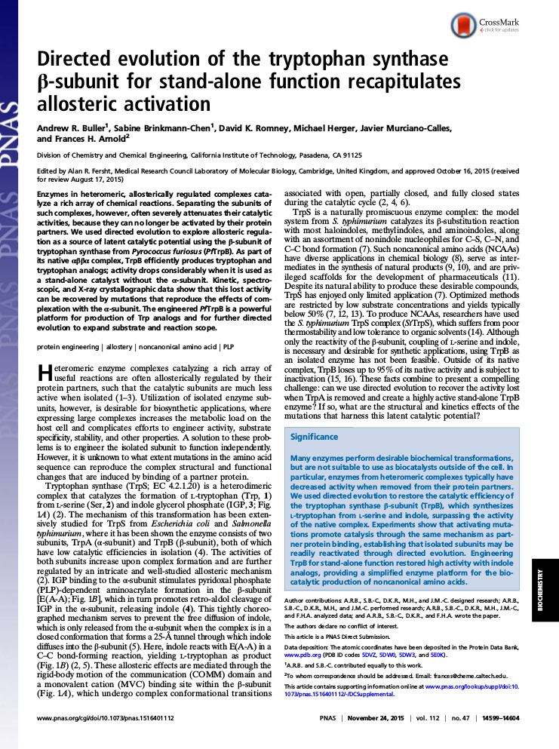


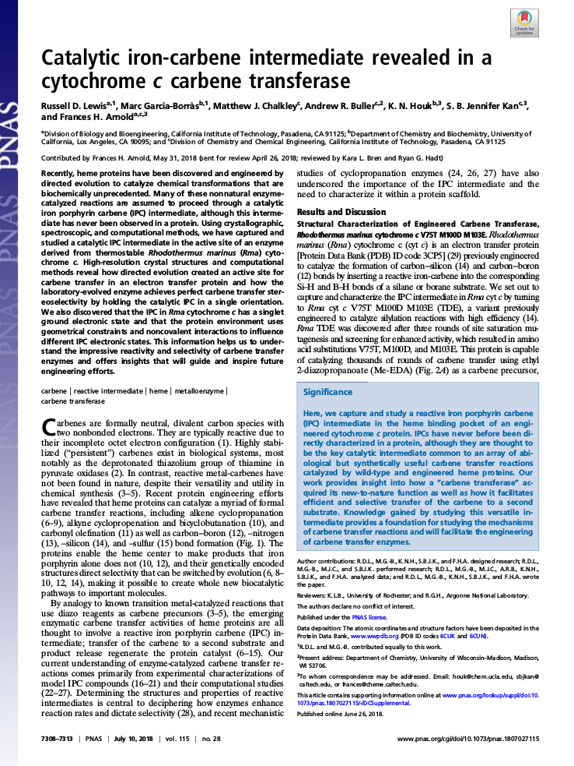
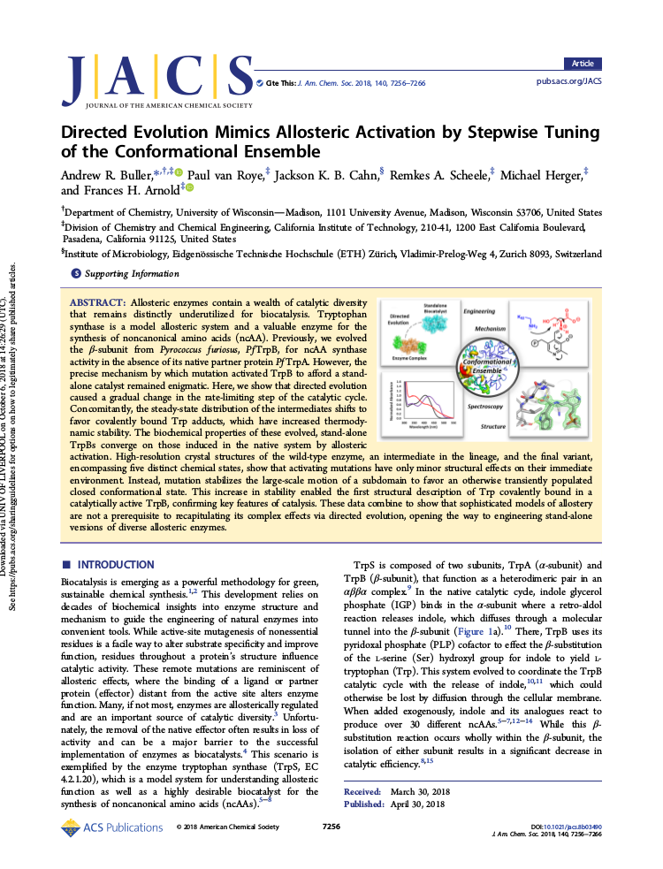
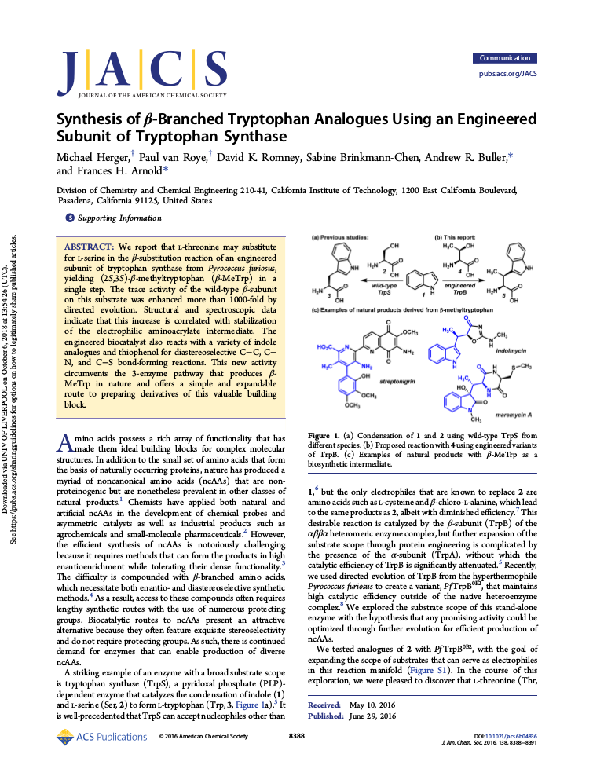

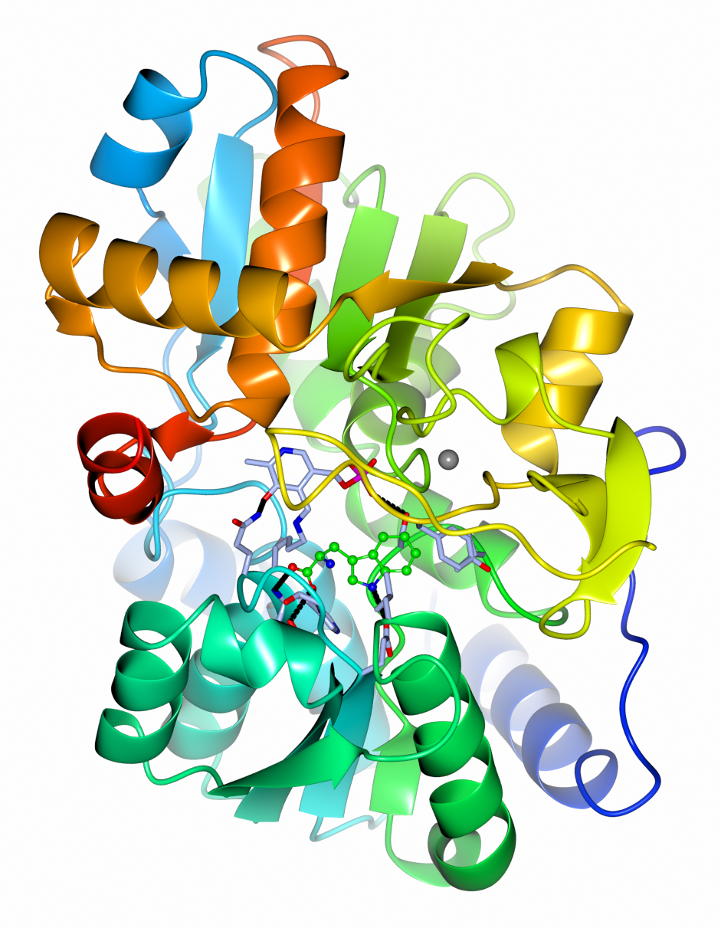
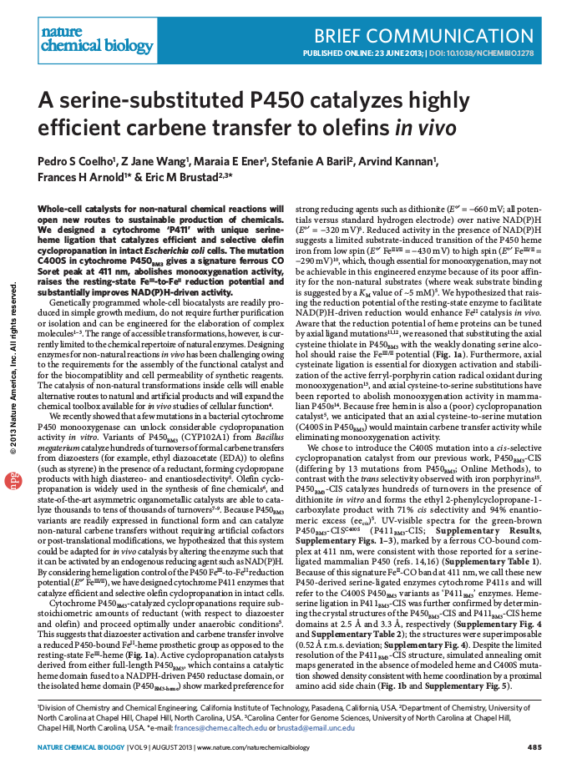


2018 Chemistry Nobel Prize
“Directed Evolution of Enzymes and Binding Proteins”
Frances H Arnold, CALTECH, California, USA
Notes:
CCP 40 year anniversary
Structural biology
Commercially successful and it sustains itself to a large extent through licencing income

Slide 21
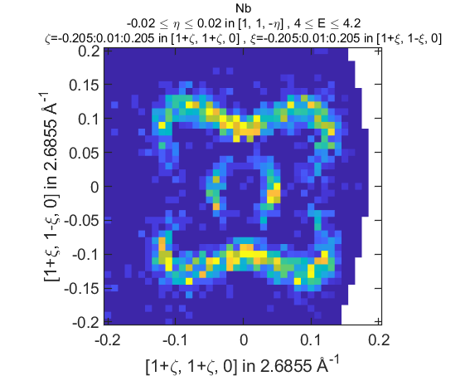
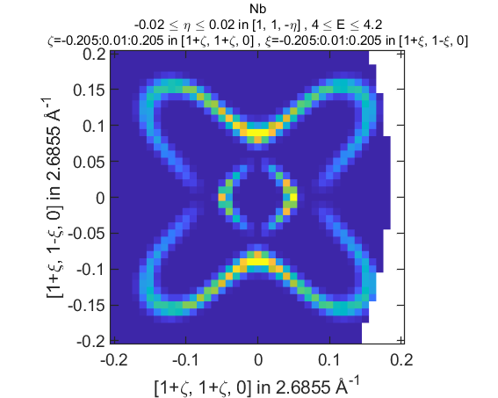
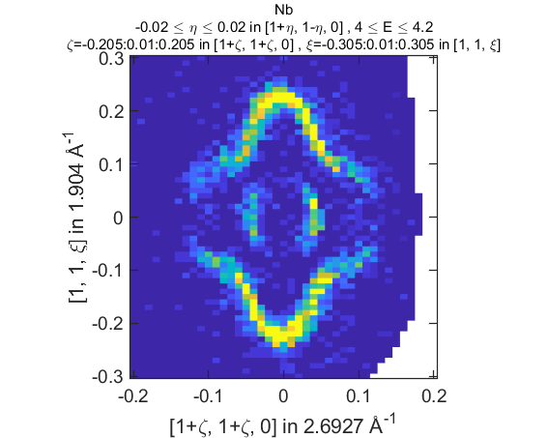
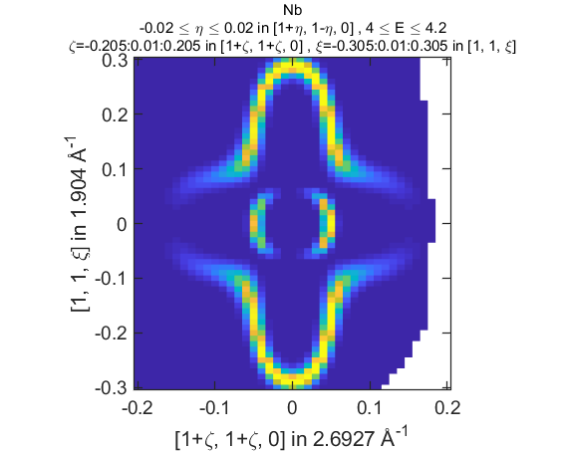

PACE Project
SCD staff have developed a tool to directly compare simulated vibrational data with experiments conducted at ISIS.
Benchmarking and validation against other tools has led to improvements that benefit ISIS, ORNL and PSI/ESRF.
To quote one instrument scientist as ISIS – “It has revolutionized my workflow.” -DV
Notes:
SCD has been involved with this project for ~18 months.
First of its kind software development project funded by ISIS in lieu of an instrument upgrade: ~£1.2M over ~3 years. Toby Perring (ISIS) approached SCD for input on software design, engineering, code optimisation and scaling to HPC.
Goals:
To have ability to conduct virtual experiments ahead of time to guide the collection of data.
To vastly improve time-to-science – currently it can take up to 3 years for an experiment to reach publication, if at all. At least an order of magnitude improvement in computation pipeline is needed.
Also to “lower the barrier to entry” for experimental users to analyse their data.
In addition to shorter time to publication to increase number and quality of publications.
A combination of shared memory and distributed computing with algorithm development will achieve this.
Currently funds one FTE within SCD with two more FTE awaiting appointment. A fourth FTE is embedded in the ISIS Excitations Group.

Slide 22
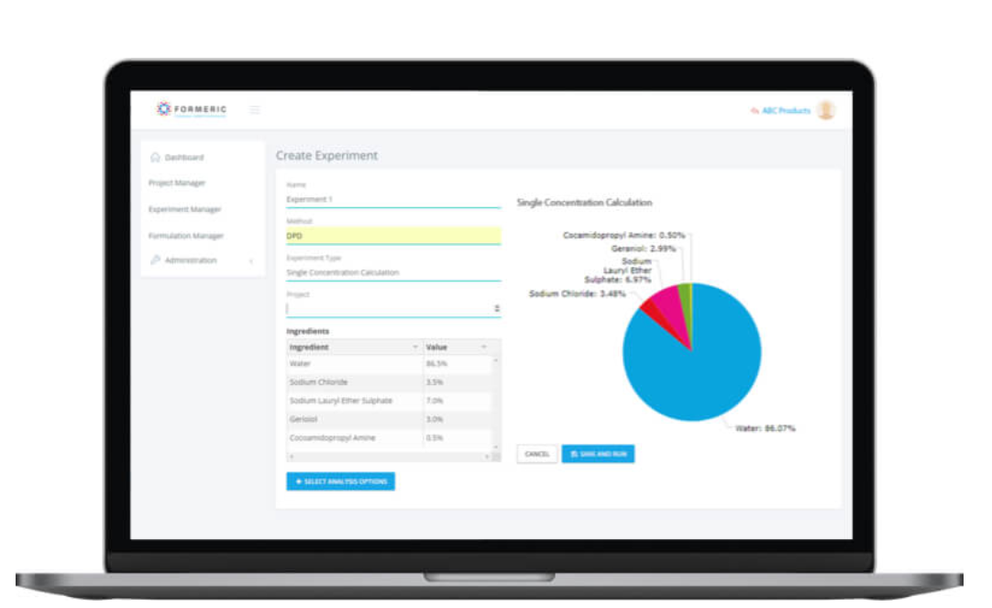
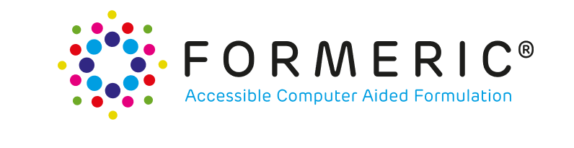
Software for Industry with Hartree Centre
https://formeric.co.uk/
Notes:
the collaboration with Hartree is also crucial. Hartree do a fantastic job to deliver the impact that computing is able to achieve. The collaboration between Hartree and CoSeC results in Hartree projects that make use of codes and expertise developed in CoSeC, increasing the industrial impact of said codes and resulting in further development of the codes. To illustrate this, I would like to mention FORMERIC an STFC spin-out venture which is all about helping industries with the design of their product formulation, from shampoos to fuels.
The aim is to shift from an ad-hoc labour-intensive process towards a more robust and adaptive computer aided formulation paradigm. Formeric meets this goal by enabling users to design new formulated products via a web-based interface which provides access to simulation and modelling tools like DL_MESO, which has been developed over many years within CoSeC.

Slide 23
Challenges/Opportunities
Technological
Social
Exascale
Data deluge
AI
Quantum computing
Etc.
Open research
Strategic approach
Community cohesion
User expectations
People pipeline
Diversity and inclusion
Etc.

Slide 24




Slide 25






Science and Technology Facilities Council
@STFC_Matters
Science and Technology Facilities Council

