Slide 1
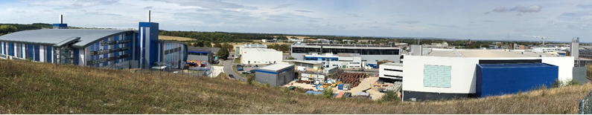
Highly diverse computing (including the long tail)
or
Computing for STFC Facilities

Slide 2
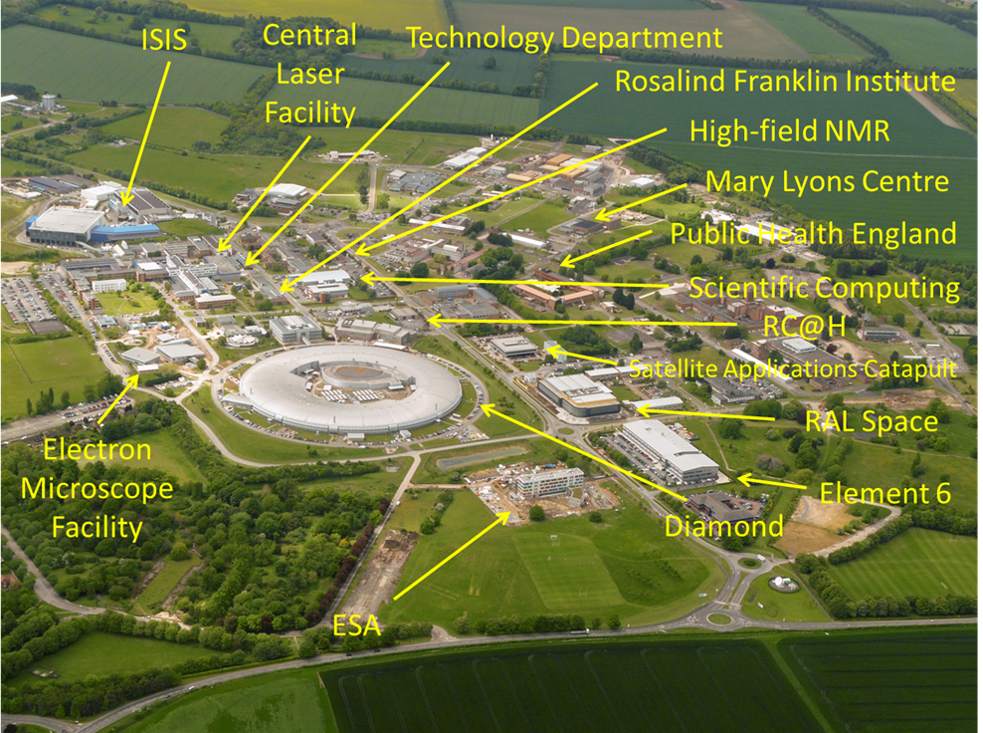
What are the STFC Facilities?
EPAC

Slide 3
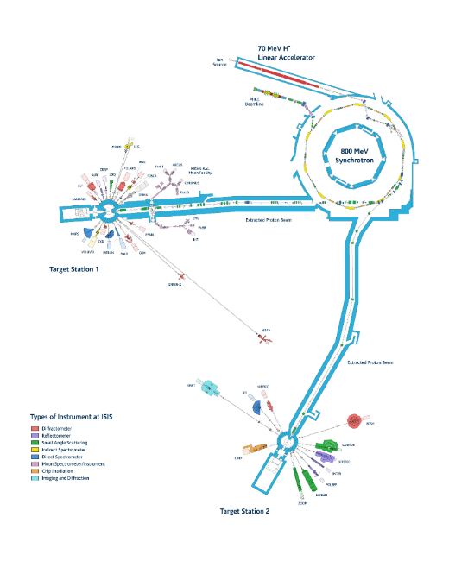
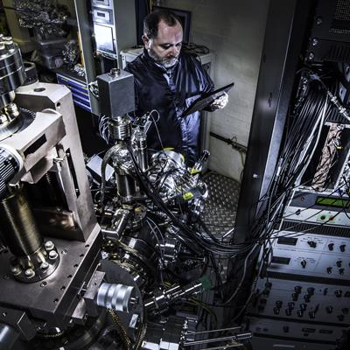
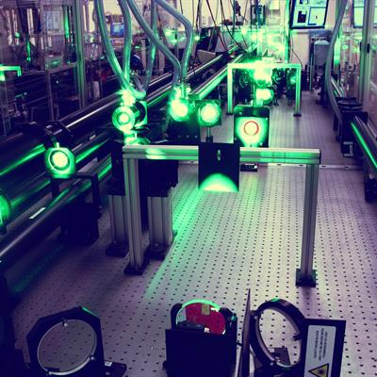
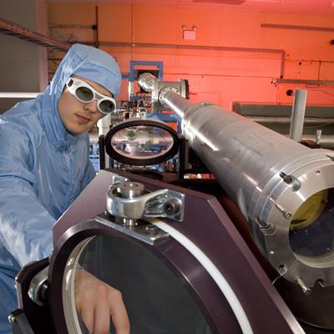
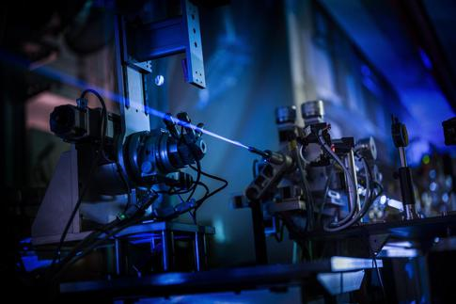
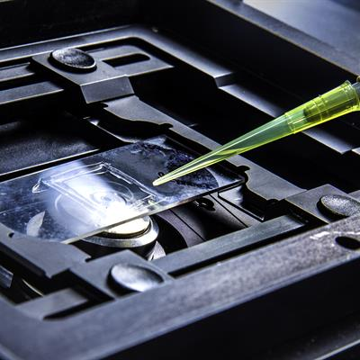
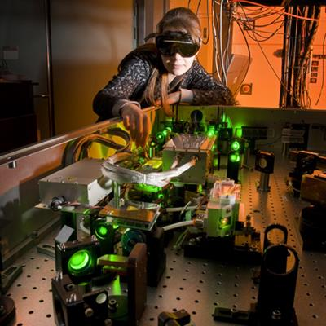
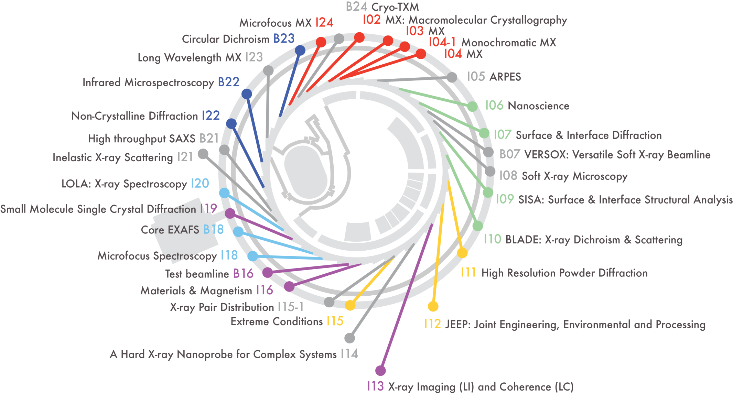
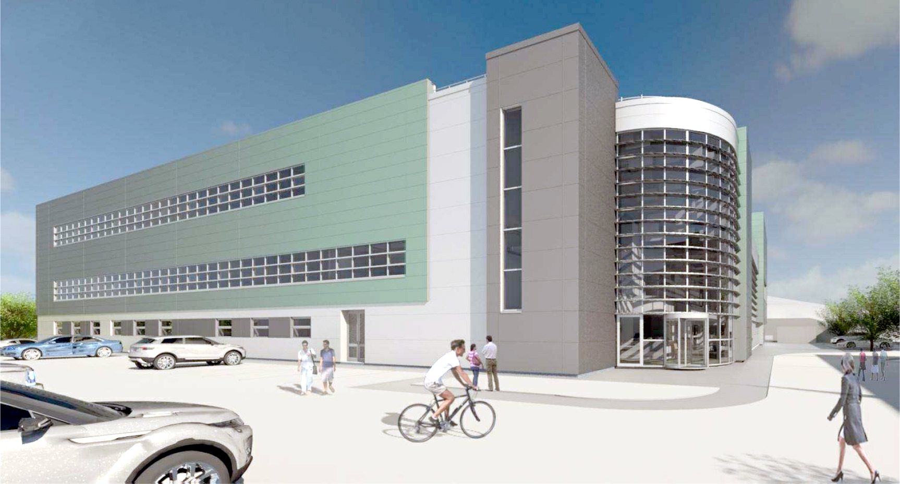
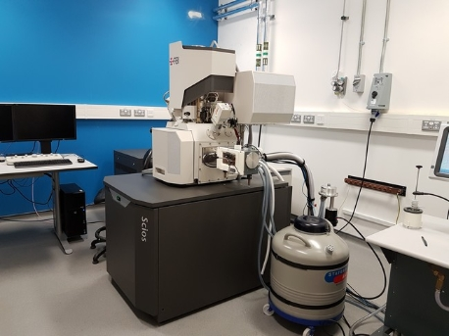
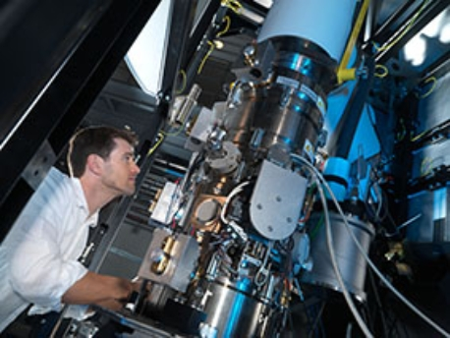
What are the STFC Facilities?

Slide 4
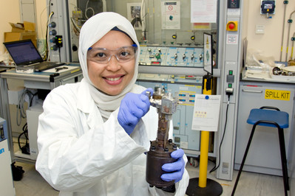
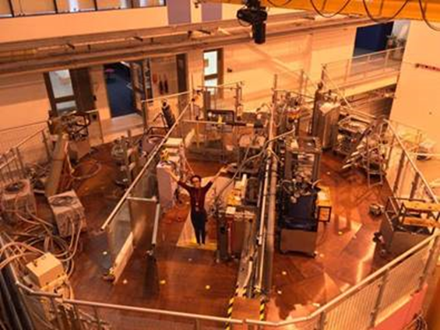
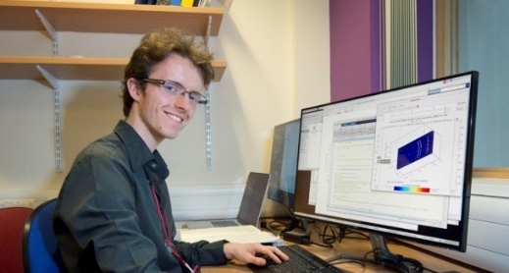
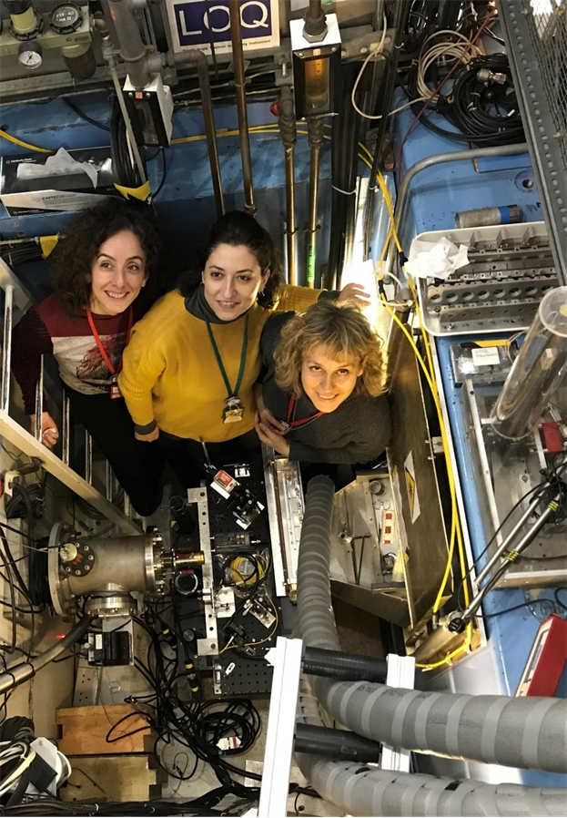
Who are the users?
Diverse …
Thousands of users – national and international, on-site and remote
Biologists to engineers
Experts to non-experts
24/7 operation, multiple simultaneous user groups, individual experiments from minutes to weeks
Continuous development, small and large (eBIC/ePSIC, EPAC, Diamond Lattice upgrade …)

Slide 5
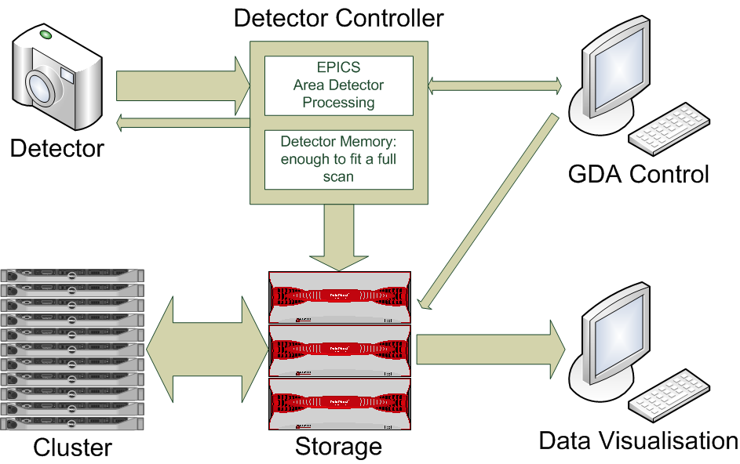
Typical User Data Flow

Slide 6

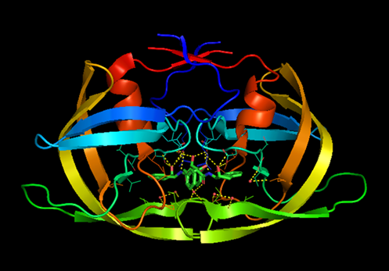
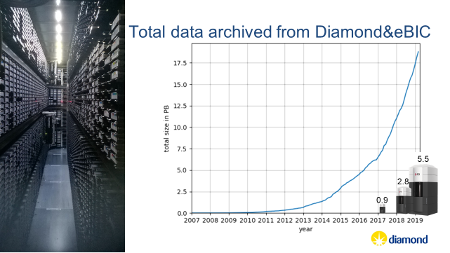
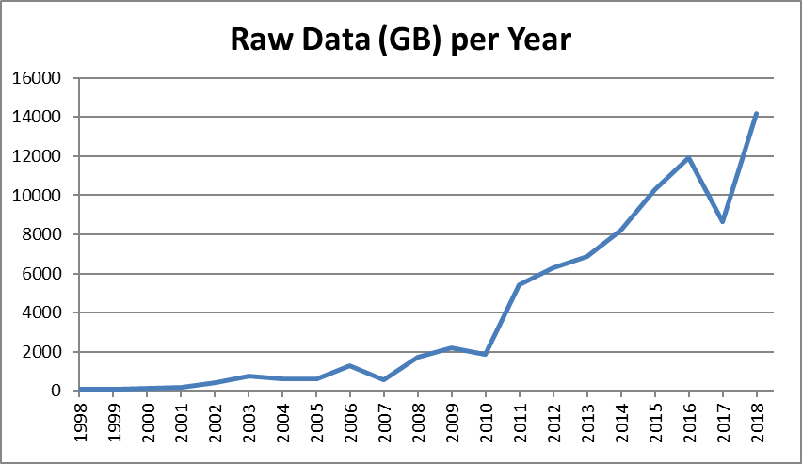
Data
Volumes
Fast/slow access
Metadata
Preservation, curation
Policy

Slide 7
Diverse demands for computing: Examples
Macromolecular Crystallography
High throughput beamlines requiring near real-time feedback on data collected
Typical collecting 300 to 900 data sets per day,
Data range: 5TB to 35TB per day RAW data, 2.5TB to 17TB per day processed data
Imaging Beamline
10 to 200 datasets per day
Data range: 0.5TB to 20TB per day (technique dependant and detector dependant)
Electron Microscopy (eBIC – Life Sciences)
1 dataset collected per 48 hours
Ranges: 4TB to 17TB per day
Electron Microscopy (ePSIC – Physical Sciences)
20 to 300 datasets per day
Data range few GB’s to 100’s GB per day

Slide 8
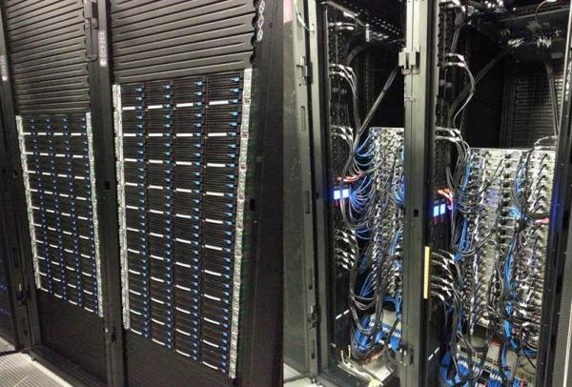
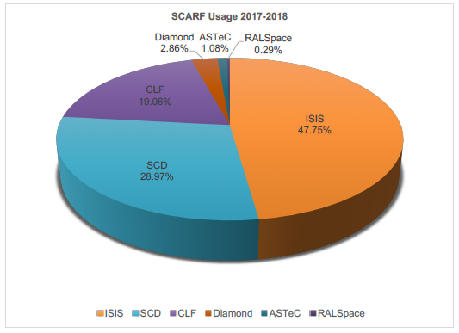
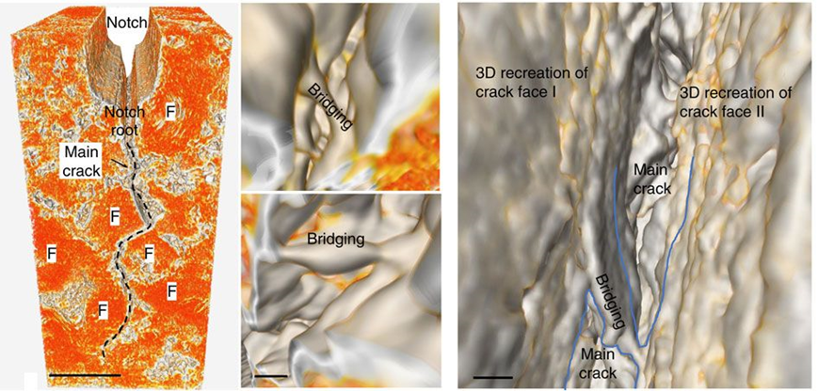
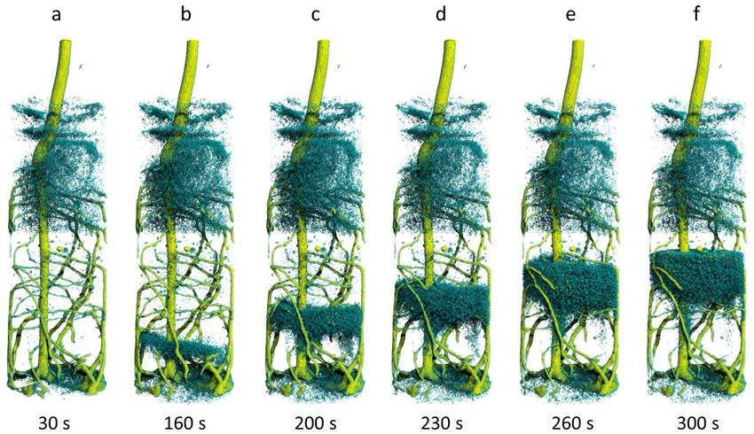
Computing infrastructure
Hardware – at facility or elsewhere (e.g. SCD Scarf)
Fast/slow access
Cloud (e.g. iDAaaS)
Support for modelling/theory?
Networking (including WiFi, Eduroam)

Slide 9
Diverse demands for computing: Infrastructure
Increasing data rates and data volume require ever increasing computational infrastructure to be deployed to support the demand
Diamond currently operates and consumes:
Two onsite data centres
~6000 X86 cores
~200GPUs
~16PB of high performance storage (GPFS) for data acquisition
Utilises offsite IRIS infrastructure for a few pioneering projects and exploring other ‘cloud’ services particularly for post-visit analysis
Retains experimental data on-disk for 30 days
  High data rate experiments are impacted most by this retention period in managing their workflow for data analysis. After 30 days data has to be restored from archive for further processing.
  Some low data rate beamlines in the ‘long tail’ can be afforded the luxury of keeping data online ‘indefinitely’.
  Overall data management has not kept up with the growth in data volumes. Poor data management is an increasing risk to data and timely analysis of data than just lacking computational resource to process data.

Slide 10
Diamond Future Cloud
Offline / Post Processing – enabling users to process data sets beyond the std. 40 day period ‘easily’
  Need to transfer data from DLS to service (driven by DLS, DLS requirement to move offsite certain types of data processing)
  Make ‘Diamond Software stack’ easily available e.g. via Docker/singularity
Burst computing – ‘top-up’ backend infrastructure for Diamond
  Transparent to end users
  Only works for defined, relatively small (depends on target site) datasets.
  Time – dependant analysis
Hosting analysis services based around Jupyter Hub notebooks – user driven/user customisable
  Need to transfer data from DLS to service (on-demand user driven service?)
  Scalable infrastructure need

Slide 11

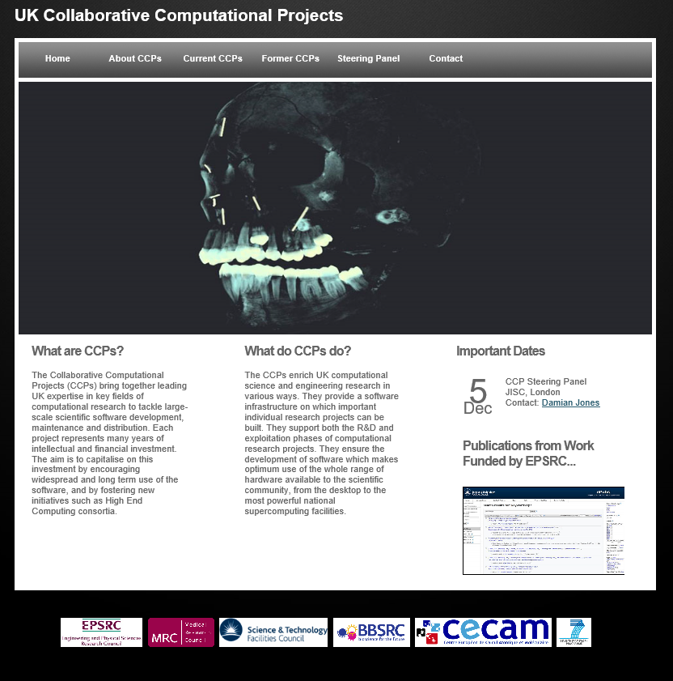
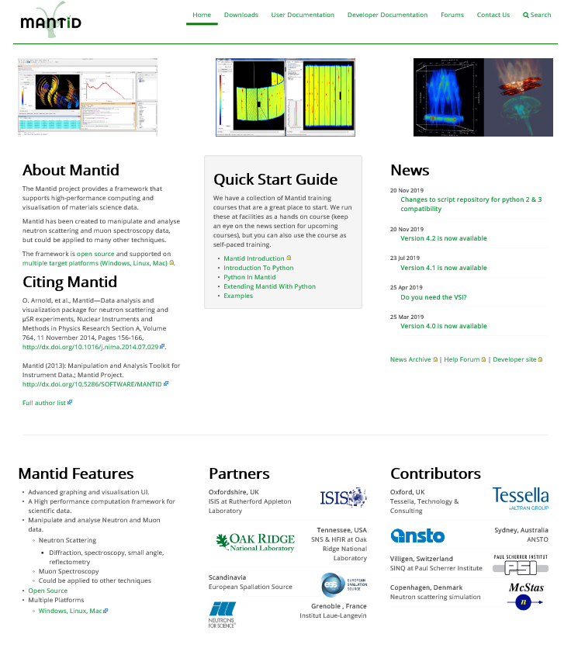
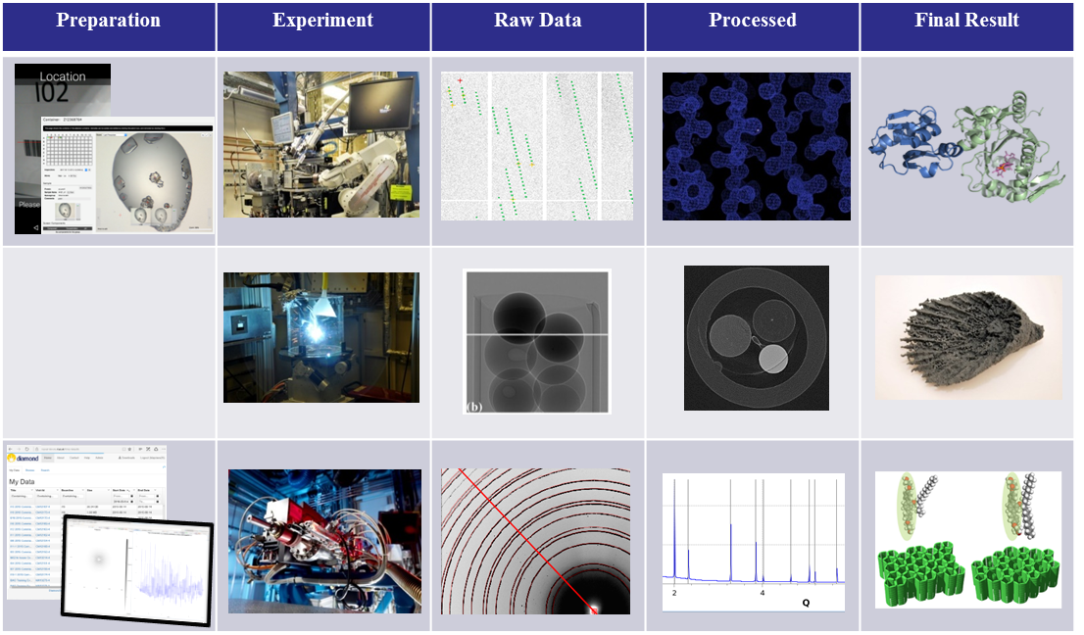
Software development
Full experiment lifecycle: Preparation, Experiment, Reduction, Analysis, Visualisation, Modelling
Transition from ‘lone amateur’ to ‘professional team’’ e.g. Mantid
Collaborative Computational Projects

Slide 12
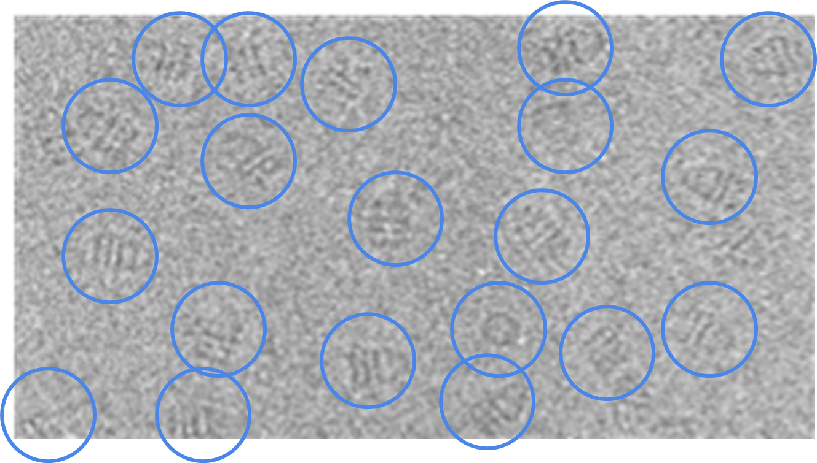

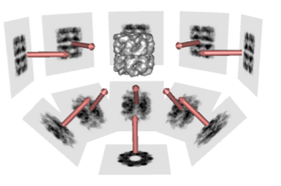
Machine Learning
‘Early days’ for facilities
Imaging was an early adopter
Exploring many other possibilities
Data quality/relevance screening
‘Downstream’ databases?

Slide 13
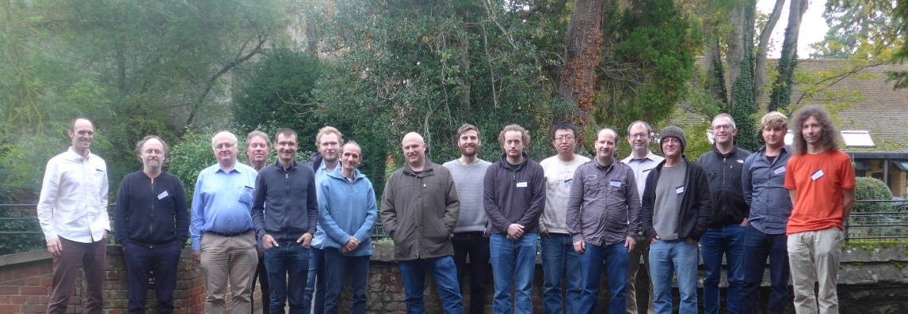
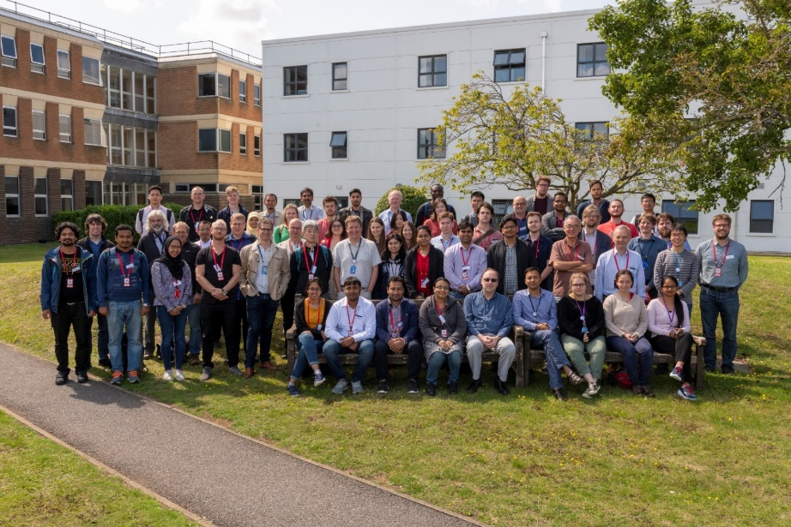
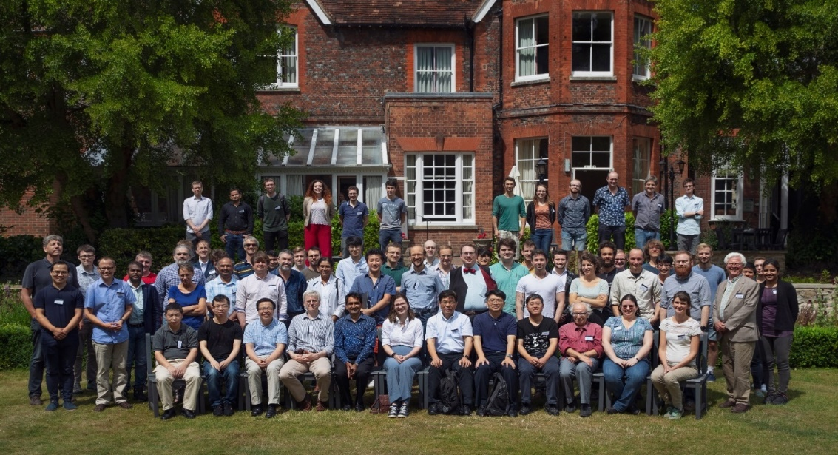
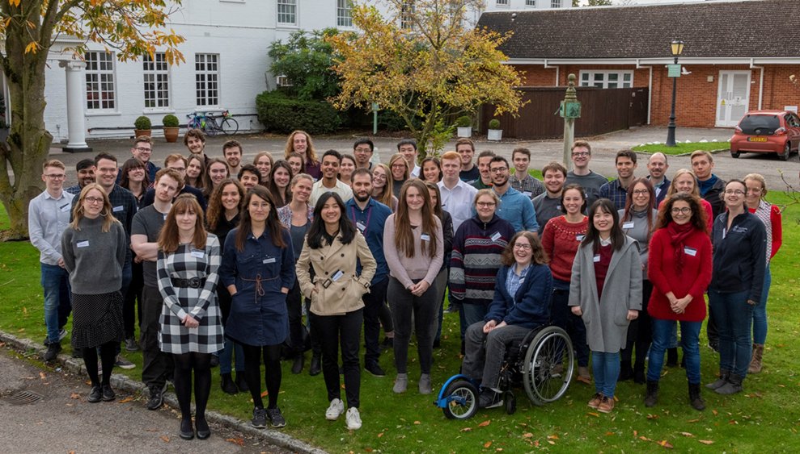
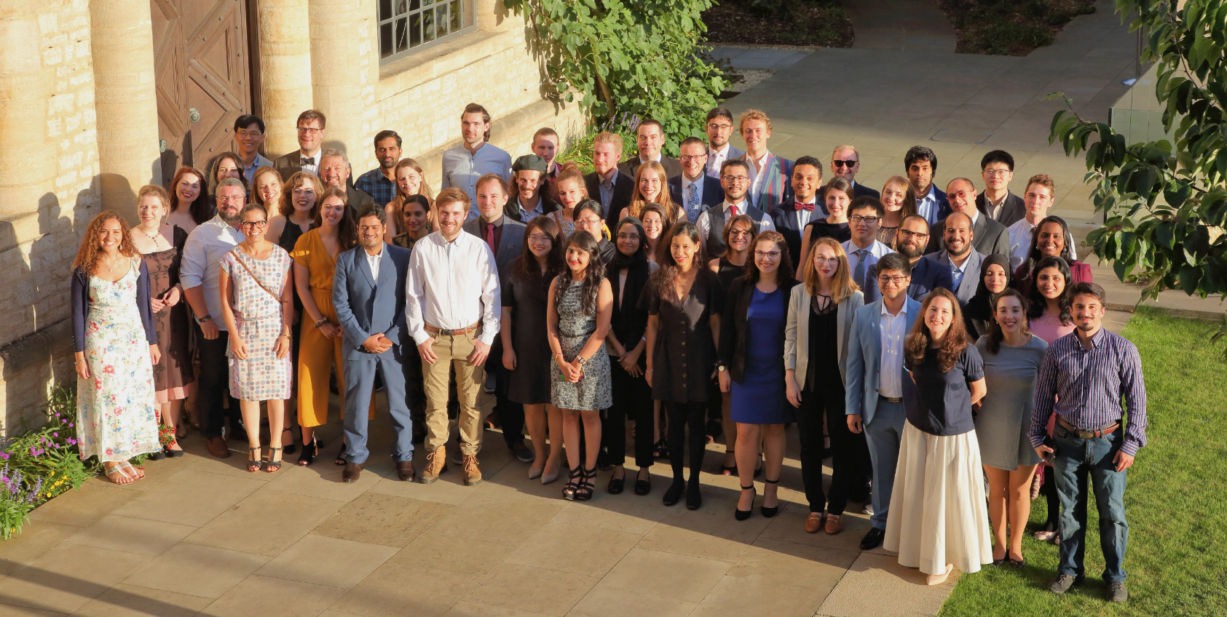
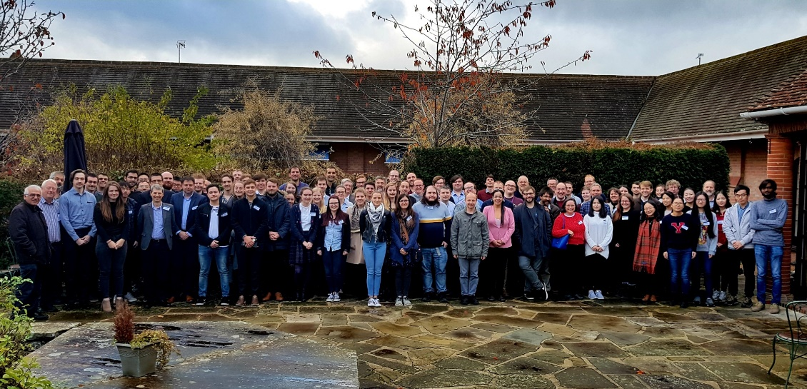
User expectations
More … and more … and more …

Slide 14
Skills
Recruitment, training and retention …

Slide 15
