Slide 1

Future of High Throughput Computing (HTC)
Andrew Sansum
Scientific Computing Department STFC
Head Systems Division
IRIS Technical Director – Joining up STFC’s National eInfrastructure
andrew.sansum@stfc.ac.uk
17/1/20

Slide 2
What is High Throughput (HTC)
loosely-coupled tasks
minimal parallel communication requirements
Focus is on maximum throughput not maximum speed
Turnaround may be measured in weeks or months
A workflow may require many thousands of jobs
Often data processing of long lived data (not work files)
Data set volumes may be measured in petabytes
Data may even be stored on tape

Slide 3
Typical HTC use Cases
Different particle physics events
different random numbers in a simulations based on Monte Carlo methods
different model parameters in ensemble simulations or explorations of parameter spaces
different patient data in large scale biomedical trials
different parts of a genome or protein sequence in bioinformatics applications

Slide 4


Historical Context
Lets have a look at the past
Notes:
The abstract pattern can be removed or repositioned if required. Be careful to ‘Send to Back’ so that it does not obscure any important information.

Slide 5

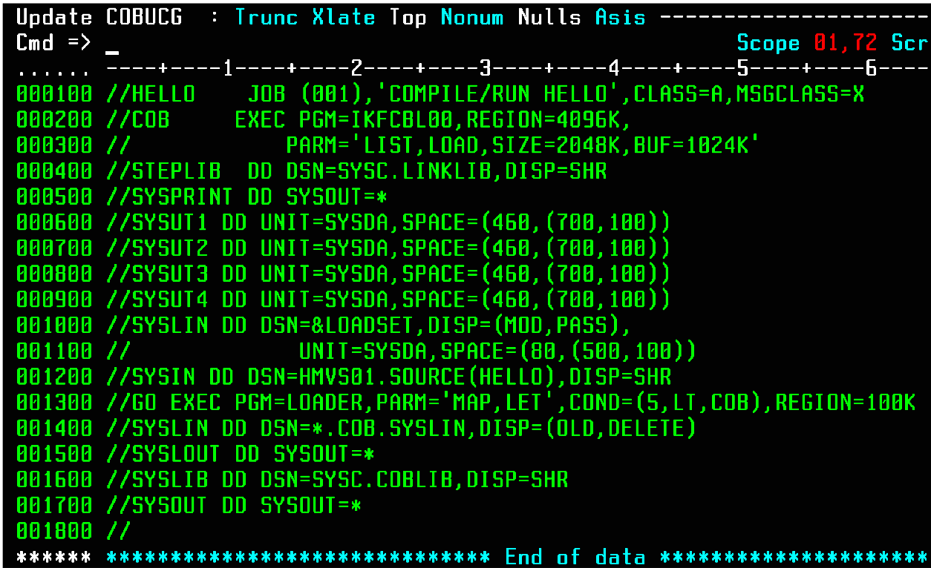

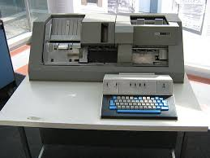
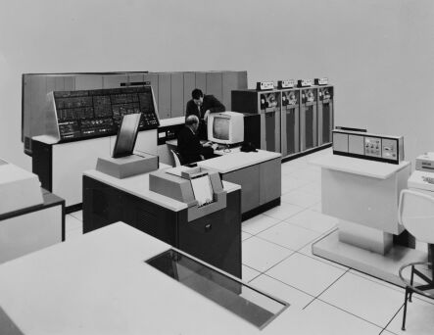
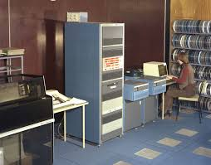
First Encounters with HTC
Postgrad
Undergraduate Days
MVT JCL
Remote Submission
HASP/Mast
Interactive job prep
1978 – Punched cards
Lineprinter Output
1981 - GEC 4085
IBM 360/195

Slide 6
Definitional Criteria for a Distributed Processing System
Philip Enslow, “What is a Distributed Data Processing System?” Computer, January 1978
Proposed Definition
  Multiplicity of resources
  Component interconnection
  Unity of control
  System transparency
  Component autonomy
Perceived Benefits
  High Availability and Reliability
  High System Performance
  Ease of Modular and Incremental Growth
  Automatic Load and Resource Sharing
  Good Response to Temporary Overloads
  Easy Expansion in Capacity and/or Function

Slide 7
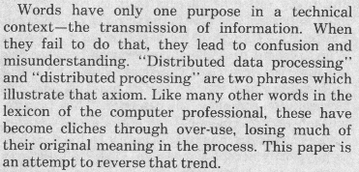
Lets try and get clear what we mean
P.H. Enslow, “What is a Distributed Data Processing System?” Computer, January 1978

Slide 8
Intel – 1991
The i860™ XP Second Generation of the i860™ Supercomputing Microprocessor Family
Target Markets:
Massively Parallel Supercomputer and Muli-Processing Systems
Super Workstation & servers
High End Workstation Graphics/Accelerator Sub-systems
High Throughput Computing Performance
"Number Crunching“ Floating-Point Capability
RealTime 3D Graphics Visualization
Particle Physics experimenting with x86 in 1990 to provide “High Computational Throughput”

Slide 9
Resource Scheduling - Condor
Mechanisms for High Throughput Computing (1997)
“Floating point operations per second (FLOPS) has been the yardstick used by most High Performance Computing (HPC) efforts to rank their systems. Little attention has been devoted by the computing community to environments that can deliver large amounts of processing capacity over very long periods of time. We refer to such environments as High Throughput Computing (HTC) environments”
M. Livny, J. Basney, R. Raman, and T. Tannenbaum, Department of Computer Sciences, University of Wisconsin. May 9 1997
CONDOR Team “working for more than a decade to provide High Throughput Computing tools”

Slide 10
Beowulf Clusters (1994-1998)
The first Beowulf cluster was built by Donald Becker and Thomas Sterling at NASA's Center for Excellence in Space Data and Information Sciences in 1994. ... was to build Commodity Off-The-Shelf (COTS) based systems.
Beowulf: A Parallel Workstation For Scientific Computation (1995)
Proceedings of the 24th International Conference on Parallel Processing. Stirling et al.
The Beowulf evolved for parallel applications but in turn the HTC community set about converting their RISC based clusters to Commodity off the Shelf Linux Clusters

Slide 11
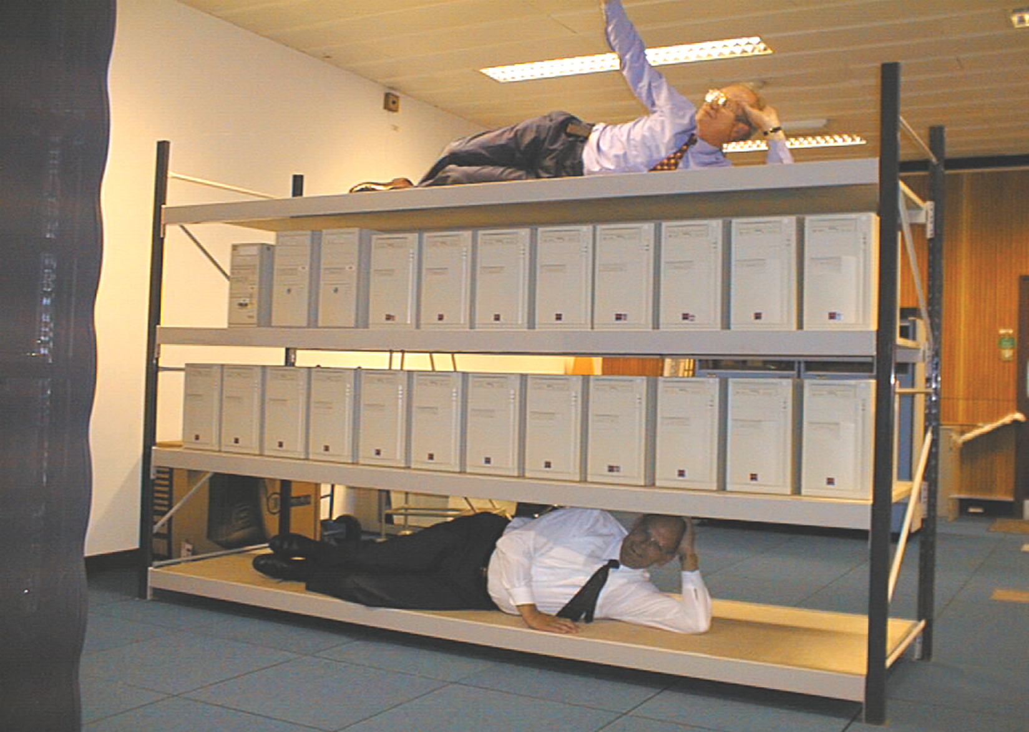
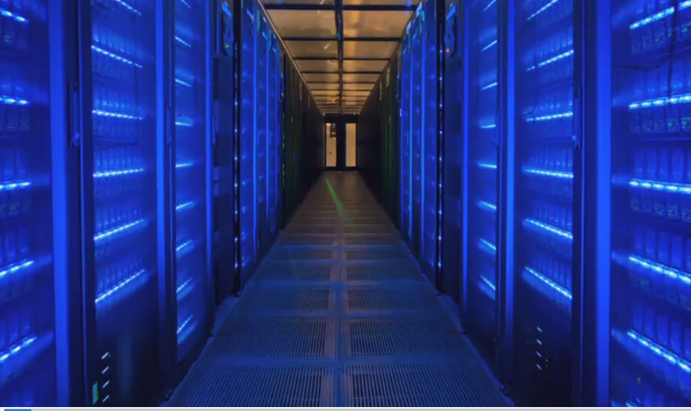
High Throughput Computing - 1999
Early effort to exploit Linux at RAL for HTC workloads. May 1999
The Central Simulation Facility (CSF). Dual Pentium 450 Cluster for particle physics
Present day

Slide 12
HTC 2025
And Forward
Notes:
The abstract pattern can be removed or repositioned if required. Be careful to ‘Send to Back’ so that it does not obscure any important information.

Slide 13
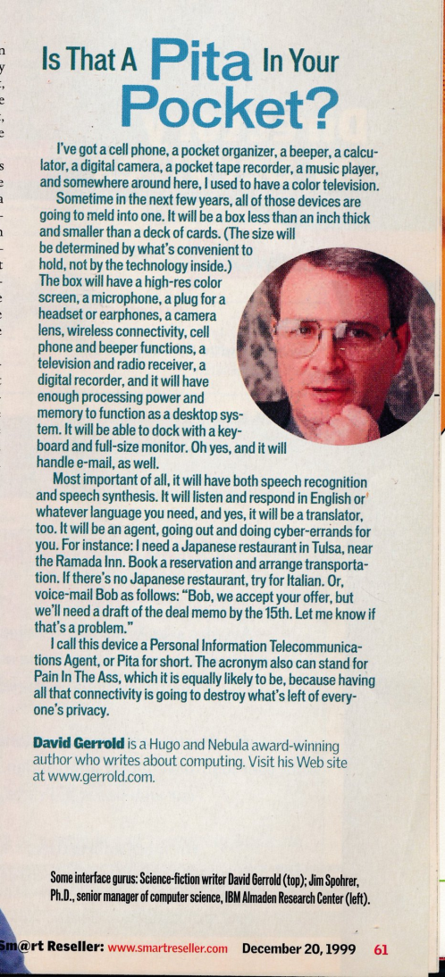
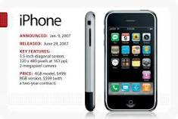
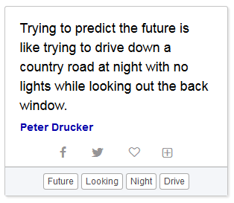
Predicting the Future Not Easy
2025 Not so far off. CPU Procurements made in FY20 will deliver in Q1 2021 and if assume 6 year life will phase out in Q1 2027. “Analyst firms have about a 10% accuracy rate predicting market trends 24 months into the future (0.4 probability) “
Found on the internet – absolutely no justification
Easier – to talk about the past than the future. What pieces have we already got in play – probably will still be there in 2026!
2007
1999

Slide 14
Existing Themes – What do we have
Moore’s law is slowing – but demand continues to rise
True commodity hardware is far behind us – we fell into the gap
Sweating the hardware capabilities – no magic solution
Handling/exploiting many core
Some communities are only now discovering batch – this is OK!
The convergence of virtual research environments (VRE) and prompt response

Slide 15
Existing Themes – (II)
Once you grow beyond capacity of a single site - more communities need access to large HTC eInfrastructures
Federation service such as AAAI become vital
Workflow and data management systems are increasingly necessary
Many workflows are International
Data placement models will evolve
The commercial cloud remains an economic challenge to exploit

Slide 16
Lets Start with Hardware
Notes:
The abstract pattern can be removed or repositioned if required. Be careful to ‘Send to Back’ so that it does not obscure any important information.

Slide 17
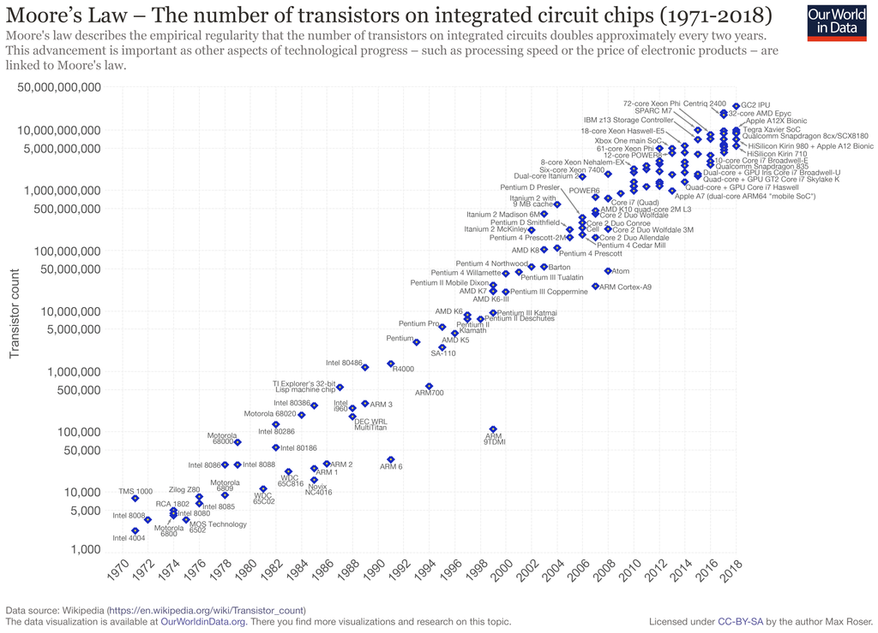
Moore’s Law

Slide 18
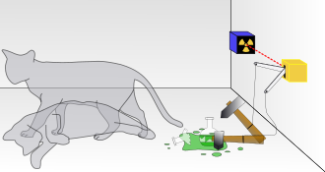




Health of Moore's law
“Debate Over Health Of Moore’s Law Continues … At Semicon West 2019, CEOs from across the industry continue to debate whether Moore’s Law is alive or dead.”
“it’s completely alive is because right now we’re facing another decade or two of amazing opportunities that themselves economically will drive the push for technology without a stop.
Maybe it’s not exactly the same curve that Moore actually drew, it doesn’t matter. The impact is what matters of the exponential.”
Aart de Geus Semicon 2019
it doesn’t [anymore] deliver simultaneous improvements in power, performance, area and cost.
Gary Dickerson, CEO of Applied Materials
“The way to think about it is Moore’s Law is the behaviour of an exponential that has techonomic feedback on the exponential that drove a revolution of what mankind can do. “

Slide 19
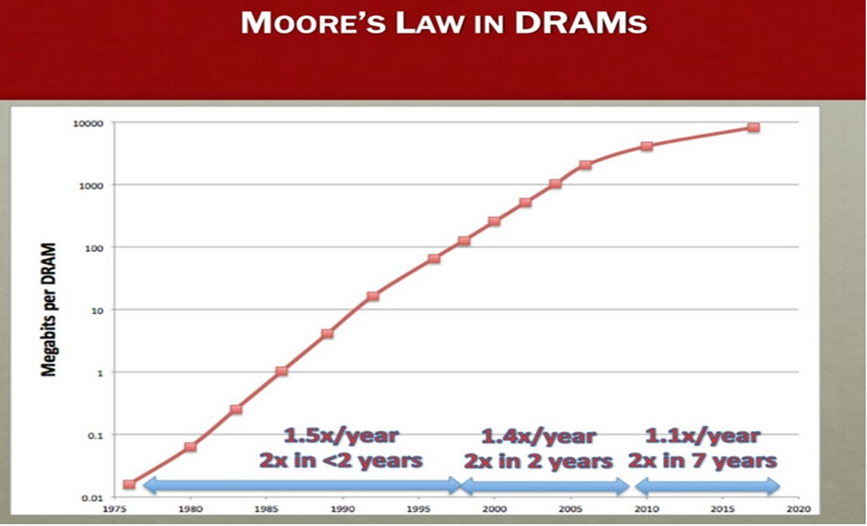
Memory (Semicon West 2019)
For almost a decade, Moore’s Law has slowed down significantly …. . “A lot of innovations have been driven in memory and technology, for example, going from 2D NAND to 3D NAND …. But there is no question that Moore’s Law is significantly challenged in memory and storage. Looking at 10 years ago versus today in NAND as well as in DRAM, the year/year bit growth that you could get from one technology transition to the next technology transition, that bit growth, that cost decline capability has more than halved now, and certainly there are challenges.”
Sanjay Mehrotra, CEO of Micron Technology

Slide 20
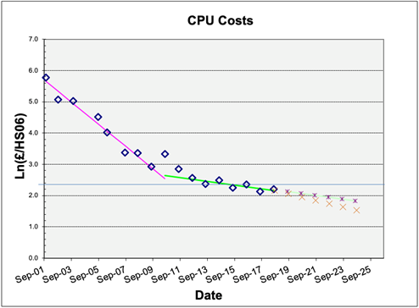
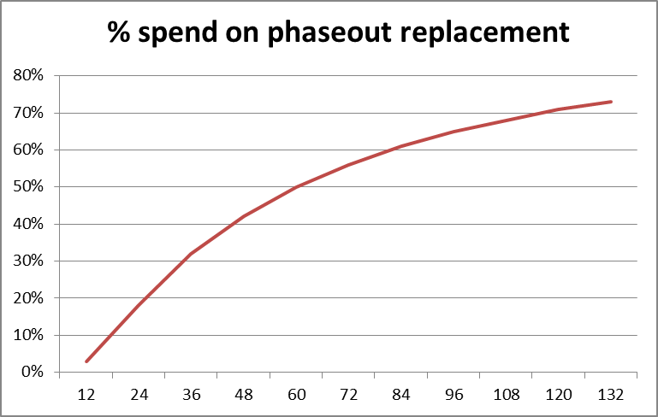
Price per unit Performance
For HTC its “bang per buck” that matters
HTC sites rarely buy the newest and fastest – looking for best value (biggest volume)
Flat cash – weak Moore’s Law– steady state majority of investment goes into phase-out replacement
Ln (Price/performance)
24 month constant
138 month constant
@138 month = 70% on phaseout
Classic Moore’s law (24 month) = 20% on phaseout
RAL Tier-1 Procurements 2001-2018
Doubling time (months)

Slide 21
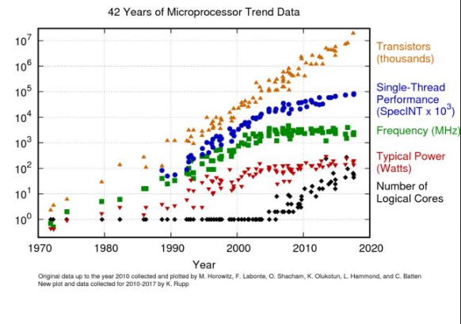
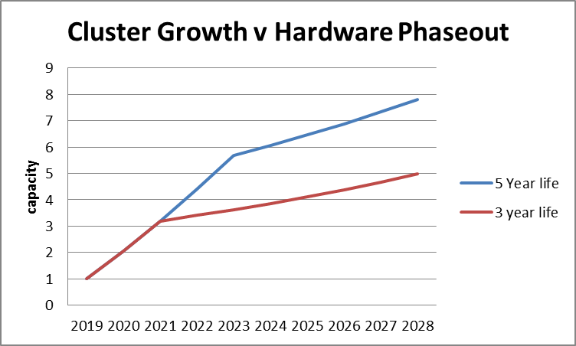
Electricity Consumption
Power consumption of CPU limiting performance
Prices forecast to be relatively flat after recent rises
Will be increased pressure to reduce CO2 footprint
Can apply energy efficiency constraint for procurement – may raise hardware costs
Or by earlier replacement – but at the cost of cluster growth rate
73% of spend -> replacement
138 month
UK Gov Forecast
2018. Existing policy
83% of spend -> replacement
now

Slide 22
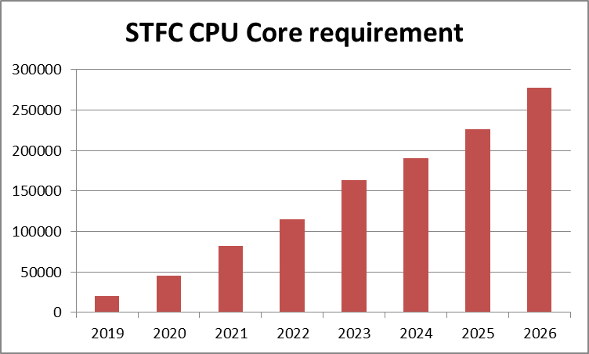
STFC Compute Requirements

Slide 23
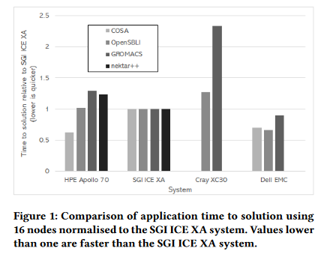
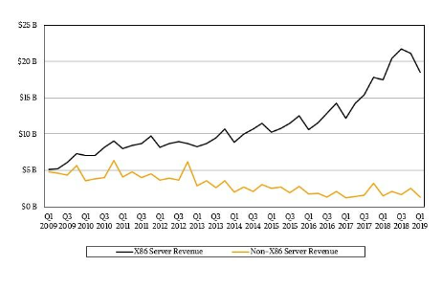
ARM – not going to help … much
Limited benchmarking in science community – but see:
“Evaluating the Arm Ecosystem for High Performance Computing – Jackson et al. EPCC - 2019” based on ThunderX2 – ARMV8
“we have also demonstrated that applications can achieve similar, or better, performance on such a system when compared with a range of existing HPC system architectures…..a viable alternative”
For x86 servers CPU represents 30-50% of total server cost, but ARM server class CPUs at comparable price. Isn’t going to save us.
Benefits may rather accrue from increasing competition in the market rather than miracle CPU.
May Help Power Consumption
ARM
Broadwell
Skylake
X86 server v non x86 server market share

Slide 24
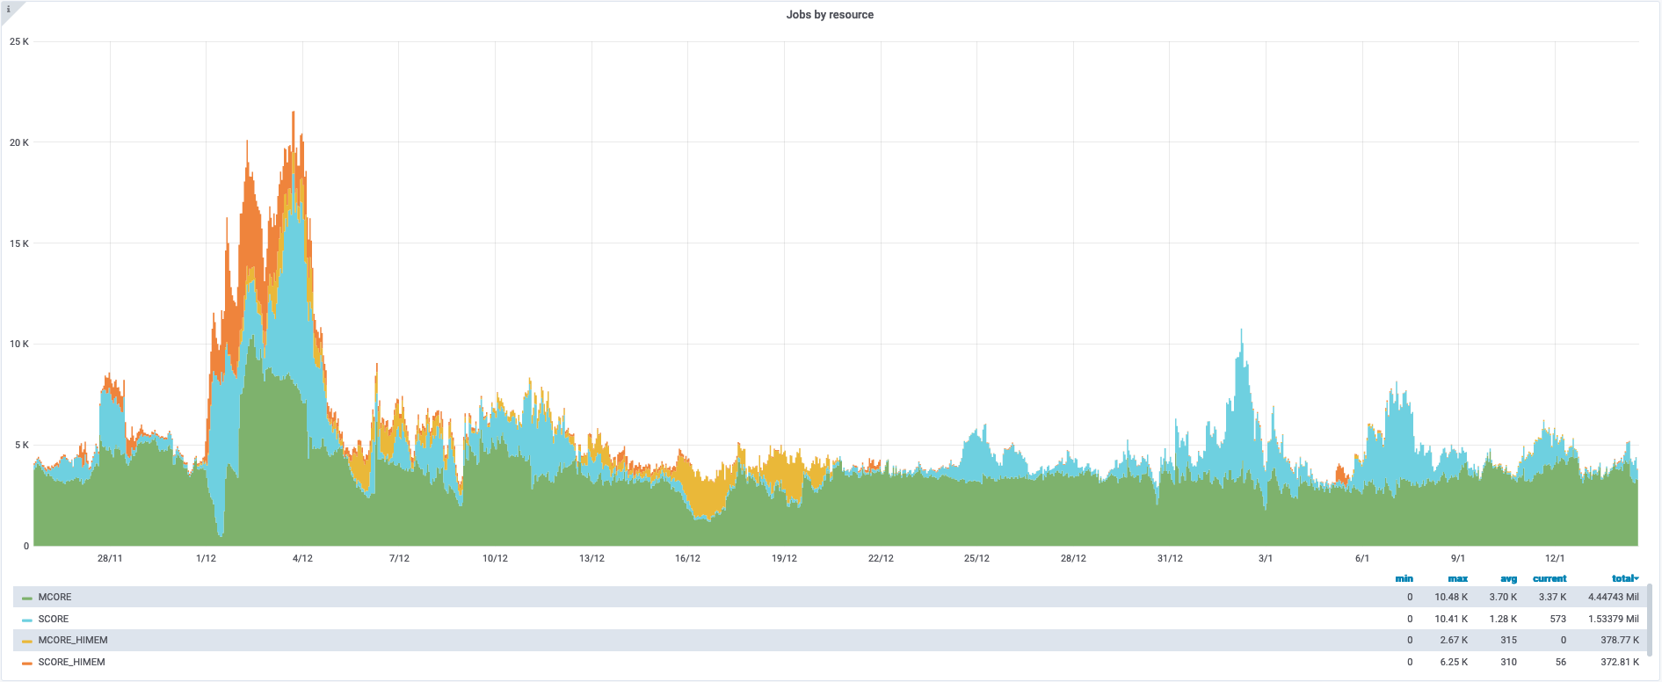
HTC but Exploiting Many Core
As system core count increases so too does complexity of cluster workload manager packing jobs with different memory requirements.
User pilot jobs can instead schedule separate threads to optimise memory footprint.
If done badly can lead to cluster inefficiency
Done well simplifies cluster scheduling
ATLAS at RAL – last 50 days
Most jobs multi-core
usually > 8 core
Single core
Multi core

Slide 25
Sweating Hardware: Code and Algorithms
Most Gains to be Made Here – Do it Smarter
Architecture specific compilation
Adapt to many hardware types - heterogeneous hardware – validation nightmare
Code re-engineering to exploit vector and other hardware units
Algorithmic improvement
Paradigm shift – eg ML rather than brute force

Slide 26
eInfrastructure
Notes:
The abstract pattern can be removed or repositioned if required. Be careful to ‘Send to Back’ so that it does not obscure any important information.

Slide 27
Modern (Mature) Descriptions
“High-throughput computing (HTC) is a powerful paradigm that allows vast amounts of independent work to be performed simultaneously across many loosely coupled computers. HTC aims at integrating multiple computing systems to enable large numbers of computing tasks to be schedule and completed as quickly as possible.”
International Journal of Trend in Research and Development, Volume 5(4), ISSN: 2394-9333 2018
Single Cluster
Homogeneous Multi-Cluster or federated cloud
Federated eInfrastructure – eg Grid
Opportunistic use – eg Commercial cloud or spare cycles – eg on HTC

Slide 28
Traditional Batch Compute Lives!
While some community requirements have grown beyond single clusters, some are only now growing into them.
In the dash to join up our eInfrastructure we continue to need classical batch services.
Login and submit some jobs.
Usually department level “interactive” services
But environment typically “one size fits all”

Slide 29
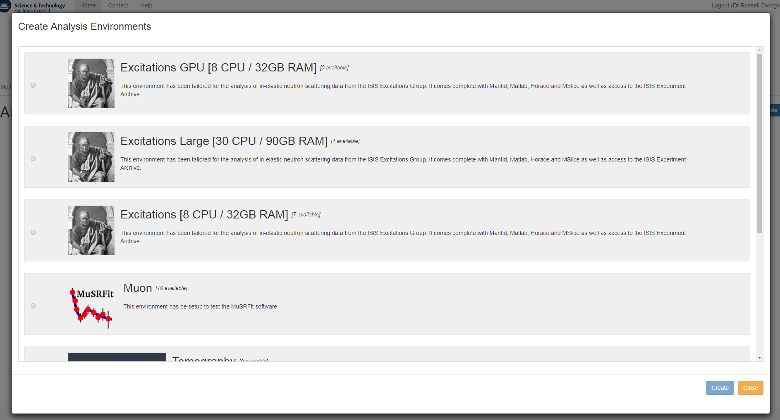
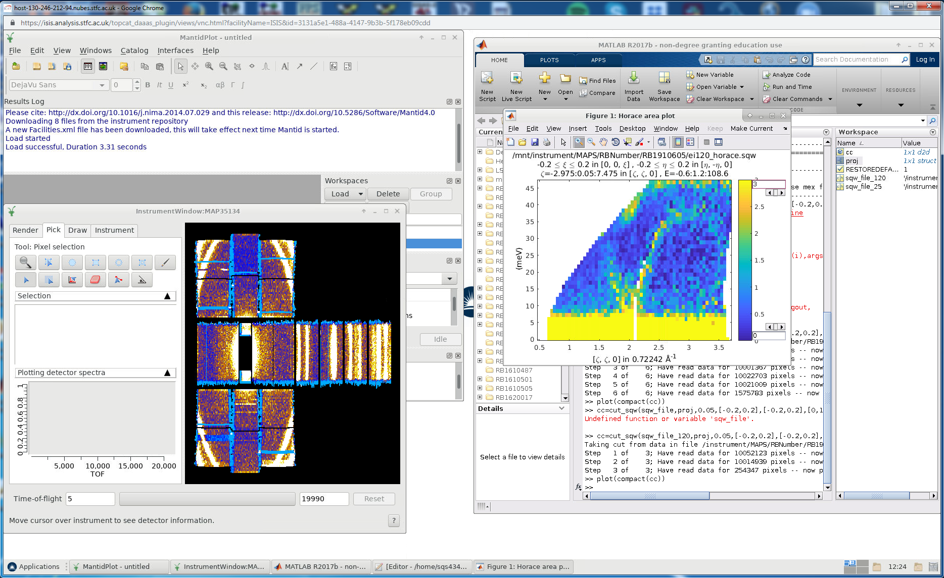
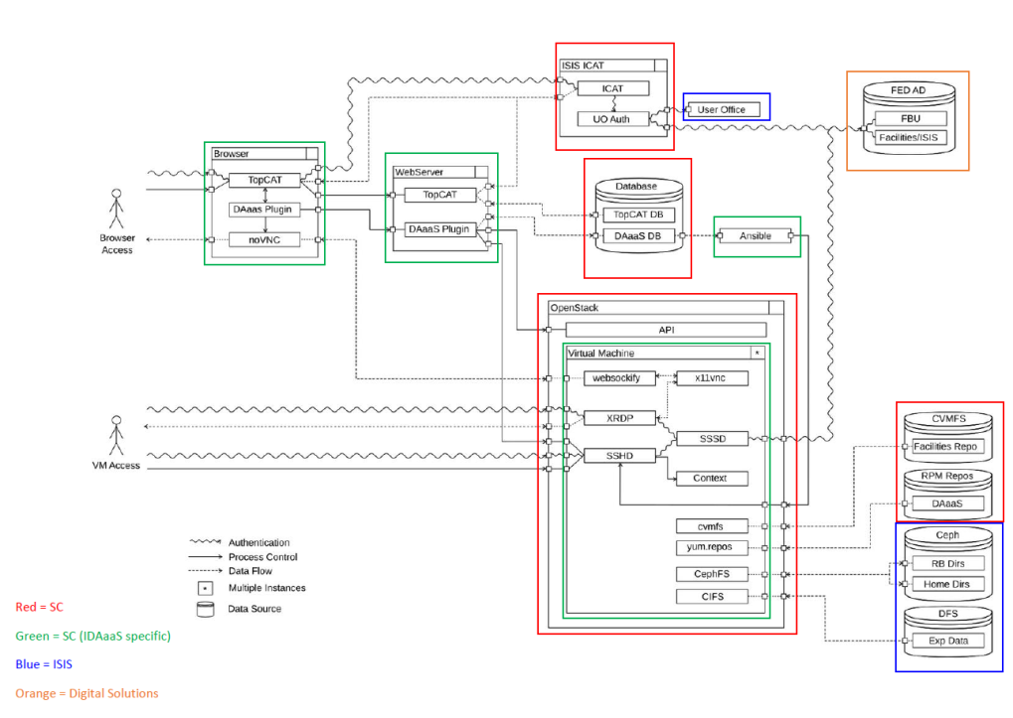
Virtual Research Environments for Science: The IDAaaS system
What it is: ISIS Data Aanalysis as a Service
VMs Tailored to community
Dynamic Creation
Expands with demand
OpenStack Platform
Can exploited multi-site
Burst capacity

Slide 30

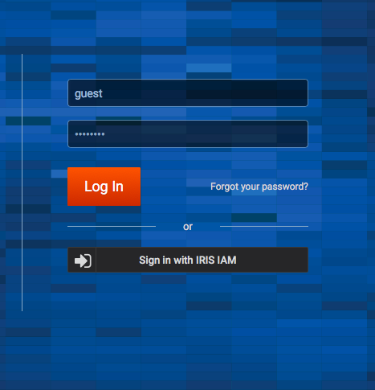
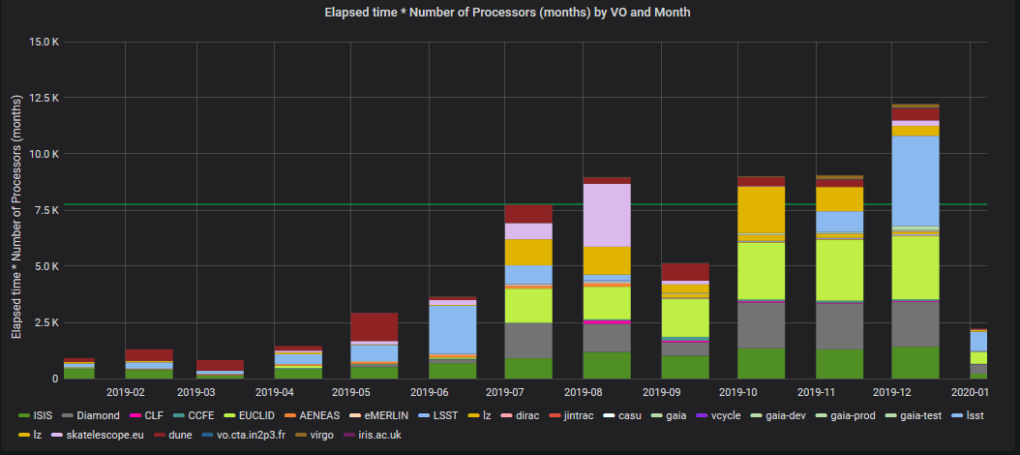
Federating STFC Distributed Computing
STFC has diverse compute infrastructure deployed around UK
  Single platform
  Multi-site
  Many user communities
IRIS – Capital only project deploying hardware. Coordinting STFC Compute Community, Resource Sharing

Slide 31
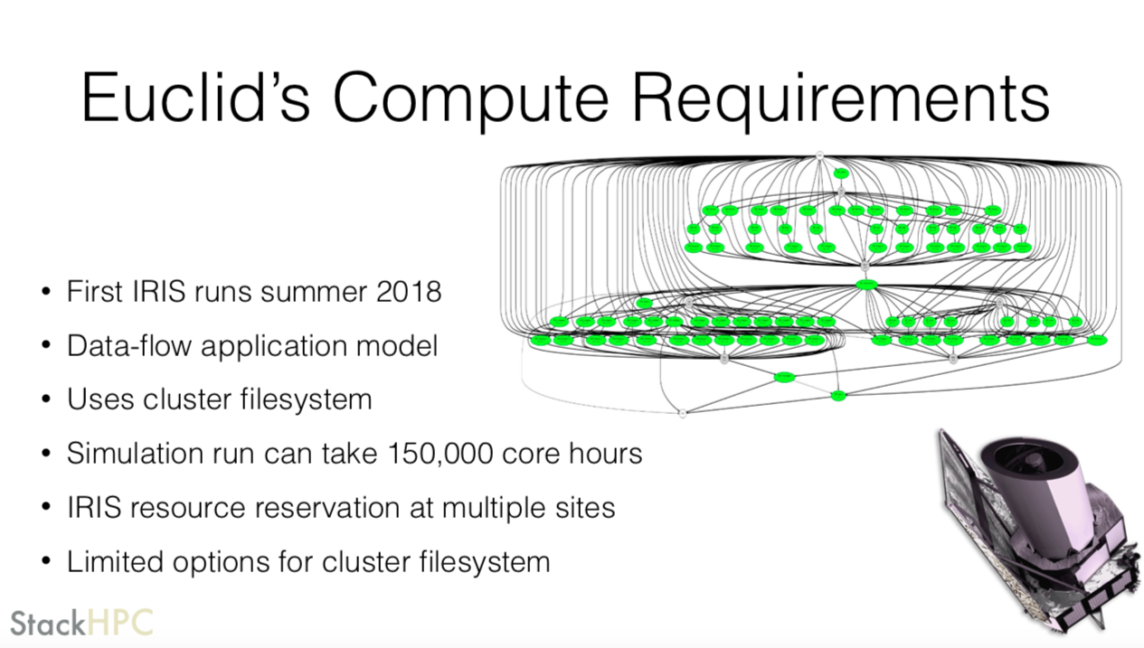
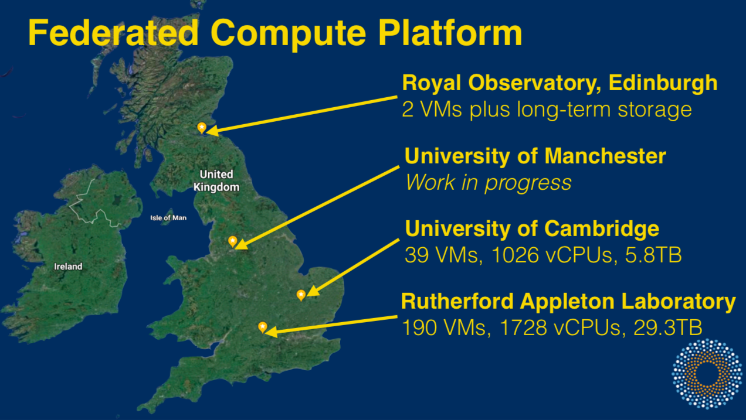
Federated – multi-site Slurm on OpenStack
Euclid Federating Multiple SLURM instances on STFC’s IRIS Infrastructure

Slide 32
Resource Scheduling in OpenStack
Typical batch compute platform has relatively sophisticated resource scheduling
Resource usage monitoring (and maybe management)
Job efficiency monitoring
Dynamic scheduling of capacity against target
Limited capability in OpenStack at present – partitions between tenencies more rigid

Slide 33
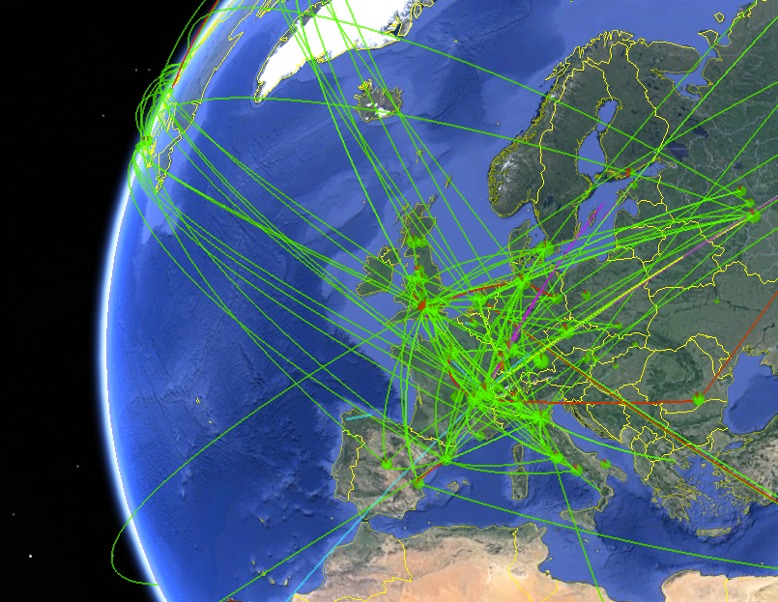
What about the Grid?
Coordinated resource sharing and problem solving in dynamic, multi-institutional virtual organizations.
The Anatomy of the Grid - Foster, Kesselman and Tuecke 2001
Sounds exactly like what we need!
Works well for a few large LHC communities.
Will still be going strong in 2025 and will probably have a few more large user communities using it.
Challenging for small communities who do not need largest possible scale
LHC Computing Grid – 900,000 cores

Slide 34
Commercial Cloud
Already routinely exploited by some STFC communities
Best fit for:
  – short term (eg burst)
  - rapid deployment of diverse services
  – low data volume
Not yet compelling price / convenience
Still requires expertise in deploying service framework
Challenges of vendor lock in of data
Main obstacles are not technical but financial / legal detailed in UKRI Roadmap Document for cloud

Slide 35
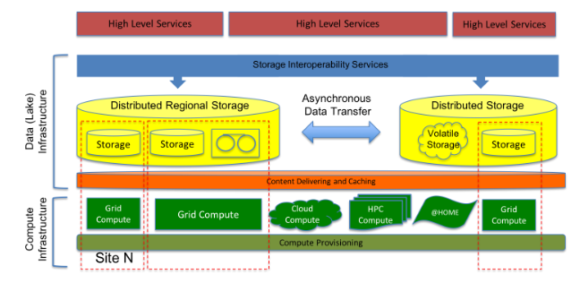
WLCG – Data lakes
Architecture and prototype of a WLCG data lake for HL-LHC (CHEP 2018)
an Bird1, Simone Campana1, MariaGirone1, Xavier Espinal1, Gavin McCance1 and Jaroslava Schovancová1
https://doi.org/10.1051/epjconf/201921404024

Slide 36
Data locality v Distributed
Tension between moving the data to the compute and accessing the data remotely
Data storage consolidation for HL-LHC
QoS – the right data on the right storage

Slide 37
Predictions → 2025+
CPU performance gains will continue but (on average slowing)
More communities will exploit federated eInfrastructure
VREs will be increasingly exploited
Data will become increasingly federated
Workflow management systems will be increasingly necessary
Heterogeneous hardware capabilities will be increasingly exploited
Federated eInfrastructure will be increasingly vital
New user communities will be exploiting the grid paradigm
Convergence of interactive and pleasingly parallel

Slide 38
Final Observations
Many science communities are currently constrained by the IT infrastructure available
For the very very largest – there will be new technical challenges to deliver sufficient compute and storage.
For some – brute forcing the compute isn’t going to deliver the needed performance gain – they need to get smarter
For most communities however – the solutions are technically understood – they just need funded effort to implement known solutions

Slide 39
Questions
Facebook: Science and Technology Facilities Council
Twitter:@STFC_matters
YouTube: Science and Technology Facilities Council

