Slide 1
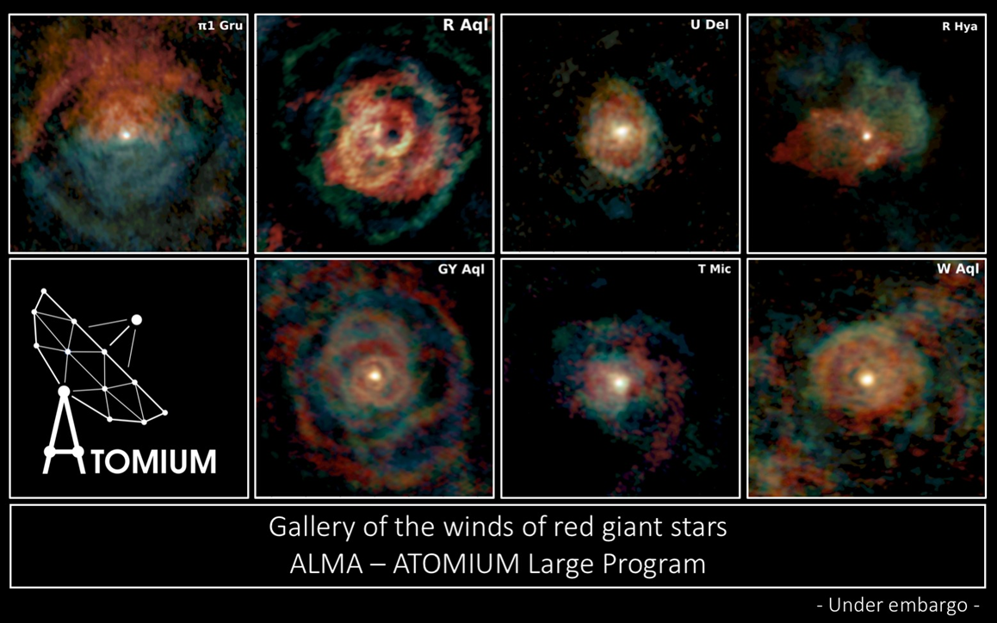
Massively
Parallel
Computing
Jeremy Yates (DiRAC, ExCALIBUR)
Mark Wilkinson (DiRAC, IRIS)
Tom Griffin (DiRAC, Scientific Computing Division)
Alison Kennedy (Hartree Centre)

Slide 2
UKRI Roadmap: Where do we lie
Using the approach taken by ESFRI the UKRI Infrastructure roadmap is structured as sectors:
Biological sciences, health and food (BBSRC lead, MRC)
Environment (NERC lead, Met Office)
Energy (EPSRC)
Physical Sciences & Engineering (STFC lead, EPSRC)
Social sciences, arts and humanities (ESRC Lead, AHRC)
Computational & e-infrastructures (EPSRC lead)
https://www.ukri.org/research/infrastructure/

Slide 3
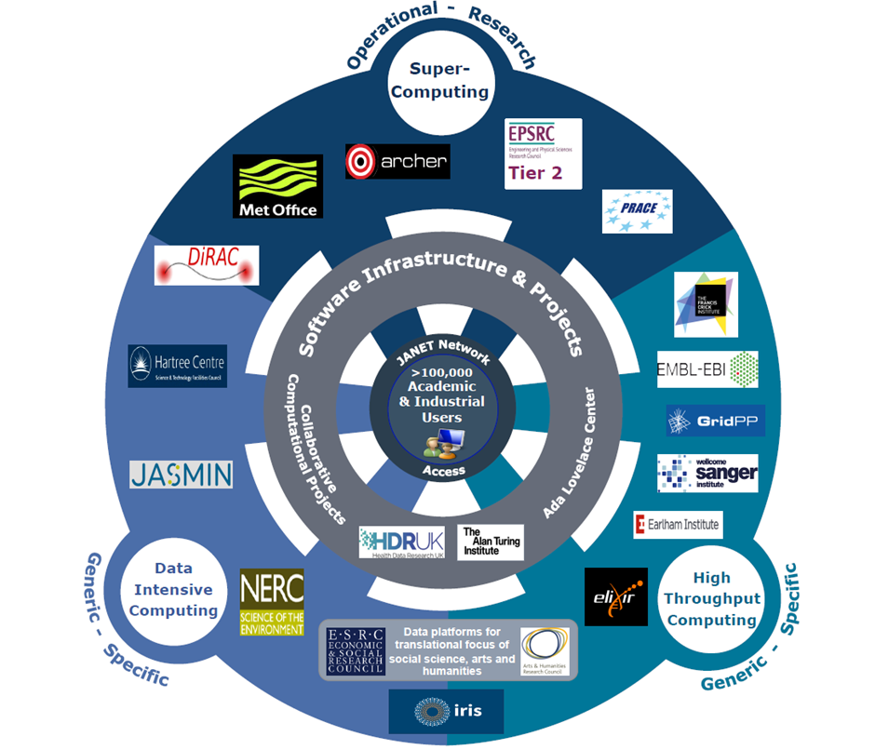
UKRI e-Infrastructure Landscape

Slide 4
What is an e-Infrastructure
e-Infra facilities:
  Provide generic facilities to a wide range of users from many research fields
  Have expert user support and help
e-Infra associated with other facilities:
  Provide tailored data storage/analysis tools/high-throughput computing for their users
  Have expert user support and help
e-Infra associated with research centres/institutes
  Often have `in-house` e-infrastructure tailored to support their research
  May be dependent on access to e-infrastructure facilities for larger-scale jobs

Slide 5
Research Drivers for Massive Parallel Computing
Computational requirements of models are increasing due to
  Increased resolution: running models based on existing understanding but at finer scales.
  Increased complexity: introducing new processes into models to reflect progress in theoretical understanding; often needed to match resolution increases.
  Coupling of models: multi-physics, multi-scale modelling; ultimate goal is real-time, `whole system modelling`.
  Quantification of modelling uncertainty using large ensembles of simulations to provide robust statistics
Direct numerical simulation and modelling increasingly a core research activity across all UKRI research areas: significant growth in new fields adopting supercomputing approaches (e.g. deep learning on social science data sets).
Growing requirement for simulations and modelling concurrent with experiments or observations so that models evolve in line with data acquired. Experimental/observational facilities therefore need access to local Tier 2 computing capabilities as well as the option to burst out to the Tier 1 or Tier 0 national supercomputing facilities.
Data analytics increasingly depend on more sophisticated algorithms as data volume, variety and complexity all increase towards exascale. Convergence of high throughput computation and supercomputing approaches as the data volume and complexity grows
AI: implications for both hardware and software

Slide 6
Themes
Theme | Ingredients
Software and Skills | UKRI strategy to emphasise centrality of software Access to RSE-type support for new/all communities Quality control support/tools (CI etc) New software – exascale, AI etc Co-design programme (maths, computer science, etc.) Training: across career stages; coordination
Network and Access Management | Janet Access management tools Cloud: computing and data storage
Industry | Proper programme to support collaboration, involvement
Computing | Sustained investment in supercomputing tiers, aiming towards exascale by 2030 Sustained investment in research computing for facilities/ research centres Technology foresight/test-bed programme
Data eInfrastructure | Sustained investment in data centres to deal with ever-increasing capacity requirements Data Curation and Data Management

Slide 7

Specific Why – Some Stellar Astrophysics
Mass loss from Red Giants
Non linear, non local process
MHD, Chemistry, Material Science, Radiative Transfer
Calibration (Signal Processing), Interferometry, Image Analysis
AL/ML to reduce and process data – learning calibration techniques that were done by eye
AL/ML to identify physical structures
High RAM Clusters to reduce data
Lower Clusters to model and interpret data

Slide 8
Data Motion – Sinks and Sources
A common mode in system design has been the idea of data motion between the various system components
Too much focus has been on the Processor unit registers and their floating operations (flops) rating.
  the Top500 bears little relationship to application performance
The performance (bandwidth and latency) and size of the memory hierarchy, the storage hierarchy and the interconnect (Networking) itself have an equal, if not more, importance.
  These get the data & instruction sets in, and then take data out.
  They are a pinch points that need to be attended to in system and application design
IO is a parallel process as well

Slide 9
Parallelism is when tasks literally run at the same time
A google search is probably the most common example
Communications are key to parallelism
Parallelism | Workflow | Required Latency (microsecs) | Required Bandwidth (Gbs) | System Type | Inter-node communication level
Embarrassing loose | Parameter search Model fitting | 100 10 | 1 10-100 | Cluster | rare
Weak | CFD, SPH | 1 | 50-100 | Cluster | occasional
strong | LQCD | <1 | 100 | Cluster | As busy as intra node
Cache Coherence | Strings? | <0.2 | 400 | Single Node | As busy on the CPU

Slide 10
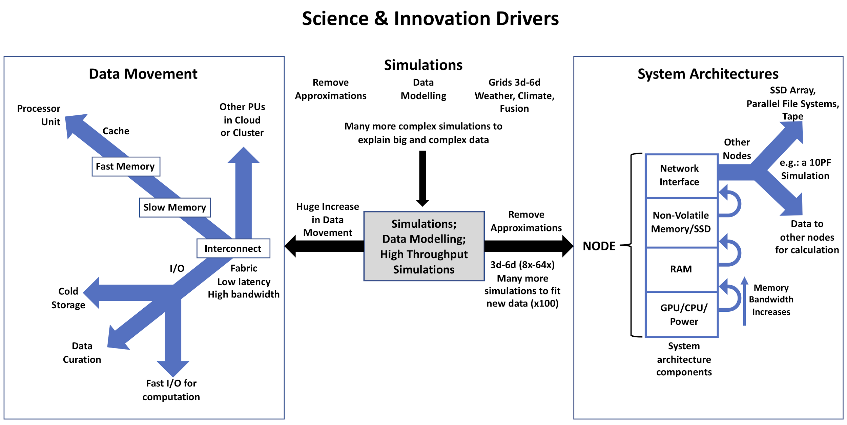
The Challenges We Face in System Design

Slide 11
Volume and Velocity and Latency
Common Model of understanding Problem need
A third axis is needed – latancy (delay)
GridPP
Exascale
Volume
Bytes
DIRAC
Latency - secs
Hartree Centre
SCD
Velocity / Bytes per sec

Slide 12
Software
Software: STFC needs a software infrastructure strategy that reflects both the central role played by software in the delivery of research and innovation and the diversity of the research code base
It is essential that codes become more agile, able to harness the power of evolving hardware architectures.
  Accelerators
This agility is needed because the pace, and nature, of hardware evolution means that it is no longer possible to programme code for long term, un-modified usage. In many areas, software development work is already overdue to support the next generation of science calculations.
Not just about applications Supporting accelerators
  E.g. Networking programming to create new cheap SSD arrays

Slide 13
Accessibility

Slide 14
How does my application work – Creating a Virtuous Software Ecosystem & Community
The LQCD community have been able to design in a quantitative manner systems based upon the operational requirements of key applications.
We need a small-ish cadre of people who understand how key applications and libraries actually operate quantitatively on hardware
  Just like for telescopes and accelerators
  Why should we be different.
They will be supported by people who write the software that makes the components actually work
Data Motion is key to qualitatively understanding of how systems and apps work together
Most people only need this level of understanding
  Need to know the hardware characteristics and
  how they work together.
  What has the compiler done to my code and how it is used by the components
  We should know how our experimental platforms work
  Personally I’d like to see computational based research degrees describe the equipment and application performance in the same way that we do for experiments..

Slide 15
Cloud for massive parallel computing
Cloud middleware development is needed to support resource-sharing and ensure optimal matching of science with supercomputing resources.
  Portable workflow
  Joining resources together
  Not being limited by the batch queue
Continued support for existing development work e.g. the OpenStack and containerisation work by IRIS/DiRAC/Cambridge/ is necessary to facilitate greater workflow movement between services and help communities from being locked into incompatible systems.
We need to maintain a watching brief on the development of commercial and community cloud offerings to assess their relevance for supercomputing resource provision.
However need to address low latency requirement

Slide 16
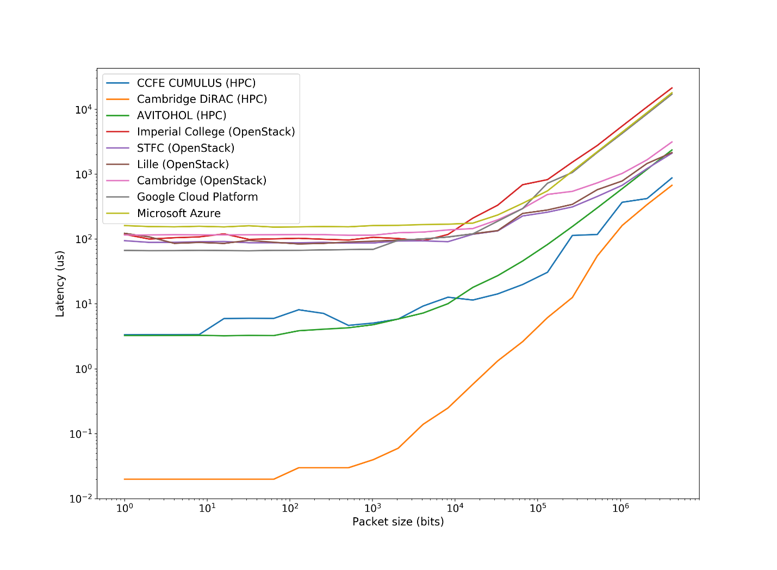
Simulations done by Andrew Lahiff CCFE

Slide 17
Need for Physical and Virtual Architecture Communities
Know who is good at what
Support key projects and people
Co-Design projects are a good way of understanding how things work together and create communities around a particular activity/technology
We’ve been quietly doing this in DiRAC for 9 years
  Need to add accelerators and cloud technology
  Both in progress
We need to now address the application understanding

Slide 18
Forward Look - All
Growing demands for modelling and simulation from the Facilities, Programmes (DiRAC) and the Hartree Centre
Faster data rates: bigger data – more processing (tomography etc)
Challenge of evolving codes to exascale architectures
Increased use of ML and AI, as an alternative to ‘traditional’ processing, in combination, and as a driver of Supercomputing in itself
Greater use of AI in simulations and data modelling
Use of new storage, networking, memory, Processor+Accelerator, middleware and software technologies
Use of Cloud/Grid technologies to design new workflows and make it easier to combine different resources for our numerical experiments
New ways to for researchers access our systems e.g. Jupyter notebooks
  Greatly expand the use of systems
Artificial Intelligence and Augmented Intelligence for Automated Investigations for Scientific Discovery – AI3SD

Slide 19

Our mission
Transforming UK industry by accelerating the adoption of high performance computing,
big data and cognitive technologies (AI, ML, DL) through challenge-led research and innovation

Slide 20
Offering
Based on the five foundations of UK Industrial Strategy:
Ideas - Collaboration across industry, UKRI and academia. Centre of excellence in translating research into innovative solutions
People – Critical mass of cross-functional teams combining chemistry, materials, engineering and life science domain expertise (internal or via collaboration with SCD or academia) , with research software engineering, numerical and computational methods, working together for economies of scale and scope
Infrastructure - Dedicated platform(s) for HPC, HPDA and AI applications and emerging technologies, providing research and innovation capabilities
Business Environment – Driving productivity, increasing collaboration e.g. across supply chains, support to growing businesses
Place – Sci-Tech Daresbury, Northern Powerhouse,
fast growing digital cluster of local companies

Slide 21
Hardware Platforms
Scafell Pike (funded from Hartree Phase 3) – Bull Sequana X1000 supercomputer​
~4 Pflop/s | Intel Xeon and Xeon Phi, GPUs
  25,728 Intel SkyLake cores
  55,680 Intel Xeon Phi cores
JADE – (funded by EPSRC Tier 2, owned by Oxford)
Bull Atos NVIDIA DGX1 Deep Learning supercomputer​
176 NVIDIA V​100 GPUs | Deep Learning frameworks
630,784+ CUDA Cores
Panther and Paragon (funded from Hartree Phase 3)
  512 POWER8 cores and 64 NVIDIA Kepler K80 GPUs (Panther)
  656 POWER8 cores and 82 NVIDIA Pascal P100 GPUs (Paragon)
(Many data science and AI projects use commercial cloud e.g. Azure)

Slide 22
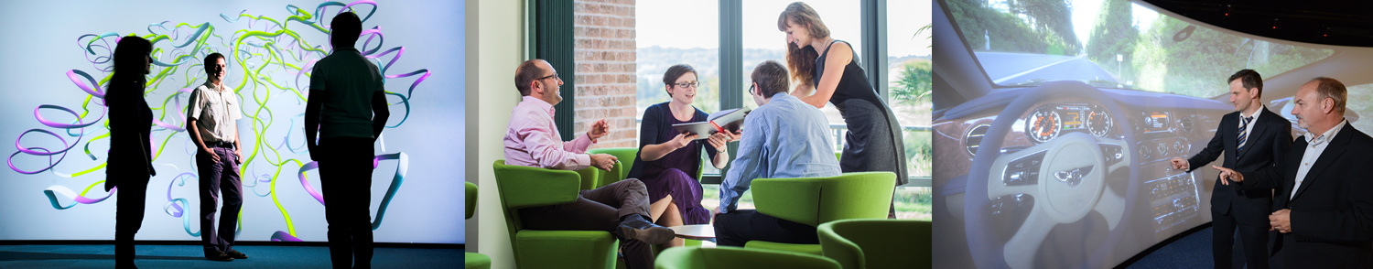
What we do
Collaborative R&D
  We build a team to deliver a solution to a particular challenge
Platform as a service
  Pay-as-you-go access to our compute power
Creating digital assets
  License industry-led software applications we create with IBM Research (IROR programme)
Training and skills
Run specialist training courses and events

Slide 23
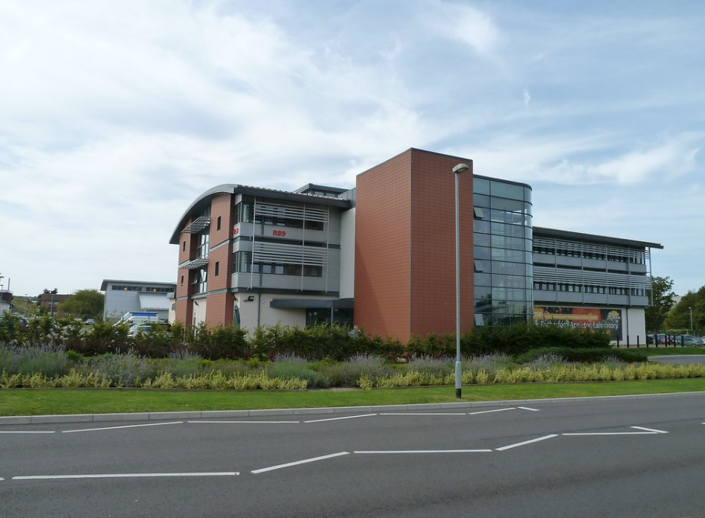

Scientific Computing Department
“to maximize the impact of scientific computing through our expertise, leadership and collaboration.”
Designing, deploying and operating large and complex computing and data systems
Supporting the research life-cycle by extracting insights and value from data
Creating algorithms and software to exploit future research computing infrastructure
Providing cross-domain expertise to develop, innovate, and sustain software, and related digital assets for research
Image © STFC John Dawson
Notes:
PLEASE DELETE/REPLACE PHOTO CREDIT IF CHANGING THE IMAGE.

Slide 24
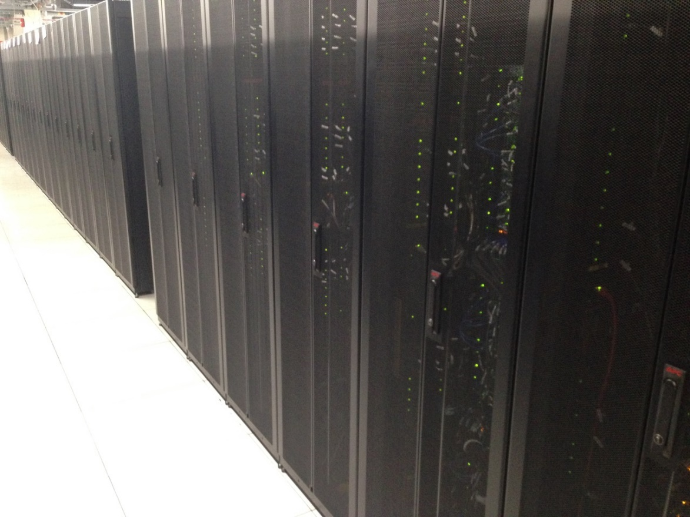
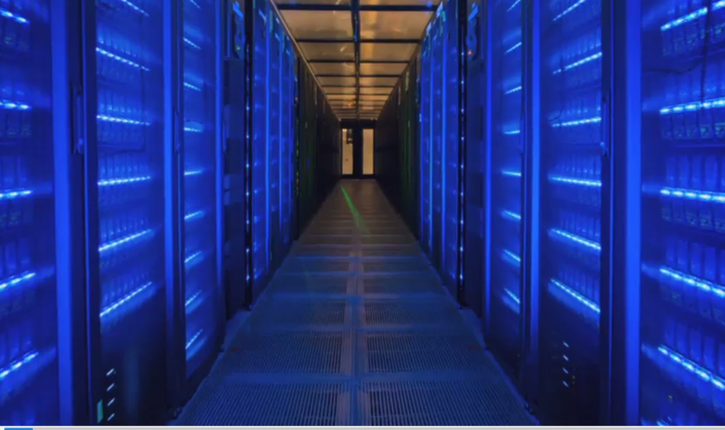
Hardware
SCARF – open to STFC departments, facilities and their users.
General Purpose CPU and GPU cluster.
Demand significantly exceeds capacity
Annual, incremental investments since 2004
570 Nodes over 5 generations
12k CPU. Infiniband
30 GPU-nodes
1PB Panasas storage
2PB GPFS
+ PEARL Deep Learning Service – 2x NVidia DGX-2
+JASMIN Super Data Cluster (NERC communities)
Image © STFC John Dawson
Notes:
PLEASE DELETE/REPLACE PHOTO CREDIT IF CHANGING THE IMAGE.

Slide 25

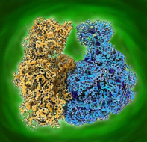
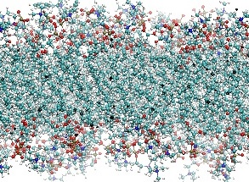
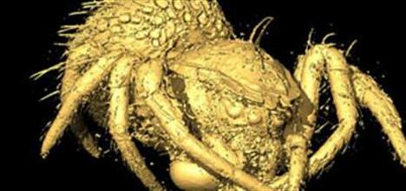
Software
CoSeC
Support for Collaborative Computing Projects (CCPs) and High End Consortia (HECs)
computational scientists and specialists research software engineers who combine science domain knowledge with software engineering skills
Wide range of areas covering bio, chemistry, physics and engineering
Image © STFC John Dawson
Notes:
PLEASE DELETE/REPLACE PHOTO CREDIT IF CHANGING THE IMAGE.

Slide 26
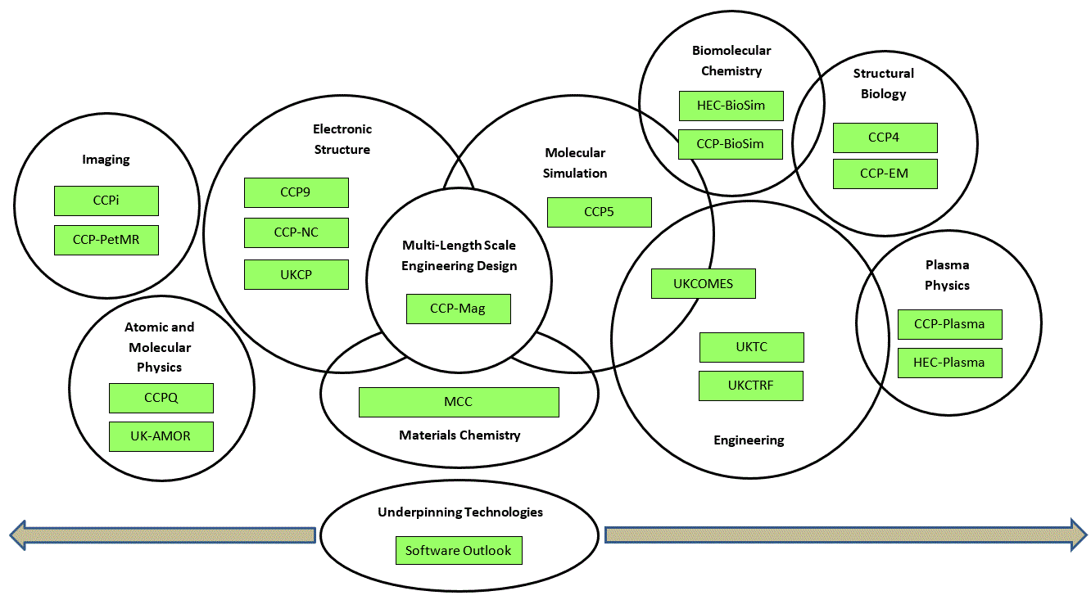
Communities
CCPs and HECs
Facilities staff and users
ISIS, CLF, Diamond
Broad range of science areas
Materials science
Bio
Imaging
Engineering
Image © STFC John Dawson
Notes:
PLEASE DELETE/REPLACE PHOTO CREDIT IF CHANGING THE IMAGE.

Slide 34
A Final Thought - AI
Current AI applications will give me 42
  But what does that mean?
  What do we understand by this?
  How did it get this answer?
  In what sense is this answer usable?
The recent UKRI AI workshops identified Explainable AI as a requirement for both research and application
To implement this we need to go from Deep Thought to the Earth in terms of system size and design
Laptop to Exascale – let’s hope the Planning Department has dealt with it…..

