Slide 1
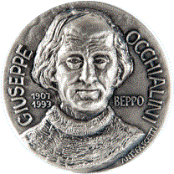

Giuseppe Occhialini Medal and Prize
In 2007 the Italian Physical Society together with the Institute of Physics instituted an award to honor the memory of Giuseppe Occhialini.

Slide 2
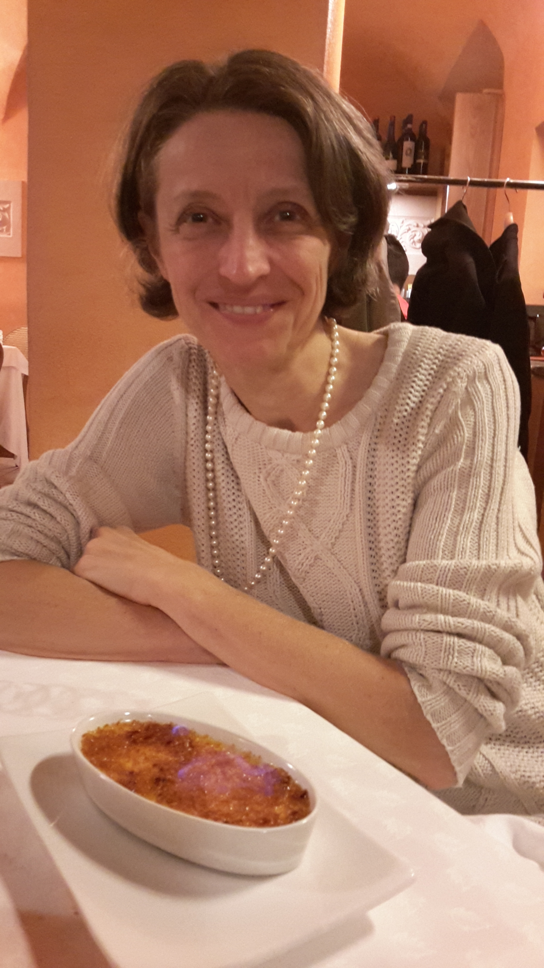
Giuseppe Occhialini Medal and Prize winner 2018
Professor Elena Pian
INAF-Osservatorio di Astrofisica e Scienza dello Spazio, Bologna
For her work of first detection, with the ESO Very Large Telescope equipped with the X-shooter spectrograph, of r-process nucleosynthesis in the optical/infrared counterpart of a gravitational radiation signal due to a binary neutron star merger.

