Slide 1
Particle Physics Advisory Panel Report
Town Meeting 2019
Roger Jones, Lancaster
on behalf of the PPAP
9th March 2019

Slide 2
Outline
Introduction
PPAP membership
Recent activities
Near future

Slide 3
Primary activities
Activity occurs in bursts otherwise we meet every few months
Interact with community
  Annual community meeting
  Information exchange with Pis
  Encourage community to notify us of new initiatives
Respond to request for information from STFC
Respond to calls for input from government
Keep Particle Physics Roadmap up to date
  We do not prioritize or tension
Reports Reports Reports

Slide 4
PPAP
Five most relevant science advisory panels
  Particle Physics Advisory Panel
  Nuclear Physics Advisory Panel
  Particle Astrophysics Advisory Panel
  Astronomy Advisory Panel
  Solar System Advisory Panel
Plus there are others like the Computing Advisory Panel
“The purpose of the Advisory Panel is to provide a link between Science Board and the community, and represent the needs of the community to STFC.”
http://www.stfc.ac.uk/about-us/how-we-are-governed/advisory-boards-panels-committees/particle-physics-advisory-panel/

Slide 5
Membership
Attempts expertise across all PP areas.
  Silvia Pascoli (IPPP)
  Veronique Boisvert (RHUL)
  Jo Cole (Brunel)
  Roger Jones (Lancaster) Chair
  Matthew Malek (Sheffield)
  Matthew Needham (Edinburgh)
  Pawel Majewski (RAL)
  Peter Ratoff (Cockcroft)
Some rotation each year. Consider volunteering for this role.
Thanks to outgoing members and particularly to Claire Shepherd-Themistocleous who stepped down as chair at the end of 2018 after serving on the panel since 2012

Slide 6
Recent Activities
Unusually, two community meetings in 2018, driven by the European Strategy Refresh, Evaluation and Roadmap update
  2 days July 2018 @ RAL
  2 days Sept 2018 @ Birmingham
Also put together the response to the ‘Big Ideas’ call from Mark Thomson
Comment on the astroparticle programme evaluation input document
Report to SB – good engagement, though we would appreciate more feedback on documents we prepare
PP Programme Evaluation Panel
PP Roadmap Update

Slide 7
Ongoing Activities
Continued Engagement with European Strategy Review
Further Input to the Particle Physics Programme Evaluation Panel as required
Update to Science Board in late 2019
Further input to the UKRI Infrastructure Roadmap
Annual Community Meeting
  Dates to be confirmed
  Given the meeting in July, we suggest September is the right time

Slide 8
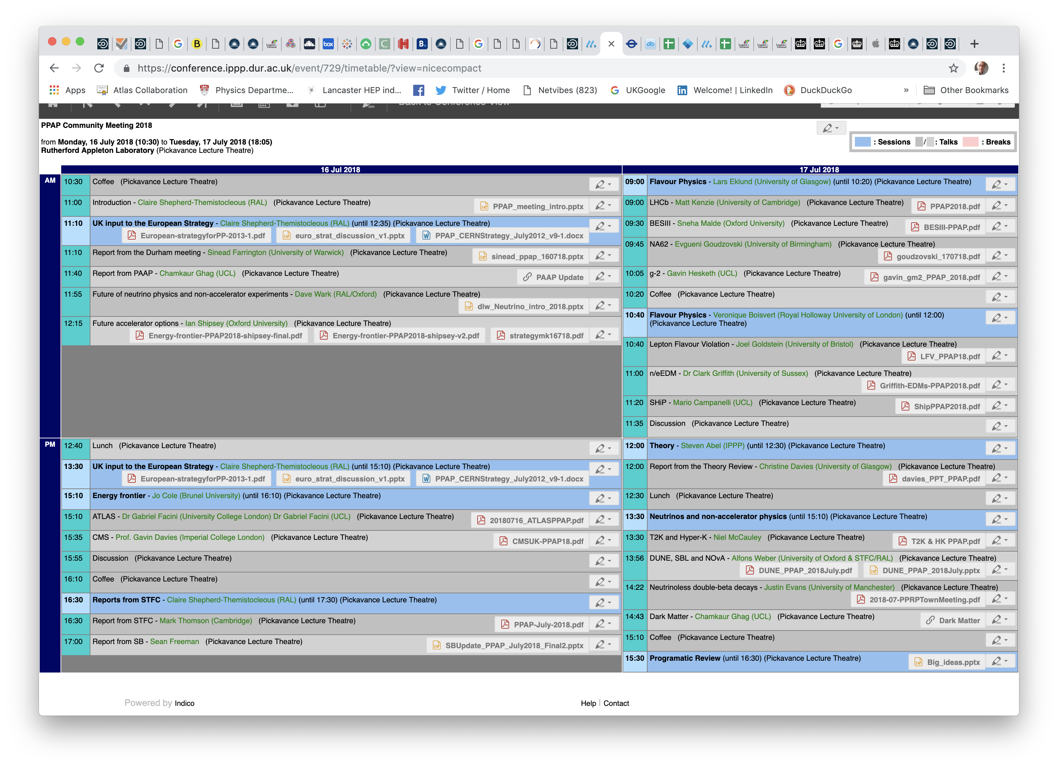
Community Meeting – July 2018, Scene Setting

Slide 9
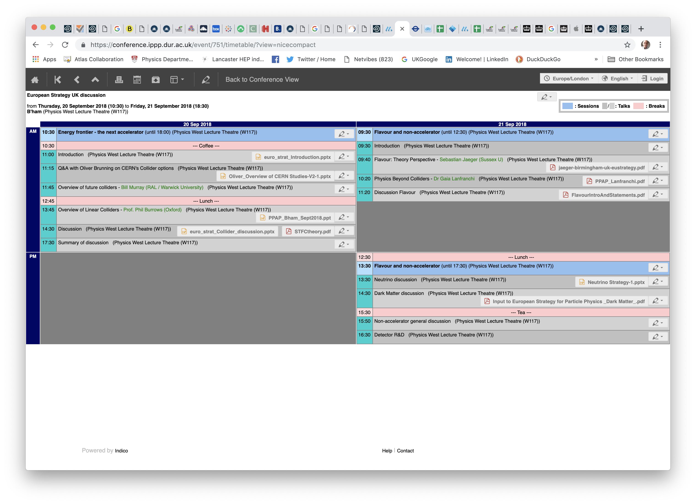
Community Meeting – Sept 2018, drilling down

Slide 10
European Particle Physics Strategy Update
Aims to do ‘that it says on the tin’.
Two major European events:
  “Open Symposium” - May 2019
    Physics Preparatory Group (PPG) produce “Briefing Book”
    Given to Physics Preparatory Group (PPG)
  “Strategy Drafting Session”. January 2020
  In the UK, there is the UK PP COMMUNITY MEETING: FROM OPEN SYMPOSIUM TO DRAFTING SESSION 1 July 2019, IoP, 37 Caledonian Rd
Written inputs were submitted in December 2018.

Slide 11

European Particle Physics Strategy Update
2017
2018
2019
2020
Jan.2018
Call for proposals for venues for Open Symposium and Strategy Drafting Session
(deadline May 15, 2018)
Dec.2018
Closing submission community input
(deadline Dec 18, 2018)
2nd half of Jan.2020
Strategy Update Drafting Session
Febr.2018
Call for scientific input
one week
March.2018
Call for nominations of PPG & ESG members
2nd half of May.2019
Open Symposium
4 days
March.2020
Strategy Update submitted to Council
June.2018
Council decision on venues and dates
Sept.2019
Physics Briefing Book available
consultation &
consensus building
Sept.2018
Council to launch the Strategy Update process & establish the PPG and ESG
organisation &
input preparation by community
Physics results appearing after May 2019 will be taken into account in the process
May.2020
Council to approve Strategy Update

Slide 12
Composition of the PPG
  Physics Preparatory Group (PPG) composition, adopted by Council, December 2013:
    The Strategy Secretary (acting as Chairperson),
    four members appointed by the Council on the recommendation of the SPC,
    four members appointed by the Council on the recommendation of ECFA,
    the SPC Chairperson,
    the ECFA Chairperson,
    the Chairperson of the European Laboratory Directors’ meeting,
    one representative appointed by CERN,
    one representative from Asia appointed by the respective regional representatives in ICFA,
    one representative from the Americas appointed by the respective regional representatives in ICFA.
  Responsible with organising the Open Symposium and to deliver to the European Strategy Group (ESG) a Physics Briefing book.

Slide 13
Roadmap Update
PPAP formulates update to Roadmap.
  Input from:
    The two community meetings
    Responses to drafts (including the strategy drafts) to the community
    Exchanges with projects
    Thanks for the feedback, even after the deadline ;-)
Reminder: the PPAP maps, it does not prioritize.
Reminder: this is a roadmap, not an OS map.
  The discussion of each project is brief and forward-looking. It is not the occasion to give chapter and verse on projects and their history
  Much of the final edit is rebalancing the level and style of the sections

Slide 14
Particle Physics Programme Evaluation
Purpose:
“Look at the portfolio and science strategy to define a balanced programme of excellent science within a realistic financial planning envelope for each scientific discipline.”
Particle Physics Evaluation due to begin in Autumn 2018.
  “Process duration approx. 6 months”
PPAP update the Roadmap supports this process
Document as input 3 January 2019
Projects (e.g. ATLAS, CMS…) also provided written input
Presentation and attendance 29 January 2019
Further attendance possible

Slide 15
UKRI Infrastrcuture Roadmap
Chairs of APs invited to consultation meeting at the IoP.
    https://www.stfc.ac.uk/research/science-challenges/
Discussion of community needs.
    Meeting 29th January, *after* interim report had been signed-off by Minister
    Inputs:
      List of large infrastructure needs expanded from v short list in interim report
      Computing and eInfrastructure concerns are cross-cutting
      Alignment of EPSRC and STFC criteria for selection
Process is expected to finalize the roadmap by the summer.

Slide 16
PPAP Concerns
Comments and concerns
  We are now broad (11 STFC funded programmes, up from 7)
    Shows creativity and vigor
    But can it all be sustained?
  Core funding! Expanding programme by seizing opportunities will make the pressure on the core worse
    Loss of senior research staff and RAs at universities and in PPD.
    Increases concern over keeping skills pipeline filled as a consequences of losses.
  At the risk of update fatigue…..
    Consequences of the CG will have profound effects on the roadmap
    Believe an update in ~1 year is appropriate

Slide 17
Future
Community Meeting September (dates soon)
  Please try to engage, and not just for ‘your’ day!
Update to Roadmap (final circulation ~now)
Continued engagement with European Strategy
Reaction to output of the Particle Physics Programme Evaluation

Slide 18
Questions?

Slide 19
Composition of the ESG
  European Strategy Group (ESG) composition, adopted by Council, December 2013:
  the Strategy Secretary (acting as Chairperson),
  one representative appointed by each CERN Member State,
  one representative for each of the Laboratories participating in the major European Laboratory Directors’ meeting, including its Chairperson,
  the CERN Director-General,
  the SPC Chairperson,
  the ECFA Chairperson.
Responsible to deliver a draft Strategy Update to Council.
  Invited:
  the President of the CERN Council,
  one representative from each of the Associate Member States,
  one representative from each Observer State,
  one representative from the European Commission,
  the Chairpersons of ApPEC, FALC, ESFRI and NuPECC,
  the members of the Physics Preparatory Group.

Slide 20
Key points in answers
Programme broader than at last programmatic review. General feeling this is at right level now.
Broadening has happened at cost to existing programme.
Concern about what flat cash will mean for programme.
Exploit significant investments to the full, while keeping a stake in the future.

