Slide 1


Global Challenges Research Fund
STFC update
      GCRF Overview
      UKRI Collective Programme
      STFC GCRF Portfolio
      Future plans
      Newton
      Final comments
Jason Green
External Innovations, Programmes Directorate
STFC

Slide 2

Global Challenges Research Fund
GCRF part of UK's Official Development Assistance (ODA) commitment to spending 0.7% of Gross National Income on International Development.
ODA-funded activity focuses on outcomes that promote long-term sustainable growth of countries on OECD Development Assistance Committee (DAC) list.
Address global challenges through disciplinary and interdisciplinary research.
Strengthening research and innovation capability in both UK and developing countries.
No requirement for matched funding from partner countries (cf Newton Fund).
Can provide funding for researchers and organisations in developing countries.
GCRF projects must: promote the welfare/economic development of countries on the DAC list of ODA recipients; address a development need; and focus on partnering
Notes:
The START project is funded through STFC’s GCRF portfolio. This slide gives a brief background to what GCRF is

Slide 3
GCRF: Overarching aim and strategic objectives
“to ensure UK science takes a leading role in addressing the problems faced by developing countries (and) harness the expertise of the UK research base to pioneer new ways of tackling global challenges, promoting global prosperity and tackling extreme poverty.”
Support excellent challenge-led research and innovation that focusses on the most pressing, urgent and intractable challenges, and assembles ground breaking research, evidence and skills which has most potential for real world impact.
Working in partnership with developing countries, global institutions and funders of research to support and promote development research and impact.
Building capacity and capability that addresses the challenges of developing countries, supports outstanding researchers in low-middle income countries and the UK, provides a critical mass of well-trained researchers and strengthens research and innovation leadership in developing countries.
Maximising the impact of investments through the promotion of research-based solutions, decision making and technological innovations and through encouraging international best practice in programme design, equitable research partnerships with the Global South, research culture and the delivery of research.

Slide 4
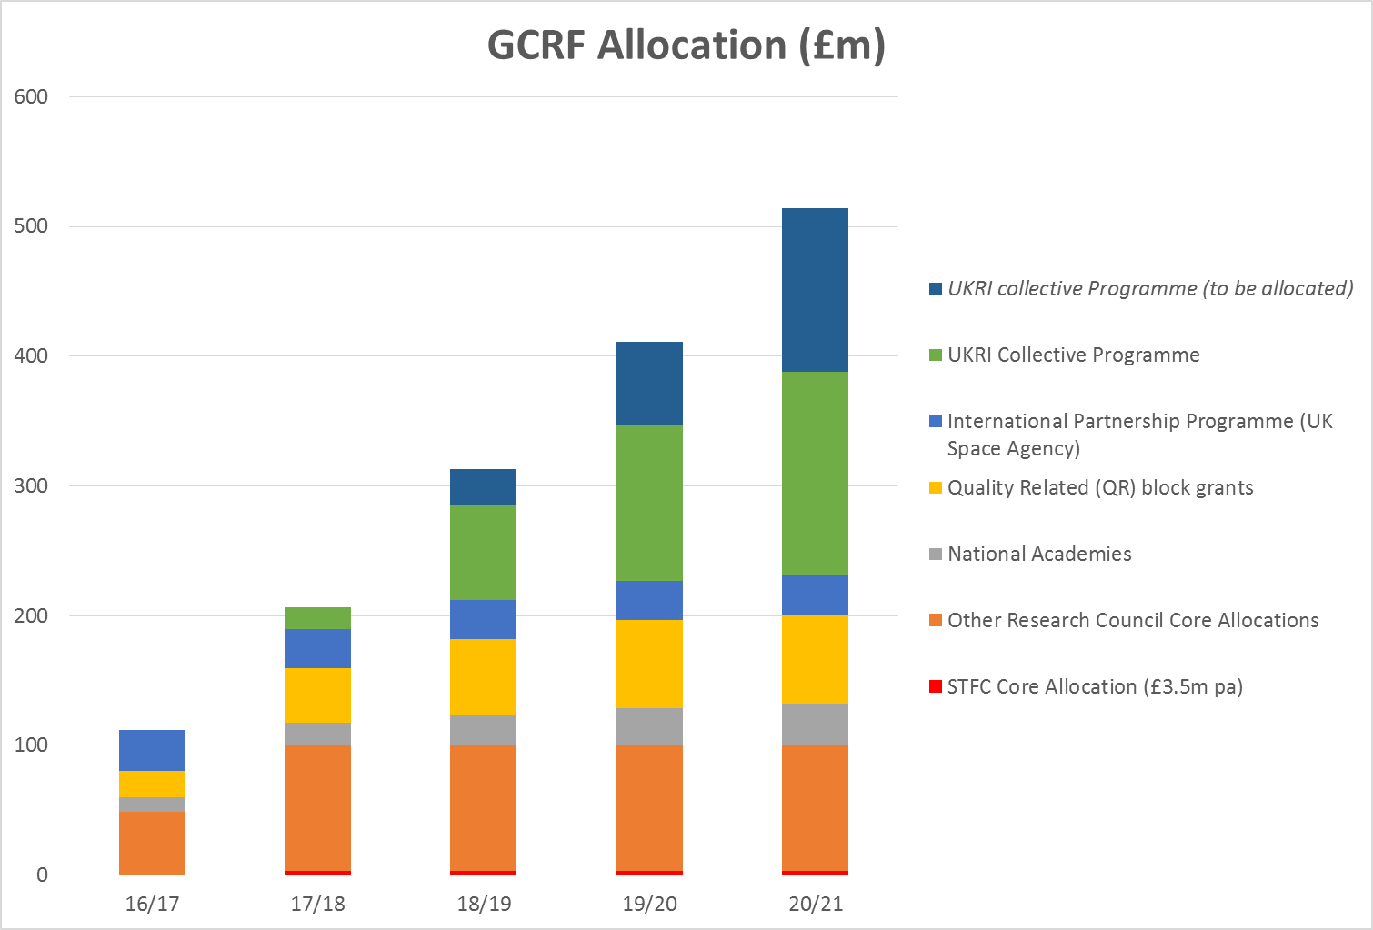
Notes:
Emphasise that STFC GCRF budget is small in comparison with the overall GCRF budget. The STFC has had the opportunity to bid into the large collective pot but without success. This is partly the reason for the emergence of the START programme, drawn together from two Diamond proposals to the first collective call. STFC EB decided that they wanted to support a flagship project.
~Highlight UK Space Agency – International Partnership Programme, providing business solutions using satellites. Projects funded include BGS, Satellite Apps Catapult, Rothampsted,
The STFC GCRF portfolio has been developed from its own GCRF allocation - £14m over 4 years (FY18/18 to 20/21).

Slide 5
UKRI GCRF Collective Programme
Calls in 2019 across six strategic GCRF Challenge portfolios.
Cities and Sustainable Infrastructure
(Re)thinking the off-grid city; Sustainable energy and international development: beyond technology
Education
Education as a driver of sustainable development Network Plus; Education in conflict and crisis research; Education Interventions for Early Childhood Development
Food Systems
Cultures and histories of agriculture, food, and nutrition; A combined Food Systems approach to developing interventions to address the Double Burden of Malnutrition
Global Health
Health and Communities
Resilience to Environmental Shocks and Change
Equitable Resilience: ensuring resilience enhances the Sustainable Development Goals; Multiple/systemic Risks
Security Protracted Conflict, Refugee Crises and Forced Displacement
Development-based approaches to Protracted Displacement; Preventing Conflict, Building Sustainable and Inclusive Peace; Protection in Contexts of Conflict and Displacement
Cross-cutting Investments
Coherence Grants; Gender and Intersectionality Network Plus; Global Engagement Networks;
Innovation and Commercialisation eg Energy and Agritech Catalysts (Innovate UK led), Digital Innovation for Africa
https://www.ukri.org/news/new-international-development-research-programme-announced-by-uk-research-and-innovation/

Slide 6


STFC GCRF Portfolio
START – Synchrotron Techniques for African Research and Technology. £3.7M
STFC GCRF 2017 and 2018 calls. Successful call run in 2017, 36 applications received, 22 projects awarded. A second call ran in 2018, 42 applications, 10 funded. Number and quality of proposals increased.
CERN Summer Studentships . Sponsoring graduate level summer studentships from Africa, Asia and Latin America to experience CERN life, working on ATLAS and CMS. 2018, sponsored 40 graduate students from 36 different LMIC countries.
China-UK SKA Programme. Joint training programme with the China Scholarship Council (CSC) to support China-UK SKA Programmes for PhDs and postdocs. Cambridge, Oxford and Manchester so far, another call likely in 2018.
Innovative, robust and affordable medical linacs for challenging environments. Supporting workshops (Botswana March 2019) and five small follow-on projects to bring together experts in accelerator and medical fields from CERN, STFC labs and UK HEIs with health staff and medical physicists from developing countries to help define radiotherapy technology needs for developing countries.
ODA Follow-on Awards Additional funds to spend in 2018 for organisations that currently have STFC GCRF or Newton Fund grants, supporting activities associated with existing ODA compliant STFC projects.
Notes:
Emphasise a portfolio approach – our two GCRF calls have been to encourage the STFC research community to explore ideas for new collaborations in developing countries that address needs there.

Slide 7
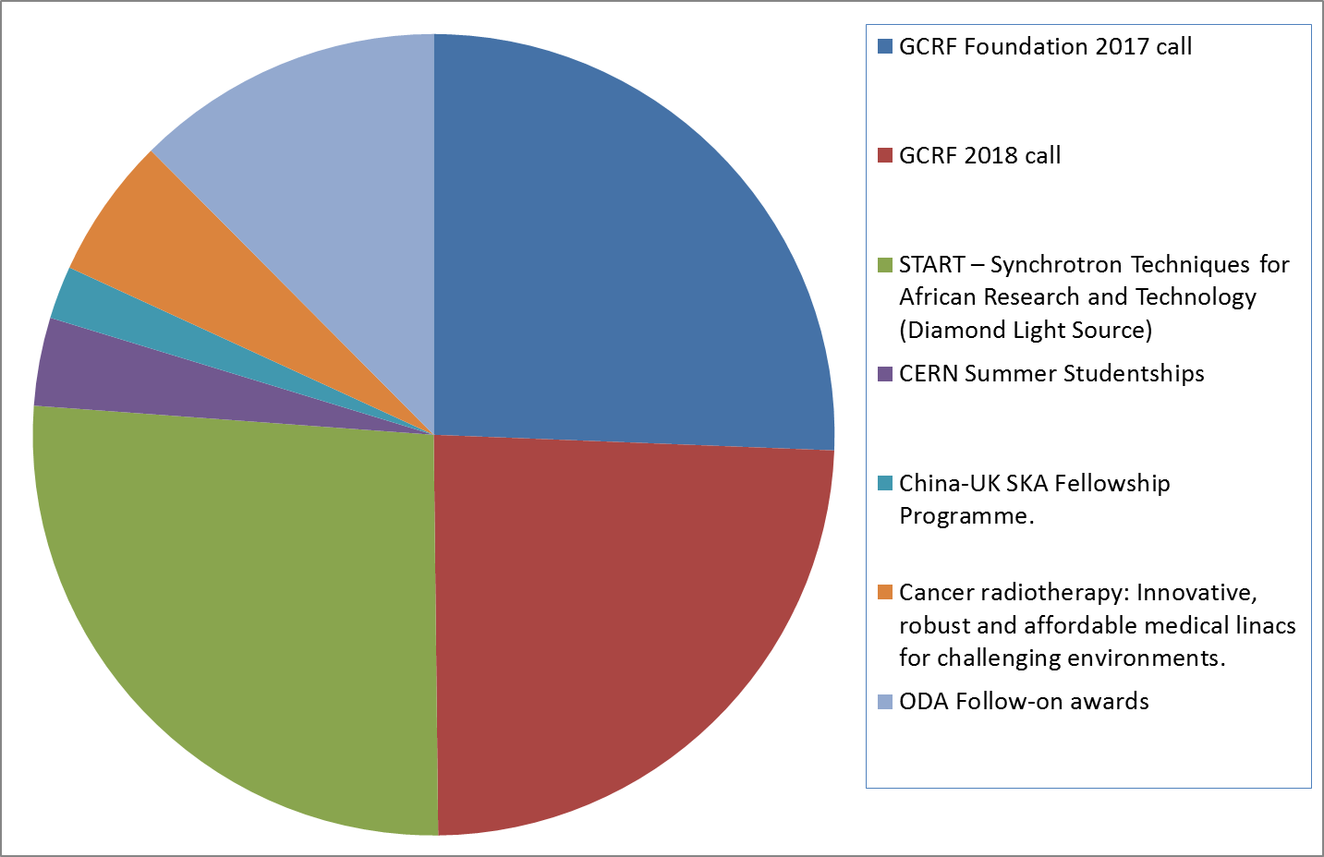
STFC GCRF – distribution of funding
Notes:
STFC GCRF funding split roughly into quarters, of which the START programme is a quarter. Therefore a major component of the STFC GCRF portfolio.

Slide 8

Synchrotron Techniques for African Research and Technology
£3.7M project building partnerships between world leading scientists in Africa (South Africa, Egypt, Ethiopia and Lesotho) and the UK working together on research using synchrotron science.
Focus is on:
developing and characterising new energy materials for example in the development of solar cells or improving energy efficiency through novel catalysts. Currently solar power comparatively expensive due to import costs of raw materials for photovoltaics.
Structural biology to understand diseases and develop drug targets for diseases such as Rift Valley Fever, Ebola, Lassa Fever. Working with South African Institute for Communicable Diseases.
Launch event, Oxford 27-28 March 2019.

Slide 9
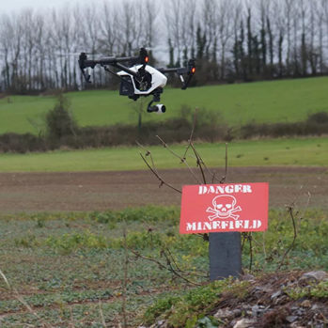
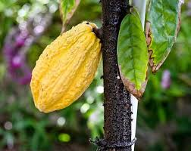
Robotics & Remote Sensing for Humanitarian Mine Action.
Using astronomical data to introduce Thai students to “Big Data” and using these skills to help local businesses to increase employability and alleviate poverty.
Understanding Cadmium Uptake by Cocoa Plants via Isotope Analyses.
Applying Astronomy Capability to Map an Invasive Weed: Leveraging Satellite Surveys to Inform "Famine Weed" Policy in Pakistan.
Build a training network in data intensive science in southern Africa.
Quantifying past food trends in Brazil to improve its environment, health and economy and making dietary recommendations which are more both healthy and sustainable.
Transforming Cold Food Chains in India through Space Science and Technologies.
Mass spectrometry techniques for rapid detection of adulteration of milk powder and vegetable oils in developing countries.
Astro-ecology: astrophysics algorithms to support conservation biology.
Astrotourism in Namibia.
Instrumentation development to measure lead contamination of food and water.
Notes:
Some examples of the 27 projects funded from STFC GCRF calls

Slide 10
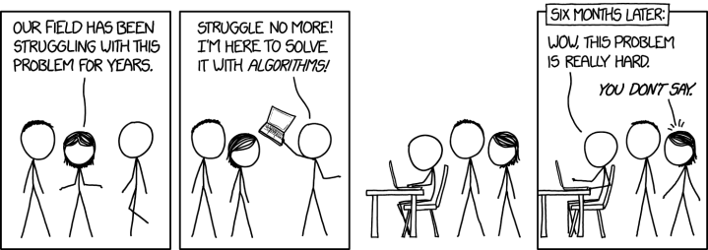
Importance of Partnerships
Co-development with international partners
Substantial, genuine and meaningful collaboration between UK and development country researchers, as well as relevant development agencies, NGOs, Civil Society Organisations, industry or other private sector organisations, policy makers
Appropriate strategy for engagement with users, intermediaries and beneficiaries
Consideration of the relevant developing country context
Ensure partner country challenge-led not UK/science push
Ensure challenge-led not UK/science push
Notes:
Just to emphasise the importance of forming equitable partnerships, where the collaborators in developing countries have an equal say in the objectives and delivery of the project

Slide 11
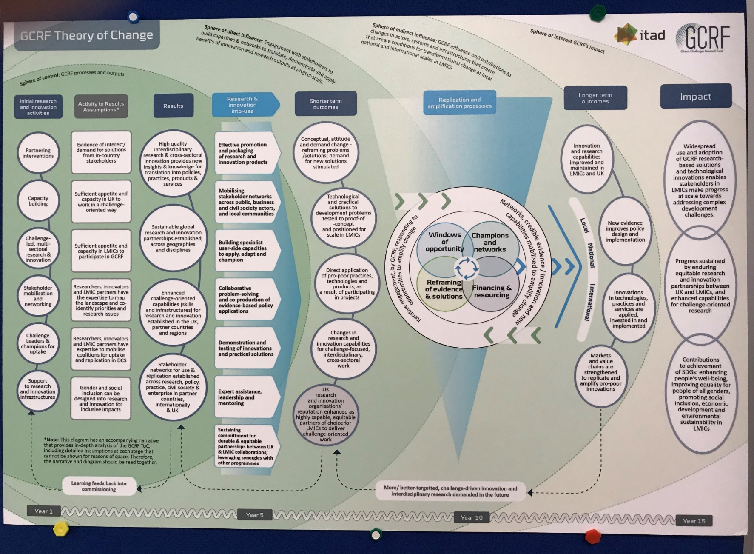
Theories of Change

Slide 12
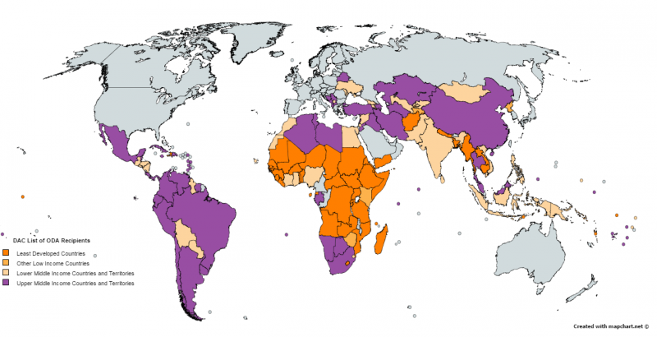
Future ideas/plans/SR period
ODA funding as Capital in next SR period – opportunities, risks?
GCRF consultation and briefing workshop in Autumn 2019. Agenda to include:
Present our current GCRF portfolio
Highlight impacts from projects
Importance of equitable partnerships
Session on Theories of Change model
Evidence to help identify potential future calls eg technology transfer, networks, or food, health…
Focus on least developed countries
Exploring possible links with
African Academy of Sciences
OECD Development Assistance Committee (DAC) Countries

Slide 13


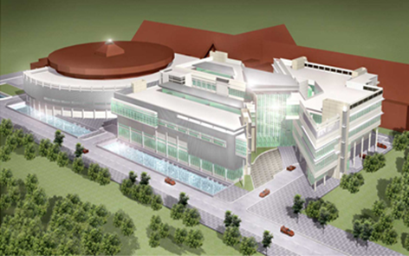
Newton Fund
The Newton Fund in the UK is a £735M funding programme to support research and innovation partnerships to tackle development challenges.
STFC has Newton Fund projects working with South Africa, Mexico, Colombia, Chile, Thailand, Indonesia, India and China:
China AgriTech programme using Earth Observation techniques and data to enhance farming efficiency
Thailand - working with: National Astronomical Research Institute of Thailand (NARIT), Synchrotron Light Research Institute (Public Organization)
Indonesia - ISIS and Diamond working with to develop new catalysts to turn palm oil wastes into useful biofuels
South Africa and into other countries – Development in Africa with Radio Astronomy (DARA)

Slide 14
Newton Extension Funds
STFC successful in obtaining additional funds 2019/20 to 2021/22:
Thailand – NARIT Astronomy Technology - £1.3m
Jordan Agritech - £1.4m
DARA and Data DARA extension activities - £0.8m
LIGO India – £0.25m
Jordan Data Intensive CDT Capacity Building - £0.3m

Slide 15
Final comments
GCRF and Newton support excellent research and innovation to tackle global risks and improve the lives of the world’s poorest, build partnerships and impact the prosperity, security and well-being of developing countries and the UK.
STFC GCRF budget is a very small proportion of overall GCRF pot…step change in quality in second call applications funding some excellent projects.
Need to look beyond Newton Fund Countries to address problems facing the poorest countries.
For collective funds, need to engage with other research disciplines in the UK – better to be part of a bigger interdisciplinary project than a single discipline unsuccessful one.
Importance of seeing the bigger picture in developing ODA projects – Theories of Change.
Thank you
Notes:
Emphasise that STFC is excited about the START project and are proud to be funding it, we look forward to hearing more about its progress over the next three years.

