Slide 1
Low Energy?
Think Positive!
IoP HEPP APP 08 Apr 2019
UV Constraints on IR Effective Field Theories
Scott Melville

Slide 2
Low Energy?
Think Positive!
IoP HEPP APP 08 Apr 2019
UV Constraints on IR Effective Field Theories
``Positivity’’ Bounds
Scott Melville

Slide 3
Low Energy?
Think Positive!
IoP HEPP APP 08 Apr 2019
UV Constraints on IR Effective Field Theories
``Positivity’’ Bounds
SMEFT
Vector Boson Scattering
B-physics Anomalies
Scott Melville

Slide 4
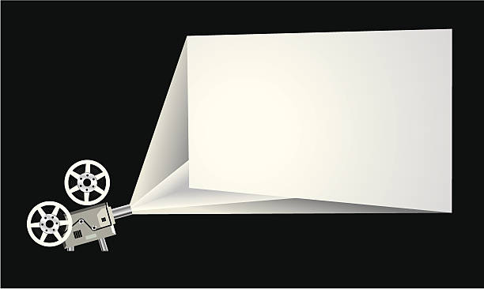
BIG
PICTURE
Big Picture

Slide 5
UV
IR
Big Picture
Notes:
Can have classicalization in other places

Slide 6
UV
IR
Standard Model
Big Picture
Notes:
Can have classicalization in other places

Slide 7
UV
New physics
IR
Standard Model
Big Picture
Notes:
Can have classicalization in other places

Slide 8

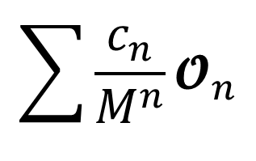


UV
New physics
$$???$$
$$M$$
$$\sum{\frac{c_{n}}{M^{n}}{\text{𝓞}}_{n}}$$
$$+$$
IR
Standard Model
Big Picture
Notes:
Can have classicalization in other places

Slide 9

UV
New physics
$$???$$
$$M$$
$$\sum{\frac{c_{n}}{M^{n}}{\text{𝓞}}_{n}}$$
$$+$$
Known operator basis
IR
Standard Model
Big Picture
Notes:
This lets us calculate things without needing to worry about the complicated underlying UV physics.

Slide 10


UV
New physics
$$???$$
$$M$$
$$\sum{\frac{c_{n}}{M^{n}}{\text{𝓞}}_{n}}$$
$$+$$
Known operator basis
IR
Standard Model
with undetermined
coefficients
Big Picture
Notes:
BUT, the price to pay is that each local operator gets its own undetermined coefficient. I’ll refer to these as EFT parameters, Wilson coefficients, or couplings.

Slide 11
UV
New physics
$$???$$
$$M$$
$$\sum{\frac{c_{n}}{M^{n}}{\text{𝓞}}_{n}}$$
$$+$$
Known operator basis
IR
Standard Model
with undetermined
coefficients
Need many measurements
Big Picture
Notes:
Problem number 1: often there are many operators to consider, even at relatively small n. We need to make AT LEAST this many independent measurements in order to fix c_n and make the theory predictive. In the SM, working with the leading order dimension 4 operators gives 19 undetermined parameters. In GR there’s all contractions of Ricci Scalar, Ricci Tensor and Riemann and their derivatives, and so we’d need to make a lot of very precise quantum gravity measurements in order to make this GR EFT predictive beyond leading orders.

Slide 12

UV
New physics
$$???$$
$$M$$
$$\sum{\frac{c_{n}}{M^{n}}{\text{𝓞}}_{n}}$$
$$+$$
Known operator basis
IR
Standard Model
with undetermined
coefficients
Need many measurements
(2) No deeper understanding of UV physics
Big Picture
Notes:
Because we’ve given up on understanding the UV, no amount of testing or experimentation can reveal fundamental truths about the underlying physics on very small length scales. This isn’t a very satisfying state of affairs.

Slide 13

UV
New physics
Unitary, Causal, Local, …
$$???$$
$$M$$
$$\sum{\frac{c_{n}}{M^{n}}{\text{𝓞}}_{n}}$$
$$+$$
Known operator basis
IR
Standard Model
with undetermined
coefficients
Need many measurements
(2) No deeper understanding of UV physics
Big Picture
Notes:
Because we’ve given up on understanding the UV, no amount of testing or experimentation can reveal fundamental truths about the underlying physics on very small length scales. This isn’t a very satisfying state of affairs.

Slide 14


UV
New physics
Unitary, Causal, Local, …
$$???$$
$$M$$
$$\sum{\frac{c_{n}}{M^{n}}{\text{𝓞}}_{n}}$$
$$c_{j}$$
$$+$$
IR
Standard Model
$$c_{i}$$
Need many measurements
(2) No deeper understanding of UV physics
Big Picture
Notes:
Any questions at this stage, about what we’re going to do or why it’s important

Slide 15
UV
New physics
Unitary, Causal, Local, …
$$???$$
$$M$$
$$\sum{\frac{c_{n}}{M^{n}}{\text{𝓞}}_{n}}$$
$$c_{j}$$
$$+$$
IR
Standard Model
$$c_{i}$$
Need many measurements
(2) No deeper understanding of UV physics
Big Picture
Notes:
Any questions at this stage, about what we’re going to do or why it’s important

Slide 16
UV
New physics
Unitary, Causal, Local, …
$$???$$
$$M$$
$$\sum{\frac{c_{n}}{M^{n}}{\text{𝓞}}_{n}}$$
$$c_{j}$$
$$+$$
IR
Standard Model
$$c_{i}$$
Need many measurements
(2) No deeper understanding of UV physics
Big Picture
Notes:
Any questions at this stage, about what we’re going to do or why it’s important

Slide 17
UV
New physics
Unitary, Causal, Local, …
$$???$$
$$M$$
$$\sum{\frac{c_{n}}{M^{n}}{\text{𝓞}}_{n}}$$
$$c_{j}$$
$$+$$
IR
Standard Model
$$c_{i}$$
Need many measurements
(2) No deeper understanding of UV physics
Big Picture
Notes:
Any questions at this stage, about what we’re going to do or why it’s important

Slide 18

UV
New physics
Unitary, Causal, Local, …
$$???$$
$$M$$
$$\sum{\frac{c_{n}}{M^{n}}{\text{𝓞}}_{n}}$$
$$c_{j}$$
$$+$$
IR
Standard Model
$$c_{i}$$
Data more constraining
(2) No deeper understanding of UV physics
Big Picture
Notes:
Any questions at this stage, about what we’re going to do or why it’s important

Slide 19
UV
New physics
Unitary, Causal, Local, …
$$???$$
$$M$$
$$\sum{\frac{c_{n}}{M^{n}}{\text{𝓞}}_{n}}$$
$$c_{j}$$
$$+$$
IR
Standard Model
$$c_{i}$$
Data more constraining
(2) Can infer UV properties from IR measurements
Big Picture
Notes:
Any questions at this stage, about what we’re going to do or why it’s important

Slide 20
UV
New physics
Unitary, Causal, Local, …
$$???$$
$$M$$
$$\sum{\frac{c_{n}}{M^{n}}{\text{𝓞}}_{n}}$$
$$c_{j}$$
$$+$$
IR
Standard Model
$$c_{i}$$
Data more constraining
Positivity Bounds
(2) Can infer UV properties from IR measurements
Big Picture
Notes:
Any questions at this stage, about what we’re going to do or why it’s important

Slide 21

Positivity Constraints

Slide 22
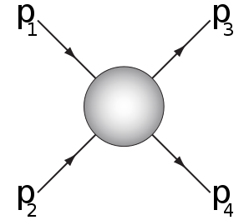




[Adams et al., 0602178]
$$a$$
$$a$$
[SM et al., in prep]
$$b$$
$$b$$
Positivity Constraints

Slide 23




[Adams et al., 0602178]
$$a$$
$$a$$
[SM et al., in prep]
$$p_{1}$$
$$p_{1}$$
$$p_{2}$$
$$p_{2}$$
$$b$$
$$b$$
Positivity Constraints

Slide 24
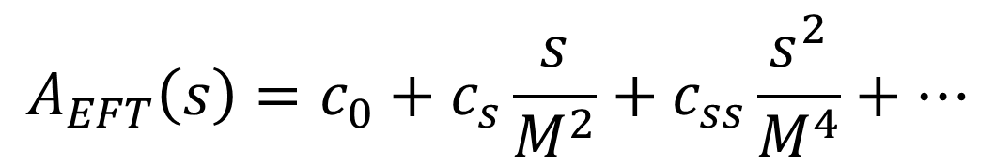

[Adams et al., 0602178]
$$a$$
$$a$$
[SM et al., in prep]
$$p_{1}$$
$$p_{1}$$
$$s=−{\left(p_{1}+p_{2}\right)}^{2}$$
$$p_{2}$$
$$p_{2}$$
$$b$$
$$b$$
$$A_{EFT}\left(s\right)=c_{0}+c_{s}\frac{s}{M^{2}}+c_{ss}\frac{s^{2}}{M^{4}}+…$$
Positivity Constraints
Notes:
C_s comes from dimension 6, c_ss comes from dimension 8 operators

Slide 25
[Adams et al., 0602178]
$$a$$
$$a$$
[SM et al., in prep]
$$p_{1}$$
$$p_{1}$$
$$s=−{\left(p_{1}+p_{2}\right)}^{2}$$
$$p_{2}$$
$$p_{2}$$
$$b$$
$$b$$
$$A_{EFT}\left(s\right)=c_{0}+c_{s}\frac{s}{M^{2}}+c_{ss}\frac{s^{2}}{M^{4}}+…$$
If new physics is unitary and causal, then:
Positivity Constraints
Notes:
We’ll justify this with a couple of simple examples, and then apply these to the dimension-6 and dimension-8 operators in SMEFT

Slide 26

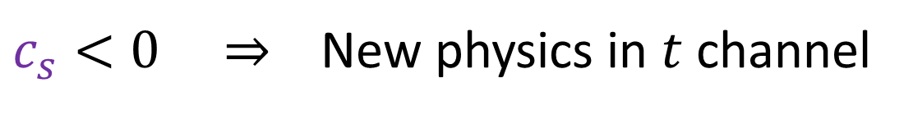



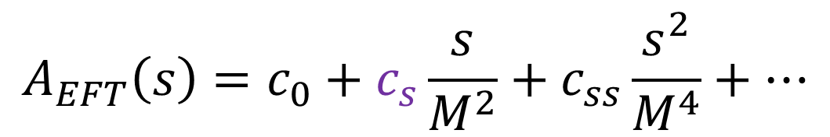
[Adams et al., 0602178]
$$a$$
$$a$$
[SM et al., in prep]
$$p_{1}$$
$$p_{1}$$
$$s=−{\left(p_{1}+p_{2}\right)}^{2}$$
$$p_{2}$$
$$p_{2}$$
$$b$$
$$b$$
$$A_{EFT}\left(s\right)=c_{0}+c_{s}\frac{s}{M^{2}}+c_{ss}\frac{s^{2}}{M^{4}}+…$$
If new physics is unitary and causal, then:
$$a$$
$$a$$
$c_{s}<0 ⇒$ New physics in $t$ channel
$$b$$
$$b$$
Positivity Constraints
Notes:
We’ll justify this with a couple of simple examples, and then apply these to the dimension-6 and dimension-8 operators in SMEFT

Slide 27

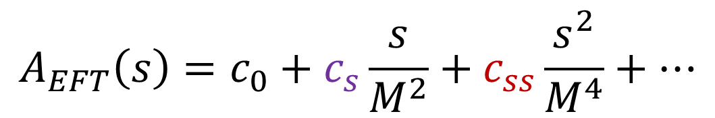
[Adams et al., 0602178]
$$a$$
$$a$$
[SM et al., in prep]
$$p_{1}$$
$$p_{1}$$
$$s=−{\left(p_{1}+p_{2}\right)}^{2}$$
$$p_{2}$$
$$p_{2}$$
$$b$$
$$b$$
$$A_{EFT}\left(s\right)=c_{0}+c_{s}\frac{s}{M^{2}}+c_{ss}\frac{s^{2}}{M^{4}}+…$$
If new physics is unitary and causal, then:
$$a$$
$$a$$
$c_{s}<0 ⇒$ New physics in $t$ channel
$$b$$
$$b$$
$c_{ss}<0 ⇒$ New physics is non-local
Positivity Constraints
Notes:
We’ll justify this with a couple of simple examples, and then apply these to the dimension-6 and dimension-8 operators in SMEFT

Slide 28
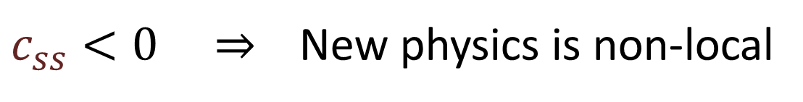
New Local Physics
$c_{ss}<0 ⇒$ New physics is non-local
Positivity Constraints

Slide 29

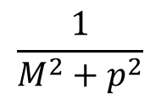

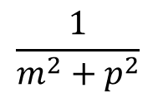
New Local Physics
$c_{ss}<0 ⇒$ New physics is non-local
UV
$$φ$$
$$H$$
$$\frac{1}{m^{2}+p^{2}}$$
$$\frac{1}{M^{2}+p^{2}}$$
IR
Positivity Constraints

Slide 30


New Local Physics
$c_{ss}<0 ⇒$ New physics is non-local
UV
$$φ$$
$$H$$
$$g H φ^{2}$$
$$\frac{1}{m^{2}+p^{2}}$$
$$\frac{1}{M^{2}+p^{2}}$$
$$g$$
IR
Positivity Constraints

Slide 31

New Local Physics
$c_{ss}<0 ⇒$ New physics is non-local
UV
$$φ$$
$$H$$
$$g H φ^{2}$$
$$\frac{1}{m^{2}+p^{2}}$$
$$\frac{1}{M^{2}+p^{2}}$$
$$g$$
$$M^{2}$$
IR
Positivity Constraints

Slide 32

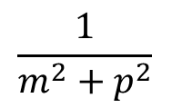
New Local Physics
$c_{ss}<0 ⇒$ New physics is non-local
UV
$$φ$$
$$H$$
$$g H φ^{2}$$
$$\frac{1}{m^{2}+p^{2}}$$
$$\frac{1}{M^{2}+p^{2}}$$
$$g$$
$$M^{2}$$
$$φ$$
$$\frac{1}{m^{2}+p^{2}}$$
IR
Positivity Constraints

Slide 33
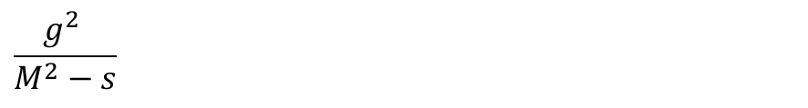
New Local Physics
$c_{ss}<0 ⇒$ New physics is non-local
UV
$$φ$$
$$H$$
$$g H φ^{2}$$
$$\frac{1}{m^{2}+p^{2}}$$
$$\frac{1}{M^{2}+p^{2}}$$
$$g$$
$$M^{2}$$
$$φ$$
$$\frac{1}{m^{2}+p^{2}}$$
$$\frac{g^{2} }{M^{2}−s} = \frac{g^{2} Z}{M^{2}} \left(1+\frac{s}{M^{2}} +\frac{s^{2}}{M^{4}}+… \right)$$
IR
Positivity Constraints

Slide 34
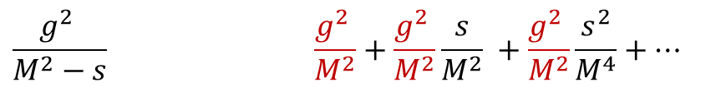
New Local Physics
$c_{ss}<0 ⇒$ New physics is non-local
UV
$$φ$$
$$H$$
$$g H φ^{2}$$
$$\frac{1}{m^{2}+p^{2}}$$
$$\frac{1}{M^{2}+p^{2}}$$
$$g$$
$$M^{2}$$
$$φ$$
$$\frac{1}{m^{2}+p^{2}}$$
$$\frac{g^{2} }{M^{2}−s} \frac{g^{2} }{M^{2}}+\frac{g^{2} }{M^{2}}\frac{s}{M^{2}} +\frac{g^{2} }{M^{2}}\frac{s^{2}}{M^{4}}+…$$
IR
Positivity Constraints

Slide 35

New Local Physics
$c_{ss}<0 ⇒$ New physics is non-local
UV
$$φ$$
$$H$$
Local
$$g H φ^{2}$$
$$\frac{1}{m^{2}+p^{2}}$$
$$\frac{1}{M^{2}+p^{2}}$$
(+Unitary)
$$g$$
(+Causal)
$$M^{2}$$
Positive $s^{2}$ coefficient
$$φ$$
$$\frac{1}{m^{2}+p^{2}}$$
$$\frac{g^{2} }{M^{2}−s} \frac{g^{2} }{M^{2}}+\frac{g^{2} }{M^{2}}\frac{s}{M^{2}} +\frac{g^{2} }{M^{2}}\frac{s^{2}}{M^{4}}+…$$
IR
Positivity Constraints

Slide 36

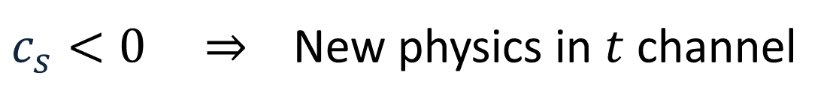
New $t$-channel Physics
$c_{s}<0 ⇒$ New physics in $t$ channel
UV
IR
Positivity Constraints

Slide 37



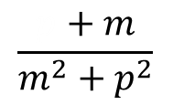
New $t$-channel Physics
$c_{s}<0 ⇒$ New physics in $t$ channel
UV
$$ψ$$
$$H$$
$$g H\overline{ψ}ψ$$
$$\frac{p+m}{m^{2}+p^{2}}$$
$$\frac{1}{M^{2}+p^{2}}$$
$$g$$
IR
Positivity Constraints

Slide 38


New $t$-channel Physics
$c_{s}<0 ⇒$ New physics in $t$ channel
UV
$$ψ$$
$$H$$
$$g H\overline{ψ}ψ$$
$$\frac{p+m}{m^{2}+p^{2}}$$
$$\frac{1}{M^{2}+p^{2}}$$
$$g$$
$$M^{2}$$
$$ψ$$
$$\frac{p+m}{m^{2}+p^{2}}$$
IR
Positivity Constraints

Slide 39
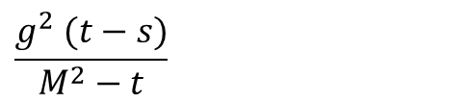
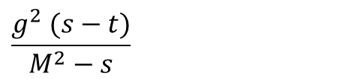
New $t$-channel Physics
$c_{s}<0 ⇒$ New physics in $t$ channel
UV
$$ψ$$
$$H$$
$$g H\overline{ψ}ψ$$
$$\frac{p+m}{m^{2}+p^{2}}$$
$$\frac{1}{M^{2}+p^{2}}$$
$$g$$
$$M^{2}$$
$$ψ$$
$$\frac{g^{2} (s−t)}{M^{2}−s} → +\frac{g^{2} Z}{M^{2}}\frac{s}{M^{2}}$$
$$\frac{p+m}{m^{2}+p^{2}}$$
IR
$$\frac{g^{2} (t−s)}{M^{2}−t} → −\frac{g^{2} Z}{M^{2}}\frac{s}{M^{2}}$$
Positivity Constraints

Slide 40
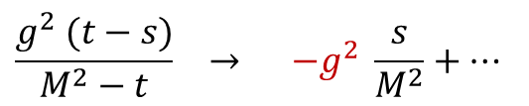
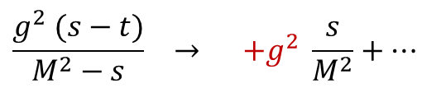
New $t$-channel Physics
$c_{s}<0 ⇒$ New physics in $t$ channel
UV
$$ψ$$
$$H$$
$$g H\overline{ψ}ψ$$
$$\frac{p+m}{m^{2}+p^{2}}$$
$$\frac{1}{M^{2}+p^{2}}$$
$$g$$
$$M^{2}$$
$$ψ$$
$$\frac{g^{2} (s−t)}{M^{2}−s} → +g^{2} \frac{s}{M^{2}}+…$$
$$\frac{p+m}{m^{2}+p^{2}}$$
IR
$$\frac{g^{2} (t−s)}{M^{2}−t} → −g^{2} \frac{s}{M^{2}}+…$$
Positivity Constraints

Slide 41
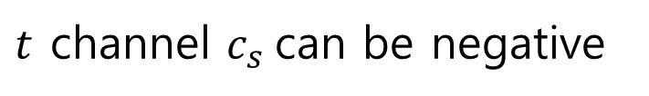
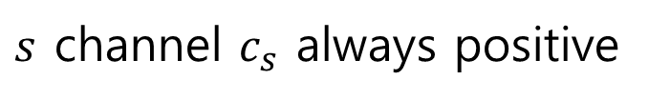
New $t$-channel Physics
$c_{s}<0 ⇒$ New physics in $t$ channel
UV
$$ψ$$
$$H$$
Local
$$g H\overline{ψ}ψ$$
$$\frac{p+m}{m^{2}+p^{2}}$$
$$\frac{1}{M^{2}+p^{2}}$$
(+Unitary)
$$g$$
(+Causal)
$$M^{2}$$
$$ψ$$
$s$ channel $c_{s}$ always positive
$$\frac{g^{2} (s−t)}{M^{2}−s} → +g^{2} \frac{s}{M^{2}}+…$$
$t$ channel $c_{s}$can be negative
$$\frac{p+m}{m^{2}+p^{2}}$$
IR
$$\frac{g^{2} (t−s)}{M^{2}−t} → −g^{2} \frac{s}{M^{2}}+…$$
Positivity Constraints

Slide 42

Vector Boson Scattering

Slide 43
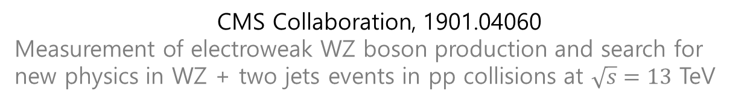
CMS Collaboration, 1901.04060
Measurement of electroweak WZ boson production and search for new physics in WZ + two jets events in pp collisions at $\sqrt{s}=13$ TeV
Vector Boson Scattering

Slide 44
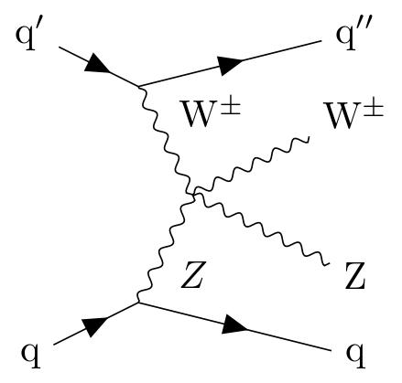
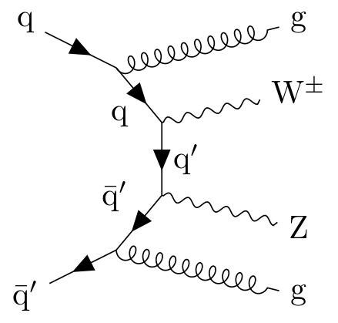
CMS Collaboration, 1901.04060
Measurement of electroweak WZ boson production and search for new physics in WZ + two jets events in pp collisions at $\sqrt{s}=13$ TeV
SM:
Vector Boson Scattering

Slide 45
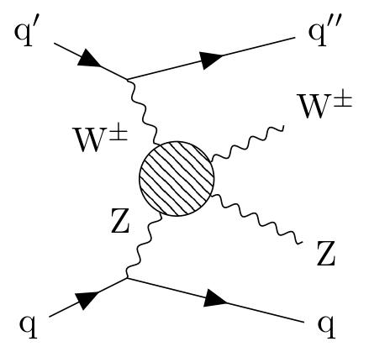
CMS Collaboration, 1901.04060
Measurement of electroweak WZ boson production and search for new physics in WZ + two jets events in pp collisions at $\sqrt{s}=13$ TeV
SM:
BSM:
Vector Boson Scattering

Slide 46
CMS Collaboration, 1901.04060
Measurement of electroweak WZ boson production and search for new physics in WZ + two jets events in pp collisions at $\sqrt{s}=13$ TeV
SM:
BSM:
Vector Boson Scattering

Slide 47
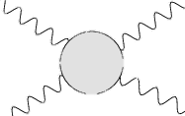



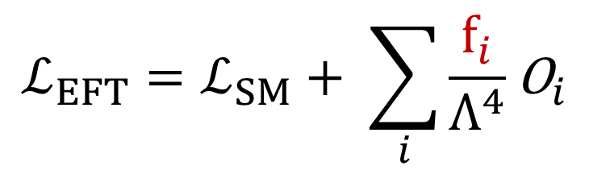
CMS Collaboration, 1901.04060
Measurement of electroweak WZ boson production and search for new physics in WZ + two jets events in pp collisions at $\sqrt{s}=13$ TeV
$$ℒ_{EFT}=ℒ_{SM}+ \sum_{i}{\frac{f_{i}}{Λ^{4}}{\text{O}}_{i}}$$
$$V$$
$$V$$
$$V$$
$$V$$
$$V=Z,W^{±},γ$$
Vector Boson Scattering
Notes:
The f’s are called aQGC (anomalous quartic gauge couplings)

Slide 48


CMS Collaboration, 1901.04060
Measurement of electroweak WZ boson production and search for new physics in WZ + two jets events in pp collisions at $\sqrt{s}=13$ TeV
$$ℒ_{EFT}=ℒ_{SM}+ \sum_{i}{\frac{f_{i}}{Λ^{4}}{\text{O}}_{i}}$$
$$V$$
$$V$$
$$V$$
$$V$$
$$V=Z,W^{±},γ$$
$$f_{S,0}$$
$$f_{S,1}$$
Vector Boson Scattering
Notes:
The f’s are called aQGC (anomalous quartic gauge couplings)

Slide 49
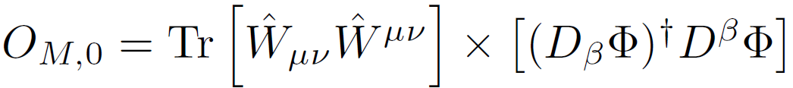
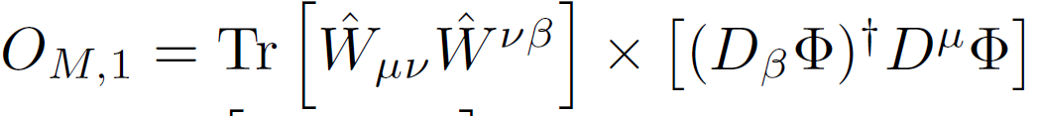


CMS Collaboration, 1901.04060
Measurement of electroweak WZ boson production and search for new physics in WZ + two jets events in pp collisions at $\sqrt{s}=13$ TeV
$$ℒ_{EFT}=ℒ_{SM}+ \sum_{i}{\frac{f_{i}}{Λ^{4}}{\text{O}}_{i}}$$
$$V$$
$$V$$
$$V$$
$$V$$
$$V=Z,W^{±},γ$$
$$f_{S,0}$$
$$f_{S,1}$$
$$f_{M,0}$$
$$f_{M,1}$$
Vector Boson Scattering
Notes:
The f’s are called aQGC (anomalous quartic gauge couplings)

Slide 50
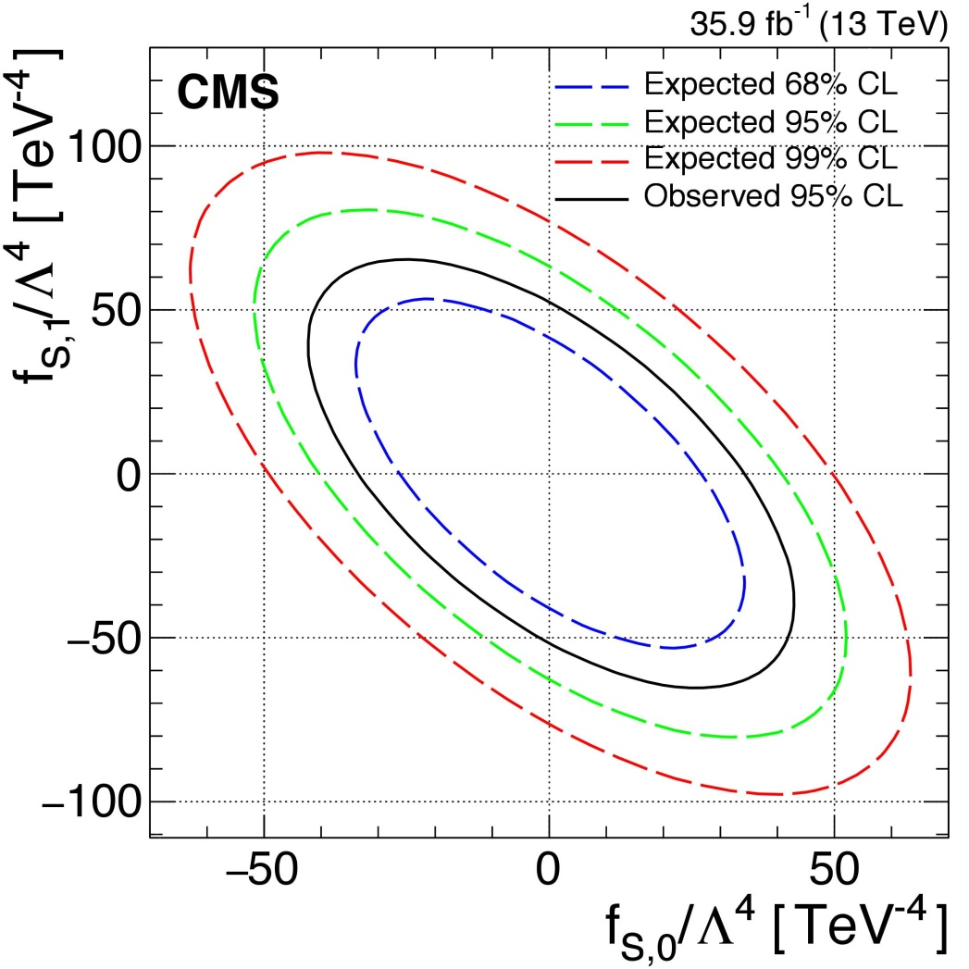


CMS Collaboration, 1901.04060
Measurement of electroweak WZ boson production and search for new physics in WZ + two jets events in pp collisions at $\sqrt{s}=13$ TeV
$$V$$
$$V$$
$$V$$
$$V$$
$$V=Z,W^{±},γ$$
$$f_{S,1}$$
$$f_{S,0}$$
$$f_{S,1}$$
$$f_{M,0}$$
$$f_{M,1}$$
$$f_{S,0}$$
Vector Boson Scattering
Notes:
The f’s are called aQGC (anomalous quartic gauge couplings)

Slide 51
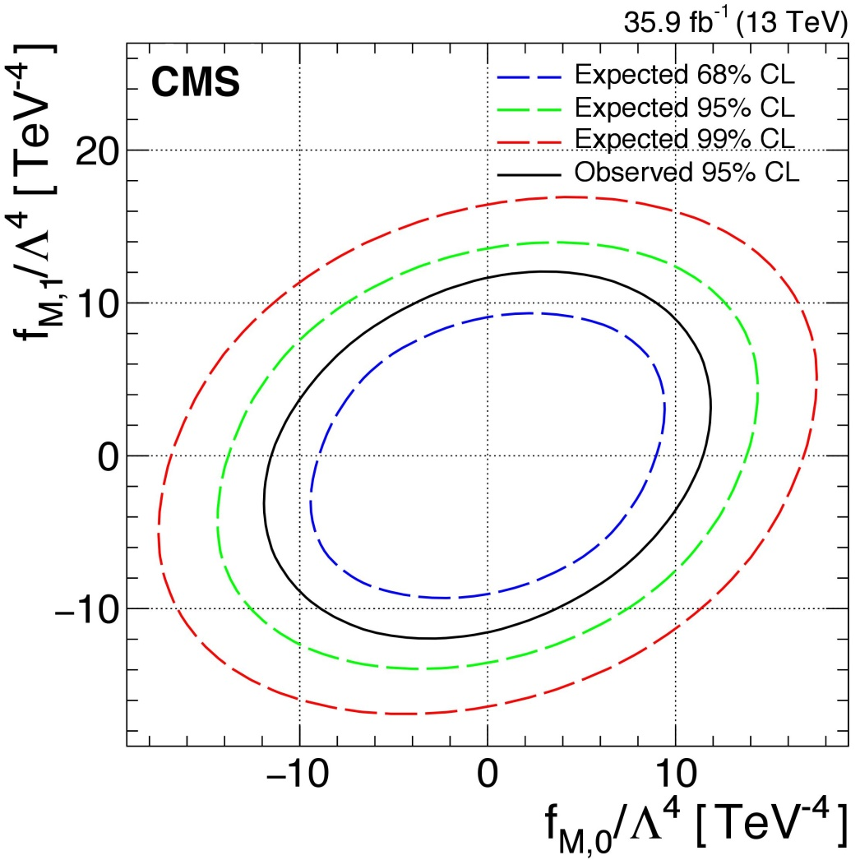


CMS Collaboration, 1901.04060
Measurement of electroweak WZ boson production and search for new physics in WZ + two jets events in pp collisions at $\sqrt{s}=13$ TeV
$$f_{M,1}$$
$$f_{S,1}$$
$$f_{M,0}$$
$$f_{S,0}$$
Vector Boson Scattering

Slide 52
New physics non-local if:
$$f_{M,1}$$
$$f_{S,1}$$
$$f_{M,0}$$
$$f_{S,0}$$
Vector Boson Scattering

Slide 53




[Zhang, Zhou, 1808.00010]
New physics non-local if:
[Bi et al, 1902.08977]
$$−f_{M,0}<0$$
$$f_{S,0}<0$$
$${2f}_{M,0}−f_{M,1}<0$$
$$f_{S,0}+f_{S,1}<0$$
$$f_{M,1}$$
$$f_{S,1}$$
$$f_{M,0}$$
$$f_{S,0}$$
Vector Boson Scattering
Notes:
Only 2.1% of the available parameter space is consistent with local microphysics.

Slide 54

LFU
Violation
Physics
B-physics anomalies

Slide 55
Buttazzo et al, 1706.07808
B-physics anomalies: a guide to combined explanations
B-physics anomalies

Slide 56


Buttazzo et al, 1706.07808
B-physics anomalies: a guide to combined explanations
$$ℒ_{EFT}=ℒ_{SM}$$
B-physics anomalies

Slide 57
Buttazzo et al, 1706.07808
B-physics anomalies: a guide to combined explanations
$$ℒ_{EFT}=ℒ_{SM}$$
B-physics anomalies

Slide 58



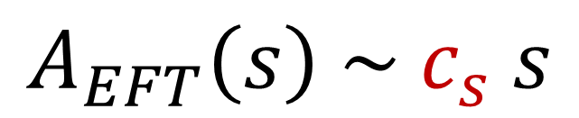

Buttazzo et al, 1706.07808
B-physics anomalies: a guide to combined explanations
$$ℒ_{EFT}=ℒ_{SM}$$
$$Q$$
$$Q$$
$$A_{EFT}\left(s\right) \sim c_{s} s$$
$$L$$
$$L$$
B-physics anomalies

Slide 59
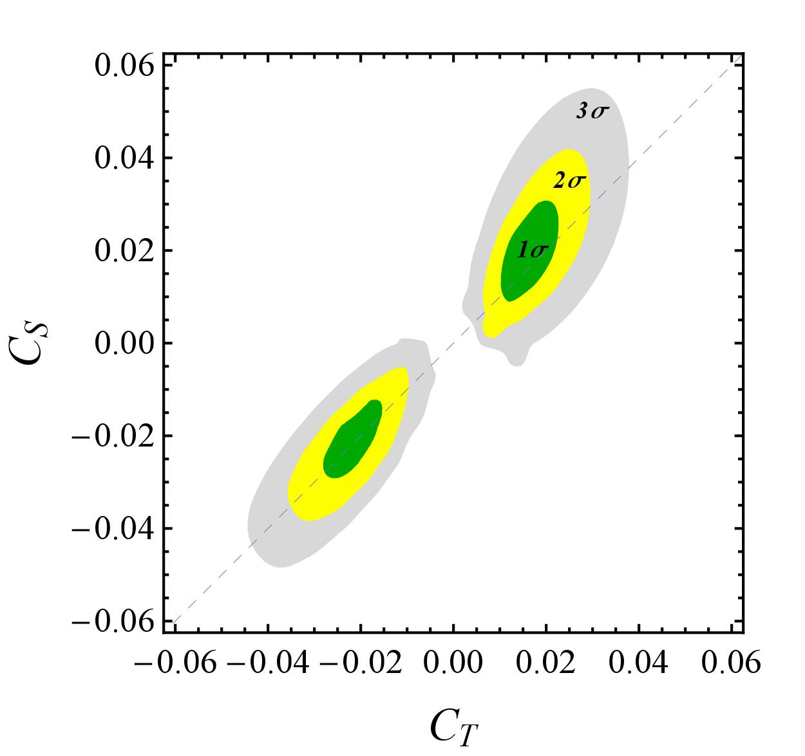
Buttazzo et al, 1706.07808
B-physics anomalies: a guide to combined explanations
B-physics anomalies

Slide 60












Buttazzo et al, 1706.07808
B-physics anomalies: a guide to combined explanations
$$q$$
$$q′$$
$$q$$
$$q′$$
or
$$l$$
$$l′$$
$$l$$
$$l′$$
$$q$$
$$q′$$
$$l$$
$$l′$$
B-physics anomalies

Slide 61


Buttazzo et al, 1706.07808
B-physics anomalies: a guide to combined explanations
$$q$$
$$q′$$
$$q$$
$$q′$$
or
$$l$$
$$l′$$
$$l$$
$$l′$$
Leptoquark
$$Z′$$
$$q$$
$$q′$$
$$l$$
$$l′$$
$$Z′$$
B-physics anomalies

Slide 62


Slide 63






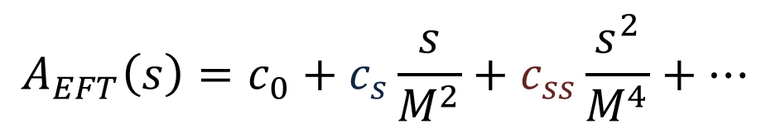
$$A_{EFT}\left(s\right)=c_{0}+c_{s}\frac{s}{M^{2}}+c_{ss}\frac{s^{2}}{M^{4}}+…$$
$$a$$
$$a$$
$c_{s}<0 ⇒$ New physics in $t$ channel
$c_{ss}<0 ⇒$ New physics is non-local
$$b$$
$$b$$
Summary

Slide 64
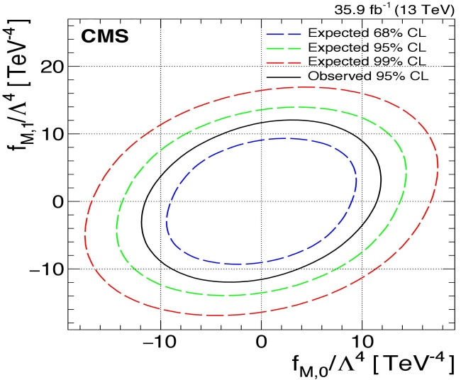
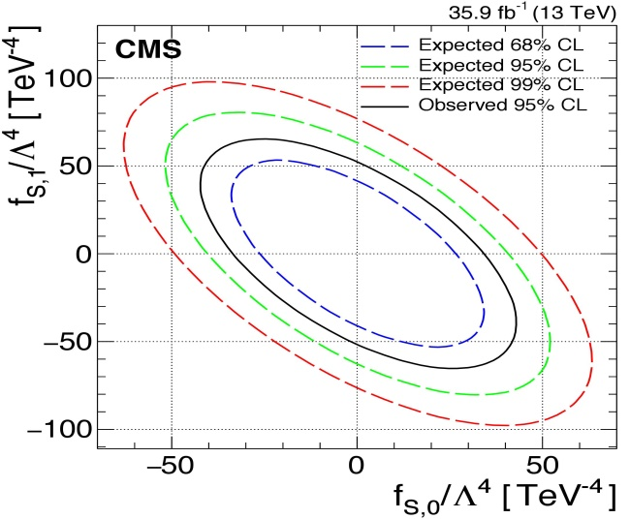

$$A_{EFT}\left(s\right)=c_{0}+c_{s}\frac{s}{M^{2}}+c_{ss}\frac{s^{2}}{M^{4}}+…$$
$$a$$
$$a$$
$c_{s}<0 ⇒$ New physics in $t$ channel
$c_{ss}<0 ⇒$ New physics is non-local
$$b$$
$$b$$
Vector Boson Scattering
Summary

Slide 65

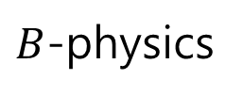
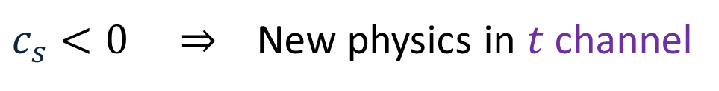
$$A_{EFT}\left(s\right)=c_{0}+c_{s}\frac{s}{M^{2}}+c_{ss}\frac{s^{2}}{M^{4}}+…$$
$$a$$
$$a$$
$c_{s}<0 ⇒$ New physics in $t$ channel
$c_{ss}<0 ⇒$ New physics is non-local
$$b$$
$$b$$
Vector Boson Scattering
$B$-physics
Summary

Slide 66
Backup Slides

Slide 67
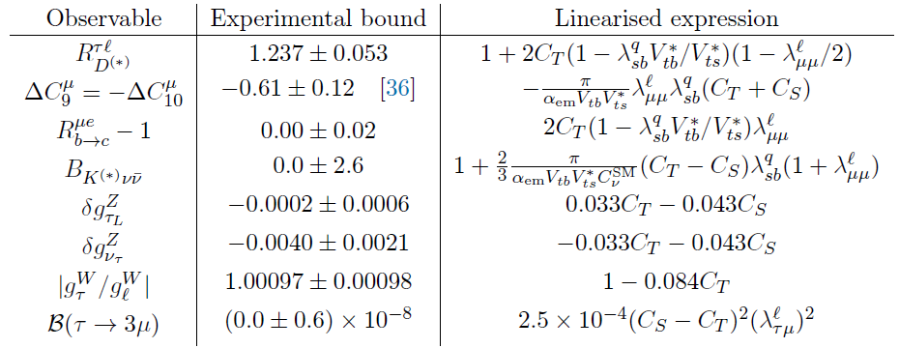
Buttazzo et al, 1706.07808
B-physics anomalies: a guide to combined explanations
Backup Slides

Slide 68
General Proof
IR
UV
Positivity Constraints

Slide 69

General Proof
$$A_{EFT}(s)$$
IR
UV
Positivity Constraints

Slide 70


General Proof
???
$$A_{EFT}(s)$$
$$A_{UV}(s)$$
$$Λ$$
IR
UV
Positivity Constraints

Slide 71


General Proof
$$s$$
$$Λ$$
$$A_{EFT}(s)$$
$$A_{UV}(s)$$
IR
UV
Positivity Constraints

Slide 72
General Proof
$$s$$
$$Λ$$
$$A_{EFT}(s)$$
$$A_{UV}(s)$$
IR
UV
Causality
$⇒ A\left(s\right)$ is analytic (up to known poles & branch cuts)
Positivity Constraints

Slide 73


General Proof
$$s$$
$$Λ$$
-
$$m^{2}$$
$$4m^{2}$$
Causality
$⇒ A\left(s\right)$ is analytic (up to known poles & branch cuts)
Positivity Constraints

Slide 74


General Proof
$$s$$
$$Λ$$
-
-
$$−t$$
$$m^{2}$$
$$3m^{2}−t$$
$$4m^{2}$$
Causality
$⇒ A\left(s\right)$ is analytic (up to known poles & branch cuts)
Positivity Constraints

Slide 75
General Proof
$$s$$
$$Λ$$
-
-
$$−t$$
$$m^{2}$$
$$3m^{2}−t$$
$$4m^{2}$$
Positivity Constraints

Slide 76


General Proof
$$s$$
$$Λ$$
$$C$$
-
x
-
$$−t$$
$$m^{2}$$
$$3m^{2}−t$$
$$4m^{2}$$
Positivity Constraints

Slide 77








General Proof
$$s$$
$$Λ$$
$$C$$
-
x
-
$$−t$$
$$m^{2}$$
$$3m^{2}−t$$
$$4m^{2}$$
$$=$$
$$s$$
$$Λ$$
$$C$$
-
x
-
$$−t$$
$$m^{2}$$
$$3m^{2}−t$$
$$4m^{2}$$
Positivity Constraints

Slide 78








General Proof
$$s$$
$$Λ$$
$$C$$
-
x
-
$$−t$$
$$m^{2}$$
$$3m^{2}−t$$
$$4m^{2}$$
$$=$$
$$s$$
$$Λ$$
$$∞$$
-
x
-
$$−t$$
$$m^{2}$$
$$3m^{2}−t$$
$$4m^{2}$$
$$∞$$
Positivity Constraints

Slide 79

General Proof
$$s$$
$$Λ$$
$$C$$
-
x
-
$$−t$$
$$m^{2}$$
$$3m^{2}−t$$
$$4m^{2}$$
$$A_{EFT}(s)$$
$$=$$
$$s$$
$$Λ$$
$$∞$$
-
x
-
$$−t$$
$$m^{2}$$
$$3m^{2}−t$$
$$4m^{2}$$
$$∞$$
Positivity Constraints

Slide 80

General Proof
$$s$$
$$Λ$$
$$C$$
-
x
-
$$−t$$
$$m^{2}$$
$$3m^{2}−t$$
$$4m^{2}$$
$$A_{EFT}(s)$$
$$=$$
$$s$$
$$Λ$$
$$∞$$
$$Poles+Im{ A}_{UV}(s)+A_{UV}(∞)$$
Positivity Constraints

Slide 81
General Proof
$$s$$
$$Λ$$
$$C$$
-
x
-
$$−t$$
$$m^{2}$$
$$3m^{2}−t$$
$$4m^{2}$$
$$A_{EFT}(s)$$
$$=$$
$$s$$
$$Λ$$
$$∞$$
$$Poles+Im{ A}_{UV}(s)+A_{UV}(∞)$$
-
x
-
$$−t$$
$$m^{2}$$
$$3m^{2}−t$$
$$4m^{2}$$
Positive
$$∞$$
Positivity Constraints

Slide 82
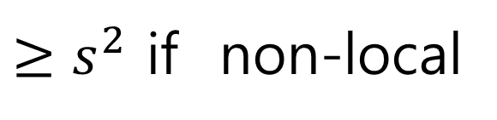
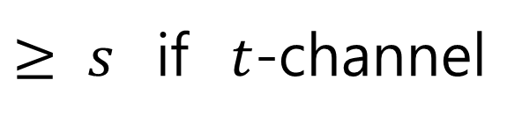
General Proof
$$s$$
$$Λ$$
$$C$$
-
x
-
$$−t$$
$$m^{2}$$
$$3m^{2}−t$$
$$4m^{2}$$
$$A_{EFT}(s)$$
$$=$$
$$s$$
$$Λ$$
$$∞$$
$$Poles+Im{ A}_{UV}(s)+A_{UV}(∞)$$
-
x
-
$$−t$$
$$m^{2}$$
$$3m^{2}−t$$
$$4m^{2}$$
Positive
$≥s^{2}$ if non-local
$≥ s$ if $t$-channel
$$∞$$
Positivity Constraints

