Slide 1
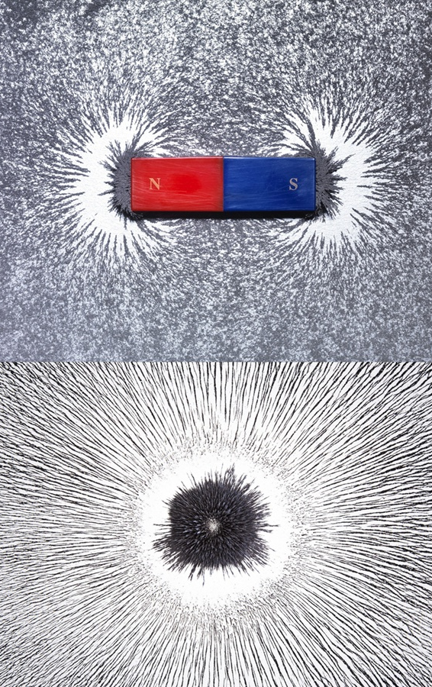


MoEDAL
Monopole and Exotics
Detector at the LHC
Lewis Millward
l.millward@qmul.ac.uk
MoEDAL Physics
MoEDAL Detector
Machine learning
for MoEDAL

Slide 2
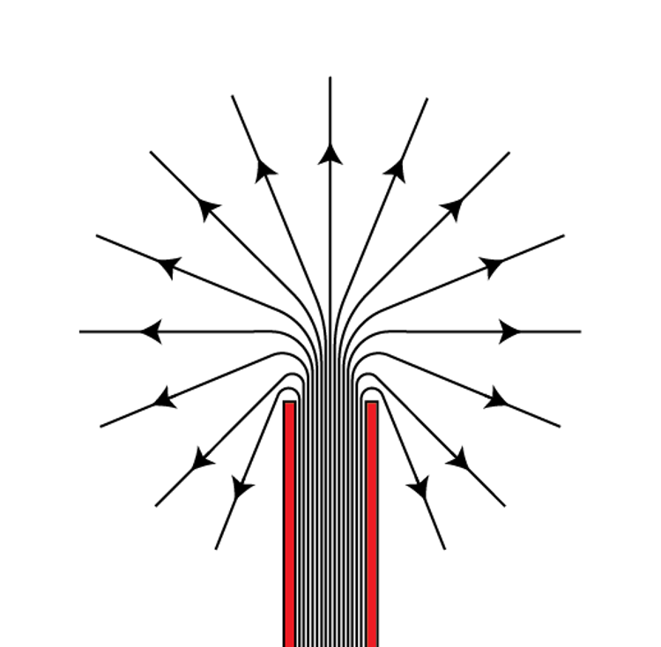
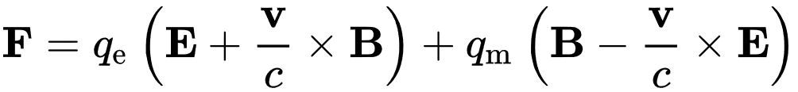
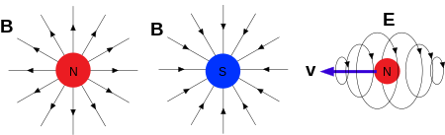
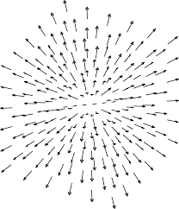
Magnetic Monopoles
Many different predictions;
Common properties;
Dirac monopole [1931]
pointlike singularity
modelled as
infinitely long
solenoid
‘dirac string’
T’Hooft-Polyakov [1973] GUT
Topological soliton
in fundamental
gauge fields in
theories with
broken symmetries.
Cho, Maison [1996] EW
modifications to SU(2) x U(1) electro-weak
theory possibly allows TeV monopoles
hybrid of Dirac / T’Hooft
Dyons, magnetic and electric
Acts like particle with magnetic charge. EM interaction with much stronger coupling! g_{D} ~ 68.5e
Mass ~ varies by theory, uncertain
Unconstrained for Dirac monopoles
EW 4~10TeV, Tevatron > 600GeV
Explains charge Quantisation, possibly baryon asymmetry, early cosmos
Stable if topological solitons
= Heavy, Stable, Highly Ionising

Slide 3
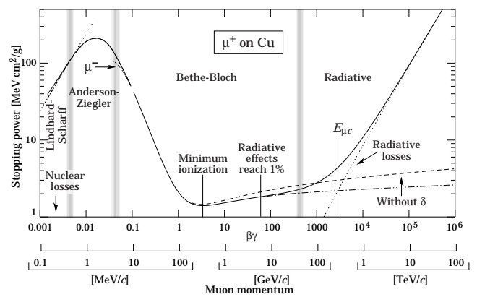
Exotics and HIPs
Monopole signal = Heavy, Stable, Highly Ionising particle (HIP)
Similar BSM exotics;
Stable Massive particles
SUSY; stops, staus, gluinos
(esp. if parity conserved)
Multi-Charged particles
eg, double charged Higgs
Bilepton
No SM background for HIP signals
High momenta + low β + highly ionising
E
7TeV
HIPs
HEP
TeV
GeV
LEP
Low energy particles
eg, Spallation Nuclei
MeV
β
C=1
Electronic Detectors optimised to trigger on light speed particles, which are minimally ionising
High LHC bunch crossing rate, most events discarded. Rare BSM signals can be missed
Lep Hep

Slide 4
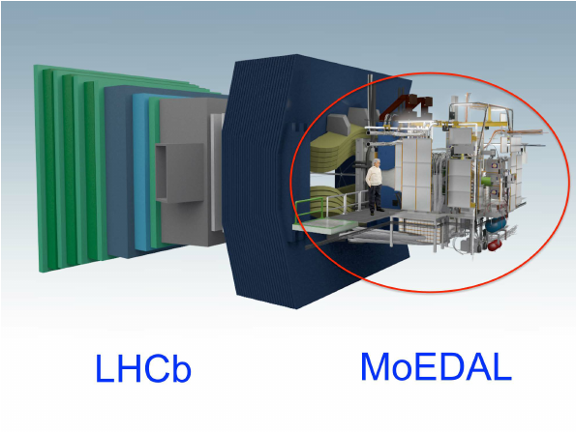
MoEDAL detector
LHC
IP:8
MMTs
Aluminium paramagnetic
monopole trappers
NTD array + VHCC
Ionisation detectors
(rest of this talk)
Timepix
Radiation environment
monitoring
MAPP
Millicharged
particle detector

Slide 5
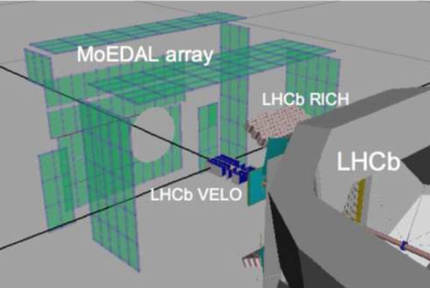
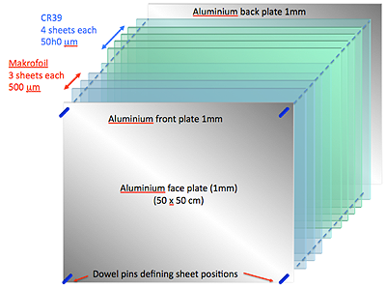
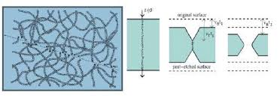
Moedal: NTD arrays
Stacked Arrays of ionisation sensitive polymer solid state nuclear track detectors (NTDs)
Sensitive to Heavily Ionising Particles, low sensitivity to standard model particles
Ionising particles break polymer chains in NTD foil in localised region
Leaves latent ‘Ion track’
Chemical etching process occurs faster along ion tracks than bulk medium
Forms ‘etch-pits’ where ionising particles entered and exited the foil
NANOSCOPIC
MICROSCOPIC

Slide 6
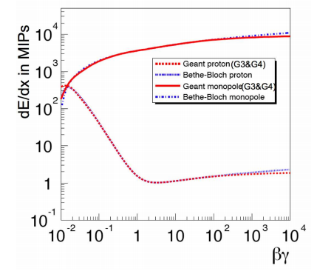
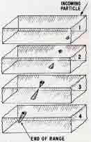
Particles in NTD stack
Standard Model Ionisation Behavior
Initial High energy causes minimal ionisation. Doesn't show up as etch pit
Particle loses energy, lower velocity, efficient ‘electronic’ ionisation. ‘Ranging in’
Reaches peak energy loss, larger etch-pits form at point of entry and exit
Energy loss, ‘electronic’ ionisation ceases, etch-pit formation stops. ‘Ranging out’
In practice MoEDAL stacks designed so SM particles only appear in 1 or 2 foils
typically ranging out (4)
Courtesy INF Bologna

Slide 7
Particles in NTD stack
BEYOND
Standard Model Ionisation Behavior
Initial High energy causes minimal ionisation. Doesn't show up as etch pit
Particle loses energy, lower velocity, efficient ‘electronic’ ionisation. ‘Ranging in’
Reaches peak energy loss, larger etch-pits form at point of entry and exit
Energy loss, ‘electronic’ ionisation ceases, etch-pit formation stops. ‘Ranging out’
Anomalously large ionisation
appears in all layers
Approx no β dependance
~ TeV Energy Momentum
Primary vertex origin
Direct search
No SM background
Courtesy INF Bologna

Slide 8

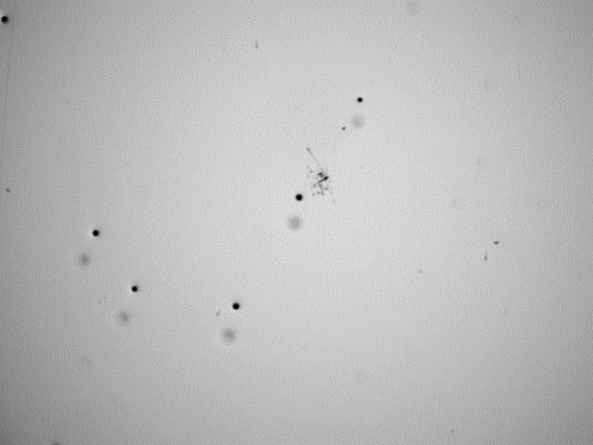
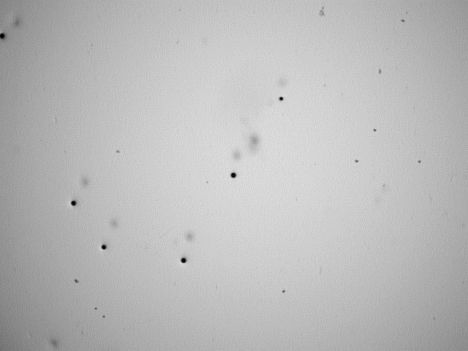
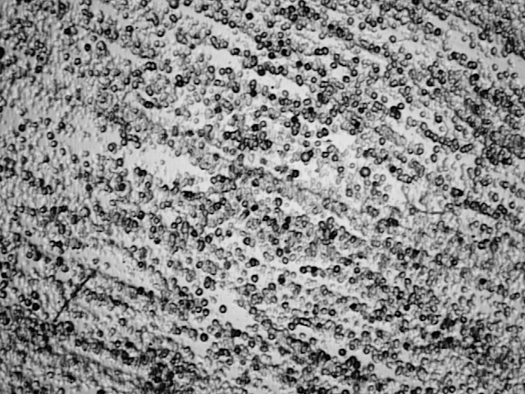
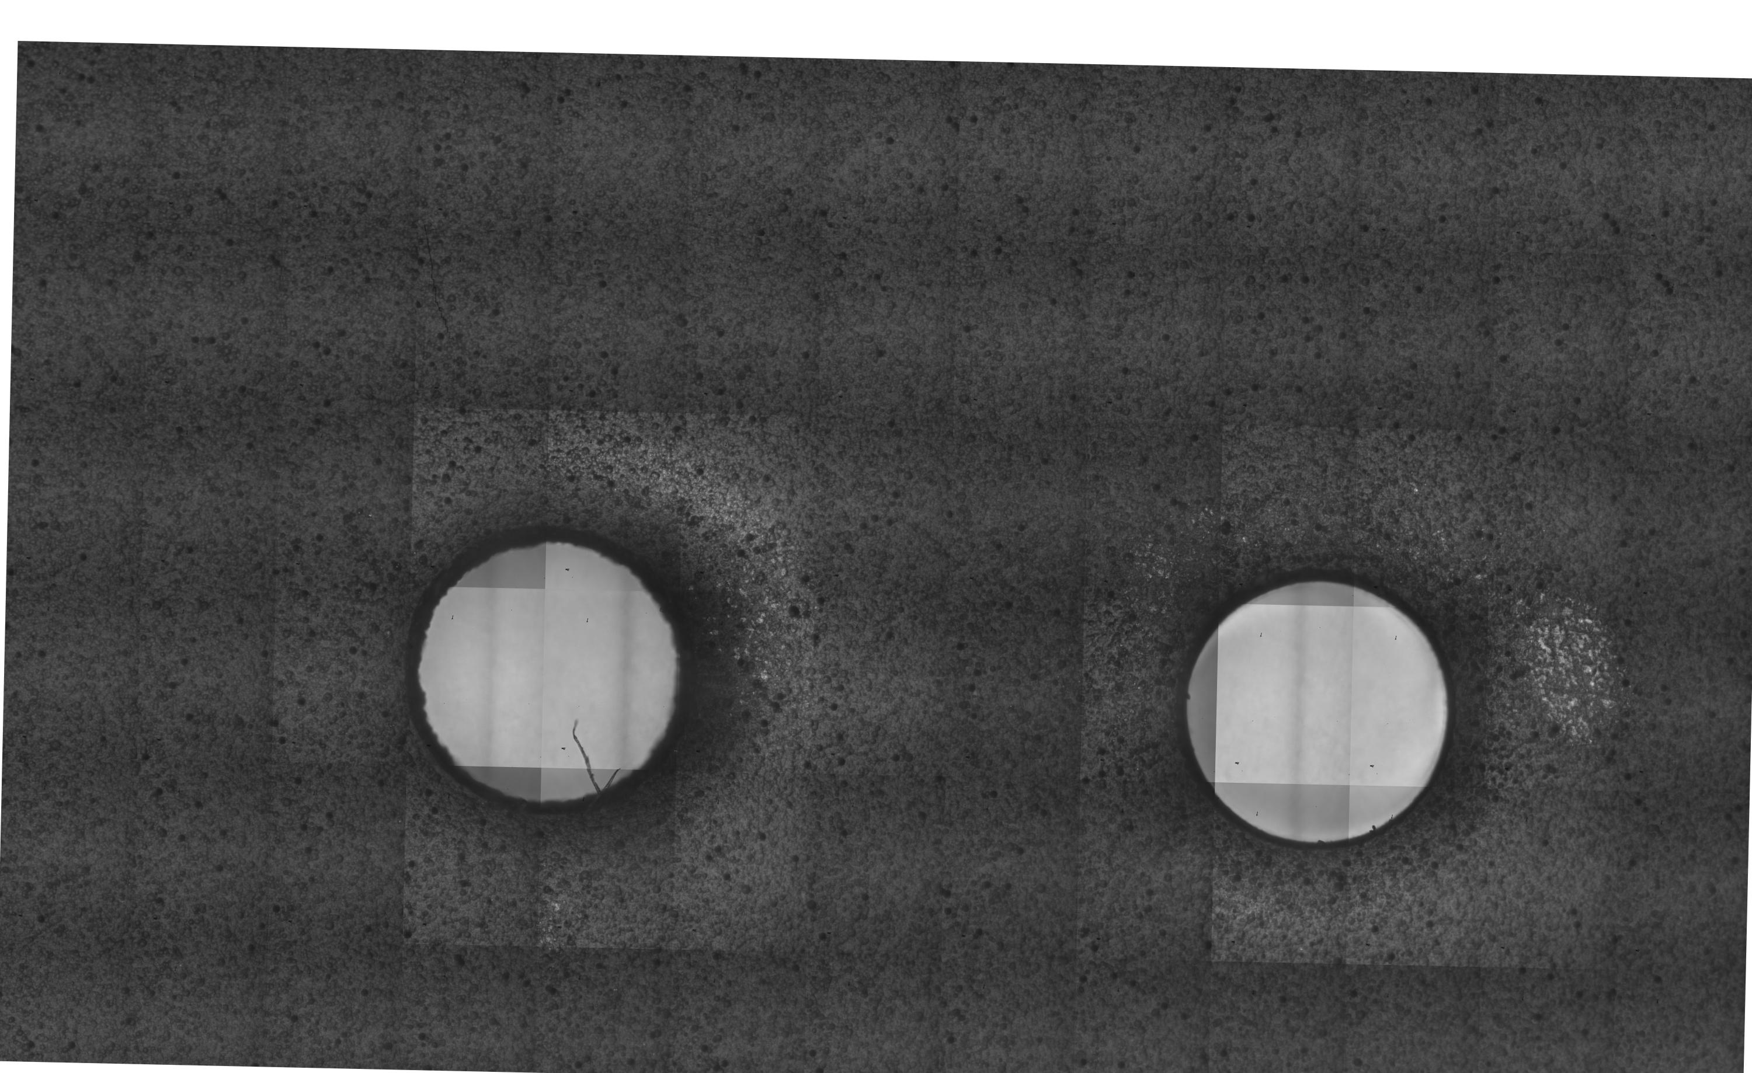
#1: Training / Modelling
Non-pertubative EM with
Magnetic charge
No ‘real’ magnetic monopole examples to train from
Huge uncertainties, many parameters. Modelling +
Monte-Carlo impractical
Calibrated heavy ions beams & LHC produces controlled HIP signal with magnified cross-section for ML RnD
Theory
parameter
space
LHC nuclear spallation
Showers
detector systematics
β dependant
interactions
HIP goes through all β regimes
Non-Linear chemical
etching process
Test beam only
LHC backgrounds

Slide 9
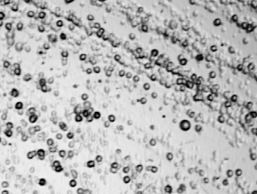
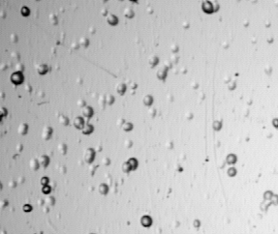
#2: Background density
CR39, Heavy ion test beam
Makrofol, heavy ion test beam
+ 8 months LHC background
LHC background
pile-up increases with Lumi
LHC Exposure
Scale
Complications
O(100) m² macroscopic foil area
Trillions of etch-pits total
Problem changes as density increases
Images represent ~mm²
Millions of etch-pits in each cm²
Foil structure altered by γ – rays
changes detector response
Etch-pit clusters merge under
etching
Foil thickness fluctuates

Slide 10
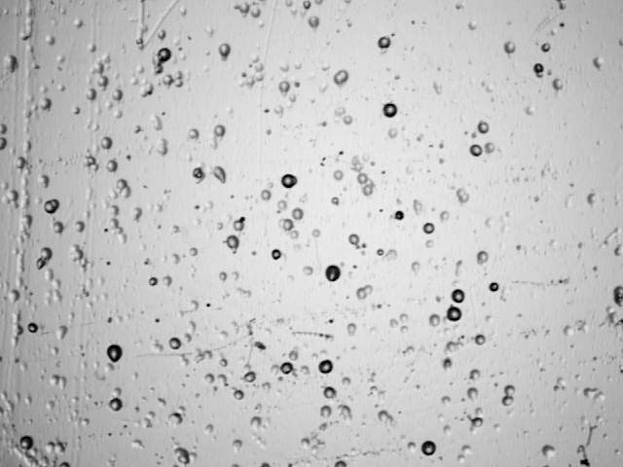
#3: Accurate identification
LHC particle flux; all different SM ionisation behaviour happening
Accurate ID requires detailed 3D inspection especially when pits start to cluster and overlap
Supervised learning only as good as its label accuracy.
Want to ID/tag peak ionisation events
Need robust signal efficiency and background
rejection. - Minimise false positive rate
Example
Entry Exit pair?
Background cluster?
Strong Visual Symmetry
between different physics
objects / backgrounds

Slide 11
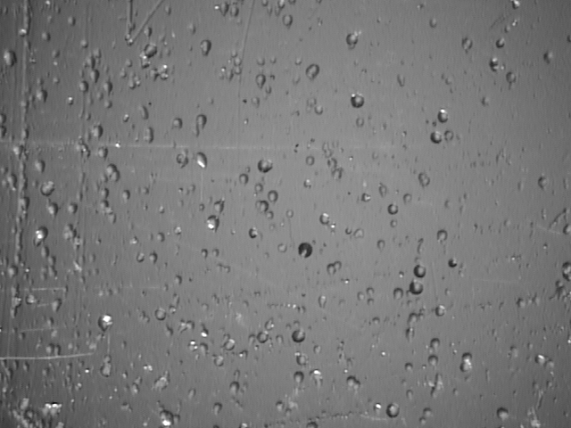
3D Dark-field imaging
Want to probe microscopic 3D structure to understand particle event interpretation
And rapidly scan
macroscopic area
with minimal motion
and large field of view
CAN parametrise illumination angle
LED grid, + Fresnell lens
Allows control of θ , φ
Retain microscopic alignment of
focal plain over macroscopic area
φ
θ
Example
X, Y, Phi becomes
3d data-space
Animation
In-phase rotation
common origin
Opposite phase
possible entry exit
ML / CNN sees all
angles at once
Entry exit pairs look different to overlapping bkg
Resolve different 3D structures
Spot anomalies or heavy ionisations

Slide 12
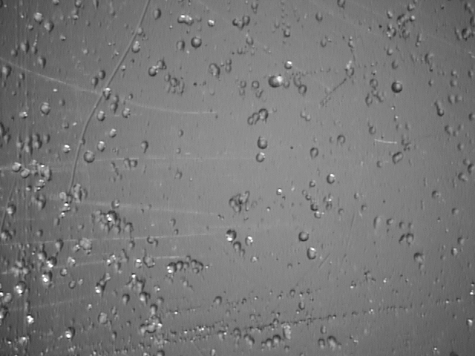
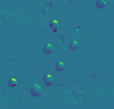
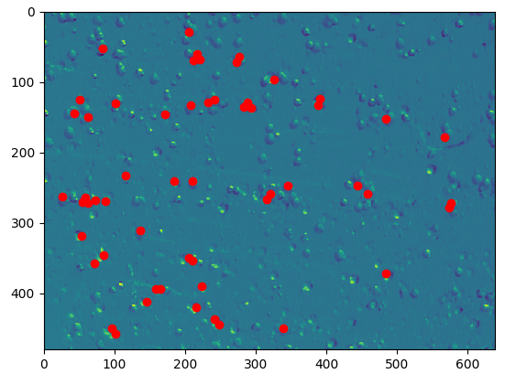
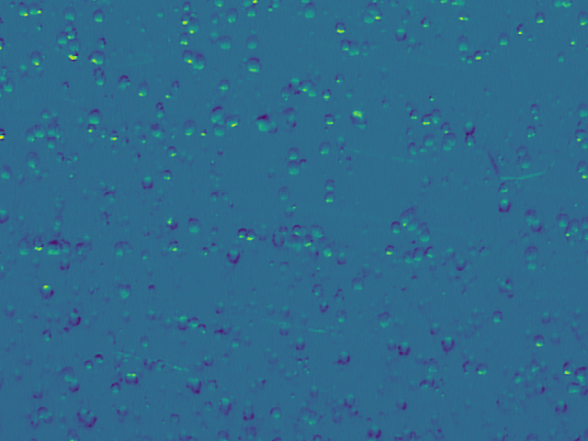
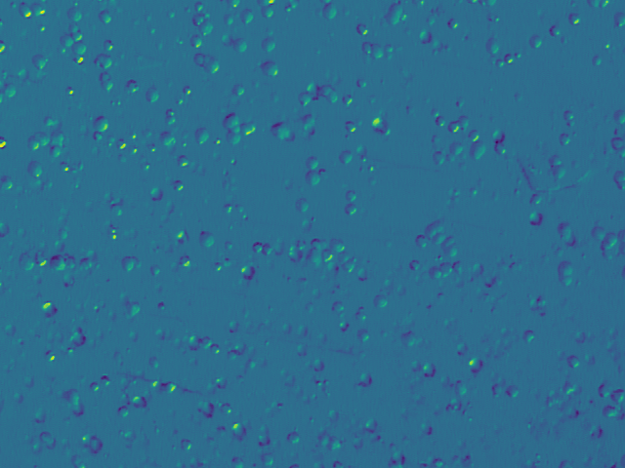
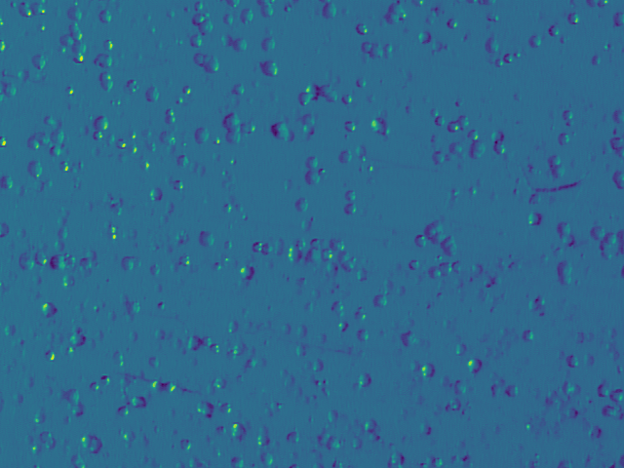
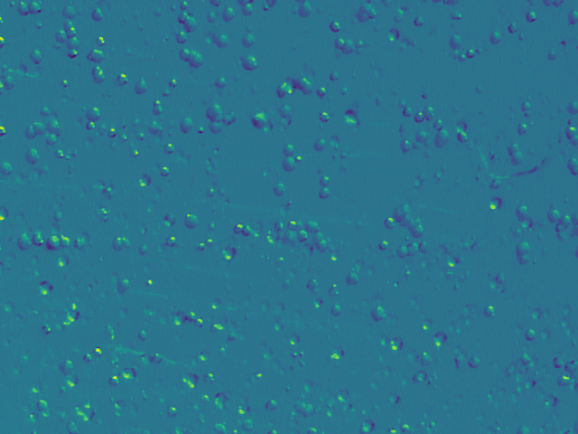
ML – Training / Analysis
“Normalisation” - Redefine relative to
local zero, ‘clean’ up low ionisation pits /
de-clutter. Remove systematic imaging
biases + non-etch pit visual backgrounds
4
Build supervised ML dataset from
preselection. Train sub-classifiers,
eg, entry exit asymmetry ~ dE/dx
replace initial search with learnt models
1
Pre-select etch-pits
reject trivial backgrounds
reduce labelling, storage
requirement ~ 1000
3
2
Convolution kernel search for
patterns of interest in 3D data space

Slide 13
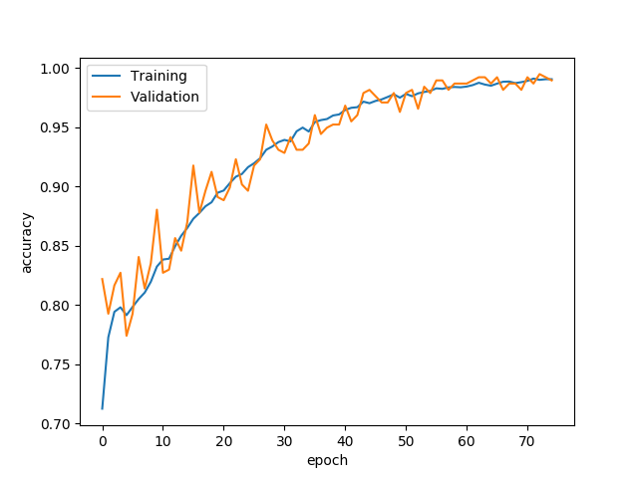
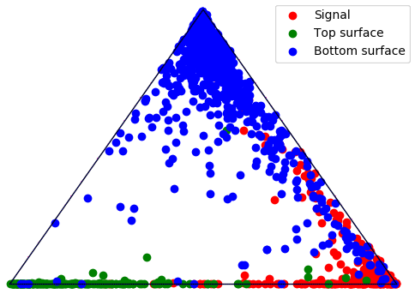
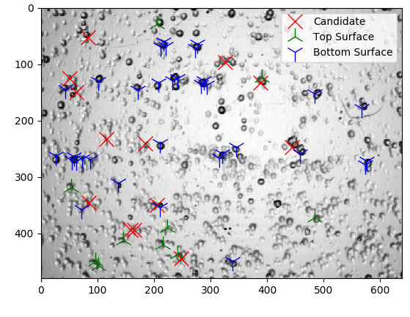
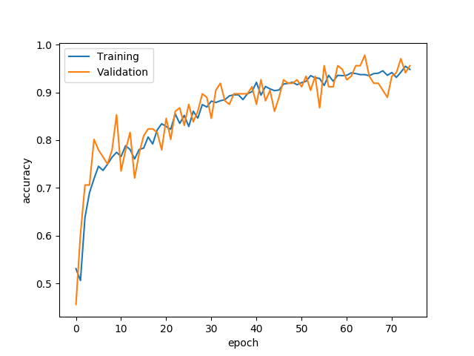
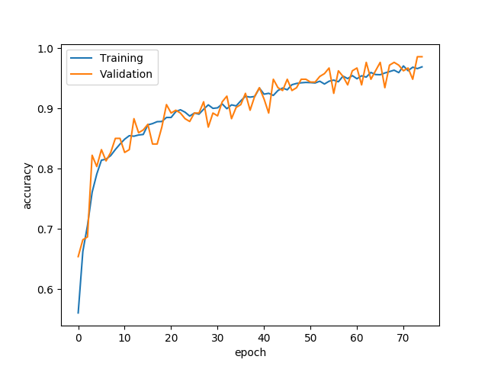
ML – Ensemble + inference
Train specialist ‘experts’ to handle sub-classifications within set of ‘signal like’ etch pits
Eg, top / bottom surface biased ionisation indicating SM range in/out
Expert Classifiers combined in ensemble to output overall classification
Robust + needs less training data
Geometric combination
C’ = C₁* C₂
vs arithmetic
C’ = aC₁+ bC₂
Can use in inference to ID
etch-pits in new areas of foil
Can use stacked neural
network, replace ensemble

Slide 14
Summary
Moedal looks for Highly ionising - high energy physics signitures
No standard model background for HIP track
Can use ML to automate + accelerate NTD analysis
Subtle 3d info can help find interesting ionisation events
Ensemble methods learn quicker with less data + more robust, easy to add new signals
Push to higher bkg densities / lumi

