Slide 1
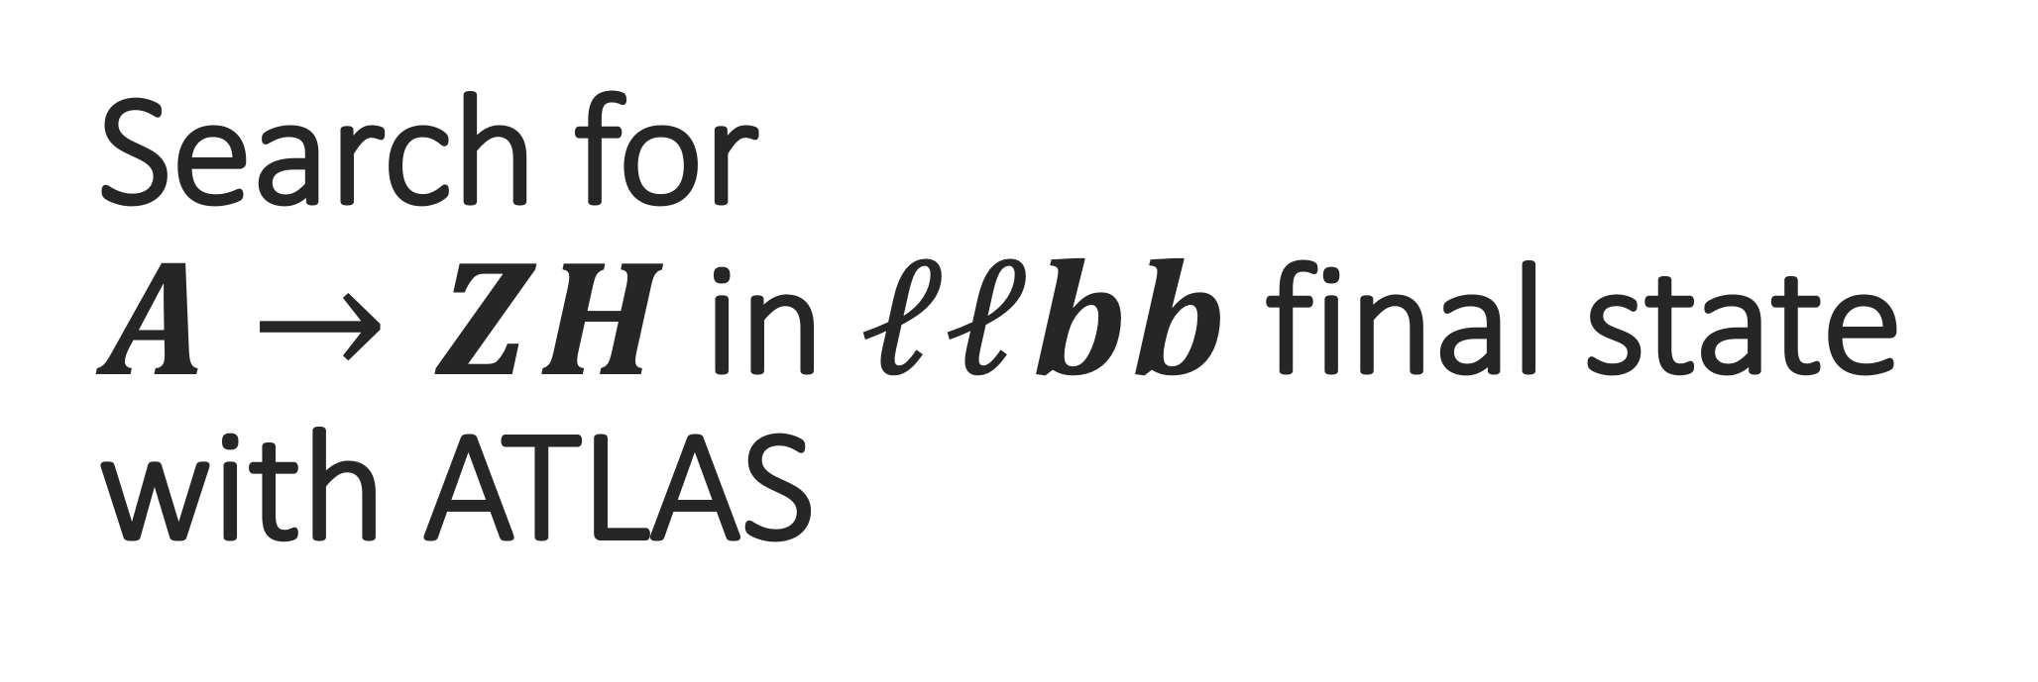
Search for
$A→ZH$ in $ℓℓbb$ final state with ATLAS
WAI YUEN CHAN
IoP joint app and hepp annual conference 09/04/2019
Notes:
Hi I am Alan from the University of Liverpool, and today I will talk about the search for heavy higgs bosons in ATLAS detector.

Slide 2
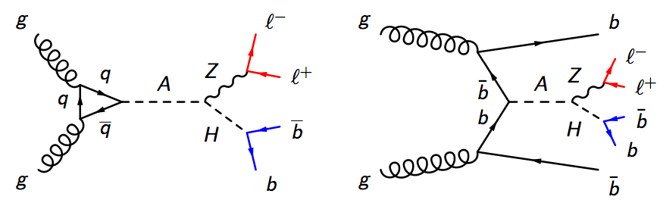
Introduction
Searching for heavy Higgs boson, A, decaying into a Z boson with another heavy Higgs boson, H, in ATLAS detector.
Extended Higgs sector
Baryogenesis
Notes:
The search is looking for the heavy higgs boson A decaying into a Z boson and another heavy higgs bosons H.
It is motivated by the extended higgs sector and baryogenesis.
So let’s talk about them.

Slide 3
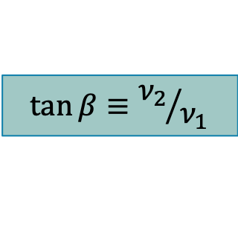






Motivation: Extended Higgs sector
Two-Higgs-Doublets-Model (2HDM):
extend the SM Higgs sector by adding an complex doublet
2 doublets ($Φ_{1}$ and $Φ_{2}$), 8 degrees of freedom
After EWSB: 5 Higgs bosons
Neutral
Charged
$$h$$
$$H$$
$$A$$
$$H^{±}$$
$m_{h}=125 GeV$ is assumed by the model which is considered.
2 parameters are important to the Higgs couplings in our search:
$$\tan{β}≡{ν_{2}}/{ν_{1}}$$
$ν_{1} (ν_{2})$ : vacuum expectation values of $Φ_{1}{(Φ}_{2})$
$$\cos{(β−α)}$$
$α$ : Mixing angle between $h,H$
Notes:
We are working on the two higgs doublet model, which extended the SM higgs sector by adding another higgs doublet, like the name suggested.
This mean we now have 8 degrees of freedom and leaving 5 higgs boson after the symmetry breaking.
Here the mass of the litter h is assumed to be 125GeV, and there are 2 parameters are important for us.
First, the tan beta, which is the ratio of VEV between 2 doublets.
Second, the cos beta minus alpha, where alpha is the missing angle between little and capital h.

Slide 4
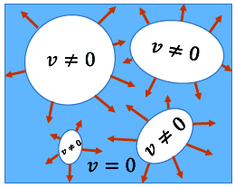
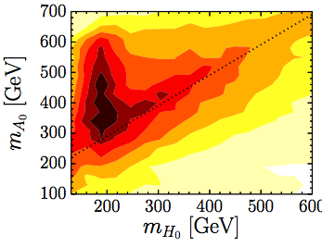
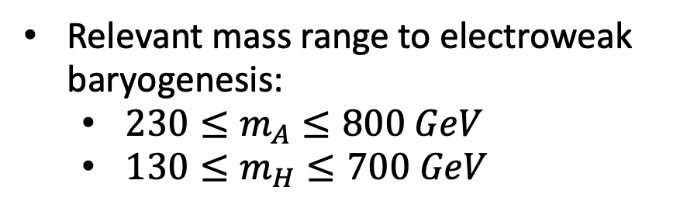
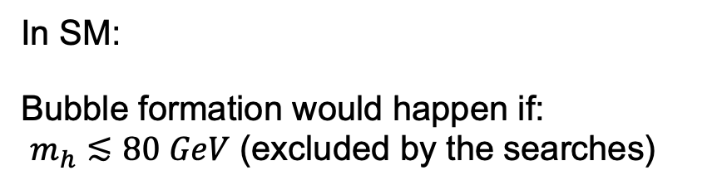
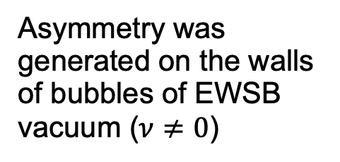
Motivation: Baryogenesis
Baryogenesis: Mechanism create the matter-antimatter asymmetry
One of the scenarios : Electroweak baryogenesis
Relevant mass range to electroweak baryogenesis:
  $230≤m_{A}≤800 GeV$
  $130≤m_{H}≤700 GeV$
Asymmetry was generated on the walls of bubbles of EWSB vacuum ($ν≠0$)
Still possible in 2HDM
In SM:
Bubble formation would happen if:
$m_{h}≲80 GeV$ (excluded by the searches)
arXiv:1405.5537
Notes:
Our another motivation, baryogenesis, is a cosmological mechanism create the matter-antimatter asymmetry in the early universe.
One of the scenarios, what we are interested in, is the electroweak baryogenesis.
This require the first-order electroweak phase transition.
What is that?
Think about the young universe, it’s hot and dense, and the electroweak symmetry is not broken yet.
When it expend, the temperature of the universe cooled down.
When it down below the electroweak scale, the spontaneous symmetry breaking happens and forming these bubbles which contain the vacuum respect to the broken symmetry.
Eventually, they will expand and fill up the whole universe, and that’s our symmetry broken universe.
Under the SM, the bubble formation, or the first order electroweak phase transition can happen if the higgs mass is roughly around 80 GeV, which we know that it’s not ture.
But this is still possible in 2HDM! This heat map here indicate the relevant mass range for capital A and H in the A to ZH decay.

Slide 5
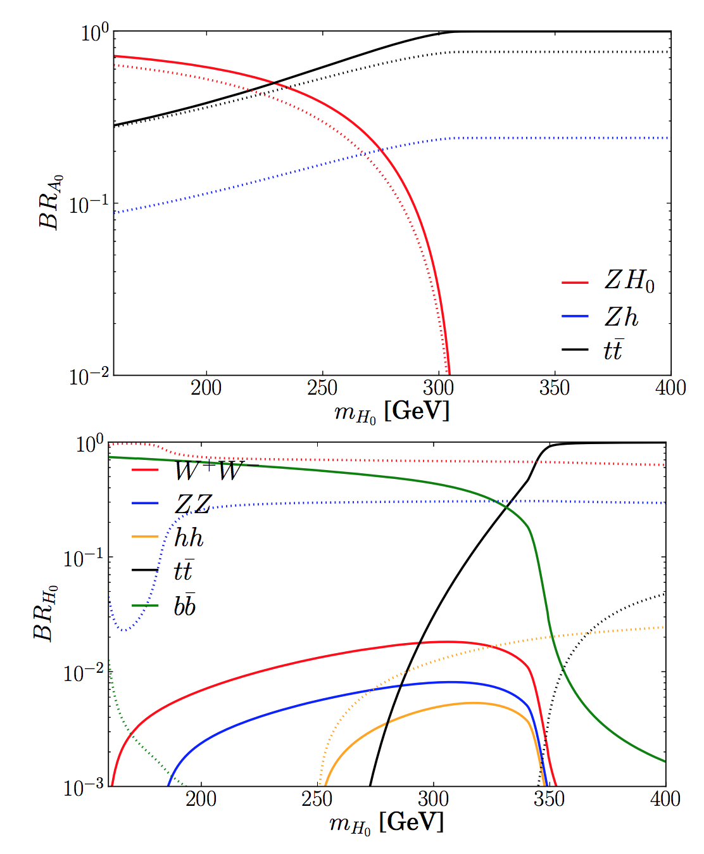
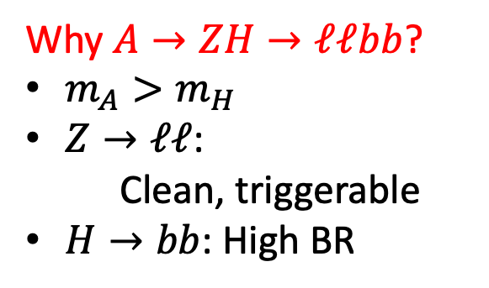
A->ZH->llbb decay
Why $A→ZH→ℓℓbb$?
$m_{A}>m_{H}$
$Z→ℓℓ$:
Clean, triggerable
$H→bb$: High BR
Solid lines are considered in this search
arXiv:1405.5537
Notes:
So, now we know that why we are looking for the heavy higgs, but why AZH to llbb?
Well, first the A are required to be heavier than H, and the Z to dileptons are easy to trigger, and of course, very clean.
For the H to bb, it has high branching ratio as you can see from this plot.
Here is also a plot for branching ratio of A as a function of mH.
And only the solid lines are relevant to us.

Slide 6
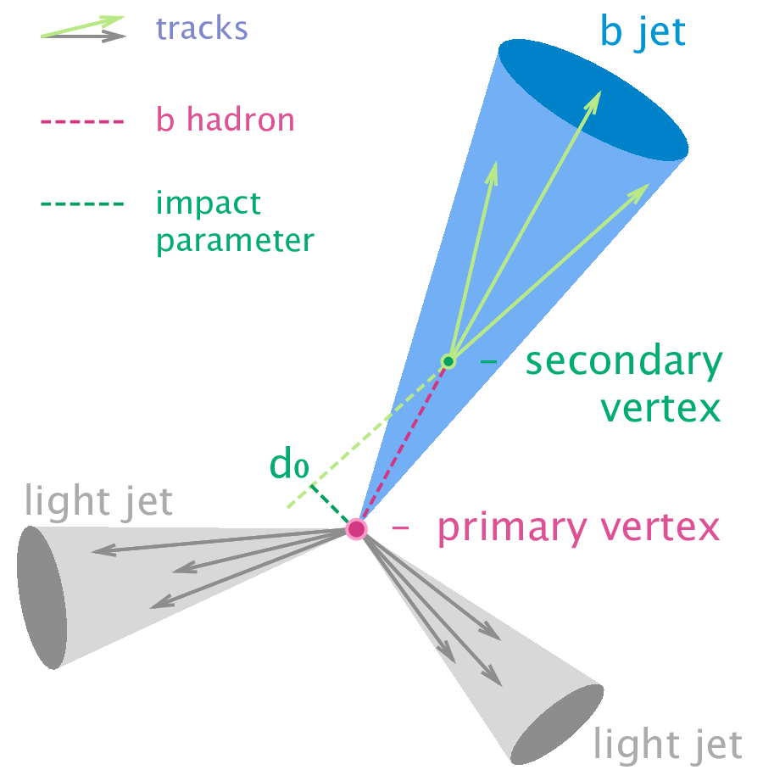
Reconstruction of b-jets
b-jet: Jet containing B hadrons
B hadrons usually have a longer lifetime and hence it travel further before decaying.
Impact parameter (IP):
Projection of distance between primary vertex and secondary vertices
Displaced vertex (secondary vertex) from primary vertex due to this property.
We observe “jets” instead of quarks in detector experiment
In ATLAS: The vertex and jet reconstructions are based on the measurement from the inner detectors.
Notes:
Ok, now I am switching the topic little bit, to talk about the reconstruct of hadronic object.
In the detector experiment, we didn’t see quarks, but the result from the hadronization, the jet.
The jet which contain a b hadron, is a b-jet, obviously.
Since the b-hadron would travel a bit longer before it decays, it will left a displaced vertex from the primary one.
And the project of the distances between these vertices is defined as the impact parameter.
We use these vertices and impact parameters to identify a b-jet, or perform a b-tagging.
In ATLAS, the measurement of these parameters are done by the inner detector.

Slide 7
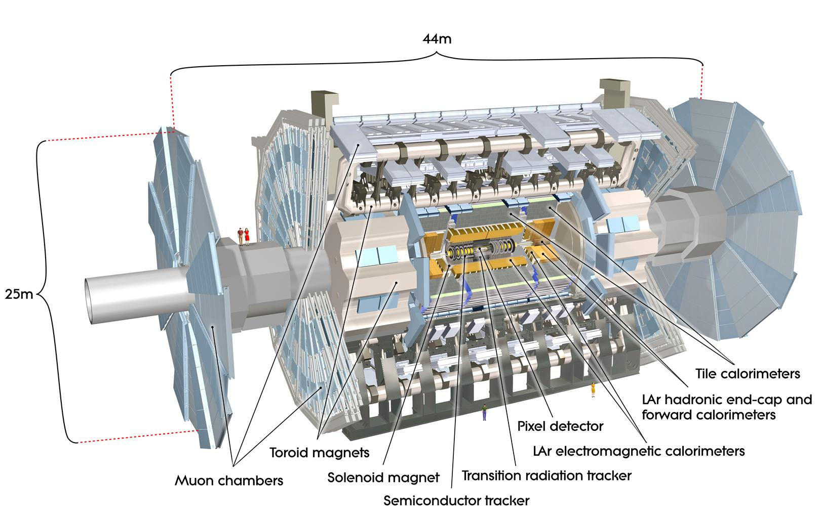
ATLAS Detector
Inner detectors:
tracking and vertexing
Hadronic Calorimeters:
Absorb the energies from hadron
Notes:
So, where is the inner detector?
Here is our ATLAS, and this is the inner detector, which is needed for tracking and vertexing.
We also need the muon detector, which is the outermost structure, they are needed to reconstruct the muon tracks from the hadronic decay.
To reconstruct a jet, we also need the measurement from the calorimeter, especially the hadronic one.

Slide 8
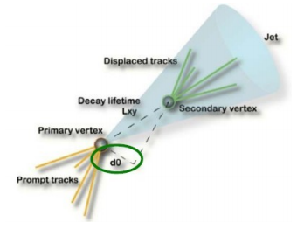

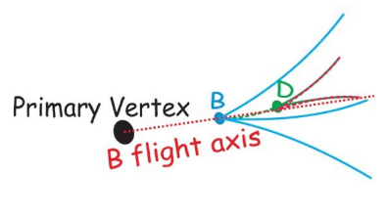
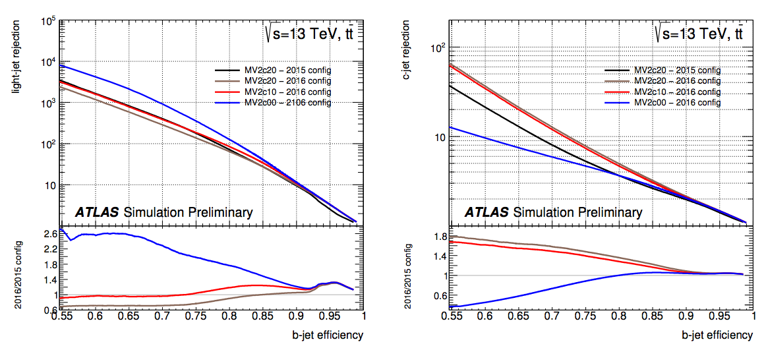
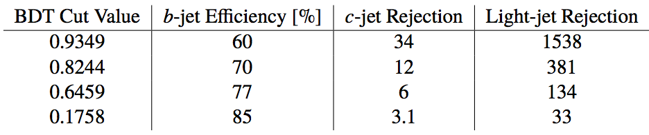
B-tagging algorithm in ATLAS Detector
ATLAS b-tagging algorithm: MV2 (BDT)
Inclusive secondary vertex finding
Impact parameter based
Multi-vertex fit
A->ZH->llbb: Using Mv2c10
(Red curve in the plot)
ATL-PHYS-PUB-2016-012
Notes:
So how do the identify a b-jet?
In ATLAS, one of the b-tagging algorithm is the MV2, which is a BDT based algorithm.
It combine the performance of some lower level tagger, which based on the topology of the jet, such as the impact parameter and the information about the vertices.
In our AZH, we use the MV2c10, where c10 is referring to the BDT training condition, which we are not going to discuss here.
The plot here shows the charm or light jet rejection vs the b-jet efficiency, which is related to the BDT score and the red curve is the performance of the MV2c10.
The rejection power decrease when the b-jet efficiency increase, so you need to balance, the value of efficiency in our search is 70%.
Ok, that’s what we need to know about b-jet for now.
Let’s back to the AZH.
Nikos: What if there is a muon, does the algorithm deal with that?
-> The muon from the leptonic/ semi-leptonic decay would be deal with another algorithm, which would consider the muon closed to the jet axis. Or what we call the ”muon-in-jet”. The output of this muon based algorithm and the output would be combined with MV2 to enhance the performance for this kind of events -> MV2Mu.

Slide 9
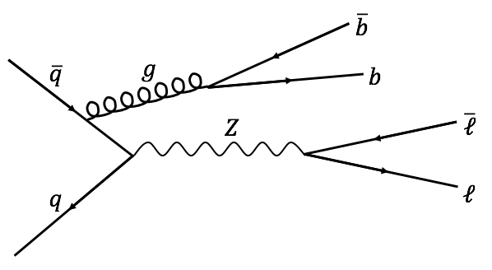
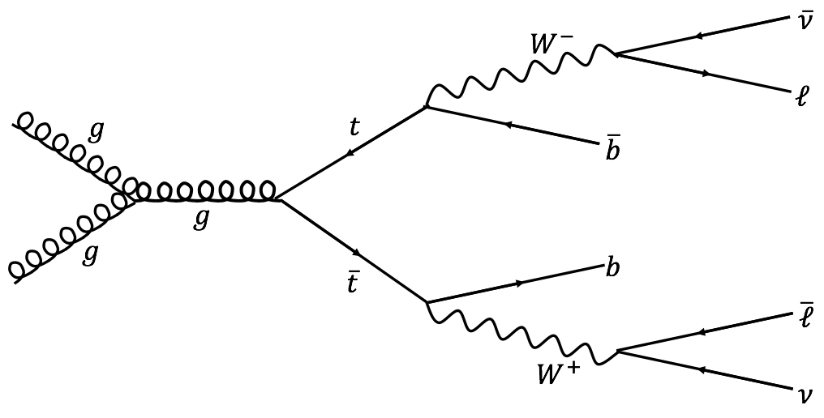
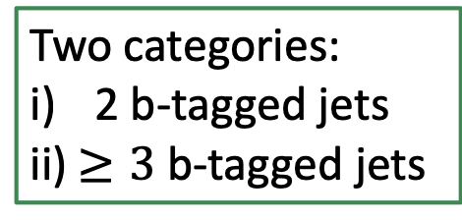


Production mechanism & backgrounds
Two categories:
2 b-tagged jets
ii) $≥3$ b-tagged jets
gluon-gluon fusion (ggA)
b-associated production (bbA)
Dominant backgrounds:
$$Z+jets$$
$t\overline{t}$ production
Notes:
We have two production mechanism, the gluon fusion, ggA, and b-associated production, bbA.
We separate our events with their number of b-jet into 2 categories, 2tag category and 3tag category.
We have 2 main backgrounds, the Z+jets, and the ttbar.

Slide 10
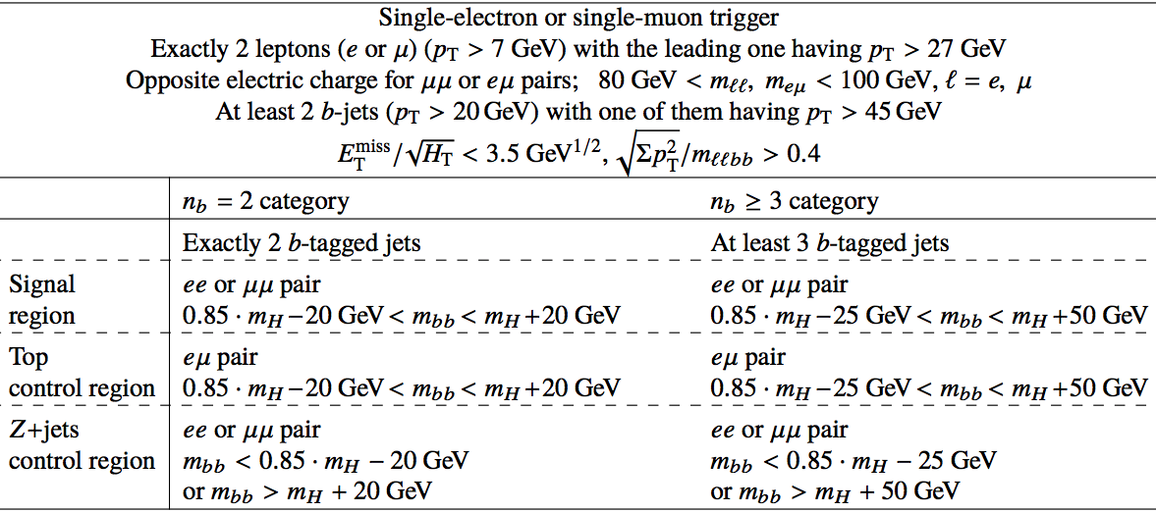
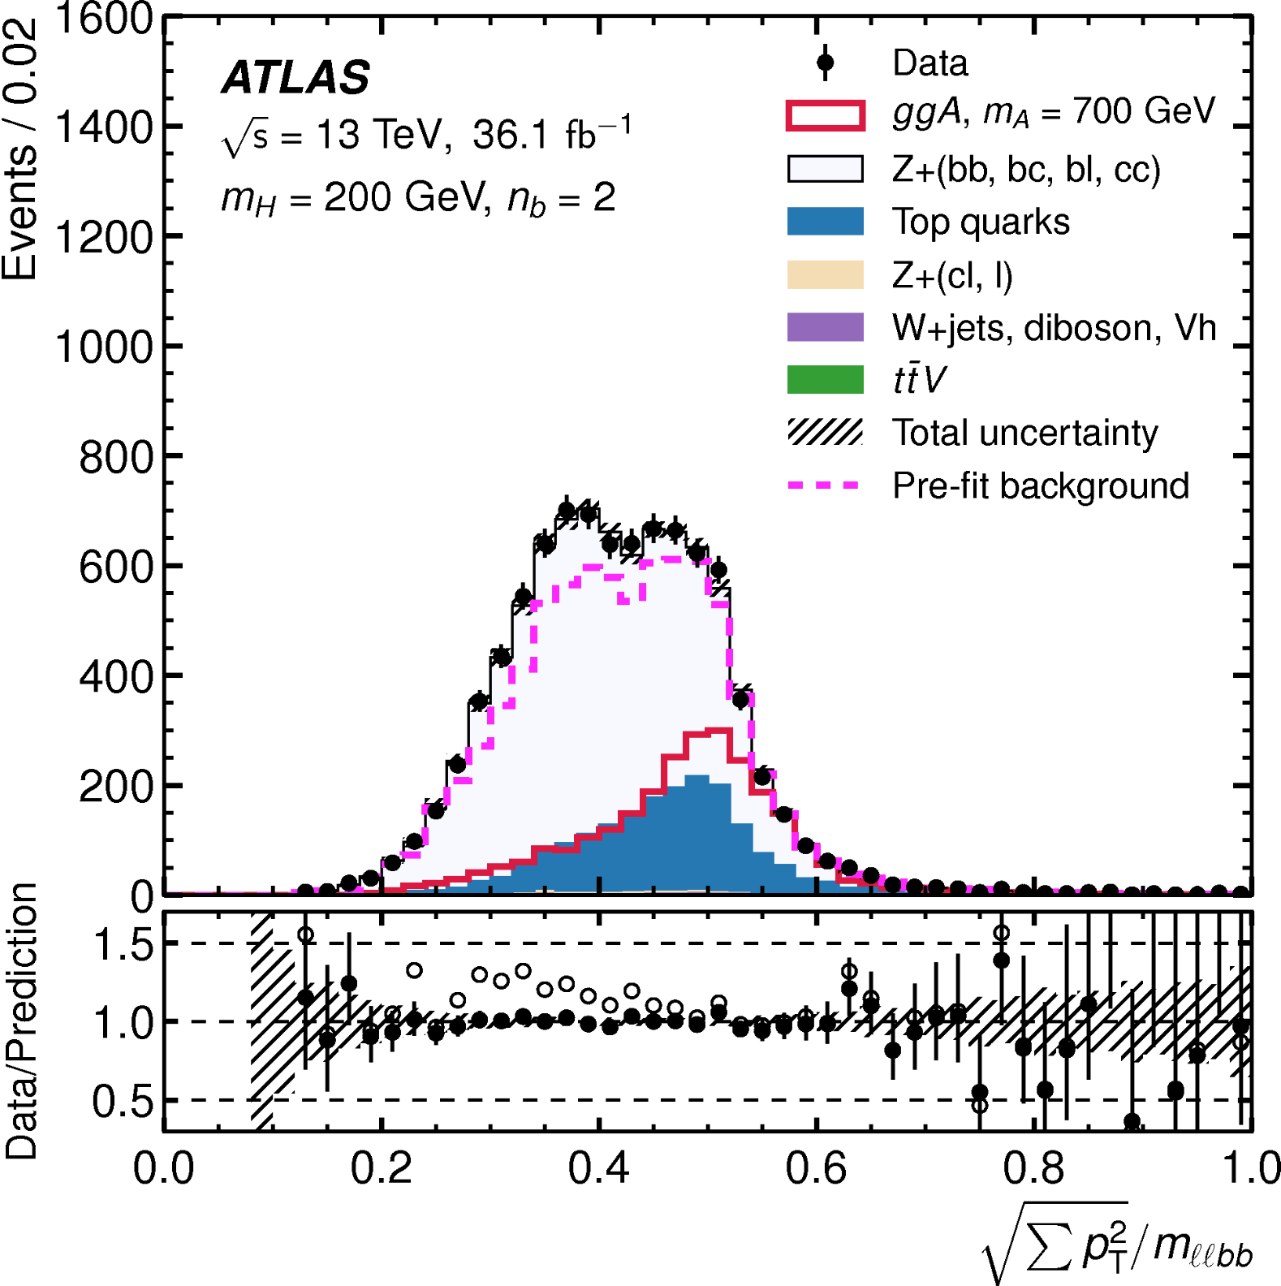
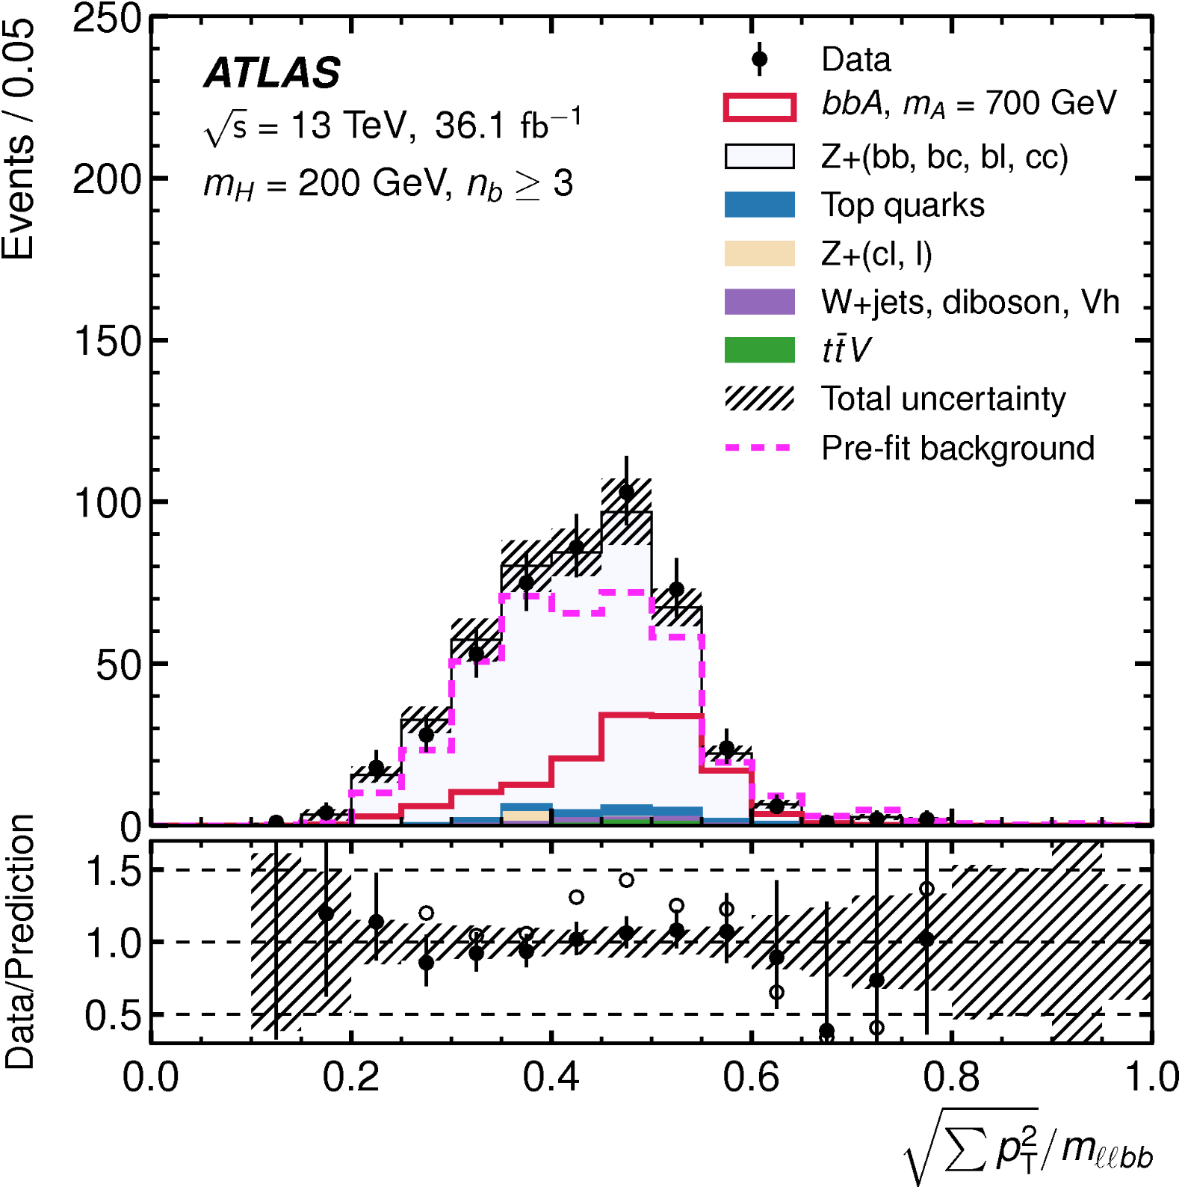

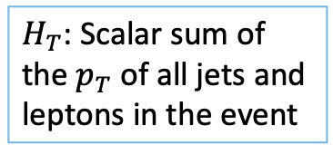

Event selection (1)
$H_{T}$: Scalar sum of the $p_{T}$of all jets and leptons in the event
SR: mH200
$$n_{b}=2$$
SR: mH200
$$n_{b}≥3$$
arXiv:1804.01126
Notes:
We perform a cut-based analysis, start from cutting at the kinematics of the leptons.
And the mass of dilepton system has to be compatible to the Z peak.
Then we only keep the events with at least 2 b-jet, with some pT requirement.
After that we cut on the ratio of missing energy and the scalar sum of all the objects in the event.
Also a cut on another quantity, the J variable, which is a ratio between the sum of pT and the mass of the llbb system.
And it does have a separation power between signal and backgrounds.
These plots are in the signal region, which we are gonna define it now.

Slide 11
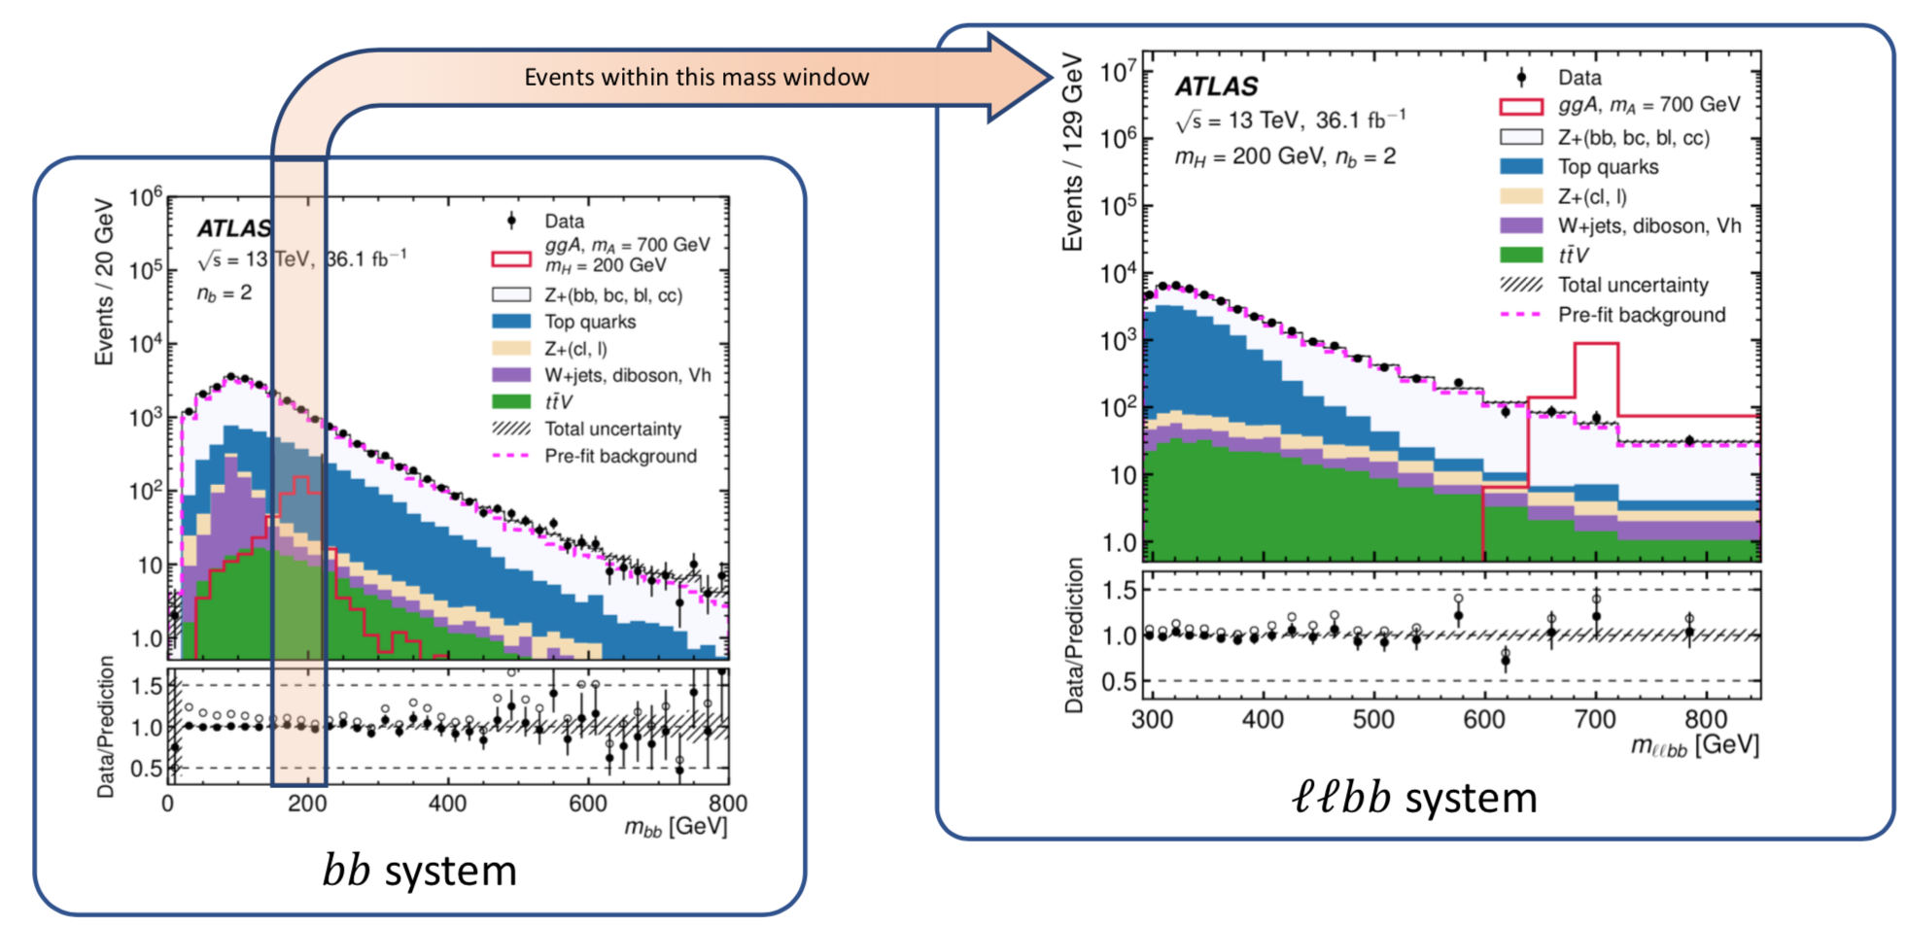
Event selection (2)
Signal Region
arXiv:1804.01126
Notes:
We need one more cut to get into our signal region, which is the window cut on the mass of the bb system.
As you can see here, the window is depending on our mH.
Everything within this window is in our signal region, and everything outside will fall into the Z control region.
Here is an example of the window cut at mH 200 GeV, our final discriminant, mass of the llbb system will then extracted after the window cut.
So you may ask, how many signal region do we have? Well, it depends on how many signal we have, right?

Slide 12
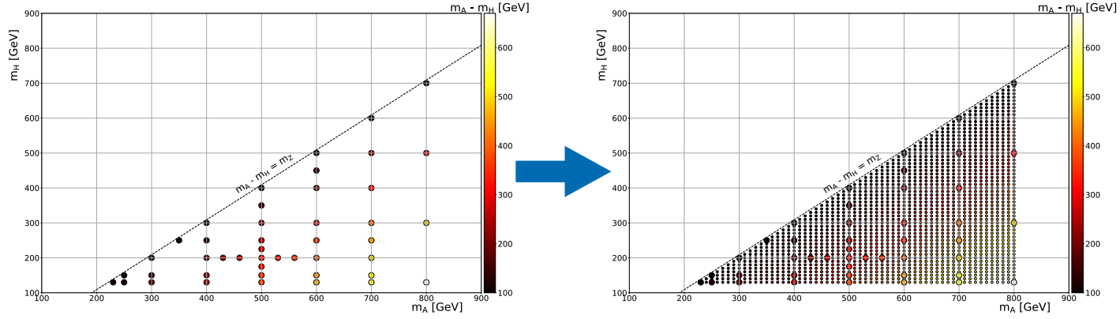
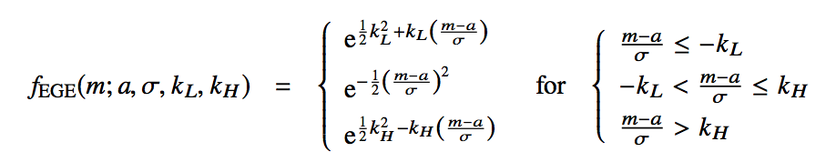
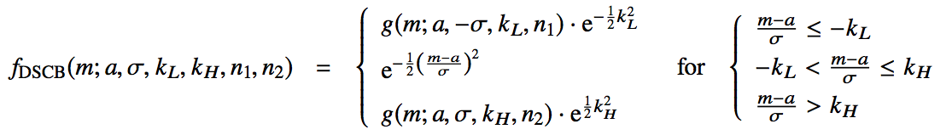
Signal interpolation
Signal between generated MC mass points are interpolation to fill in the gap of the mass gird.
ggA, MC generated
ggA, MC generated + interpolated
First we fit the $m_{ℓℓbb}$ distribution from the MC generated mass points:
For ggA
For bbA
Then we interpolate the fit parameters as function of $m_{A}$- $m_{H}$ (Mass difference) by tracing the parameter evolution.
Notes:
So, how many signal do we have? Here is what we have from the MC.
We use them to preform to object selection, but we also want to scan the whole space, which means we need to fill in all the gaps.
However, we cannot request that much MC samples. Therefore we interpolate them.
To do so, first we fit the mllbb from the MC signals with these function, regrading to their production mechanism.
Then we parametrised and interpolate these parameters as a function of the mass difference between A and H.
After that, we have around 3000 signal points, with 57 mH values.
So, we end up with 57 signal regions.

Slide 13
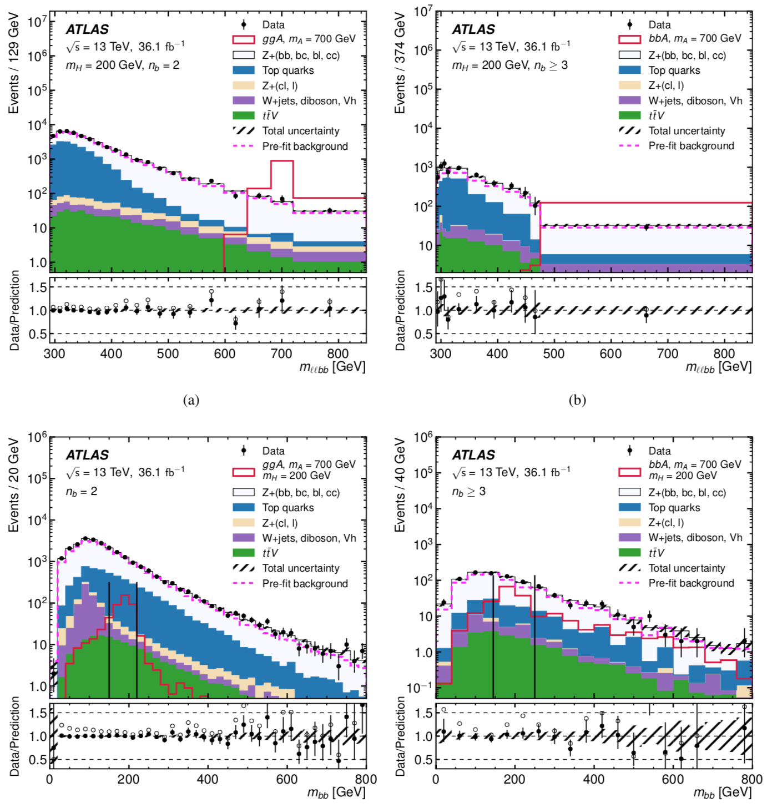
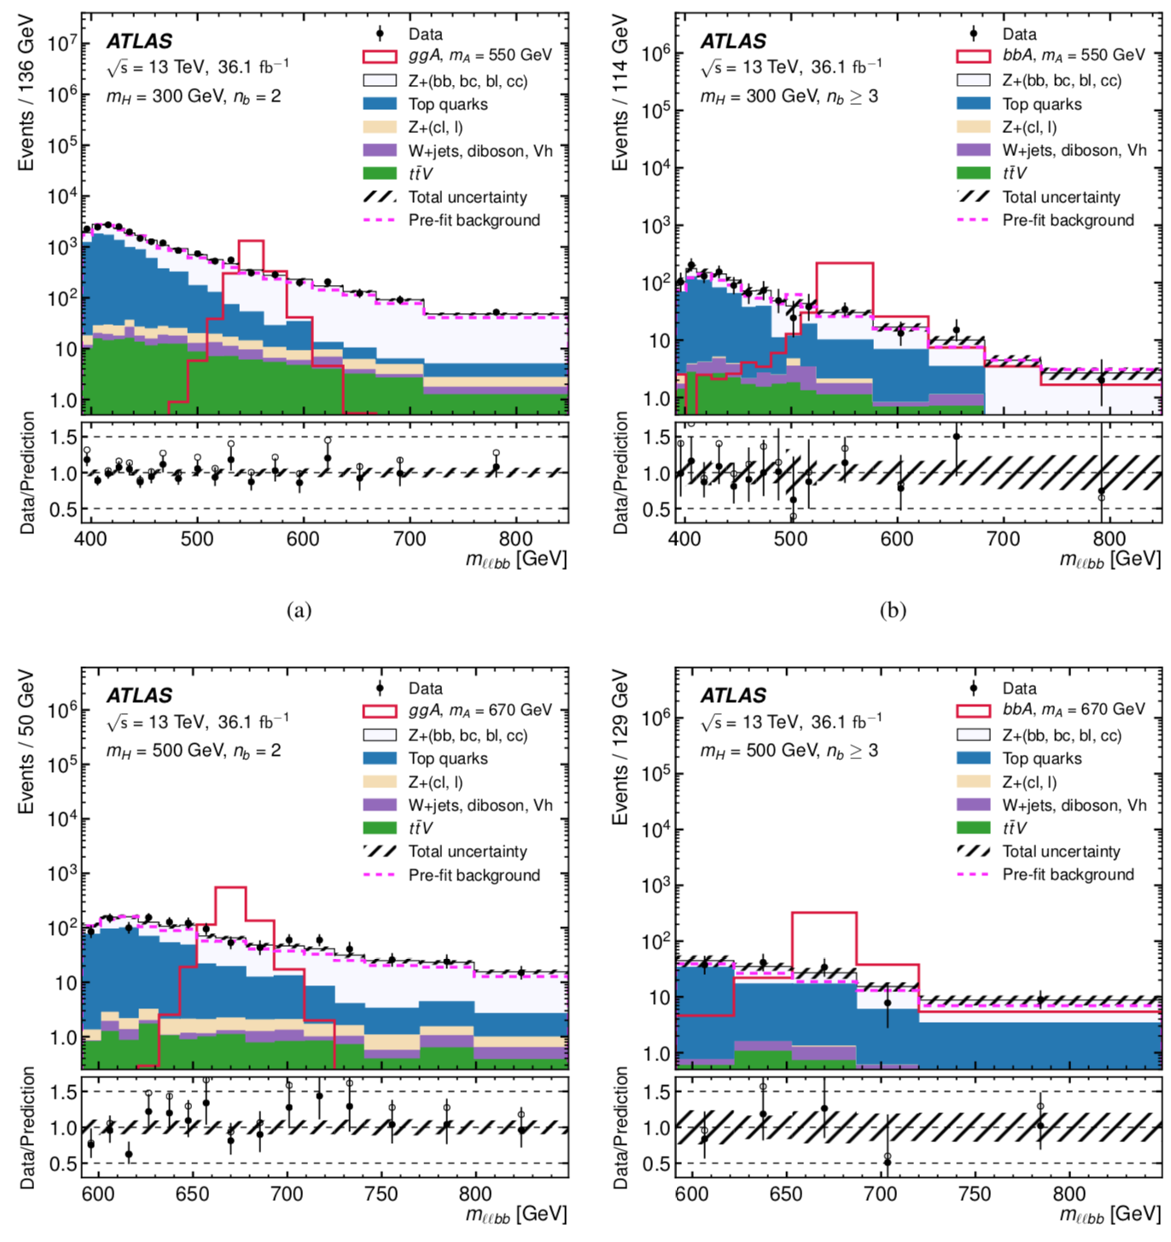






Result
SR: mH200
$$n_{b}=2$$
SR: mH300
$$n_{b}=2$$
SR: mH500
$$n_{b}=2$$
SR: mH200
$$n_{b}≥3$$
SR: mH300
$$n_{b}≥3$$
SR: mH500
$$n_{b}≥3$$
arXiv:1804.01126
Notes:
Then do we found something? Well, let’s have a look in different signal region.
Of course I am not gonna show you all of them because I don’t want to delay the lunch time. So don’t worry.
Here is the mllbb in signal region mH200, in both 2tag and 3tag categories.
And also in mH300, and mH500.
We didn’t see any excess in these signal regions as well as the others, so we set the limit instead.

Slide 14
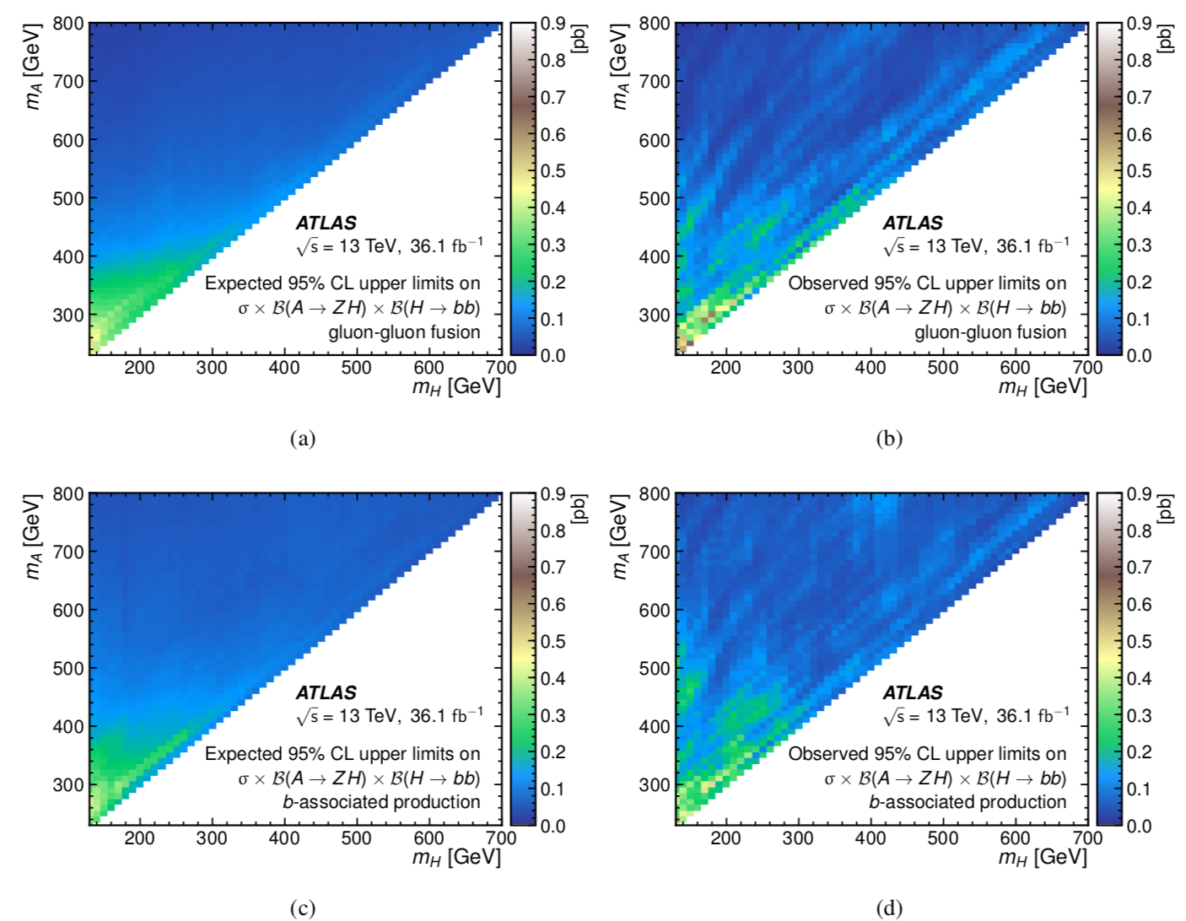
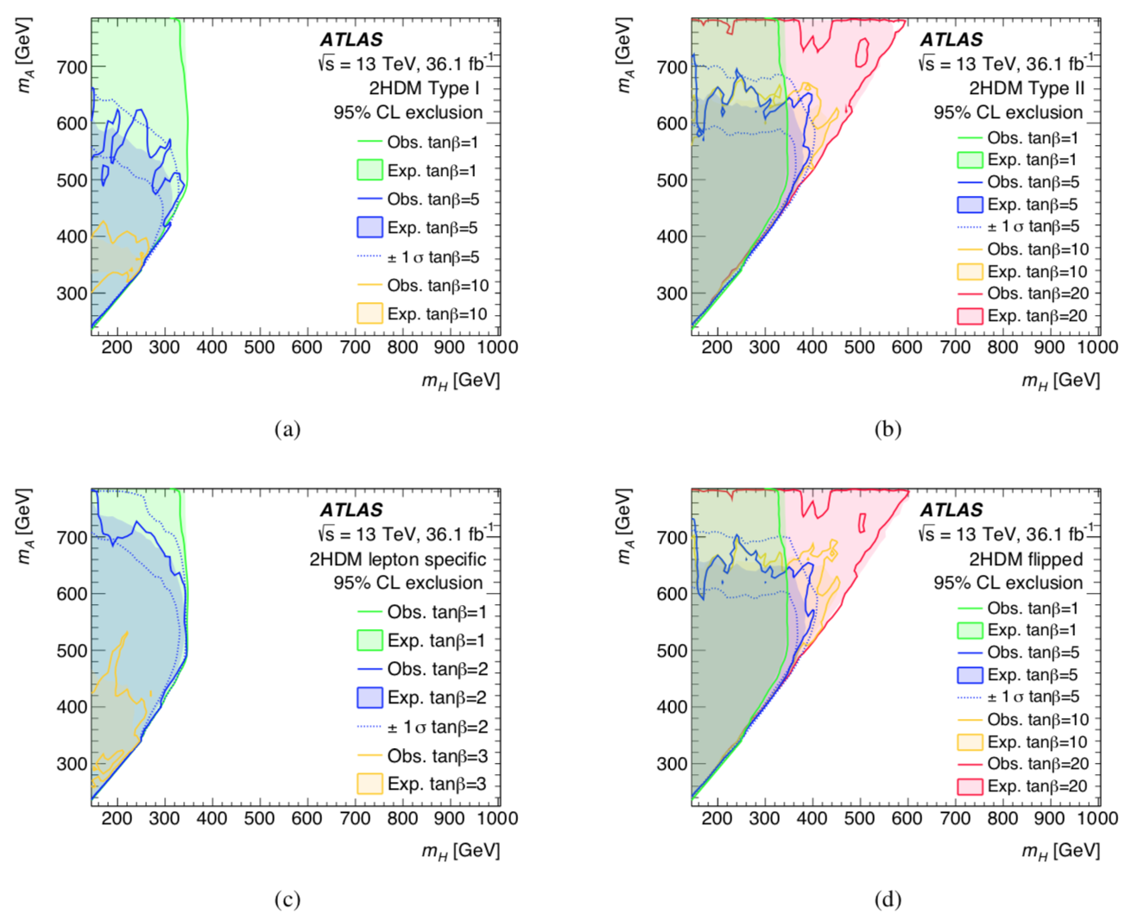
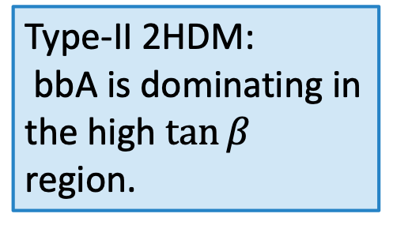
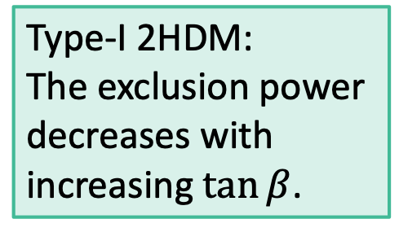
Exculsion Limits
Cross section limit
2HDM parameter space
Type-I 2HDM:
The exclusion power decreases with increasing $\tan{β}$.
ggA
Type-II 2HDM:
bbA is dominating in the high $\tan{β}$ region.
bbA
arXiv:1804.01126
Notes:
We set the limit on the product of cross section and the branching ratios, with ggA and bbA separately.
We also set the limit on the 2HDM parameter space, as you can see here we set a limit with different tan beta values in type 1 2HDM.
The exclusion power is low in the high tan beta region.
On the other hand, in type 2 2HDM, we have more exclusion power from the bbA in the high tan beta region.
Nikos: limit on baryogenesis? No, because we didn’t implement the parameter for baryogenesis here, but it is something we are working on

Slide 15
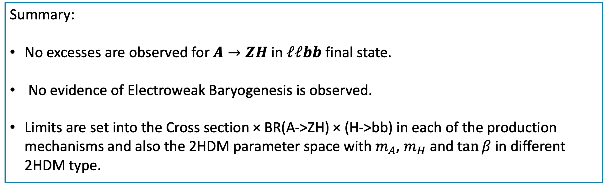
Summary & Outlook
Summary:
No excesses are observed for $A→ZH$ in $ℓℓbb$ final state.
No evidence of Electroweak Baryogenesis is observed.
Limits are set into the Cross section × BR(A->ZH) × (H->bb) in each of the production mechanisms and also the 2HDM parameter space with $m_{A}$, $m_{H}$ and $\tan{β}$ in different 2HDM type.
Outlook:
Analysis with ATLAS full Run-2 dataset collected between 2015 to 2018.
Notes:
So, in summary, we didn’t found any heavy higgs nor the evidence of electroweak baryogenesis.
We then set a limit in the product of cross section and branching ratios, also the 2HDM parameter space.
We are now working with the ATLAS full run2 dataset, and hopefully we will find something at the end.

Slide 16
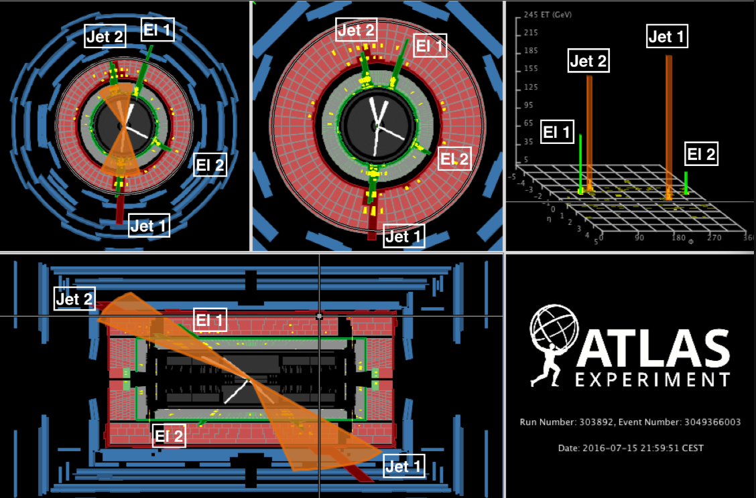
Notes:
And before I go, I will to show you this event displace for one of our events. That’s all I have today, thank you.

Slide 17
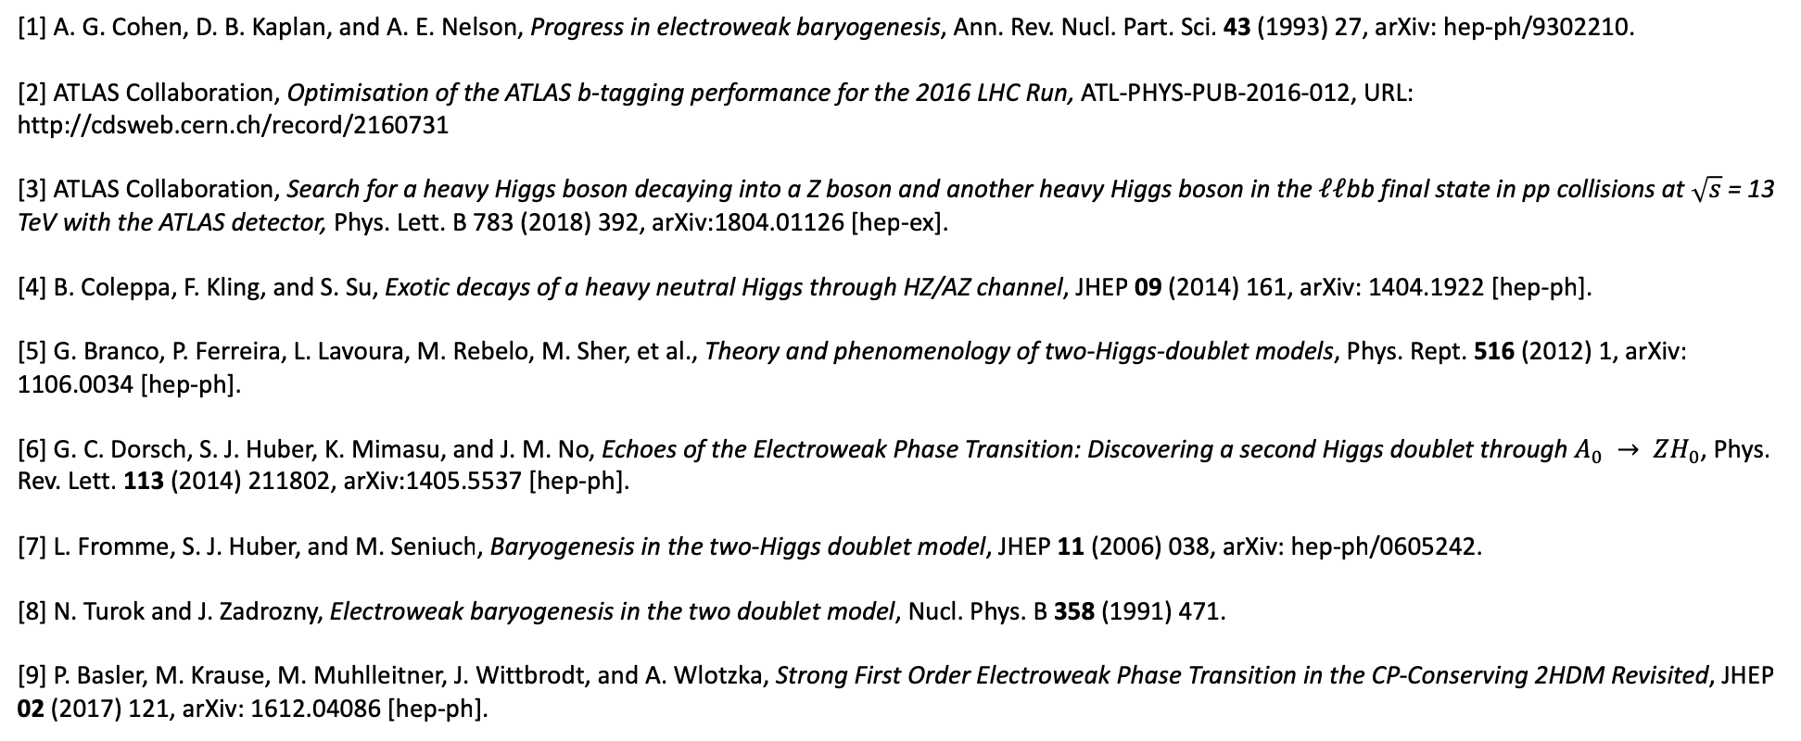
Reference
[1] A. G. Cohen, D. B. Kaplan, and A. E. Nelson, Progress in electroweak baryogenesis, Ann. Rev. Nucl. Part. Sci. 43 (1993) 27, arXiv: hep-ph/9302210.
[2] ATLAS Collaboration, Optimisation of the ATLAS b-tagging performance for the 2016 LHC Run, ATL-PHYS-PUB-2016-012, URL: http://cdsweb.cern.ch/record/2160731
[3] ATLAS Collaboration, Search for a heavy Higgs boson decaying into a Z boson and another heavy Higgs boson in the $ℓℓ$bb final state in pp collisions at $\sqrt{s}$ = 13 TeV with the ATLAS detector, Phys. Lett. B 783 (2018) 392, arXiv:1804.01126 [hep-ex].
[4] B. Coleppa, F. Kling, and S. Su, Exotic decays of a heavy neutral Higgs through HZ/AZ channel, JHEP 09 (2014) 161, arXiv: 1404.1922 [hep-ph].
[5] G. Branco, P. Ferreira, L. Lavoura, M. Rebelo, M. Sher, et al., Theory and phenomenology of two-Higgs-doublet models, Phys. Rept. 516 (2012) 1, arXiv: 1106.0034 [hep-ph].
[6] G. C. Dorsch, S. J. Huber, K. Mimasu, and J. M. No, Echoes of the Electroweak Phase Transition: Discovering a second Higgs doublet through $A_{0} → ZH_{0}$, Phys. Rev. Lett. 113 (2014) 211802, arXiv:1405.5537 [hep-ph].
[7] L. Fromme, S. J. Huber, and M. Seniuch, Baryogenesis in the two-Higgs doublet model, JHEP 11 (2006) 038, arXiv: hep-ph/0605242.
[8] N. Turok and J. Zadrozny, Electroweak baryogenesis in the two doublet model, Nucl. Phys. B 358 (1991) 471.
[9] P. Basler, M. Krause, M. Muhlleitner, J. Wittbrodt, and A. Wlotzka, Strong First Order Electroweak Phase Transition in the CP-Conserving 2HDM Revisited, JHEP 02 (2017) 121, arXiv: 1612.04086 [hep-ph].

Slide 18
Backup

Slide 19
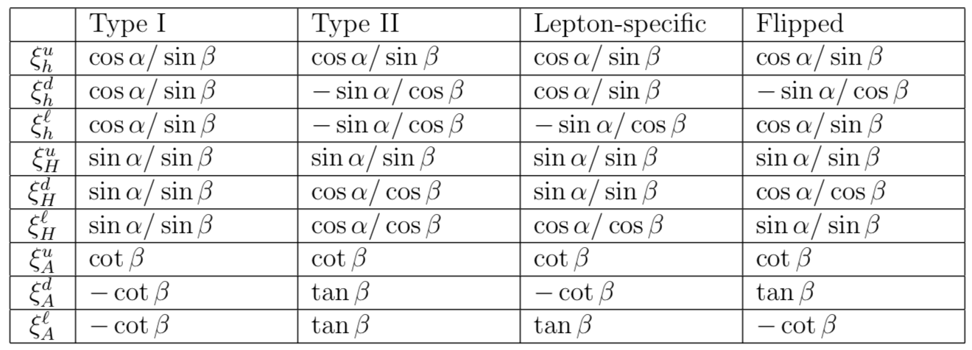
Yukawa coupling coefficients in 2HDM

Slide 20
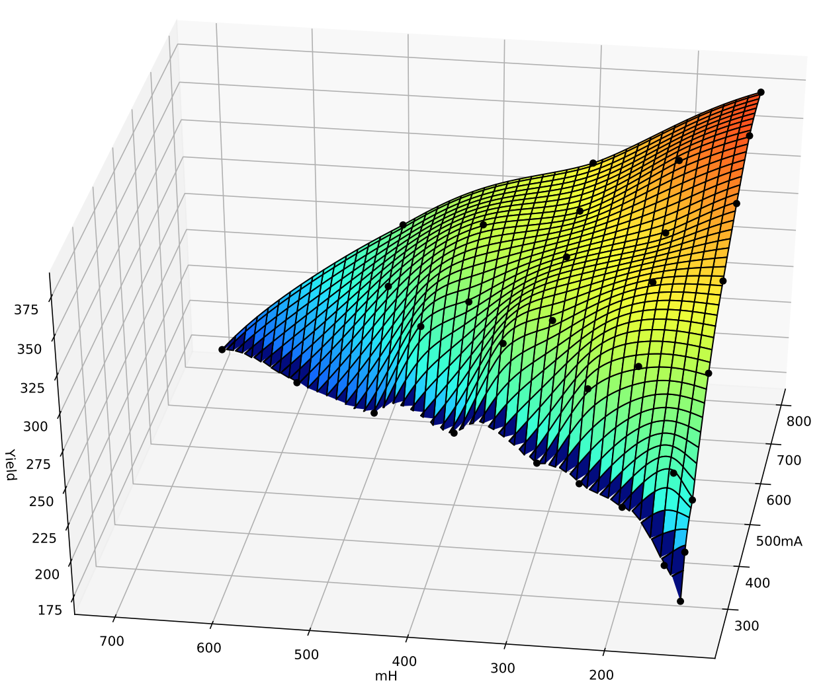
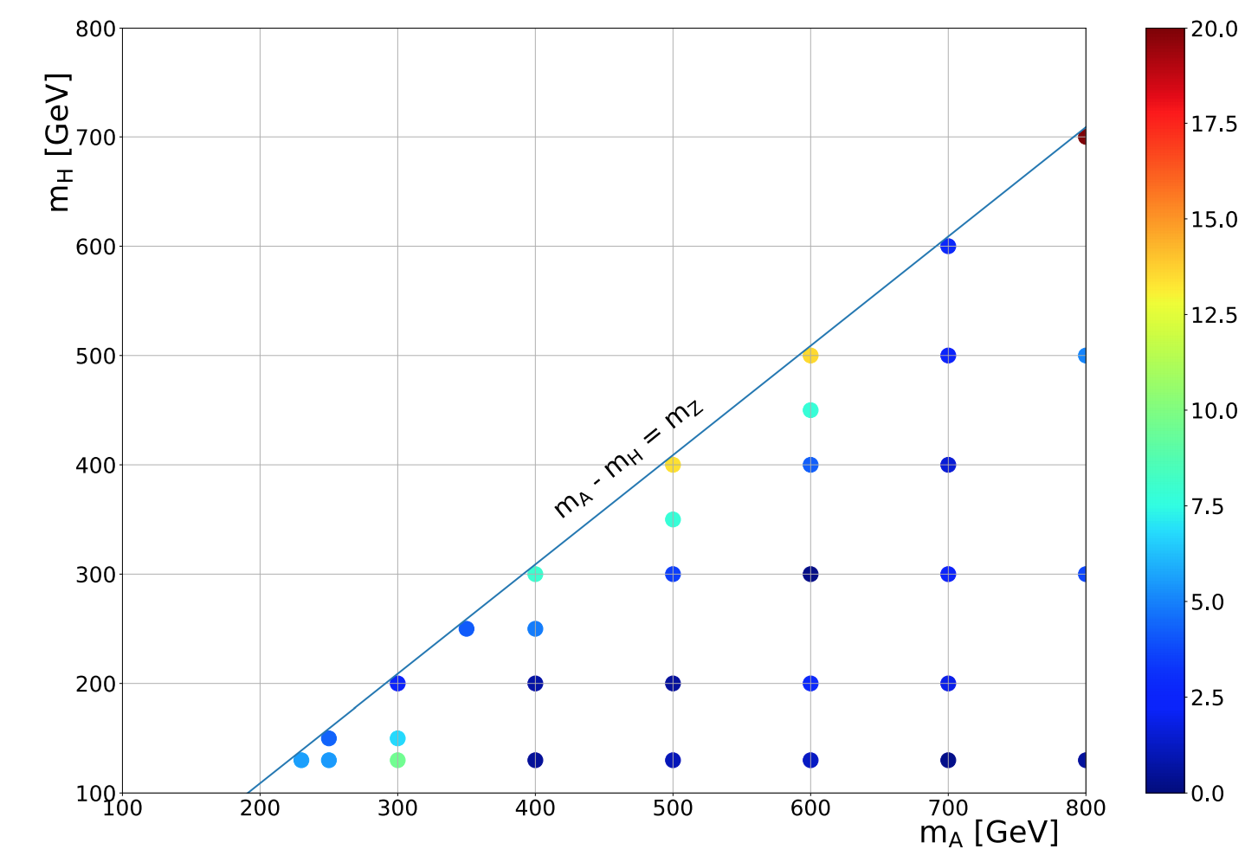
Interpolation yield

Slide 21
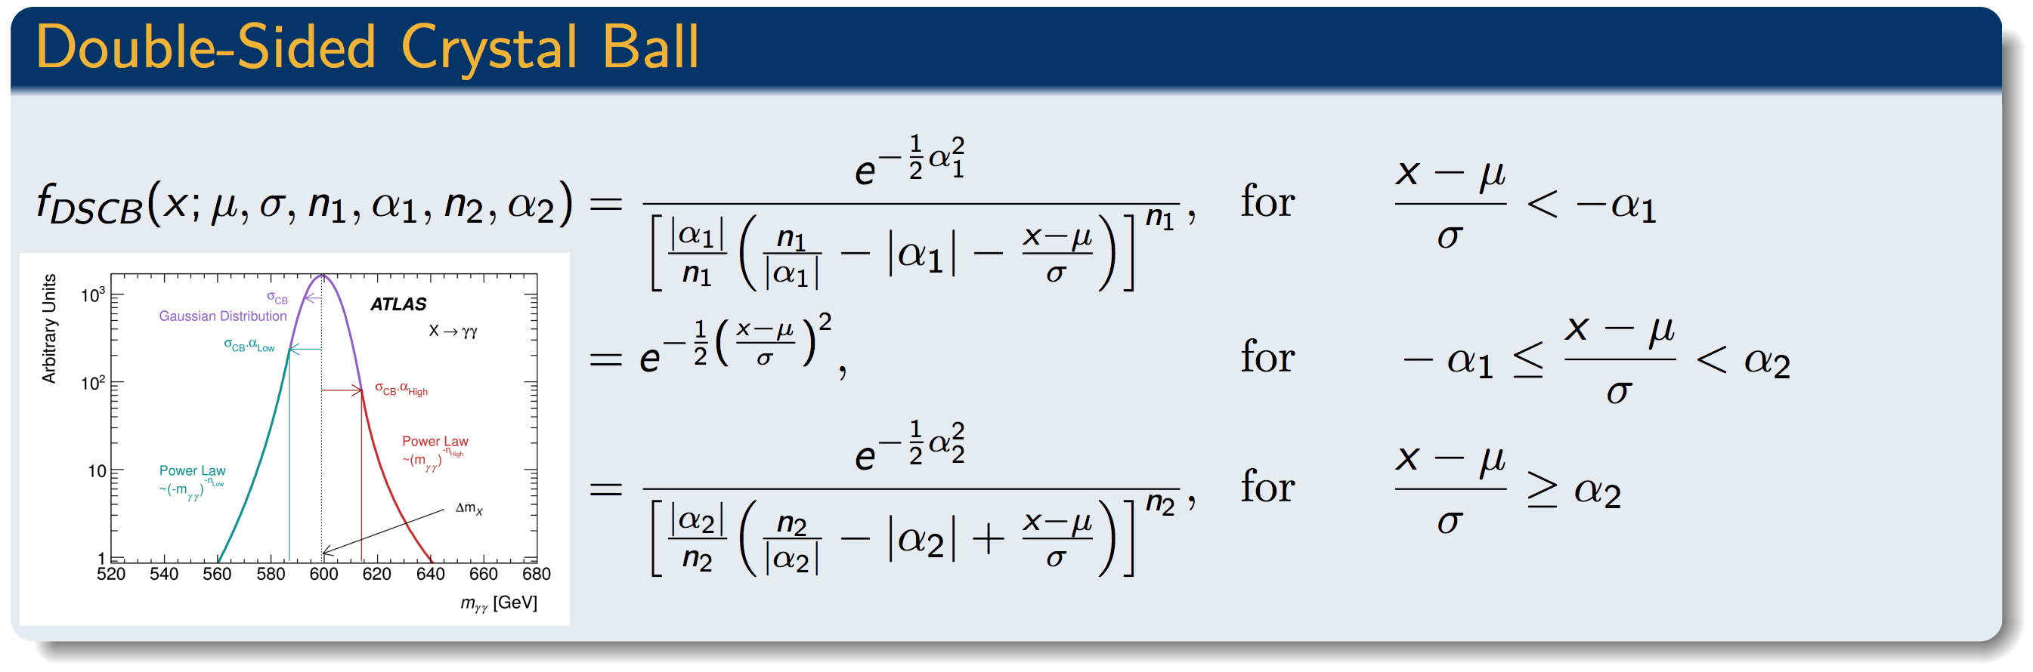
DSCB function

Slide 22
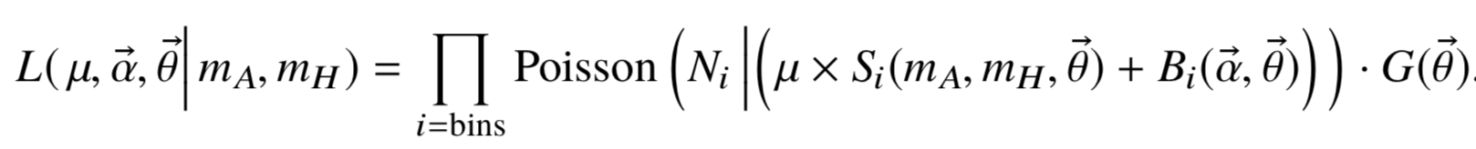
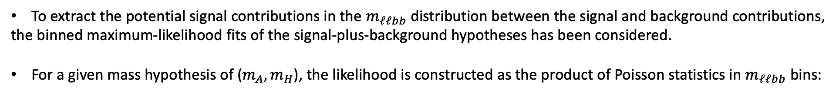
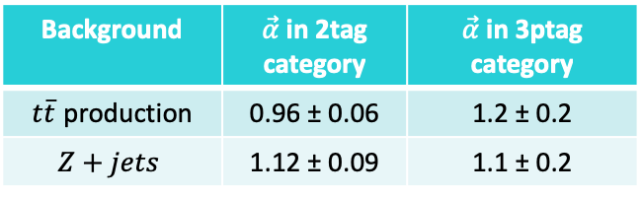
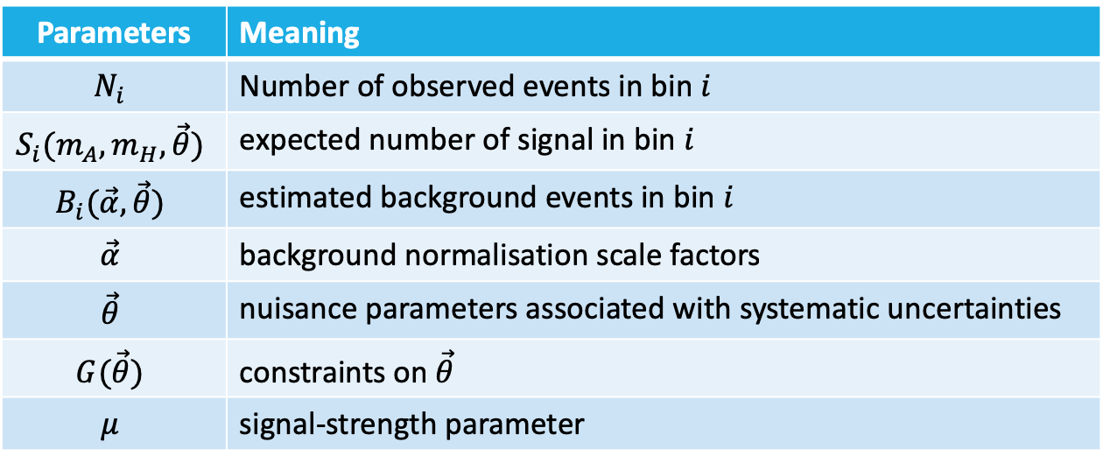
Fit function
To extract the potential signal contributions in the $m_{ℓℓbb}$ distribution between the signal and background contributions,
the binned maximum-likelihood fits of the signal-plus-background hypotheses has been considered.
For a given mass hypothesis of ($m_{A},m_{H}$), the likelihood is constructed as the product of Poisson statistics in $m_{ℓℓbb}$ bins:
Parameters | Meaning
$$N_{i}$$ | Number of observed events in bin $i$
$$S_{i}(m_{A},m_{H},\vec{θ})$$ | expected number of signal in bin $i$
$$B_{i}(\vec{α},\vec{θ})$$ | estimated background events in bin $i$
$$\vec{α}$$ | background normalisation scale factors
$$\vec{θ}$$ | nuisance parameters associated with systematic uncertainties
$$G(\vec{θ})$$ | constraints on $\vec{θ}$
$$μ$$ | signal-strength parameter
Background | $\vec{α}$ in 2tag category | $\vec{α}$ in 3ptag category
$t\overline{t}$ production | 0.96 ± 0.06 | 1.2 ± 0.2
$$Z+jets$$ | 1.12 ± 0.09 | 1.1 ± 0.2

Slide 23
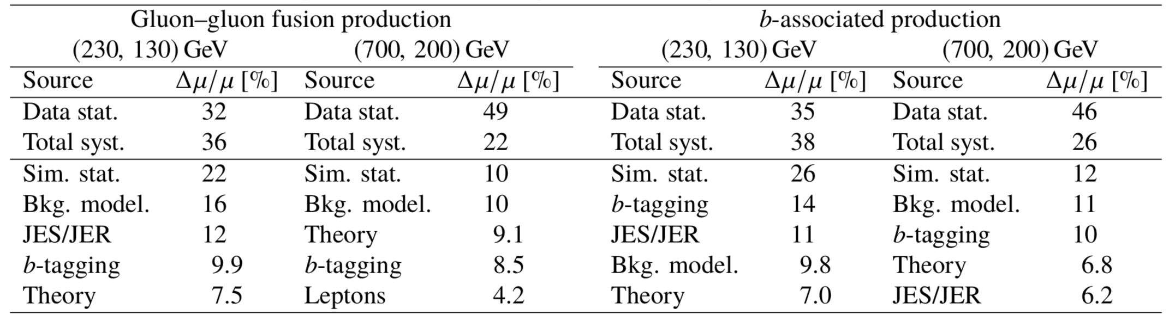

Systematic uncertainties
Uncertainties in the search having the largest impact depend on the choice of ($m_{A},m_{H}$).
The leading uncertainties in two example mass points are shown as follow:
$μ$: Signal strength
The leading sources of systematic uncertainty are similar for other mass points.
The limited size of the simulated samples has the largest impact on the search sensitivity among all the sources of systematic uncertainty.

Slide 24
Result I: Cross section limit
ggA
ggA
bbA
bbA
arXiv:1804.01126

Slide 25

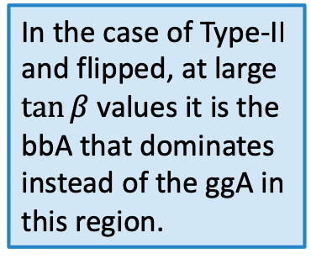
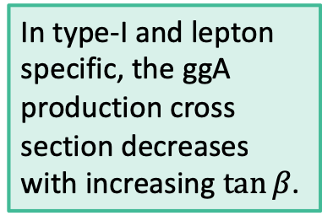
Result II: ($m_{A}$, $m_{H}$) plane vs $\tan{β}$
In type-I and lepton specific, the ggA production cross section decreases with increasing $\tan{β}$.
In the case of Type-II and flipped, at large $\tan{β}$values it is the
bbA that dominates instead of the ggA in this region.
arXiv:1804.01126

