Slide 1
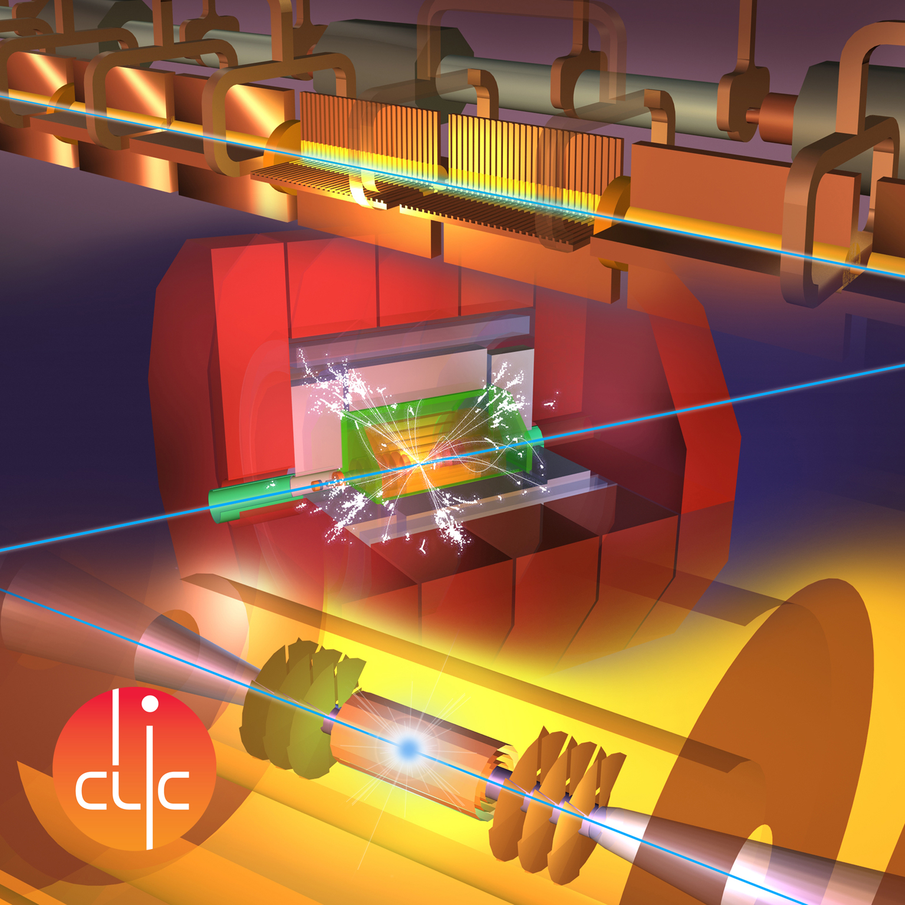

Prospects for top-Yukawa coupling and Higgs boson CP at the CLIC e⁺e⁻ collider
Yixuan Zhang
University of Edinburgh
IoP Joint HEPP and APP Annual Conference 2019, Imperial College London

Slide 2

Outline
CLIC overview
The top Yukawa analysis at 1.4 TeV
  Strategy and Pre-selections
  Event Reconstruction and flavour-tagging
  Multivariant selection (TMVA)
  Results
CP property of Higgs boson
  Sample production and cross-section calculation
  Preliminary sensitivity to CP mixing (cross-section)
  Up-down asymmetry
  Preliminary sensitivity to CP mixing (cross-section + up-down asymmetry)
Summary

Slide 3
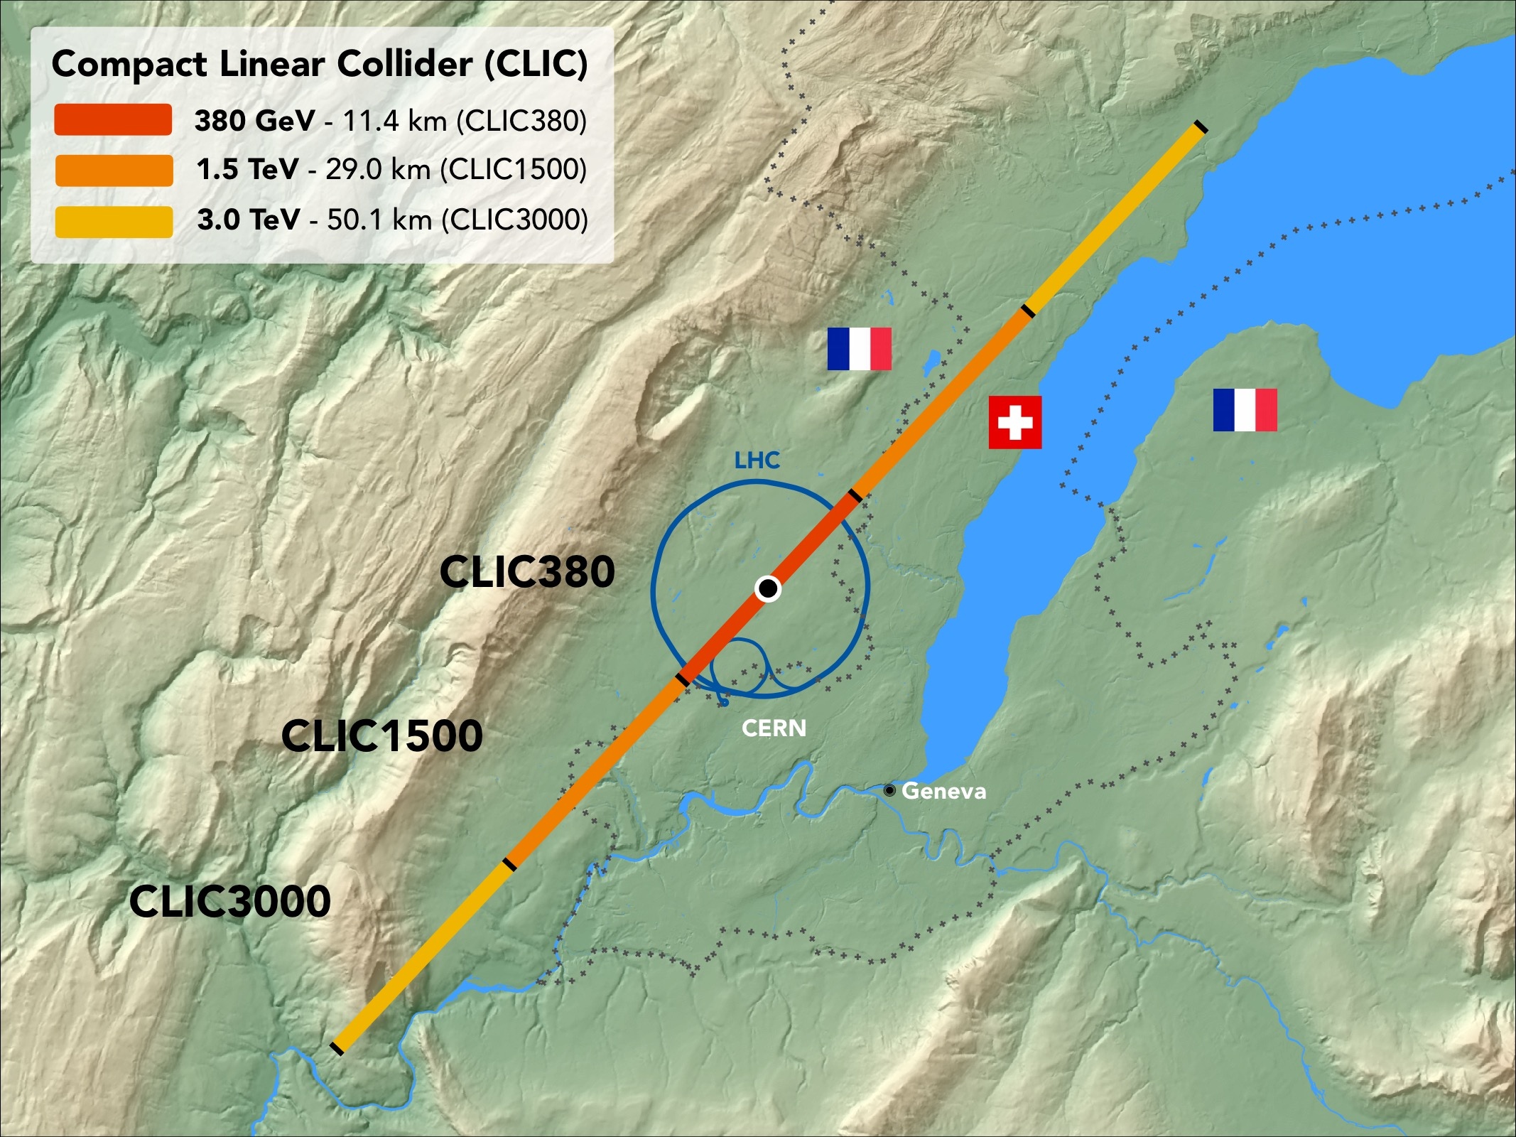
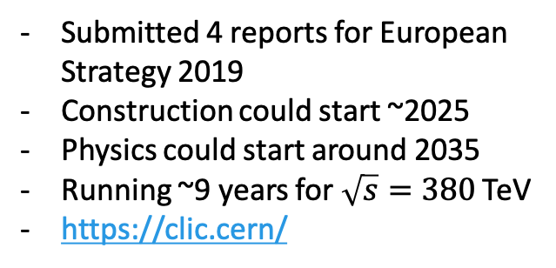
Submitted 4 reports for European Strategy 2019
Construction could start ~2025
Physics could start around 2035
Running ~9 years for $\sqrt{s}=380$ TeV
https://clic.cern/

Slide 4
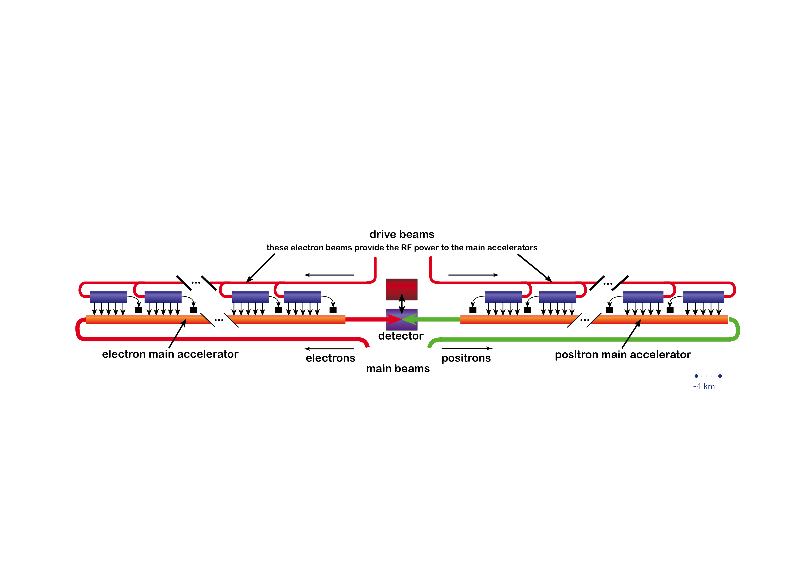
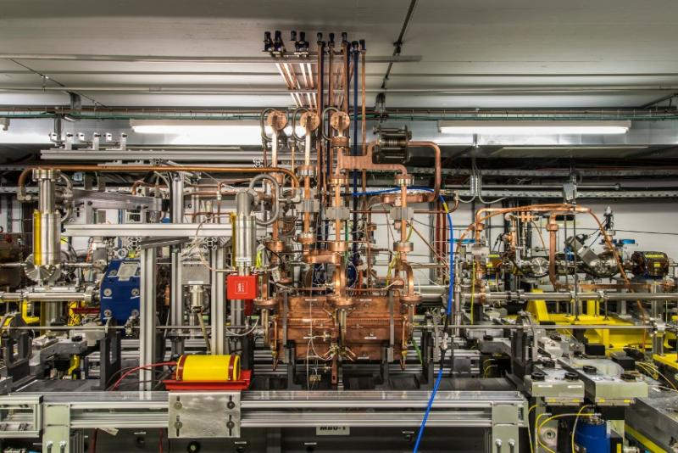
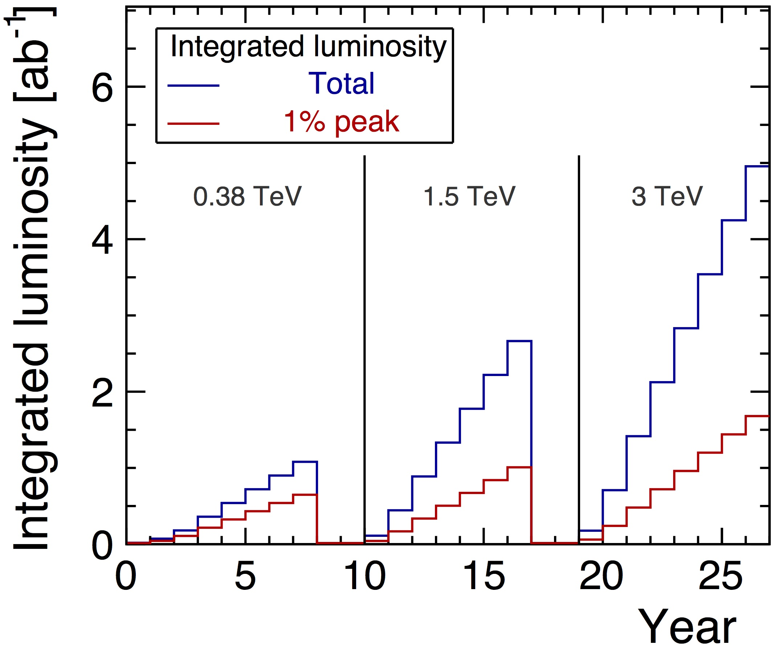
Compact Linear Collider (CLIC)
Drive beam
Stage 1
Stage 2
Stage 3
Main beam
CTF3 facility

Slide 5
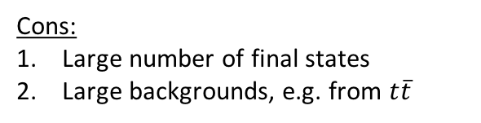
Motivation
Stage1
Stage2
Stage3
Pros:
Strongest Yukawa coupling
High rates of production of Higgs with top pairs
Direct probe of CP properties of Higgs boson
Cons:
Large number of final states
Large backgrounds, e.g. from $t\overline{t}$

Slide 6












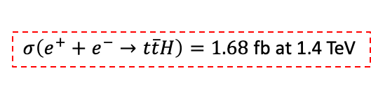
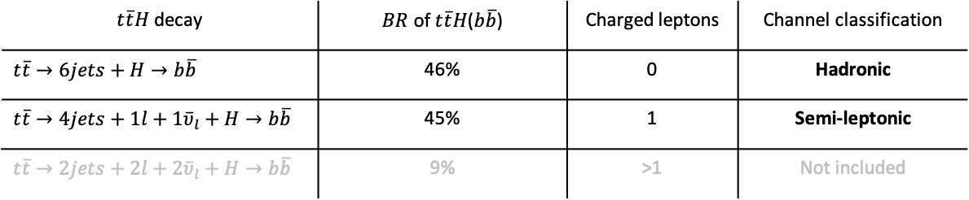

Analysis Strategy
$σ\left(e^{+}+e^{−}→t\overline{t}H\right)=1.68$fb at 1.4 TeV
$H→b\overline{b}(≈56\%)$, $ℒ=2.5$ ab⁻¹
$$g_{t\overline{t}H}$$
$$g_{t\overline{t}H}$$
$$q$$
$${\overline{υ}}_{l}$$
$$\overline{b}$$
$$q$$
$$\overline{b}$$
$$l$$
$$b$$
$$b$$
$$q$$
$$q$$
$$q$$
$$q$$
Hadronic channel: 6 jets
Semi-leptonic channel: 4 jets
$t\overline{t}H$ decay | $BR$ of $t\overline{t}H$($b\overline{b}$) | Charged leptons | Channel classification
$$t\overline{t}→6jets+H→b\overline{b}$$ | 46% | 0 | Hadronic
$$t\overline{t}→4jets+1l+1{\overline{υ}}_{l}+H→b\overline{b}$$ | 45% | 1 | Semi-leptonic
$$t\overline{t}→2jets+2l+2{\overline{υ}}_{l}+H→b\overline{b}$$ | 9% | >1 | Not included
Notes:
-- You are focusing on the H-->bb final state, since it's the largest BR of the Higgs
-- That the main backgrounds are from tt and ttbb production. (I know you say that on the next slide, but this slide is about strategy!)
-- that this talk will focus on the semi-leptonic channel

Slide 7
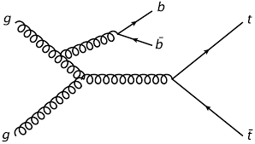
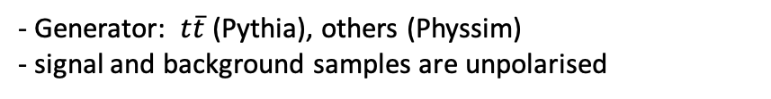













Backgrounds
$$\overline{f}$$
$$\overline{b}$$
$$H$$
$$f$$
$$g$$
$$b$$
signal<1%
Other $t\overline{t}H$ decays
$t\overline{t}b\overline{b}$
$$\overline{f}$$
$t\overline{t}$ 95%
$$Z$$
$$f$$
$t\overline{t}Z$
$t\overline{t}$
- Generator: $t\overline{t}$ (Pythia), others (Physsim)
- signal and background samples are unpolarised

Slide 8
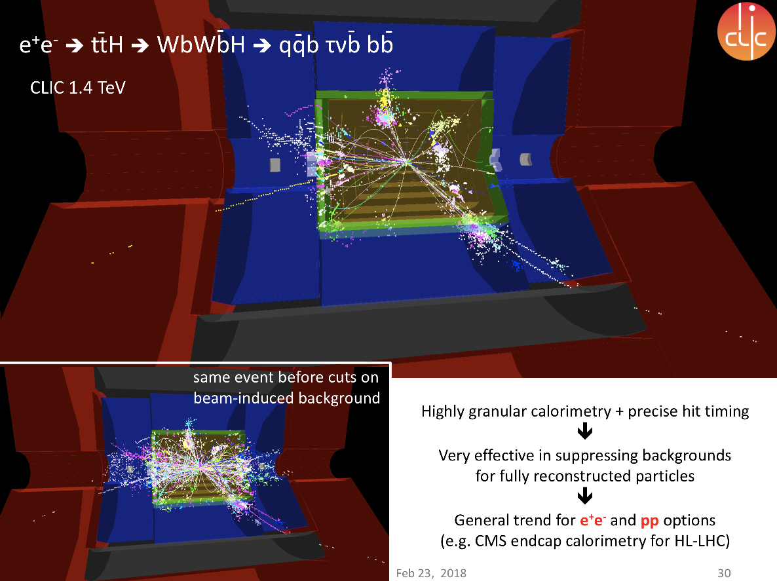
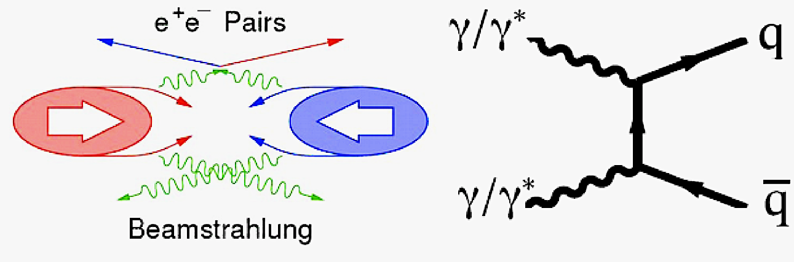
After
Before
Timing cut and momentum cut applied to suppress the beam-induced backgrounds.

Slide 9
Event reconstruction strategy
k_{T} algorithm
Cluster into 6 jets + beam bkg
0
stop
Start
All particles
particles that are not a lepton
1
Remove beam induced background
>1
stop
Recluster into 6 jets
All particle information and variables
Reconstruct invariant masses of t, W± and H
Perform flavour tagging
6 jets
Reclustered 6 jets

Slide 10
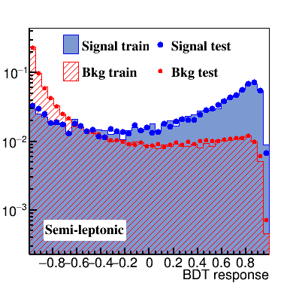
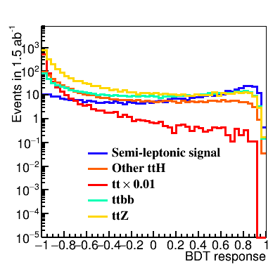
BDTG response
The BDTG response for signal and background samples.
(Left): Normalised BDTG response.
Optimise significance $S/\sqrt{S+B}$
(Right): Scaled BDTG to number of events expected in 1.5 ab⁻¹ with new set of samples by using the result from (Left).

Slide 11
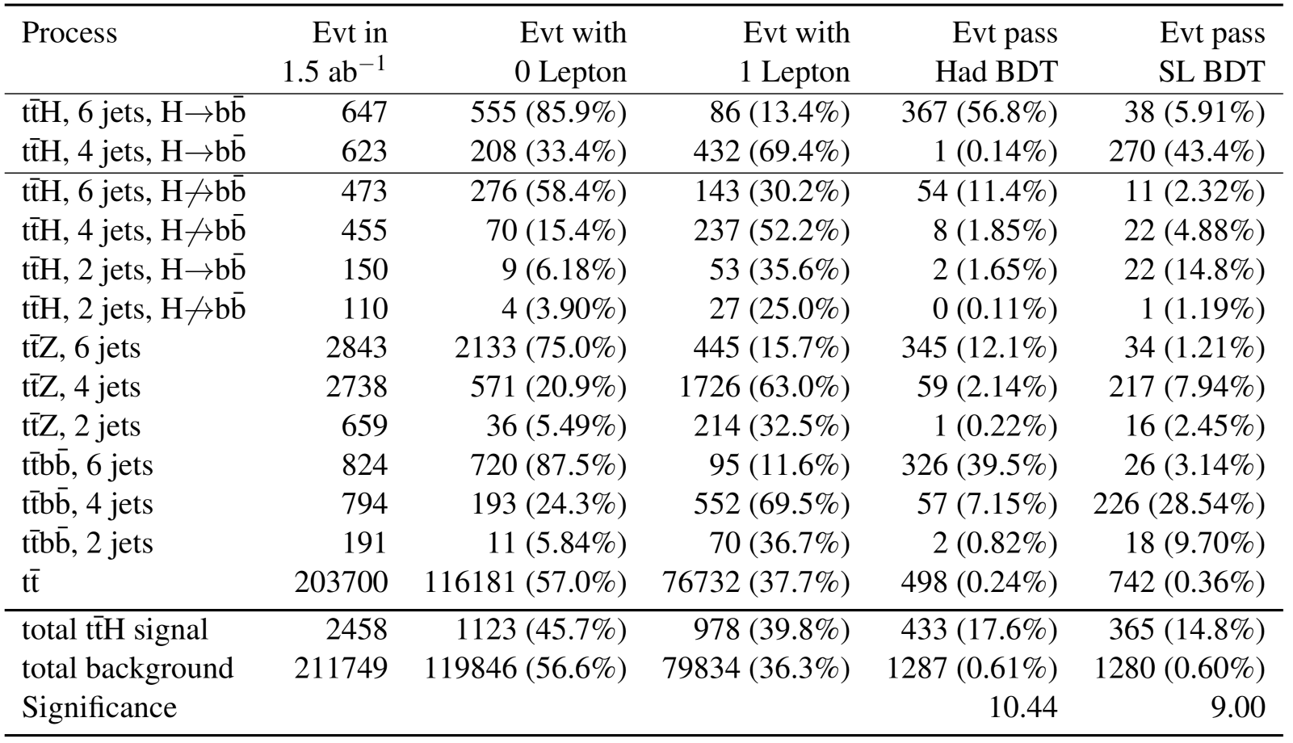
Selection efficiency after BDTG cut

Slide 12
Selection efficiency after BDTG cut
signal<1%
Before
After

Slide 13
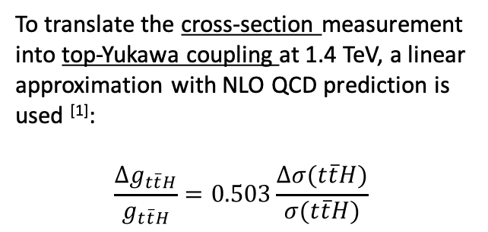
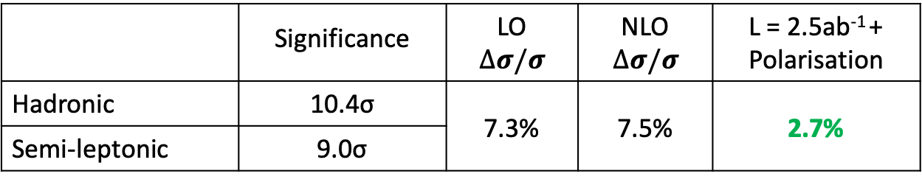

Result on top-Yukawa coupling
To translate the cross-section measurement into top-Yukawa coupling at 1.4 TeV, a linear approximation with NLO QCD prediction is used ^{[1]}:
$$\frac{Δg_{t\overline{t}H}}{g_{t\overline{t}H}}=0.503\frac{Δσ(t\overline{t}H)}{σ(t\overline{t}H)}$$
No contribution from $g_{t\overline{t}H}$
L = 1.5ab⁻¹
L = 1.5ab⁻¹
L = 1.5ab⁻¹
 | Significance | LO $$∆σ/σ$$ | NLO $$∆σ/σ$$ | L = 2.5ab⁻¹ + Polarisation
Hadronic | 10.4σ | 7.3% | 7.5% | 2.7%
Semi-leptonic | 9.0σ
[1] JHEP 1612 (2016) 075
Notes:
$e^{+}e^{−}→Z^{∗}H$ where $Z^{∗}→t\overline{t}$. is independent of $g_{ttH}$.
But it contributes a non-negligible fraction to the total cross section.

Slide 14
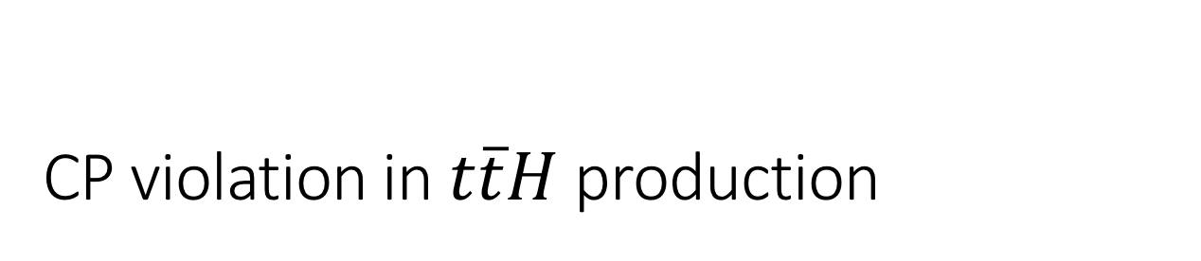
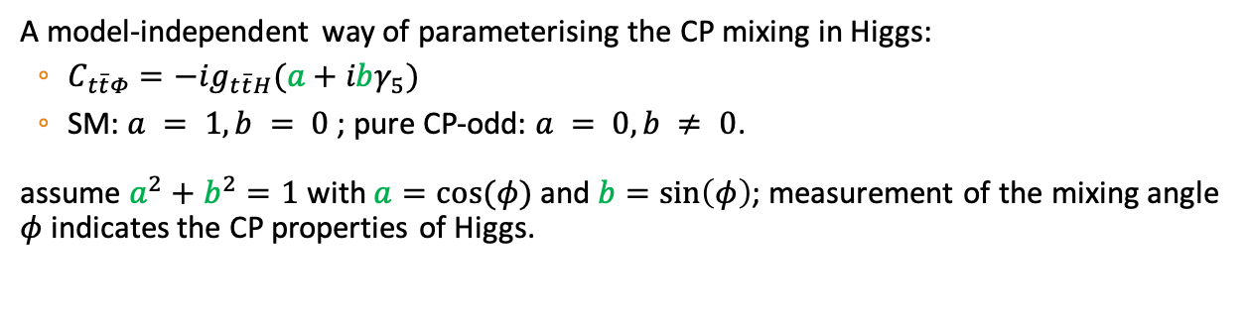
CP violation in $t\overline{t}H$ production
A model-independent way of parameterising the CP mixing in Higgs:
  $C_{t\overline{t}Φ}=−ig_{t\overline{t}H}(a+ibγ_{5})$
  SM: $a = 1, b = 0$; pure CP-odd: $a = 0, b ≠ 0$.
assume $a^{2}+b^{2}=1$ with $a=cos⁡(φ)$ and $b=sin\left(φ\right)$; measurement of the mixing angle $φ$ indicates the CP properties of Higgs.

Slide 15

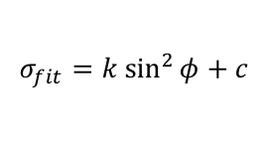
CP violation in $t\overline{t}H$ production
A model-independent way of parameterising the CP mixing in Higgs:
  $C_{t\overline{t}Φ}=−ig_{t\overline{t}H}(a+ibγ_{5})$
  SM: $a = 1, b = 0$; pure CP-odd: $a = 0, b ≠ 0$.
assume $a^{2}+b^{2}=1$ with $a=cos⁡(φ)$ and $b=sin\left(φ\right)$; measurement of the mixing angle $φ$ indicates the CP properties of Higgs.
$t\overline{t}Φ$cross section
$H→Φ$ as Higgs boson is no longer pure CP-even
• 12 different values of $sin\left(φ\right)$samples produced
$$σ_{fit}=k {sin⁡}^{2}φ+c$$

Slide 16
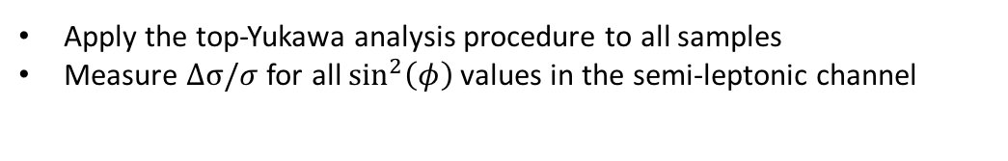
Cross section to CP-mixing sensitivity
1.5ab⁻¹
1.5ab⁻¹
Apply the top-Yukawa analysis procedure to all samples
Measure $∆σ/σ$ for all ${sin⁡}^{2}\left(φ\right)$values in the semi-leptonic channel
Extrapolate to result to include fully-hadronic channel

Slide 17
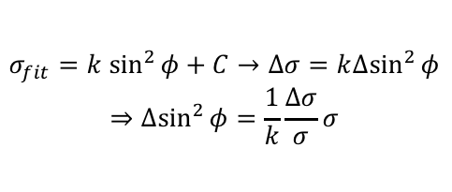
Cross section to CP-mixing sensitivity
1.5ab⁻¹
1.5ab⁻¹
$$σ_{fit}=k {sin⁡}^{2}φ+C→∆σ=k∆{sin⁡}^{2}φ$$
$$⇒∆{sin⁡}^{2}φ=\frac{1}{k}\frac{∆σ}{σ}σ$$

Slide 18
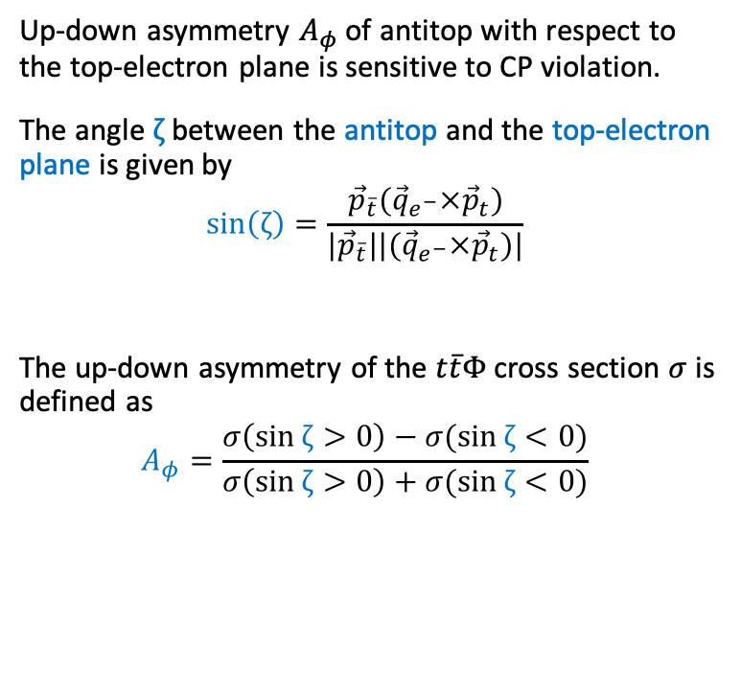
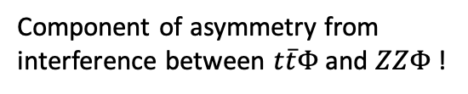






Up-down asymmetry
Up-down asymmetry $A_{φ}$ of antitop with respect to the top-electron plane is sensitive to CP violation.
The angle $ζ$ between the antitop and the top-electron plane is given by
$$\sin\left(ζ\right)=\frac{{\vec{p}}_{\overline{t}}({\vec{q}}_{e^{−}}×{\vec{p}}_{t})}{{|\vec{p}}_{\overline{t}}||({\vec{q}}_{e^{−}}×{\vec{p}}_{t})|}$$
The up-down asymmetry of the $t\overline{t}Φ$ cross section $σ$ is defined as
$$A_{φ}=\frac{σ\left(\sin{ζ}>0\right)−σ(\sin{ζ}<0)}{σ\left(\sin{ζ}>0\right)+σ(\sin{ζ}<0)}$$
x
$$t$$
$$Φ$$
$$e^{−}$$
$$e^{+}$$
$$\overline{t}$$
z
$$ζ$$
y
Component of asymmetry from interference between $t\overline{t}Φ$ and $ZZΦ$ !
[1] arXiv:1103.5404v1

Slide 19



$sin⁡ζ$ and $A_{φ}$ with tight cuts
Pure CP-even
50% CP-even & CP-odd
Pure CP-odd
$$sin⁡ζ$$
$$sin⁡ζ$$
$$sin⁡ζ$$
before
After
Quality cuts:
Remove taus and mis-reconstructed tops

Slide 20
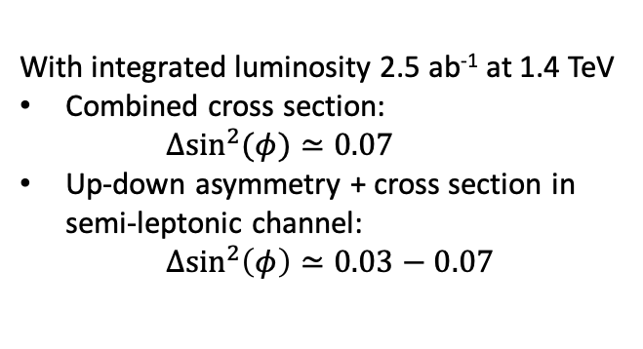
Preliminary results on mixing angle
With integrated luminosity 2.5 ab⁻¹ at 1.4 TeV
Combined cross section:
$Δ{sin⁡}^{2}(φ)≃0.07$
Up-down asymmetry + cross section in semi-leptonic channel:
$Δ{sin⁡}^{2}\left(φ\right)≃0.03−0.07$

Slide 21
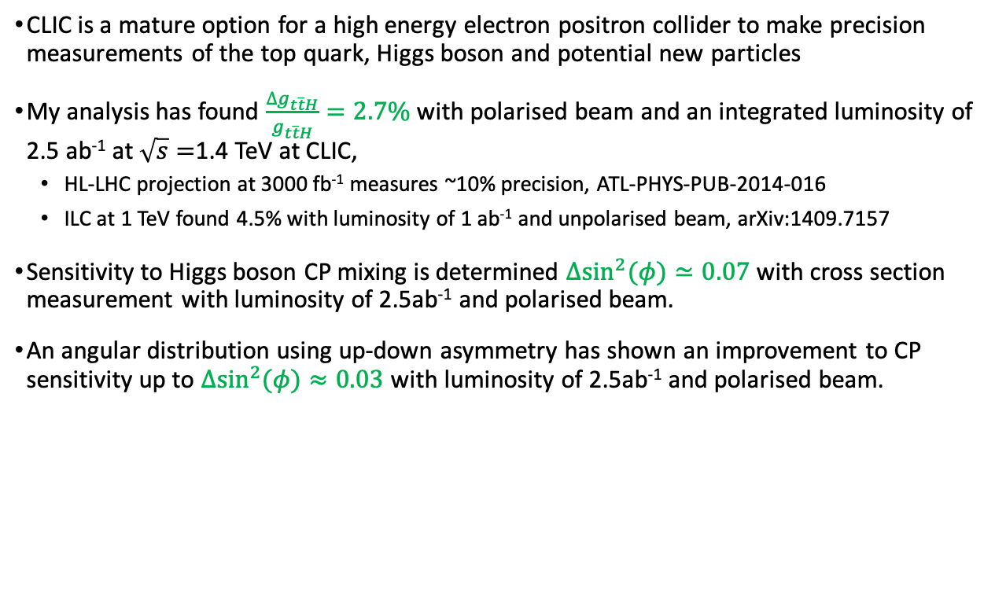
Summary
CLIC is a mature option for a high energy electron positron collider to make precision measurements of the top quark, Higgs boson and potential new particles
My analysis has found $\frac{∆g_{t\overline{t}H}}{g_{t\overline{t}H}}=2.7\%$ with polarised beam and an integrated luminosity of 2.5 ab⁻¹ at $\sqrt{s}=$1.4 TeV at CLIC,
  HL-LHC projection at 3000 fb⁻¹ measures ~10% precision, ATL-PHYS-PUB-2014-016
  ILC at 1 TeV found 4.5% with luminosity of 1 ab⁻¹ and unpolarised beam, arXiv:1409.7157
Sensitivity to Higgs boson CP mixing is determined $Δ{sin⁡}^{2}(φ)≃0.07$ with cross section measurement with luminosity of 2.5ab⁻¹ and polarised beam.
An angular distribution using up-down asymmetry has shown an improvement to CP sensitivity up to $Δ{sin⁡}^{2}(φ)≈0.03$ with luminosity of 2.5ab⁻¹ and polarised beam.

Slide 22
Backup Slides

Slide 23
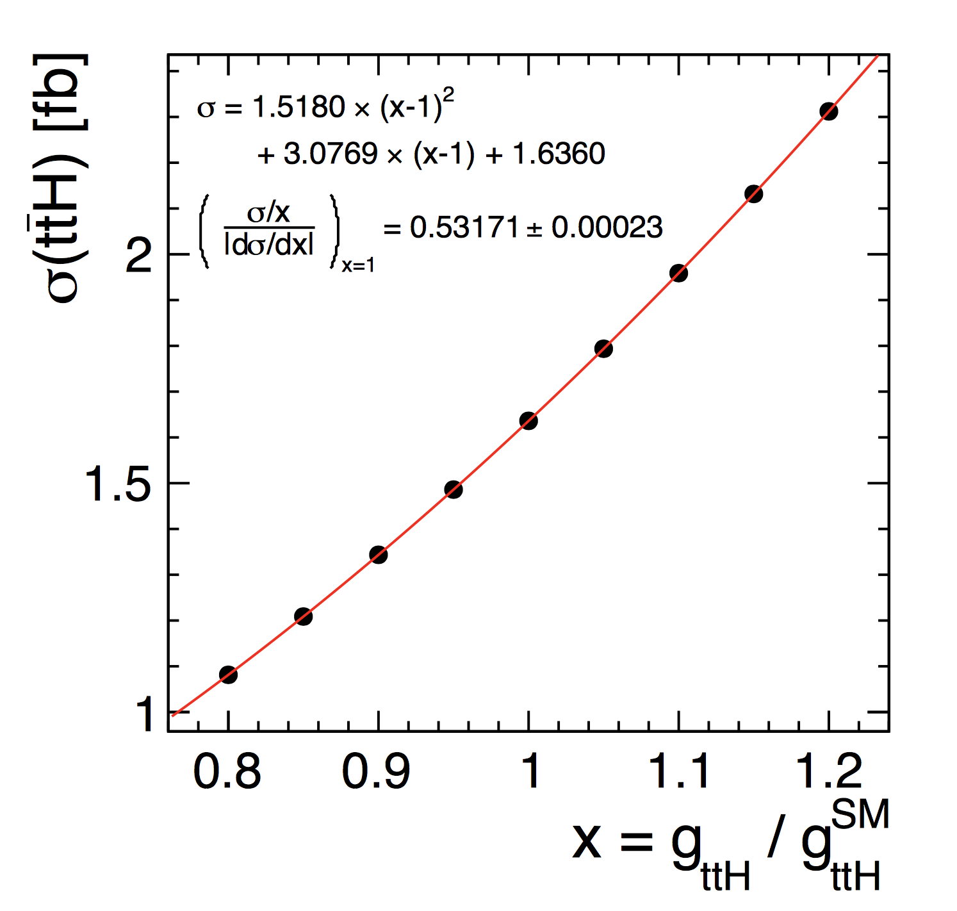
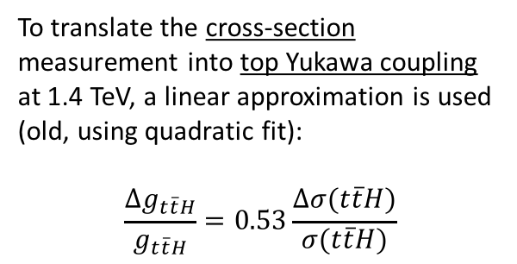
Result on top-Yukawa coupling
To translate the cross-section measurement into top Yukawa coupling at 1.4 TeV, a linear approximation is used (old, using quadratic fit):
$$\frac{Δg_{t\overline{t}H}}{g_{t\overline{t}H}}=0.53\frac{Δσ(t\overline{t}H)}{σ(t\overline{t}H)}$$
Notes:
$e^{+}e^{−}→Z^{∗}H$ where $Z^{∗}→t\overline{t}$. is independent of $g_{ttH}$.
But it contributes a non-negligible fraction to the total cross section.

Slide 24
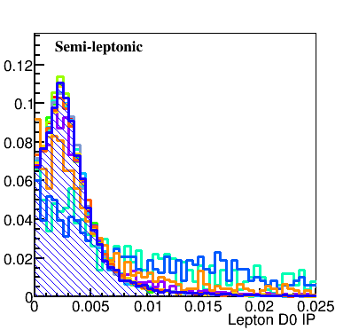
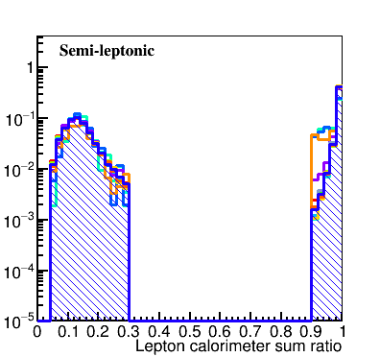
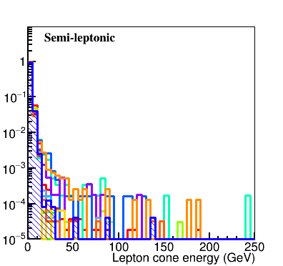
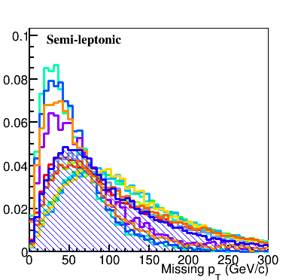
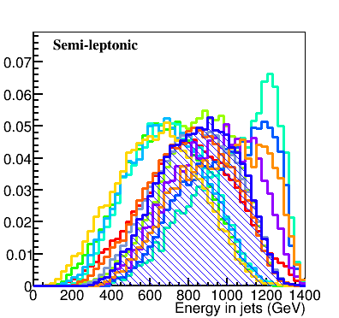
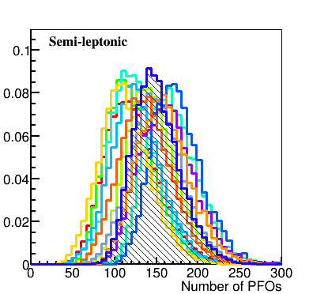
N.B The results presented here are all for the semi-leptonic signal channel.

Slide 25
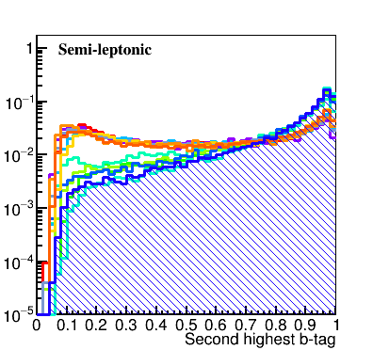
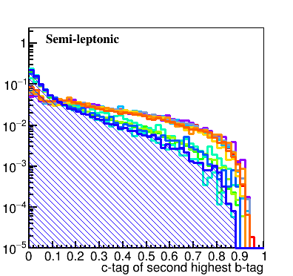
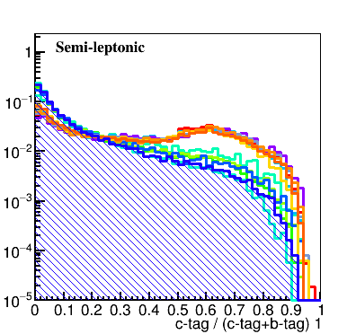
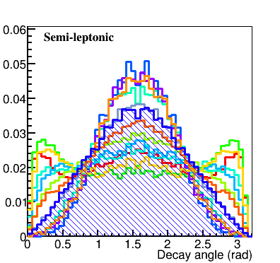
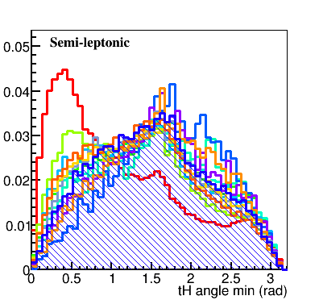
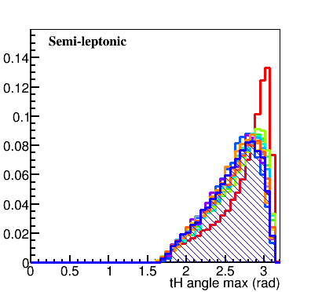

Slide 26
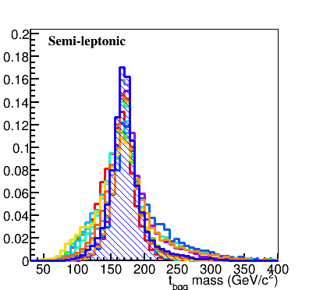
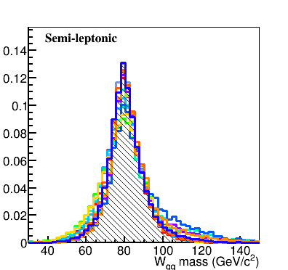
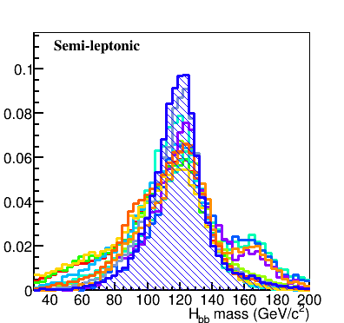
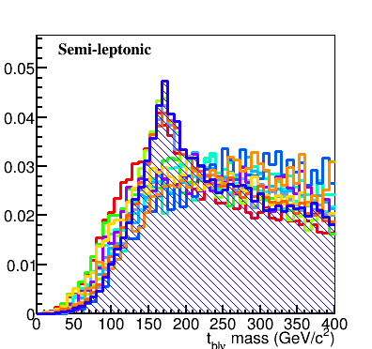
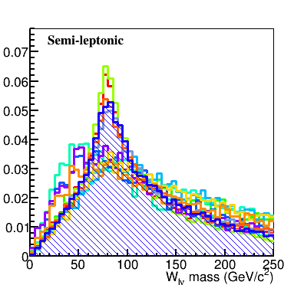
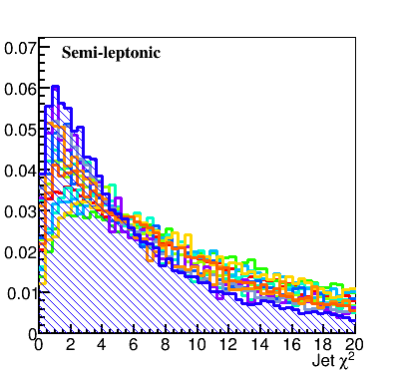

Slide 27
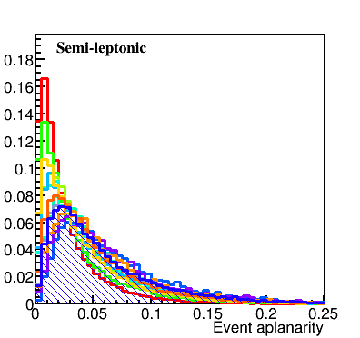
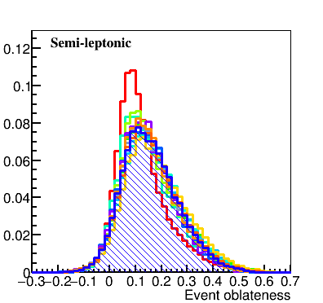



Slide 28


















Top, $W^{±}$and Higgs Reconstruction
Chi-square method is used to reconstruct the $W^{±}$, top and Higgs candidates by combining the jets.
Semi-leptonic:
$χ_{6}^{2}=\frac{{{(M}_{12}−M_{W^{±}})}^{2}}{σ_{W^{±}}^{2}}+\frac{{{(M}_{123}−M_{t})}^{2}}{σ_{t}^{2}}$+ $\frac{{{(M}_{45}−M_{H})}^{2}}{σ_{H}^{2}}$
Hadronic:
$χ_{8}^{2}$ $=\frac{{{(M}_{12}−M_{W^{±}})}^{2}}{σ_{W^{±}}^{2}}+\frac{{{(M}_{123}−M_{t})}^{2}}{σ_{t}^{2}}+\frac{{{(M}_{45}−M_{W^{±}})}^{2}}{σ_{W^{±}}^{2}}+\frac{{{(M}_{456}−M_{t})}^{2}}{σ_{t}^{2}}+\frac{{{(M}_{78}−M_{H})}^{2}}{σ_{H}^{2}}$
Reorder jets
$${χ^{2}}_{min}={χ^{2}}_{min}$$
For $χ^{2}={χ^{2}}_{min}$
1
$$M_{12}$$
2
$$M_{123}$$
Calculate $χ^{2}$
No
3
<${χ^{2}}_{min}$?
1
2
3
4
5
6
4
$$M_{45}$$
$$+l+p_{}^{miss}$$
5
Yes
$$q_{W_{had}}$$
$$q_{W_{had}}$$
$$b_{t_{had}}$$
$$b_{H}$$
$$b_{H}$$
$$b_{t_{lep}}$$
6
$${χ^{2}}_{min}=χ^{2}$$
6! permutations
$$t_{had}$$
$$H$$
$$t_{lep}$$

Slide 29


BDTG cut efficiency & optimal significance
signal
background
significance
$$=S/\sqrt{S+B}$$
Optimal significance obtained for the semi-leptonic channel.

Slide 30
Improvement of top reconstruction
How to cut away mis-identified top?
Choose suitable cuts by looking at events passing or failing (sin$ζ$ in range -1 to 1):
$\left|sin(ζ_{rec})−sin(ζ_{mc})\right|<0.05$:
Example: $m_{t_{lep}}−m_{t_{had}}$ from reconstruction:
Tight cuts:
$${→m}_{t_{l}}−m_{t_{q}}<100$$
${→jetmatch χ}^{2}<10$ ($χ^{2}$ used to match jets into t, W and H )
$→$ remove hadronic taus

Slide 31

Error estimation
Fitting function:
$$f(x)=exp⁡(\frac{−{(x−μ)}^{2}}{g})\left\{\begin{aligned}g=2σ_{L}^{2}+α_{L}{(x−μ)}^{2}, x<μ \\ g=2σ_{R}^{2}+α_{R}{(x−μ)}^{2}, x>μ\end{aligned}\right.$$
${sin⁡}^{2}φ:0−0.1$
${sin⁡}^{2}φ:0.2−0.8$
${sin⁡}^{2}φ:0.9−1$
$$∆{sin⁡}^{2}φ=σ_{R}$$
$$∆{sin⁡}^{2}φ=\frac{FWHM}{2\sqrt{2ln⁡2}}$$
$$∆{sin⁡}^{2}φ=σ_{L}$$
NB: Bin size=20 for all.

Slide 32







$χ^{2}$ template fitting
Calculate $χ^{2}$ for a specific ${sin⁡}^{2}φ$ value (e.g =0.5)
$$χ^{2}$$
$$χ_{n}^{2}({sin⁡}^{2}φ=0.5)=\sum_{i=1}^{nbins}{{\left(\frac{O_{data({sin⁡}^{2}φ=0.5)}−O_{MC(n)}}{σ_{data}}\right)}^{2}}$$
X times
$$N$$
n is the different ${sin⁡}^{2}φ$ samples.
$O_{MC(n)}$ is the number of events in the same bin of different ${sin⁡}^{2}φ$ samples.
Smear as Poisson
$$⁡{sin⁡}^{2}φ$$
Find minimum and fill Histogram
$$sin⁡ζ$$

Slide 33
Sensitivity to CP property

