Slide 1
LHC Detector Upgrades

Slide 2
Outline and initial comments
Choice of material
Focus on ATLAS & CMS and LHCb
  In line with the profile of the conference
  Apologies for any bias in the choice of topics
  Apologies to ALICE and other present and future LHC experiments
Credits: colleagues in ATLAS, CMS and LHCb who provided material
Outline of the talk and timeline of the upgrades
Detector upgrades until now
Upgrades in preparation
  LS2, LS3 & LS4
Conclusion

Slide 3
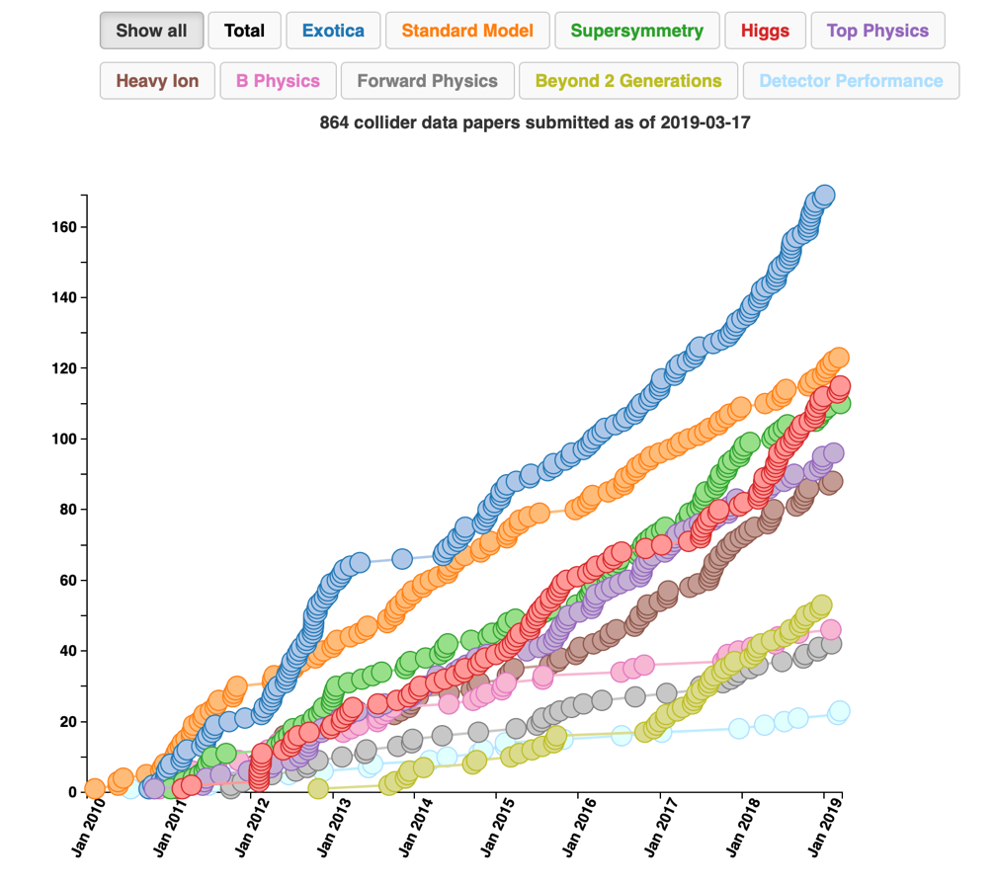
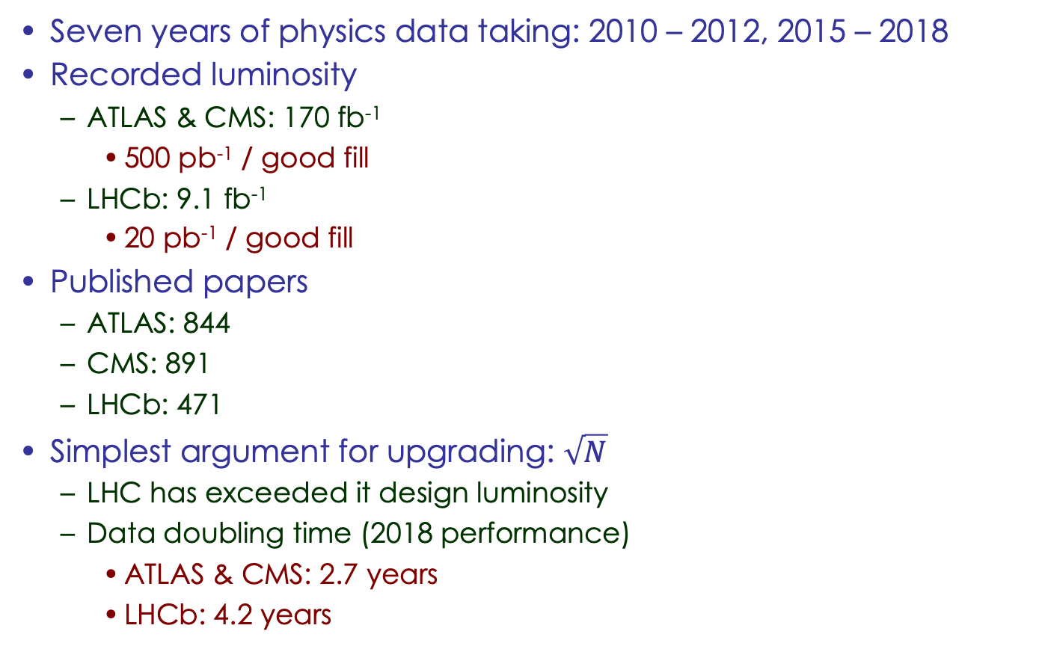
LHC Experimental achievements & status
Seven years of physics data taking: 2010 – 2012, 2015 – 2018
Recorded luminosity
  ATLAS & CMS: 170 fb⁻¹
    500 pb⁻¹ / good fill
  LHCb: 9.1 fb⁻¹
    20 pb⁻¹ / good fill
Published papers
  ATLAS: 844
  CMS: 891
  LHCb: 471
Simplest argument for upgrading: $\sqrt{N}$
  LHC has exceeded it design luminosity
  Data doubling time (2018 performance)
    ATLAS & CMS: 2.7 years
    LHCb: 4.2 years
CMS publications versus time
26.8 k citations
LHCb luminosity

Slide 4
Timeline – Luminosity & upgrades
Energy
7 TeV
8 TeV
13 TeV
14(?) TeV
Run 1
LS1
Run 2
LS2
Run 3
LS3
CMS & ATLAS
∫ ℒ = 21 fb⁻¹
ℒ = 0 – 8 x 10³³
Upgrade
phase I
∫ ℒ = 170 fb⁻¹
ℒ = 1 – 2 x 10³⁴
Upgrade
phase I
∫ ℒ = 380 fb⁻¹
ℒ 2.5 x 10³⁴
Upgrade
phase II
2010 2011 2012 2013 2014 2015 2016 2017 2018 2019 2020 2021 2022 2023 2024 2025 2026
LHCb
∫ ℒ = 3 fb⁻¹
ℒ = 0 – 4 x 10³²
∫ ℒ = 9 fb⁻¹
ℒ = 3 – 4 x 10³²
Upgrade 1
∫ ℒ = 23 fb⁻¹
ℒ = 1 – 2 x 10³³
Upgrade 1b
Energy
14 TeV
14 TeV
14 TeV
Run 4
LS4
Run 5
LS5
Run 6
CMS & ATLAS
∫ ℒ = 1000 fb⁻¹
ℒ = 3 – 5 x 10³⁴
∫ ℒ = 2000 fb⁻¹
ℒ = 5 x 10³⁴
∫ ℒ = 4000 fb⁻¹
ℒ = 5 – 7 x 10³⁴
2026 2027 2028 2029 2030 2031 2032 2033 2034 2035 2036 2037
LHCb
∫ ℒ = 50 fb⁻¹
ℒ = 2 x 10³³
Upgrade
2
∫ ℒ > 300 fb⁻¹
ℒ = 1 – 2 x 10³⁴
ℒ = 1 – 2 x 10³⁴
[cm⁻²s⁻¹]

Slide 5
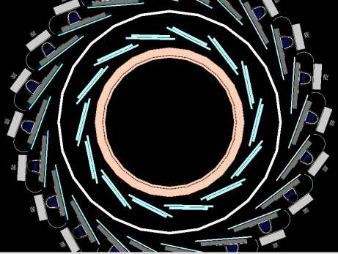
ATLAS phase I upgrade – during LS1
Detector consolidation
  Complete muon chamber installation
  Repairs & improvements
Insertable 4th pixel layer: IBL
  3.3 cm from beam axis
  Improved IP resolution
    B-tagging efficiency
Trigger & DAQ improvements
  L1 trigger, high-level trigger
  Fast track trigger
Software improvements
Forward proton tagger
IP⊥ resolution
2012 vs 2015

Slide 6
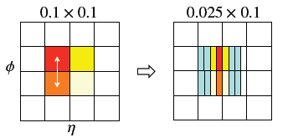
ATLAS phase I upgrades – LS2
Replace first layer for endcap muon
  New small wheel (NSW)
  < 1 mrad angular resolution
    Trigger vector capability
    Reduces L1 muon rate up to 5 times
TDAQ upgrade
  L1 muon and calorimeter triggers
  Topological triggers
  High level trigger
  Readout
LAr readout electronics
  Improved granularity
Upgrades to the forward detector system
Computing
LAr readout cells

Slide 7
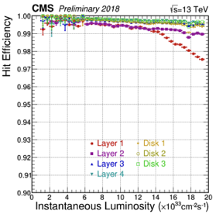
CMS phase I upgrade – until present
L1 Trigger upgrade (2016)
  Full system upgrade
Pixel detector upgrade (2017)
  Change 3 → 4 layers
  Improved hit efficiency
  Closer to the beam & less material
Repairs of DC/DC converters (2018)
    Adjusted operating procedure
HCAL upgrade (2015-2018)
  Photo detectors (HPD → SiPM)
  Front- and backend electronics
  Optimised readout
Hit Efficiency 2016
Hit Efficiency 2018
Material budget
SiPM array

Slide 8
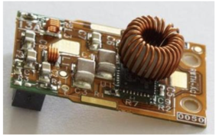
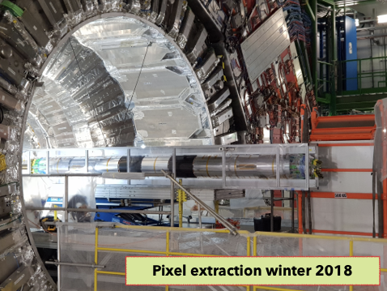
CMS phase I upgrades – LS2
Complete repairs of the pixel detector
  Permanent solution for the DC/DC converters
  Redesign of the converter
Consolidation of previous upgrades
Preparation for phase II upgrade
  Infrastructure in the cavern
Upgrades of the data readout
Computing and trigger algorithm developments

Slide 9
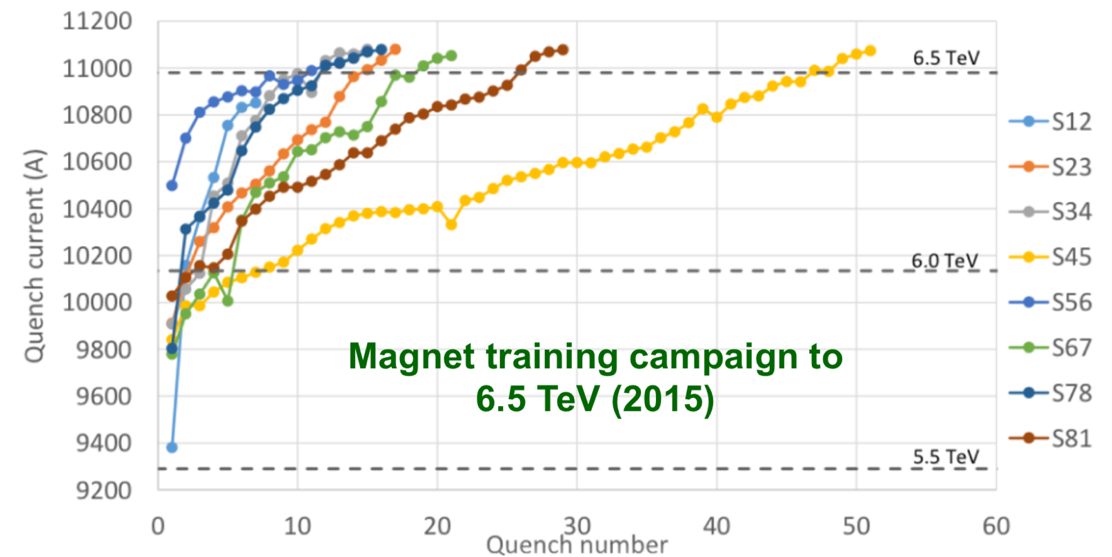
LS2 – accelerator upgrades
Preparing for HL-LHC
  Civil engineering
  Consolidation work
Upgrade of the injector chain
  Increased brightness and intensity
  Increased reliability and lifetime
Increasing the CoM energy
  Magnet training in 2016
    2 sectors reached 6.75 TeV
  Estimate ~500 quenches to reach 14 TeV
Parameter | 2018 | Design | Run 3
Energy [TeV] | 6.5 | 7.0 | 7.0
# bunches | 2556 | 2808 | ~2760
Stored energy [MJ] | 312 | 362 | >500
β* [cm] | 30-25 | 55 | 40-30
p/bunch [10¹¹] | 1.1 | 1.15 | 1.8
Emittance [μm] | ~1.8 | 3.75 | 1.5-2.0
Peak luminosity [10³⁴] | 2.1 | 1.0 | 3-4
Crossing angle [μrad] | 285 | 320 | 340

Slide 10
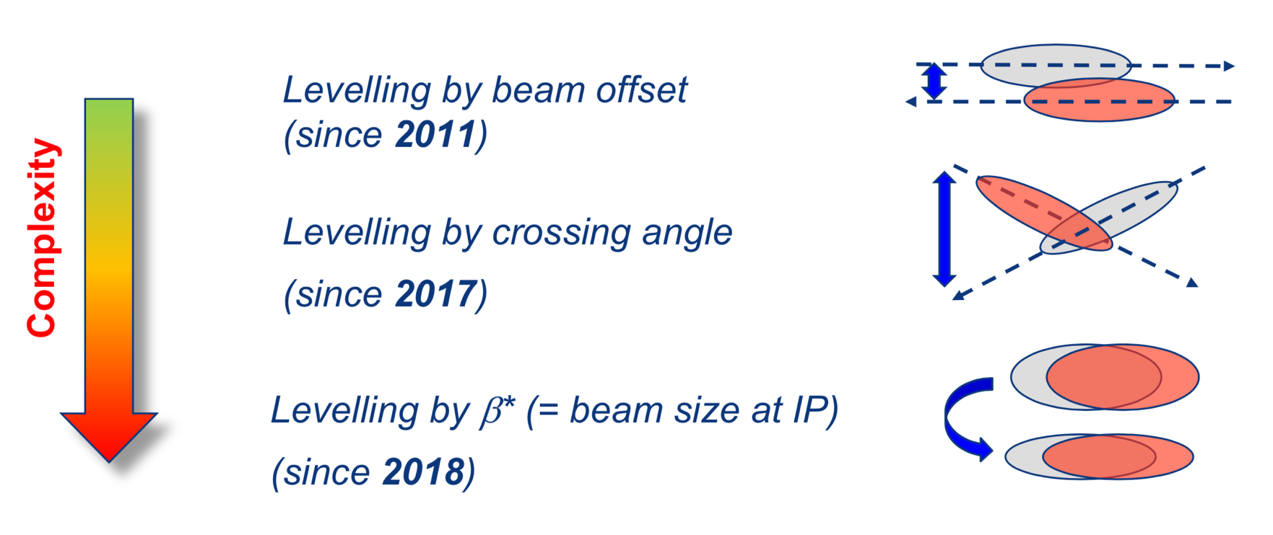
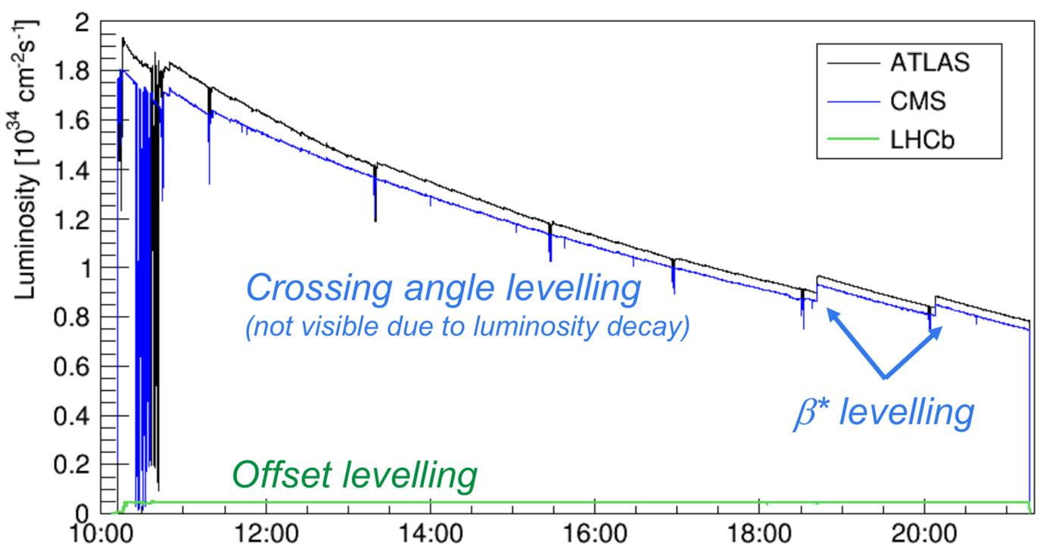
Luminosity levelling
LHCb & ALICE take data at levelled luminosity since 2011
  Stable optimal conditions
    Optimal may be subjective!
Three methods employed
ATLAS & CMS vs. LHCb in 2018
  Nominal 12h long fill (average ~8h)
    50x peak luminosity
    30x integrated luminosity
Levelling for all experiments in Run III
  Longer average fill lengths
  More favourable conditions

Slide 11
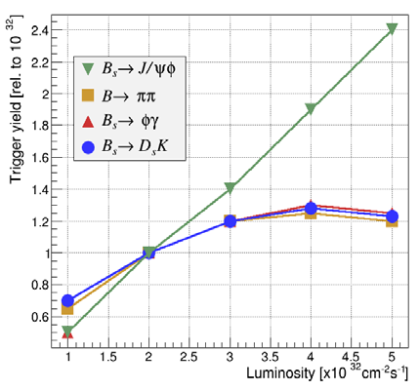
LS2 – LHCb Upgrade – physics motivation
LHCb – still statistics limited
  Significant scope for improvements
LHCb levels luminosity at 4x10³² cm⁻²s⁻¹
  Data doubling time 4.2 years
  LHC can deliver higher luminosity
Primary limitation: L0 trigger
  Decision based on muons & calorimeters
    Rate reduced from 40 MHz to 1 MHz
  Signal yields in hadronic modes saturates
Secondary limitation: occupancy
  Currently 2x design luminosity
  Requires detector upgrades
current luminosity

Slide 12
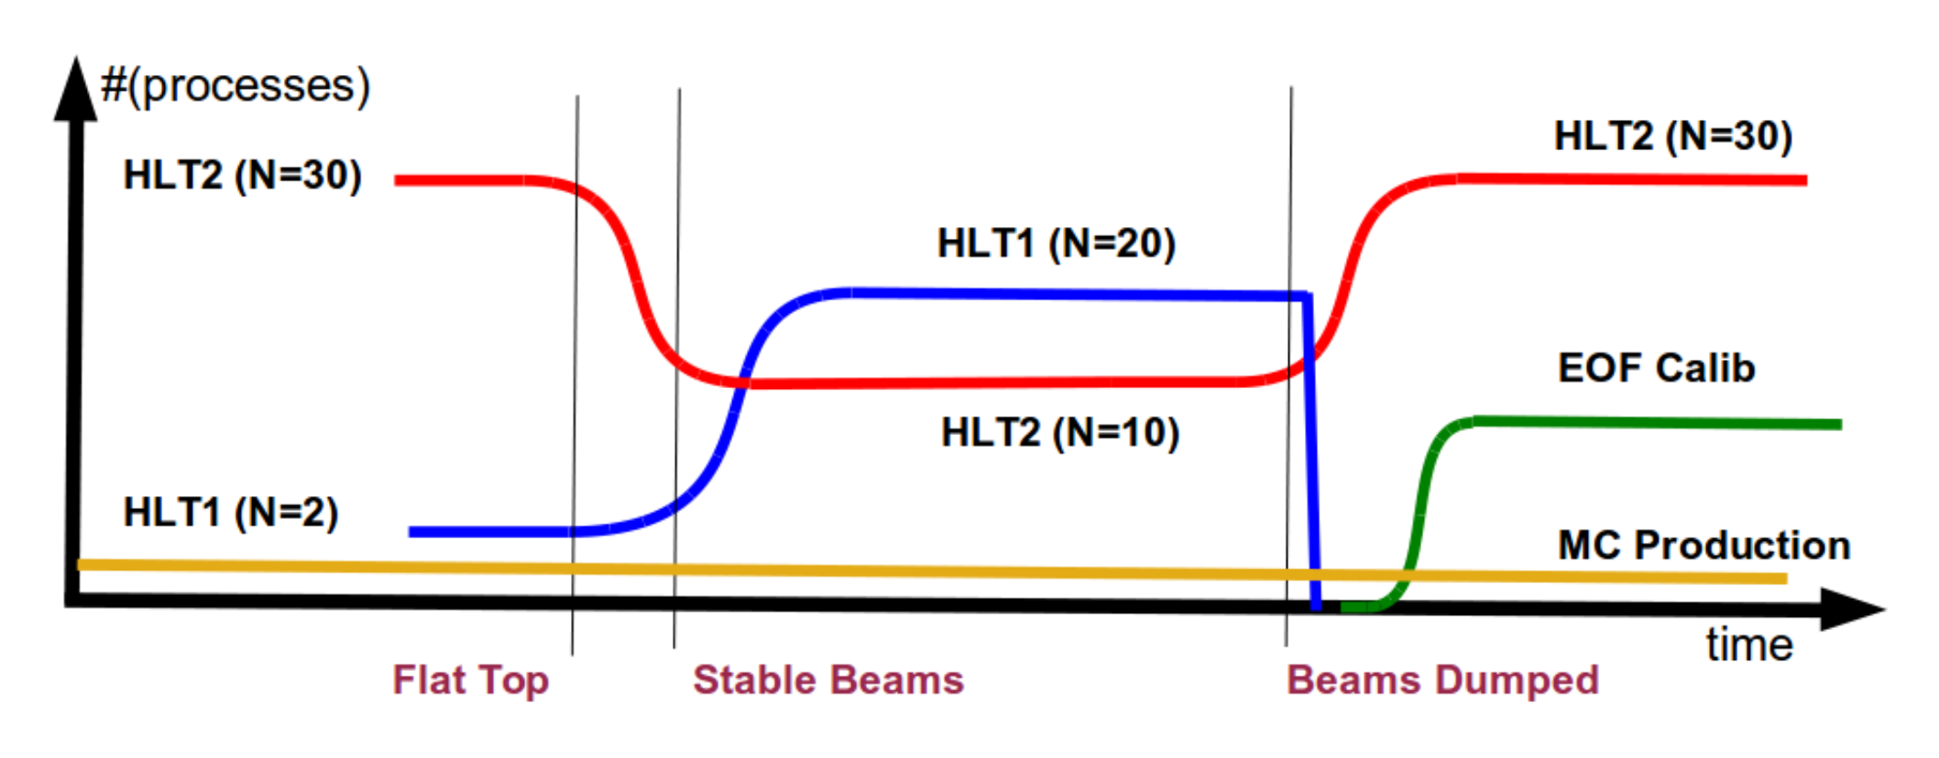
LHCb Upgrade – trigger
LS1: Online reconstruction and trigger upgrade
  HLT1 – partial reconstruction
    1 MHz → 100 kHz
  Buffer for O(days)
    Alignment & calibration
  HLT2 – offline quality selections
    Asynchronous – better use of computing resources
LHCb upgrade trigger
  Remove H/W trigger completely
    Full detector readout @ 40 MHz
  Continue current HLT1/HLT2 strategy
    Even tighter online selections

Slide 13
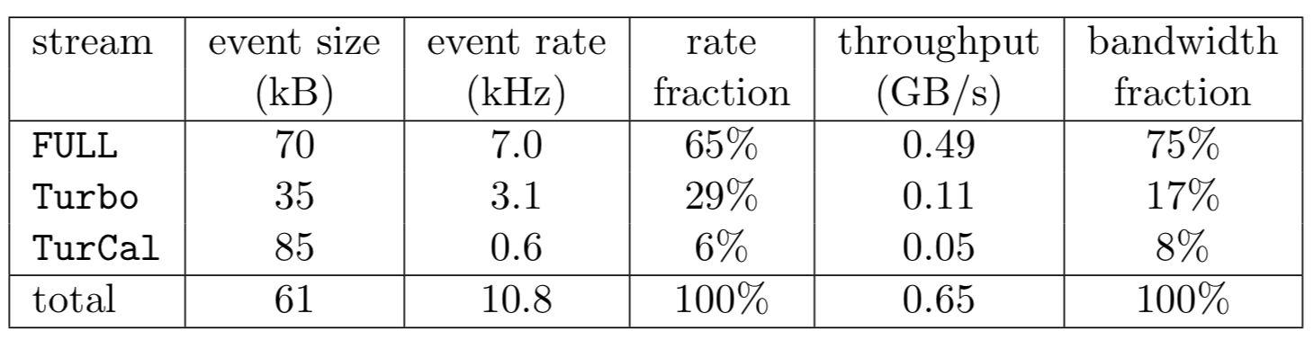
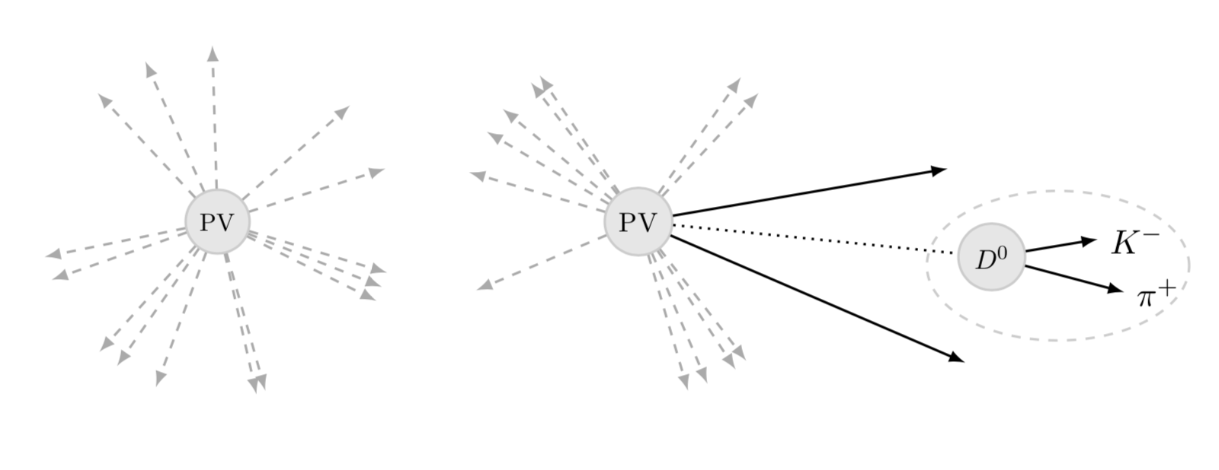
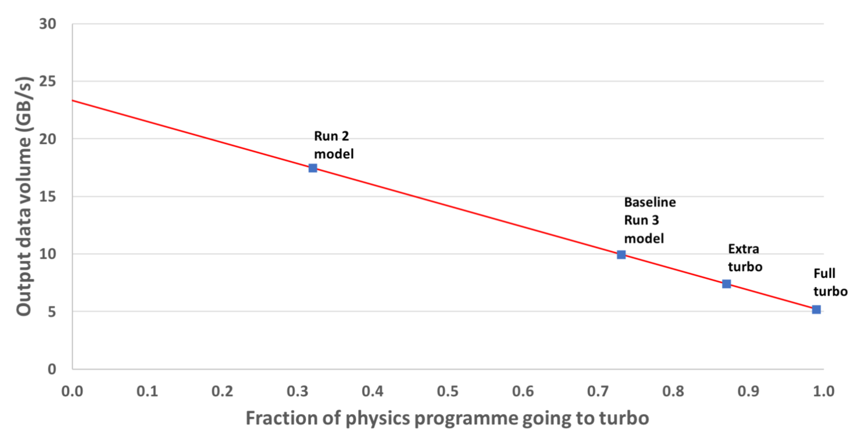
LHCb upgrade – data processing strategy
2018 output rates & bandwidths
Run II output streams from the HLT
  Full stream: complete event information
    Allows re-processing offline
    Requires central pre-selections
  Turbo stream: only physics objects
    Data analysis directly on HLT output
  Configurable persistence options
    Only signal candidate → full event information
LHCb upgrade processing
  Employ same strategies – more aggressively
    HLT output is already signal dominated
  Increase fraction of Turbo to increase the output rate
    Majority of analyses will use Turbo

Slide 14
LS2 – LHCb Upgrade 1
UK contribution
Trigger, DAQ and timing system complexly replaced
40 Tb/s data read out to the trigger farm
OT & IT: replace with scintillating fibre tracker
Muon system: replace FE electronics and remove M1
TT: replace with new strip detector
VELO: replace with new pixel detector
UK contribution
RICH: new photodetectors & electronics. Modified optics & mechanics
Calorimeters: replace FE electronics and remove PS/PSD
UK contribution

Slide 15
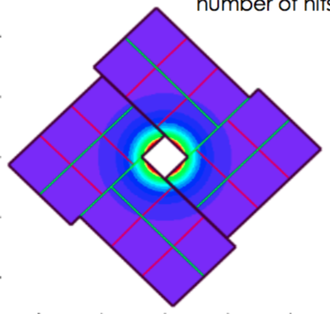
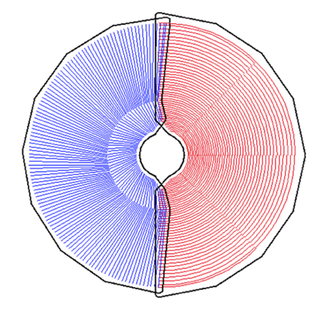
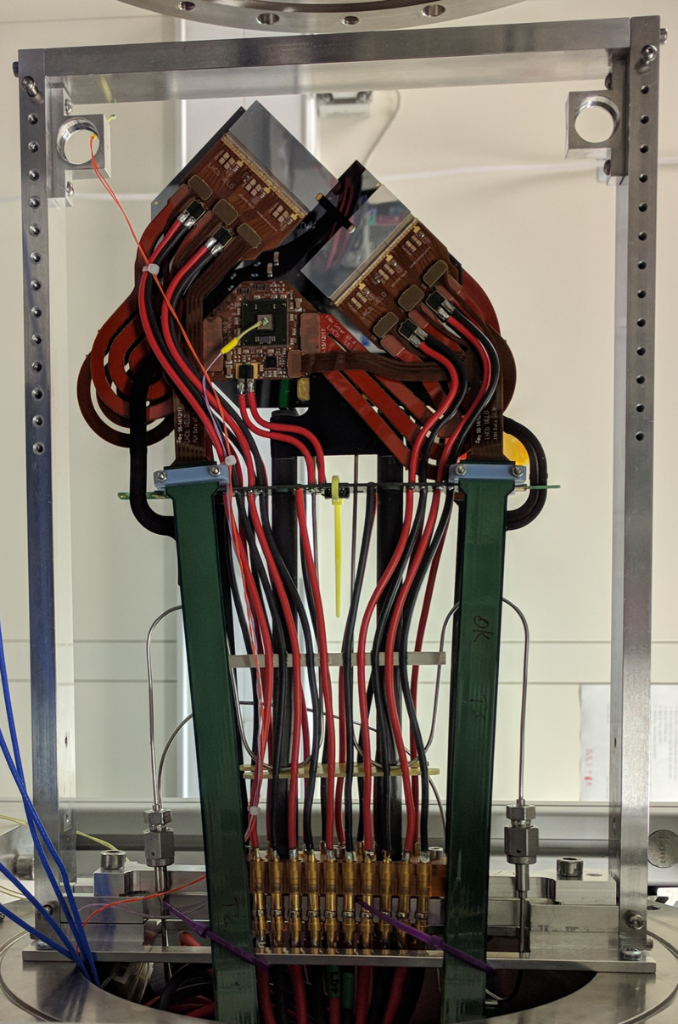
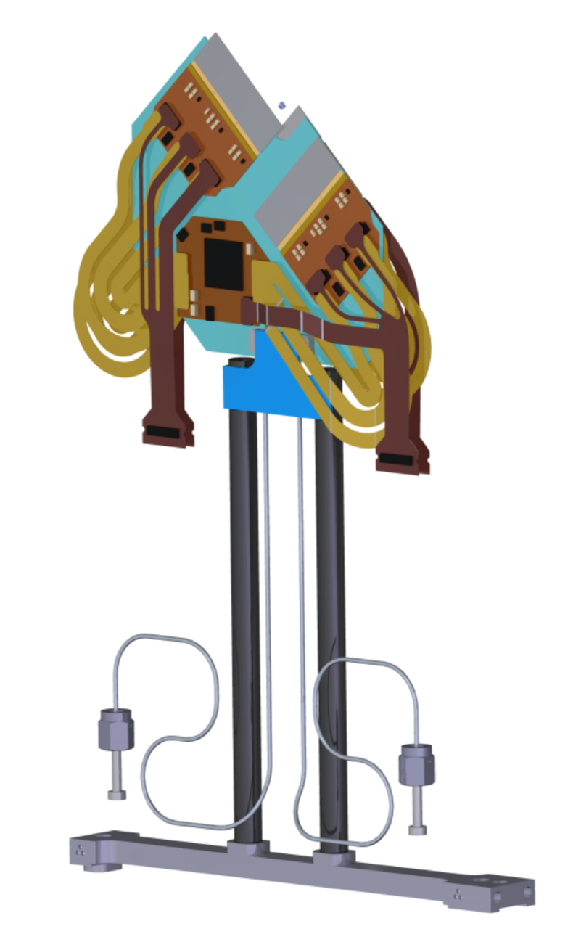
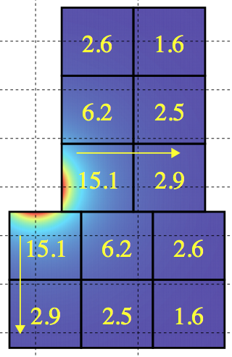
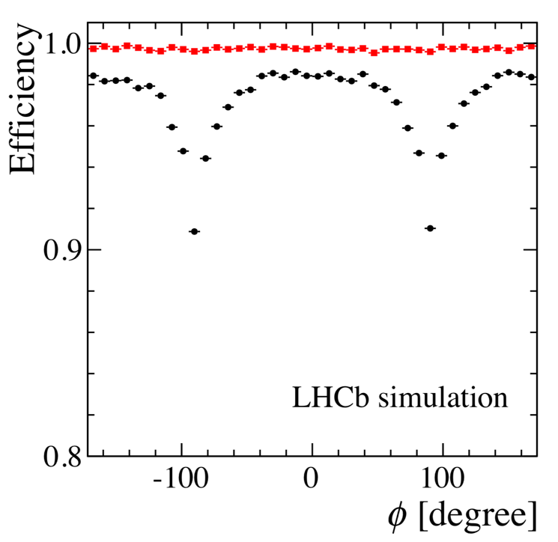

LS2 – LHCb Upgrade – VELO
Upgrade Current
Si Pixel modules
  VeloPix ASIC: 55x55 μm² pixels
    Built on TimePix3
  Silicon micro-channel cooling base
    CO₂ cooling in 12x200 μm² channels
  L-shaped modules
    5.1 mm from the beam
41M channels read out at 40 MHz
  15.1 Gb/s for hottest ASIC
  1040 data links (5.12 Gb/s)
Maintained or improved performance compared to current VELO
Peak data rates [Gbit/s/ASIC]
Upgrade VELO
Current VELO
$$\left\langle μ\right\rangle =5.2$$

Slide 16
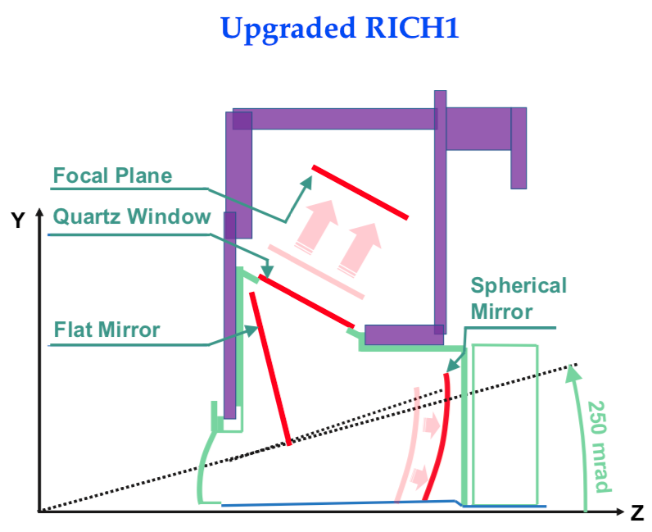
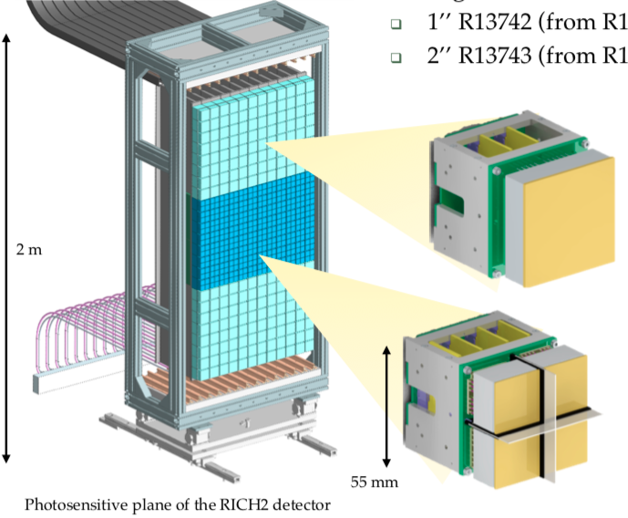
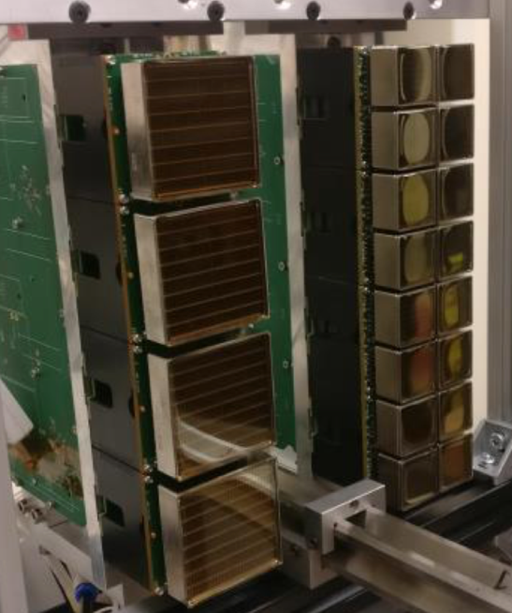
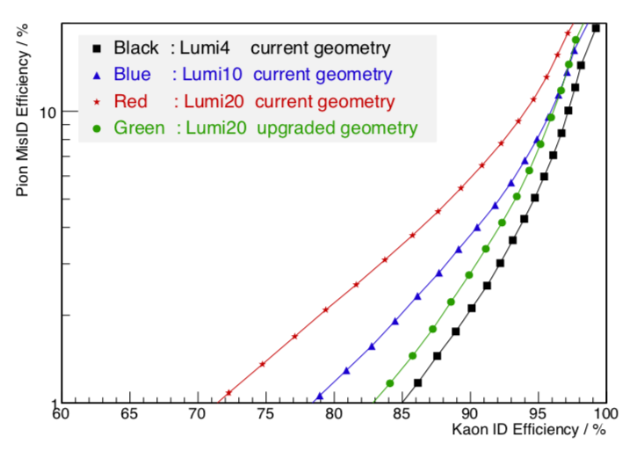
LS2 – LHCb Upgrade – RICH
New RICH 1 mechanics & optics
  Increase focal length
    Reduced occupancy (<30%)
Replace photodetectors
  HPDs → 1” or 2” MaPMTs
    Single-photon sensitivity
    8x8 pixel array
40 MHz readout
  CLARO8 amplifier & discriminator
  Digitiser board and GBTx high speed links
Maintain current PID performance
RICH 2 photodetectors

Slide 17
Timeline – Luminosity & upgrades
Energy
7 TeV
8 TeV
13 TeV
14(?) TeV
Run 1
LS1
Run 2
LS2
Run 3
LS3
CMS & ATLAS
∫ ℒ = 21 fb⁻¹
ℒ = 0 – 8 x 10³³
Upgrade
phase I
∫ ℒ = 170 fb⁻¹
ℒ = 1 – 2 x 10³⁴
Upgrade
phase I
∫ ℒ = 380 fb⁻¹
ℒ 2.5 x 10³⁴
Upgrade
phase II
2010 2011 2012 2013 2014 2015 2016 2017 2018 2019 2020 2021 2022 2023 2024 2025 2026
LHCb
∫ ℒ = 3 fb⁻¹
ℒ = 0 – 4 x 10³²
∫ ℒ = 9 fb⁻¹
ℒ = 3 – 4 x 10³²
Upgrade 1
∫ ℒ = 23 fb⁻¹
ℒ = 1 – 2 x 10³³
Upgrade 1b
Energy
14 TeV
14 TeV
14 TeV
Run 4
LS4
Run 5
LS5
Run 6
CMS & ATLAS
∫ ℒ = 1000 fb⁻¹
ℒ = 3 – 5 x 10³⁴
∫ ℒ = 2000 fb⁻¹
ℒ = 5 x 10³⁴
∫ ℒ = 4000 fb⁻¹
ℒ = 5 – 7 x 10³⁴
2026 2027 2028 2029 2030 2031 2032 2033 2034 2035 2036 2037
LHCb
∫ ℒ = 50 fb⁻¹
ℒ = 2 x 10³³
Upgrade
2
∫ ℒ > 300 fb⁻¹
ℒ = 1 – 2 x 10³⁴
ℒ = 1 – 2 x 10³⁴
[cm⁻²s⁻¹]

Slide 18
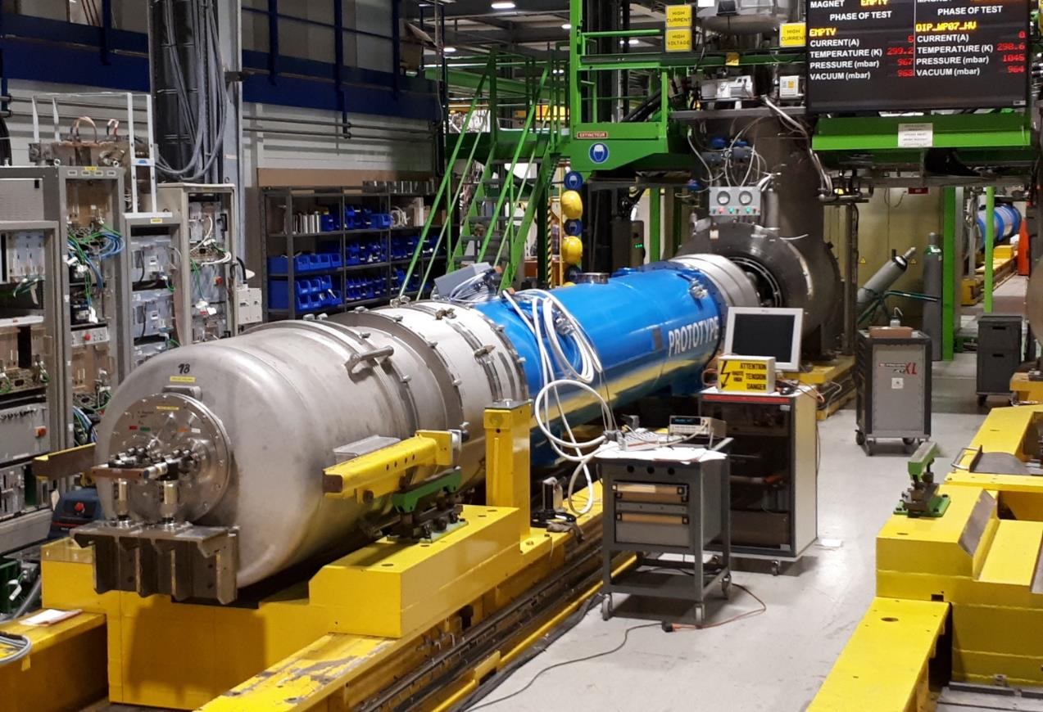
LHC machine upgrades in LS3
The world’s largest accelerator project
  1.2 km of the LHC to be replaced
  Inner triplets a the IRs (Nb₃Sn)
  Short 11 T dipoles (Nb₃Sn)
  Crab cavities
  Collimators
  Machine protection
  etc.
Infrastructure
  Civil engineering
  Cryogenics
  Vacuum
  Cold powering
Parameter | 2018 | Design | Run 3 | Run 4
Energy [TeV] | 6.5 | 7.0 | 7.0 | 7.0
# bunches | 2556 | 2808 | ~2760 | ~2760
Stored energy [MJ] | 312 | 362 | >500 | >650
β* [cm] | 30-25 | 55 | 40-30 | 15
p/bunch [10¹¹] | 1.1 | 1.15 | 1.8 | 2.2
Emittance [μm] | ~1.8 | 3.75 | 1.5-2.0 | 2.5
Peak luminosity [10³⁴] | 2.1 | 1.0 | 3-4 | 5 levelled
Crossing angle [μrad] | 285 | 320 | 340 | 510

Slide 19
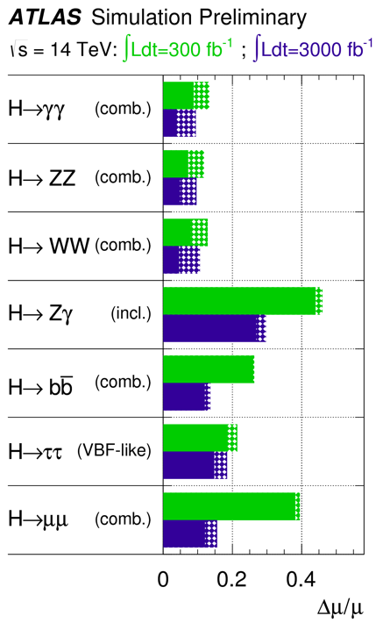
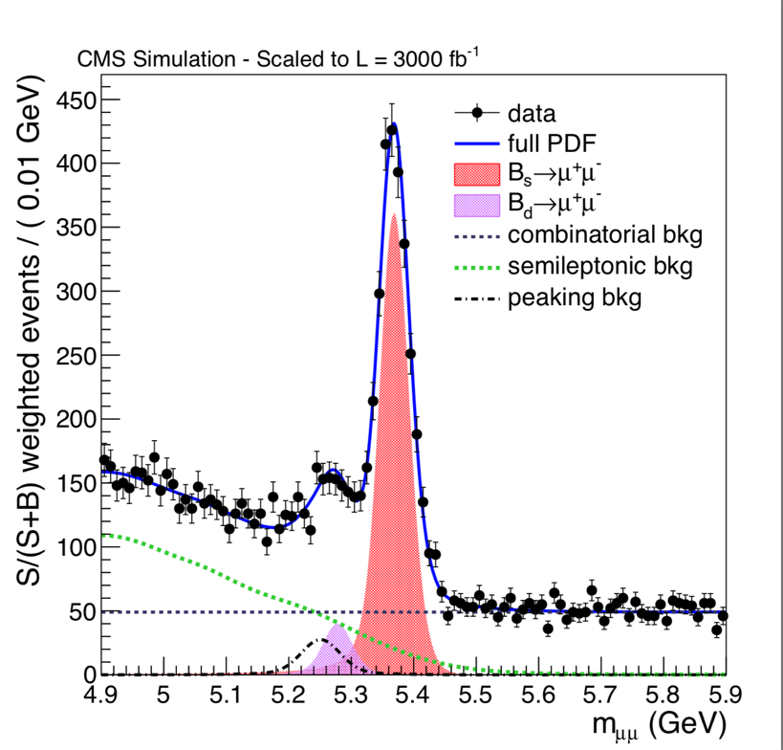
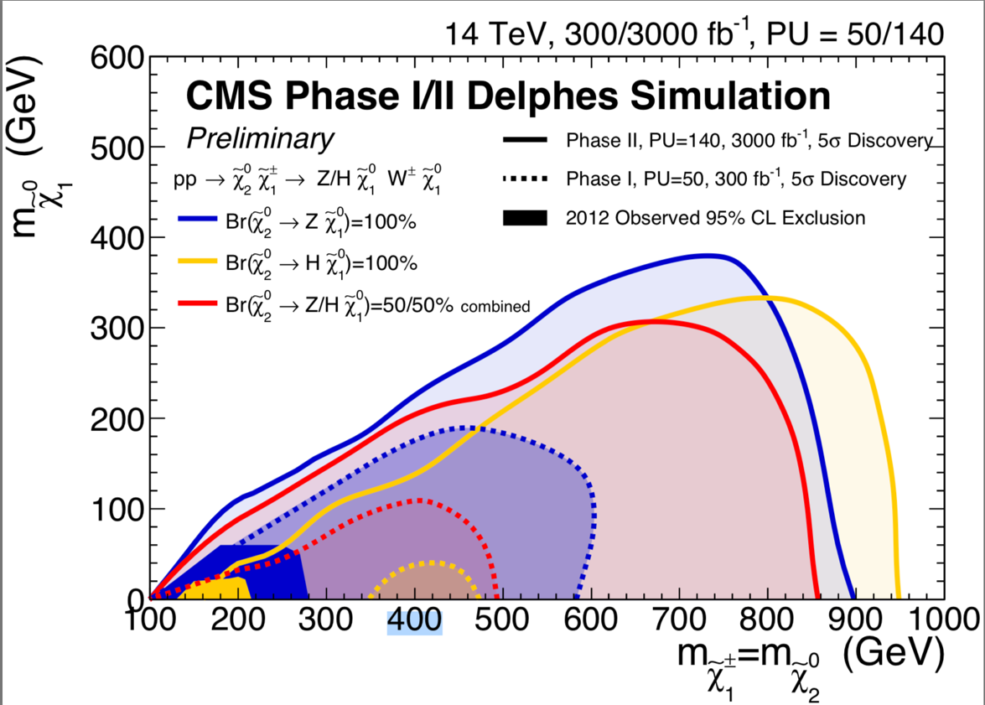
LS3 – ATLAS & CMS phase II – physics motivation
The LHC is the energy frontier machine
  Exploit its full potential
Precision measurements
  Higgs couplings
  EW physics
  Top physics
  Flavour physics
Direct searches
  Extending the mass range
  Sensitivity to rare signatures
Detailed studies in the HL-LHC yellow reports

Slide 20
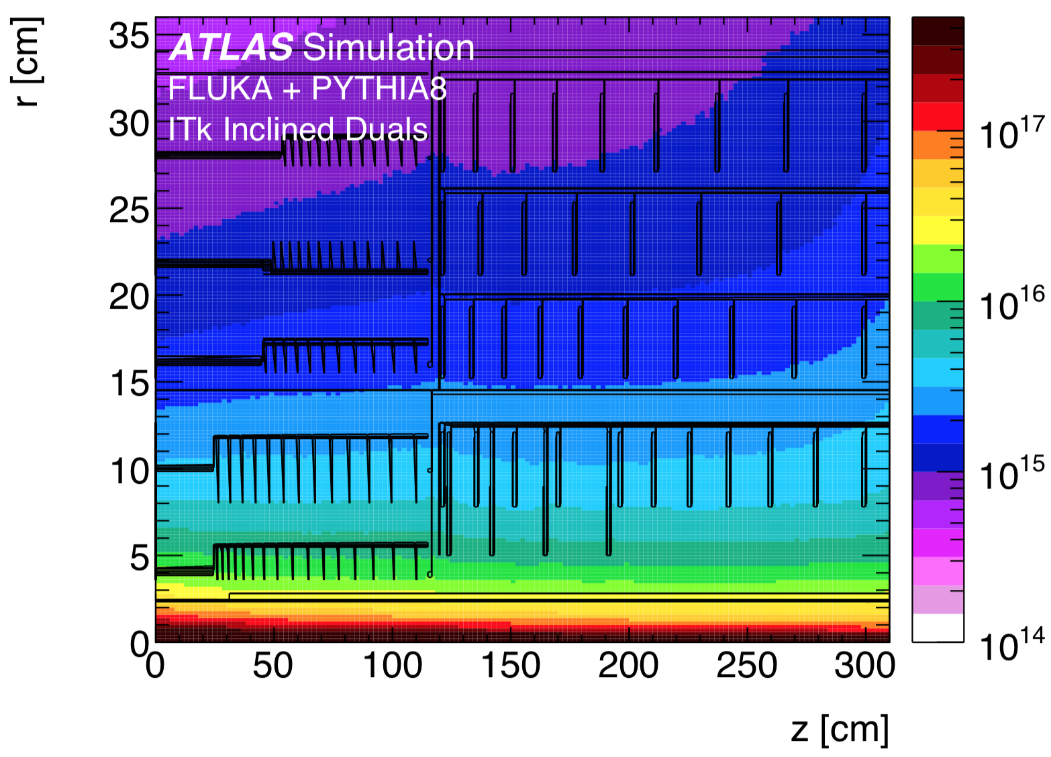
LS3 – ATLAS & CMS phase II - challenges
Pile-up of 200 interactions / crossing
  Increased track multiplicity
  Event reconstruction
Radiation damage
  10x dose compared to Run 3
  1st pixel layer: 2x10¹⁶ n_{eq}/cm² (3000 fb⁻¹)
Data readout
  Data cables will become a significant part of the material budget
    Serial powering, DC/DC & CO₂ cooling reduced material for LV cables and cooling
Computing
  Significant challenges for offline computing
n_{eq}/cm²

Slide 21
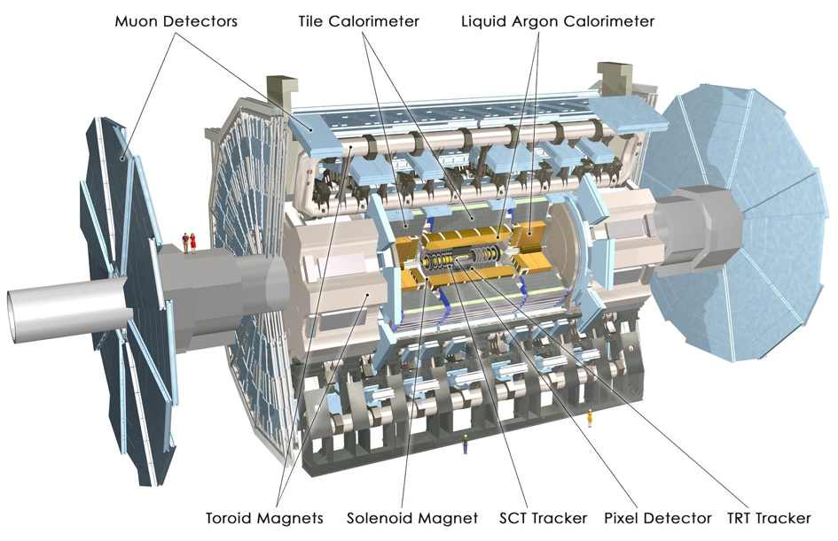
LS3 – ATLAS phase II – detector upgrades
UK contribution
TDAQ: new readout for ITk, LAr/Tile calorimeters & muons
H/W trigger output 1 MHz (data rate 42 Tbit/s)
Trigger: L1, H/W track & calo triggers and event filter
ITk: New inner tracking system
Muon system: New inner barrel region
New forward tagger (option)
UK contribution
HGTD: High granularity timing detector (option)

Slide 22
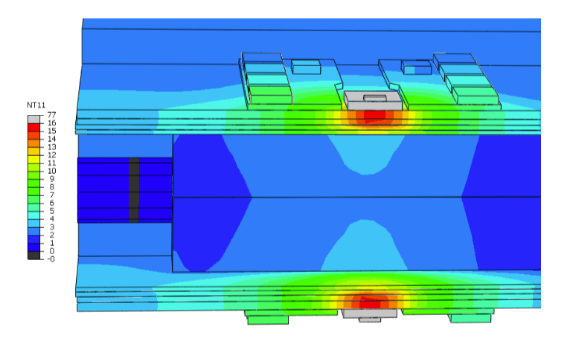
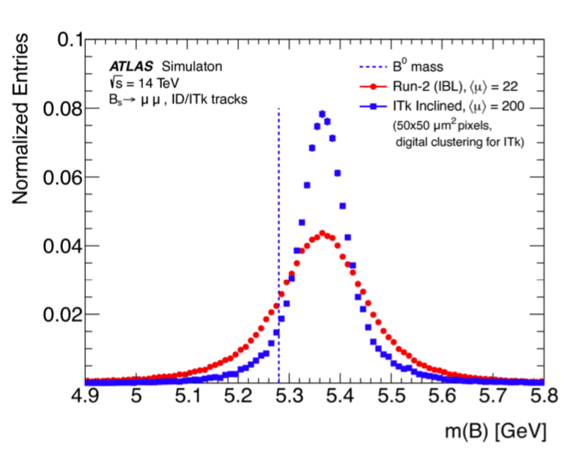
LS3 – ATLAS phase II – Inner tracking system
All silicon tracker replaces ID
  Pixels: 10 m² – 10 000 modules
    Increase coverage |η| < 4
  Strips: 165 m² - 17 888 modules
    Mass-producibility & ease of integration
2-phase CO₂ cooling system
  Higher efficiency, reduced mass
  Careful thermal design
Serial LV powering
  Reduced mass in cables
Data readout
  High-speed electrical and optical links
Improved performance
  E.g. mass resolution in B_{s} → μ⁺μ⁻

Slide 23
LS3 – ATLAS phase II – High granularity timing detector
4D reconstruction
  Adding time information to tracks
High granularity timing detector
  Timing plane in front of endcap CALO
  4-layer LGAD detector
    1.3x1.3 mm² pads (<10% occupancy)
    Timing resolution 30-50 ps
Reduces the effects of pile-up
  Light jet pile-up reduced up to 5 times

Slide 24
LS3 – CMS phase II – detector upgrades
Trigger & data acquisition
Full detector readout at 750 kHz (data rate ~50 Tb/s)
Upgrade of the trigger system
UK contribution
UK contribution
UK contribution
Calorimeters:
Barrel ECAL – electronics for single-crystal R/O
Forward – high-granularity calorimeter
Tracker: new full-silicon tracker
MiP timing detector:
Barrel – LYSO + SiPM
Forward – LGADs
Muon system:
Extended coverage
New GEM chambers

Slide 25
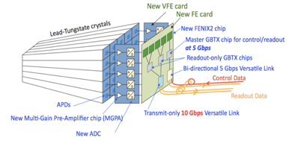
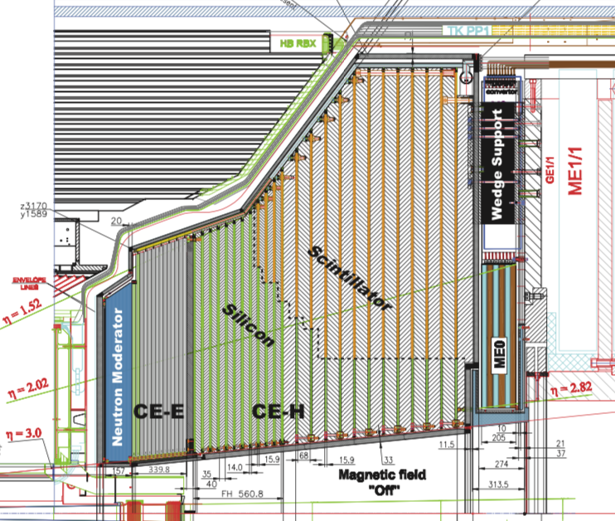
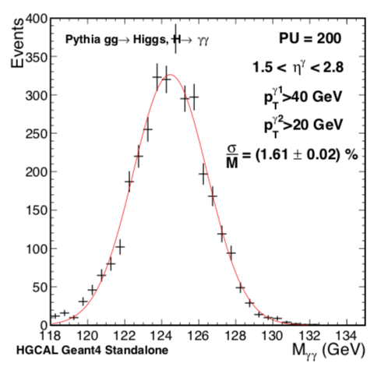
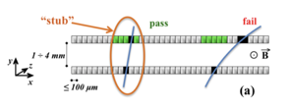
LS3 – CMS phase II – detector upgrades
Barrel ECAL electronics
  Single crystal readout
    C.f. 5x5 crystals now
Forward high-granularity calorimeter
  ECAL: Silicon-W-Cu-Pb-Fe
  HCAL: Silicon/Scintillator-Fe-Cu
  Particle flow calorimetry
Tracker upgrade
  Increased granularity
  Extended coverage
  Stub-detecting module
    Low-pT track rejection
    40 MHz input to trigger

Slide 26
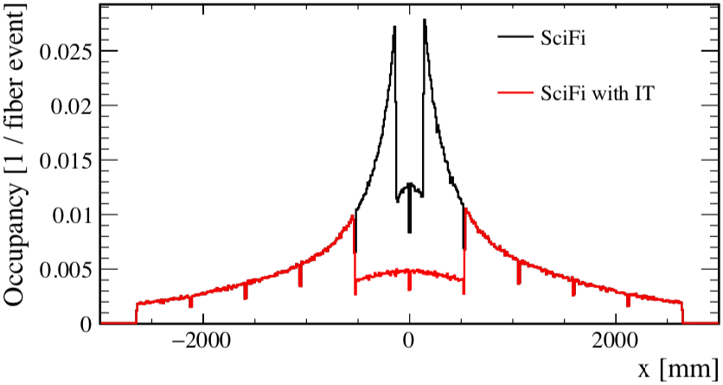
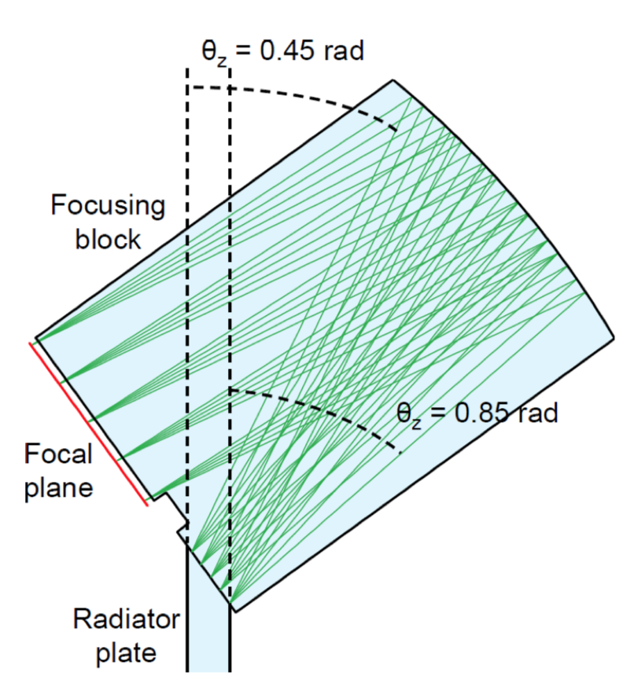
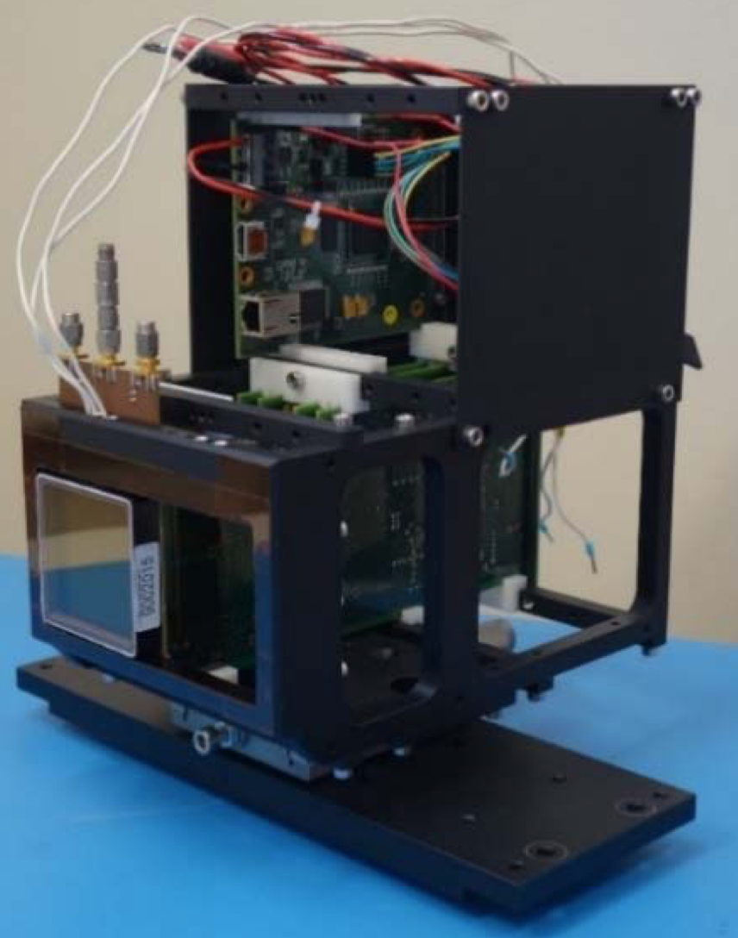
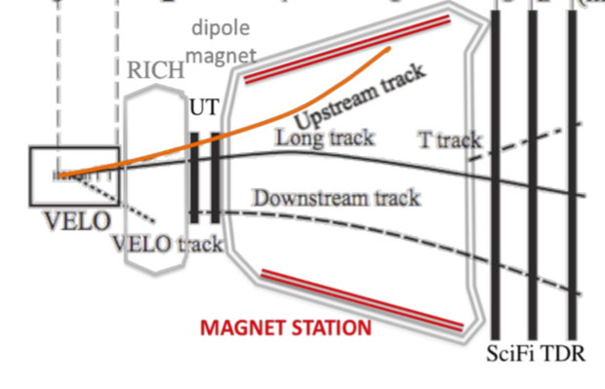
LS3 – LHCb Upgrade 1b
Consolidation work of LS2 upgrade
  Possibility to enhance performance in key areas
  Several concepts under study
New inner tracker
  HV-CMOS tracker at the centre of SciFi
TORCH – DIRC & ToF combined
  Improved PID for p < 10 GeV
  Prototyped in beam tests
Magnet side stations
  Increased acceptance for low momentum tracks
Run 4 occupancy with and w/o new IT

Slide 27
Timeline – Luminosity & upgrades
Energy
7 TeV
8 TeV
13 TeV
14(?) TeV
Run 1
LS1
Run 2
LS2
Run 3
LS3
CMS & ATLAS
∫ ℒ = 21 fb⁻¹
ℒ = 0 – 8 x 10³³
Upgrade
phase I
∫ ℒ = 170 fb⁻¹
ℒ = 1 – 2 x 10³⁴
Upgrade
phase I
∫ ℒ = 380 fb⁻¹
ℒ 2.5 x 10³⁴
Upgrade
phase II
2010 2011 2012 2013 2014 2015 2016 2017 2018 2019 2020 2021 2022 2023 2024 2025 2026
LHCb
∫ ℒ = 3 fb⁻¹
ℒ = 0 – 4 x 10³²
∫ ℒ = 9 fb⁻¹
ℒ = 3 – 4 x 10³²
Upgrade 1
∫ ℒ = 23 fb⁻¹
ℒ = 1 – 2 x 10³³
Upgrade 1b
Energy
14 TeV
14 TeV
14 TeV
Run 4
LS4
Run 5
LS5
Run 6
CMS & ATLAS
∫ ℒ = 1000 fb⁻¹
ℒ = 3 – 5 x 10³⁴
∫ ℒ = 2000 fb⁻¹
ℒ = 5 x 10³⁴
∫ ℒ = 4000 fb⁻¹
ℒ = 5 – 7 x 10³⁴
2026 2027 2028 2029 2030 2031 2032 2033 2034 2035 2036 2037
LHCb
∫ ℒ = 50 fb⁻¹
ℒ = 2 x 10³³
Upgrade
2
∫ ℒ > 300 fb⁻¹
ℒ = 1 – 2 x 10³⁴
ℒ = 1 – 2 x 10³⁴
[cm⁻²s⁻¹]

Slide 28
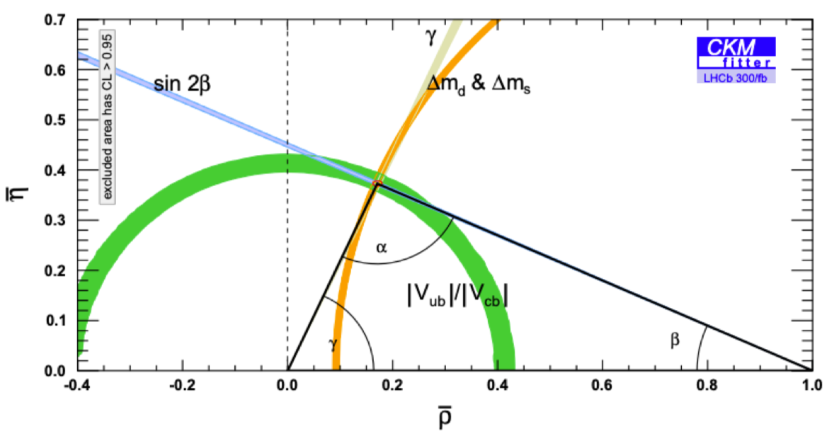
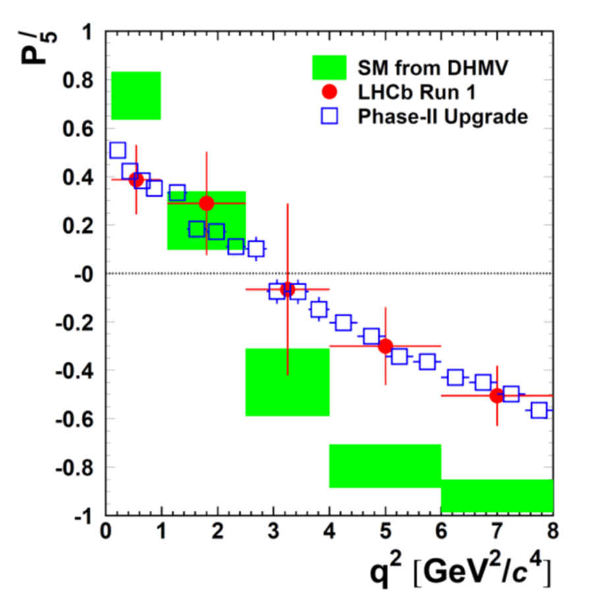

LS4 – LHCb Upgrade II – physics motivation
Precision measurements of the SM
  Flavour physics, spectroscopy, etc.
Search for deviations from the SM
  Rare decays, LFU, LFV, etc.
LHCb upgrade is (still) not limited by the LHC
  1–2 x 10³⁴ cm⁻²s⁻¹ achievable at IP8
  Exploit the full potential of LHC
    > 300 fb⁻¹ possible at IP8
Belle II data taking 2019 – 2025
  LHCb is the planned flavour experiment beyond 2026
CKM triangle with LHCb @ 300 fb⁻¹
 | 2019 [5 fb⁻¹] | 2025 [23 fb⁻¹] | Upgrade II [300 fb⁻¹]
σ(R_{K}) | 6% | 2.5% | 0.7%
$P_{5}^{′}$ in $B^{0}→K^{∗0}μ^{+}μ^{−}$ with LHCb @ 300 fb⁻¹

Slide 29
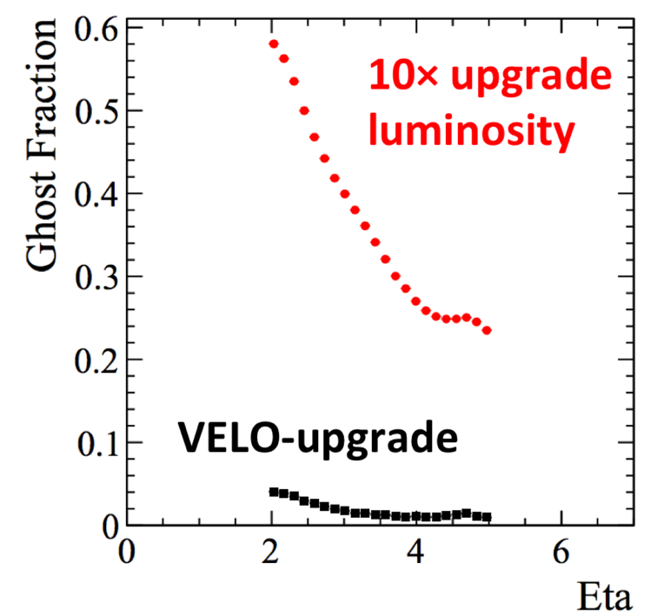
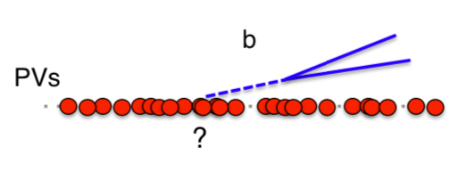
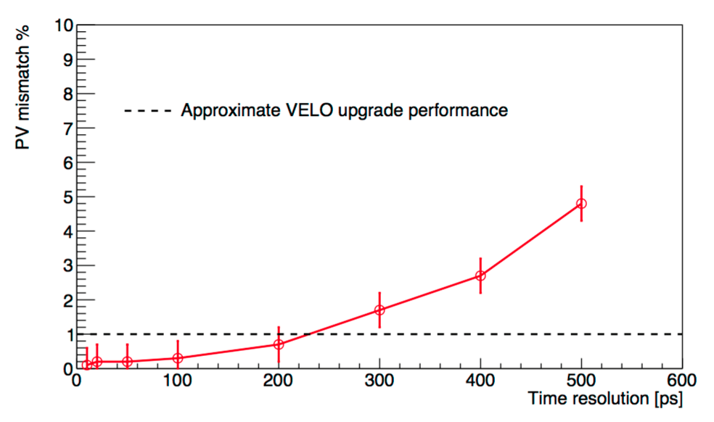
LS4 – LHCb upgrade II – detector concepts
All detector systems will require upgrades
  Increased granularity & rates
  Calorimeters largely untouched in upgrade 1
    Potential for significant physics gains
Maintain or improve the performance
  Keep 40 MHz triggerless readout
10x luminosity – 10x multiplicity
  Tracking and reconstruction challenges
  Favour physics – secondary vertices
4D tracking: add time information
  Pattern recognition for tracking
  Primary & secondary vertex association
PV mismatch vs. hit time resolution
Time resolution per hit [ps]

Slide 30
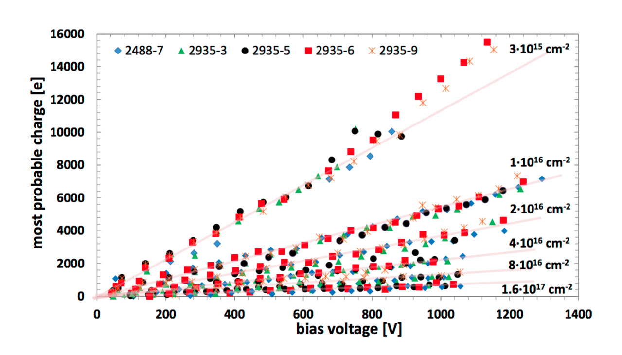
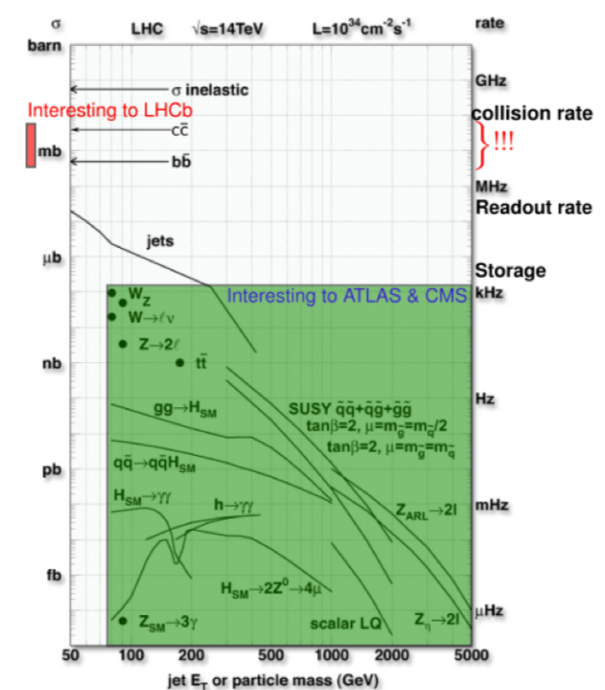
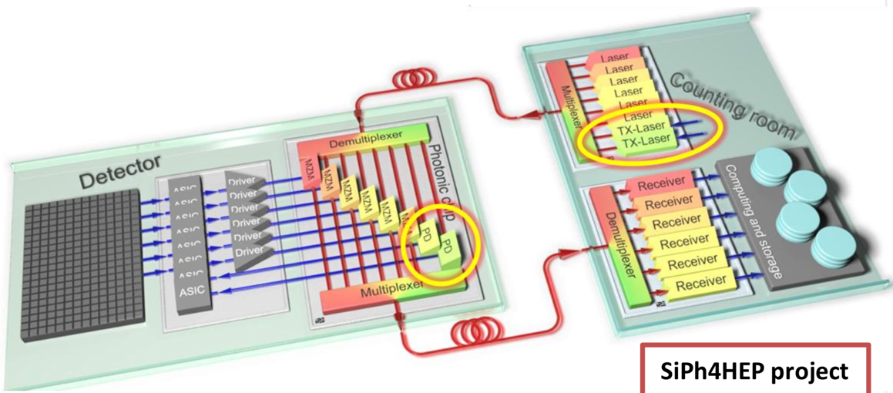
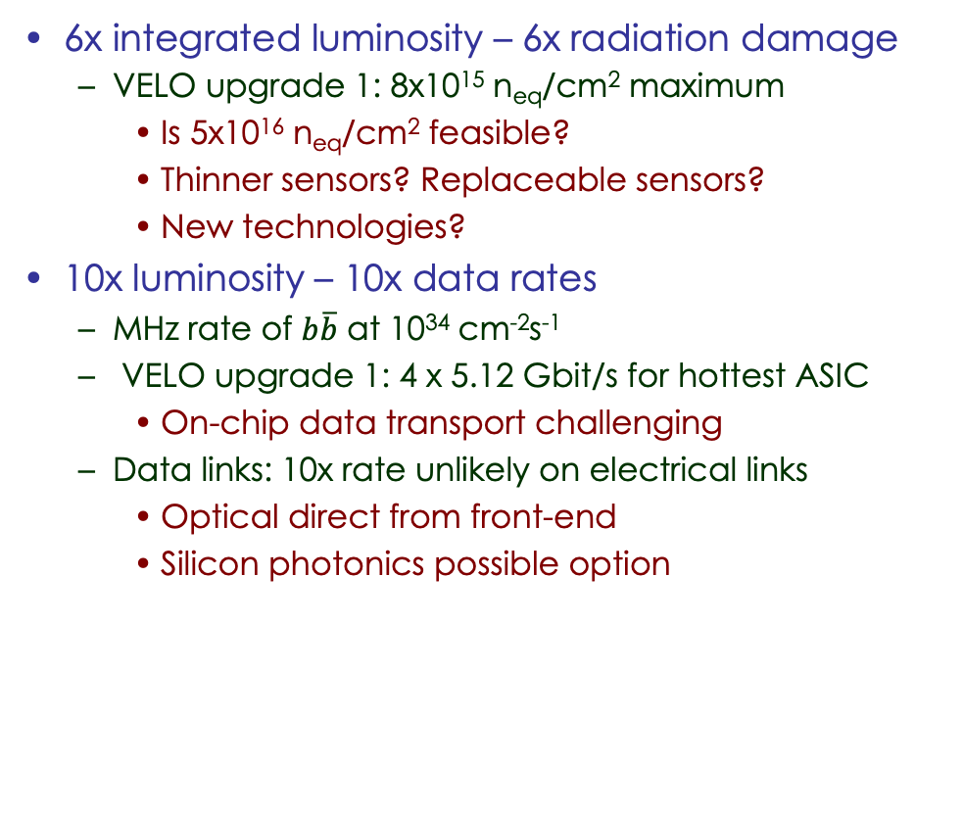
LS4 - LHCb Upgrade II – detector concepts
JINST 8 (2013) P08004
6x integrated luminosity – 6x radiation damage
  VELO upgrade 1: 8x10¹⁵ n_{eq}/cm² maximum
    Is 5x10¹⁶ n_{eq}/cm² feasible?
    Thinner sensors? Replaceable sensors?
    New technologies?
10x luminosity – 10x data rates
  MHz rate of $b\overline{b}$ at 10³⁴ cm⁻²s⁻¹
  VELO upgrade 1: 4 x 5.12 Gbit/s for hottest ASIC
    On-chip data transport challenging
  Data links: 10x rate unlikely on electrical links
    Optical direct from front-end
    Silicon photonics possible option

Slide 31
Timeline – Luminosity & upgrades
Energy
7 TeV
8 TeV
13 TeV
14(?) TeV
Run 1
LS1
Run 2
LS2
Run 3
LS3
CMS & ATLAS
∫ ℒ = 21 fb⁻¹
ℒ = 0 – 8 x 10³³
Upgrade
phase I
∫ ℒ = 170 fb⁻¹
ℒ = 1 – 2 x 10³⁴
Upgrade
phase I
∫ ℒ = 380 fb⁻¹
ℒ 2.5 x 10³⁴
Upgrade
phase II
2010 2011 2012 2013 2014 2015 2016 2017 2018 2019 2020 2021 2022 2023 2024 2025 2026
LHCb
∫ ℒ = 3 fb⁻¹
ℒ = 0 – 4 x 10³²
∫ ℒ = 9 fb⁻¹
ℒ = 3 – 4 x 10³²
Upgrade 1
∫ ℒ = 23 fb⁻¹
ℒ = 1 – 2 x 10³³
Upgrade 1b
Several future facilities are being discussed
Energy
14 TeV
14 TeV
14 TeV
Run 4
LS4
Run 5
LS5
Run 6
energy upgrade: HE-LHC
CMS & ATLAS
∫ ℒ = 1000 fb⁻¹
ℒ = 3 – 5 x 10³⁴
∫ ℒ = 2000 fb⁻¹
ℒ = 5 x 10³⁴
∫ ℒ = 4000 fb⁻¹
ℒ = 5 – 7 x 10³⁴
ep collider: LHeC
2026 2027 2028 2029 2030 2031 2032 2033 2034 2035 2036 2037
LHCb
∫ ℒ = 50 fb⁻¹
ℒ = 2 x 10³³
Upgrade
2
∫ ℒ > 300 fb⁻¹
ℒ = 1 – 2 x 10³⁴
ℒ = 1 – 2 x 10³⁴
[cm⁻²s⁻¹]

Slide 32
Summary
The LHC experiments have collected physics data since 2010
  Produced an extraordinary set of results
The upgrade programme started already in LS1 (2013-2014)
  Continuous improvements during shut-downs
Major accelerator and detector upgrades in preparation
  LS2 (2019-2020): LHCb Upgrade 1
  LS3 (2024-2025): ATLAS & CMS Phase II upgrades (LHCb Phase 1b)
  LS4 (2030): LHCb Upgrade 2
LHC will remain a major player in our field for at least 20 more years

